Slide 1
Welcome to Feminism, Politics and Social Change in Modern Britain
Introductions
Module Overview - assessments
What is feminism?
Origins of the term feminism
Break
The ‘waves’ of feminism
Problems with waves?
Questions and thoughts for the day
Readings for next week

Slide 2
Feminism, Politics and Social Change in Modern Britain - overview
1500 word essay (10%) Historiographical overview key feminist thinkers/historians/theorists. Submission: Wed 18 November 2026
3000 word source based essay (40%) Submission : Wed 10 March 2027 Modern Records Centre or choice of digitised original document
3000 word traditional essay (40%) Submission : Wed 12 May 2027
Seminar contribution (10%) Submission: Wed 19 May 2027
You can use any seminar ‘Questions to ponder…’ for essay titles or create your own – just check with me first!

Slide 3

What is Feminism? Competing definitions of Feminism in the West
Task 1: What does feminism mean to you? Is it still relevant?

Slide 4
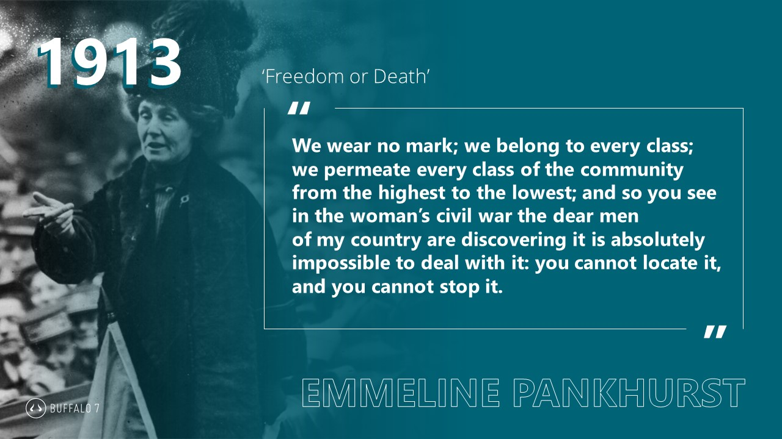
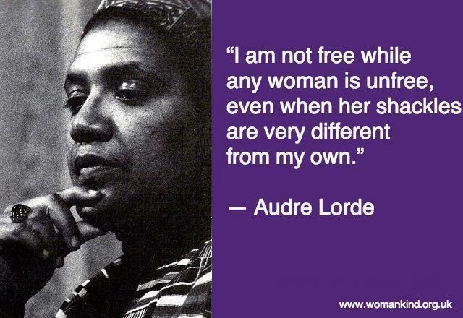
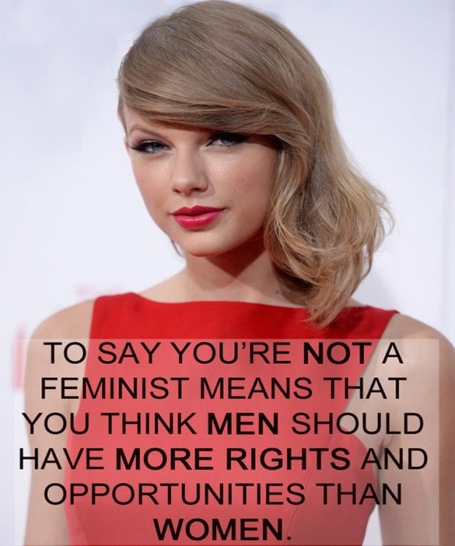


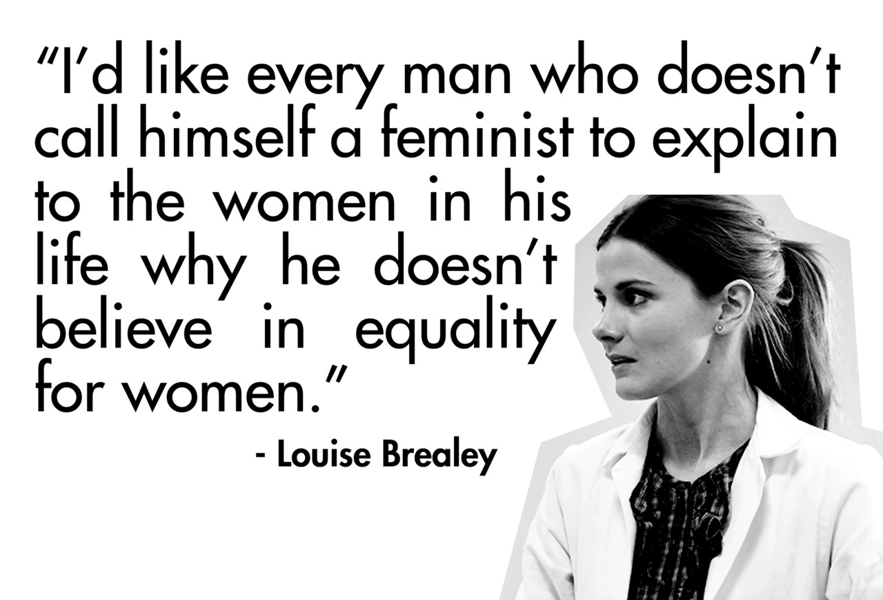

Slide 5
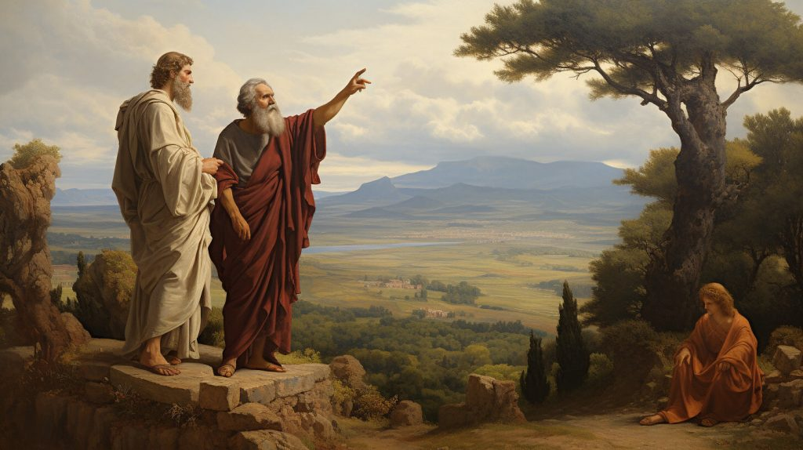
Intellectual discussions of women’s role in society have a long history
Plato c. 428 and 423 BC
‘Women can learn just as well as men if they are given the same opportunities and education’
‘If women are expected to do the same work as men, we must teach them the same things’
Plato’s views on women were unusual at that time, so, historians have asked, was Plato a feminist? But was does that mean, and how do we study and use the term feminism as historians?

Slide 6
What does the term feminism mean & where does it come from (origins)?

Slide 7
Mid-1800s was used to refer to ‘the qualities of females’
Consciousness evolves around work of Wollstonecraft (English) and Olympe de Gouges (French)- ‘Vindication of the Rights of Women’ (1792) ‘Declaration of the Rights of Woman and of the Female Citizen (1791)
Derived from Fèministe (French)
International Women's Conference (Paris) 1892 was popularised
English use in Britain around the time of the women’s suffrage campaign
Still not widely used until 1913 onward - period of modernism
Distinctions and divisions early on: ‘all feminists were suffragists, but not all suffragists were feminists. To real feminists the vote was just a tool. The real goal was a complete social revolution’
Overtime feminism becomes ‘umbrella’ term used for multiple woman-centred movements, campaigns, ideals and opinions

Slide 8
So, how have historians looked at the history of feminism?
Based on your readings, discuss & make notes ready to feedback on:
What are the ‘waves’ of feminism and how many are there?
Can you identify some characteristics for each wave?
Why might the ‘wave approach’ be problematic for us as historians?
Give examples if you can…

Slide 9

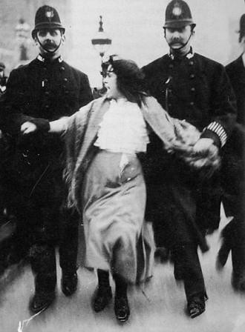
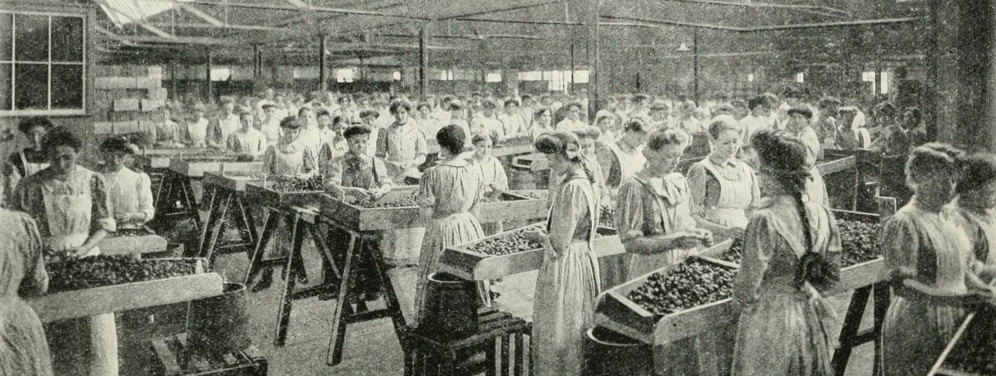
First ‘Wave’ Feminism
Late nineteenth and early twentieth century
Focus on struggle to achieve basic legal & political rights
Some reforms to women’s marriage, work, education rights etc…
Public protests/art activism
Organised campaign begins 1866
Some women over 30 with property get vote in 1918 (not on same terms as men until 1928)

Slide 10
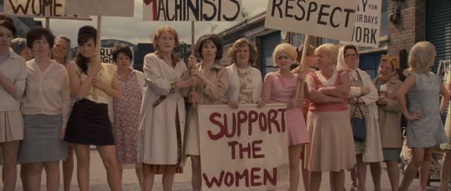
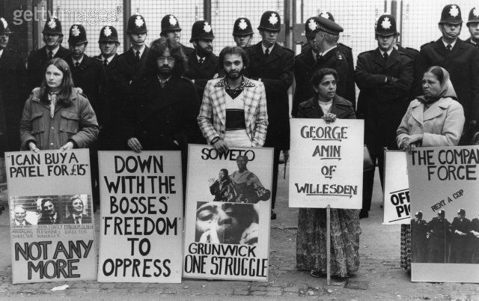
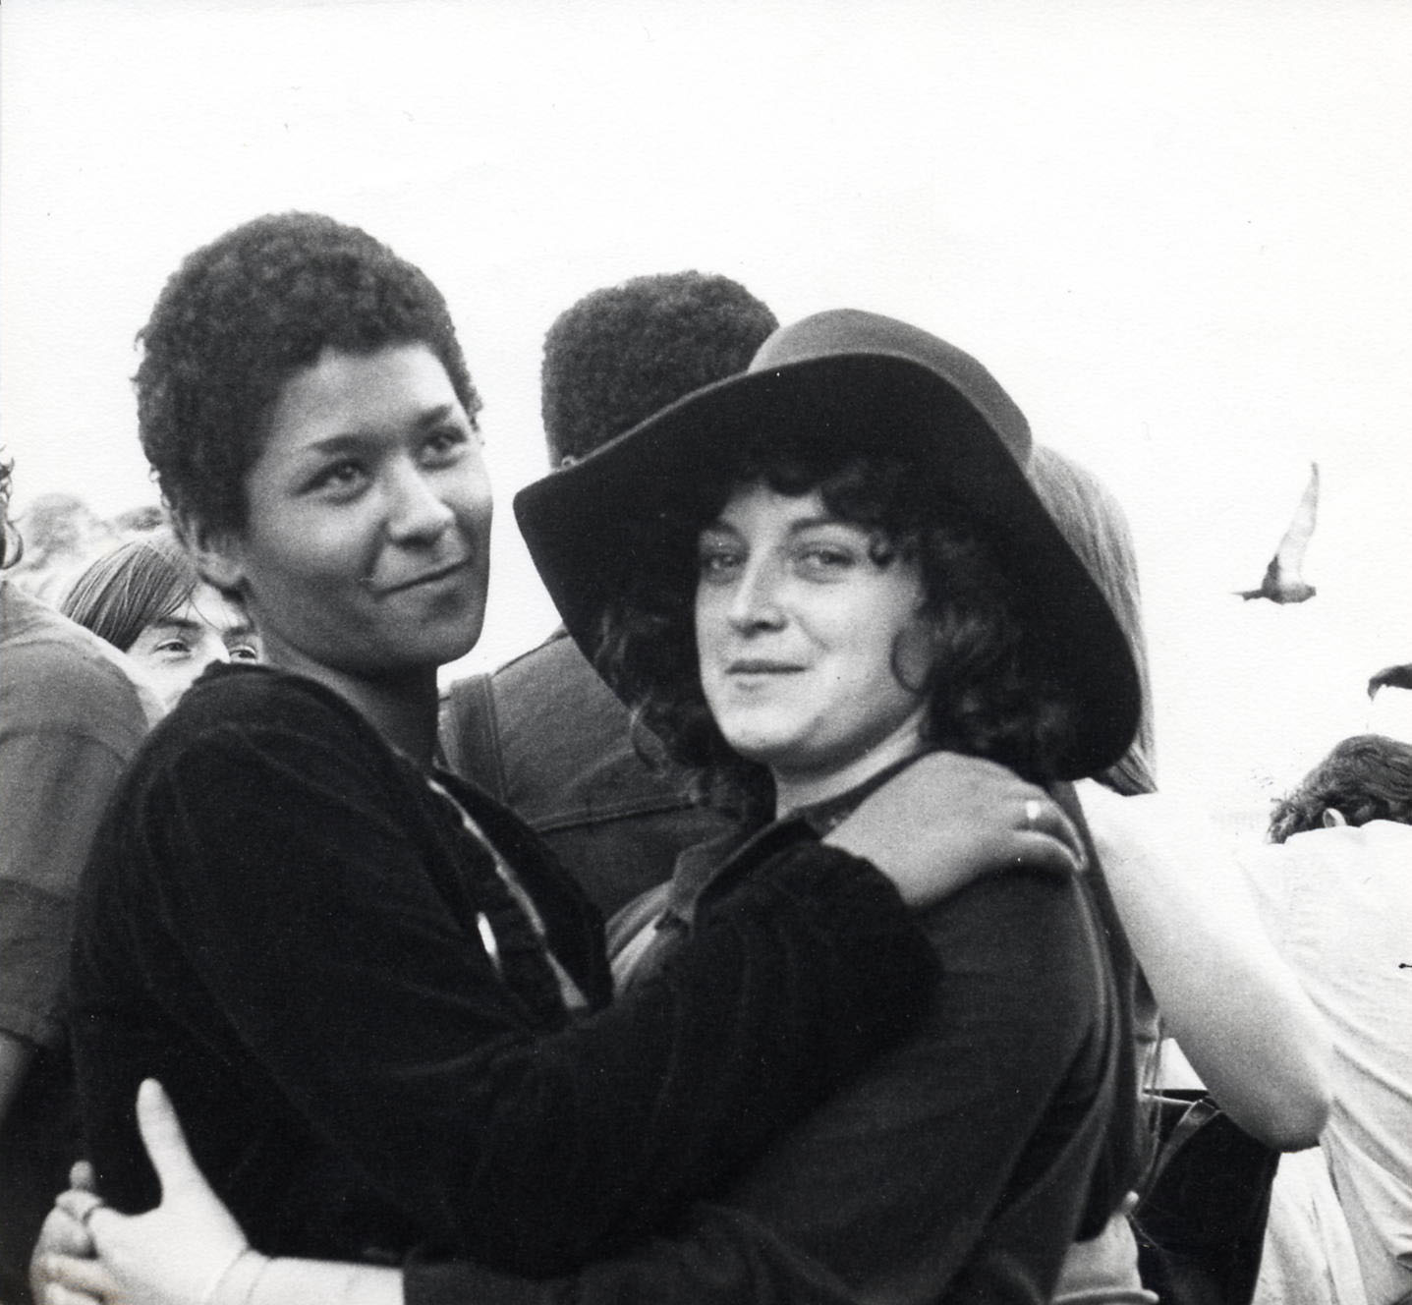
Second Wave Feminism
1960s and 1970s
Workplace rights
Family, abortion & sexual rights
Emergence of black feminist consciousness
‘Reclaim the night’

Slide 11
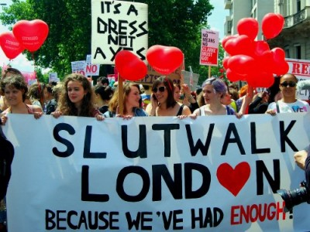
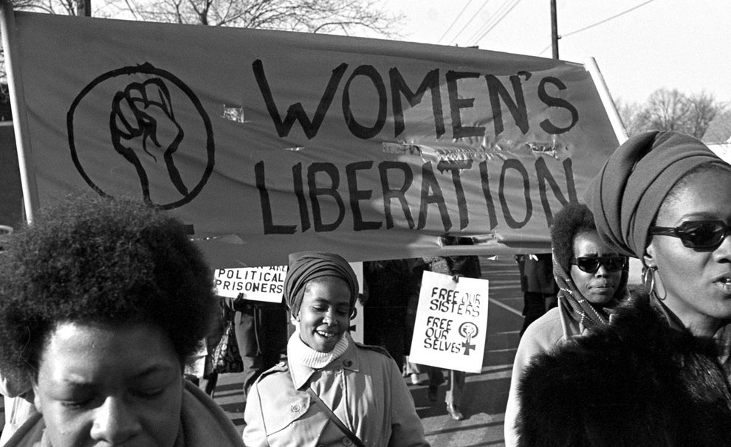
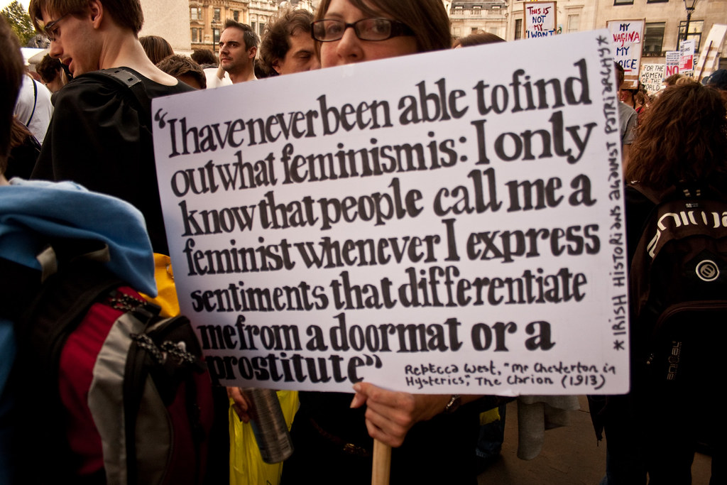
Third Wave
1990s-2010s
Critiques second wave’s lack of diversity -race, class, disability…
Intersectional
‘Gender’ histories & identities
Sexual violence #metoo
https://www.slutmeansspeakup.org.uk/

Slide 12
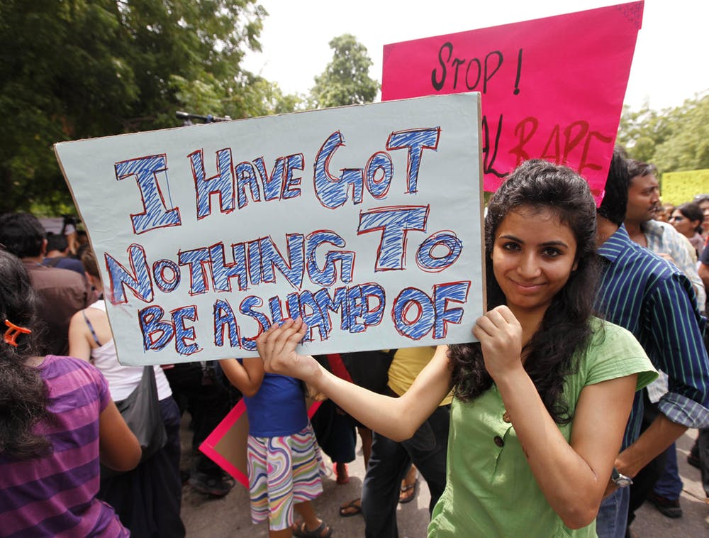
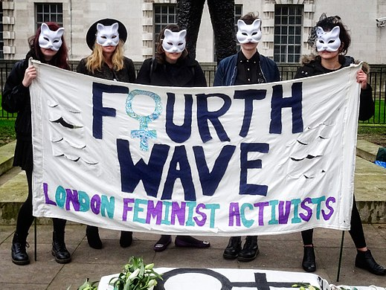
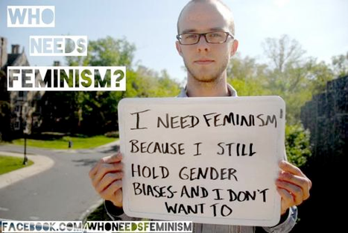

Fourth Wave..
2000s – now?
Digital activism/zines
Decentralized
Less formal
Sexual violence-body shaming- calls out misogyny
Intersectional-international
Transfeminism – gender identities
Sista-hood
https://www.masterclass.com/articles/feminism-meaning#77Wl4H14JAP1qRVxbG6PHa

Slide 13
Based on your readings consider…
How has feminism changed overtime?
Are there core values you can identify throughout?
What do we have to be aware of when using the term Feminism?
Final thoughts for the day?

