Slide 1
Welcome to Feminism, Politics and Social Change in Modern Britain - Today’s discussions
Introductions
Module Overview - assessments
What is feminism?
Origins of the term feminism
Break
The ‘waves’ of feminism
Problems with waves?
Questions and thoughts for the day
Readings for next week

Slide 2
Feminism, Politics and Social Change in Modern Britain - overview
1500 word essay (10%) Historiographical overview key thinkers/historians/theorists. Submission: Wed 19 November 2025
3000 word source based essay (40%) Submission : Wed 11 March 2026 Modern Records Centre or choice of digitised original document
3000 word traditional essay (40%) Submission : Wed 13th May 2026
Seminar contribution (10%) Submission: Wed 20 May 2026
You can use any seminar ‘Questions to ponder…’ for essay title or create your own – but check with me first!

Slide 3

What is Feminism? Competing definitions of Feminism in the West
Task 1: What do you think Feminism is? What does it mean to you? Is it relevant?

Slide 4
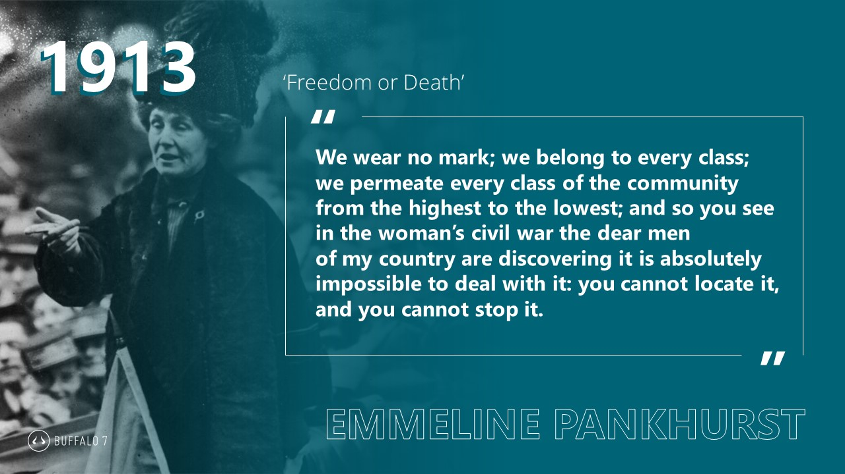
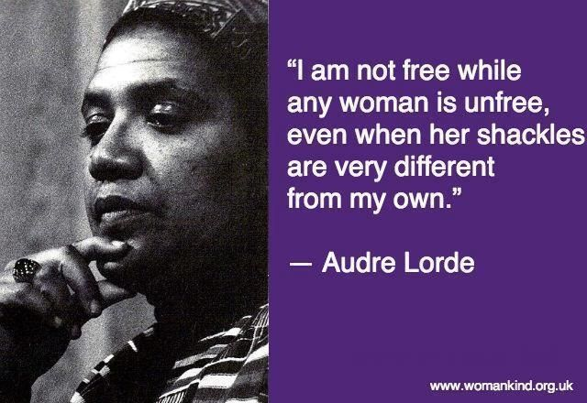
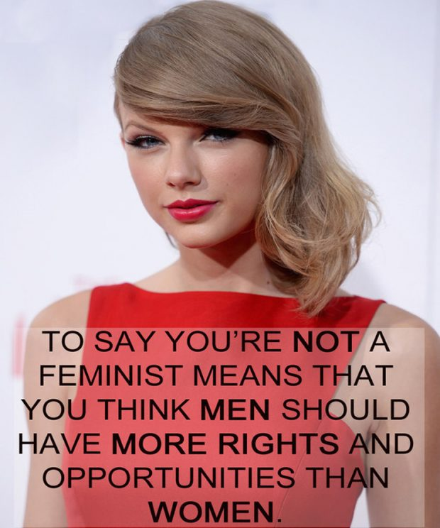
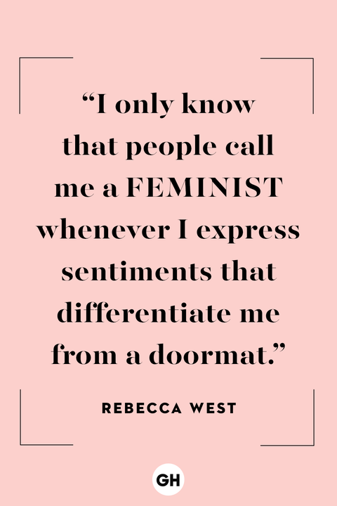



Slide 5

Key terms to get familiar with
Chat with the person next to you – jot down thoughts on what some or any of these terms mean to you…
Women’s movement
Womanism
Sexist/sexism
Oppression
Patriarchy
Gender
Socialist
Woman
Sex
Intersectional
Sista-hood
Radical
Liberal
Trans
Misogyny

Slide 6
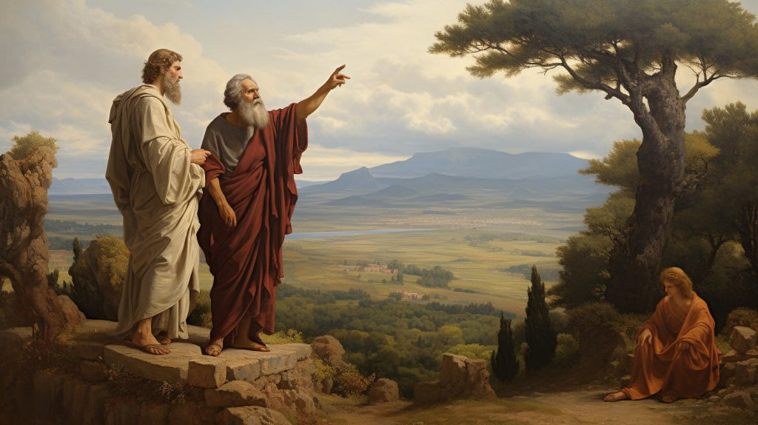
Intellectual discussions of women’s role in society have a long history
Plato c. 428 and 423 BC
‘Women can learn just as well as men if they are given the same opportunities and education’
‘If women are expected to do the same work as men, we must teach them the same things’
Plato’s views on women were unusual at that time, so, historians have asked, was Plato a feminist? But was does that mean, and how do we study and use the term feminism as historians?

Slide 7
Origins of the term ‘feminist/m’
Mid-1800s was used to refer to ‘the qualities of females’
Consciousness evolves around work of Wollstonecraft (English) and Olympe de Gouges (French)- ‘Vindication of the Rights of Women’ (1792) ‘Declaration of the Rights of Woman and of the Female Citizen (1791)
Derived from Fèministe (French)
International Women's Conference (Paris) 1892 was popularised
English use in Britain around the time of the women’s suffrage campaign
Still not widely used until 1913 onward - period of modernism
Distinctions and divisions early on: ‘all feminists were suffragists, but not all suffragists were feminists. To real feminists the vote was just a tool. The real goal was a complete social revolution’
Overtime feminism becomes ‘umbrella’ term used for multiple woman-centred movements, campaigns, ideals and opinions

Slide 8
So how is the history of feminism looked at by historians ?
Based on your readings, discuss and make notes ready to feedback on:
What are the ‘waves’ of feminism and how many are there?
Can you identify what defines each wave?
What problems might we encounter as historians with the wave approach?
Give examples if you can…

Slide 9

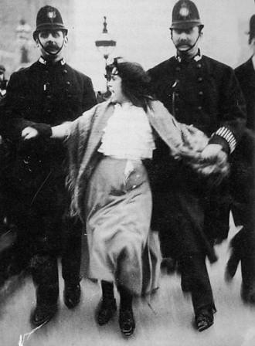
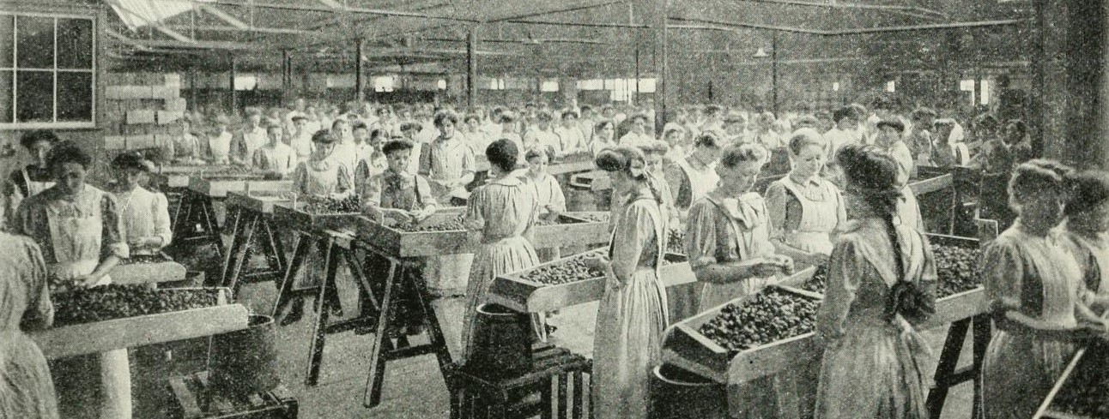
First ‘Wave’ Feminism
Late nineteenth and early twentieth century
Focus on struggle to achieve basic legal & political rights
Some reforms to women’s marriage, work, education rights etc…
Public protests/art activism
Organised campaign begins 1866
Some women over 30 with property get vote in 1918

Slide 10
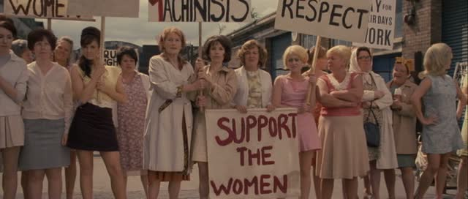
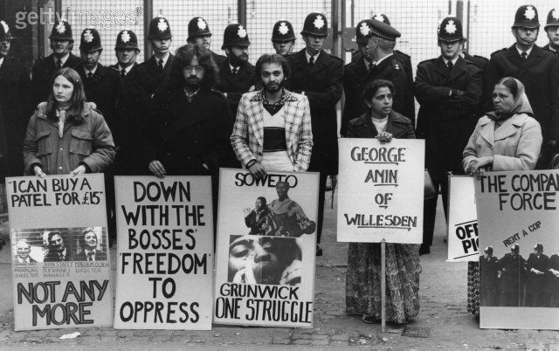
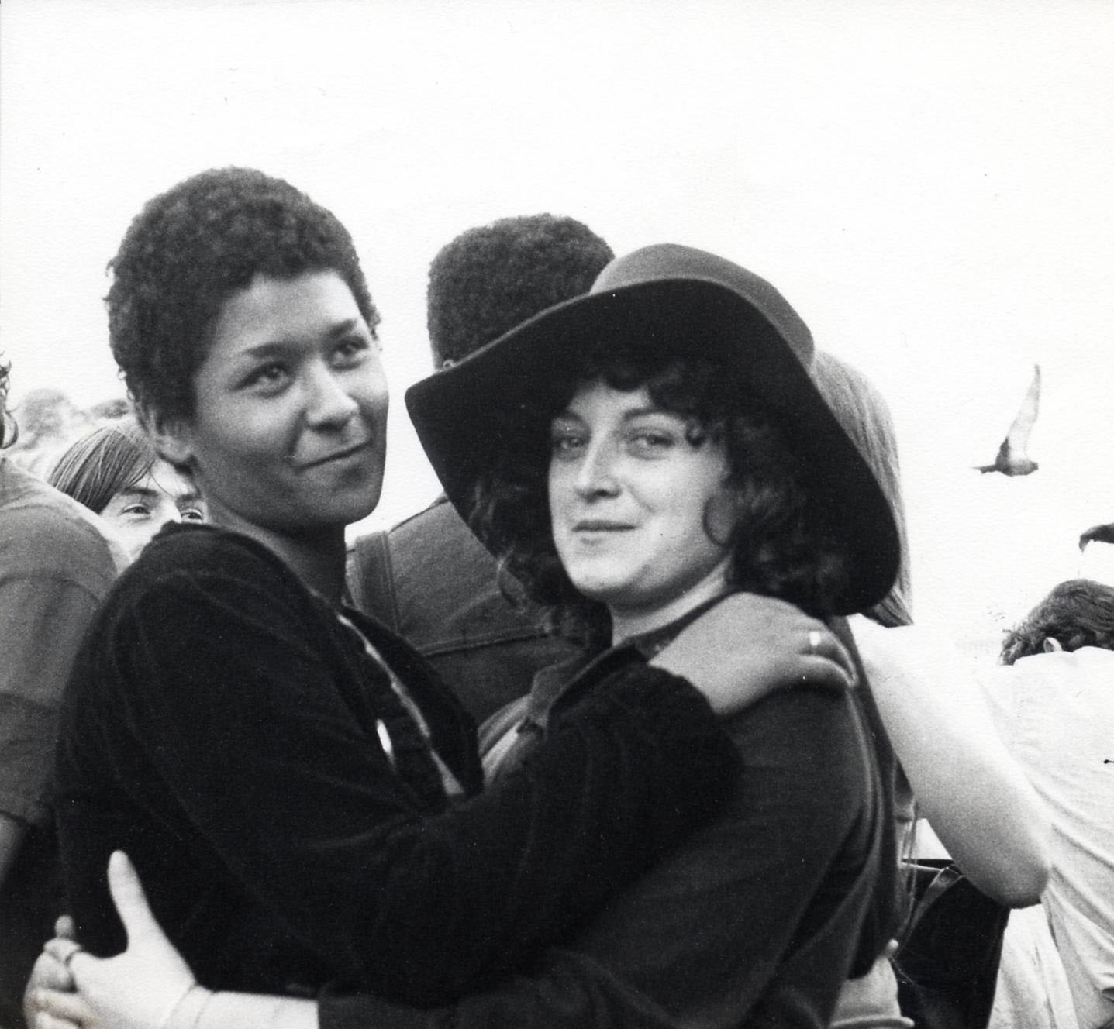
Second Wave Feminism
1960s and early 1970s
Workplace rights
Family, abortion & sexual rights

Slide 11
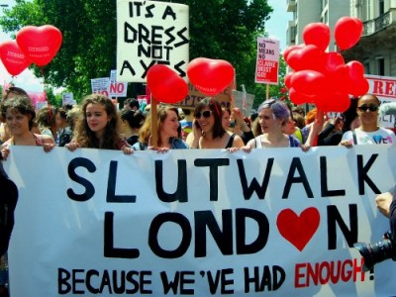
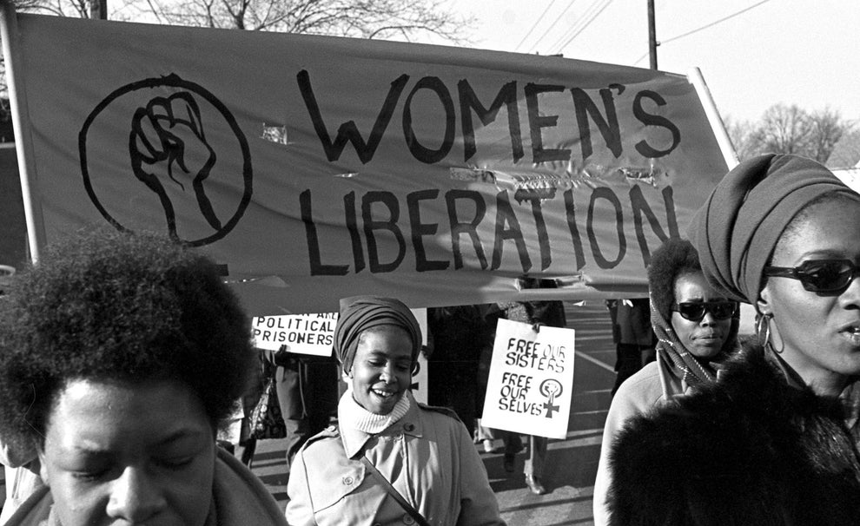
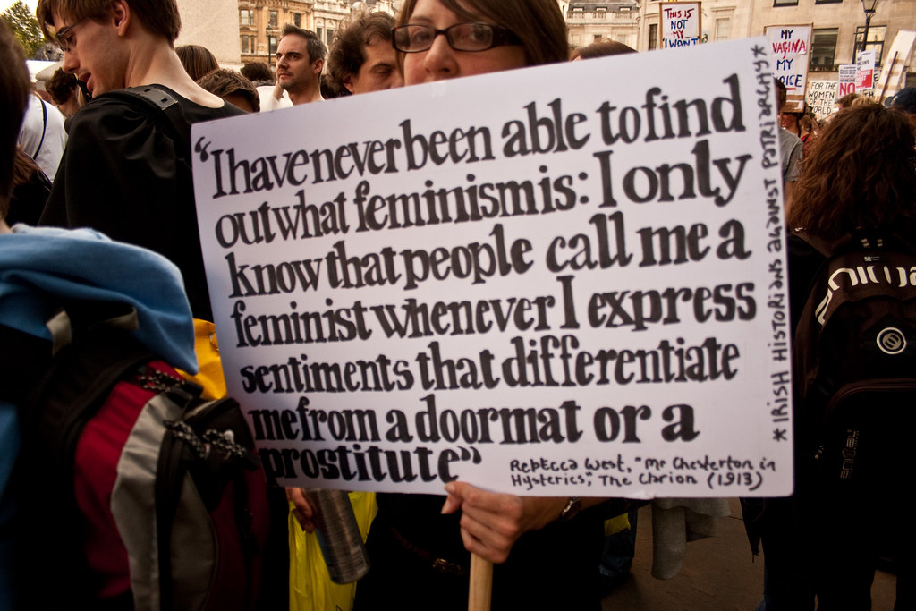
Third Wave
1990s-2010s
Critiques second wave’s lack of diversity -race, class, disability…
Intersectional
‘Gender’ histories & identities
Sexual violence #metoo
https://www.slutmeansspeakup.org.uk/

Slide 12
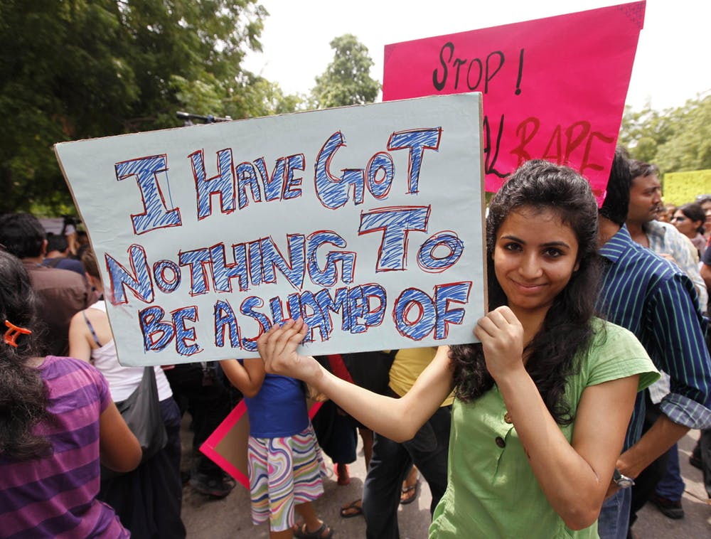
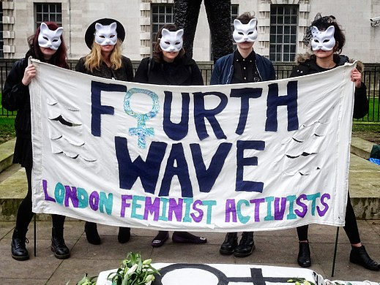
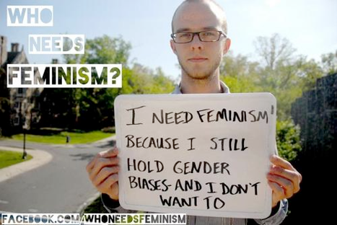

Fourth Wave..?
2000s - now
Digital activism/zines
Decentralized
Less formal
Sexual violence-body shaming-misogyny
Intersectional-international
Transfeminism – gender identities
Sista-hood
https://www.masterclass.com/articles/feminism-meaning#77Wl4H14JAP1qRVxbG6PHa

Slide 13
Task – based on your readings make notes on…
How has feminism changed overtime?
Does it have core values that you can identify?
What do we have to be aware of when using the term Feminism?
Thoughts for the day? Stick up your post-it note on the way out

