Slide 1
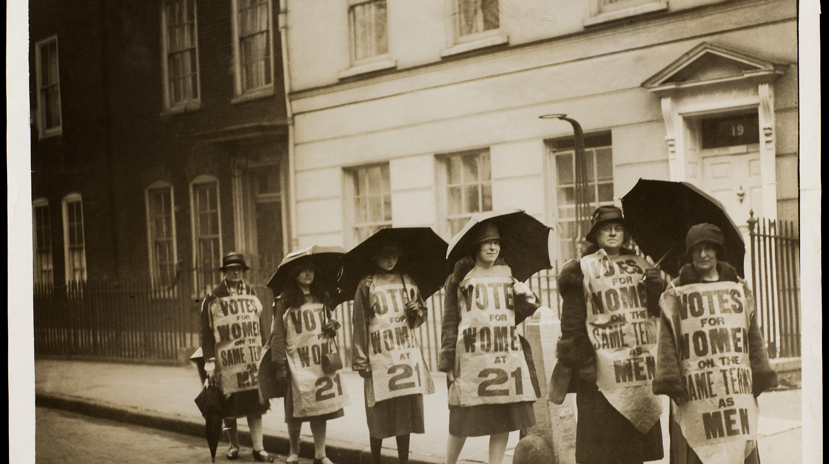
‘There's always been a women's movement this century?'
Assessing Decline, Impact and Social Change 1918-1945

Slide 2
Assessing Decline, Impact and Social Change 1918-1945
Popular notion that feminist activities declined post 1918-1945
Is this true?
Partial vote in 1918 saw women face new set of questions - what does citizenship for women really look like and mean?
Multiple issues affecting women needed to be addressed
NUWSS NUSEC – six-point plan:
1. Equal suffrage 2. Equal moral standard 3. Women candidates for parliament 4. Equal pay for equal work & equality in industry and professions 5. Widows pensions & equal guardianship 6. Active support for League of Nations & principle of equal opportunity

Slide 3
However, some feminists saw ‘six-point plan’ as too broad and suggested focusing on either: full suffrage, economic improvements, contraception
Strengthening of Labour and Conservatives as drive to become mass political parties also splits feminist colleagues along ideological lines
Nonetheless, see impact of feminist legislation despite limitations:
Criminal Law Amendment Act 1922 (raised age of consent for girls to 16)
Married Women Maintenance Act
Guardianship of Infant’s Act
Widows, Orphans and Old Age Contributory Pensions Act1925
Equal Franchise Act 1928.

Slide 4
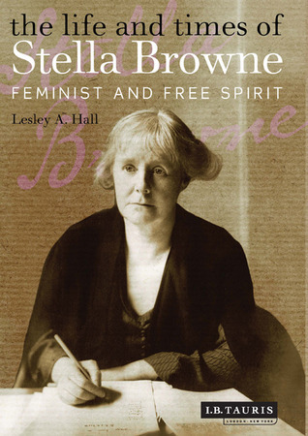
Task 1: Read, discuss, answer:
1. Some historians see a change from ‘old’ feminism to ‘new’ feminism in the interwar years. What does this mean?
2. Focusing on Stella Browne in Lesley Hall’s chapter (core reading):
How radical was Stella?
What did she focus on?
What does her activity tell us about interwar feminism? Think campaign and class

Slide 5
The war in assessing the women’s movement, impact & social change
Opened new opportunities for middle class women via Women’s Emergency Core, Women’s Volunteers Reserves etc… but an extension of previous philanthropic work.
Clerical & industrial jobs opened to women but only temporarily ‘taking’ men's jobs & rates of pay substantially lower than men had earned.
Marriage bars expanded for women’s work, restriction on openings in civil service, no maternity help for single mothers.
Motherhood duties and responsibility for ‘thrifty’ domestic economy emphasised during war
Women used in propaganda to shame men into war
Many returning men physically and emotionally traumatised believe women had it easy, had benefitted from war, women empowered while men were diminished.
Creates hostility & distance between the sexes who become ‘estranged’ recorded in writings such as Vera Britten’s Testament of Youth (1933).

Slide 6
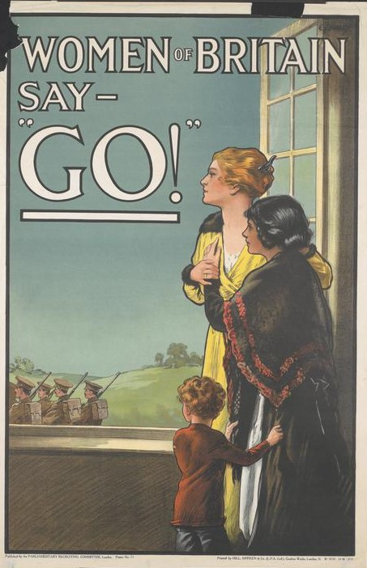
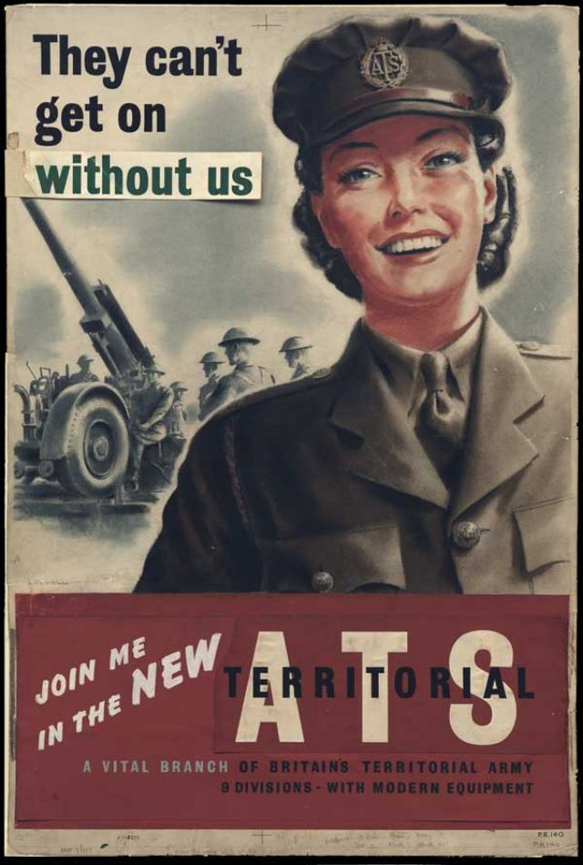
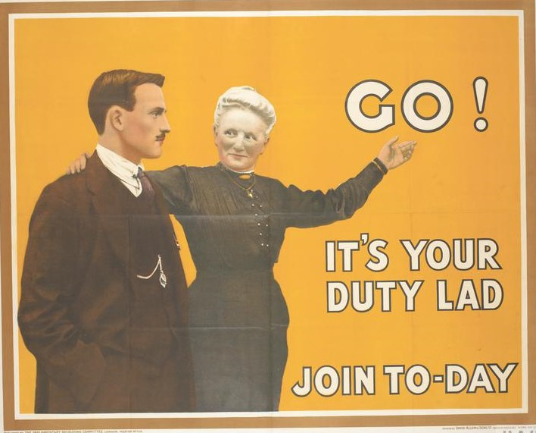

Slide 7
Task 2
Listen to Dale Spender podcast
Discuss Dale Spender article core reading
Answer:
There's always been a women's movement this century?
Why popular notion that feminist activities declined post 1918-1945?

Slide 8
Summary- why popular notion that feminist activities declined post 1918-1945:
‘Quiet’ feminism compared to ‘drama’ of suffrage campaign
Interwar feminists concern with family welfare seen as less threatening to gendered social structures often reinforcing traditional family life and women’s role in it whether intentionally or not.
Not seen as tackling ‘controversial’ topics of their time (like Butler did in hers). Based on Stella Browne is this fair?
Feminists divided over what to focus on diffused campaigns
Join mainstream political parties (i.e. Labour, Conservatives)
‘Malestream’ historians ignore or vilify historical feminists/m
‘That feminist activities and debates should have disappeared so comprehensively even in the immediate aftermath of the momentous suffrage campaign show how tenuous a hold women have both on history and popular traditions’ – Barbara Caine.

Slide 9
3000 word source based essay (40%)
Choose a primary source and perform an in-depth analysis
This can be from the MRC or elsewhere (check with me) but must fit in with the module themes
No need for a ‘title’. E.g. ‘Leaflet Advertising the Indian Female Evangelist (1880): A Source Analysis’ is fine
You are not setting a question to answer or making an argument in the sense of a traditional essay, you are analysing a primary document
Context of the document (authorship, purpose, date, intended audience). Analyse the content (explain arguments, bias, subjectivity or views of the document). Is it useful to historians (i.e. reliability, does it offer views on discourses of the era). If other historians have commented on it – do you agree or disagree with their opinions on it.
Develop historical understanding from the source you choose
Due 12 Noon Wednesday 11th March 2026

