Slide 1
Feminism & Imperialism, 1860-1914
1. ‘Feminist Imperialism’: Abolitionist Roots? Women Against Slavery before 1860
2. ‘Feminist imperialism’ : A Case Study of India, 1860-1914

Slide 2
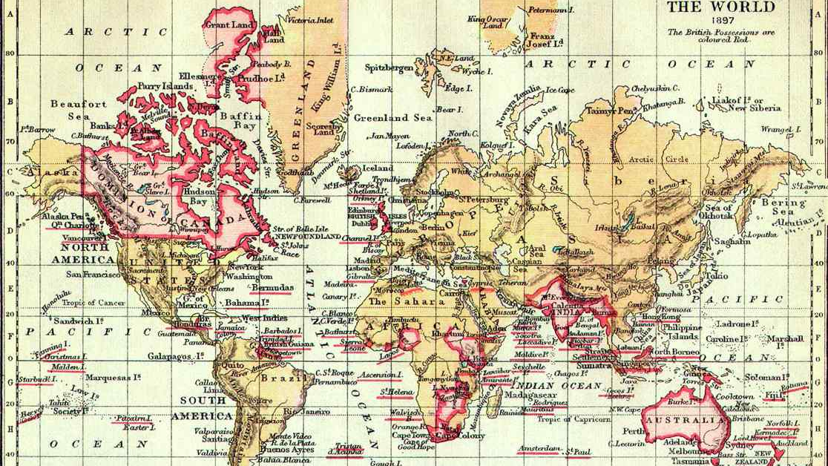

Slide 3
1. Feminist Imperialism: Abolitionist Roots? Women Against Slavery before 1860
Wollstonecraft:
Slave trade as “this abominable traffic,” she argued for the “natural rights” of all men and women, of whatever colour, to “be allowed to enjoy their birthright—liberty.”
Rhetoric - repeatedly likened men’s domination of women to the planters’ domination of slaves.
In her 1792 essay “Vindication of the Rights of Woman” referring to slave-produced sugar she asked:
‘Is one half of the human species [i.e. women], like the poor African slaves, to be subject to prejudices that brutalize them…only to sweeten the cup of men?’

Slide 4
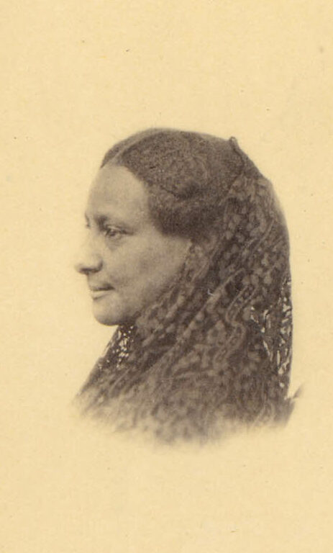
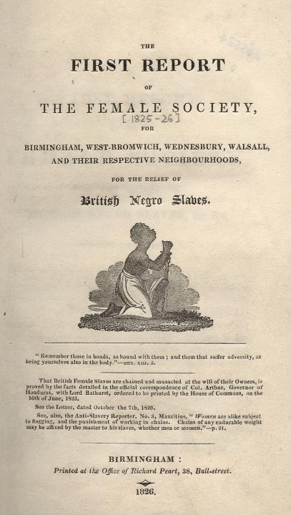
1825 - The Birmingham Ladies Society for the Relief of Negro Slaves formed - renamed The Female Society for Birmingham – slams British slavery Leaders include Lucy Townsend, Elizabeth Heyrick, Mary Lloyd, Sarah Wedgwood Boycott sugar, distribute pamphlets, call meetings, draw up petitions William Wilberforce – objects to anti-slavery ladies’ associations: “For ladies to meet, to publish, to go from house to house stirring up petitions—these appear to me proceedings unsuited to the female character as delineated in Scripture.” 1833 Abolition of Slavery Act US anti-slavery campaigner Sarah Remond Parker tours Britain 1858-1862 (US abolition 1865)

Slide 5
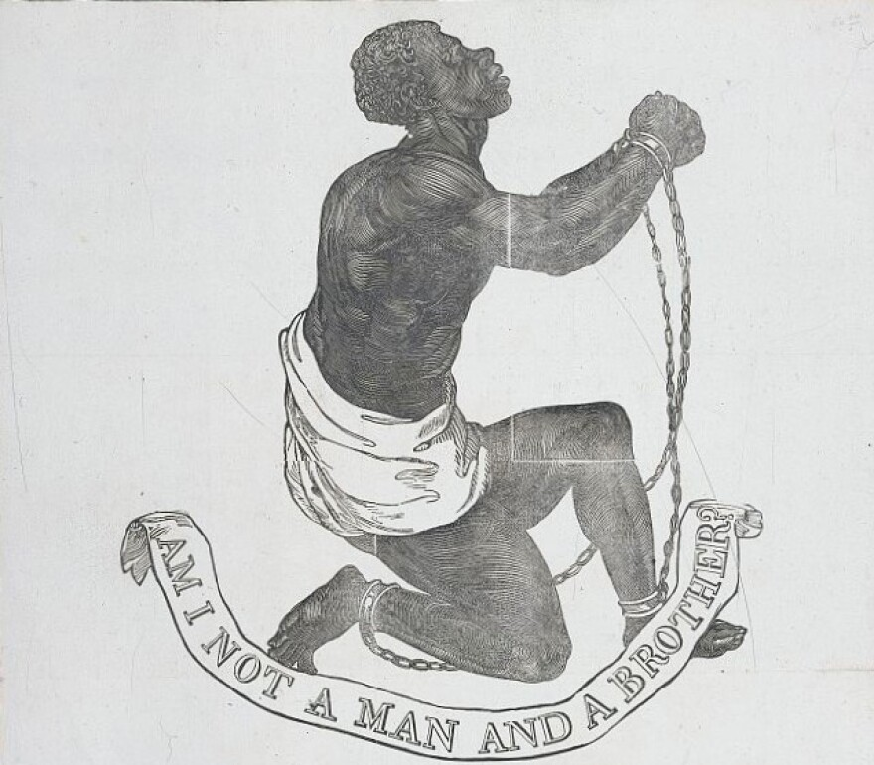
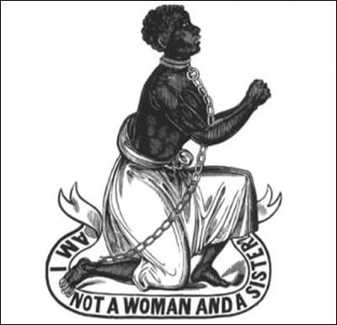
Left: original Wedgwood design used to decorate anti-slavery objects for sale
Right: Sophia Sturge design. Sophia (Bewdley, Midlands) belonged to The Female Society for Birmingham
What strikes you about these images? Why did the Female Society create this image? Does it tell us anything about British women against slavery?
Read the short source extract from the Society:
How does it sit with Claire Midgley’s article on ‘proto-feminism’?
How are female abolitionists justifying their interventions?
Is the rhetoric more religious or racial?

Slide 6
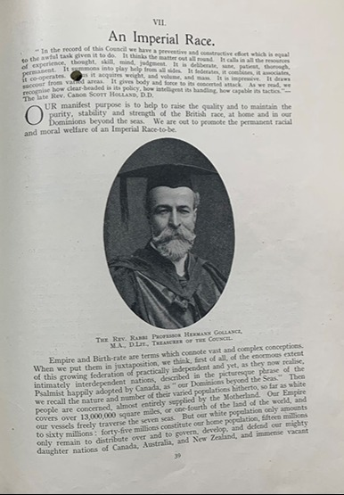
2. ‘Feminist Imperialism’: A Case Study of India, 1860-1914
Imperial expansion
Britian passes the Government of India Act of 1858 – begins direct rule in India.
Troops, state machinery, railways, architecture etc… colonisation of India British Raj established.
Women travel from Britian often as wives of colonial officials ‘memsahibs’ or ‘missionaries’
Late 19th early 20th century British Empire in trouble (Boer Wars etc...) India – jewel in the crown so much focus on it
Period of new ‘science’ of eugenics with genetic and racial hierarchies (Eugenics Society 1907)

Slide 7
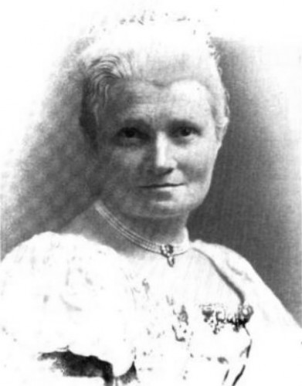
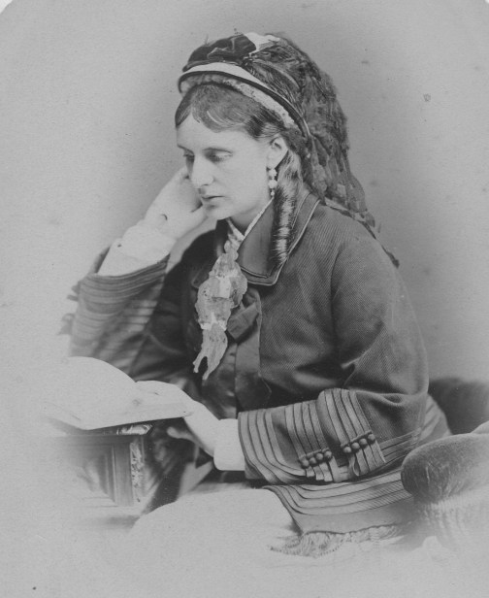
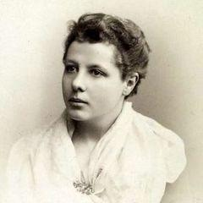
Florence Annie Steel
Supportive of women’s rights
Writes on experiences of living in India as wife of civil engineer ‘memsahib’:
“Indian household can no more be governed peacefully without dignity and prestige than an Indian Empire”…“first duty” of English mistress is “to give intelligible orders’’ and ‘‘to insist on her orders being carried out”
Josephine Butler
Takes British CD Acts campaign to India challenges state complicity in prostitution
Indian prostitutes' ‘helpless victims’ needing special protection from British feminist "sisters"
Butler’s Christian feminism posits Indian women as equals, but imperialized view with Indian women falling between the saint and ‘the noble friend of man, the dog’ (see Burton c.5)
Annie Besant
From 1907 helps organise Indian Women’s Societies
Calls for feminist reform based on ancient Hindu texts where women are equal
1917 joins Indian Nationalist leaders openly criticizing British rule
Interned for 94 days by British Raj
1917 voted president Indian National Congress

Slide 8
Task
Look at materials: https://cdm21047.contentdm.oclc.org/digital/collection/tav/id/1471
https://cdm21047.contentdm.oclc.org/digital/collection/tav/id/1487
How do British women interact with Indian Women?
Can you see similarities or differences to women abolitionists rhetoric?
Do you think British feminists/feminism benefitted from imperialism?

Slide 9
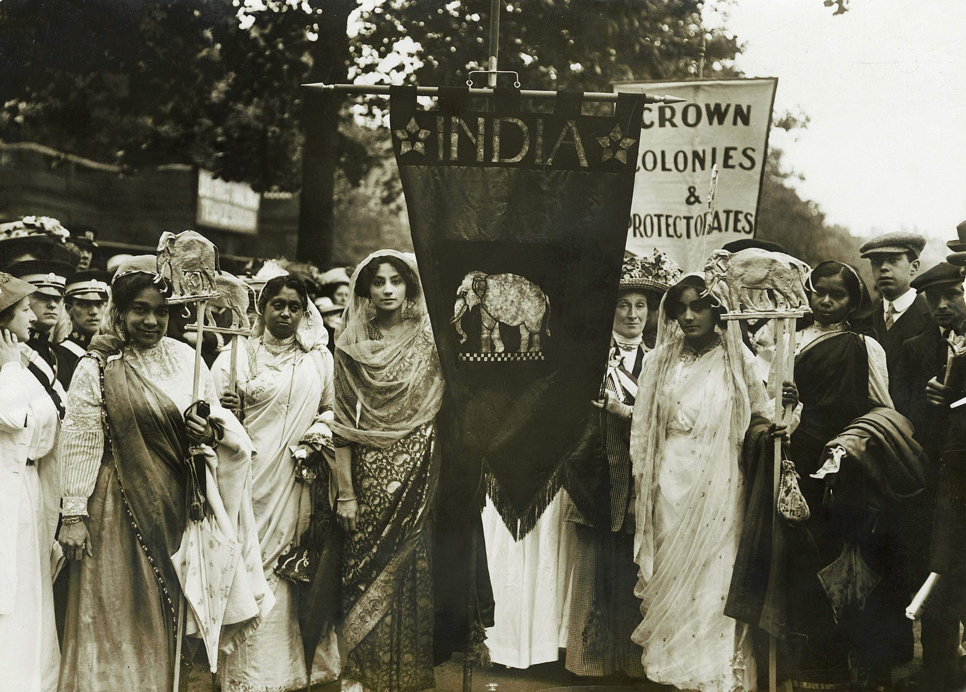
Final thoughts…
Steel, Butler & Besant active in the British women’s suffrage movement.
So were Indian women.
Historian Sumita Mukherjee remarks, Indian women were not there to represent the campaign for votes in India, an issue which was not raised until after 1917, when democratic assemblies were slowly introduced by the imperial parliament.
Next time… the Women’s Suffrage Movement
Image: 1911 Suffrage Women’s Coronation Procession, London.

