Slide 1
Origins of the Victorian Women’s Movement
Historical backdrop – tumultuous times
Key social, political, and intellectual factors shaping the early Victorian women’s movement
Break
Team investigations – What are women doing? (Readings, active women, class, education)
Feedback & Summary

Slide 2
Backdrop Britain – tumultuous times
1789 French Revolution - upend social order
1791 Thomas Paine ‘Rights of Man’ – later prosecuted
1792 Wollstonecraft ‘Vindication of the Rights of Women’
1792 Royal Proclamation against seditious writing ‘Gagging Acts’
1793-1815 War with France (dissent in Ireland against British rule)
1819 Peterloo Massacre (demo for manhood suffrage)
1819 Gov ‘Six Acts’ prohibit meetings, writings, arrests, harassment of reformers
Disruptive politics of class (owenite socialism, chartism) and ‘feminism’ seen as threat to social order (crown, church, political elite & wealthy)
Wollstonecraft work targeted - a ‘hyena in petticoats’ (Walpole)

Slide 3
3 key factors emerge to shape women’s role in Victorian Britain.
In your groups, discuss and make notes under each heading below, ready to feedback.
Industrialization What happens? How does it start to change women and men’s roles?
Growth of ‘separate spheres’ ideology – what was this ideology? What or who was encouraging this notion? What was the impact on women? Did this differ by class?
Men’s rights BTW how were men’s political rights changing in this era?

Slide 4
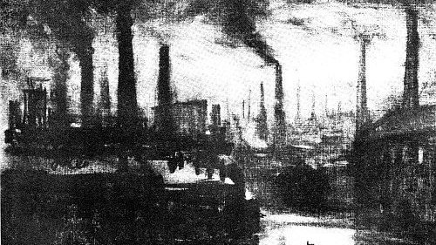
Industrialisation
Shifts populations to towns and cities
Creates new industries and factories
Demands new modes of production
Different ways of organising work
Shifts waged work away from shared home/family ‘unit’
Separates productive waged work from reproductive (domestic) work

Slide 5
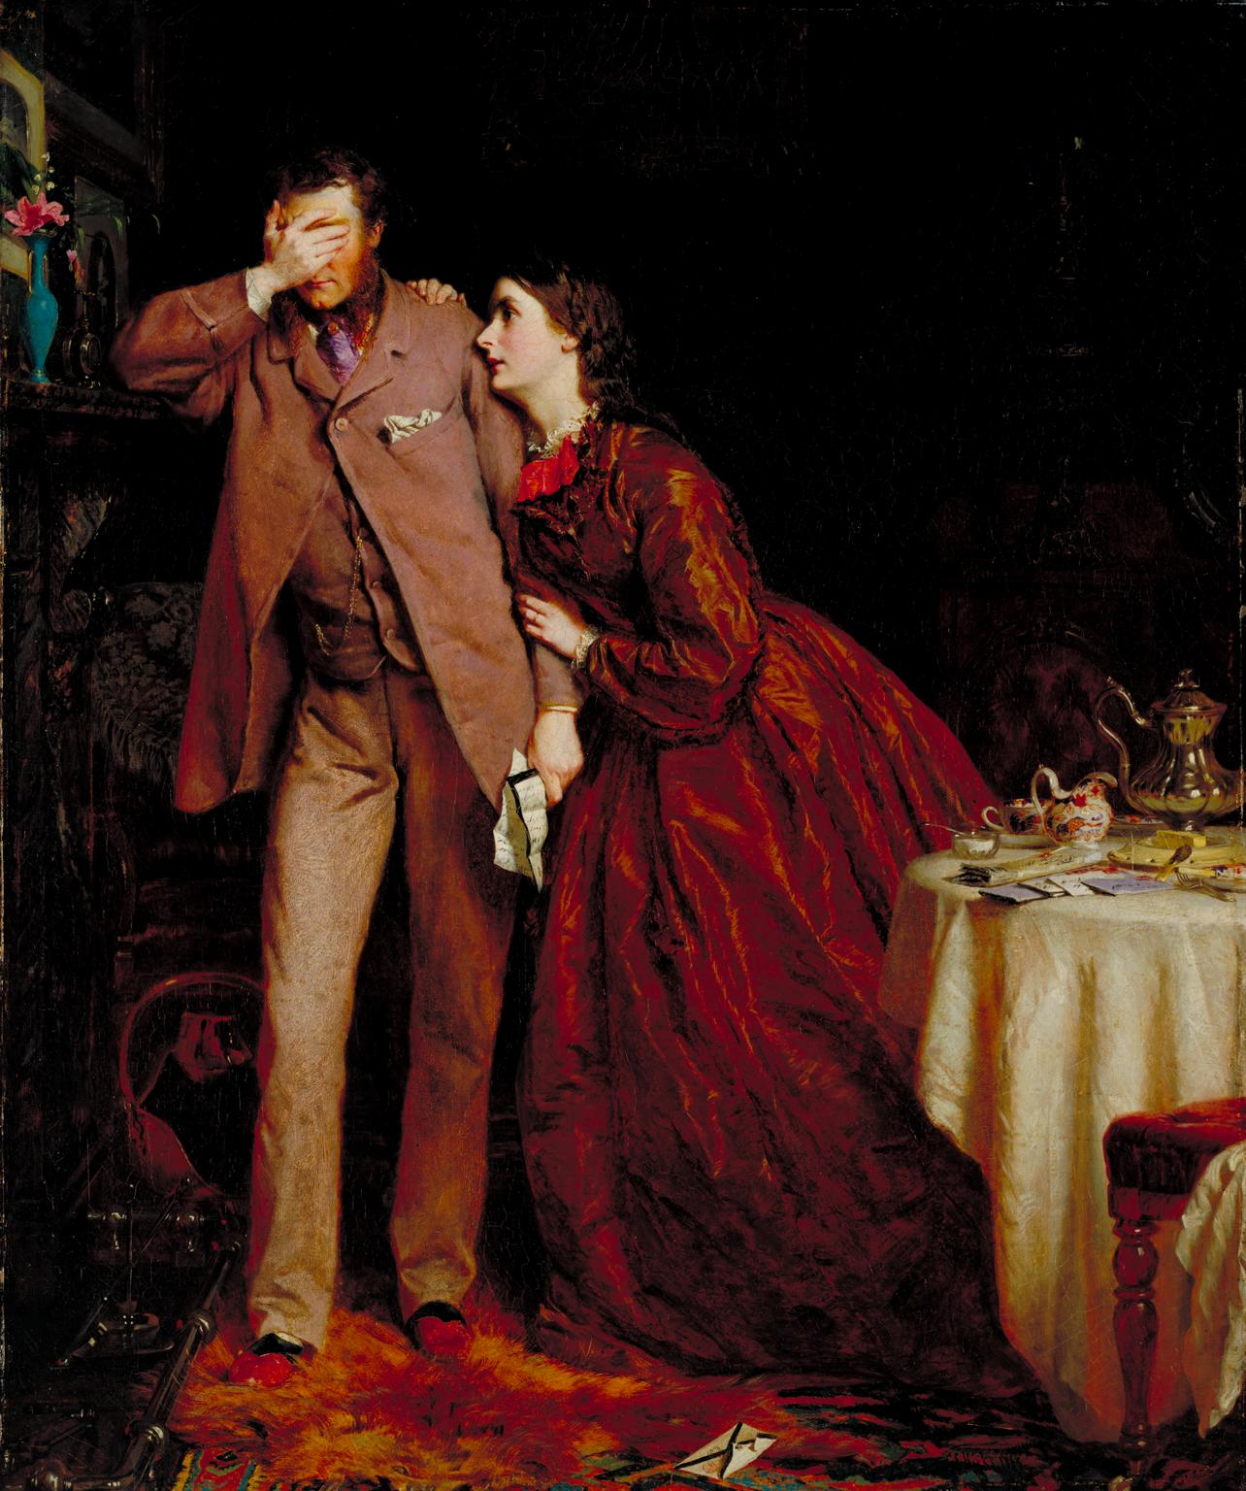
Social impacts – ‘resoectability’
Women and men’s roles increasingly defined in opposition to each other - polarised
Men become associated with the ‘public’ world of waged work and industry
Portrayed as rational, strong, dynamic, breadwinners and so educated differently
Women’s role increasingly defined by and confined to the ‘private’ space of domesticity/home
Portrayed as physically weak, emotional, need men’s protection, nurturers, and so education discouraged
Religious reinforcement of women as ‘angels of the home and hearth’ and as men’s moral superiors but intellectual inferiors
‘wives submit yourselves unto your husbands as unto the lord’

Slide 6
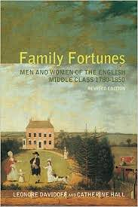

‘Separate Spheres’ ideology
Men fitted for the public world of work, politics, thus need education etc..
Women relegated to the private sphere of home, children, domesticity, purity
Shapes gender roles and expectations encouraging women and men into ‘separate spheres’
Phrase coined by historians Leonore Davidoff and Catherine Hall's book Family Fortunes
Hugely influential on women, gender, and feminist histories
Reality of separate spheres questionable
BUT powerful ideology for governing classes so had material effects

Slide 7
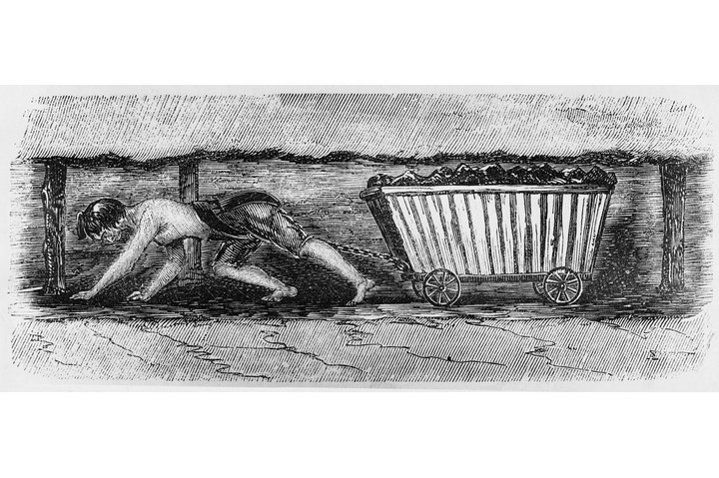
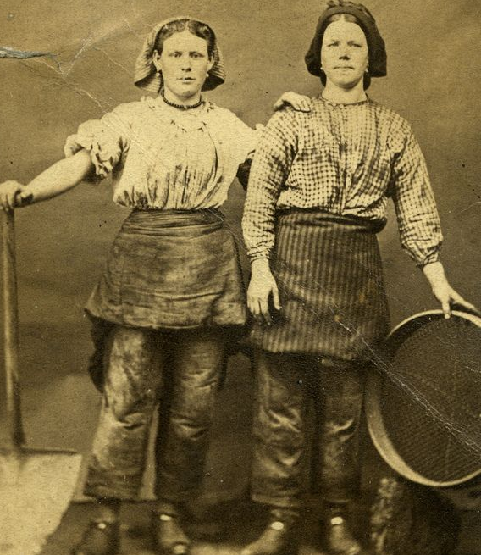
Impact on women and girls
Protective legislation – questionable motives
Women’s work marginalised to ‘unskilled’ labour, factory work, domestic servitude
Reinforces employers paying women less than men
Middle class women limited options (marriage, governess…)
Gendering of education
Professions closed to women
Political & legal equality denied
Heightens women’s consciousness of exclusion

Slide 8
Gain rights, freedoms and (incrementally) votes in Britain’s ‘Great’ Reform Act (1832) which enfranchises some working men & more with Second (1867) and Third (1884) Reform Acts but still NO women
Meanwhile, men in Britain….

Slide 9
What are women doing?
Team 1 - investigate
Owenite socialism – why was it a threat? Who did it represent? What was women’s role in it?
Catherine Barmby (m. John Goodwyn Barmby) – what is she arguing in her 1843 Tract?
See also, Anna (Doyle) Wheeler & Emma Martin https://sslh.org.uk/2024/12/13/class-encounters-emma-martin-owenite-lecturer/
Team 2 – investigate
Emily Davies – who was she? What was she involved in? Who does she represent?
What is she arguing in ‘The Higher Education of Women’ (1866)
What do publications like the EWJ tell us about the role of class and social notions of ‘respectability’ in the early Victorian Women’s Movement?

Slide 10
Summary
By the 1850s separate spheres ideology & notions of respectability was influential on middle (governing) classes
Organised Victorian women’s movement increasingly focuses on rights of middle-class women. Three key areas:
Education (secondary and university for middle class women)
Employment (for middle class women)
Suffrage (right to vote in parliamentary (general) elections. Campaign kicks off with 1867 Reform Act but not a mass movement until the early twentieth century)
Next week: Feminism, Religion and Secularism 1860-1914

