Slide 1
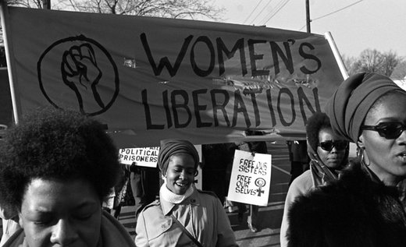
Feminism, Race & Racism
Week 19

Slide 2
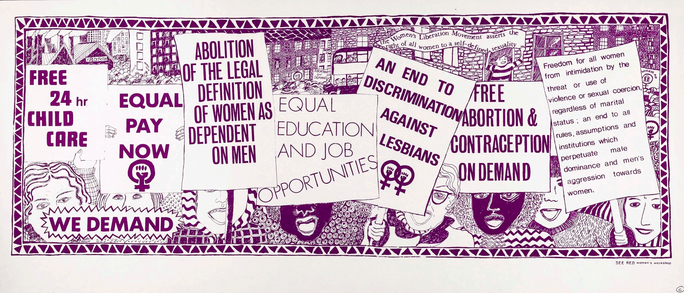

Slide 3
The Combahee River Collective Statement (US)
We are a collective of Black feminists who have been meeting together since 1974. During that time we have been involved in the process of defining and clarifying our politics, while at the same time doing political work within our own group and in coalition with other progressive organizations and movements. The most general statement of our politics at the present time would be that we are actively committed to struggling against racial, sexual, heterosexual, and class oppression, and see as our particular task the development of integrated analysis and practice based upon the fact that the major systems of oppression are interlocking. The synthesis of these oppressions creates the conditions of our lives. As Black women we see Black feminism as the logical political movement to combat the manifold and simultaneous oppressions that all women of color face.

Slide 4
Task
Discuss the core reading
Why is slavery & imperialism important to thinking through the British WLM ‘second wave’ debates about racism?
What parallels/ differences can you identify between debates about the nineteenth-century?
Compare and contrast core reading articles
What is your analysis of the articles. What are your thoughts on their respective arguments?
Prepare to feedback

Slide 5
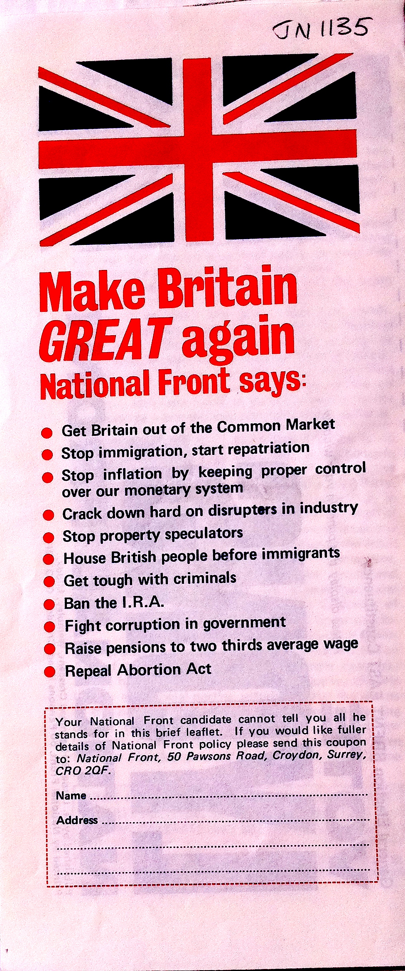
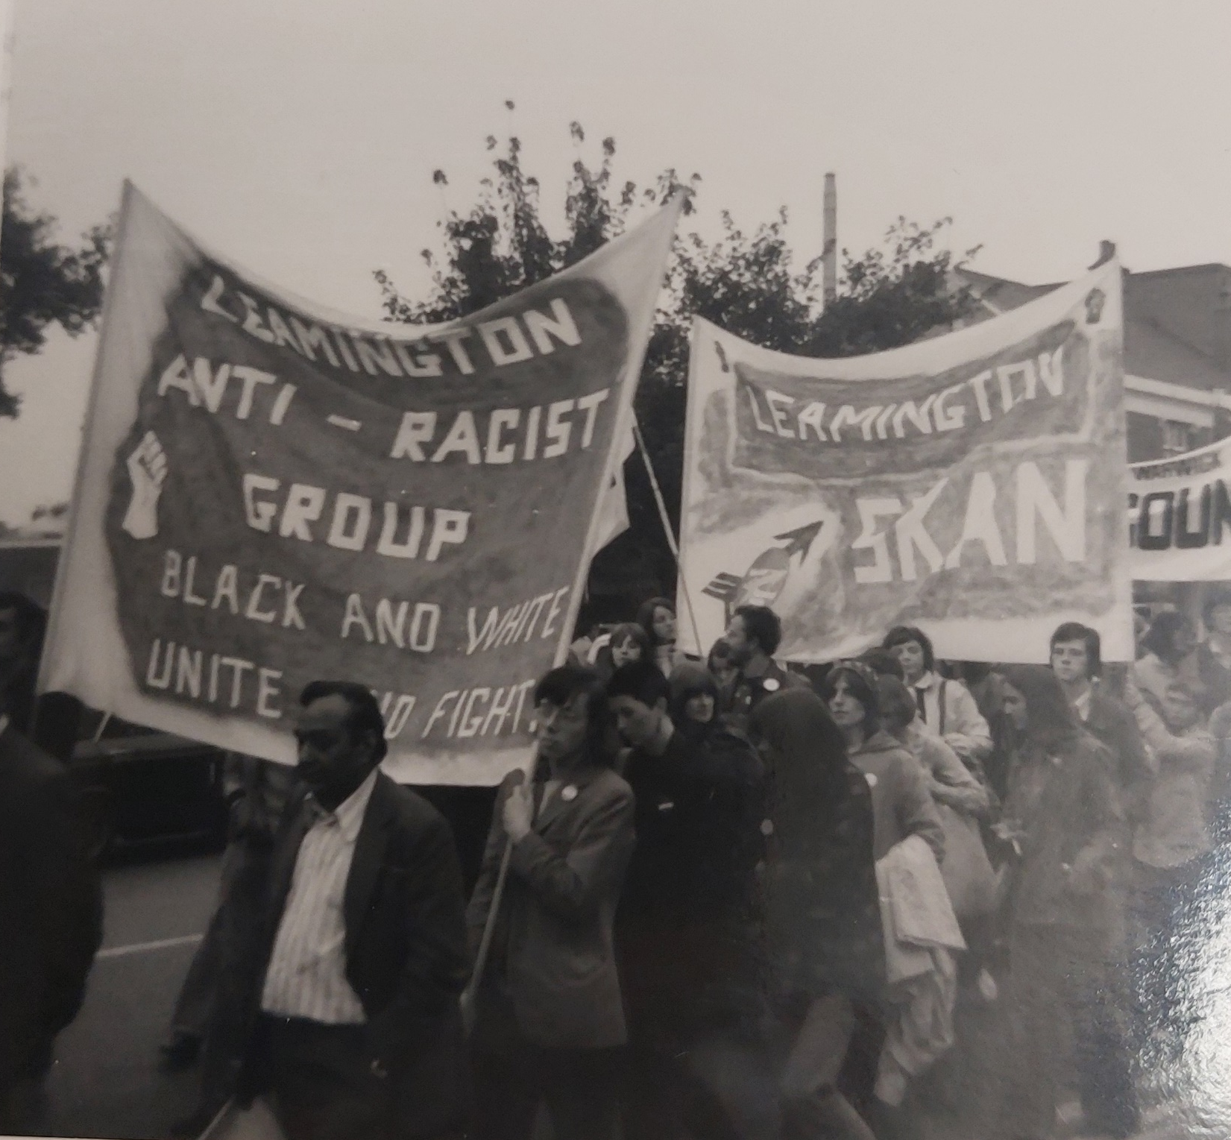
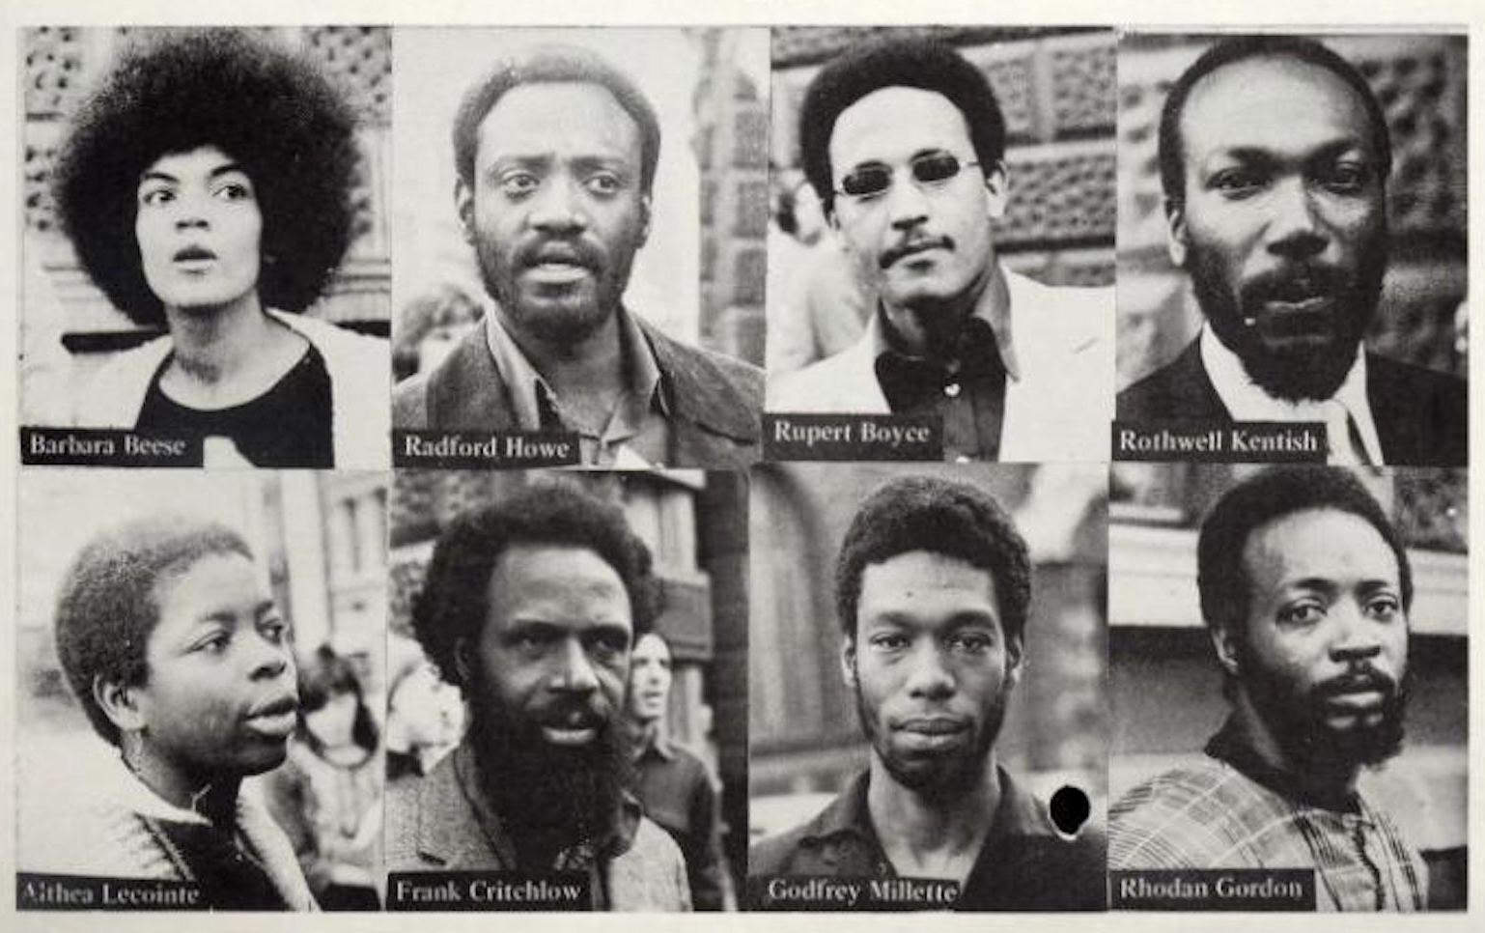
Britain 1970s-1980s…..
1979 Thatcher government
1970s-1980s National Front – British National Party
Hostile immigration policies
Mangrove 9 (1970)
British Black Panthers (1968-73)
Brixton riots 1981 (others followed)
1976-8 Grunwick strike

Slide 6
Task 2
Research black women involved in the Women’s Liberation Movement in Britain.
Research key people & organisations for Black feminism in Britain. Prepare a case study and timeline. Use the sources and online resources on the worksheet to help you.
Key searches: Olive Morris, Southall Black Sisters, Black Women’s Brixton Group, OWAAD (Organisation of Women of Asian and African Descent), Amrit Wilson, Diane Abbott
Key terms: womanism sista-hood
Audre Lorde’s inclusion is to show US/UK black feminist cultural sharing and captures feelings of black women within the WLM.

Slide 7
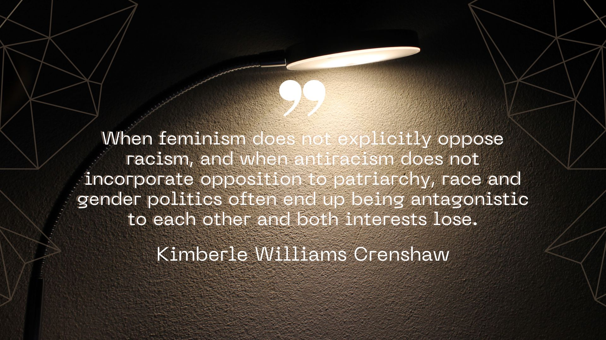
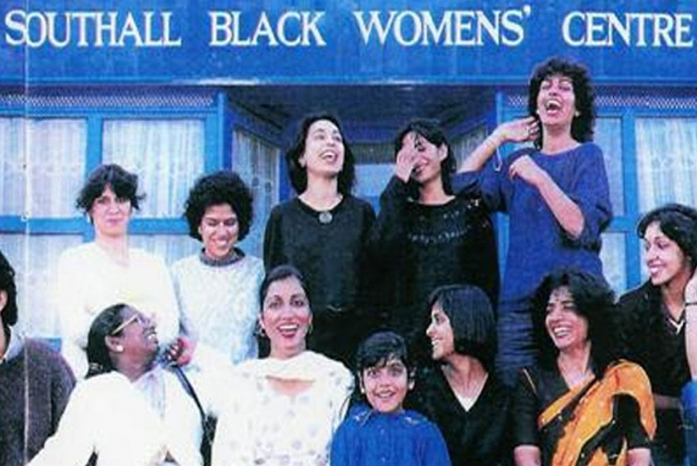
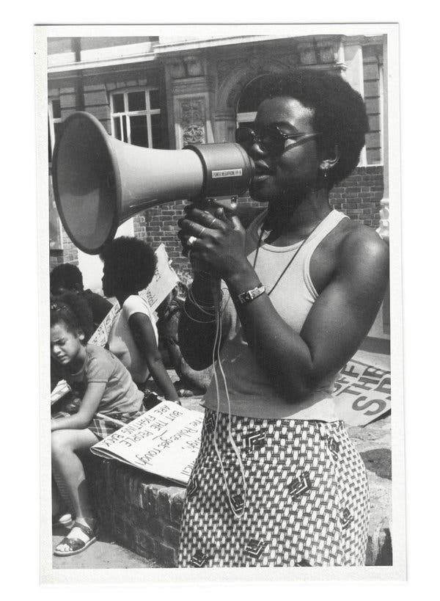
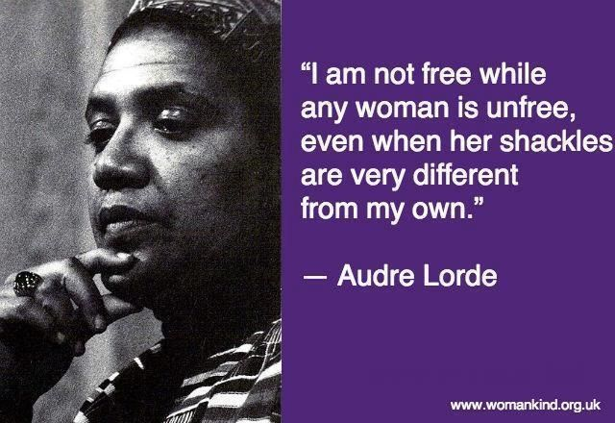
TASK: Research the names & organisations below (including timelines)
Why and how were Black women involved in the WLM
Why did black feminists struggle with or reject the label ‘feminist’
OWAAD
(Organisation of Women of Asian & African Descent)
Brixton Black Women’s Group
Southall Sisters
Diane Abbott
Olive Morris
Audre Lorde
Claudia Jones

