Slide 1

Feminism, Religion & Secularism 1860-1914
Part one
Christianity: A belief in women’s subordination to man retained a powerful hold over attitudes in the Church of England and Anglo-Catholicism throughout the nineteenth century
Primary source reading Margaret Jane Menzies, Eighth monthly letter to young women (1880)
Part two
Women’s pathway to public duty: Evangelicalism, individual piety and inner faith
Readings on Josephine Butler
Part three
Women, Secularism and the Free-thinking Movement
Primary source: Annie Besant

Slide 2
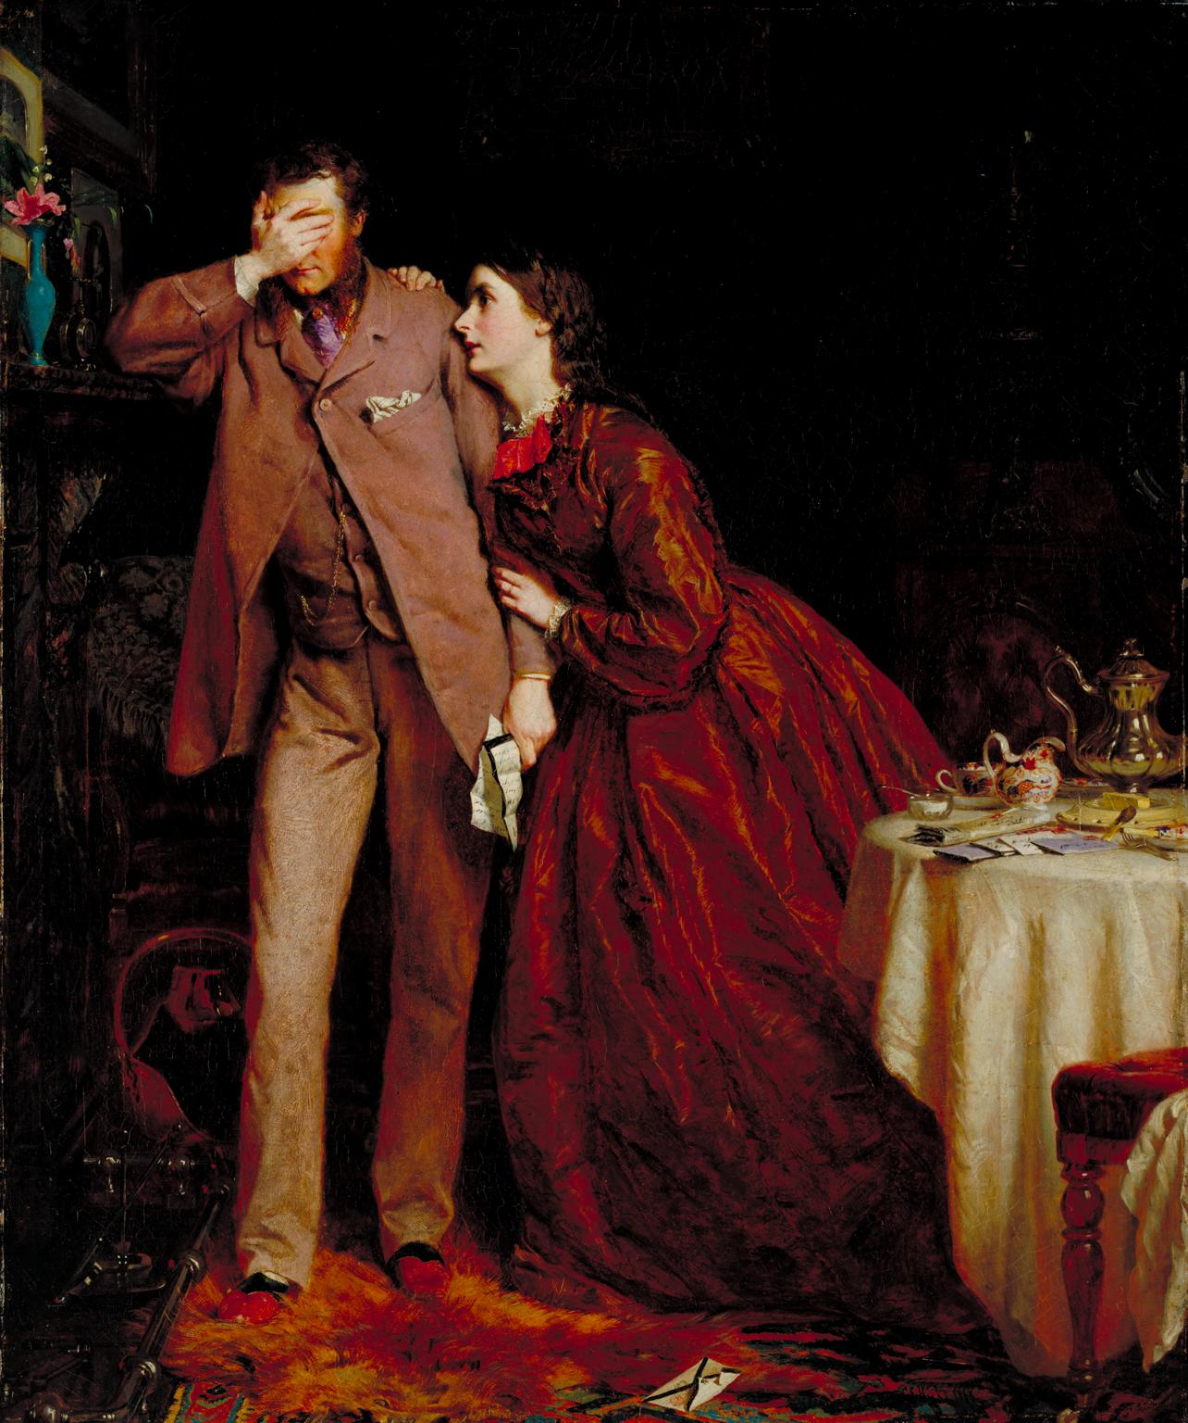
1: Christianity and the position of women
Domestic ideology & notion of ‘separate spheres’
Christian commentators of all denominations were central to promoting an idealised and prescriptive view of womanhood
Ideals of womanhood: physically and intellectually weaker than man yet also his moral superior, with a stronger tendency to care for others and place their needs before her own.
Women were discussed in ‘biblical’ terms
‘Angel of hearth and home’
As ‘saints’ or ‘sinners’ – ‘fallen woman’ (sexually immoral i.e. prostitution)

Slide 3
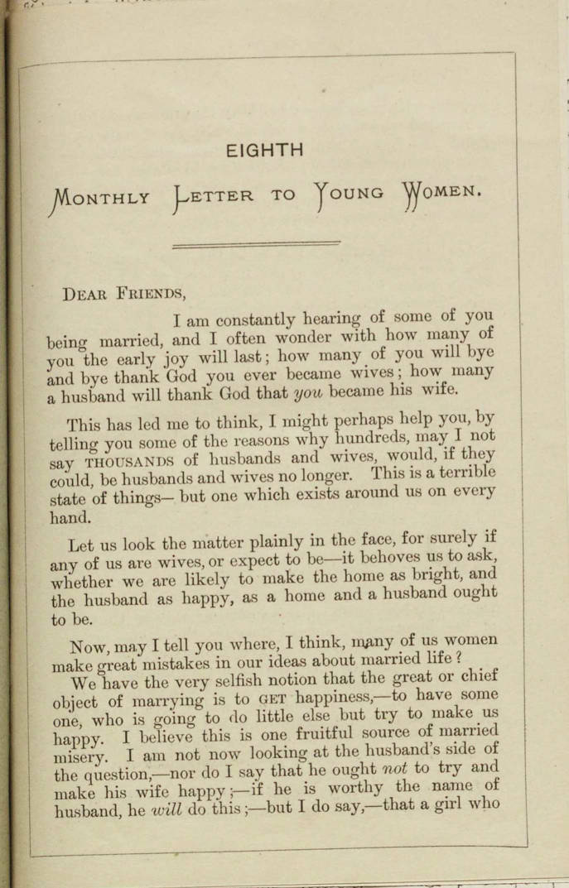
Task 1
Read Margaret Jane Menzies, Eighth Monthly Letter to Young Women (1880) https://wdc.contentdm.oclc.org/digital/collection/tav/id/1412/
What is her position on young Christian women’s role?
Do you have a sense of why she’s felt compelled to write it?

Slide 4
2: Women’s pathway to public duty: Evangelicalism, individual piety and inner faith
Some Christian women circumvented ‘domestic piety’ by drawing upon their ascribed ‘moral superiority’ to men within church teaching
Sarah Lewis’ 1839 best-seller Woman’s Mission, argued that although the church deemed women socially subordinate to men, it recognised that they possessed a superior moral power which gave them ‘no less office than that of instruments (under God) for the regeneration of the world.’
Nonconformists (i.e. unitarians, Quakers) & Evangelicals sought personal faith
Women use ‘moral sphere’ to justify expansion into the public world. Middle-class women embark on a variety of philanthropic endeavours, ministering to the working class, poor, missionaries in ‘heathen’ nations

Slide 5
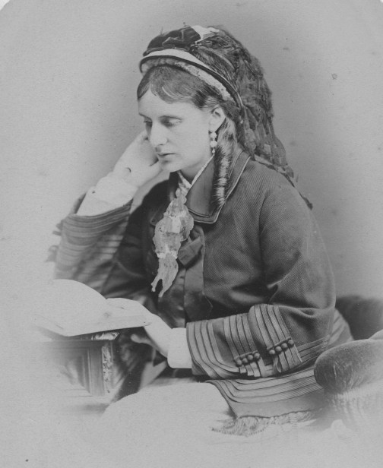
Task 2
Josephine Butler readings/handouts:
What role does religion, inner faith & personal piety play in her work?
How does this link with her feminism?
Facts
CD Acts 1864, 1866, 1869 passed to reduce disease among soldiers by enabling women in garrison towns ‘suspected’ of prostitution to be snatched, forcibly examined, detained in ‘lock hospitals’
Men not checked or punished – sexual double standard (& male prostitution not recognised or mentioned)
Butler heads campaign to repeal Act (succeeds 1886)

Slide 6
3: Women, Secularism & the Free-thinking Movement
End of the nineteenth century into early twentieth century, religious cultures transformed in Britain with rise of esoteric and occult religions popular in progressive circles.
i.e. Theosophy (1880s); Hermetic Order of the Golden Dawn (est. 1888); Freethinkers - question religious assumptions about the ordering of the world & reject all forms of organised religion. Maintain Owenite critique of sexual morality
Charles Bradlaugh - leading champion of Secularism. 1866 organises first conference of the National Secular Society (NSS) - elected president.
NSS declared ‘That human improvement and happiness cannot be effectively promoted without civil and religious liberty; and that, therefore, it is the duty of every individual … to actively attack all barriers to equal freedom of thought and utterance for all, upon Political and Theological subjects’
Many women’s rights campaigners had links to free thinking movement

Slide 7
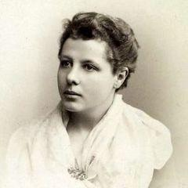
Annie Besant: book extract
What do you think motivates Annie’s public work?
Does anything strike you about her writing?
******
Born Annie Wood, 1 October, 1847, London.
Begins as devout Christian (m. priest Frank Besant). Starts questioning faith. Marriage fails. Keeps custody of daughter but not son.
Becomes socialist (Matchgirls strike), theosophist, women’s rights campaigner & for Indian nationalism (first female president of the Indian National Congress in 1917)
National Secular Society speaker & friend of Bradlaugh
Pair arrested in 1877 for publishing book on contraception by Charles Knowlton. Loses custody of both children. Put on trial released on technicality.

Slide 8
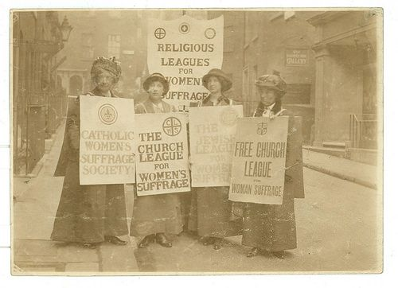
Final thoughts….
Does religion supress women more than it supports them?
How as historians might we examine the relationship between religion, secularism, and women’s rights in this era?
Can we say feminism was secular?

