Slide 1
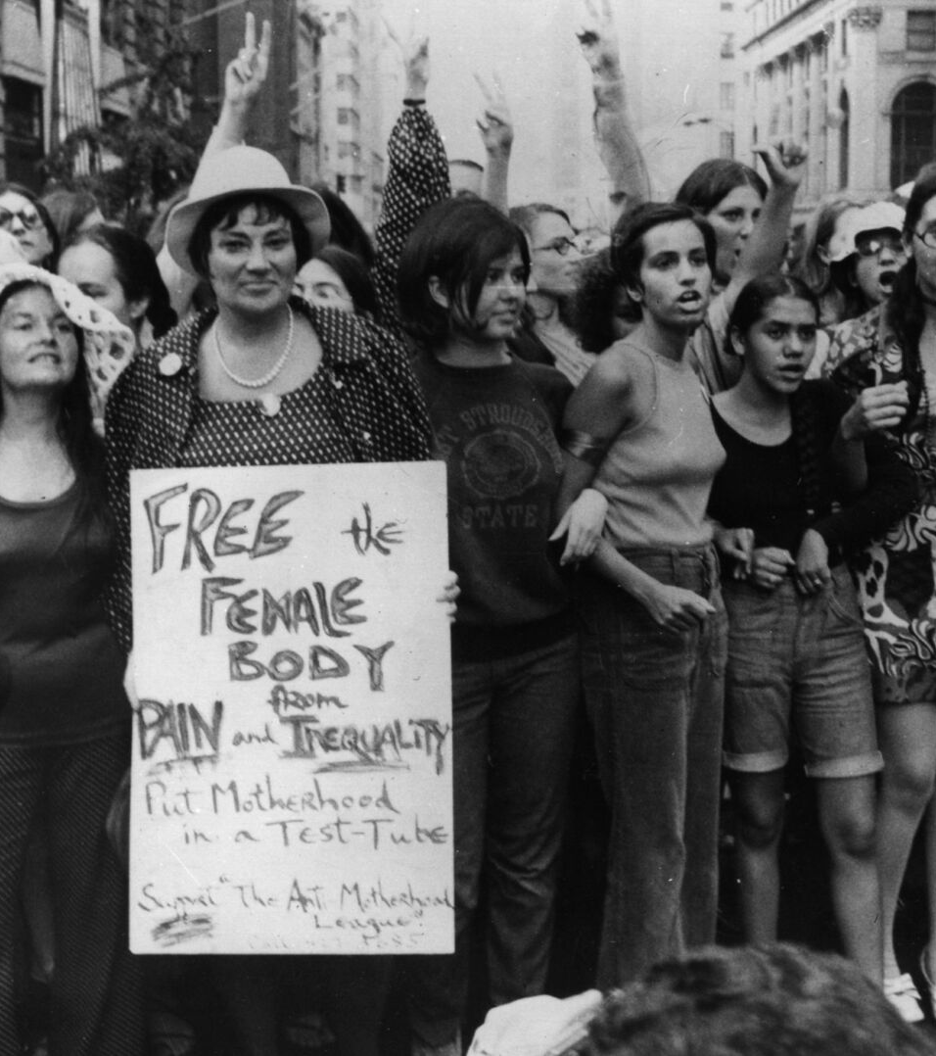
The Struggle for Sexual freedom 1870-1930
This presentation will include:
An introduction: This focuses on the historical context, time frame, key terms and historiography – Lydia and Lottie
Sections 1-4: We have each chosen readings from the seminar list and have created our own slides highlighting the key arguments and historiographical positioning of our texts.
A conclusion- This is a summary of the overall historiographical positioning, key takeaways and final comments- All
Power point: Lydia

Slide 2
Introduction:
The struggle for sexual freedom
This presentation examines women’s struggles for sexual freedom between 1870 and 1930, a period marked by rapid social, political and moral change in Britain. During these decades, women challenged Victorian sexual norms, the double standard, and the legal and social systems that limited their bodily autonomy.
The presentation will provide historical context for the era, including key legislative, social and cultural developments, and unpack the historiographical debates and significance.
Lydia – Studied Lucy Bland’s, Purifying the Public world: Feminist Vigiliantes Prostitution and public surveillance and Chapter 7 Speaking of sex, Banishing the beast: English feminism and sexual morality 1885-1914. – I provide historical context, a summary, the historiographical contribution and an overview.
Su- read Laura Schwartz’s Article, ‘Freethought, Free Love and Feminism in England 1850-1885’. And Sheila Jeffrys’ Chapter, ‘Feminism and Social Purity’ in The Spinster and her Enemies.
Lottie- looked at Free Love and Victorian Feminism: The Drivers Matrimonials of Elizabeth Wolstenholme and Ben Elmy, by Sandra Stanley Holton, Outspoken Women: An Anthology of Women’s Writing on Sex, 1870-1969, by Lesley A. Hall and The Real Facts of Life: Feminism and the Politics of Sexuality c 1850-1940, by Margaret Jackson
Gisele – did Outspoken Women: An Anthology of Women’s Writing on Sex 1870-1969 (Victorian Women 1870 -1901)

Slide 3
Context and summary
Text: Lucy Bland, ‘Purifying the Public world: Feminist Vigiliantes Prostitution and public surveillance
Context: Lucy Bland is a modern British historian of gender and sexuality whose work examines how feminism, morality, and state power interacted in Britain from the Victorian period onward.
Writing within contemporary feminist historiography, she reassesses earlier movements by showing how campaigns for women’s protection could also reinforce social surveillance and limited sexual autonomy
Summary: She argues that feminist reformers sought to purify public life but often did so through strategies that reinforced surveillance and social control rather than expanding women’s sexual autonomy.
Bland shows that many campaigners framed the fight against prostitution as a struggle to protect women from male exploitation. However, this often meant supporting controls that restricted women’s movement and moral choices. Feminists believed that transforming sexuality required reshaping public morality, not granting individual freedom.
feminists pursued a campaign “to reform the male sexual code” (p. 100), insisting that men—not women—must change.
they emphasized “the moral elevation of the community” rather than personal sexual liberty (p. 104)
Section 1: Lydia Hall

Slide 4
Historiography and overview:
Historiography: Bland challenges earlier historians who celebrated purity reform as straightforwardly emancipatory. She argues it both challenged and reinforced patriarchal sexual morality—a position influencing later scholarship.
- feminist vigilance work “subverted male control while reproducing many of its assumptions” (p. 111).
, Bland demonstrates that reformers wanted not expanded sexual choice but a universal code of restraint.
Their ideal was not freedom but a society where both sexes adhered to “the single standard of chastity” (p. 101).
Overview: Bland’s chapter shows that the feminist struggle against prostitution in the 1880s was not primarily a movement for sexual liberation but a campaign to:
- discipline men’s sexuality,
- protect women within a conservative moral framework,
- reform the nation’s public character.
These efforts helped place sexuality at the center of feminist politics, but they also constructed new systems of surveillance and control
This is a paradox that Bland identifies as central to Victorian sexual reform.
Section 1: Lydia Hall

Slide 5
Context and summary:
Text: Chapter 7 Speaking of sex, Banishing the beast: English feminism and sexual morality 1885-1914- Lucy Bland
Context: Banishing the Beast was written in the late 1980s and published in 1995. It was written at a time when feminist scholarship was increasingly re-evaluating the history of sexuality through the lenses of social control, gender power, and the influence of sexology.
Summary: In Chapter 7, Bland explores how early English feminists discussed sex explicitly — not just as a moral danger, but as a topic deserving debate, education, and reform.
She argues that feminists challenged the double standard of sexual morality by calling out male privilege in sexual matters: they insisted women should have sexual knowledge and choice, not just be protected or silenced.
Bland also shows that many feminists remained cautious: they embraced sexual reform (e.g., sex education, birth control) but were often worried about appearing “too radical” or undermining social respectability.
She also highlights class tensions: working-class women and middle-class feminists had different stakes in “speaking of sex,” since class shaped whether sexual freedom meant protection, respectability, or liberation.
Section 1: Lydia Hall

Slide 6
Historiography and Overview
Historiography:
Bland challenges older historiography that portrayed first-wave feminism as uniformly conservative on sex. She shows a more complex picture: some feminists were very forward-thinking, even if they couched reforms in moral language.
Her work contributes to debates about how early feminists interacted with scientific discourses (e.g. Havelock Ellis and sexologists). Bland argues they selectively used scientific arguments to legitimize sexual reform.
She engages with scholarship about how feminists balanced the need for social respectability with their critique of sexual norms. This adds nuance to debates about whether first-wave feminists were “radical” or “safe.”
Classed perspectives on sexuality: Bland’s chapter raises historiographical issues about class: not all women experienced sexual “reform” the same way, and class shaped their access to and interest in sexual freedom.
Overview: Bland highlights the increase in
Elevation of public morality,
Protection of women through discipline rather than autonomy,
Respectability as the basis for political legitimacy.
Lucy Bland argues, these strategies helped place sexuality at the centre of feminist politics, but they also reproduced new hierarchies of class, authority and surveillance.
Section 1: Lydia Hall

Slide 7
Conclusions:
The struggle for women’s sexual freedom between 1870 and 1930 was not a straightforward march toward liberation, but a complex attempt to renegotiate sexual power in a society deeply rooted in Victorian moral codes.
Reformers challenged the sexual double standard, demanded access to sexual knowledge, and sought to redefine women as moral and political subjects rather than passive victims.
Bland uses both chapters to show that late-Victorian feminism fought to reshape sexual morality but did so in ways that reinforced respectability, social control, and class-based authority.
This reveals that sexual reform was not a simple march toward liberation but a deeply ambivalent transformation of power.
Section 1: Lydia Hall

Slide 8
Text: Laura Schwartz’s Article, ‘Freethought, Free Love and Feminism in England 1850-1885’.
Summary
· Discussing new forms of heterosexual relationships.
· Questions religious dominance in society.
· Started radical discussion of sexuality, divorce, monogamy, and free love.
· Focuses on Elizabeth Wolstenholme’s free union with Ben Elmy.
· Argues that Freethinkers were a development from Owenite radical thought. Key arguments
· Origins of the women’s movement – women involved in the English Women’s Journal – same circles as women in freethinking groups.
· Key texts such as Richard Carlile’s What is Love? – encouraged couples into free unions over marriage.
· Freethinkers protected women that wanted to separate and divorce their abusive husbands – valuing themselves over ‘social respectability’.
· In response to sexual double standards – women called for greater self-control of men. Key historiographical debates related to text
· The breadth of the freethinking movement has not been explored in scholarly fields much.
· Historians tended to believe that radical ideas of marriage and love amongst feminists by the second half of the 19th century had disappeared - Schwartz argues against this.
Section 2: Su Yu

Slide 9
Text: Sheila Jeffrys’ Chapter, ‘Feminism and Social Purity’ in The Spinster and her Enemies.
Summary
· Two main elements of the social purity movement: religion and the C.D. Acts.
· Led to formation of groups like the ‘Moral Reform Union’ – believed that education would lead to greater morality – main objective was to transform the sexual morality of men.
· After the 1900s social purity movements seemed to move away from feminism, becoming more conservative and nationalistic.
o Women in this movement naturally turned towards suffrage campaigns. Key arguments
· Aims of social purity was eliminating prostitution and preventing sexual violence against women.
· Argued against the idea that prostitution was necessary because of the nature of male sexuality.
· Significance of figures like Jane Ellice Hopkins in the 1880s – started purity organisations, setting up refuges for sex workers, other preventative and rescue work. Key historiographical debates related to text
· Historians tended to see social purity as ‘evangelical, anti-sex, and repressive’. Or also, social purity as a form of ‘moral panic’.
Section 2: Su Yu

Slide 10
Free Love and Victorian Feminism: The Drivers Matrimonials of Elizabeth Wolstenholme and Ben Elmy, by Sandra Stanley Holton
Brief Overview:
Holton shows how the personal relationship between feminist Elizabeth Wolstenholme and Ben Elmy. Rooted in free love ideal and this became a political act that revealed major fault lines within Victorian feminism.
Core Points:
Free Love as Protest: Their choice to cohabit without marriage challenged Victorian marriage laws, especially coverture, and embodied their belief in women’s autonomy.
Public Backlash: When Elizabeth became pregnant, pressure from the feminist movement and wider society forced the couple into a civil marriage. Here we see the limits of radicalism under scrutiny in practice.
Movement Tensions: Their case highlights internal divisions between radical feminists who questioned marriage itself and moderates who prioritised respectability for political strategy.
Holton's interpretation: Holton uses this relationship to show that early feminism extended beyond suffrage, encompassing debates about sexuality, the state, and personal freedom.
Takeaway:
The Wolstenholme–Elmy union illustrates how deeply intertwined the personal and political were in Victorian feminism, and how radical ideals could be constrained by social pressures and movement politics.
Section 3- Lottie Casey

Slide 11
Outspoken Women: An Anthology of Women’s Writing on Sex, 1870-1969, by Lesley A. Hall
Brief Overview:
Hall showcases how women across a century wrote boldly about sex, challenging social taboos and asserting their authority over sexual knowledge and experience.
Key Points:
Wide Historical Span (1870-1969): Includes Victorian feminists, interwar reformers, medical professionals, activists, and post-war modernists.
Themes Covered: Sexual desire, marriage, contraception, sexual double standards, lesbianism, reproductive rights, and pleasure.
Breaking Silence: Women’s writings confront restrictive sexual norms, exposing how silence and ignorance harmed women’s autonomy.
Diverse Voices: Mix of radical and conservative perspectives shows that women debated sexuality among themselves, not just against patriarchy.
Cultural Impact: Demonstrates how women’s writing helped shift public discourse on sex, from moral purity frameworks to more open, rights-based, and experiential understandings.
Takeaway: It reveals a long, rich tradition of women speaking openly about sex. Women were redefining sexual knowledge and challenging the power structures that sought to silence them.
Section 3: Lottie Casey

Slide 12
The Real Facts of Life: Feminism and the Politics of Sexuality c 1850-1940, by Margaret Jackson
Brief Overview:
Jackson maps how feminists from the mid-19th to early 20th century reshaped debates on sexuality, challenging dominant Victorian values and redefining women’s sexual autonomy.
Key Points:
Victorian Sexual Ideology: Society framed women as passive, moral guardians. Sexuality was controlled through marriage, purity norms, and limited reproductive knowledge.
Feminist Interventions: Early feminists contested sexual double standards, campaigned for marital reform, access to birth control, and protection from male violence.
Changing Strategies (1850-1940): Approaches evolved from moral purity campaigns to more radical demands for sexual freedom, contraception, and recognition of women’s desire.
Key Debates: Prostitution regulation, marital rape, reproductive rights, motherhood, and the emergence of sexology shaped feminist thinking and internal disagreements.
Jackson's Interpretation: Jackson shows feminism was never solely about political rights; it sought to transform sexual relations, bodily autonomy, and women’s lived experience.
Takeaway: Feminism between 1850 and 1940 was a sustained challenge to sexual oppression, reshaping public discourse and laying foundations for modern understandings of gender, power, and sexuality.
Section 3: Lottie Casey

Slide 13
Outspoken Women: An Anthology of Women’s Writing on Sex 1870-1969 (Victorian Women 1870 -1901)
Key sexual‑related concerns for Victorian women
Legal double standards – Men could divorce on simple adultery while women had to prove adultery plus cruelty, abandonment, sodomy or incest, leaving wives trapped in unhappy marriages. ” The wife is the husband’s property, and by marriage she has lost the right of control over her own body. The English marriage law sweeps away all the tenderness, all the grace, all the generosity of love, and transforms conjugal affection into a hard and brutal legal right” Annie Besant (1882)
Marital rape – The law treated any conjugal violence by a husband as legal, effectively denying women protection from sexual assault within marriage.
“force or constraint is recognised by the law as rape, in all cases save that of marriage . . . no rape can be committed by a husband on a wife; the consent given in marriage is held to cover the life, and if – as sometimes occurs – a miscarriage or premature confinement be brought on by the husband’s selfish passions, no offence is committed in the [14] eye of the law” Annie Besant (1882)
Prostitution and the Contagious Diseases Acts – Women were subjected to compulsory medical examinations and criminalisation even when not prostitutes; activists led by Josephine Butler’s Ladies’ National Association demanded repeal.
Sexual double standard – Society excused male immorality while harshly judging female sexuality, a theme repeatedly attacked by reformers. “The root of the evil is the unequal standard in morality… a large section of female society has been told off… while the male profligate can desire.” Josephine Butler (1879)
Section 4: Gisele Melki

Slide 14
Birth‑control and sexual health – The Malthusian League and feminists such as Annie Besant and Elizabeth Blackwell argued that contraception protected women’s health, reduced unwanted pregnancies and allowed “healthy sexual relations.”
Sexual education – Both “social‑purity” and “free‑thought” groups, though differed in many discourses pertaining to women, called for enlightened instruction for youth, opposing the notion that ignorance equated to innocence. - Sexual knowledge as “healthy knowledge”. Yet, as the “social purity” perspectives were heavily religious, this sexual knowledge differed slightly in content
Marital dissatisfaction – Writers like Edith Lees Ellis and Ellice Hopkins described marriage as a “bitter disappointment” and warned that women’s “lower moral standard” forced them into unhealthy or exploitative sexual arrangements
Social Purity VS Contraception
Both groups advocated for what they saw as women’s sexual liberty. The “social‑purity” campaign presented itself as a moral regeneration of Victorian society, seeking to eradicate prostitution and the double standard that punished women while excusing men. Yet, other feminists argued that true regeneration required women’s control over their own bodies. (Malthusian League)
Other women apart of the social purity group feared contraception would ‘incite’ further exploitation of women’s bodies by lustful men – Contraception empowered men to take further advantage of women – to “degrade” them sexually
Section 4: Gisele Melki

Slide 15
“We cannot degrade women without degrading men. We find wherever woman has been regarded merely as the instrument of man’s pleasure or gain, there, men are low and mean and sensual, and I was going to say devilish . . . . And I was also going to say that I thanked God it was so, because justice is the foundation of all real improvement.” - Catherine Booth
Divorce: Female autonomy in marriage
Differential divorce statutes made the marriage contract a one‑sided shield for men and a prison for women.
A husband could keep any number of mistresses without jeopardising his right to a divorce, whereas a wife could obtain freedom only if the husband’s adultery was coupled with an additional offence
There was a consensus among feminists that the divorce law exposed the Victorian marital structure as fundamentally gender‑biased. It protected male privilege while rendering women legally powerless over their own bodies and futures
Middle Ground between social purity movement and pro-contraception movement
While the social purity movement opposed ‘free love’ to preserve a moral order, it also recognised that the importance of lawful divorce for women’s freedom. The push for divorce reform was not an endorsement of unrestricted sexual activity but to ensure women could leave intolerable marriages without having to abandon structures of social purity.
Section 4: Gisele Melki

