Slide 1
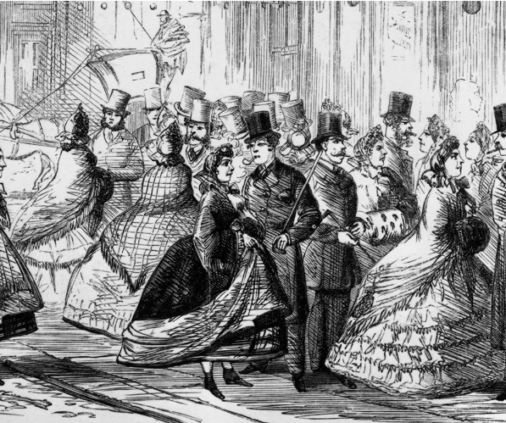
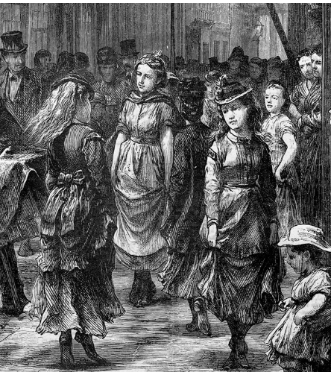
Campaigns Against Sex
By: Toni Routledge, Jas Madeley, Millie Hudson, Komal Mistry and Chloe Mitchell

Slide 2
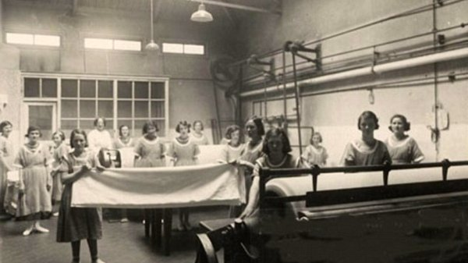
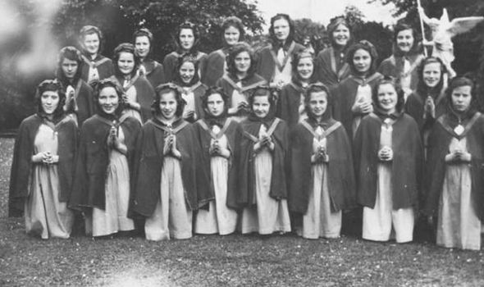
The state’s critique of prostitution Luddy, Maria, ‘“Abandoned Women and Bad Characters”: Prostitution in Nineteenth-Century Ireland’, Women’s History Review, 6.4 (1997), 485–504 https://doi.org/10.1080/09612029700200157
Visibility
Prostitution highly visible towns and cities, seen as a source of physical and moral contagion
Not illegal police used broad powers (1847,1854) arrest women labelled ‘common prostitutes’ pushing them out ‘respectable areas’ rather eliminating prostitution
Contagious Diseases Act (CDAs) enforced 1864-1886 – police extensive control prostitutes military districts compulsory medical exams and detention Lock Hospitals
Opposition equal morality standards men and women
Rescue’ work and Magdalen Asylums
Run largely lay and religious women- 11 in Dublin 1835
Aimed ‘reform’ and confine ‘fallen women’ removing them public view
Strict regimes: new identities, labour, hair cutting, restrictions on speech and movement
Functioned space concealment became place families send daughters to maintain respectability
Women’s Agency?
Many women entered voluntarily, temporary refuge, re-entering multiple times
Resistance moving towns forming supportive groups eg.Curragh ‘Wrens’
Decline Prostitution 1870s linked rising middle-class morality and Church influence not policing alone
2

Slide 3
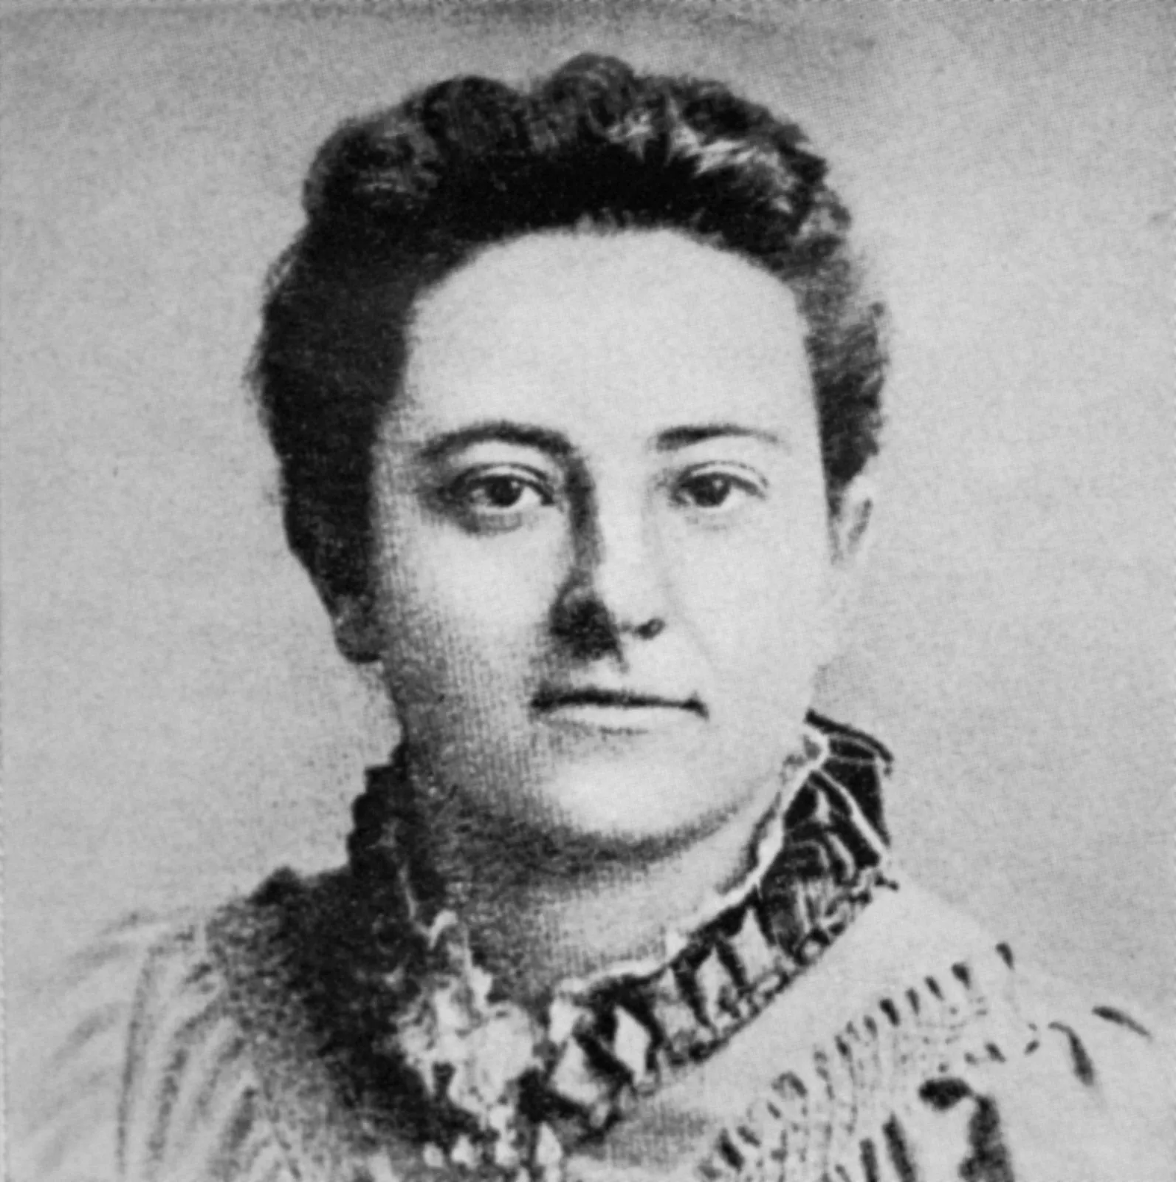
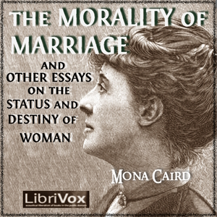
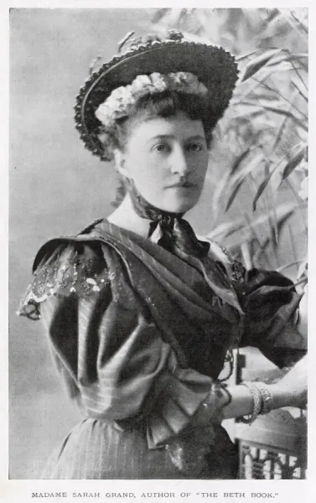
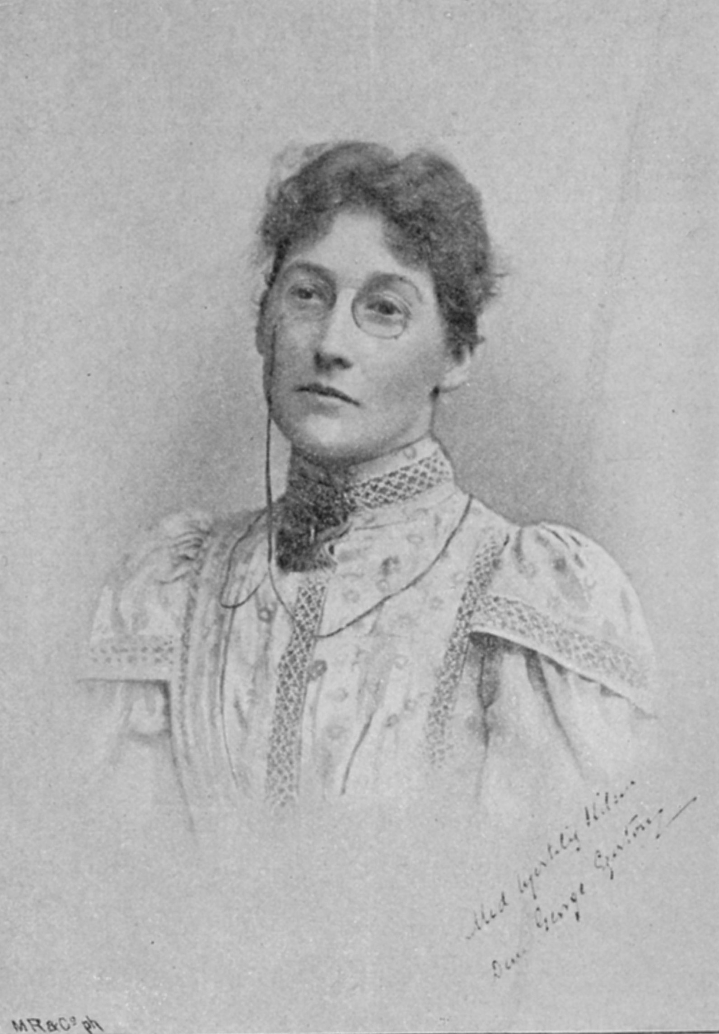


Feminist writer’s critique of Prostitution Stephanie Forward, ‘Attitudes to Marriage and Prostitution in the Writings of Olive Schreiner, Mona Caird, Sarah Grand and George Egerton’, Women’s History Review, 8.1 (1999), 53–80 https://doi.org/10.1080/09612029900200192
1.Marriage compared Prostitution
Many Victorian marriages financial not emotional
Olive Schriener, Mona Caird, George Egerton ‘legalised prostitution’ ‘nightly degradation’
Caird controversially framed motherhood socially imposed prostitution
2. Female Financial dependence/slavery
Economic subjection= resentment, vulnerability, and prostitution
Schreiner warned against ‘sex paratism’ women living off society passively – love no longer bought or sold
Ending Prostitution through labour: Schreiner advocated financial independence
Legal reforms not suffice needed overhaul people’s attitudes – Sarah Grand men’s vice women perpetuating system self-sacrifice should teaching self-control
3. Olive Schreiner Activism/successes
Directly engaged Prostitutes understand lives advocate for them, after mistaken police 1885 to be a prostitute, she publicly criticised the vulnerability of women under existing law – linked prostitution broader gender equality reform men recognise women equals – political enfranchisement
Maiden Tribute Exposé 1885- exposed child prostitution London raised age consent 13-16 Criminal Law Amendment Act Schreiner Praised but argued legal reform was not enough- also had the repeal CD Acts

Slide 4
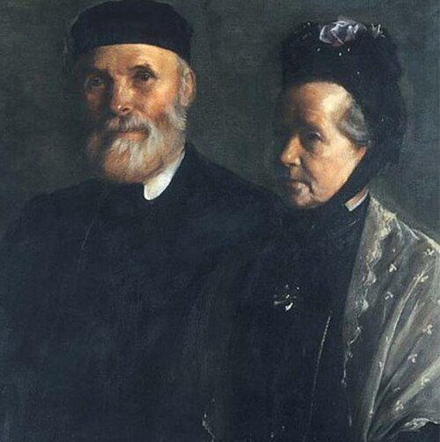
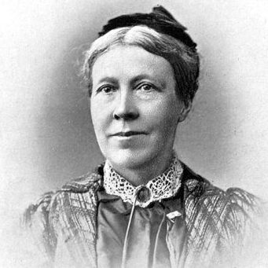
Women and the Contagious Diseases Act 1864-1886, By Maria Luddy
The 1864 CDA - enabled police officers to arrest any woman, force her to undergo an invasive physical examination and if any symptom of a venereal disease was found, she was sent to a lock hospital.
Effects of these new acts - more shame and secrecy for those involved in prostitution as well as increased surveillance of women's public activities in general.
Opposition to these laws - Targeted mainly women, interfered with civil liberties and viewed as state recognition or even support of vice.
Activist Organisations - The National Association for the Repeal of the Contagious Diseases Act (NARCDA) and the Ladies National Association (LNA).
Methods of protest - Petitions sent to parliament, distributed pamphlets and held meetings to raise awareness on the injustice of this matter.
Impacts of this activism - Attempts to improve the difficult conditions faced by women in education, work and politics in order to reduce rates of poverty and prostitution. Development of social purity movement, an effort to reform the behaviours for men and their treatment of women.
Significance of the opposition to the CDA - Raised questions about a woman's place in society, acknowledge women's sexuality and questioned the role of government in controlling an individual's moral behaviour.
Activists Thomas and Anna Haslam
Activist Isabella Tod

Slide 5
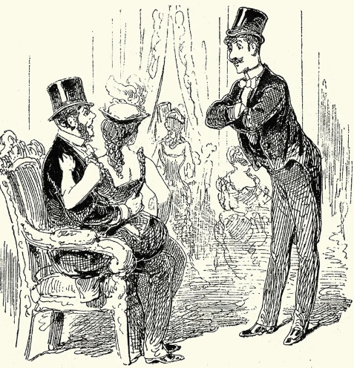
Prostitution in Victorian Society - 'The Great Social Evil'
Prostitution was seen as a 'moral threat' - believed to corrupt women's: Christian values, moral purity and marriage.
Police targeted poor working class women, who were often labelled as 'common prostitutes'. The CDA was introduced to protect male bodies.
The word 'prostitute' became a symbolic site for greater anxieties within Victorian Society - exposed Victorian society's obsession with controlling sexuality and policing social boundaries.
Indulged male leisure culture and provided contact zone between them and prostitutes: bars, pubs, dance halls, music halls and theatres.
Prostitution was a part of working-class survival and an economic necessity.
The social structure of Victorian society controlled perceptions of prostitution.
Notes:
Prostitution in Victorian society – Judtih Walkowitz
-She viewed prostitution as not just morally failing but something that was built and embedded in Victorian urban life. She explores how this was encouraged by class inequalities, state control and male leisure culture.
1.This notion of prostitution being a 'moral threat' associated the word 'evil' in women's sexuality, but encouraged men to explore their natural instincts – creating a sexual double standard. It was also a threat to the gender power dynamics; women were gaining independence and men couldn’t control them anymore. This hate was also directed from middle class women who were eager to separate themselves from a 'fallen woman' label.
2.Police and medical institutions used 'moral regulations' as an excuse to police women's bodies and force medical examinations upon them. Surveillance upon working class women was also justified. All of this takes away their autonomy over their own bodies.
3.Prostitution was not just a sexual transaction, but it was an outlet for people to blame their greater and more deeper anxieties on. It allowed people to condense their broader fears into this notion of 'the prostitute'.
4.Music halls such as the Oxford and the Alhambra became famous spaces where prostitutes openly mingled with the male customers. Red light districts surrounded ports and barracks because soldiers and sailors were young, unmarried men and prostitutes were seen as 'essential to military male leisure'.
5.Working class women were at in a constant vulnerability to poverty as they had very few opportunities to earn a living. This created feminised poverty that pushed women to become prostitutes as the jobs they were offered such as domestic labour did not equate to the same pay.
6.The majority of the contemporary writing about prostitution at the time was written by middle class women speaking for the lower class women. They were not able to speak on their own experiences, but were being spoken for, speaking retrospectively, creating the idea of the 'sub-altern', coined by theorist Gayatri Spivak, who asks 'can the subaltern speak?'. The prostitutes of lower classes were constantly being spoken for.

Slide 6
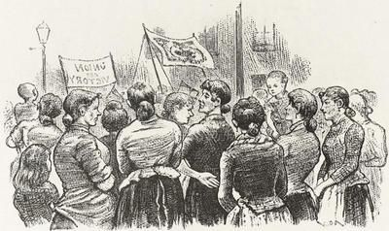
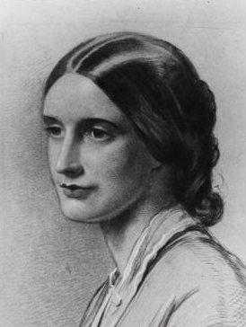
The politics of the female body
Summers, Anne, 'The Constitution Violated: The Female Body and the Female Subject in the Campaigns of Josephine Butler', History Workshop Journal, 48 (1999).
'Medical science reinforced, if it did not invent, binary representations of the sexes... the female as a womb with a body attached; the male as the subject, and the female as the object of power' (Summers, p.13.)
Opposition to Contagious Diseases Act, based on infringing three principles:
Morality: legitimised sex as a recreational activity, made it safer for men
Constitution: no opportunity to appeal or trial by jury
Natural Justice: inequality in penalties between men and women
Male doctors held political power negating the principle of representative government
They were able to influence legislation on the female body, women lacked suffrage and had no ability to challenge this
'Legislation can never in these days, and at the stage of civilisation which we have reached, be just and pure until women are represented' Josephine Butler
Notes:
Jas

Slide 7
The importance of the female experience:
Her experience as a women made her a legitimate voice on the perspective of the female body which male doctors and midwifes lacked
'She nevertheless grounded her every action on her biological identity as a woman' (p.8.)
'Negative ideas on the body's right not to be assaulted and positive ideas on its innate capacity for health and regeneration' (p.8.)
'They knew that, even if they did not live with men who sexually exploited and abused women, they were obliged to encounter them socially, to entertain them in their homes, and to entrust their husbands and sons to their company' (p.13)
It fell to women 'to revolt against the medical encroachments on their bodies which threatened the political constitution' (p.13)
'It was this fusion of the moral with the nakedly personal which gave such force to the immediate campaign, and the power to inspire later generations of feminists' (p.9.)
Her religious beliefs impacted upon these arguments and her liberal understanding of medicine, did not believe in a micro-organic theory of infection
Distrust of particularly male physicians
Important distinction between good and bad doctors: those who used their knowledge for political power
Butler believed in the need for revolution not just reform, beginning with women's suffrage
Summers argues that this approach to her campaigns is what makes Butler stand out as a feminist figure that continues to be drawn upon today.
Notes:
Jas

Slide 8
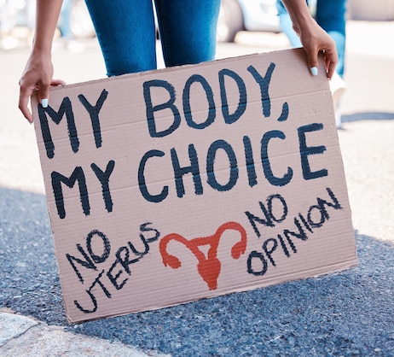
Was Josephine Butler the original pro-choice activist?
Well... probably not
BUT her understanding of representative politics combined with the importance of women's sovereignty over their own bodies bears a startling similarity to debates in feminist politics today.
Notes:
Jas

Slide 9
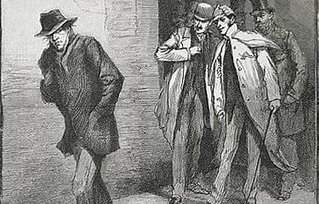
Male Vice and Feminist Politics - Judith R. Walkowitz
Modern campaigns against pornography have deep historical roots in earlier campaigns against male vice and the double standards
Campaign against Contagious diseases Acts
Josephine Butler and the Ladies National Association- acts allowed a double standard of sexual morality and deprived poor women of their constitutional rights
Portrayed 'fallen women' as victims of male pollution, blamed the system that put the women into the situation, not prostitution itself
Many feminists ambivalent about prostitutes who used their sexuality as a commodity, no libertarian defense of prostitutes due to lack of 'purity’
'Maiden Tribute of Modern Babylon' -
After CD acts suspended- movement shifted to the "foreign traffic in women" and entrapment of children into prostitution in London
Led to collaboration with W.T Stead of Pall Mall Gazette to create this expose
Detailed seduction of poor girls by aristocrats - focus on passive, innocent female victims and individual evil men
Led to passage of 1885 Criminal Law Amendment Act – raised age of consent from 13 to 16, formed basis for prosecuting homosexual men and greater jurisdiction over working class women and children, uprooted them from their neighborhoods, destroying the brothel as a female subculture
Feminist Strategy and Impotence-
Feminist operated within a separate sphere ideology- stressing purity and moral supremacy
Sexual restraint, female passionlessness/ de-sexualization provided women with some gains – ability to define incest and rape as crimes against them
This however led to repressive campaigns against male vice and sexual variation- which were controlled by men and had conservative interests e.g Army of West End Men hunting Jack the Ripper patrolled poor women instead
Conclusion- Started as libertarian fight evolved into using instruments of state for repressive purpose ​
Dilemma- how to devise effective strategy to combat sexual violence without playing into hand of conservative forces- Feminist protest can turn into politics of repression

