Slide 1
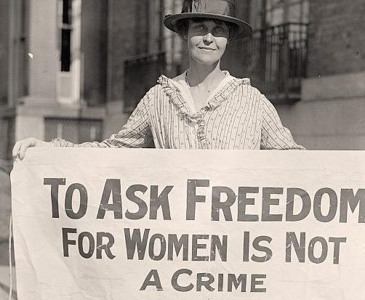
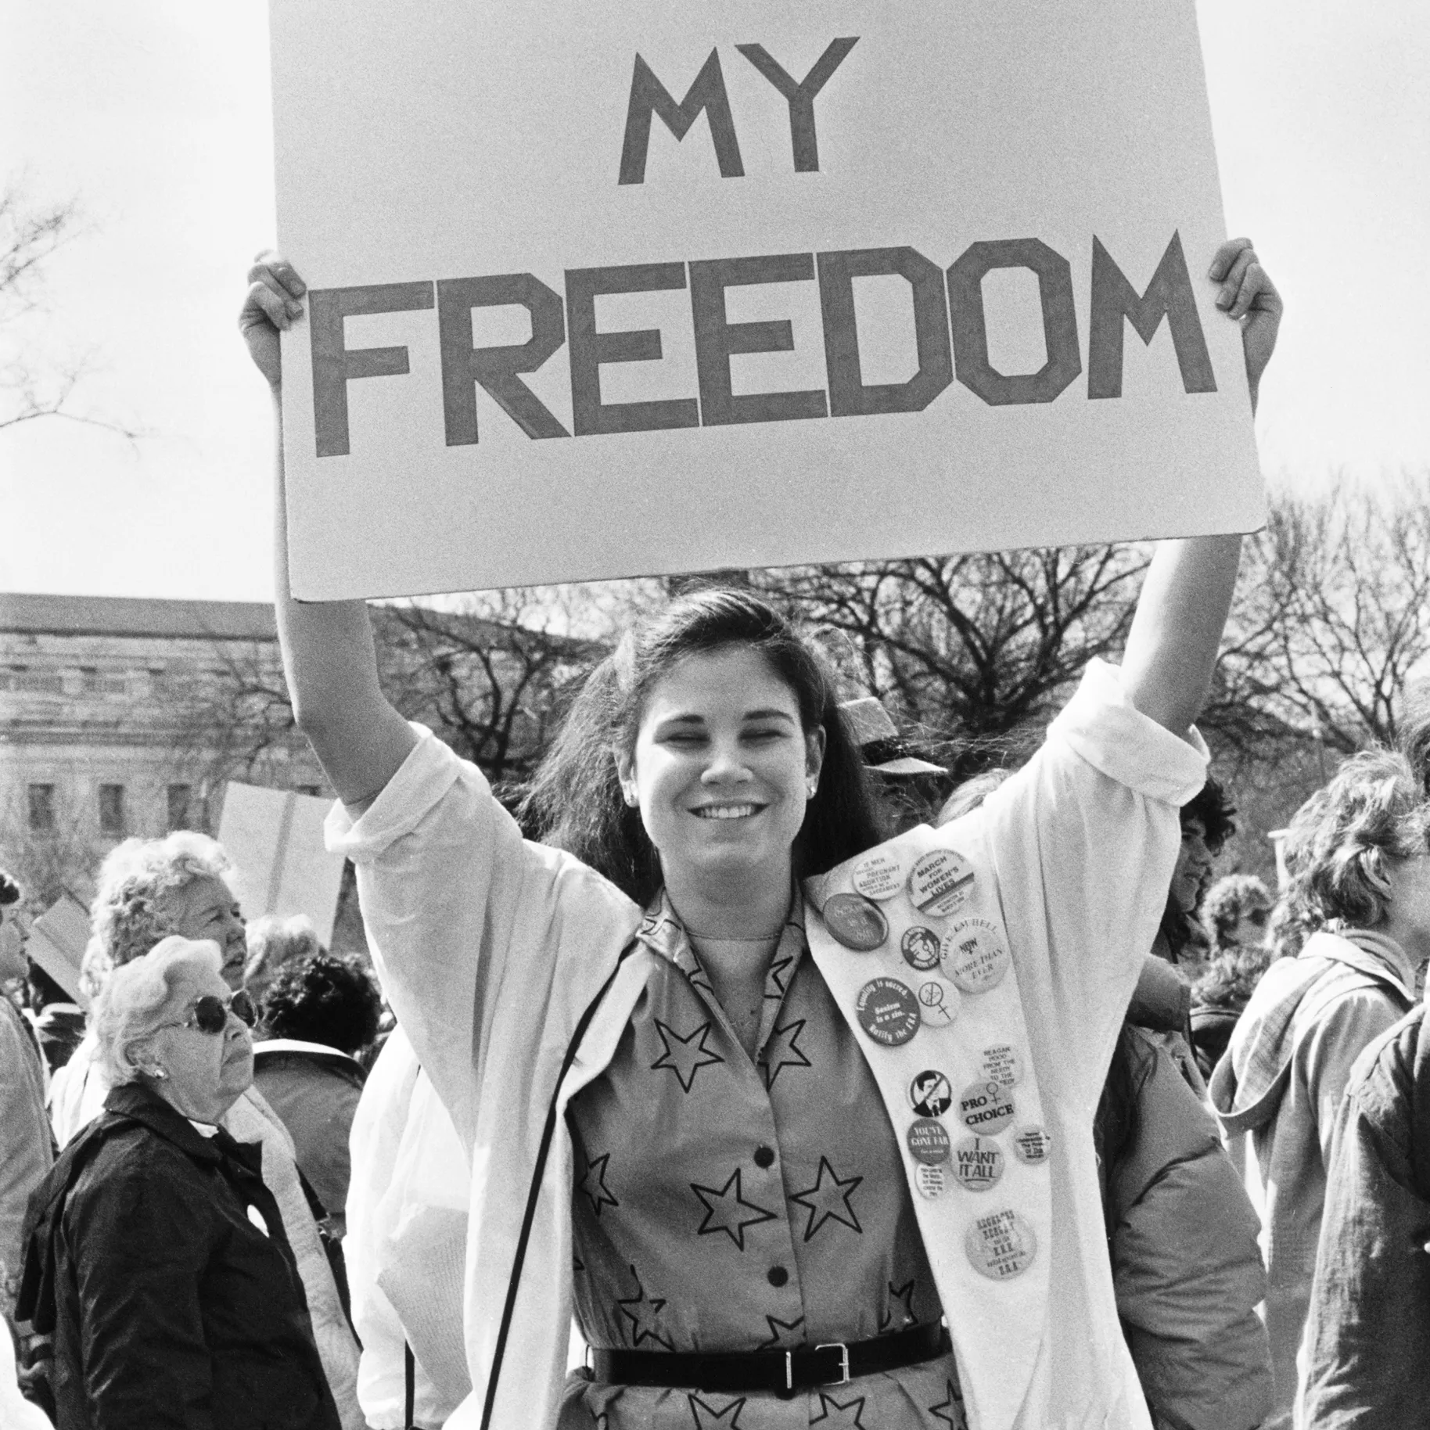
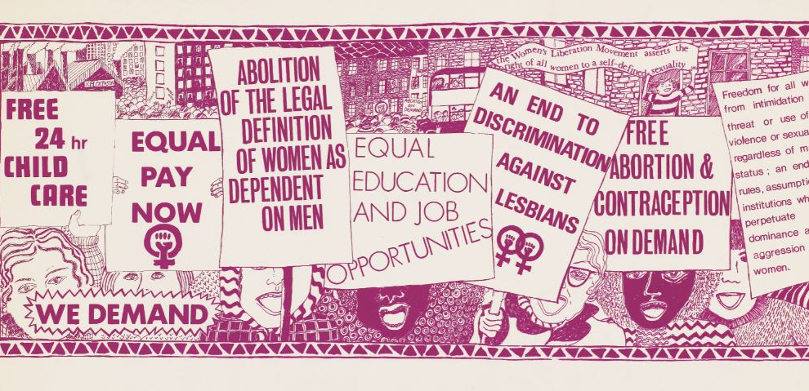
Struggles for sexual freedom
Emily, Georgia, Lily, Samai and Maisie

Slide 2
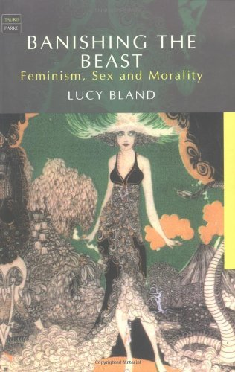
Maisie:
Lesley Hall, Review of L.Bland, Banishing the Beast and Margaret Jackson, The Real Facts of Life
Discussion Points:
Lucy Bland shows that struggles for sexual freedom between 1885–1914 were diverse, evolving, and deeply contested, not just simple fights over morality.
Bland highlights the full complexity of feminist sexual politics, whereas Jackson applies a simplified narrative that obscures the real dynamics of feminist sexual politics.
Bland demonstrates that women were not passive recipients of sexology, Malthusianism, or purity discourse- they actively reworked these ideas with agency, to claim sexual autonomy

Slide 3
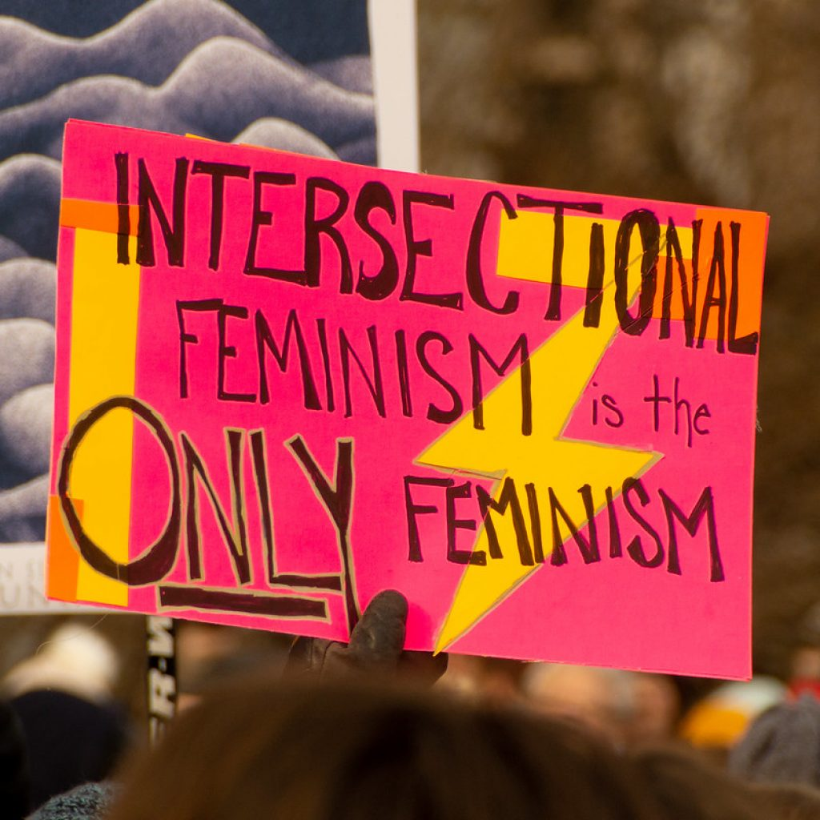
Rethinking Sexual Freedom: Bland’s Contribution
Bland explains the context that early feminists operated within e.g. ideas about purity, chastity, desire, and reproductive control.
Rather than treating “purity feminism” as anti-sex, she uncovers how women used it to challenge male power, resist sexual exploitation, and assert moral authority in public debates. (outside of the domestic sphere)
Sexuality was shaped by social hierarchies, so the concept of sexual freedom was complex- depending on a woman’s class, sexuality or race. Showing that “sexual freedom” sometimes meant different freedoms for different women.
Bland’s approach emphasizes complexity over judgement, allowing us to see sexual morality as an evolving negotiation rather than a fixed ideology.

Slide 4
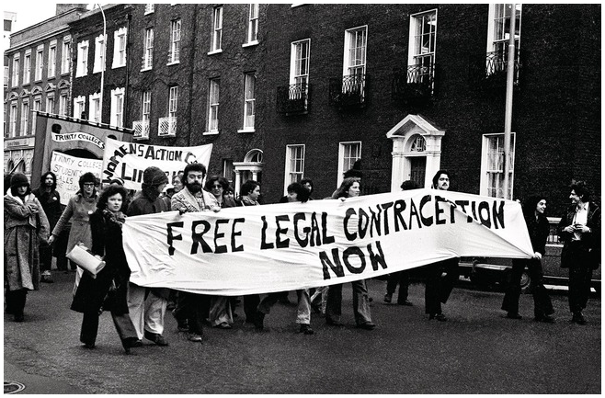
The Politics of Interpretation: Bland vs. Jackson
Jackson frames feminist sexual history as a story of “heroes and villains,” claiming feminism took a “wrong turn” in the 1920s- an approach that overlooks the nuanced debates women were having.
Her reliance on limited sources and static interpretations ignores the fact that feminist thought was often experimental and constantly changing.
Jackson’s treatment of major figures like Havelock Ellis and Marie Stopes overlooks readership, context, and reception- missing how women actively interpreted and reshaped sexual knowledge. Havelock Ellis was a sexologist whose work analysed sexuality, and Marie Stopes wrote about birth control and women’s sexual health. For example, women might use Stopes’s advice on contraception to protect themselves from unwanted pregnancy, while rejecting other aspects of her moral framework.
This contrast highlights how interpretations of sexual freedom can either illuminate feminist agency (Bland) or erase it (Jackson).

Slide 5
Feminist Agency in the Struggle for Sexual Freedom
Feminists strategically used scientific and moral languages to engage in discussions of contraception, consent, and bodily integrity.
Figures like Frances Swiney illustrate how contradictory ideas- neo-Malthusianism, chastity, women’s superiority- could coexist as part of the search for a more equitable sexual order.
Bland’s work shows that the struggle for sexual freedom wasn’t a straightforward debate toward liberation but a series of creative, often contradictory steps in redefining sexuality.
Recognising these contradictions allows us to appreciate how early feminists expanded the boundaries of sexual discourse, shaping modern understandings of women’s autonomy.

Slide 6
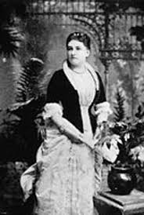
Frances Swiney
Held extreme views: women’s superiority, male “toxicity,” and the need for female chastity. She believed women were naturally superior to men, both morally and biologically. She thought male sexuality was harmful to women, which led her to promoting chastity.
Joined the Malthusian League, which promoted birth control- an unexpected alliance. But she used contraception as a tool for women’s protection, even though her broader philosophy was anti-sex or chastity-focused.
Saw contraception as a way to protect women from unwanted sexual demands- birth control wasn’t about encouraging sex; it was about limiting men’s access to women’s bodies. She saw it as a tool that could reduce women’s physical and emotional vulnerability.
Shows that “sexual freedom” meant different things to different feminists e.g. Some feminists fought for the right to sexual pleasure. Others, like Swiney, fought for the right not to engage in sex. This shows how varied feminist goals were during this period.
Illustrates Bland’s argument that early feminist sexual politics were complex and often contradictory, not unified.

Slide 7
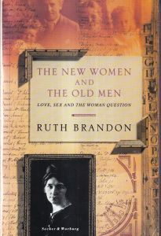
Lily:
Ruth Brandon, The New Women & The Old Men: Love, Sex and the Woman Question (1991)
Discussion Points:
The Concept of the 'New Women'
Sexual Politics
Key individuals: Olive Schreiner

Slide 8

The 'Woman Question'
Book explores woman's sexual role, sexuality and independence.
Published in the 1990s, yet focuses on late-Victorian/Edwardian thinkers/radicals.
Purpose = Examines how women attempted to express sexuality and womanhood in an era they couldn't
The concept of the 'New Woman' has connotations of a shift in societal values & how women were able to express themselves
Therefore, book is organised into biographical case studies that examine how these women aligned with this concept of 'New' Womanhood

Slide 9
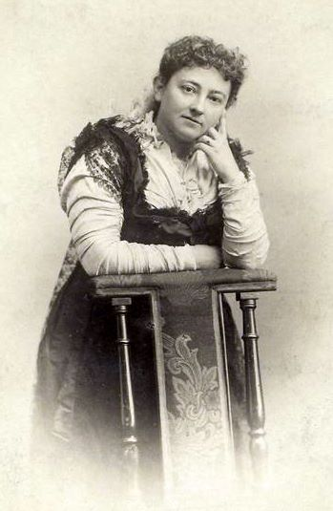
Case Study of Olive Schreiner
Who was she?:
South African writer and early feminist
"one of the most important - and radical - social commentators of her day" (late 19th century)
1880, travelled to England with hopes of becoming a doctor, but due to ill health, continued to write.
Continued to be involved in feminist discourse – even wrote an (unfinished) introduction for The Vindication of the rights of women.
Ruth Brandon discussion of her embodiment of 'New Woman'':
"No; anything Olive wanted she was going to have to find for herself, and that included intellectual stimulation"
1878, Letter to a friend: "You say you wish it had been my own engagement I wrote to tell you of. You will never hear of that...No one will ever absorb me and make me lose myself utterly...In fact I am married now, to my books!"

Slide 10
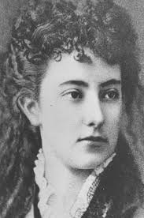
s
Sexual Freedom & Olive
Brandon tries to show Olive as living this intellectual life, free of marriage constraints and sexual double standards, with the main focal point being a progressive London Society called the 'Men and Woman's Club', whereby radical intellects would discuss topics about Women's freedoms, including the expression of sexuality.
Brandon uses Olive as an example to position her against the concept of these "New Men' who were involved in the discussion of women's rights. In reality, they were 'Old Men' who were hypocritical in their views.
Therefore, she often took matters regarding sexual freedom for women into her own hands both towards other women, and personally (eg: "Olive began to take a special interest in individual prostitutes, trying to get to know them..." (p.58)
Key moment - her complete rejection of sexual normativity as a whole - "All that my sexual nature had to give, I gave years ago, and it is agony now when men call on me for what my nature has not to give" - Ruth suggests this is perhaps evidence of her being asexual (more on p.68 about her asexuality)
The 'Woman Question':
"The truth was that Olive, at this stage in her life, was torn between two powerful conflicting necessities: to satisfy her sexual and emotional nature, and to achieve acceptance in the man's world and the intellect" (p.69)

Slide 11
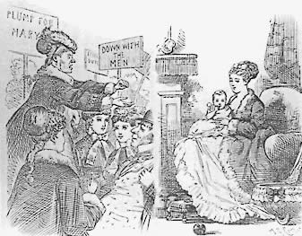
Ruth Brandon's conclusions
Reflects on the women she has spoken about and how despite their beliefs, very few "of these brilliant, forceful, ambitious women, managed to avoid living their lives on the terms of a male lover of husband". The men involved in the societies however, lived according to their own plans.
It was only Olive Schreiner who she discusses, who impossibly followed her career driven drive by becoming a politician.
Concludes that while these feminist ideals about sexual freedom were noble, society and its patriarchal norms simply were not ready, hence why it was easy for these 'New' and 'Radical' men to preach about women's sexual freedom, as they could go about their lives with their own freedoms.
The 'Woman Question' is still unsolved, with uneven and discrimination against many areas of female sexuality, thus reinforcing gender inequality within society.

Slide 12
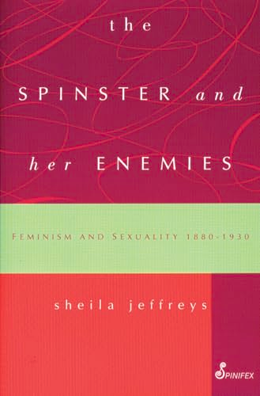
Georgia:
Sheila Jeffreys
The spinster and her enemies: feminism and sexuality, 1880-1930
(1997)
Discussion Points:
Spinsterhood and Celibacy
Women’s Friendships and Lesbianism

Slide 13
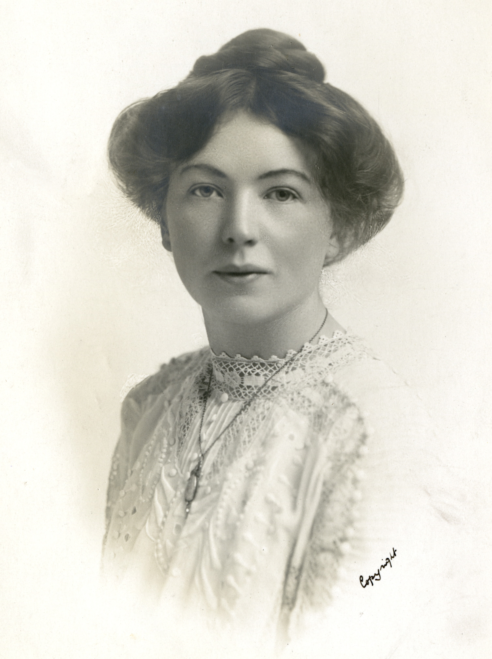
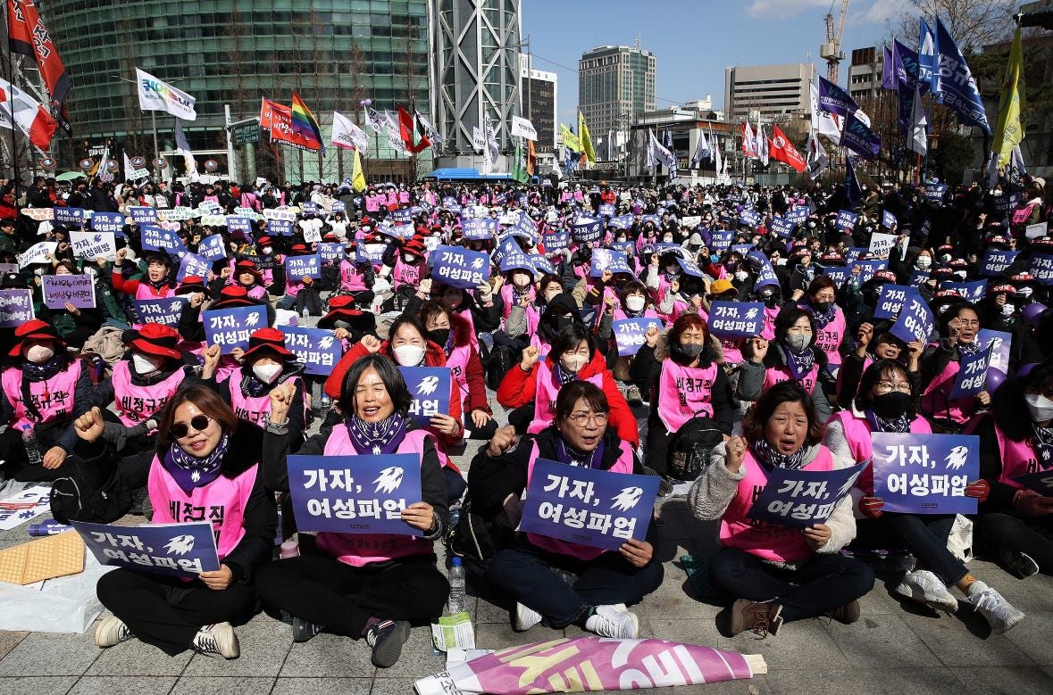
"There can be no mating between the spiritually developed women of this new day and men who in thought and conduct with regard to sex matters are their inferiors.”​ - Christabel Pankhurst
​
Chapter 5 – Spinsterhood and Celibacy
Celibacy as a political decision:
Christabel Pankhurst framed spinsterhood as a political decision = a refusal to enter “sex-slavery” with men whose sexual behaviour was exploitative​
she argued that women could not “mate” with men whose sexual attitudes were inferior to theirs​
Lucy Re-Bartlett saw feminist celibacy as a positive refusal to enter relationships with men until male sexuality and social conditions were changed
not an 'anti-men' revolt but against society’s patriarchal conditions​
4B movement, South Korea 2024

Slide 14
Chapter 5 – Spinsterhood and Celibacy
“But it is Society that has wronged women and not Nature. She, indeed, has well fitted the female for the part she was intended to take, for woman is physically complete. Though she is a necessity to man, he is not necessary to her.” - Margaret Hill
A refusal of ‘service’​:
​
‘surplus women’ were of huge concern for men – they were not fulfilling their ‘duty’ of servicing men sexually and domestically​
​
demands were aimed at dealing with this problem of ‘surplus’ women in ways that served women’s interests​
​
mainly concerned with middle-class spinsters who couldn’t leave home and enter jobs available to working-class women due to Victorian notions of respectability→ left dependent and without purpose​
​
Oppositions to the spinsters
both male and female critics attacked spinsters as:
sexually thwarted, bitter, and destructive
cold, sexless, lacking “sex attraction”
Freewoman writers insisted sexual intercourse with men was vital to women’s health
this narrative pathologized women who chose not to have sex with men, delegitimising celibate women

Slide 15
Chapter 5 – Spinsterhood and Celibacy
Promoting sexual freedom:
marriage could not be the solution to the spinsters’ problems
they argued if there are more women than available husbands you can’t say “just get married” as the fix
instead of marriage being the only legitimate route they argued women should be free to have sex without needing a husband
‘Sex freedom’ as a way to eliminate prostitution:
if everyone had sexual freedom, prostitution would no longer be needed
Jeffreys argues that 'sex freedom' and prostitution can coexist
she criticises that the idea transfers responsibility for men’s use of women in prostitution from men to women

Slide 16
Chapter 6 – Women's Friendships and Lesbianism
close friendships between women were socially approved
these relationships were useful to men as they encouraged women to "learn to love" in preparation for marriage
a vital support system for women
sexologists developed a ‘scientific’ description and stereotype of lesbianism and the "pseudo-homosexual"
lesbianism was stigmatised and isolated = women's friendships were deprived due to suspicion of their closeness
A threat to society?
the women’s movement developed to challenge men’s dominance
social and economic changes enabled middle-class women to choose not to marry and be dependent on men
self-definition
women denied themselves of genital sexual expression to avoid having to fit into the definition of homosexuality
lost free expression in their relationships – they had to decide if they were either homosexual or just friends

Slide 17
Chapter 6 – Women's Friendships and Lesbianism
The lesbian amendment 1921
The bill was destroyed – but not due to opposition
MPs vocally expressed their discomfort of having to discuss the subject
opposition to the amendment = concerns that criminalising lesbianism was giving it too much publicity
men were worried that it would cause lesbianism to spread
"Any act of gross indecency between female persons shall be a misdemeanour and punishable in the same manner as any such act committed by male persons under section 11 of the Criminal Law Amendment Act 1885" - Parliamentary Debates, Commons, 1921, 145, 1799
Key concerns of MPs:
lesbianism could cause ‘our race to decline’
husbands might lose their wives to lesbians
lesbianism undermined the institutions of marriage and the heterosexual family which enabled male dominance over women

Slide 18
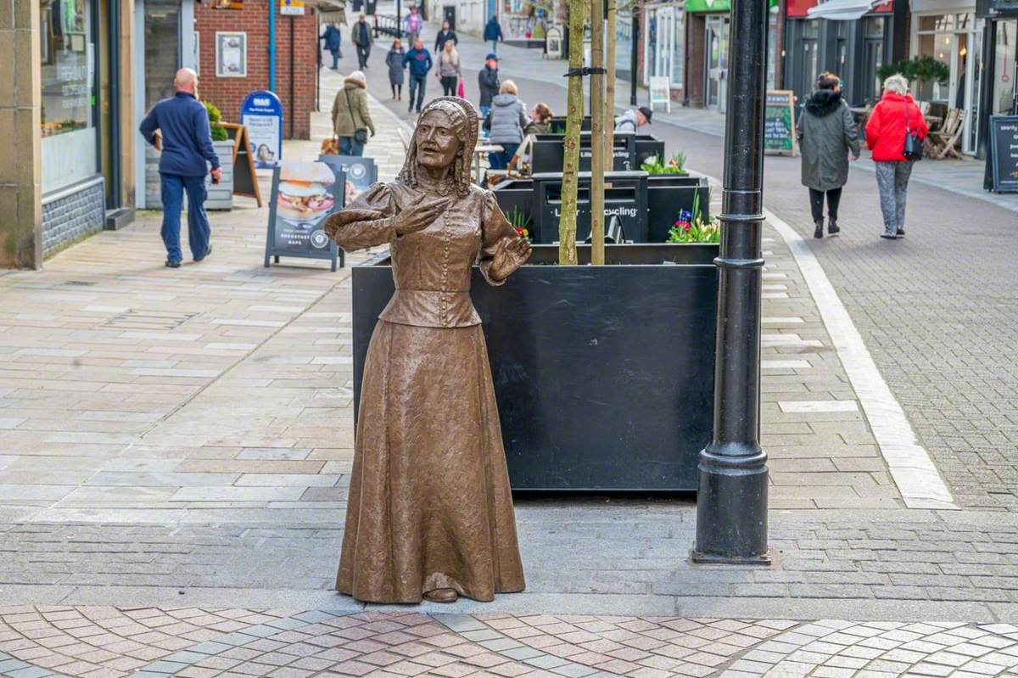
Emily:
Laura Schwartz
'Freethought, Free Love and Feminism: secularist debates on marriage and sexual morality, England c. 1850-1885'
Key Themes:
Freethinkers and Secularism
Connection to mainstream Feminism and how it differs
Mary Wolstenholme Elmy, 1833-1918

Slide 19
Freethinkers and Freethought feminism: A Radical Counter-Tradition
Freethinking:
Freethinkers – rejected religion and questioned religious assumptions
Focused on freedom of speech and of the press
Advocated for free unions – wanted a "a far more radical transformation of heterosexual relationships than anything argued for by the rest of the women's movement"
"based only on love and sexual attraction" - Richard Carlile, 1826
The women's movement's formation was "closely bound up with Freethinking networks"
"Secularists saw religion as the root of women's oppression"
Takeaway: Freethinking feminism preserved radical sexual ideas that the mainstream movement abandoned and been forgotten

Slide 20
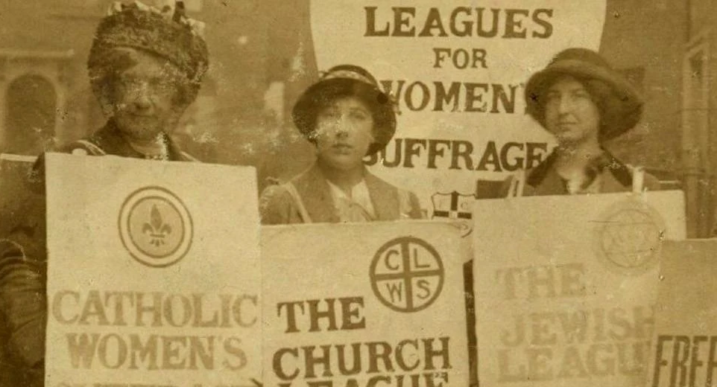
The Struggle Over Marriage and Sexual Freedom
How did Freethinking ideologies help to promote change and ideas around sexuality?
Renunciation of the Church:
Rejection the moral authority of the Church, especially with sexuality and sexual relations
Needed to find a new way for looking and basing morality
"A rejection of Christian morality propelled Secularists into imagining new ways for men and women to love and desire each other"
Freedom of Speech:
"the central Freethinking principle of free enquiry necessitated a commitment to open discussion of sexual matters"
"long-standing commitment to free speech and freedom of press to represent a variety of differing opinions in the pages of their journals"
Takeaway: Secularism created the public space where marriage, sexuality, and free love could be debated openly

Slide 21
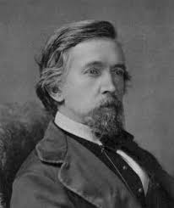
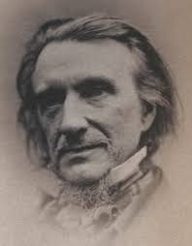
Who discussed this?
George Jacob Holyoake:
"remained committed to the need for more liberal divorce laws and the right of men and women to form unions free from the sanction of Church and State"
"primarily concerned for the security and freedom of women, in both marriages and free unions"
Wanted the divorce laws to allow women to escape abusive husbands
"opposed the current marriage laws because they introduced compulsion and coercion into relationships"
He wanted love to be kept free and spontaneous
Francis Newman – more religiously motivated:
'Articles in The Reasoner, 1855 - "in all societies throughout history, 'unchastity' - which he defined as sexual relations outside lifelong marriage – guaranteed the 'degradation' of women"
"No man could ever love a woman, he believed, who had herself loved another"
However, Newman did acknowledge that "our existing laws do press hardly upon wives' who were unable to escape from 'tyrant' husbands"
Takeaway: Discussions on greater sexual freedom were permitted and prevalent within the Freethinking movement

Slide 22
The Rejection of Sexual Unorthodoxy by Mainstream Feminists
Schwartz discusses how mainstream feminists rejected the moves made by Freethinkers for sexual freedom
"Freethinking feminists were...considered a liability because they continued to discuss radical ideas on marriage and sexual morality"
Respectable Women:
Victorian Christian feminists "deeply concerned to present themselves as respectable"
Maintaining this public respectability meant the exclusion of sexually radical women, like Freethinkers
Elizabeth Wolstenholme's Free Union:
Entered into Free Union with Ben Elmy
Received "shabby treatment at the hands of the women's movement"
Millicent Garrett Fawcett = "wrote privately to Wolstenholme condemning her conduct and asking her to remove herself from activities in order to prevent any further damage to the suffrage movement"
Shwartz states how this treatment "pointed as an example of the refusal of the nineteenth-century women's movement to countenance any form of sexual unorthodoxy"

Slide 23
Mainstream Feminism vs. Freethinking Feminism
Mainstream Feminists:
Aimed to reform marriage, not abolish or radically transform it - "demanding that women have the same legal and property rights as men within marriage, rather than calling for free unions or emphasising women's right to leave unhappy marriages"
Never considered women’s right to sexual expression outside marriage
Responded to the double standard by calling for male self-control, not sexual freedom
Avoided topics like free unions, monogamy critique, or sexual desire
Freethinking Feminists:
Continued debates on divorce accessibility, the legitimacy of free unions, whether lifelong monogamy was viable
Were unafraid to challenge Christian morality and social norms
Argued that rejecting Christian sexual ethics made new, equal relationships possible
Takeaway: "Freethinking feminists made far more radical demands than those being advanced within the mainstream of the women's movement"

Slide 24
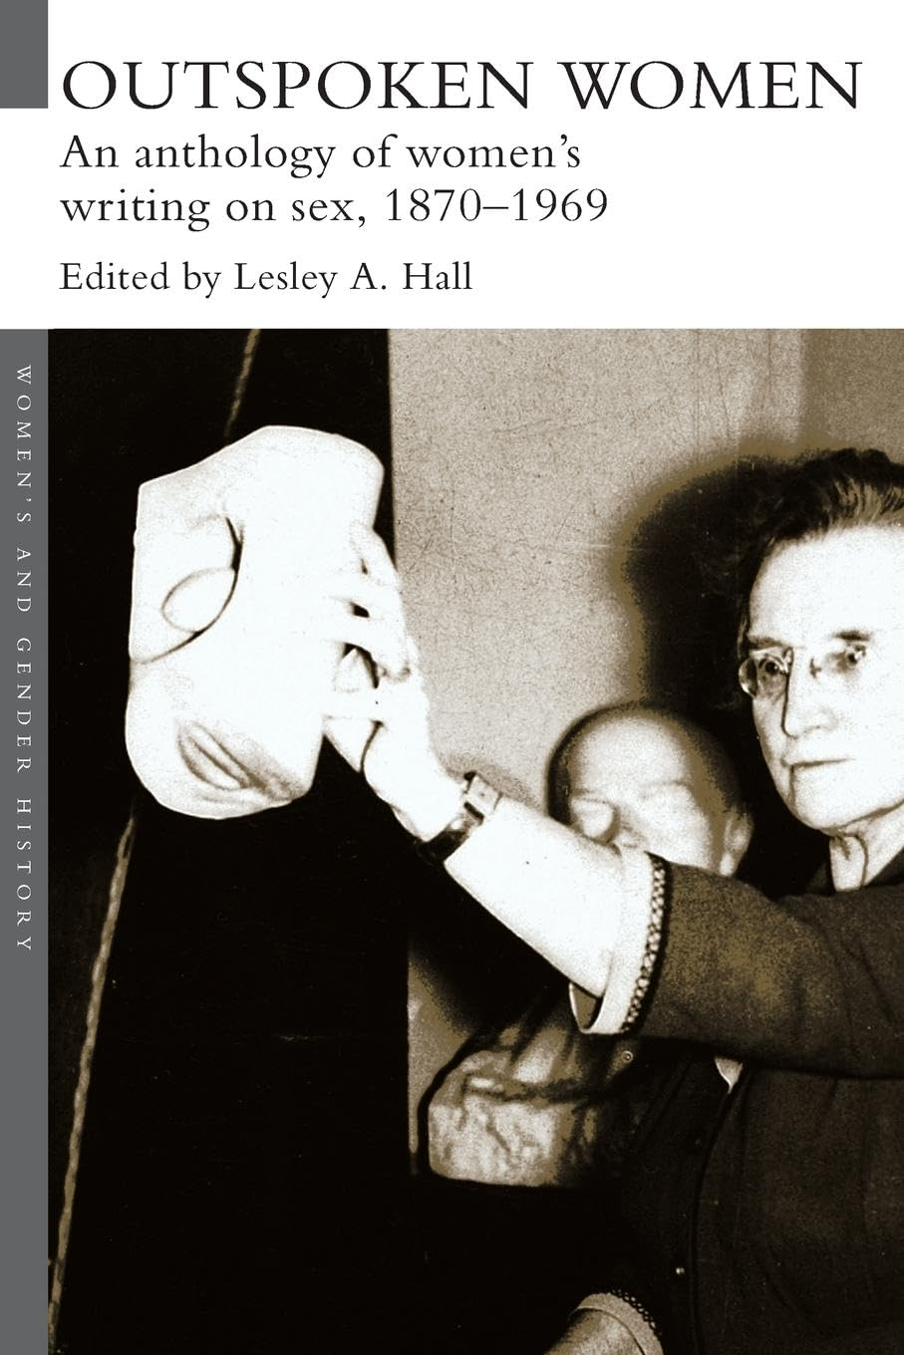
Samai:
Lesley Hall
‘Outspoken Women: An Anthology of Women’s Writing on Sex 1870-1969
Main objective:
To explore what women, particularly female scholars, thought about topics pertaining to sex during the Victorian era

Slide 25
Marriage
Josephine Butler, Social Purity, 1879
Marriage does not change a man's nature — they remain selfish and unrestrained
Annie Besant, Marriage, 1882
’A married woman lose control over her own body’
Idea that marriage commodifies women and turns them into a form of property
Sheds light on the issue and prevalence of marriage rape
The law removes law
Jane Clapperton, Scientific Meliorism, 1885
Marriage leaves people devoid of any substantial happiness
Calls marriage an artificial sham
Edith Lees Ellis, ‘A Noviciate for Marriage’ c.1892
Repression and excess meet in the name of Love
Ellice Hopkins, The Power of Womanhood, 1899
Being a wife is emotionally and physically draining
Marriage is not merely a contract but a sacramental union of love and life
Key takeaways:
Marriage is criticised as an institution that preserved male privilege and harmed women
Seen by many feminist writers as a site of female subordination, bodily control, and emotional strain
Concerns centred on marital rape, commodification of women, emotional labour, and lack of legal autonomy
Critics challenged the idea that marriage naturally “civilised” men or produced happiness
Some reformers still viewed it as a sacred emotional union, not merely a legal contract, and urged men to reform their behaviour

Slide 26
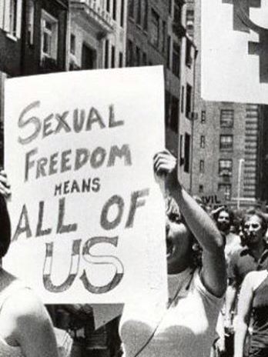
Desire, pleasure and satisfaction
Elizabeth Blackwell, Counsel to Parents on the Moral Education of their Children, 1882
Physical passion is an essential part of our nature
Feeling of sex regarded as a mental passion is stronger in women than in men
Women desire more
Jane Clapperton, Scientific Meliorism, 1885
She promotes the stimulation of female sexual organs
Annie Besant, The Law of Population, 1889
Celibacy as unnatural and that all bodies require legitimate satisfaction
Diseases stem from celibacy such as chlorosis and hysteria in the female
Elizabeth Blackwell, The Human Element in Sex, 1894
Nothing evil in physical pleasure
Sex is divinely created
Sexual feeling should not be denied to women
Sex as a way of displaying love
Key takeaways:
Late Victorian female thinkers argued that women possessed sexual desire, countering ideas of innate female passivity
Increasing emphasis on the idea that sexual pleasure was natural, moral, and healthy for women
Some writers linked celibacy and sexual repression to illness, arguing women needed fulfilment for physical and mental health
Sex recast as part of love, spirituality, and mutual emotional expression, not simply reproduction
Early advocates of female pleasure promoted the idea that women needed knowledge of their own bodies and sexual autonomy

Slide 27
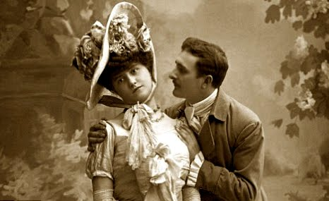
Heterosexual relationships outside of marriage
Josephine Butler, The Constitution Violated, 1871
The definition of what a prostitution is falls into the hands of the policeman who accuses her — leaves her helpless
Elizabeth Blackwell, Counsel to Parents on the Moral Education of their Children, 1882
Prostitution violently destroys the mental and physical joys of sex
Annie Besant, Marriage, 1882
2 disadvantages of unlegalised unions: women have to face disapprobation, children of unlegalised unions do not have same rights as those born of legal wedlock
Ellie Hopkins, The Power of Womanhood, 1899
Any relaxation of the marriage bond will cause disastrous consequences for women
Key takeaways:
Reformers condemned legal and social systems that criminalised or stigmatised women in non-marital relationships
Viewed prostitution and “irregular unions” as products of inequality, not inherent female immorality
Highlighted that moral judgement and legal disadvantages fell disproportionately on women and children
Some writers warned that greater tolerance of non-marital relationships could worsen women’s vulnerability due to patriarchal norms
Overall theme: Victorian society punished women for sexuality outside marriage, while excusing men

Slide 28
Prostitution and venereal disease
Josephine Butler, The Constitution Violated, 1871
Difficult to view men as immoral characters
Prostitution laws were not created to purify society but to pit one sex against the other
Josephine, Some Thoughts on the Present Aspect of the Crusade against the State Regulation of Vice, 1874
Men have imposed on women a stricter rule in morality than they have imposed on themselves or are willing themselves to obey
The searching and scrutinising of women is un-Christlike
Josephine Butler, Social Purity, 1879
The root of evil is the unequal standard in morality
There is one core of morality for men and another for women
Has dictated everyday life
Elizabeth Blackwell, Rescue Work in Relation to Prostitution and Disease, 1881
Prostitution is the destruction of humanity
Argues its the production of disease, of gross physical cruelty, of moral death
Catherine Booth, The Iniquity of State Regulated Vice, 1884
We cannot degrade women without degrading men
Women should not be regarded as mere instruments of male pleasure or gain
Key takeaways:
Strong critique of the double standard of sexual morality, especially under the Contagious Diseases Acts
Prostitution understood as a social and moral injustice produced by male demand and economic inequality
Reformers insisted that policing and medical inspection targeted women while leaving male sexuality unregulated
Prostitution associated with disease, exploitation, moral degradation, and institutional violence against women
Many argued the state’s approach was un-Christian, unequal, and socially destructive, exposing deep gendered hypocrisy

Slide 29
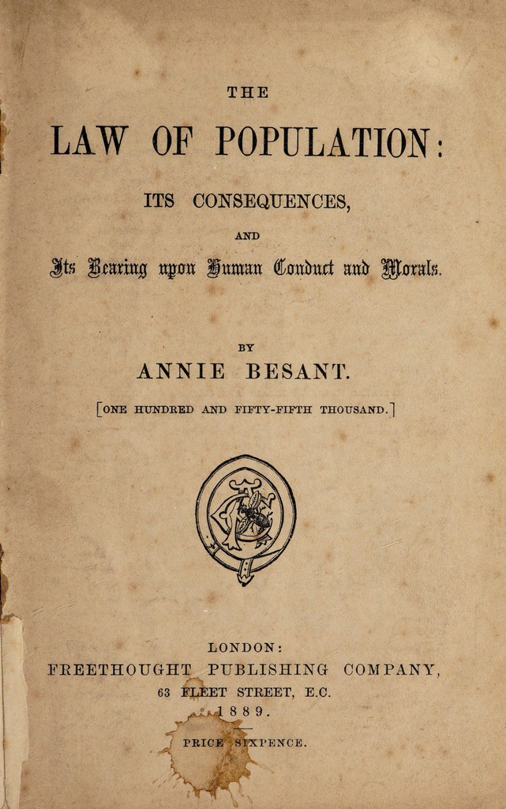
Birth control
Key takeaways:
Debates centred on whether contraception promoted women’s health and freedom or undermined moral order
Some feminists framed birth control as a responsible, ethical response to over-childbearing and marital strain
Advocates insisted it was not immoral, arguing it could prevent poverty and improve women’s wellbeing
Practical contraceptive methods openly discussed for the first time, signalling shifting attitudes towards female bodily autonomy
Critics feared that contraception could encourage sexual irresponsibility or weaken the family structure
Annie Besant, The Law of Population, 1889
Sexual intemperance (the over procreation of children) is as immoral as intemperance in drink
Believes that birth control should be accessible
Discusses a method of contraception which includes closing the passage into the women by using either a soluble pessary, the India-rubber pessary, and the sponge
Birth control is not immoral or unnatural
Jane Clapperton, Scientific Meliorism, 1885
Not sure how birth control can be used without damaging society

Slide 30
Ignorance and sex education
Elizabeth Blackwell, Rescue Work in Relation to Prostitution and Disease, 1881
Personal modesty should be taught to both little boys and little girls to prevent prostitution
Elizabeth Blackwell, Counsel to Parents on the Moral Education of their Children, 1882
It is important for young children to learn about sex to protect their physical and moral welfare
Edith Lees Ellis, ‘A Noviciate for Marriage’ c.189
Boys and girls should be taught the art of love and they should learn the physical facts of sexual life
Girls are taught that it is unwomanly to discuss sexual questions with their future husbands — she deems that this is wrong
Young girls should enter marriage with sexual knowledge
Key takeaways:
Growing consensus that sexual ignorance harmed women, leaving them vulnerable in marriage and to exploitation
Reformers argued for early sex education to protect children’s moral and physical welfare
Emphasis on teaching both genders about modesty, bodily respect, and the realities of sexual life
Female writers stressed the need for girls to enter marriage informed, prepared, and able to communicate about sex
Leaving women uninformed was seen as a deliberate tool of patriarchal control that perpetuated inequality

