Slide 1
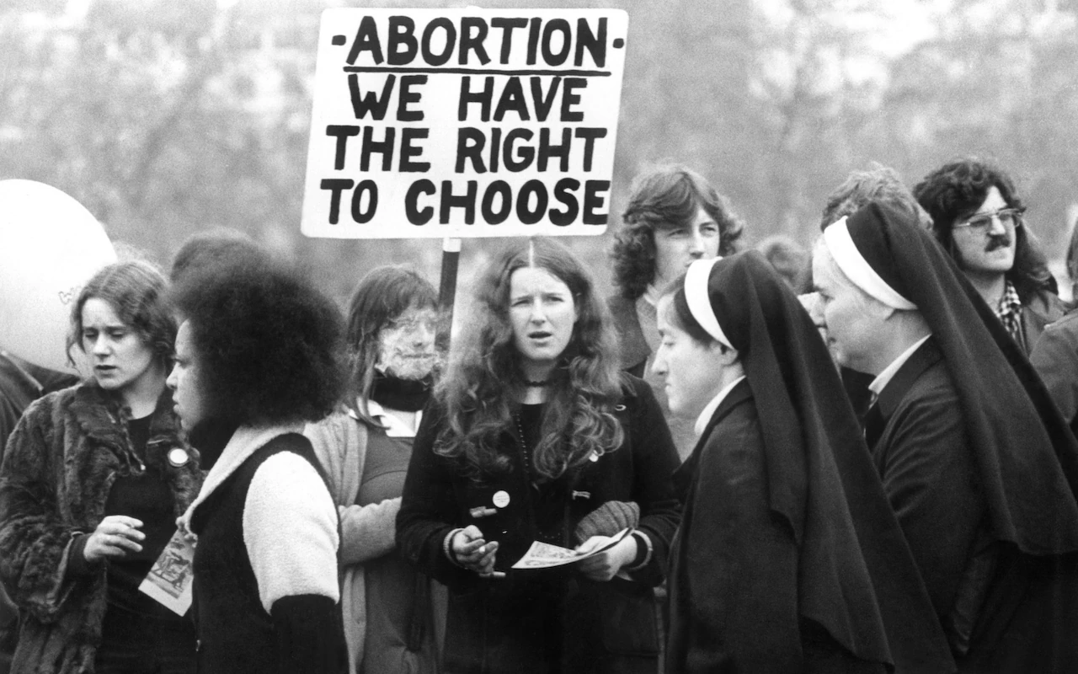
Sexuality & Abortion
Exploring WLM feminist challenges to men’s/patriarchal control over women’s sexual and reproductive bodies

Slide 2
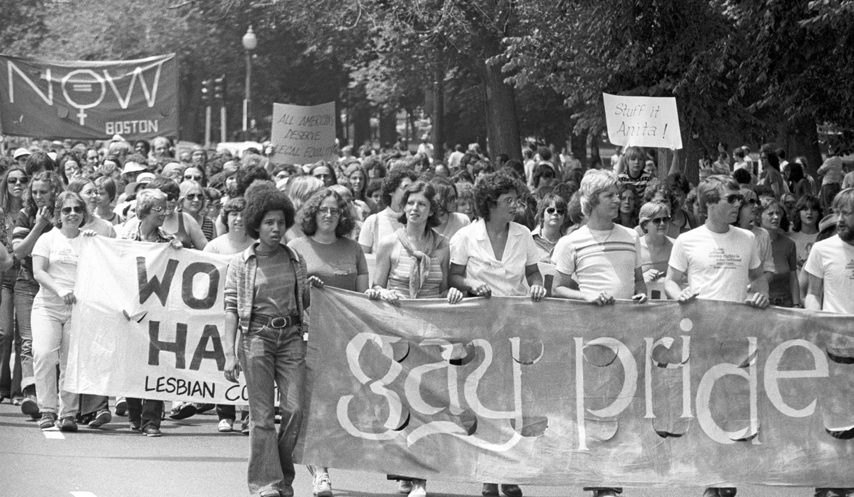

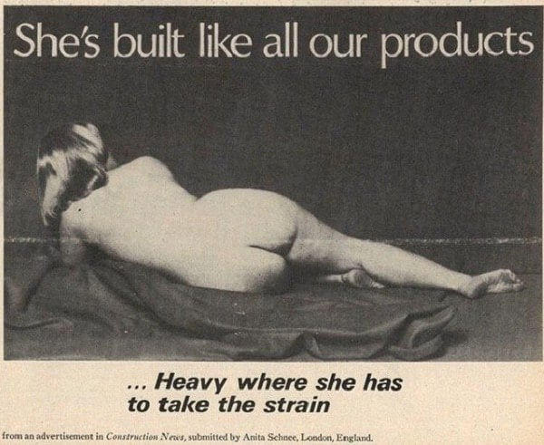
Sexuality: Let’s talk about sex
Sexual Revolution (what was happening?)
Homosexuality (gay rights)
What was the ‘myth’ of the vaginal orgasm (& why is this important?)
Why did feminists see sexual pleasure and liberation as a source of political power?

Slide 3
Sexuality – Lets talk about sex summary
Reality of Sexual Revolution or ‘permissive’ society was patchy often metropolitan and male sex centred – objectifying women
‘woman was the 'erotic symbol' of permissive society and, of course, this was a double-edged sword, at once signalling a newly won sexual power and autonomy, and objectification and exploitation’
Gay rights movement joined with WLM & lesbianism vocalised
‘Myth’ of the vaginal orgasm challenged male, penis-centred notions of women’s sexual pleasure exposing the cultural coercion of women to self-blame, maintain men’s egos, sex dominance & control
Why did feminists see sexual pleasure and liberation as a source of political power?
Sexual freedom gave an opportunity to 'question male supremacy’ exploring different ways of living sexual and emotional lives which had revolutionary potential

Slide 4
Abortion (context)
1861: Offences Against the Person Act performing an abortion or trying to self-abort = life imprisonment
1929: Infant Life Preservation Act crime to kill a viable foetus (then fixed at 28 weeks) except when the woman’s life was at risk. Not clear whether it would be legal to terminate for the same reason before 28 weeks.
Throughout this period access very restricted.
1923-33: 15% of maternal deaths due to illegal abortions ‘In the thirties, my aunt died self-aborting. She had three children and couldn’t feed a fourth…So, she used a knitting needle. She died of septicaemia leaving her children motherless.”
1934: Conference of Co-operative Women passed resolution calling for the legalisation of abortion (socialist)
1936: Abortion Law Reform Association (ALRA) was established to campaign for the legalisation of abortion
1967: The Abortion Act legalises abortion under certain conditions
1973: U.S Roe v. Wade establishes women’s right to abortion under certain conditions across U.S states

Slide 5
Abortion & WLM
FREE CONTRACEPTION & ABORTION ON DEMAND
We want to be free to choose when and how many kids to have, if any. We have to fight for control over our own bodies, for even the magic pill or (in the case of mistakes) abortion on demand only gives us the freedom to get into a real mess without any visible consequences. We still can’t talk about sex as anything but a joke or a battleground.
One of the ‘four demands’ formulated at the Women’s Conference, Ruskin College, 1970.

Slide 6
WLM & Abortion discussion
What did you learn from the core reading ‘Second Wave Feminism, Labour, and the Defence of the Abortion Act, 1967-90’?
Why was “free abortion on demand” so central to the politics of the Women’s Liberation Movement?
Why did some feminists (especially Black and working-class women) find this too narrow and argue instead for reproductive rights?

Slide 7
Why did some feminists (especially Black & working-class women) find this too narrow arguing instead for reproductive rights?
U.S Relf sisters Montgomery, Alabama Minnie Lee, 12, and Mary Alice, 14, 1973 put on unapproved contraceptive drug Depo-Provera as part of welfare package
Fears around cancer emerged so sterilised the girls without their consent (illiterate mother signed X)
‘Mississippi Appendectomy’ euphemism for mass forced sterilisations
Between 100,000 -150,000 poor women sterilized using government funds
1983 43% affected were African American (while making up only 12% of overall population) others Latino, Native American…
In Britain Afro-Caribbean & Asian women campaigned against Depo-Provera use among im/migrant women (licensed here 1978 (short term use) & 1984 (long term use))
Generally preferred WLM activism centred on women’s health education and advocacy

Slide 8
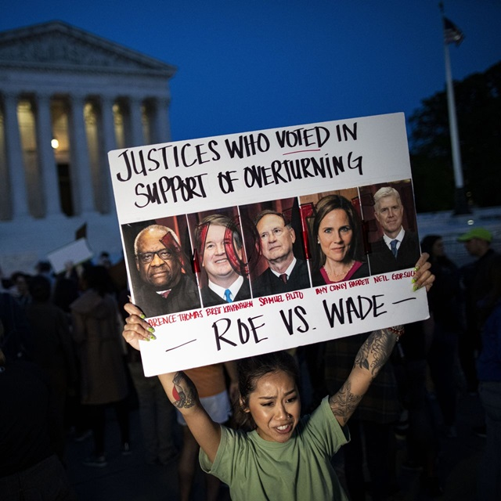
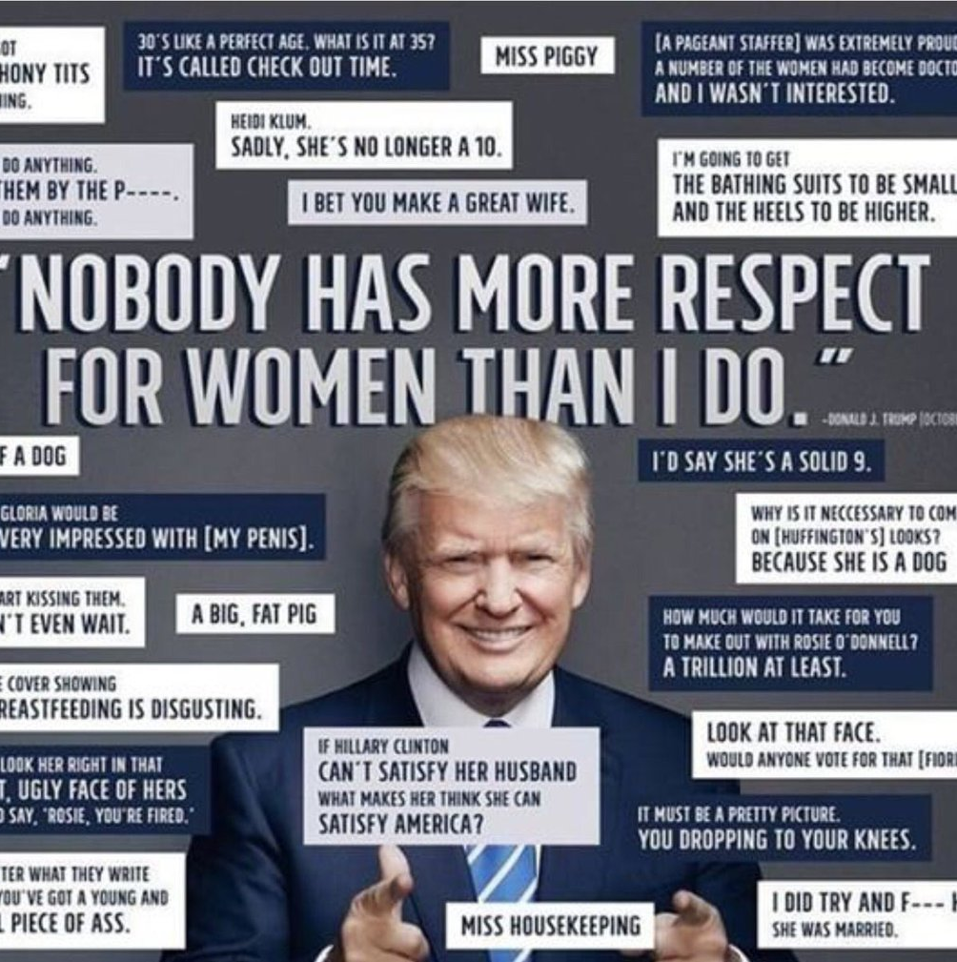


Where are we now? Trends to ponder…
Precarity of Abortion rights - challenged in U.K & U.S since established 60s/70s
Rise of right, manosphere ‘Red pill’ sees new challenges to women’s rights
2022 Roe v. Wade overturned by Dobbs v. Jackson (retrogressive)
U.S VP Vance Catholic pro-life; defends UK anti abortion protests within exclusion buffer zones
Growing use of racist language in U.S & U.K politics ‘garbage’ Somalians, immigrant ‘invasion’ ‘swamping’ etc…
‘Great Replacement theory’ white supremacy conspiracies raising fears on ‘controlling’ numbers of non whites in Europe & U.S

