Slide 1

Smash the family!
Week 15

Slide 2
Today we are exploring why WLM feminisms challenged the traditional family & notions of ‘mothering’ at its centre
We need to ask:
Why women? Why have women dominated the roles and activities of childcare, to the point where these have become the very essence and definition of womanhood?
Why is the ideal of the traditional nuclear family so powerful & enduring?
Qui bono? Always ask who benefits?

Slide 3
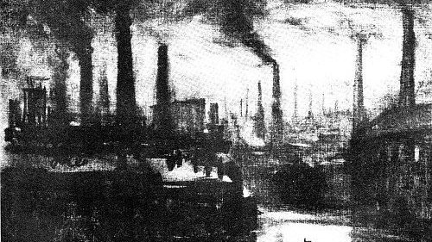
Industrialisation Economic & social changes
Pre industrialisation families ‘laboured’ together
New industries & modes of production shift populations to cities
Families separated men, women, and child labour
Waged work shifts away from home separating productive waged work (outside) from reproductive (domestic) work
‘Separate spheres’ ideology reinforces notion women ‘stay at home’ in natural role looking after house, children, husbands
Frees men to labour while burden of reproducing/raising future workforce is performed cost free by women
Reality - women’s work continues but is deskilled, redefined as peripheral, casual
First wave feminists campaigned for women’s rights within marriage, family, work, but did on the whole mount a significant challenge to the notion of the traditional family itself or the role of women in it

Slide 4
Task in your team – drawing on film viewing & core readings, prepare answers for each question:
Why did feminists attack the institutions of marriage and the family?
Do you think their critique was valid?
What alternatives did they put forward?
What does a Black feminist perspective bring to these debates?

Slide 5
Historical approaches to family & ‘mothering’
Mainstream historians tended to emphasise mothers neglect of children pre 1700 and idealised ‘sentimental’ view of mothers at home afterward
Psychologists influence via ‘attachment’ theory put mother-child relationship (good or bad) at centre of historical/cultural understanding of family
Women’s historians start reevaluating/critiquing views of family & mothering
Shift to gender rather than women’s history sees examination decline except in Black American feminist histories of enslaved women which acknowledged women’s double burden of reproductive as well as productive labour
Feminist-socialists highlight state role in perpetuating nuclear family ideal (esp Thatcher)
Fresh perspectives on family begin decentralising notions of ‘mothering’ also looking at non heteronormative experience to de-myth traditional notions nuclear family

Slide 6
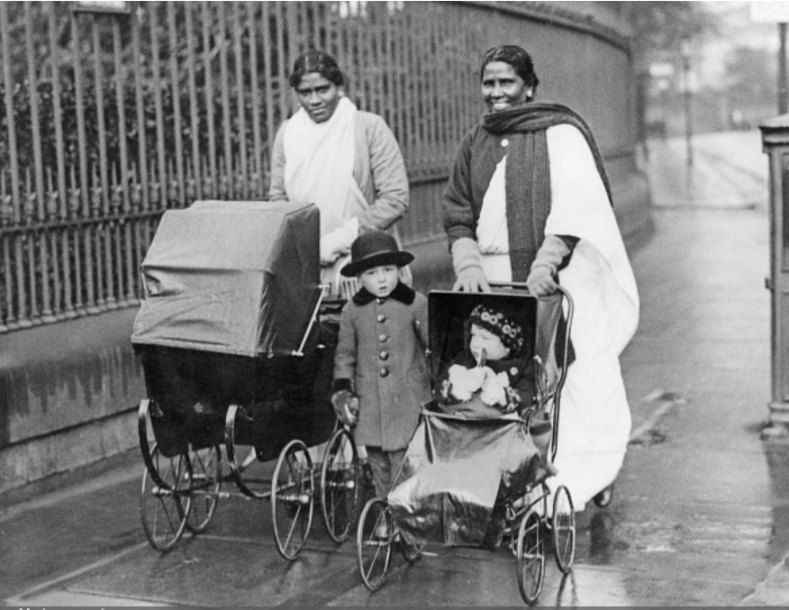
Recent historical approaches deconstruct myth of the ‘ideal’ family & its collapse if mothers aren’t at home
Othermothering emerges from black feminist thought on mothering under slavery where women acted communally to raise children and its community legacy.
Experiences among working poor in white working-class communities in nineteenth/early twentieth centuries (sister-mothers, neighbours, grandmothers)
Care chains or shadow mothering substitute ‘mothers’ that satisfy the needs of privileged women at the expense (sometimes exploitation) of their less fortunate counterparts (nanny’s, governesses, etc…) and piecemeal child minders
Emotional work ‘caring about a child is not the same as caring for a child’ exploring how women shoulder most emotional labour in families
Black feminism shows British state hypocrisy in commitment to ‘family’ ideal while racist immigration laws keep families apart

