Slide 1
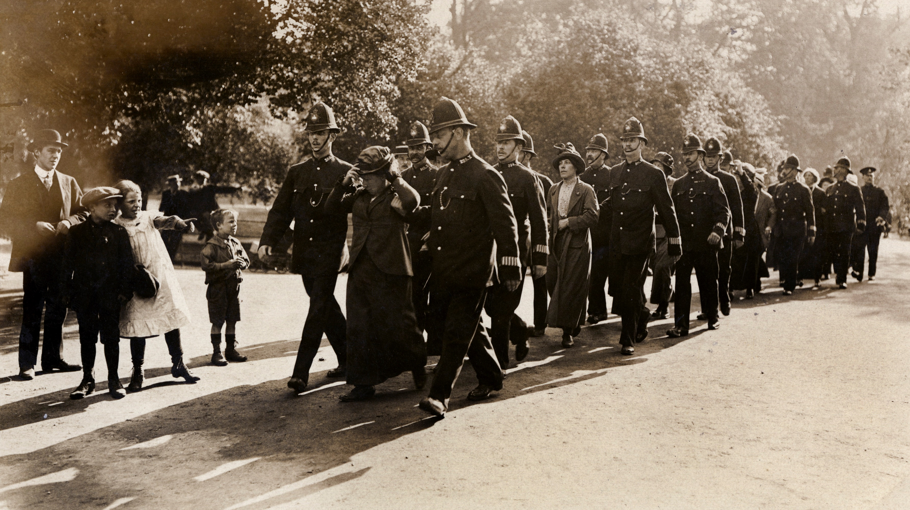
The Suffrage Movement 1893-1918
Part 1: Exploring the movement: societies & identities
Part 2: Militancy, womanhood and the state

Slide 2
Suffrage: the right to vote in general (parliamentary) elections
1866 petition for women’s amendment to 1867 Second Reform Act allowing some women the parliamentary vote - rejected
1867 National Society for Women’s Suffrage (Lydia Becker, Manchester)
1869 single women able to vote in town elections
1888 single women allowed to vote in county elections
1892 International Women’s Conference (Paris)
1894 married women allowed to vote in local elections
1897 National Union of Women’s Suffrage Societies
1903 Women’s Social and Political Union
1907 all women allowed to vote in local elections
Women gain parliamentary vote Isle of Man 1881, New Zealand 1893, Finland 1906

Slide 3
Quick task - Why did women want the vote?
Can you summarise 2 or 3 arguments put forward for women’s suffrage
Can you summarise 2 or 3 arguments put forward by opponents of women’s suffrage
How useful are these images to historians investigating these questions?
Prepare some feedback

Slide 4
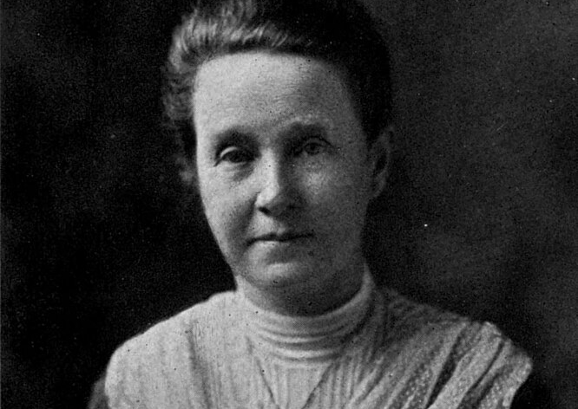
National Union of Women’s Suffrage Societies
Formed 1897 (London)
Led by Mrs Millicent Fawcett
Constitutional methods ‘suffragists’
Law abiding
Votes for women on same terms as men
Branches countrywide
Non-political but leadership ties to Liberal Party – aligned with Labour Party in 1912
Socially mixed membership but leadership tended to be middle class (not unusual in political movements)
1914 had 52,000 formal members
Newspaper Common Cause

Slide 5
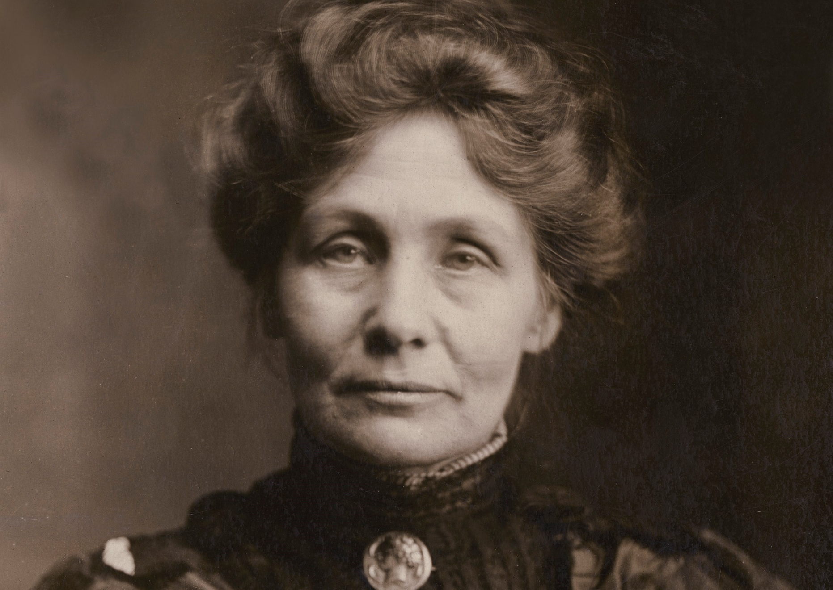
Women’s Social and Political Union
Formed 1903 (Manchester)
Led by Mrs Emmeline Pankhurst (& daughters Christabel, Sylvia, Adela)
Militant law-breaking ‘suffragettes’
Votes for women on same terms as men
Branches countrywide
Non-party but roots in labour movement
Publicly supported working class causes
Women’s Freedom League 1907 splinter group – Pankhurst’s too ‘autocratic’
1913 socialist Sylvia Pankhurst breaks -East London Federation of Suffragettes
Socially mixed with some high-profile working class ‘leaders’ (Annie Kenney) but also notable elites
Newspaper Votes for Women

Slide 6
Traditional scholarship dismissive (some written by male historians) presents suffrage campaigners as self-interested middle class
Jill Liddington & Jill Norris ‘One hand tied behind us’ broke this myth demonstrating working class involvement. Also, case studies saw class ‘mix’ and place differences. For instance, Oldham = mostly middle-class/ Clitheroe = mostly working-class
Sumita Mukherjee ‘Indian suffragettes: Female identities and Transnational Networks’ highlights role of Indian women in British Suffrage movement
LGBTQ presence
New research - Mapping Women’s Suffrage project (ongoing)

Slide 7
Reflect on: how representative was the suffrage movement?
Some suggestions to look up on map:
Constance Lytton
Sophia Duleep Singh (Princess)
Annie Kenney
Annie Lettice Floyd
Vera ‘Jack’ Holmes
Sarah Wanley
Eleanor Rathbone
John Howard Bertram Masterman (Rev)
Drawing on reading (Hannah Mitchell -Suffrage Days) & explore website/map/links below
www.mappingwomenssuffrage.org.uk
For quick how to use guide see
https://youtu.be/ZhLIV25PFrw
https://www.womanthology.co.uk/on-the-trail-of-the-indian-suffragettes-dr-sumita-mukherjee-associate-professor-in-modern-history-at-the-university-of-bristol/

Slide 8
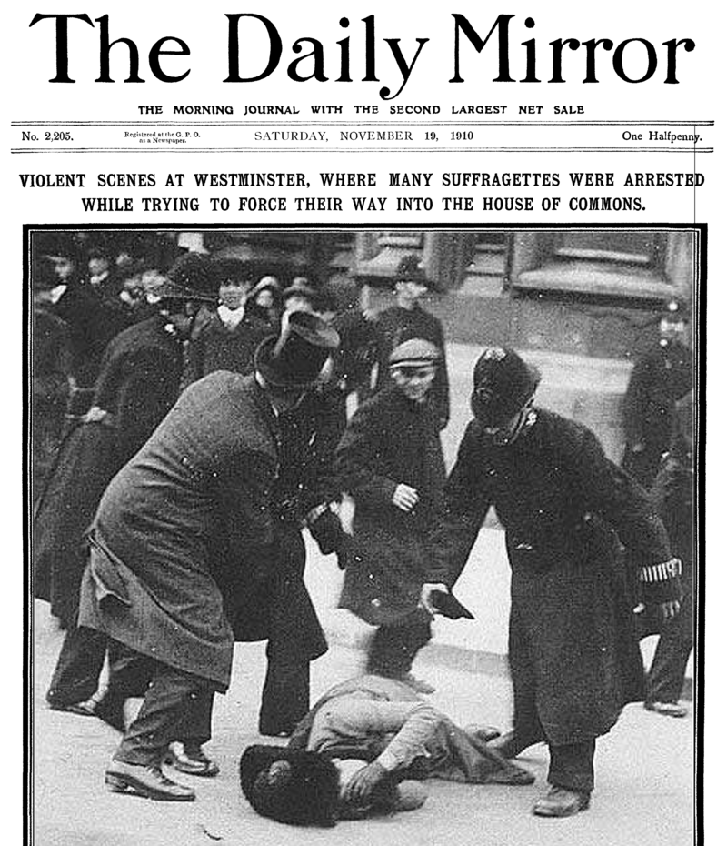
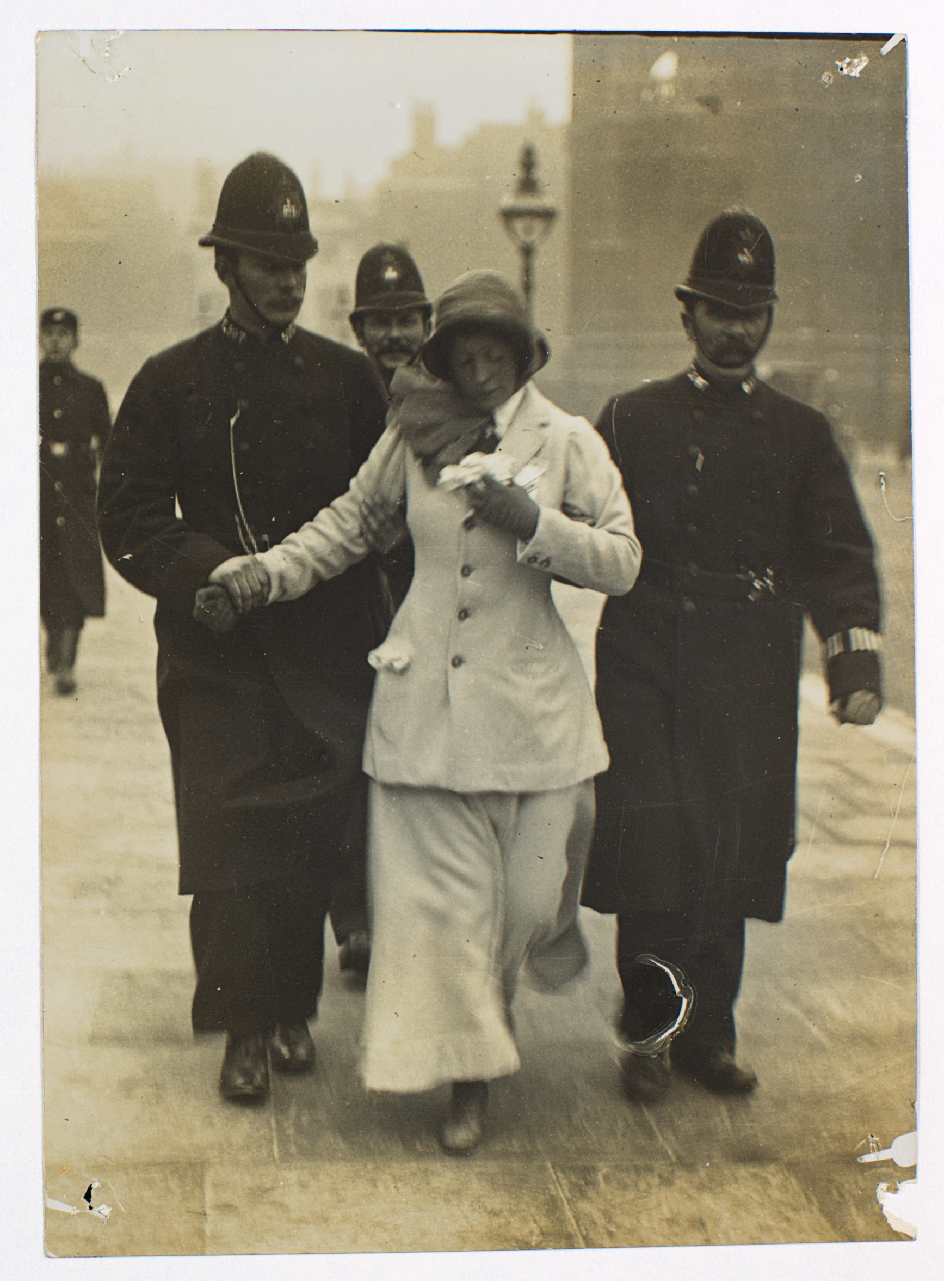
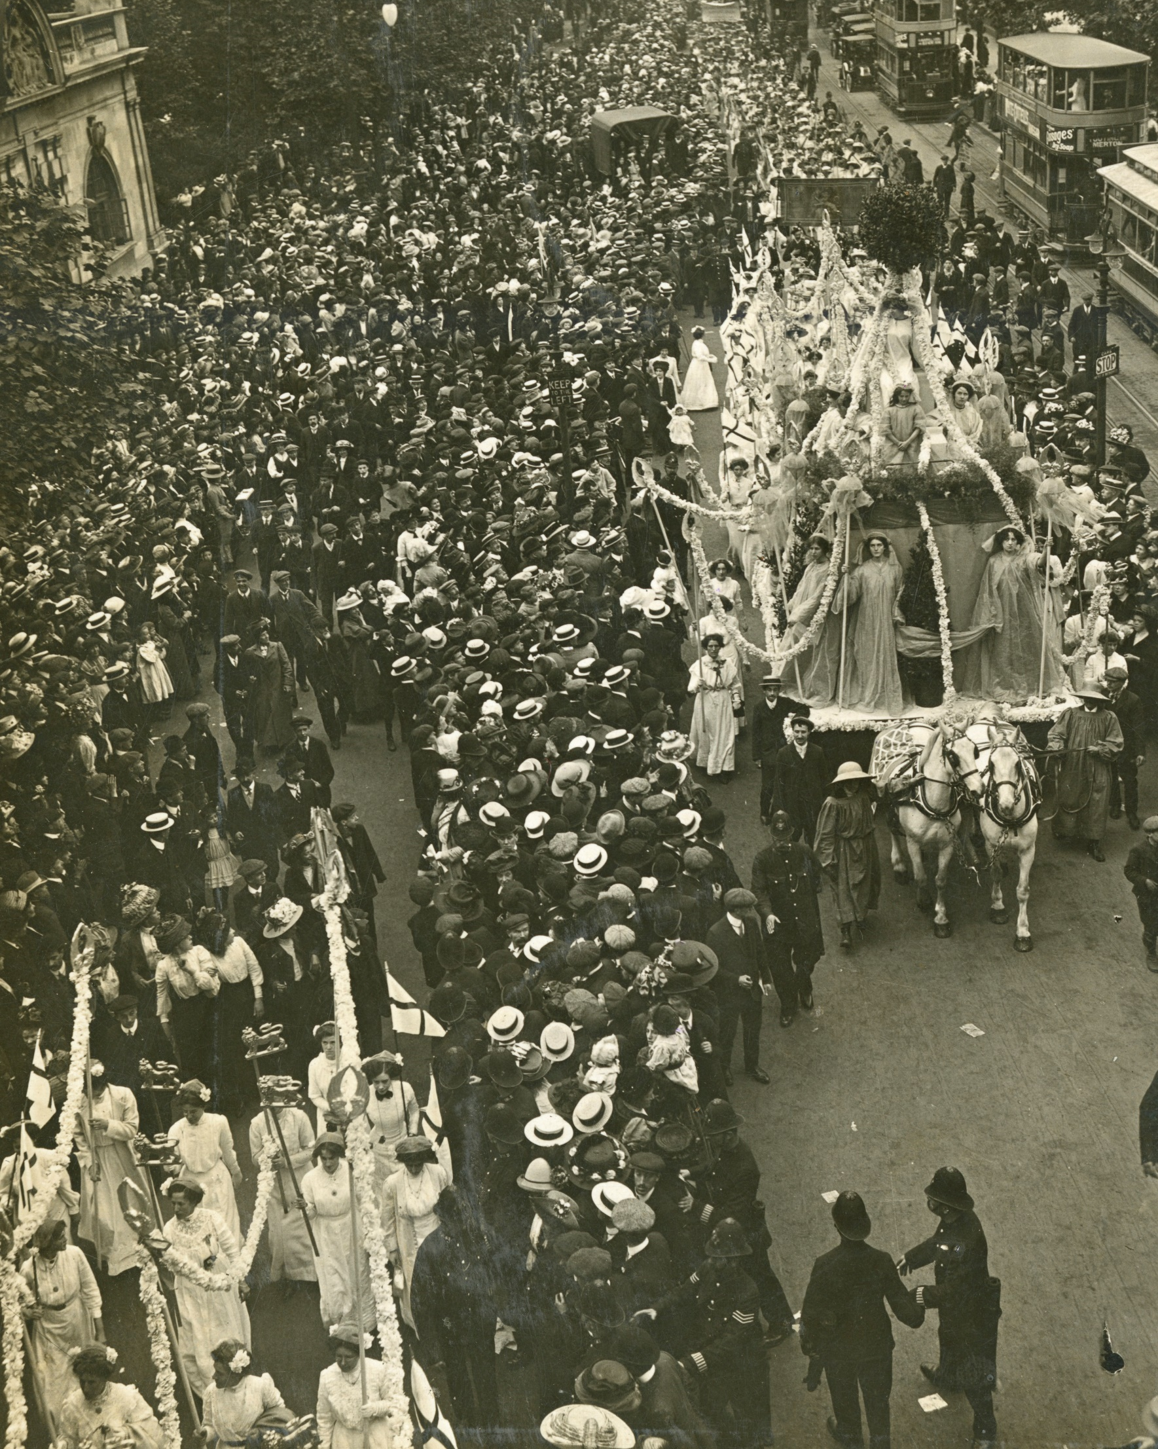
Part 2: Militancy, Womanhood and the State
FamilyID=Office_ArchiveTorn

Slide 9
Government action
1906-1914 Liberal government
1906 refused plural voting would have given some propertied women the vote
1907 suffrage bill rejected
1909 second reading of suffrage bill failed
1910 first conciliation bill failed as gov didn’t allow parliamentary time
1911 second conciliation bill fails Asquith announces prefers to extend manhood suffrage
1912 third conciliation attempt fails
1913 gov franchise bill introduced universal male suffrage but amendment to enfranchise women rejected
1913 Cat and Mouse Act passed & Government Franchise Bill suggested universal suffrage for all men
‘Suffragettes’
1860-1914 all societies used peaceful methods throughout campaign
1905 Annie Kenney & Christabel Pankhurst arrested for heckling
1906 WSPU move HQ to London
1907 first large march NUWSS/Artists Suffrage League – kicks of artistic propaganda/ public demos of support
1908 publicity stunts, window smashing, ‘rush’ on House of Commons
1909 first hunger strike & first forcible feeding
1910 Black Friday
1911 census boycott, first post box destroyed, huge demo Women’s Coronation Procession
1912-14 militancy escalates heckling, vandalism, arson, bombings of gov ministers' empty properties, churches

Slide 10
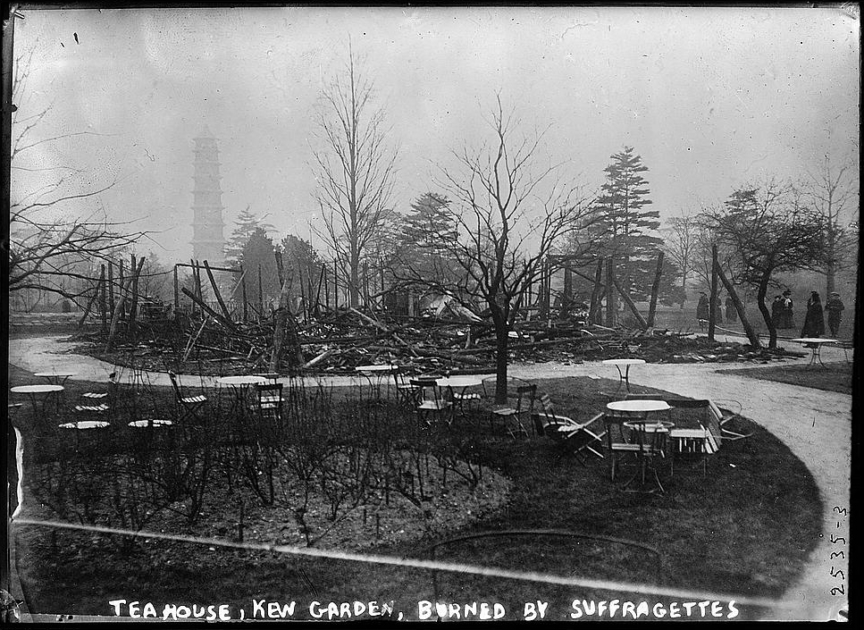
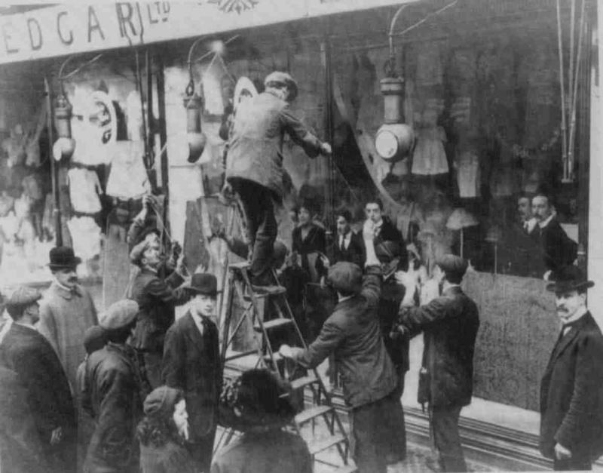
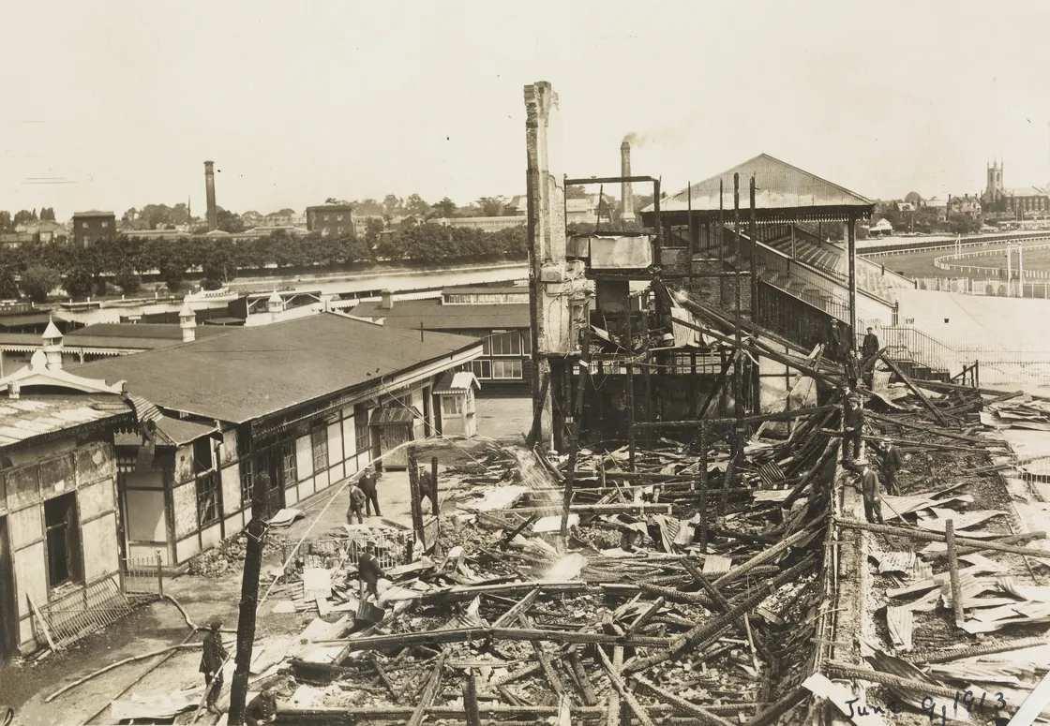

Slide 11
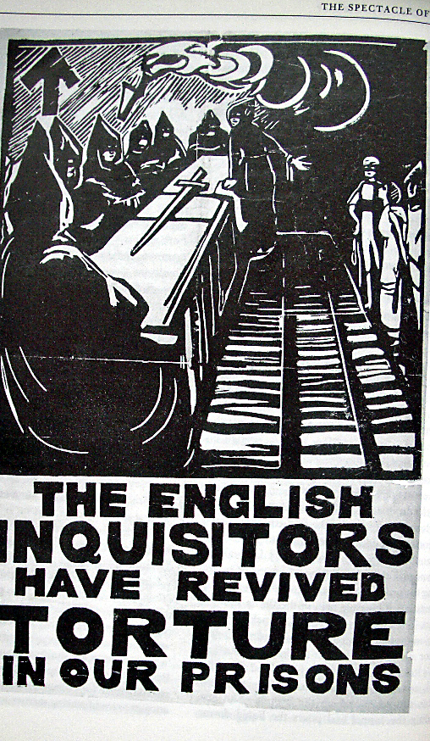
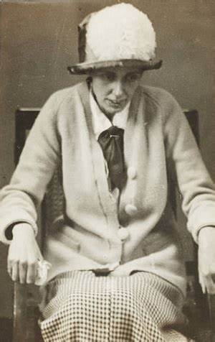
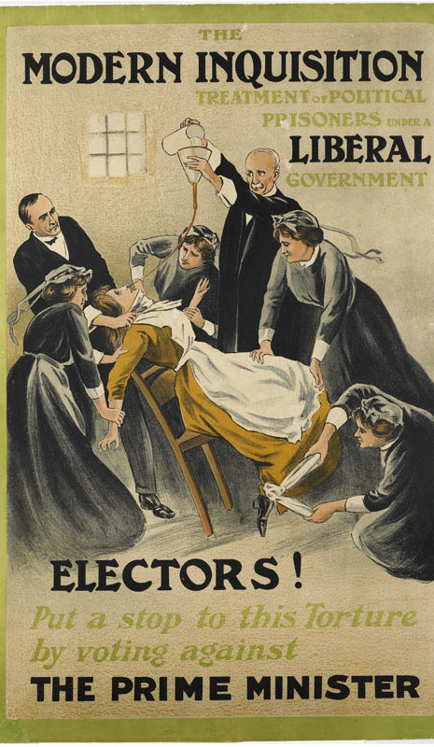

Slide 12
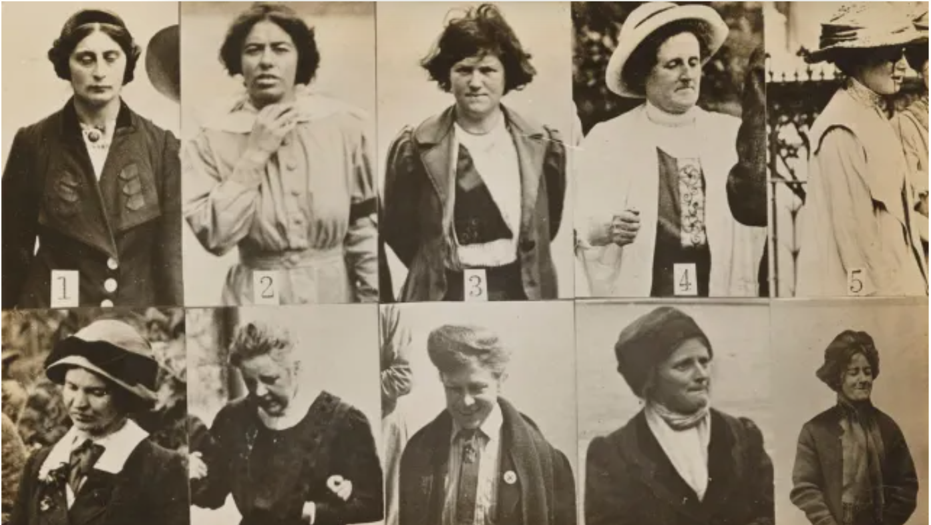
Notes:
Source: The National Archives

Slide 13
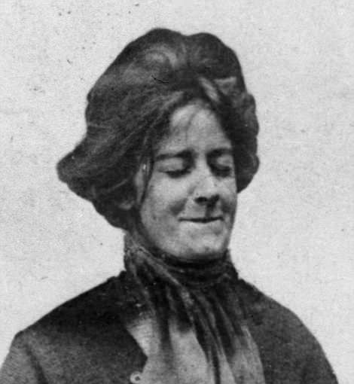
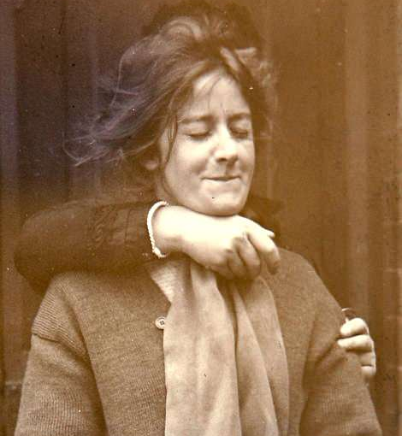
Notes:
Evelyn Manesta, 1913. Source: The National Archives

Slide 14
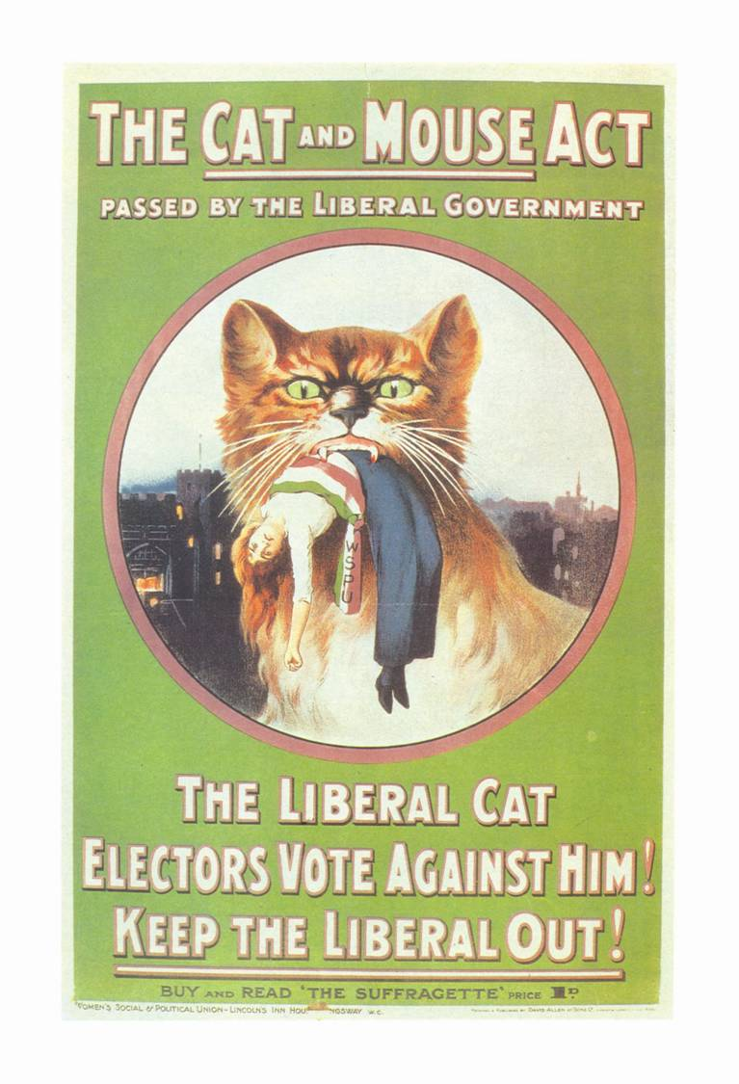
Task: Purvis reading and today’s materials/slides:
Was militancy an elitist tactic? Discuss.
How great a threat to the social order did the suffragettes represent?
Give reasons

Slide 15
Militancy:
Smashes notions of ‘ideal womanhood’
State (men’s) brutality to women exposed (bogus ‘chivalry’)
War:
WSPU joined war effort ceased campaigning
NUWSS (split), WFL, ELFS continued campaigning (anti-war)
1918 Representation of the Peoples Act
All men over 21
Some women over 30 who were householders (or wives of); paid more than £5 per annum rent; or graduates of British university
Often sold by politicians/popular history narratives as ‘reward’ for women’s war work. Fallacy as most single, young, munitions' workers not eligible, most working-class women
Post 1918 - NUWSS – NUSEC; WFL suffrage campaign continues

Slide 16
Next Week: Sex, Sexuality & Sex Work, 1870-1930
Group 1 – Struggles for Sexual Freedom
Group 2 – Writing Lesbian/Queer Histories
Group 3 – Campaigns Against Prostitution
20 min presentation in groups to the rest of the class
Give overview of the key historical debates on these themes
If using, send PPTs by 10am on morning of seminar or bring handouts

