Slide 1
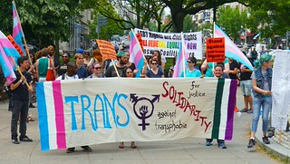
Transfeminism & the TERF wars

Slide 2
Historians recognise that gender is not natural or inherent but is socially constructed and historically contingent.
Gender is not the same as sex

Slide 3
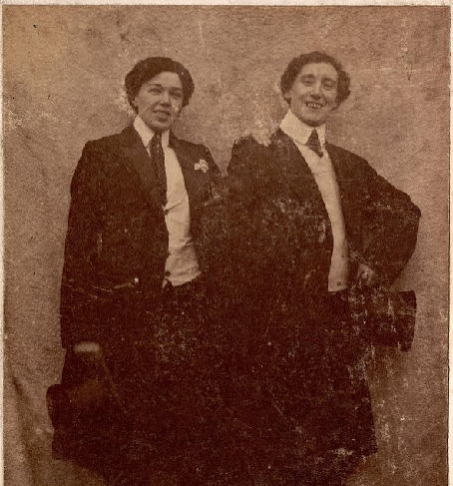
Vera ‘Jack’ Holme

Slide 4
2004 Gender Recognition Act allows for Gender Recognition Certificate for age 18+, gender dysphoria diagnosis, lived full time in acquired gender for 2 years, permanent intent
Differences between England & Scotland
2010 Equalities Act Trans people are protected from discrimination & harassment in the workplace. The EA requires only that a trans person has proposed to undergo gender reassignment, which may be physical (i.e. medical transition) or through changing “other attributes of sex”.
2025 UK Supreme Court rules definition of a woman in equalities law is based on biological sex

Slide 5
Task 1 focus on transfeminism
Based on your core reading work through the following questions. Identify and get ready to use specific examples from your reading.
What do struggles for trans rights and feminism have in common?
What do transphobia and misogyny have in common?
Assess and historicise the key themes/arguments of trans feminism.

Slide 6
Task 2 (Trans-Exclusionary Radical Feminist)
What are the ‘TERF wars’ about? Consider not just the ideological debate but also the wider historical and political context/ motivations.
Some current groups:
https://forwomen.scot/
https://sex-matters.org/
Does transgenderism work towards diminishing or reinforcing gender stereotypes?

