Slide 1
Term 2
Thank you for your feedback – formal response by the end of the week
Next assignment: 3,000 word (40%) source-based essay due 11th March 2006
Most of this term focuses on the Women’s Liberation Movement ‘second wave’ encompassing late 1960s, 1970s, 1980s
Today’s session is an overview of some of the themes we’ll be examining in detail in the coming weeks
First task – spend a few minutes reflecting on prewar and interwar feminism. Make a quick list of key campaign areas.

Slide 2
3000 word source based essay (40%)
Choose a primary source and perform an in-depth analysis
This can be from the MRC or elsewhere (check with me) but must fit in with the module themes
No need for a ‘title’. E.g. ‘Leaflet Advertising the Indian Female Evangelist (1880): A Source Analysis’ is fine
You are not setting a question to answer or making an argument in the sense of a traditional essay, you are analysing a primary document
Context of the document (authorship, purpose, date, intended audience). Analyse the content (explain arguments, bias, subjectivity or views of the document). Is it useful to historians (i.e. reliability, does it offer views on discourses of the era). If other historians have commented on it – do you agree or disagree with their opinions on it. How does it fit with/what does it tell us about the social/cultural/political context of the time
Develop historical understanding from the source you choose
Due 12 Noon Wednesday 11th March 2026

Slide 3
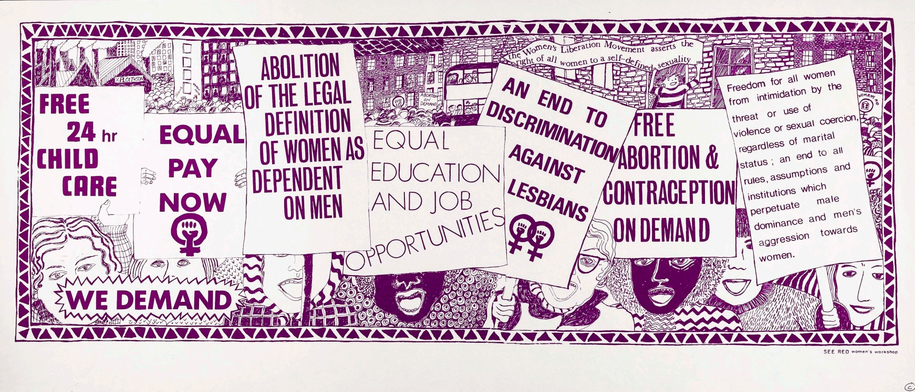

Slide 4
The Birth of the Women’s Liberation Movement
First national women’s conference, Ruskin College, Oxford, 1970, four demands were formulated:
1. Equal Pay
2. Equal Education & Opportunity
3. 24 Hour Nurseries
4. Free Contraception & Abortion on Demand
The overarching question for today is what factors ‘birthed’ this new ‘second wave’ feminist movement in Britain? And how was it different?

Slide 5

Task – Group discussion of core readings
Sheila Rowbotham (now 82)
Pioneer of WLM at Oxford University (originally from lower middle-class family in Hull)
Studied history
1969, published pamphlet Women's Liberation and the New Politics, arguing that Socialist theory needed to consider the oppression of women in cultural as well as economic terms.
Editor of feminist/socialist magazines and later lecturer & author
Women and men should stand equally against both capitalism and sexism to achieve radical social reorganisation
Papers at LSE

Slide 6
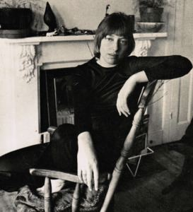
Task – Group discussion of core readings
Juliet Mitchell (now 85)
Oxford University studied English (later psychoanalysis)
Inspired by black civil rights movement
Active in leftist politics, editing committee of New Left Review
WLM seminal article "Women: The Longest Revolution" (1966) accusing socialism of failing to lead to the emancipation of women, theoretically reproaching socialist ideology for studying the position of women only through their role in economic production
Book Women's Estate (1971)

Slide 7
To consider in our discussion…
Discuss the social and cultural context in which the WLM emerged? In other words, what was going on at this time of ‘crisis’ at home and abroad?
Was the sexual revolution an important factor in the rise of the WLM? If so, how?
Was the Left responsible for the emergence of a ‘second wave’ of feminism in the 1970s?
What are the main differences you perceive between ‘first’ and ‘second’ wave feminism? Are these useful labels for the historian?
What obstacles did women face in forming a feminist consciousness in the early days of the WLM?

Slide 8
Follow on discussion -
https://wdc.contentdm.oclc.org/digital/collection/boar/id/1972
MRC, click on module, click on birth of the WLM, Warwick Women’s Liberation? 1969 under ‘Selected Sources’
Read the student article in The Warwick Boar
As young students at Warwick, can you relate to this article? If so how?
https://www.lse.ac.uk/library/collection-highlights/womens-liberation-movement

Slide 9
Summing up…
In the nineteenth century ‘first wave’ feminists fought for equal rights in the public spheres of the workplace, higher education and national politics, culminating in the suffrage campaign and the partial vote in 1918.
In the inter-war years feminists shifted attention to the private sphere of the family, listing among their demands the provision of reliable contraception, state recognition of the value of mothers’ unpaid work at home (later family allowances 1945)
‘Second wave’ or WLM feminisms (deliberately plural) in the late sixties shared some of these objectives, but were more ambitious - they aimed at a radical shift in male-female relations

