Slide 1
Lecture 2:
Enlightenment and History: An Introduction
Historiography 2018/19

Slide 2
The question of human agency and human experience?
The question of historical change and what causes change?
The question of scale. The relationship between ‘particulars’ and ‘universals’ or, to frame it otherwise, between historical ‘facts’ and their wider meaning.
What are historical ‘facts’? Is there such a thing?
The nature of historical work and the persona of the historian? Can s/he be neutral and objective? Is objectivity in history writing a value, or not? Can it be achieved or is it a convenient myth?
What is history? A science (in the sense of a natural science) or an art? Is it simply fiction?
To what end does history writing serve?

Slide 3
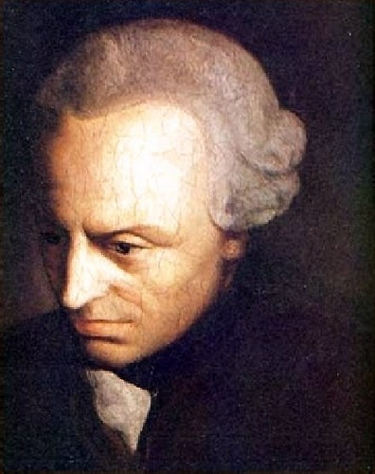
Immanuel Kant, 1724-1804

Slide 4
‘Enlightenment is mankind’s exit from self-incurred immaturity. Immaturity is the inability to make use of one’s own understanding without the guidance of another. Self-incurred is the inability if its cause lies not in the lack of understanding but rather in the lack of the resolution and the courage to use it without the guidance of another. Sapere aude! Have the courage to use your own understanding! It is thus the motto of the enlightenment.’
(From: Immanuel Kant, ‘An Answer to the Question: What is Enlightenment?’ Berlinerische Monatsschrift (1784): 481-494, 481.)

Slide 5
‘It is now asked “whether we live at present in an enlightened age?”, the answer is: “No, but we do live in an age of enlightenment.” As matters stand now, much is still lacking for men to be completely able – or even to be placed in a situation where they would be able – to use their own reason confidently and properly in religious matters without the guidance of another. Yet we have clear indications that the field is now being opened from them to work freely towards this , and the obstacles to general enlightenment or to the exit out of their self-incurred immaturity become even fewer.’
From Immanuel Kant, ‘An Answer to the Question: What is Enlightenment?’ Berlinerische Monatsschrift (1784): 481-494, 481

Slide 6
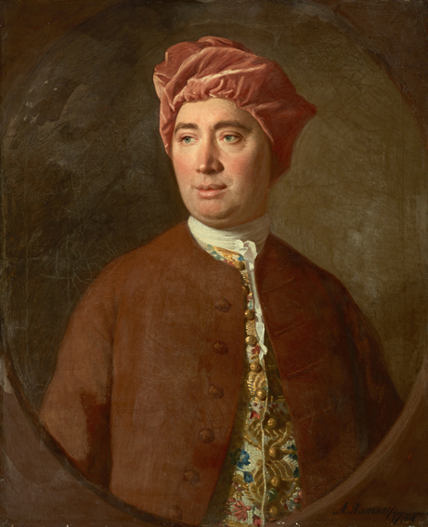
Enlightenment and History Writing
What should historians focus on and how to write it?
A Treatise of Human Nature: Being
an Attempt to introduce the
experimental Method of Reasoning
into Moral Subjects (1739) – no success
An Enquiry Concerning Human Understanding (1748)
The History of England: from the invasion of Julius Caesar to the Revolution of 1688 (1754–61) , first published in installments
“I believe this is the historical
Age and this the historical Nation”, 1777
David Hume 1711-1767

Slide 7
How to do history?
Rejection of ‘antiquarianism’
“a man strangely thrifty of Time past, and an enemy indeed to this maw,
whence he fetches out many things when they are now all rotten and stinking.
Hee is one that hath that unnaturall disease to bee enamour'd of old age and
wrinckles, and loves all things (as Dutchmen doe Cheese) the better for being
mouldy and worme-eaten.”
(John Earle, Micro-Cosmographie: or A Peece of the World Discovered
(7th edn., London, 1660), p. 33)

Slide 8
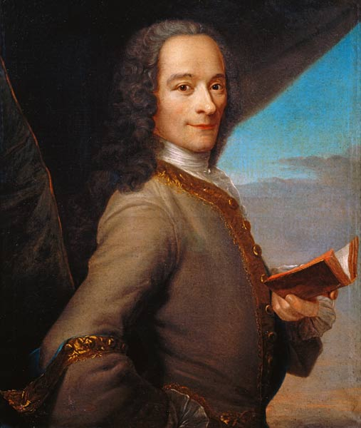
Philosophical History based on Facts
History of Charles XII, King of Sweden
(1731)
The Age of Louis XIV (1751)
Candide, or Optimism, 1759
Essay on the Manners of Nations
(or 'Universal History') (1756)
‘History is the narrative of facts taken
to be true, in contrast to the fable
which is the narrative of facts taken
to be false.’
From: “Histoire”, p. 164
François-Marie Arouet, 1694-1778,
known as Voltaire

Slide 9
Why study history according to David Hume:
Entertainment
Leads to erudition and improvement of the mind
‘A man acquainted with history may, in some respects, be said to have
lived from the beginning of the world, and to have been making
continual additions to his stock of knowledge in every century.’
(knowledge is accumulative)’
3. History has the power to direct readers’ wills and to become
more virtuous; because historian do not possess the vice of self-love
or self-interest
How can this be done? How can history make the reader more virtuous?

Slide 10
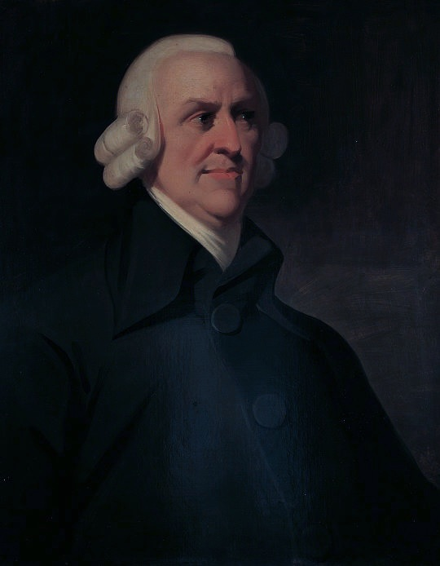
Understanding the past through ‘sympathy’
“The accidents…which affect the human
Species interest us greatly by the
sympatheticall affections they raise in us.
We enter into their misfortunes, grieve
when they grieve, rejoice when they rejoice,
and in a word feel for them in some respect
as if we ourselves were in the same
condition.”
(Lectures on Rhetoric and Belles Lettres, 1762, p. 90)
Human experience, or the experience of reading about past experiences, makes one virtually ‘feel’ history, empathise with others, absorb moral lessons, and become more virtuous.
Adam Smith, 1723-1790

Slide 11
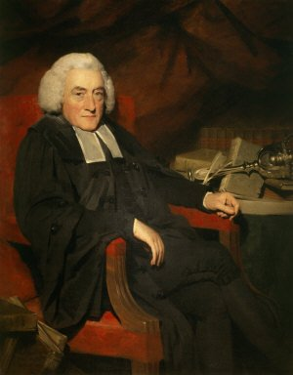
‘Transhistorical’ sympathy between humans in the present and those of the past as a way to understand the past
‘The Queen, worn out with fatigue,
covered with dust, and bedewed with tears,
was exposed as a spectacle to her own
Subjects.’
(History of Scotland, 1759, vol. 1, p. 367)
William Robertson, 1721-1793

Slide 12
“The facts must be real otherwise they will not assist us in our future conduct, by pointing us the means to avoid or produce any event. Feigned Event and the Causes contrived from them, as they did not exist, can not inform us of what happened in former times, nor of consequences assist us in a plan of future conduct.”
(p. 91)
Adam Smith, 1723-1790

Slide 13
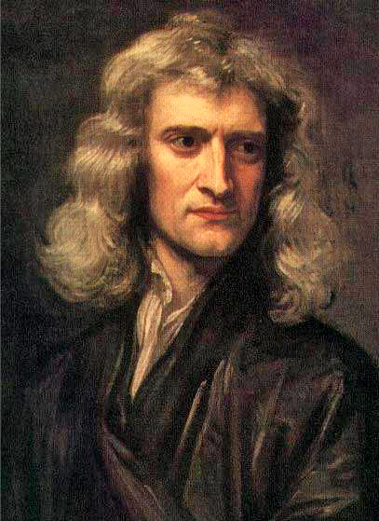
How does change in history happen?
Laws or Principles
David Hume:
Experimental method of reasoning:
‘the empirical observation of human
activities in the present and past.
‘Mankind are so much the same, in all times
and places, that history informs us of nothing
new or strange in this particular. Its chief use is
only to discover the constant and universal
principles of human nature, by showing mean
in all varieties of circumstances and situations
and furnishing us with materials from which
we may form our observations and become
acquainted with the regular spring of human
action and behaviour…’
(Hume, Enquiry Concerning Human
Understanding, 1748, pp. 83-4)
Isaac Newton, 1642-1726

Slide 14
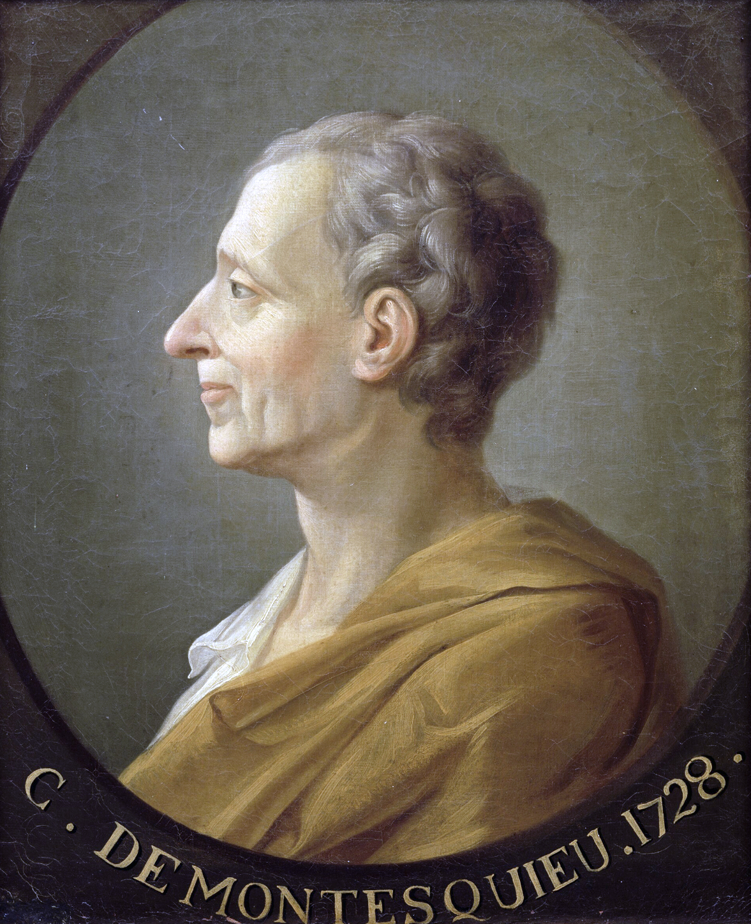
How does change in history happen?
Considerations on the Causes of the Greatness of the Romans and their Decline, 1734
The Spirit of Laws (1748)
Famous for theory of the separation of powers which is implemented in many constitutions
the first consistent attempt to survey the varieties of human society, and to classify and compare them and, within society, to study the inter-functioning of institutions.
Charles-Louis de Secondat, Baron de La Brède et de Montesquieu, 1689-1755

Slide 15
Considerations on the Causes of the Greatness of the Romans and their Decline, 1734
His philosophy of history minimized the role of individual persons and events.
Each historical event (accident) was by a principal causal movement:
“It is not chance that rules the world. Ask the Romans, who had a continuous sequence of successes when they were guided by a certain plan, and an uninterrupted sequence of reverses when they followed another. There are general causes, moral and physical, which act in every monarchy, elevating it, maintaining it, or hurling it to the ground. All accidents are controlled by these causes. And if the chance of one battle—that is, a particular cause—has brought a state to ruin, some general cause made it necessary for that state to perish from a single battle. In a word, the main trend draws with it all particular accidents.”
Charles-Louis de Secondat, Baron de La Brède et de Montesquieu, 1689-1755

Slide 16
One of the physical cause of historical change is climate and geography:
Environment shapes human character and the character of society and its political system.
Claim: climate drove Europe from classical world of virtuous republics to commercial monarchies
Suggestions of a linear move of history
Charles-Louis de Secondat, Baron de La Brède et de Montesquieu, 1689-1755

Slide 17
How does change in history
happen?
Providence:
the idea that human history is a gradual unfolding of a divinely ordained plan.
Note: to be ‘enlightened’ did not mean to be an
atheist
William Robertson, 1721-1793

Slide 18
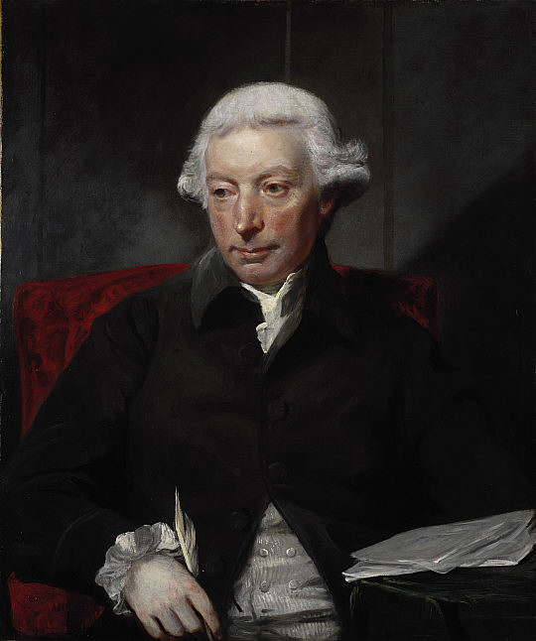
The story of Humankind:
Conjectural History
Def.: A rational reconstruction or speculation of what must have happened to mankind in the past, even if it can’t be empirically shown Note: a hypothetical state of human nature is taken as a normative guide
‘Mankind are to be taken in groups, as they have always subsisted. The history of the individual is but a detail of the sentiments and thoughts he has entertained in the view of his species: and every experiment relative to this subject should be made with entire societies, not with single men.’
(Ferguson, Essay on the History of Civil Society, p. 6)
‘…if we are asked therefore, Where the state of nature is to be found? we may answer, It is here; and it matters not whether we are understood to speak in the island of Great Britain, at the Cape of Good Hope, or the Straits of Magellan. While this active being is in the train of employing his talents, and of operating on the subjects around him, all situations are equally natural.’
(Ferguson, Essay on the History of Civil Society, pp. 11–12)
Adam Ferguson, 1723-1816

Slide 19
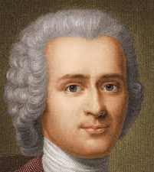
Conjectural History as a story of ‘decline’
Humans were born free and moral (or at least morally neutral) but civilisation corrupted them. (Discourse on the Origins of Inequality)
Attack on Hobbes’s idea of human inherent wickedness
Scottish historians would refute this.
Jean-Jacques Rousseau, 1712-1778

Slide 20
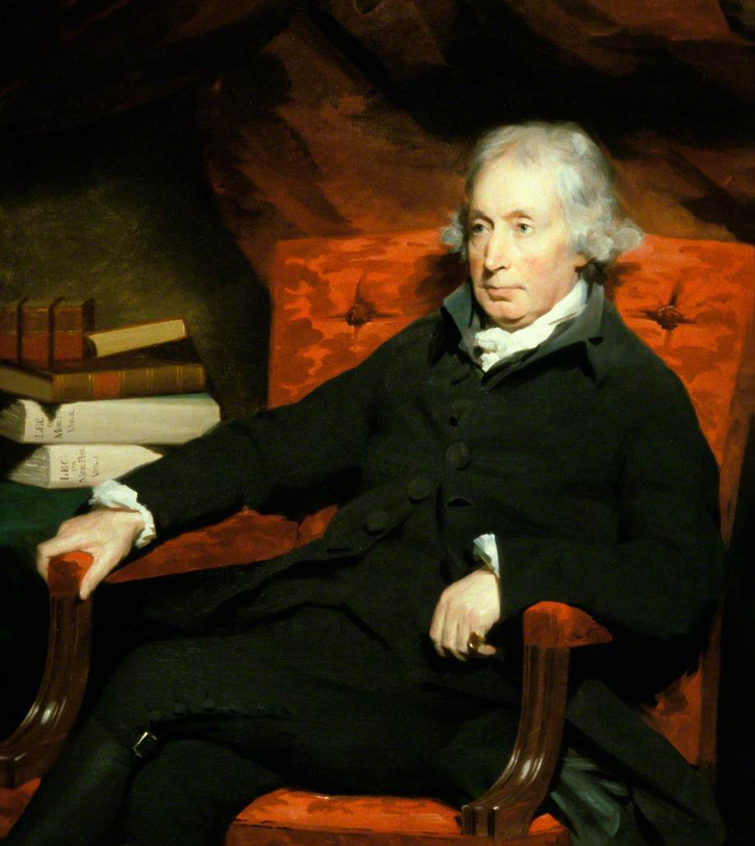
stage/stadial history as a story of ‘progress’
Stadial History (stages)
1. Hunting – no property, no wealth to accumulate, stage of savagery’
2. Pasturage – less mobile but still nomadic, wealth can be accumulated
3. Agriculture -- even less mobile, farmer live on land in own houses,
more wealth and greater inequality
4. Commerce – property ownership, laws governing property, complex societies
Adam Ferguson

Slide 21
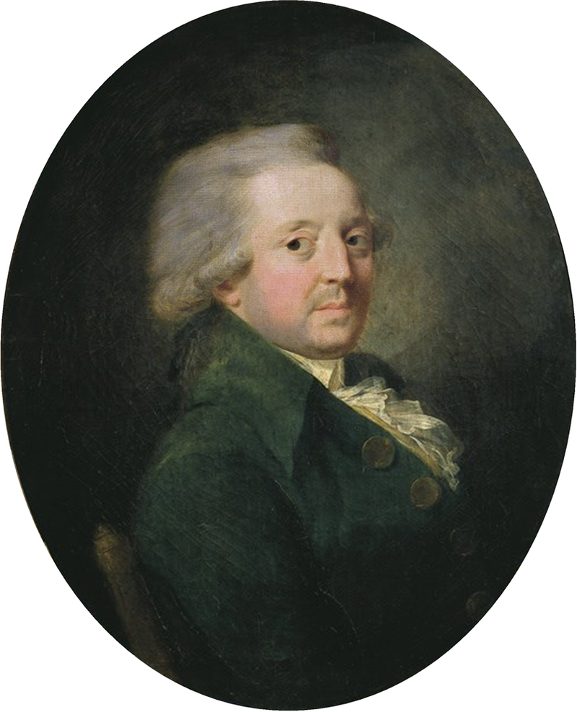
Sketch for a Historical Picture of the Progress of the Human Spirit (1795)
One of the most influential formulation of the idea of progress ever written. It made the idea of progress a central concern of Enlightenment thought.
Claim: expanding knowledge in the natural and social sciences would lead to an ever more just world of individual freedom, material affluence, and moral compassion.
Three general propositions:
that the past revealed an order that could be understood in terms of the progressive development of human capabilities
that the progress of the natural sciences must be followed by progress in the moral and political sciences
that social evils are the result of ignorance and error rather than an inevitable consequence of human nature.
Marie Jean Antoine Nicolas de Caritat, Marquis of Condorcet, 1743- 1794

