Slide 1
HISTORIOGRAPHY
LECTURE 8
The ‘New’ Social History and the Power of Experience ‘From Below’

Slide 2
‘…..who fell victim to the fascist and communist belief in inexorable laws of historical destiny.'
(Karl Popper, The Poverty of Historicism, 1957)

Slide 3
Between the 1930s and 1960s the disposition of the Annales
paralleled those of Marxists:
objectivst idea of history as a ‘social science
a holistic and totalising approach to history
quantitative methodologies
long-run analysis (long duree) analysis of economic fluctuation trough prizes, interest in trade flows and population, or geographical conditions
a materialist and structural model of causation (e.g. geography in the case of Braudel; forces of productive for Marxists)

Slide 4
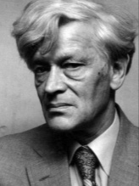
The rise of ‘experience’ and ‘culture’ as central
categories of history writing from the 1960s
Edward Palmer Thompson (1924-1993)

Slide 5
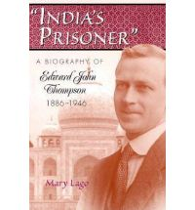
Edward John Thompson 1880-1940

Slide 6
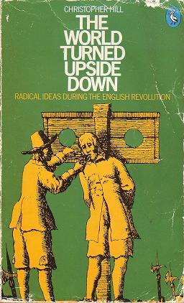
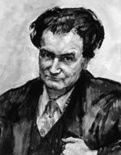
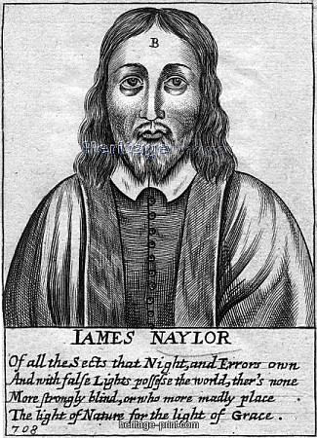
Christopher Hill (1912-2003)
The 17th century English revolutionary tradition

Slide 7
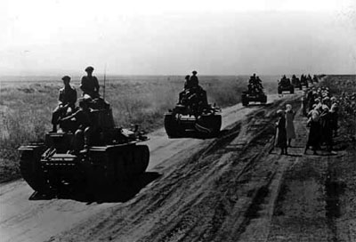

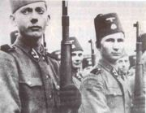
The Second World War in the Balkans
Frank Thompson
(1922-1944)
Partisans

Slide 8
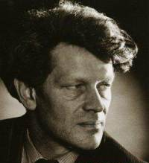
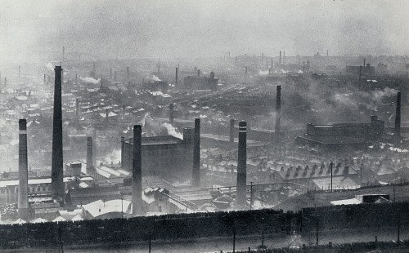
1948-65
Lectureship in Leeds University Extra-Mural Department, based in Halifax, West Yorkshire to teach English and History
Halifax in the 1950s

Slide 9
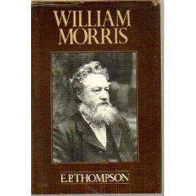
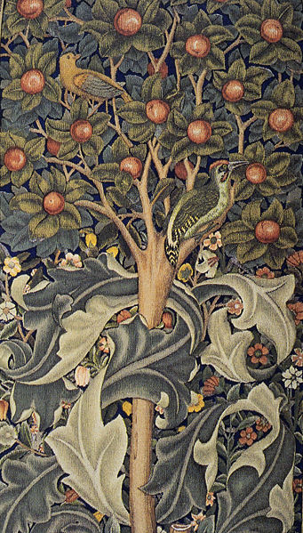
William Morris: Romantic to Revolutionary
(1955)

Slide 10
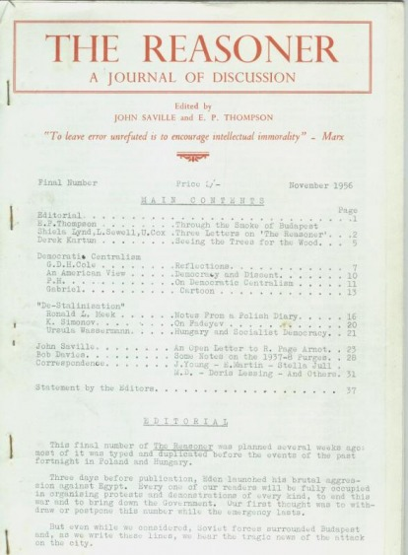

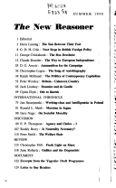
Communist Party Historian’s Group and ‘history from below’ 1946-1956
The Reasoner (1956) soon becomes The New Reasoner
New Left Review (1959)

Slide 11
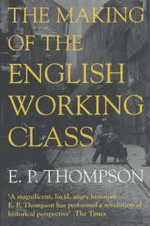
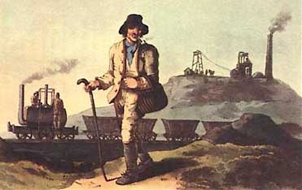
The Making of the English Working Class (1963)

Slide 12
‘The working class did not rise like the sun at an appointed hour. It was present at its own making.’

Slide 13
‘I do not see class as a “structure”, nor even as a “category”, but as something which in fact happens (and can be shown to have happened) in human relationships...Like any other relationship, it is a fluency which evades analysis if we attempt to stop it dead at any given moment and anatomize its structure.
The finest-meshed sociological net cannot give us a pure definition of class, any more than it can give us one of deference or of love. The relationship must always be embodied in real people and in a real context. Moreover, we cannot have two distinct classes, each with an independent being, and then bring them into relationship with each other. We cannot have love without lovers, nor deference without squires and labourers. (p.1)

Slide 14
‘I am trying to rescue the poor stockinger, the Luddite cropper, the “obsolete” hand-loom weaver, the “utopian” artisan, and even the deluded follower of Joanna Southcott, from the enormous condescension of posterity...(p.13)

Slide 15
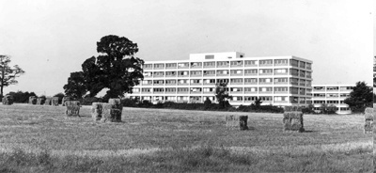
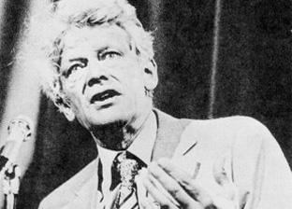
The University of Warwick 1965-1972
Photograph above shows the Humanities Building c. 1964.
Source: University of Warwick, Modern Records Centre, Warwick University Archive.

Slide 16
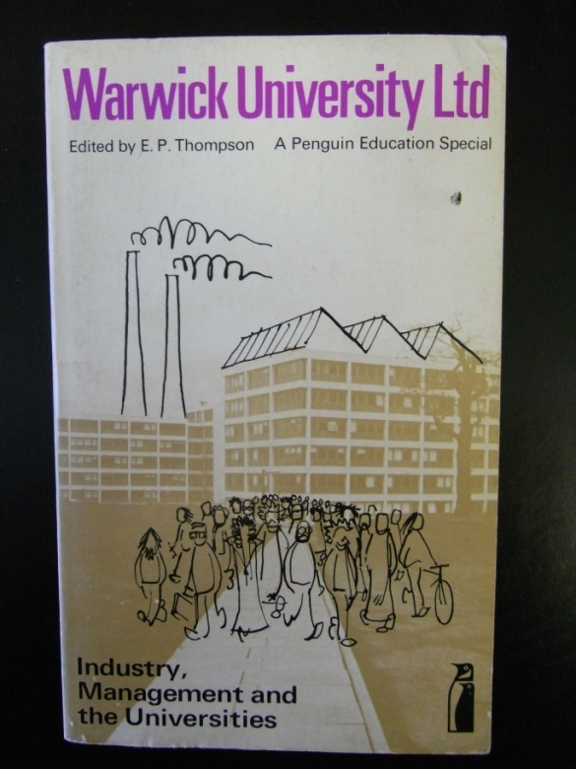


Published as a Penguin Education Special, 1973, a few weeks after Thompson’s article `The Business University’, New Society, 19 Feb 1970.

Slide 17

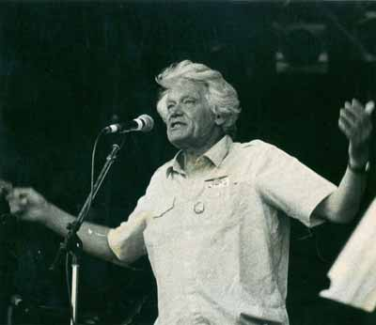
Thompson the anti-nuclear activist
1980

Slide 18
Rejection of Marxist structuralism
Rejection of economic reductionism (the idea that all action can be traced back to ‘the economic base’ of a society)
‘Marxist humanism’: historical subjects are active in the shaping of their own lives.
Resistance: above all a social and political act

Slide 19
Critiques of Thompson
Thompson’s periodization of this class-formation (c.1780-1850) is wrong.
Thompson’s representation of the English working class in Making of the English Working Class is partial.
In Making of the English Working Class, class is gendered as male, as is working-class experience.
‘Experience’ is not a valid category for social, historical, or philosophical investigation.
‘Experience’ is construed as a momentary thing.
If class is ‘a relationship, not a thing’ (Making of the English Working Class), then surely we need to investigate the experience of that relationship from both sides: workers and employers; masters and servants?
Inadequate account of ‘culture’ in Making of the English Working Class:

Slide 20
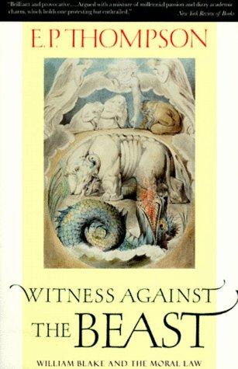
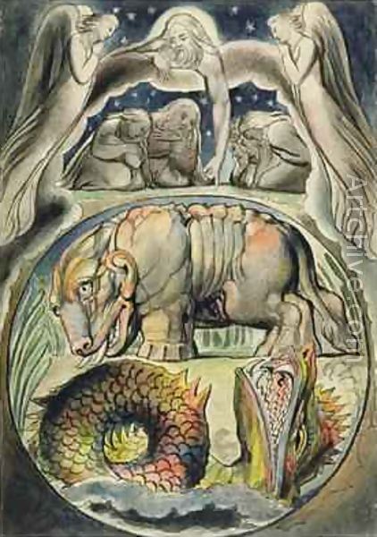
Witness against the Beast
(1994)
William Blake, `Behemoth
and Leviathan’ (Plate 15)
Illustrations of 'The Book of
Job'
1823-26

Slide 21
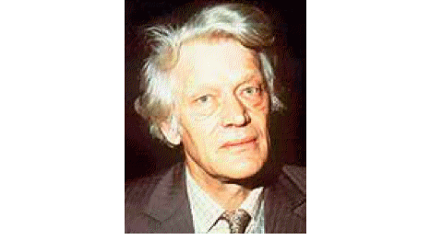
` … There is never the least sign of submission to “Satan’s Kingdom”. Never, on any page of Blake, is there the least complicity with the kingdom of the Beast’.
E.P. Thompson (1924-1993)

