Slide 1
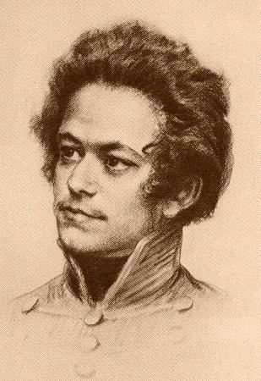
Historiography Week 5
Karl Marx
1818-1883

Slide 2
For 9 minute overview of Marx’s views, click here

Slide 3
Where he was born
Trier, in what is now the western part of Germany near Luxemburg; then under Prussian authority

Slide 4
1850s
London
Family lives in poverty

Slide 5
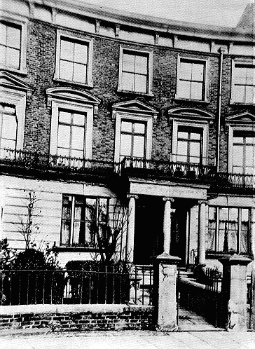
Maitland Park Road, HaverstockHill London, where he spend the a last 15 years of his life.
Situation improved through money Jenny inherites

Slide 6
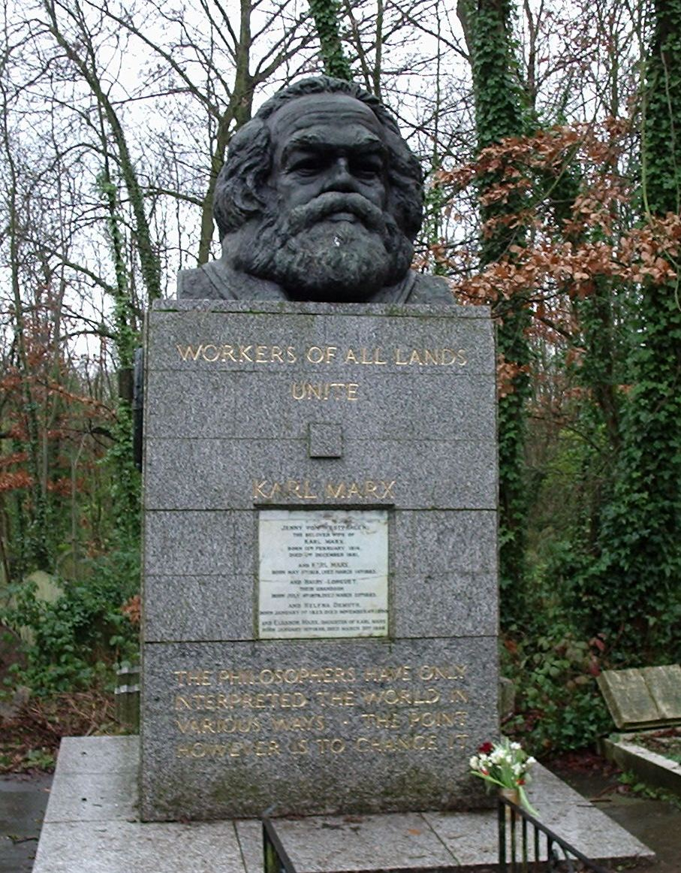
Highgate Cemetery, London

Slide 7
Marx’s Life
1818-35: childhood and early youth in a liberal bourgeois family in Trier. Exposed to Enlightenment, Romantic, liberal and radical world-views through family and acquaintances.
1835-36: University of Bonn. Heavy drinking, gambling, etc – father intervenes to move him to Berlin. Gets engaged to Jenny von Westphalen before leaving to Bonn in 1836, a relationship often portrayed as a ‘fairy-tale’ romance; three children survive: Jenny, Laura, Eleonore; one illegitimate child called Frederic with family servant Helene Demuth. To avoid scandal the boy grew up with foster parents.
1836-42: University of Berlin. Develops wide range of intellectual interests: jurisprudence, history, and especially philosophy. Involved in ‘Left-Hegelian’ circles. Hegelian philosophy remains important for this thinking for the rest of his life
1842-49: Cologne, Paris, Brussels, Paris, Cologne, Paris. Years of revolution and counter-revolution: for Marx, constant political exile and flight. Years of intense political agitation, radical political journalism (heavily censored). Marx begins studying political economy. Develops lifelong friendship with Friedrich Engels (son of wealthy manufacturer).
1849-1883: London.
List of his/Engel’s publications in chronological order see:
https://www.marxists.org/archive/marx/works/date/

Slide 8
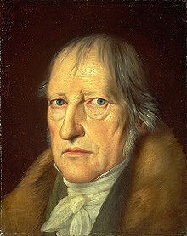
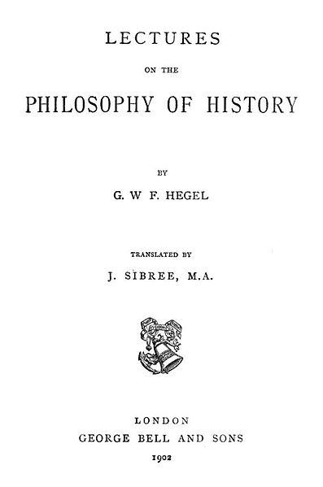
The Young Hegelians and their critique of Hegel’s Philosophy
Georg Friedrich Hegel (1770-1831)
"World history... represents the development of the spirit's consciousness of its own freedom and of the consequent realization of this freedom.”
Spirits develops along logical path and concerns
‘thinking’; move to higher stages is ’dialectic’

Slide 9
The Young Hegelian
Hegel’s dialectic in his Phenomenology of Spirit (which Marx uses later)
Thesis – antithesis -(struggles) – synthesis (master/slave example)
Critique:
Accuse Hegel of being part of Prussian establishment; highest form of spirit in contemporary Prussia
Judge his philosophy both mystifying and incomplete.
Aim of all history: not freeing abstract spirit but freeing all of humanity
Religion is true alienation of man from himself, from his true ‘essence’ (Feuerbach); philosophy too keep man from realising its full potential by make him admire fancy words and abstract concepts.

Slide 10
Marx goes further than Feuerbach:
Money is the universal, self-constituted value of all things. Hence it has robbed the whole world, the human world as well as nature, of its proper value. Money is the alienated essence of man’s labour and life, and this alien essence dominates him as he worships it.
(On the Jewish Question, 1843)
The working class or ‘proletarians’ gains central importance in fighting human alienation
‘In the formation of a class with radical chains….a sphere of society having a universal character because of its universal suffering…a sphere, in short, that is the complete loss of humanity and can only redeem itself through the total redemption of humanity. This dissolution of society as a particular class is the proletaria.’
(Toward a Critique of Hegel’s Philosophy of Right: Introduction, 72-3)
The working class has now self-interest, he argues, and can act for the whole of humanity
‘The proletarian have nothing to lose but their chains. They have a world to win.’ (Communist Manifesto, 77)

Slide 11
By the 1840s Marx had ‘discovered’ 2 things:
Economic and material conditions are the chief form of human alienation
The material force that would liberate humanity from this alienation by the economic and material condition was the working class, the proletaria.
Allows him to develop a different philosophical standpoint from Hegel:
‘In direct contrast to German philosophy which descend from heaven to earth, here we ascend from earth to heaven. That is to say, we do not set out from what men imagine, conceive, nor from men as narrated, thought of, or imagined, conceived in order to arrive at men in the flesh. We set out from real, active men and on the basis of their real life process we demonstrate the development of the ideological reflexes and echoes of this life process. The phantoms formed in the human brain are also, necessarily, sublimates of their material life process, which is empirically verifiable and bound to material premises. Morality, religion, metaphysics and all the rest of the ideology and their corresponding forms of consciousness no longer seem to be independent. They have no history or development.
Rather, men who develop their material production and their material relationship alter their thinking and the products of their thinking along with their real existence. Consciousness does not determine life, but life determines consciousness.
(The German Ideology, Selected Writings, p. 164)

Slide 12
Allows him to develop a different philosophical standpoint from Hegel:
‘In direct contrast to German philosophy which descend from heaven to earth, here we ascend from earth to heaven.
That is to say, we do not set out from what men imagine, conceive, nor from men as narrated, thought of, or imagined, conceived in order to arrive at men in the flesh. We set out from real, active men and on the basis of their real life process we demonstrate the development of the ideological reflexes and echoes of this life process. The phantoms formed in the human brain are also, necessarily, sublimates of their material life process, which is empirically verifiable and bound to material premises. Morality, religion, metaphysics and all the rest of the ideology and their corresponding forms of consciousness no longer seem to be independent. They have no history or development.
Rather, men who develop their material production and their material relationship alter their thinking and the products of their thinking along with their real existence. Consciousness does not determine life, but life determines consciousness.’
(The German Ideology, Selected Writings, p. 164)

Slide 13
Historical Materialism:
It was a term which refers to the philosophical view which holds that matter in motion is the fundamental constituent of the universe (since Greeks)
Marx does not mean this!
Marx took a firm stand against materialism, a position most progressive thinkers (particularly in the anglophone held) at his time. Such materialist claimed that ‘the’ substratum/basis of all mental and spiritual phenomena was to be found in matter and material processes. In its most vulgar and superficial form, this kind of materialism taught that feelings and ides are sufficiently explained as a result of chemical bodily processes.
M. fought this what he considered mechanical ‘bourgeois’ materialism, ‘the abstract materialism of natural science, that excluded history and its processes’
So, what does historical materialism investigates and claims?
Claims that man, the real and total man, the ‘real living’ individual – not the ideas produced by these individuals – are the subject matter of history and of the understanding of its laws

Slide 14
The great difference between Marx and other thinkers of 18th/19th century is that he does NOT consider capitalism – or commerce culture – was the outcome of human nature and the motivation of man in capitalism to be the universal motivation in man !!!!
‘Drives’ according to Marx:
Fixed and constant (hunger, sex etc)
‘relative drives’ which ‘owe their origin only to a certain type of social organisation’ (desire for money and property – capitalism)
‘Men can be distinguished from animals by consciousness, by religion and anything else you like. They themselves begin to produce their means of subsistence, a step which is conditioned by their physical organisation. By producing their means of subsistence men are indirectly producing their actual material life.’
(German Ideology, p. 7)

Slide 15
‘In the social production which men carry on they enter into definition relations that are indispensable and independent of their will; these relations of production correspond to a definite state of development of their material powers of production. The sum total of these relations of production constitutes the economic structure of society – the real foundation, on which rise legal and political superstructures and to which correspond forms of social consciousness. The mode of production of material life conditions the general character of the social, political and spiritual processes of life. It is not the consciousness of men that determines their existence, but, on the contrary, their social existence determines their consciousness.
At a certain stage of their development the material forces of production in society come into conflict with the existing relations of production or – what is but a legal expression for the same thing – with the property relations within which they had been at work before. From forms of development of the forces of production these relations turn into their fetters. Then comes the epoch of social revolution.’
(Critique to Political Economy, p. 389)

Slide 16
Three parts of society:
productive forces: things used to produce (machinery, raw materials, and human skills etc)
Give rise to ....
the relations between people or between people and material things – relations of production = economic order of society
Gives rise to ...
Superstructure (legal, political institutions of society; culture, arts etc.)
‘The hand mill gives you a society with the feudal lord; the steam mill, society with the industrial capitalist’
Move from one ‘mode’ to another is through dialectic struggle (see Hegel)

Slide 17
Note: Marx is not that deterministic all his life; change views in The Eighteenth Brumaire of Louis Bonaparte, focusses on the effects of ideas and personalities, and makes less deterministic general statements.
‘Men make their own history; but they do not make it just as they please; they do not make it under circumstances chosen by themselves, but under circumstances directly encountered, given, and transmitted from the past’. (The Eighteenth Brumaire of Louis Bonaparte, 1852, p. 300)

Slide 18
Capitalism sows the seeds of his own destruction. The constant cylce of boom and bust and the alienation of workers – or dehumanisation—of workers as commoidites that it entails feeds in the workers the need to become free of this alienation. Before long, they will realise that to be fully human, they will have to bring an end to the conditions which makes for capitalist society. Capitalists will be forcibly out. After a transitional period in which workers are the ruling class, there will arise a new form of society in which no classes exist.
In this form of society, called communism by Marx, people will act in accordance with plans devised for the good of all
(Communist Manifesto).

Slide 19
Marx concept of human nature?

