Slide 1
Lecture 5 Empiricism and Positivism in British History Writing of the 19th Century

Slide 2
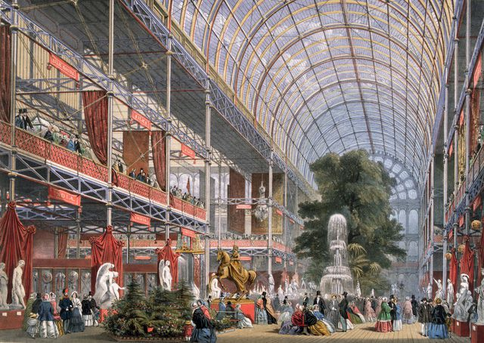
The Great Exhibition of 1851 in the Crystal Palace
The
A brilliant showcase of technology and science and the powers of the British empire
The first international trade
show; many will follow...

Slide 3
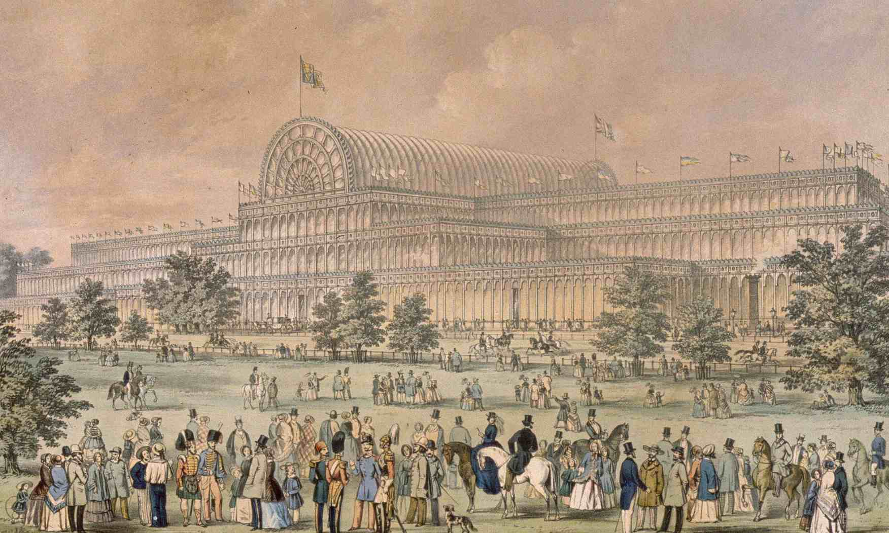
Crystal Palace in Hyde Park

Slide 4
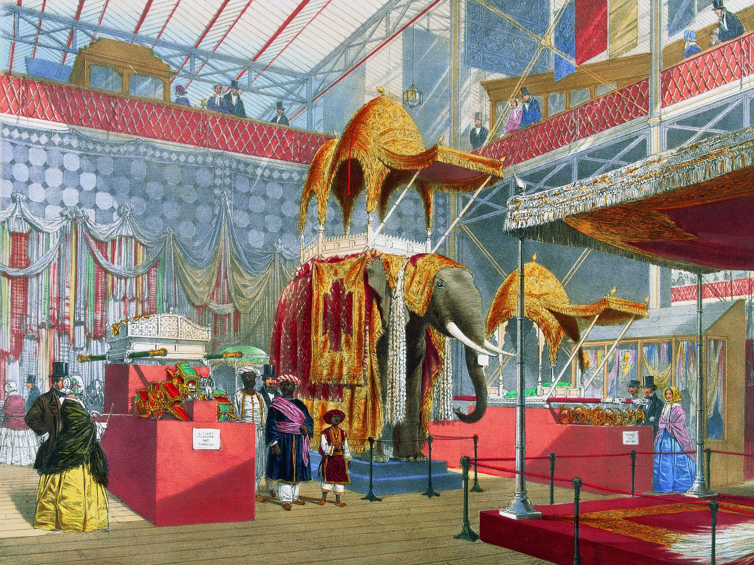
Wonders from around
the world...

Slide 5
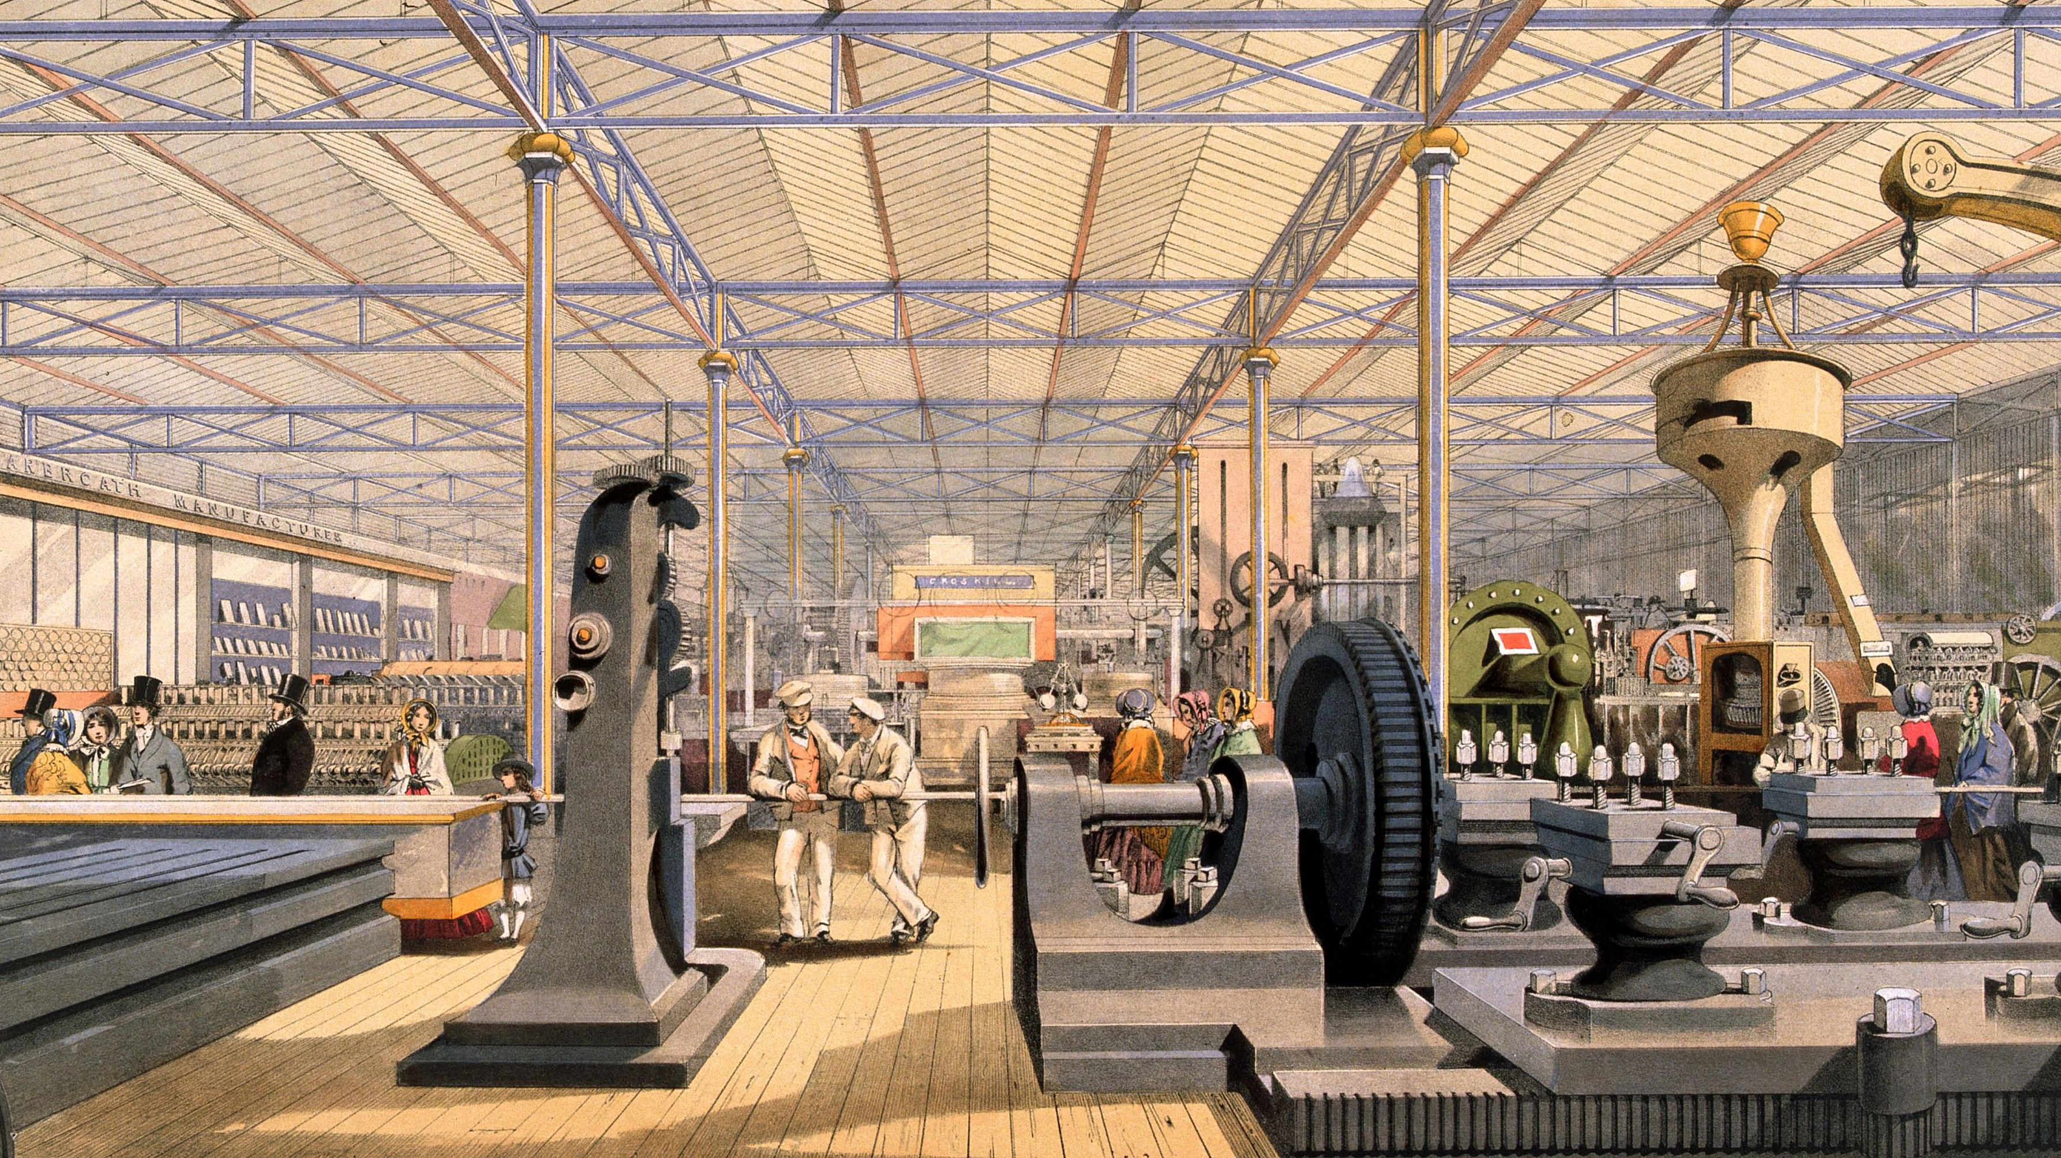
But the greatest wonders were the new technologies....

Slide 6
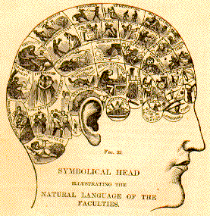
A virtual craze for phrenology which offered hope
To gain certainty in uncertain times...
Def. phrenology: a science that was primarily focused on measurements of the human skull, based on the concept that the brain is the organ of the mind, and that certain brain areas have localized, specific functions or modules.
Phrenology claims that the brain is composed of many particular "organs", each one of them related or responsible for a given mental faculty.
Note: it is not a pseudy-science at the time!

Slide 7
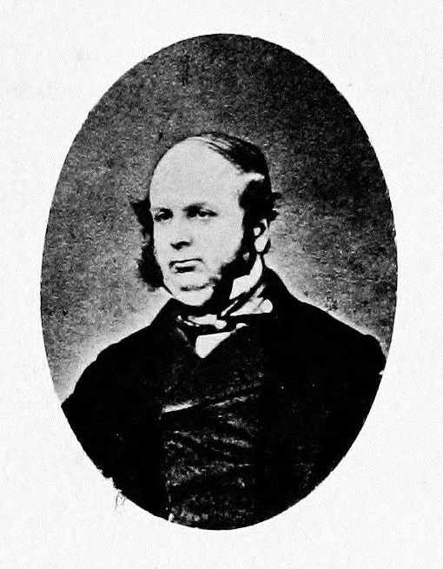
The ‘father’ of scientific history?
The History of Civilization in England (1857)
‘It was provocative, topic, well-written and, what is more, it was shocking.’
(Hesketh, Science of history in Victorian Britain)
Why?
Henry Thomas Buckle (1821-1862)

Slide 8
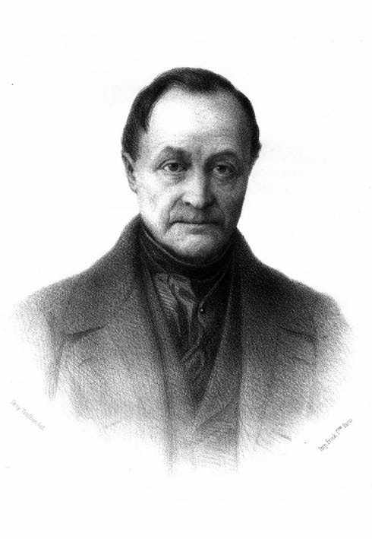
Buckle relies on August Comte, the founder of the positivism
Def. Positivism
Holds that only true and authentic knowledge is knowledge that is based on actual sense experience and its empirical collection. ‘Positive’ knowledge can only derive from affirmation of theories through strict ‘scientific’ method. Any metaphysical speculation is supposed to be avoided (note: difference to historicism)
Important: Positivism also holds that society, like the physical world, operates according to general physical laws. Introspective and intuitive knowledge is rejected, as are metaphysics and theology.
Auguste Comte, 1798-1857

Slide 9
Course in Positive Philosophy (six volumes between 1830-1841) (translated into English in 1853)
The Theological stage refers to explanation by personified deities. During this stage people believe that all the phenomena of nature are the creation of the divine or supernatural. Mankind failed to discover the natural physical causes/laws of various phenomena and hence attributed them to a supernatural or divine power.
The Metaphysical stage is a further development (progressive) extension of the theological stage. Metaphysical stage refers to human explanations by impersonal abstract concepts. People often tried to believe that God is an abstract being. They believe that an abstract power or force guides and determines events in the world. Metaphysical thinking discards belief in a concrete God. The nature of inquiry was legal and rational in nature.
Both stages are childish stages of human development, he argued and needed to be put behind us.
The Positive stage, also known as the scientific, industrial and technological stage. ‘Positive’ refers here to natural scientific explanation based on observation, experiment, and comparison through mathematical methods and statistics. Positive explanations rely upon a distinct method, the scientific empirical and inductive method of the natural sciences —of course in the understanding of Comte at the time -- for their justification.
Positivism is believed to be a purely rational way of looking at the world; as well, it emphasizes observation and classification of data and facts and involves the heavy use of mathematics and statistics.
Aim: the creation of a single scientific method that would bring order to the intellectual chaos surrounding the studies of man and mankind

Slide 10
Buckle was shocking because he left no room for God or human free-will
‘I have been long convinced that the progress of every people is regulated by principles – or as they are called, Laws – as regular and as certain as those which govern the physical world. To discover those laws is the object of my work.
With a view to this, I propose to take a general survey of the moral, intellectual, and legislative peculiarities of the great countries of Europe, and I hope to point out the circumstances under which those peculiarities have risen. This will lead to a perception of certain relationships between the various stages through which each people have progressively passed.
Of these general relations, I intend to make a particular application; and by, a careful analysis of England, show how they have regulated our civilisation, and how the successive and apparently the arbitrary forms of our opinions, our literature, our laws, and our manners, have naturally grown out of their antecedents.’

Slide 11
Belief in evolution (but not Darwin’s version as it is only published in 1857
Follower of the geologist Charles Lyell who argued that:
geological change as the steady accumulation of minute changes over enormously long spans of time
Note: Darwin too takes these ideas from Lyell (therefore he does not ‘discover’ evolution; the concept of evolution is widespread at the time already when he takes it up in concept which is his Origin of Species (1859)

Slide 12
England on the right way to a ‘positivist’ stage of cilivilization but still lots of obstacles for ‘positivist history writing’ according to Buckle:
‘Instead of telling us those things which alone have value, - instead of giving us information respecting the progress of knowledge, and the way in which making has been affected by the diffusion of that knowledge, -- instead of these things, the vast majority of historians fill their works with the most trifling and miserable details: personal anecdotes of kings and courts; interminable relations of what was said by one of the ministers, and what is thought by another; and, what is worse than all, long accounts of campaigns battles and sieges, very interesting to those engages in them, but to us utterly useless, because they neither furnish new truths, nor do they supply the means by which new truths will be discovered.’
‘Usefulness’ of history for Buckles lies in its usefulness and application to the present; history is to be used to reach the ‘positive stage’
Note: Ranke and his followers insist on exploring each period in and for itself

Slide 13
Buckle claims not be interested in individual action but ‘the masses’ (but clearly not a Marxian sense!)
Traces development over a very long time; individual and human life in correspondence
with natural development and its laws
Less interested in events, ‘great men’ and their actions but in the ‘average man’.
(great men’: ‘tools by which that work was done which the force and accumulation of preceding circumstances had determined should be done. They were good instruments; sharp and serviceable instruments but nothing more.’
Heavy use of statistics to get at the ‘average man’ and to overcome the focus of the ‘unique individual’
Statistics: a branch of mathematics dealing with data collection, organization, analysis, interpretation and presentation. Originates in the seventeenth century.
Note: probability theory -- the measure of the likelihood that an event will occur -- is developed in late 18th/early 19th century and offers new possibilities for data processing and prediction. Heavily use of probability theory in risk assessment and modelling of everyday life.

Slide 14
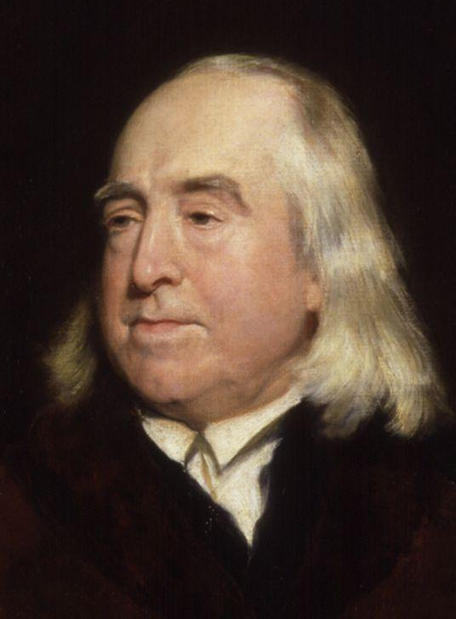
Buckel’s ‘Friends’
Moral philosophy of utilitarianism
Principle:
‘It is the greatest happiness of the greatest number that is the measure of right and wrong’
‘Nature has placed mankind under the governance of two sovereign masters, pain and pleasure. It is for them alone to point out what we ought to do, as well as to determine what we shall do. On the one hand the standard of right and wrong, on the other the chain of causes and effects, are fastened to their throne. They govern us in all we do, in all we say, in all we think ..’
(The Principles of Morals and Legislation)
The central concept of utilitarian morality is ‘happiness’ and it makes utilitarian philosophy a form of hedonism.
Def.: Hedonism is a school of thought that argues that the pursuit of pleasure is the primary or most important goals of human life.
Note: For Bentham ‘happiness’ is identical with ‘utility’ -- he defines as the increase of pleasure (happiness) and avoidance of pain.
Jeremy Bentham 1748 – 1832

Slide 15
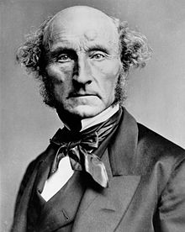
Raised by his father James Mill and Bentham as the first true
utilitarian human being – nervous breakdown at 20!
Critiques Bentham but remains faithful to the overall system of utilitarianism
One the most influential thinkers in the history of liberalism, he contributed widely to social theory, political theory, and political economy. Mill's conception of liberty justified the freedom of the individual in opposition to unlimited state and social control
Interested in Comte and enthusiastic about Buckle’s history on the basis of
purely ‘scientific principles’ – huge debates over the ‘inductive method’
A System of Logic (1843)
The Principles of Political Economy: with some of their Applications to
Social Philosophy (1848)
On Liberty (1859)
John Stuart Mill, 1806 – 1873

Slide 16
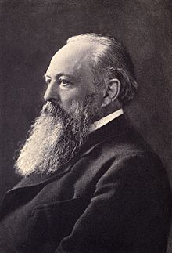
Buckle’s Opponents: British Rankean historians
position: impossible to generalise man’s actions -- which Acton they believed, was brought about by man’s free will -- to a singular physical law. (against the use of statistics in history writing
Rejection of positivism:
‘Theory invented) ....by under-educated, or half-educated men, adepts in physical sciences, but ignorant of the principles of any other, who insists that all science must have the same method as theirs, and that metaphysical realities must be measures and explained by physical laws.’
Ranke – or what was interpreted as Ranke’s critical theory’ – became the benchmark for
British history writing in the 19th and early 20th century
John Emerich Edward Dalberg-Acton, 1st Baron Acton, 1834 – 1902

Slide 17
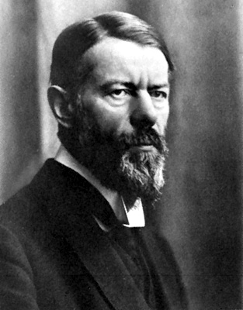
An anti-positivist and anti-utilitarian stance and a critique of Marx: the sociologist Max Weber
One of the founders of sociology – the scientific study of society -- which he defines as the study the ‘togetherness’ of people
The ‘last’ historicist
Max Weber (1864-1920)

Slide 18
Late 19th century definition of ‘objectivity’, spreading at the time of Weber:
‘Objective’ accounts are attempts to capture the nature of the object studied in a way that does not depend on any features of the particular subject who studies it. An objective account is...one, which could ideally be accepted by any subject, because it does not draw on any assumptions, prejudices, or values of particular subjects’.
Stephen Gaukroger, in: N. J. Smelse and P. B. Baltes, P. B. (eds.) International Encyclopedia of the Social and Behavioral Sciences (Oxford, 2001), pp. 10785.
Reminder: That is NOT how Ranke understood ‘objectivity’; at his time – and the same is true for
Buckle ---‘objectivity’ did not mean that the historians could not take a position; objective or impartial
Means for Ranke to represent all possible views in a given period.

Slide 19
‘
There is no absolutely ‘objective’ scientific analysis of culture... All knowledge of cultural reality... is always knowledge from particular points of view. ... An ‘objective’ analysis of cultural events, which proceeds according to the thesis that the ideal of science is the reduction of empirical reality to "laws," is meaningless... [because]... the knowledge of social laws is not knowledge of social reality but is rather one of the various aids used by our minds for attaining this end.’
(Max Weber, ‘Objectivity’ in Social Science, 1897)
Involves empathetic liaison of the observer with the observed – intuition (note: historicism)
He set against this his sociology of ‘Verstehen’ (understanding)

Slide 20
Ideal-type
A representative figure who stands for a whole social group
(it is not an empirical average)
Term used by Max Weber to denote entities (including types of action, societies, institutions) as constructed `hypothetically’ by an investigator from component elements, with a view to making comparisons and developing theoretical explanations. The elements out of which a `type’ is constructed are either empirically observable or historically recognised. The ideal is not a norm or an average; it is rather a construction that emphasises certain characteristics (of actions, societies, institutions, persons) that can be combined to form a coherent whole, or description.
(E. Shils and H. A. Finch [eds], Max Weber on the Methodology of the Social Sciences, 1947)

Slide 21
Def. rationalisation:
‘…a set of interrelated social processes by which the modern world had been systematically transformed’.
‘The fate of our times is characterised by rationalisation and intellectualisation and, above all, by the
"disenchantment of the world.’

Slide 22
The aim of Protestant Ethics:
….whether and at what points certain ‘elective affinities’ are discernible between particular types of religious beliefs and the ethics of work-a-day life.
By virtue of such affinities the religious movements have influenced the development of material culture, and (an analysis of these affinities) will clarify as far as possible the manner and the general direction (of that influence)…We are interested in ascertaining those psychological impulses which originated in religious belief and the practice of religion, gave direction to the individual’s everyday way of life and prompted to adhere to it’.
Aim is the understand ‘rational capitalism’

