Slide 1
Postcolonial Histories
Professor David Lambert
Historiography (HI323)
10-11am, 19th February 2019

Slide 2
‘Postcolonial’
histories

Slide 3
‘Post-colonial’
histories

Slide 4
‘Postcolonial’
histories

Slide 5
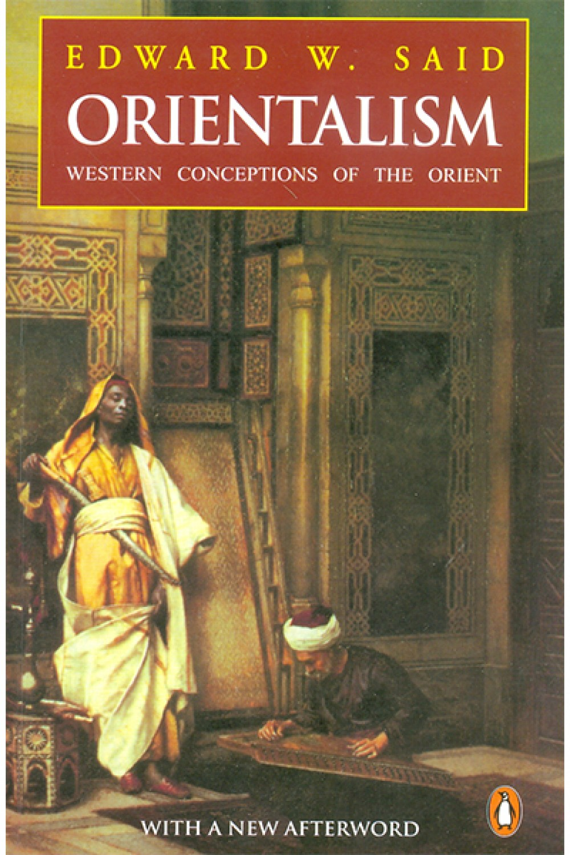
‘the other’
‘othering’
‘Can the subaltern speak?’

Slide 6
Postcolonial theory
Postcolonial studies
Postcolonialism

Slide 7
Defining postcolonialism
‘[I]t is an insight or a perspective that is extraordinarily fertile simply because it provides a point of view from outside the modernizing perspective of Enlightenment rationality that has fostered so much of our modern historical thinking. In other words, it is a perspective which views many of the rationalizing and modernizing forces in the world not only as trends that develop naturally from our historical conditions of existence, but just as much as a powerful ideology or worldview of dominant Westernizing forces in the world, whether in the West or in the new nation-states of the non-West’ (Duara, 2002, p. 417).

Slide 8
Defining postcolonialism
‘Historiographically, the postcolonial perspective has sought to deconstruct the grand narratives of imperial and national histories deriving often from an Enlightenment vision of a progressive history, in order to reveal or point to suppressed, defeated, or negated histories and stories’ (Duara, 2002, p. 417).

Slide 9
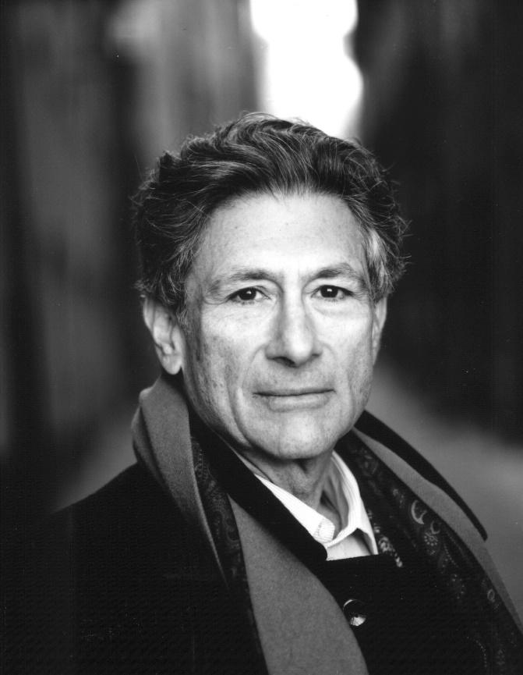
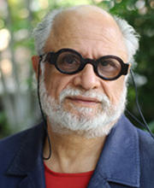

The ‘holy trinity’ of postcolonialism
Edward Said
Homi K. Bhabha
Gayatri Chakravorty Spivak

Slide 10
Lecture structure
History encounters postcolonialism
Pathways of influence
Opposition
Impact in (British imperial) history
Identity, culture and power
Imaginative geographies
Deconstructing the nation
Colonial networks and imperial careering
Conclusions

Slide 11

History encounters postcolonialism

Slide 12
History encounters postcolonialism
‘For more than a few historians, the advent of postcolonial studies, with its strange language and theoretical promiscuity, appeared akin to an invasion by a barbarian horde. These historians manned the barricades, determined to defend their discipline against the alien invaders. Some patrol the parapets still, though their redoubt is now much diminished’ (Kennedy, 2013, p. 1).

Slide 13
History encounters postcolonialism
‘Postcolonialism has managed over time to infiltrate the borders of history and mix with the natives. While important pockets of resistance and points of disagreement remain, the discipline’s stance toward this alien interloper has for the most part shifted from suspicion and antagonism to tolerance and even fraternization’ (Kennedy, 2013, p. 1).

Slide 14
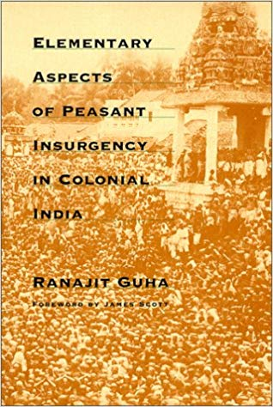
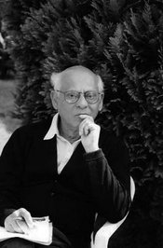
Subaltern Studies group

Slide 15
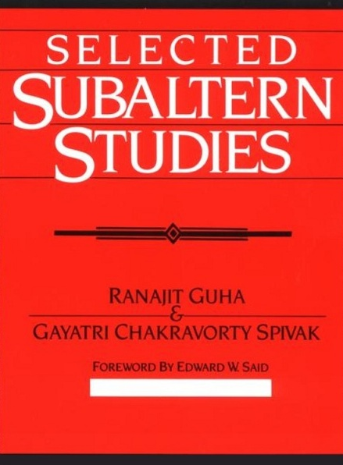
Subaltern Studies group

Slide 16
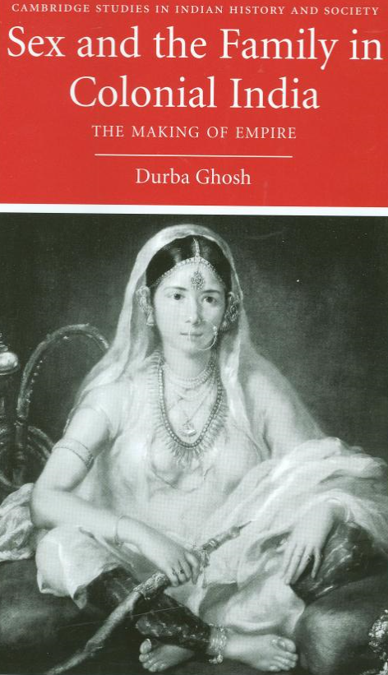

Feminist historians of empire

Slide 17
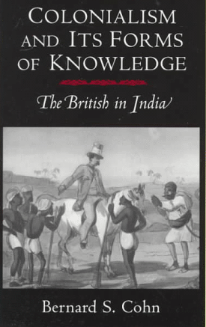
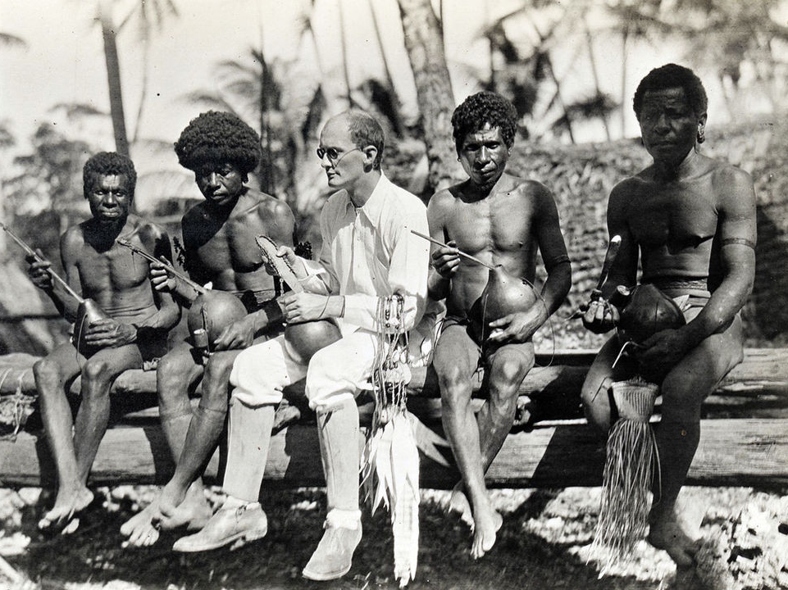
Other disciplines: historical anthropology

Slide 18
History encounters postcolonialism

Slide 19
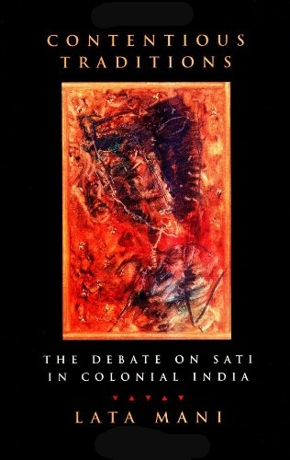

1) Identity, culture and power

Slide 20
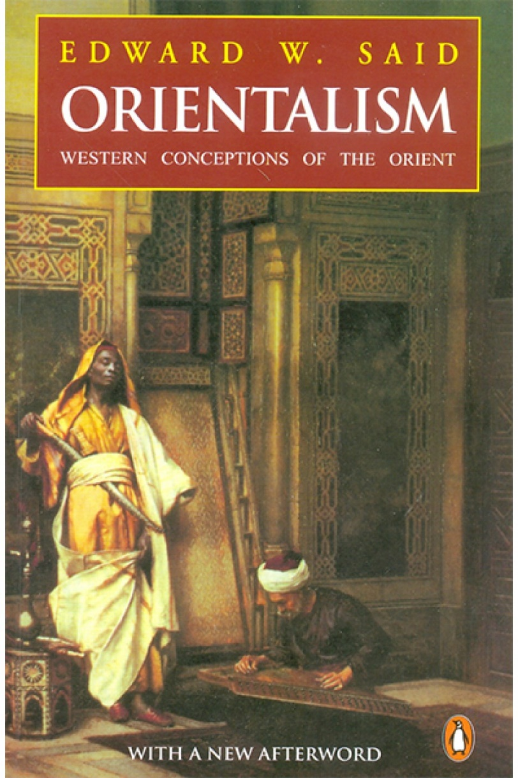
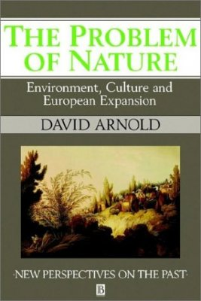
2) Imaginative geographies

Slide 21
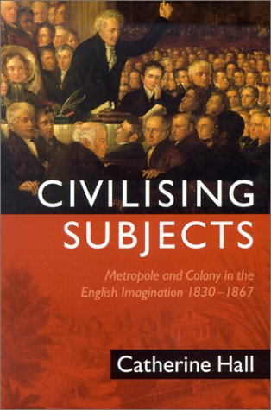
3) Deconstructing the nation
Place ‘metropole and colony in a single analytical field’ (Stoler and Cooper, 1997, p. 4).
Focus on transnational historical phenomenon
Use of metaphors of ‘web’ and ‘network’
Characteristic of the ‘New Imperial History’

Slide 22
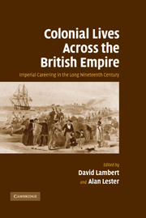
‘New Imperial History’
Co-edited with Alan Lester (Professor of Historical Geography, University of Sussex)
Part of the ‘New Imperial History’
12 biographical studies of trans-imperial careers

Slide 23
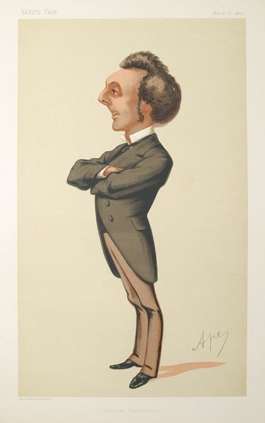
Sir John Pope Hennessy (1834-91)

Slide 24
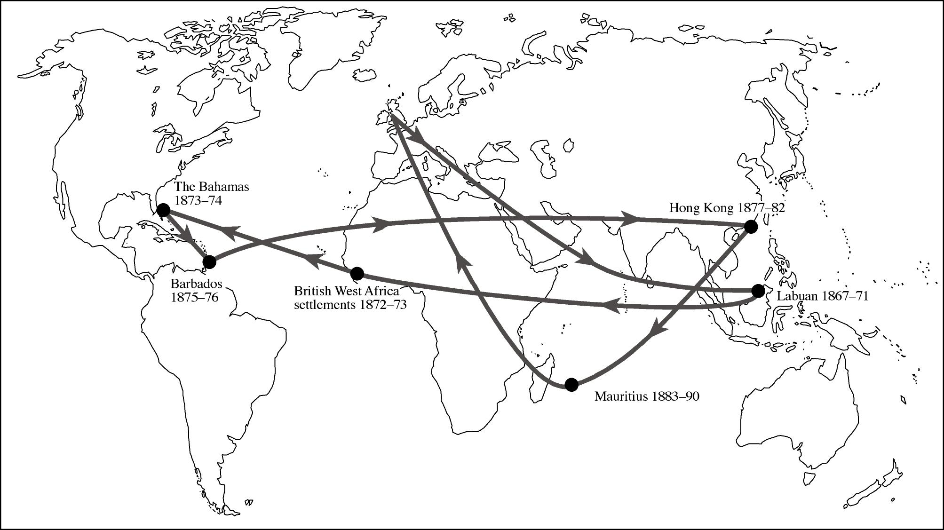

Slide 25
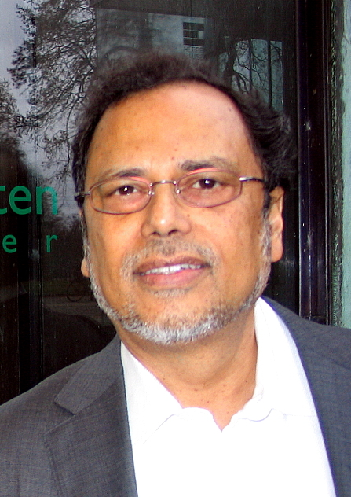
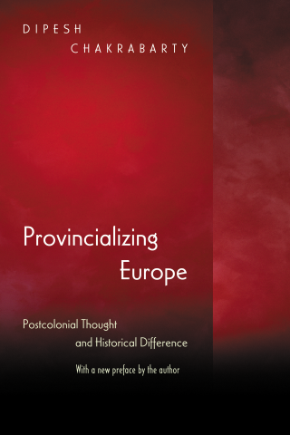
Postcolonializing history

Slide 26
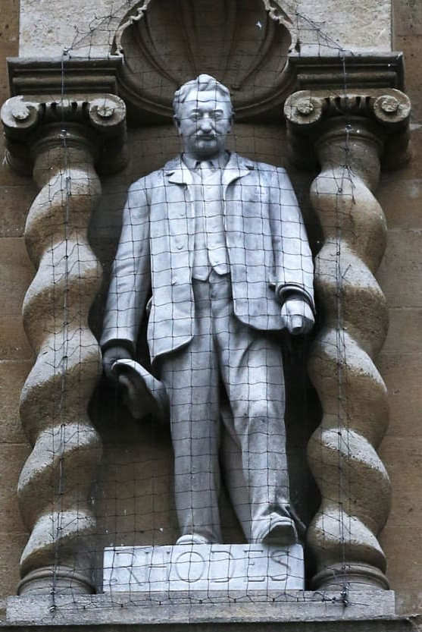
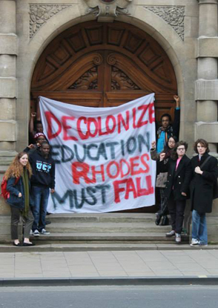
Decolonizing the curriculum

Slide 27
Postcolonial Histories
Professor David Lambert
Historiography (HI323)
10-11am, 19th February 2019

