Slide 1
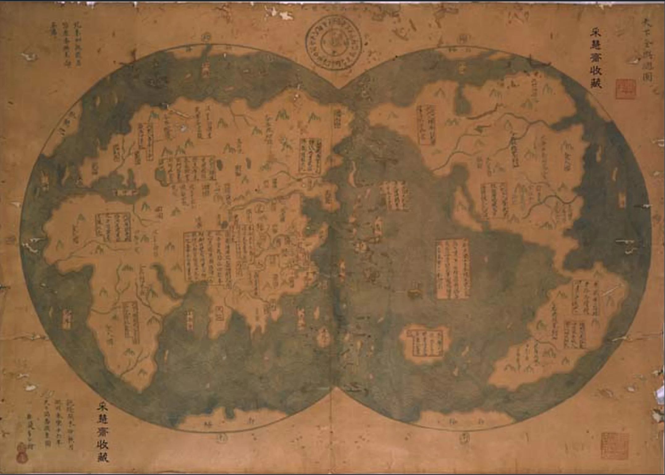
Theory Applied IV: Global History
Anne Gerritsen

Slide 2


Slide 3
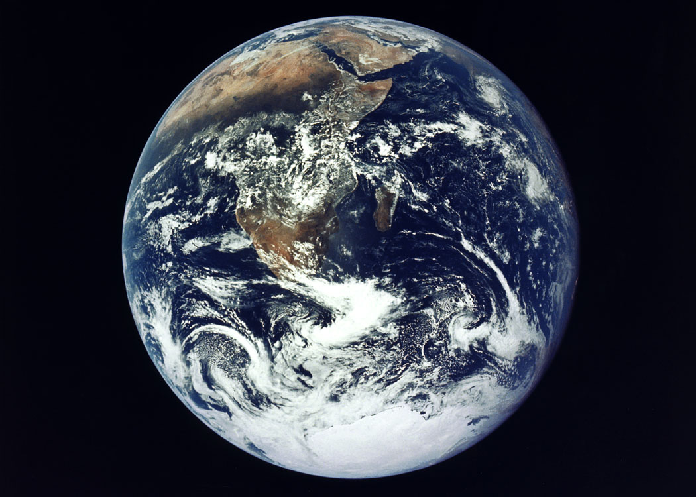
Lecture outline
The history of global history
World civilizations
World history
Economic history goes global
Global history
Ways of doing global history
The entire globe as the unit
Global history as comparative history
Global history as the history of connections
Global history as histories of space
Micro-global history
Critiques of the approach
Sources?
Agency?
History of globalization/endorsement of globalization
Strengths of global history
Challenge to the nation state
History of migration/history of environment

Slide 4
Lecture outline
The history of global history
World civilizations
World history
Economic history goes global
Global history
Ways of doing global history
The entire globe as the unit
Global history as comparative history
Global history as the history of connections
Global history as histories of space
Micro-global history
Critiques of the approach
Sources?
Agency?
History of globalization/endorsement of globalization
Strengths of global history
Challenge to the nation state
History of migration/history of environment

Slide 5
I. The history of global history
The ‘Western Civ’ and ‘World Civ’ model

Slide 6
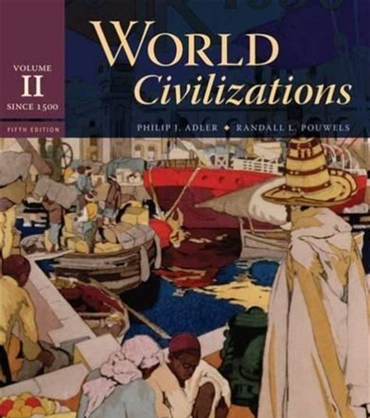
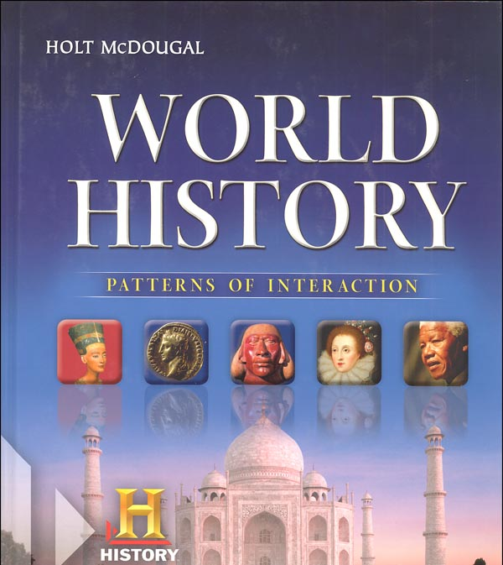
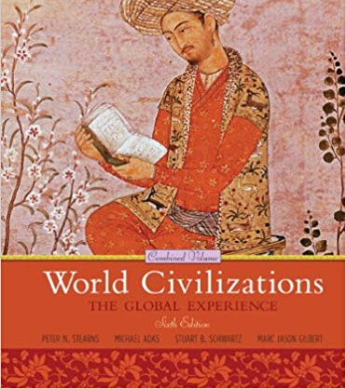
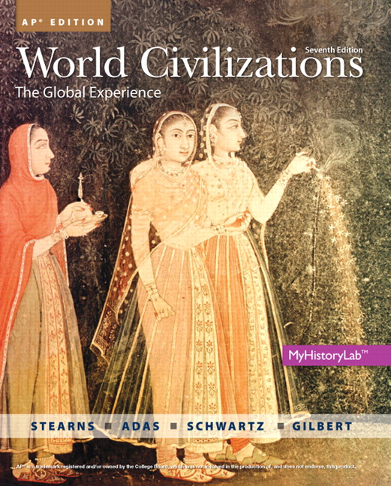
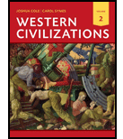
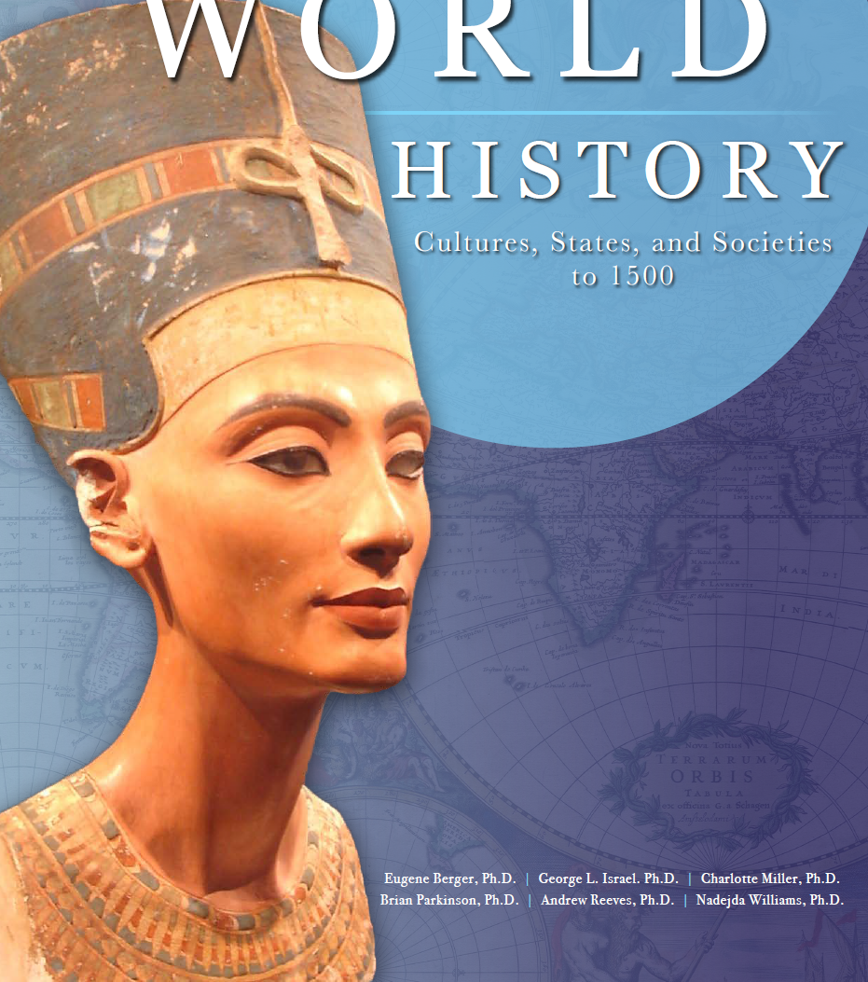

Slide 7
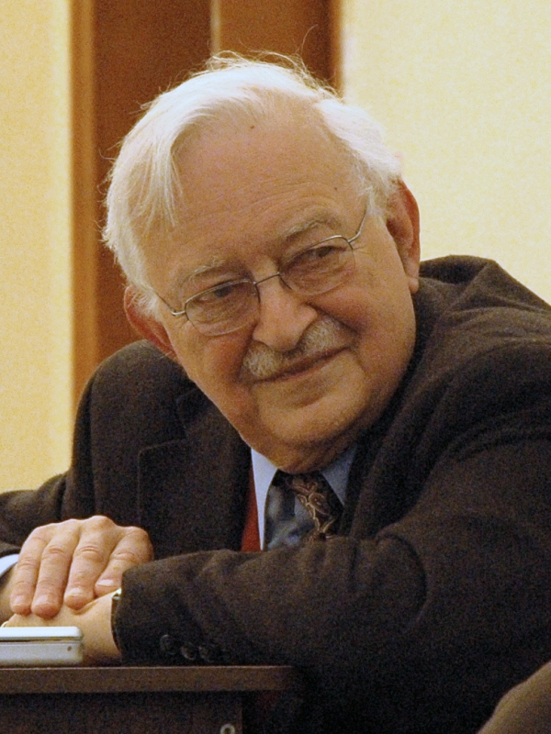
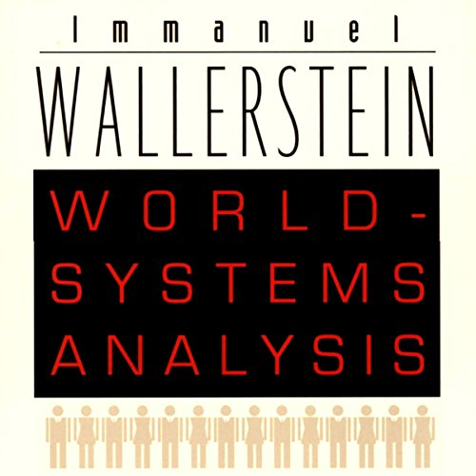
Immanuel Wallerstein (b. 1930), sociologist
Questions why there is such profound inequality in the world

Slide 8
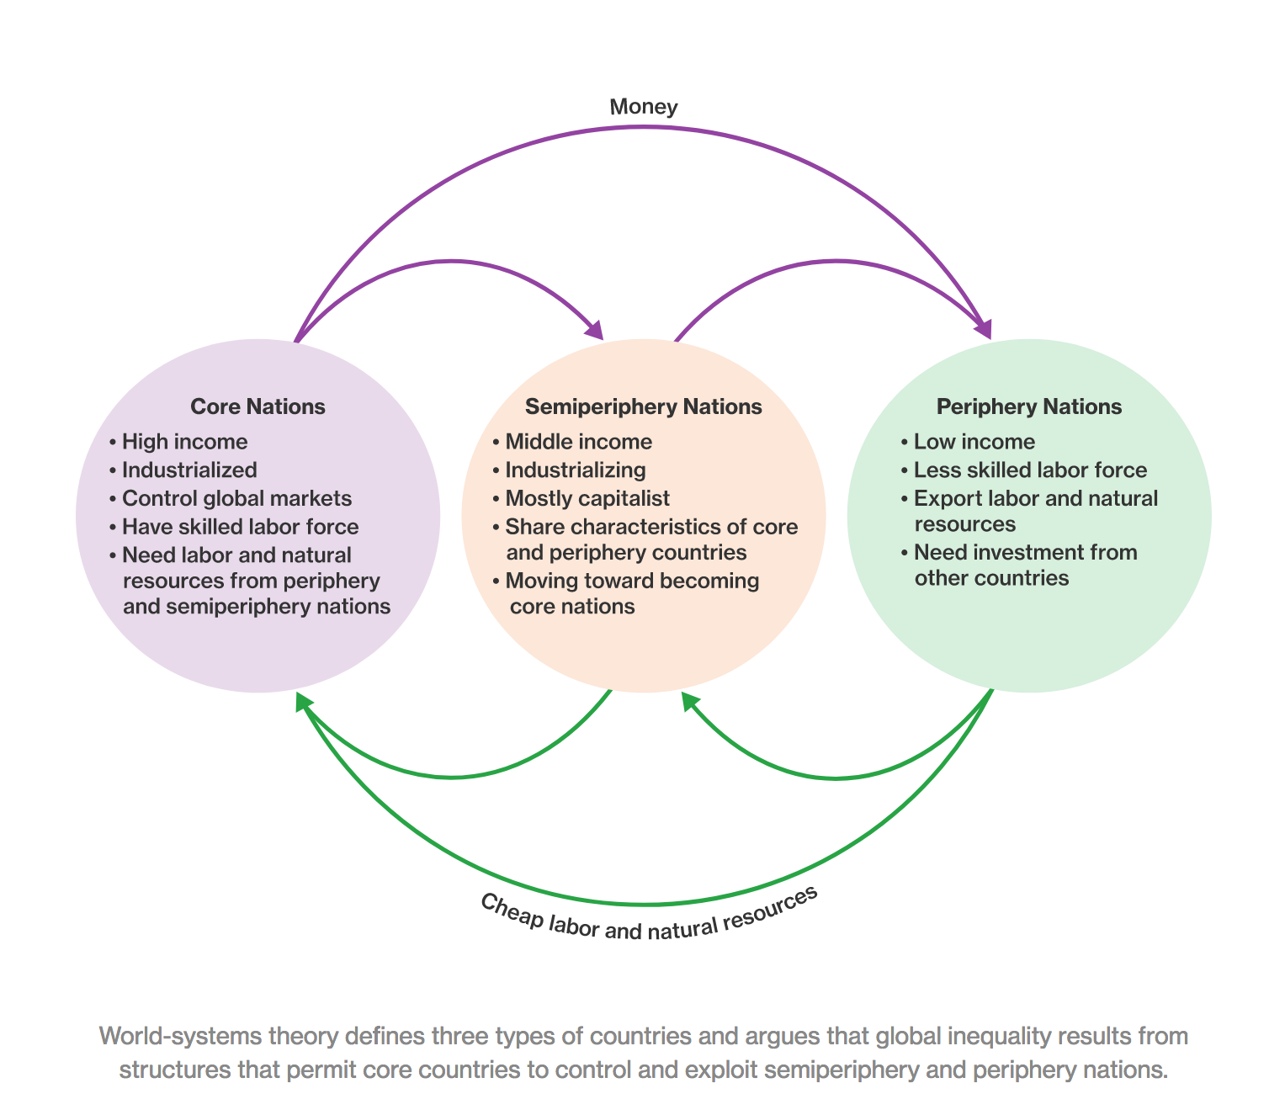
https://www.coursehero.com/sg/introduction-to-sociology/world-systems-theory/

Slide 9
His most important work, The Modern World-System, has appeared in four volumes since 1974. In it, Wallerstein draws on several intellectual influences:
Karl Marx
emphasizes underlying economic factors and their dominance over ideological factors in global politics
dichotomy between capital and labour.
BUT: He also criticizes the traditional Marxian view of world economic development through stages such as feudalism and capitalism, and its belief in the accumulation of capital, dialectics, and more;
Dependency theory, most obviously its concepts of "core" and "periphery".
Source: Wikipedia. https://en.wikipedia.org/wiki/Immanuel_Wallerstein 23/2/19

Slide 10
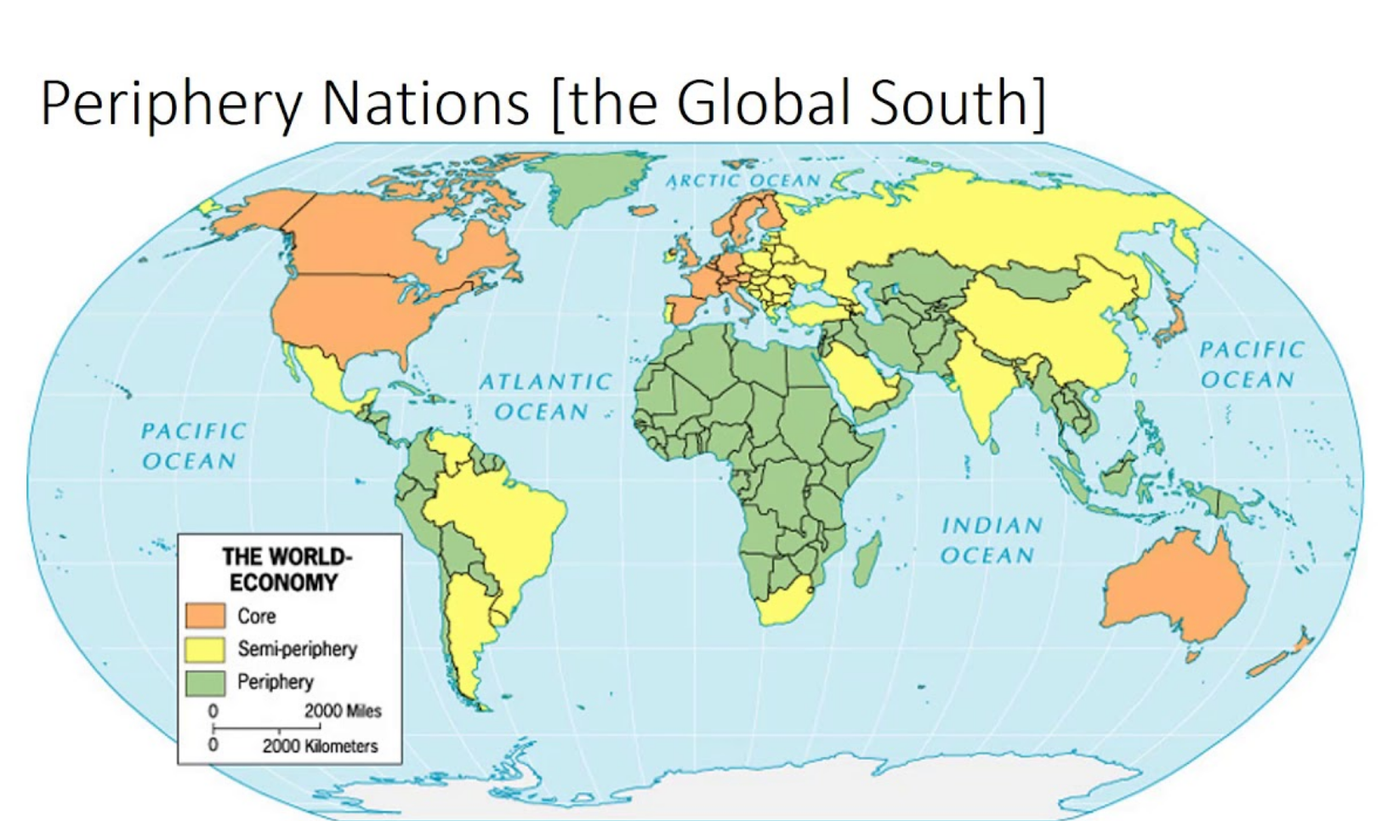

Slide 11
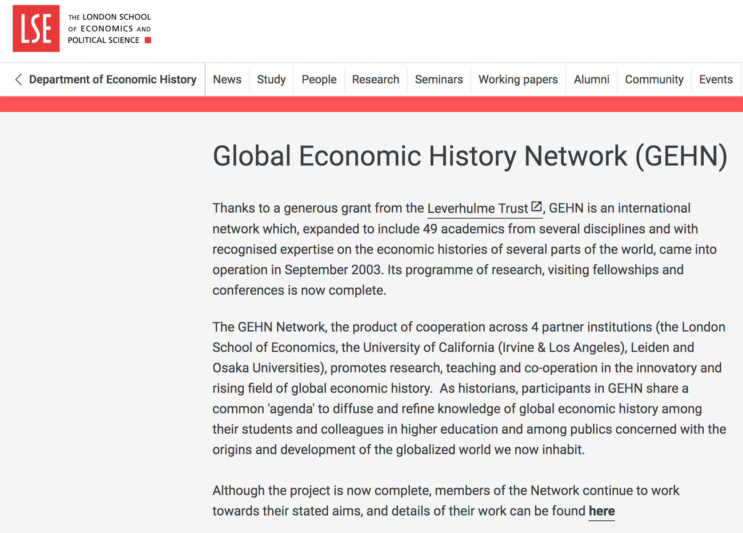
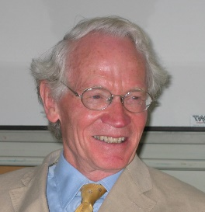
Patrick O’Brien (LSE)
http://www.lse.ac.uk/Economic-History/Research/GEHN/Global-Economic-History-Network-GEHN

Slide 12
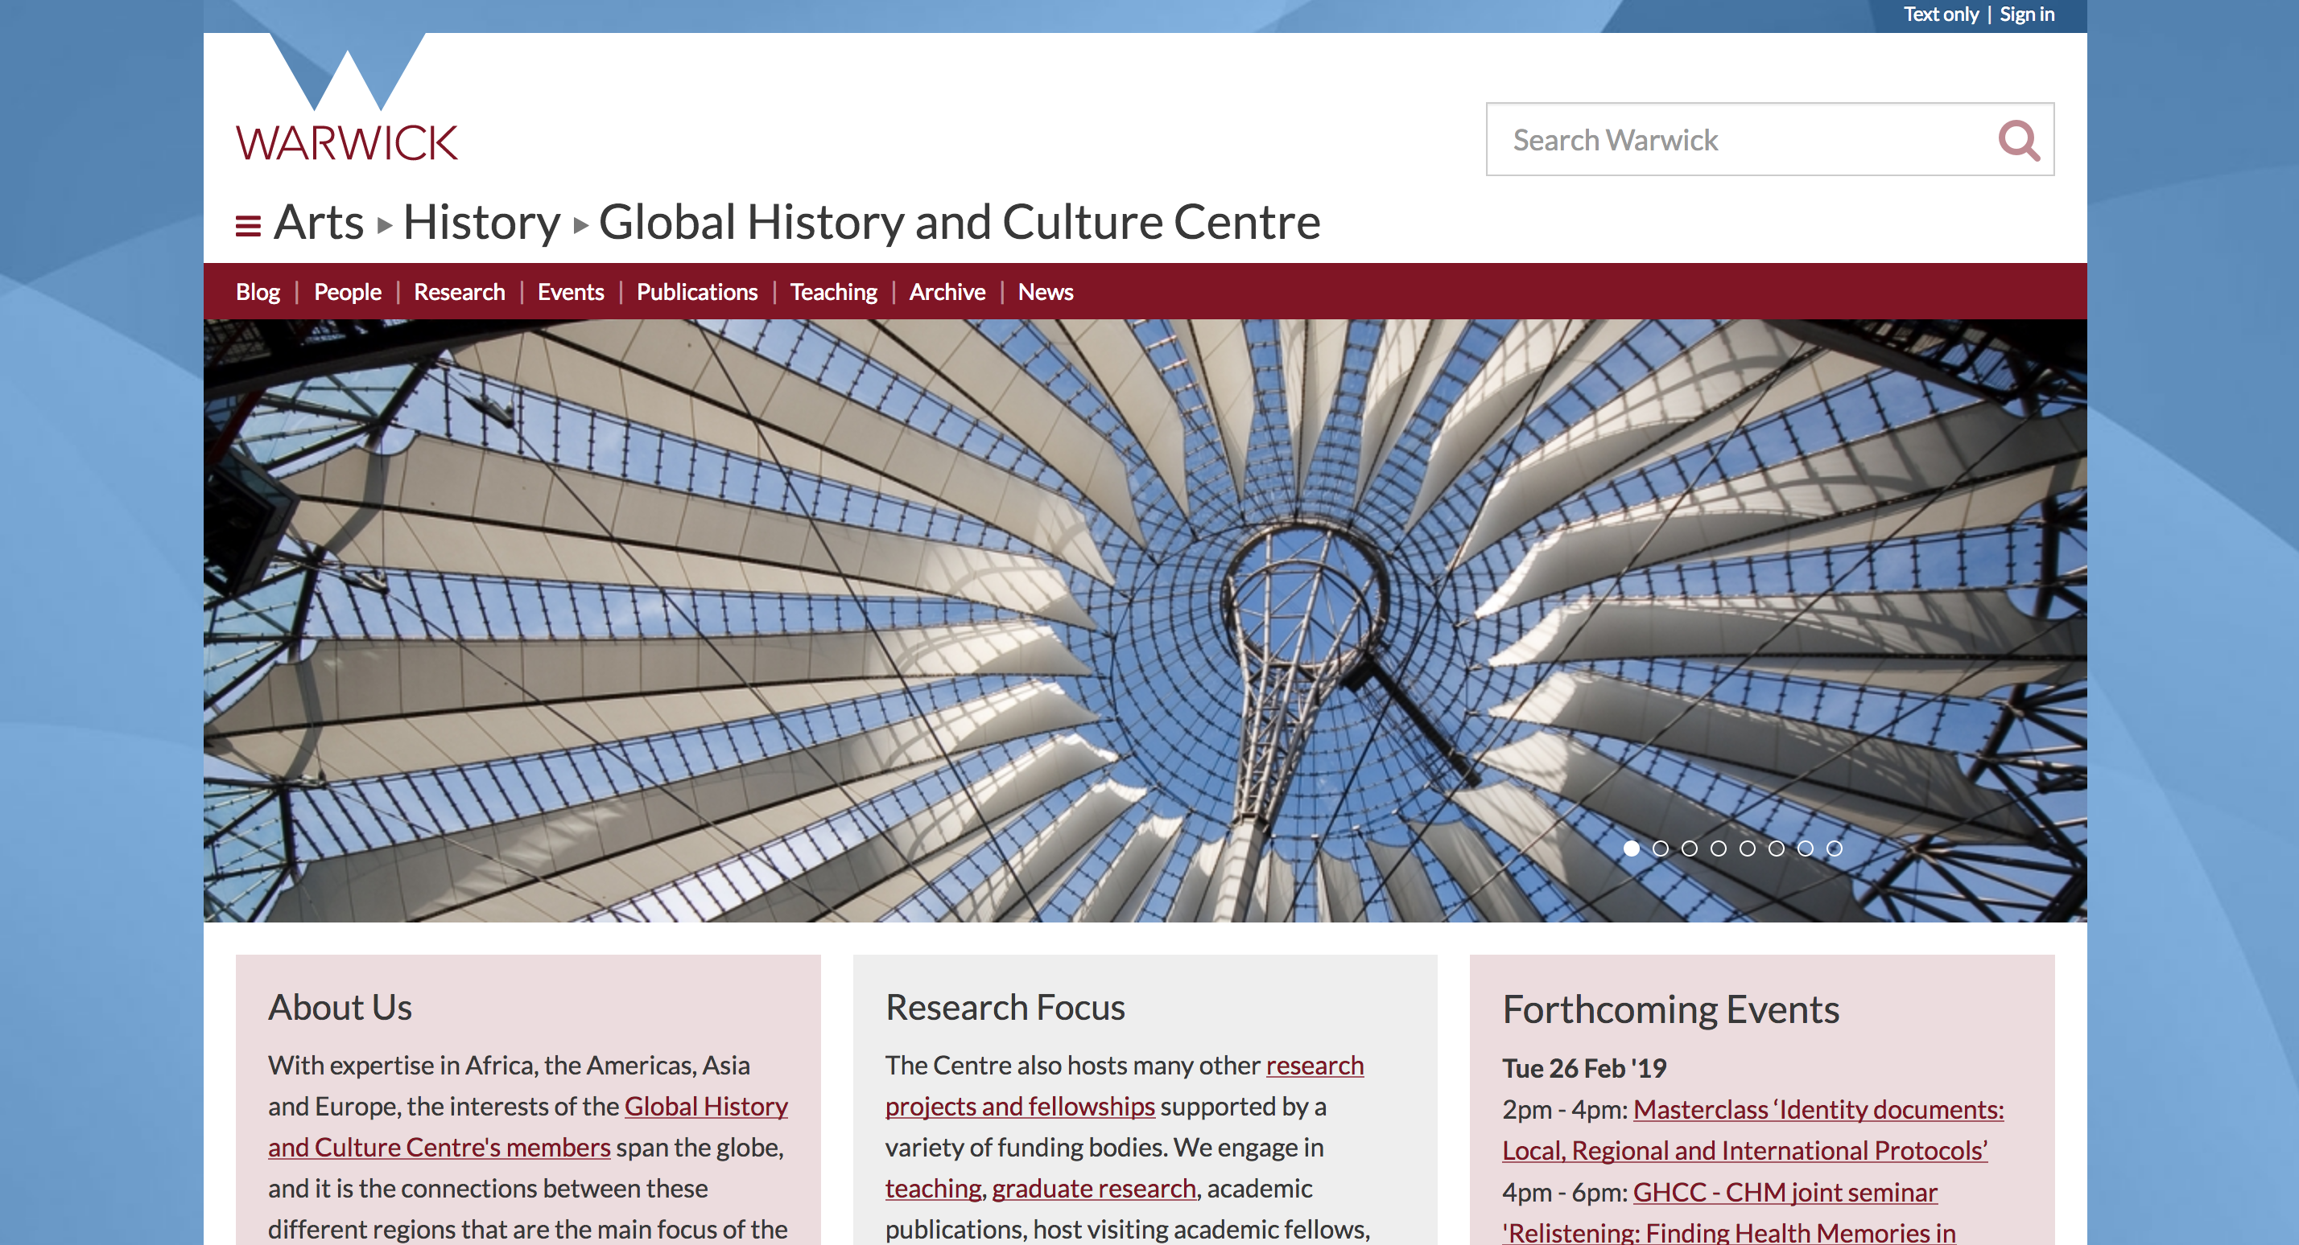
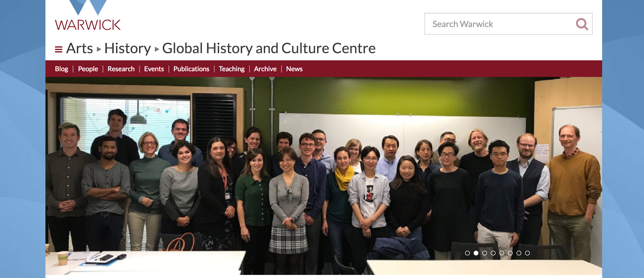

Slide 13
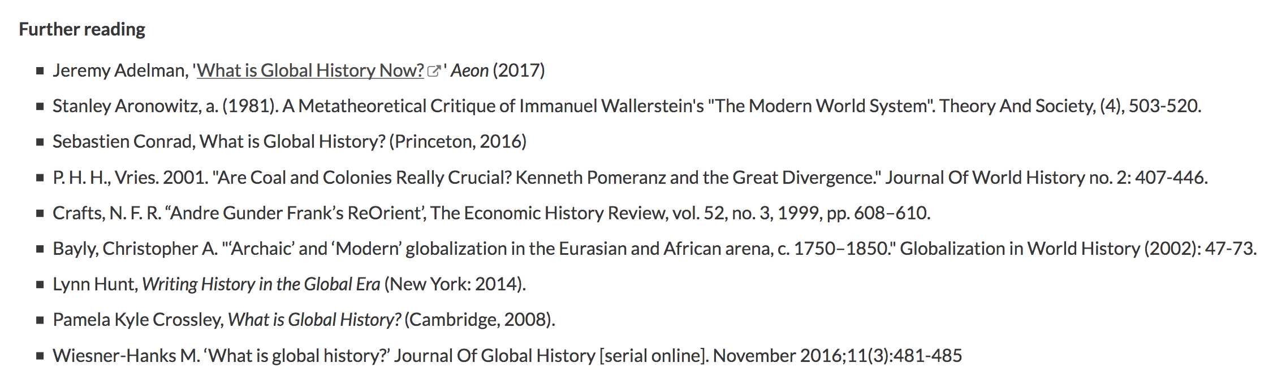
Note how many of the ‘Further readings’ are entitled ‘What is global history’ (4)

Slide 14

What is global history?
History that challenges the dominance of the nation-state narrative;
History that compares or connects different parts of the world;
How can you know about the uniqueness of anything or anywhere without knowing about other things and places?
History that attempt to understand (aspects of) the ways in which people, ideas and things move;
Histories that seek to explain inequalities between different parts of the world as well as their commensurabilities.

Slide 15
Lecture outline
The history of global history
World civilizations
World history
Economic history goes global
Global history
Ways of doing global history
The entire globe as the unit
Global history as comparative history
Global history as the history of connections
Global history as histories of space
Micro-global history
Strengths of global history
Challenge to the nation state
History of migration/history of environment
Critiques of the approach
Sources?
Agency?
History of globalization/endorsement of globalization

Slide 16
Ways of doing global history
The entire globe as the unit
Global history as comparative history
Global history as the history of connections
History of global iterations of the same thing
Global history as histories of space
Micro-global history

Slide 17
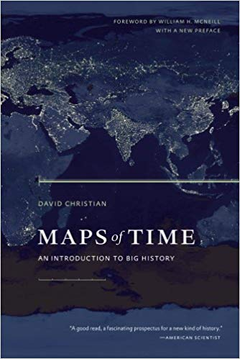
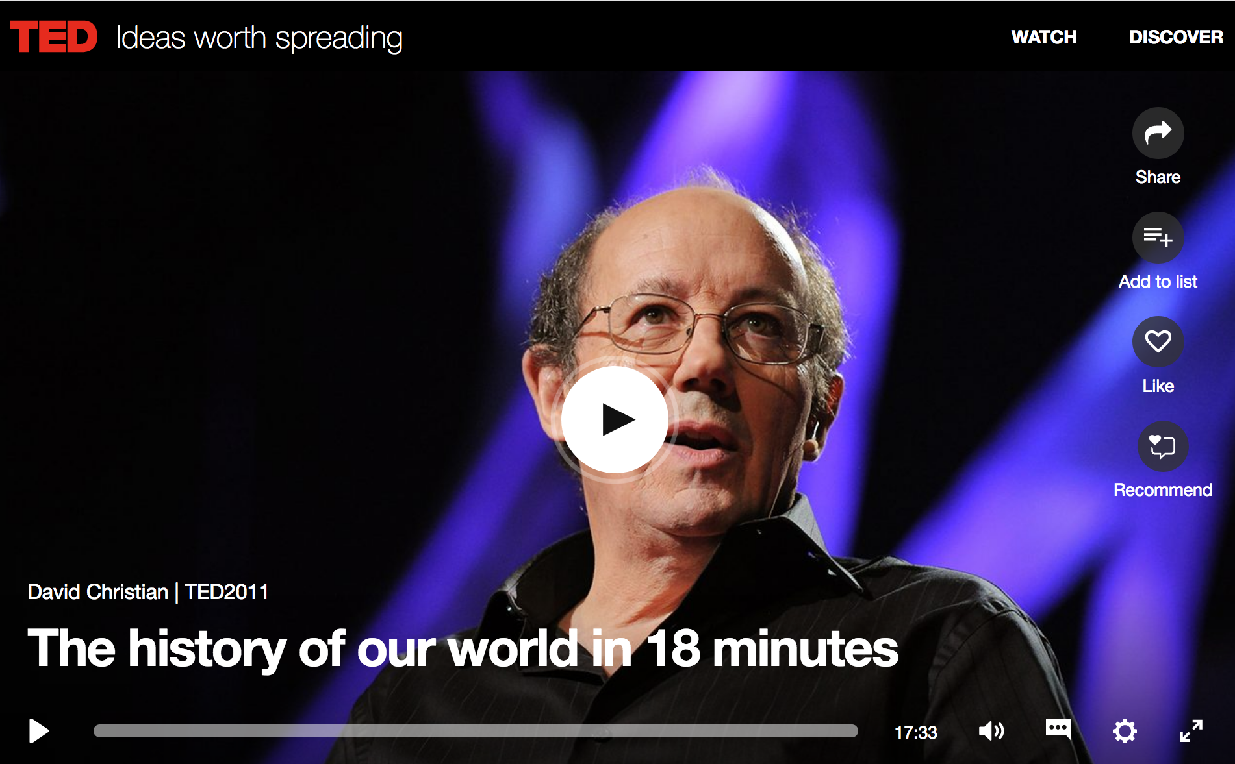
The entire globe as the unit
Maps of Time: An Introduction to Big History, 2005, University of California Press

Slide 18
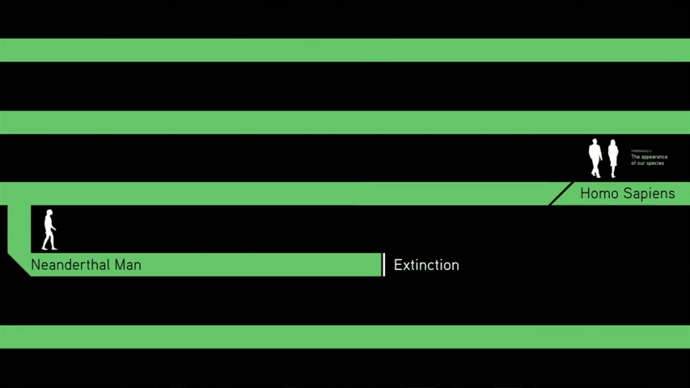
The entire globe as the unit
https://www.ted.com/talks/david_christian_big_history?language=en

Slide 19

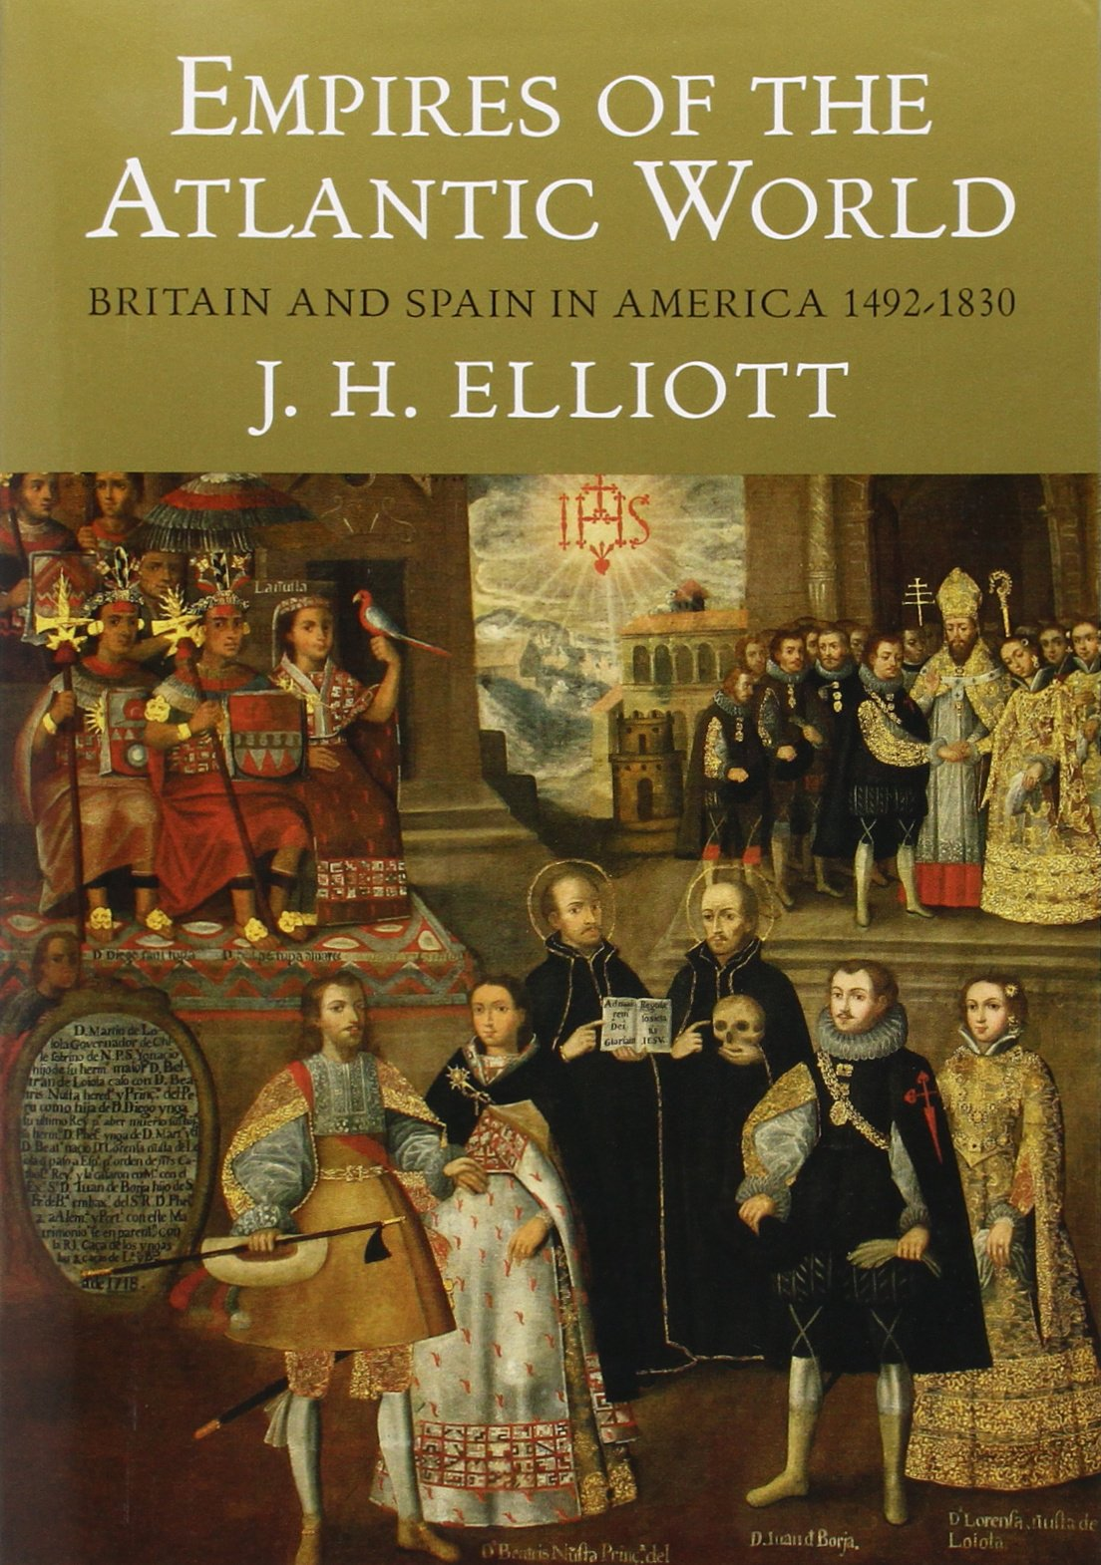
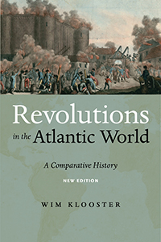
Global history as comparative history

Slide 20
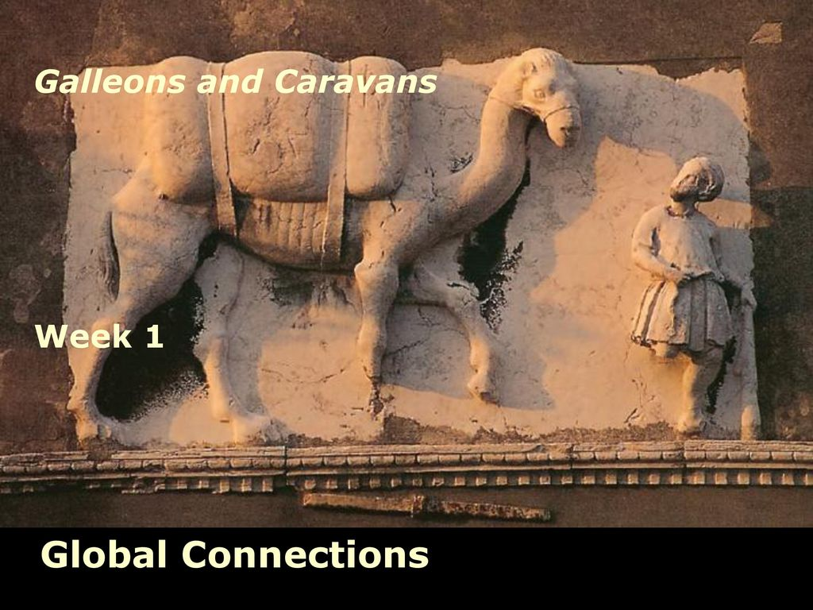
Global history as the history of connections

Slide 21

Iterations of the same thing across the globe
Calvi, G. (2010). Global Trends: Gender Studies in Europe and the US. European History Quarterly, 40(4), 641–655. https://doi.org/10.1177/0265691410376883

Slide 22
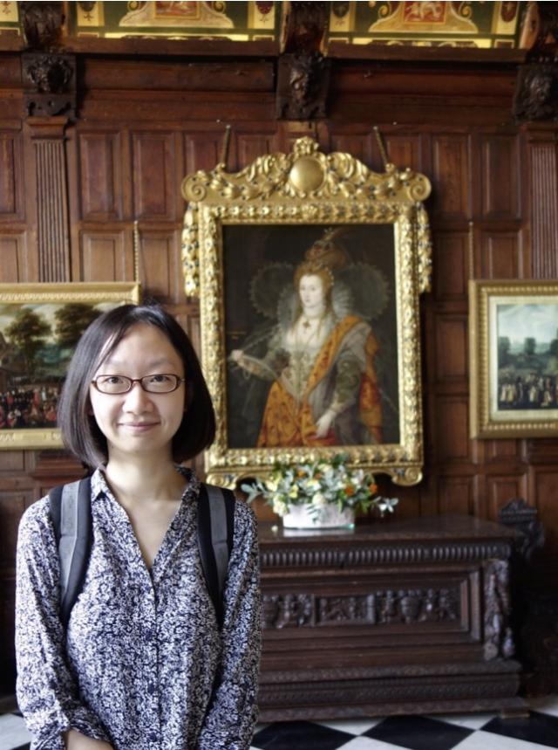
Iterations of the same thing across the globe
National Holidays and Minority Festivals in Canadian Nation-building. PhD thesis, University of Sheffield.

Slide 23
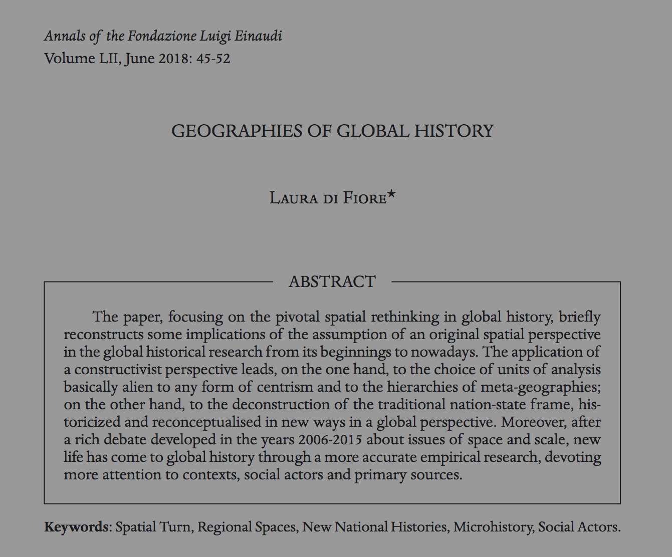
Spatial approach to history

Slide 24
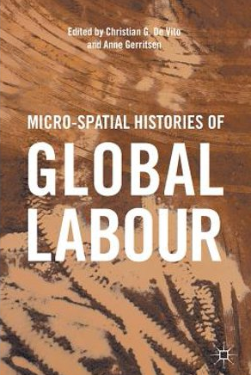
Spatial approach to history
Christian G. De Vito and Anne Gerritsen, eds. Micro-spatial histories of global labour. Springer, 2017.

Slide 25
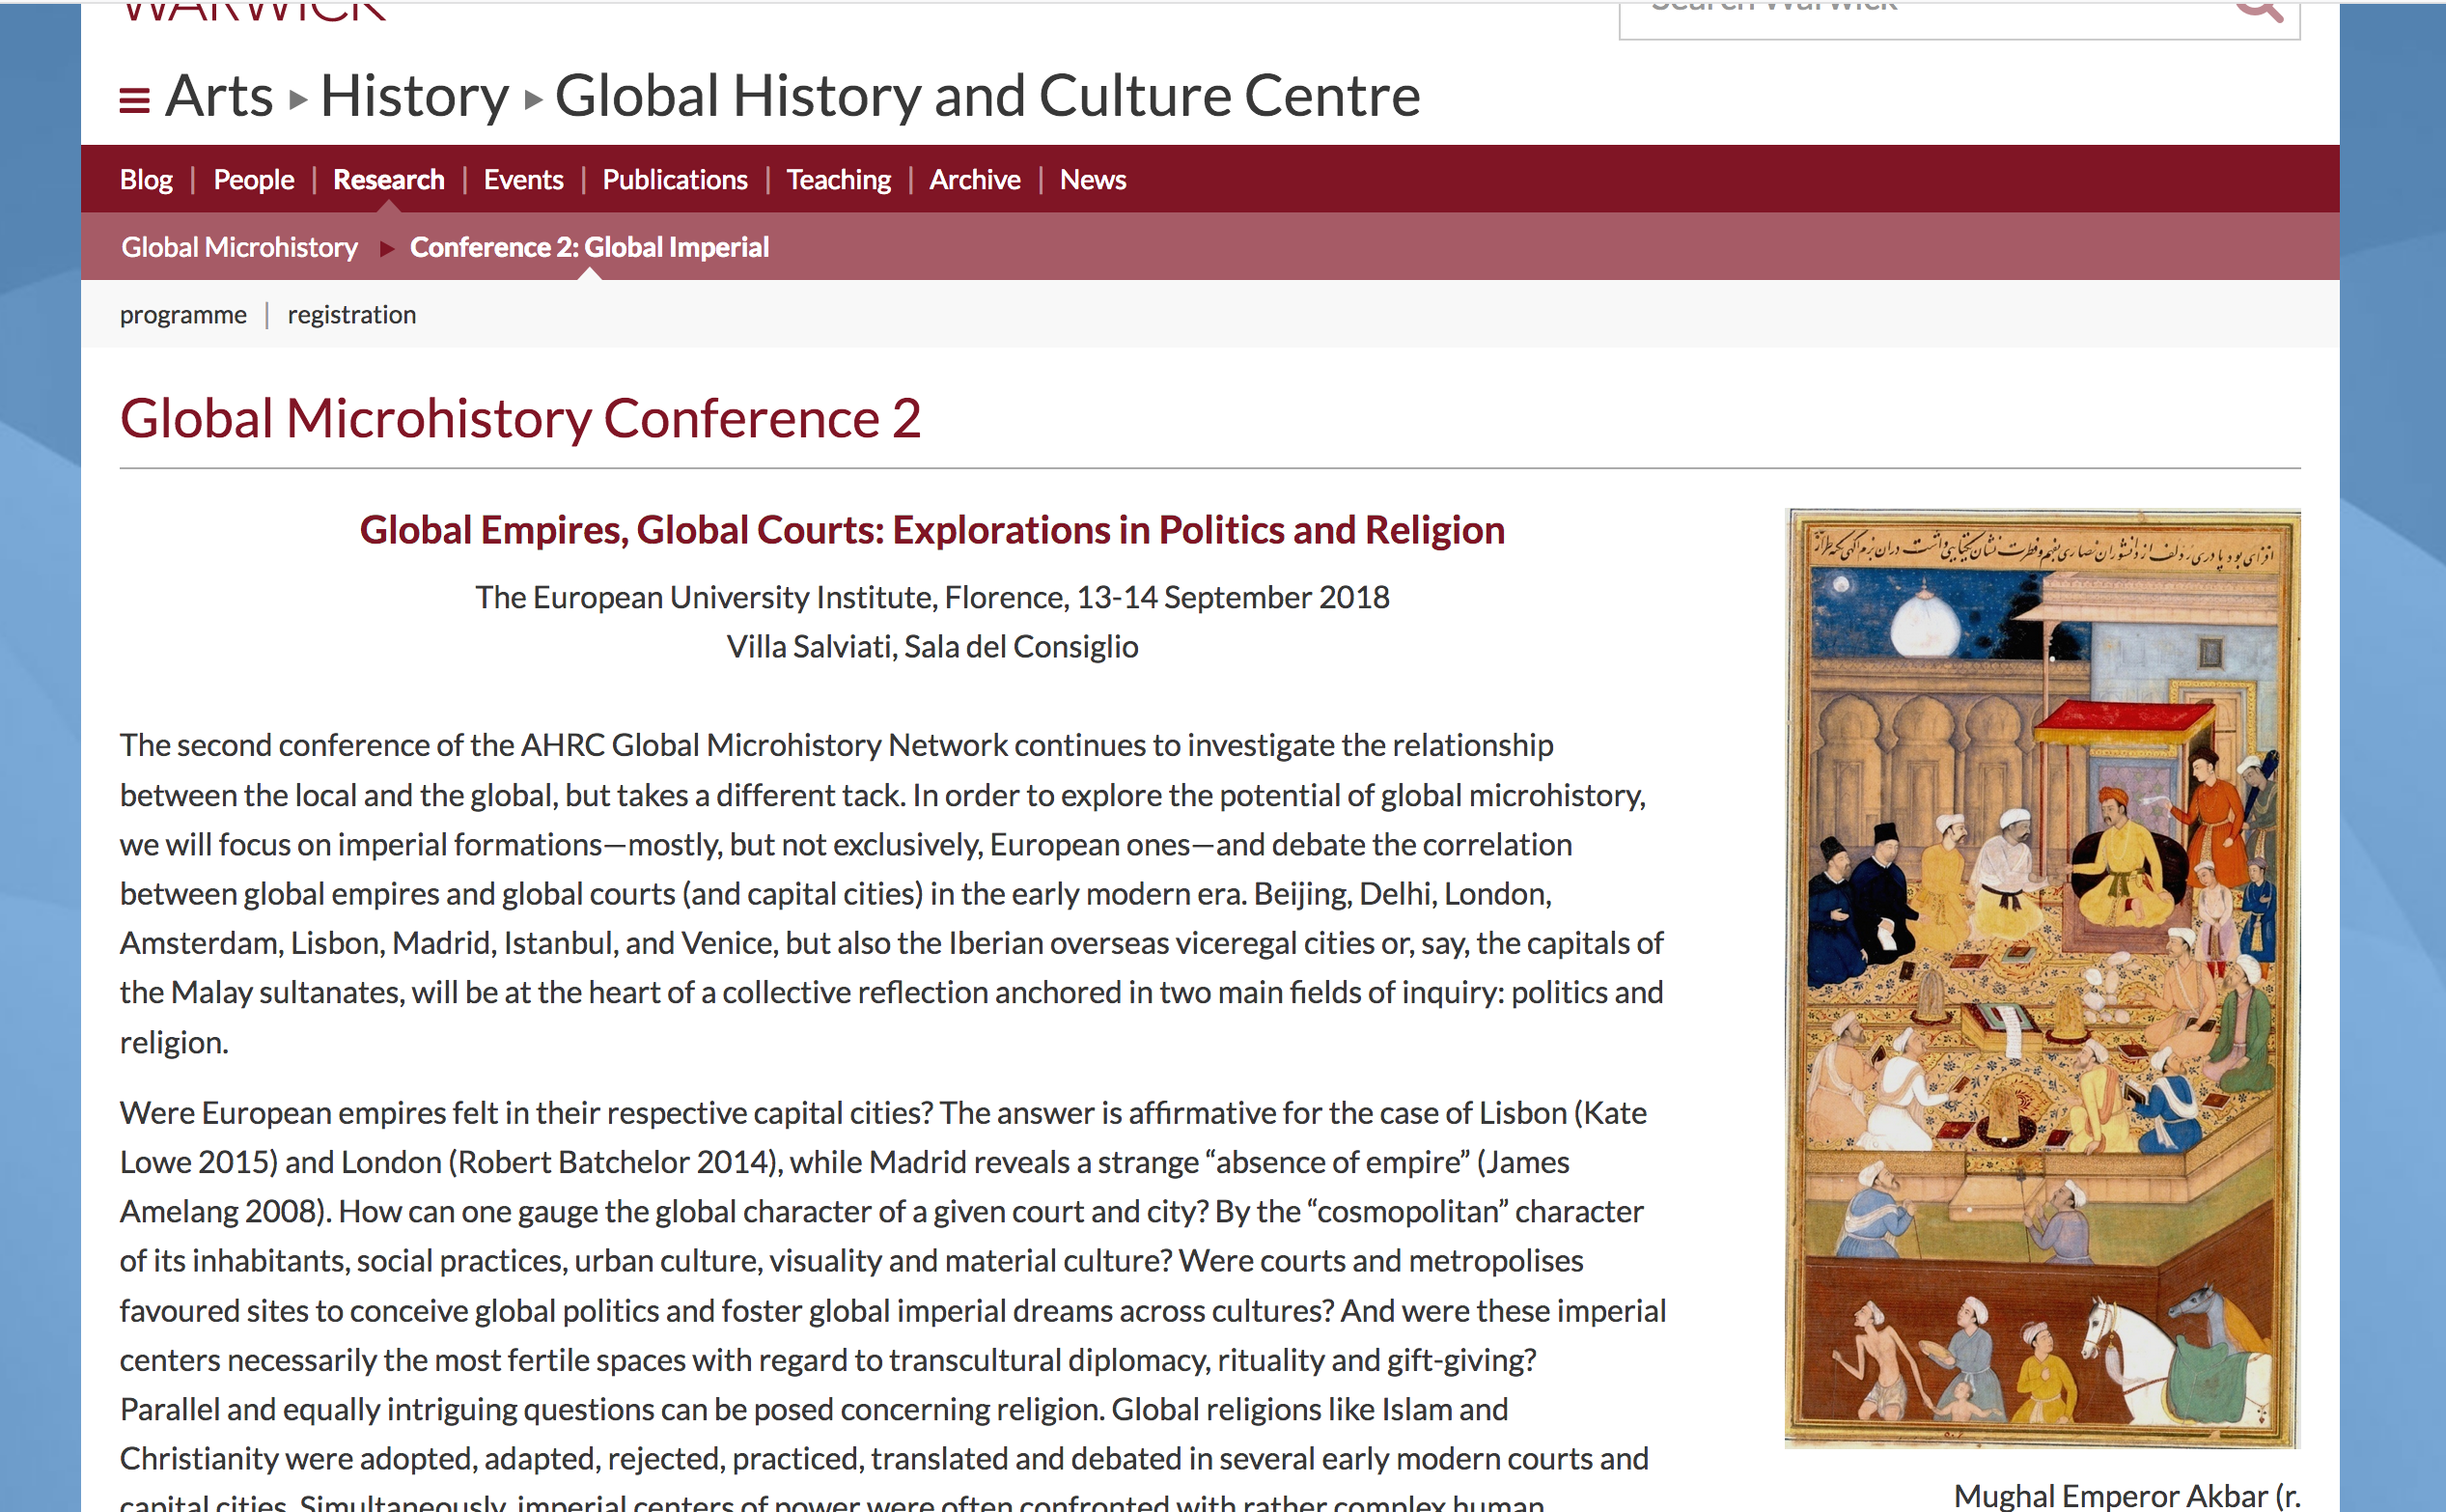
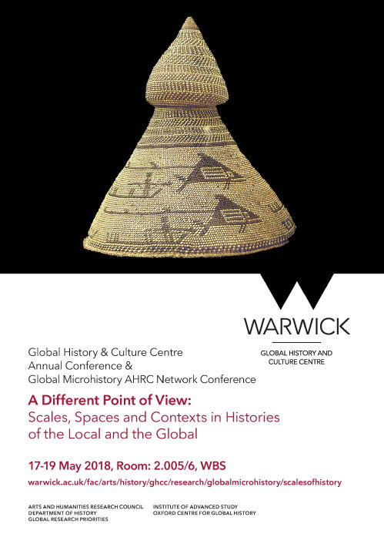
Micro-global history

Slide 26
Conclusion: there are many different ways of doing global history
The entire globe as the unit
David Christian
Merry Wiesner-Hanks
Global history as comparative history
Patrick O’Brien
Chris Wickham
Global history as the history of connections
Janet Abu-Lughod
Maxine Berg
History of global iterations of the same thing
Zhu Lianbi
Giulia Calvi
Global history as histories of space
Christian de Vito
Micro-global history

Slide 27
Lecture outline
The history of global history
World civilizations
World history
Economic history goes global
Global history
Ways of doing global history
The entire globe as the unit
Global history as comparative history
Global history as the history of connections
Global history as histories of space
Micro-global history
Critiques of the approach
Sources?
Agency?
History of globalization/endorsement of globalization
Strengths of global history
Challenge to the nation state
History of migration/history of environment

Slide 28
‘I could never know enough to be able to call myself a global historian’
‘It is not postcolonial history’
‘There are no sources that are truly global’
‘There are no humans in it’
‘Who or what has agency in global history?’
‘Global history is a neo-liberal enterprise that endorses globalization’

Slide 29
The Adelman critique and the Drayton and Motadel response
Jeremy Adelman, ‘What is global history now?’, Aeon, 2 March 2017.
http://blog.journals.cambridge.org/2018/02/15/the-futures-of-global-history/#.WoWUz7Irwbo.twitter
Drayton, R., & Motadel, D. (2018). Discussion: The futures of global history. Journal of Global History, 13(1), 1-21.

Slide 30
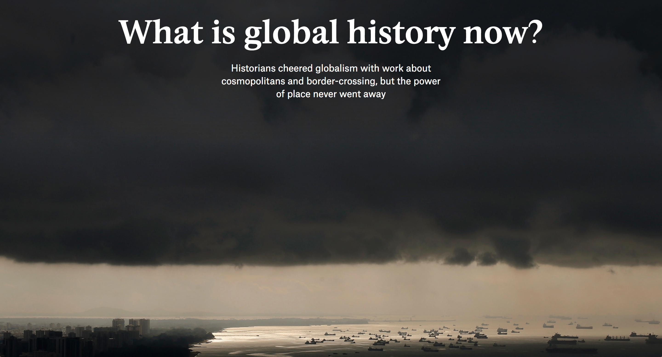

Slide 31
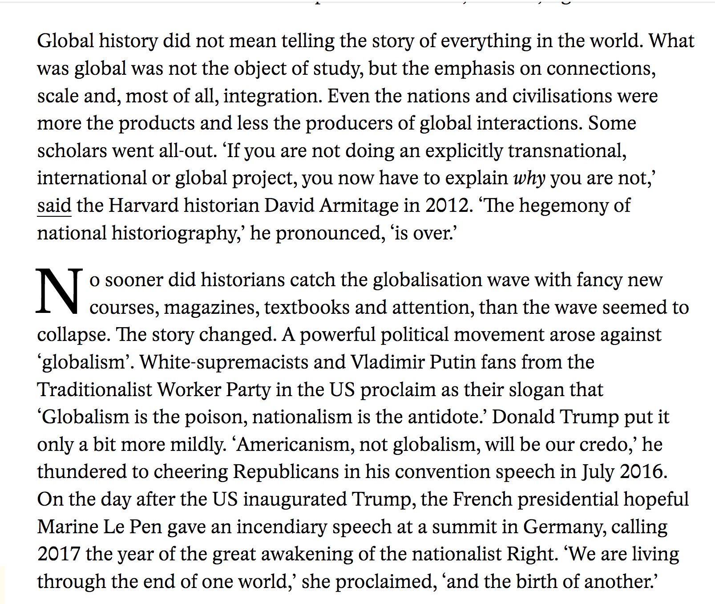

Slide 32
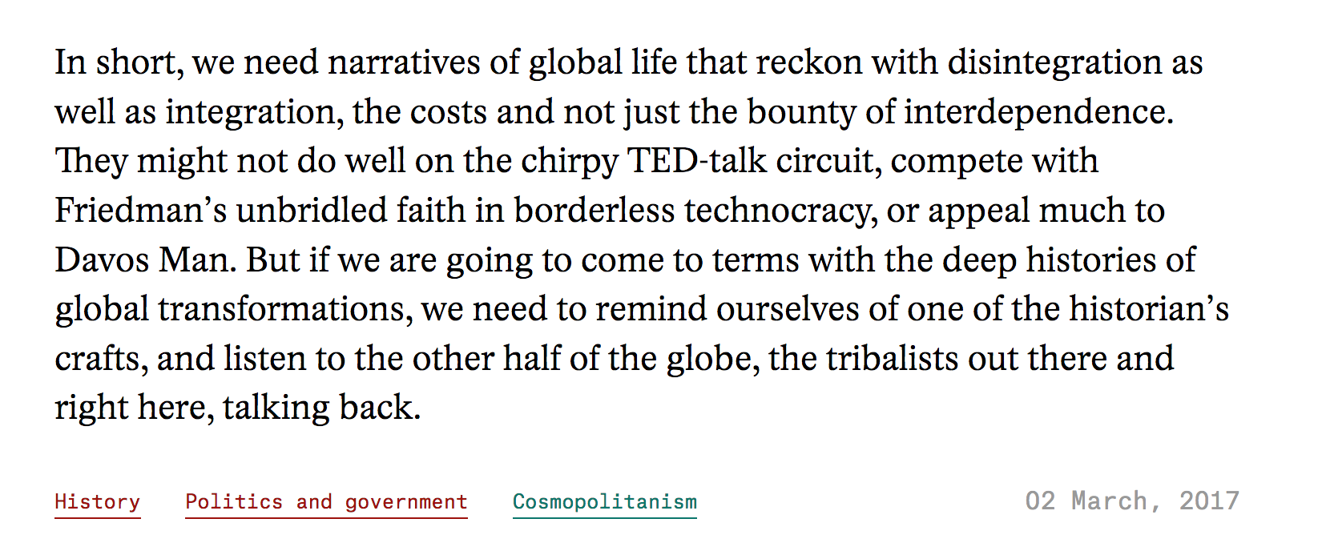

Slide 33
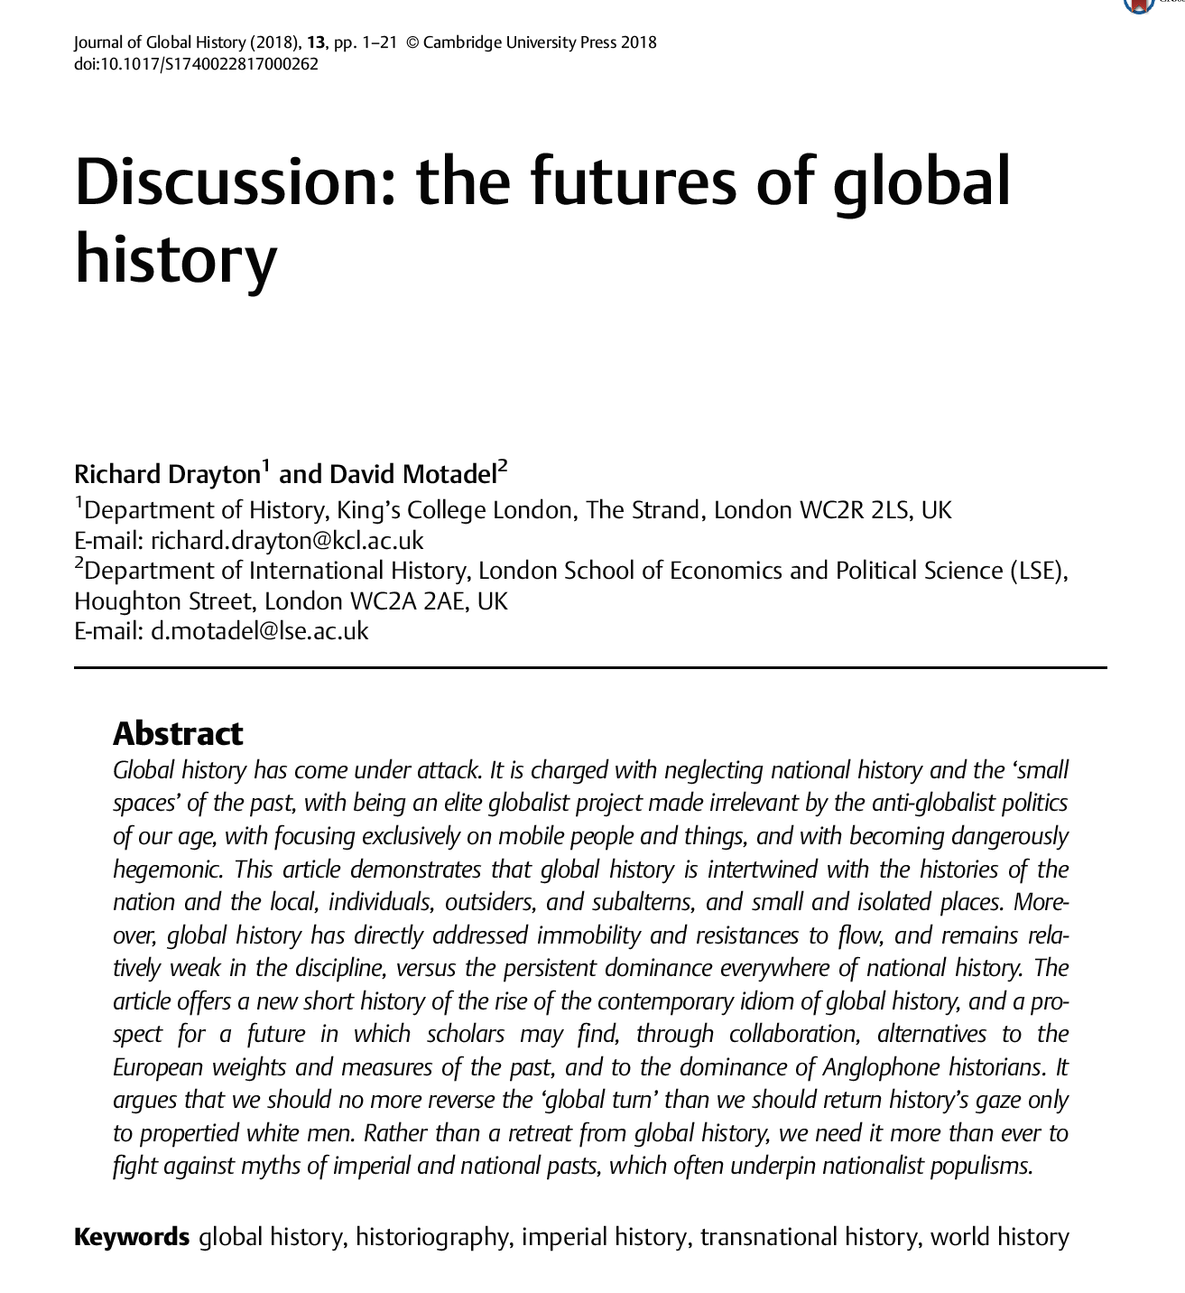

Slide 34
Lecture outline
The history of global history
World civilizations
World history
Economic history goes global
Global history
Ways of doing global history
The entire globe as the unit
Global history as comparative history
Global history as the history of connections
Global history as histories of space
Micro-global history
Critiques of the approach
Sources?
Agency?
History of globalization/endorsement of globalization
Strengths of global history
Challenge to the nation state
History of migration/history of environment

Slide 35
Strengths of global history?
Important challenge to Eurocentrism that continues to be relevant (not least in many history departments in Britain)
Challenge to the dominant nation-state narrative; questions histories that mainly serve to legitimize the history of the state and its borders (which is why Xi Jinping is highly critical of the approach in Chinese universities)
Lends itself well to topics that are not contained within a specific space

Slide 36
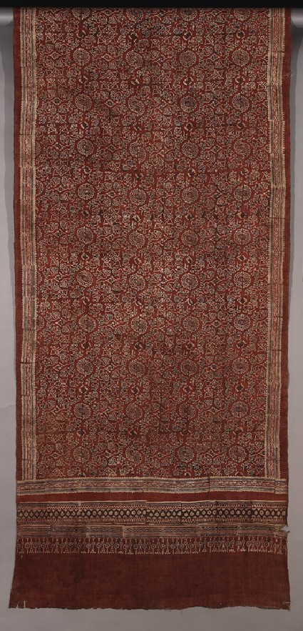
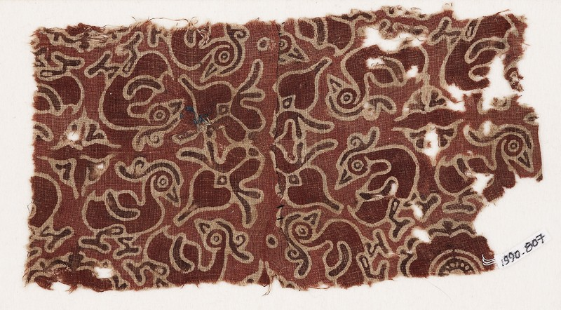

Giorgio Riello’s work on cotton textiles
Hamsa pattern from Fustat (Egypt)
Hamsa pattern from Sulawesi

Slide 37
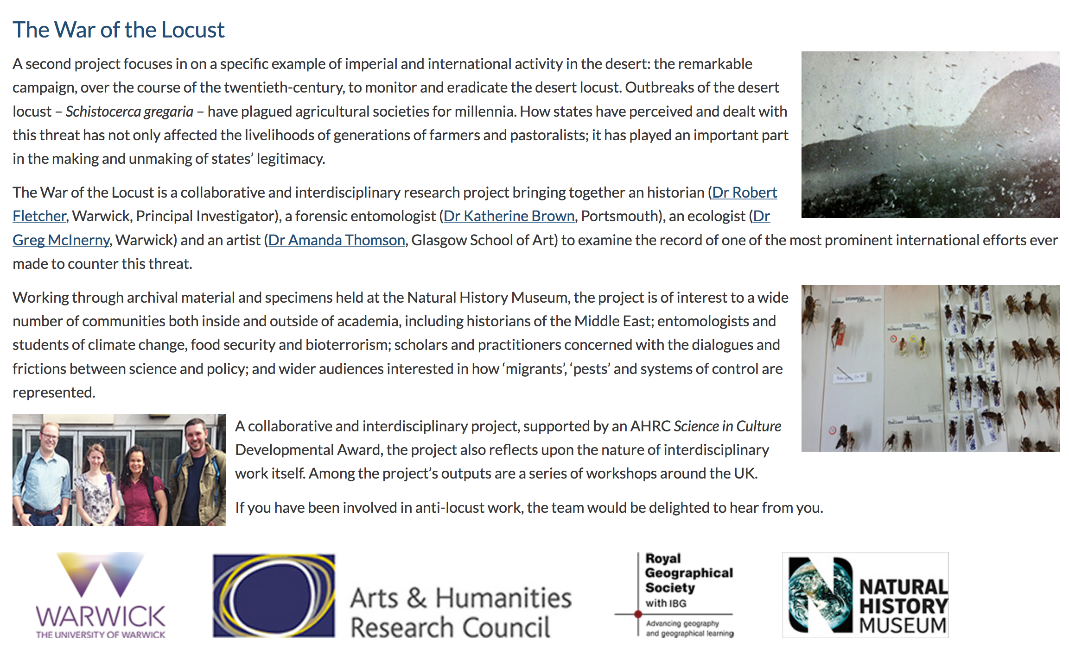
Robert Fletcher’s work on the impact of locusts

Slide 38
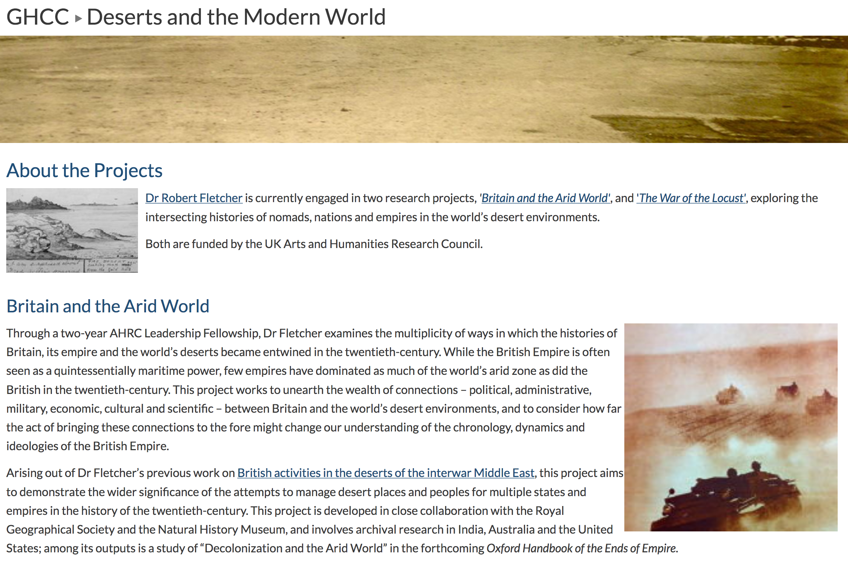
Robert Fletcher’s work on arid regions of Central Asia

Slide 39
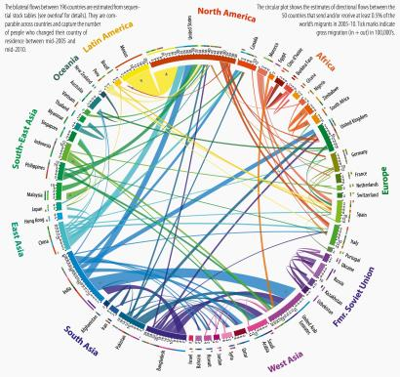


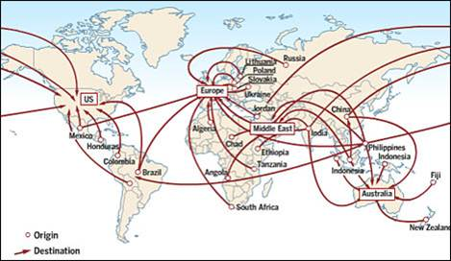
Global migration

Slide 40


