Slide 1
Lecture 2
Enlightenment traditions of history writing
Historiography 2016/17
‘History, as you know, is a very ticklish business.’
- Estienne Pasquier, Researches on France (1596)

Slide 2
Early Renaissance Histories
Valuing the past for its pastness
‘Our own age has always repelled me […]
In order to forget my own time, I have constantly striven to place myself in the spirit in other ages, and consequently, I delighted in history.’
14th century humanist: Francesco Petrarch
Ancient Rome was thought to be better… medieval period as ‘Dark Ages’.

Slide 3
Renaissance Histories
Philology: study of classical texts
Initially, classical texts as source for absolute standards
But to understand classical texts, one needed to understand the contexts of ancient Rome and of translations of classical texts through the ages. Thus, a ‘historicist’ view developed, and with it, a relativist understanding of the past. (Same period as development of perspective in painting.)
Individual Chronicles
First-hand accounts written in the vernacular (Italian city-states)
History as memory
History as full of contingent (and often recent) events: printing press, discovery of the New World, invasions, flourishing city-states
Narrative tropes inflected by knowledge of classical history (Rome): tragic decline.

Slide 4
Renaissance Histories
Histories of Great men, Great women
Lives of notable individuals – moral lessons
Women recognised as historical subjects and as readers of history
But often in sexist way: women had specific virtues (chastity, silence, obedience)
History was instructive for them – more so than rhetoric or philosophy – since it dealt with only facts (not reasoning or public speaking)
Example titles
Vespasiano da Bisticci: Lives of Illustrious Men (late 15th century)
Giovanni Boccaccio: Concerning Famous Women (1365)
Christine de Pizan, The Book of the City of Ladies (1405)
Women could be virtuous, too… Used historical examples

Slide 5
French-English Renaissance Histories
Unlike Italy, France and England did not have the illustrious tradition of Ancient Rome to celebrate
More focused on ‘the nation’; wrote in the vernacular
Estienne Pasquier’s Researches on France (1560)
William Camden, Britannia (1586)

Slide 6
Historical Methodology in Renaissance
People noted at the time that History lacked a set of rules
Historians as butts of jokes, especially by philosophers
Q: ‘What would you call the writer who told you about effects without looking for any causes?’
A: ‘A historian.’ (Patrizi: Ten Dialogues on History)
History was an art in search of a scientific method
What was history’s purpose?
Moral instruction, the search for moral and political truths
How should it be practiced?
Emphasis on factual accuracy and rigorous methodology or was rhetorical style more important for conveying moral lessons?

Slide 7
Types of Renaissance Histories
Antiquarianism
Assessment and accumulation of facts. Technical and specialised. With intense scrutiny of evidence. Not widely read, but influential.
Political History
More popular
Italian Renaissance: Machiavelli, Guicciardini
Cyclical history: from the rule of one, to the rule of the few, to the rule of the many, then back to the rule of one.
Focus on how morality and institutions interact in each phase of the cycle
French Renaissance: Jean Bodin - ‘History for the most part deals with the state and with changes taking place within it.’ Method for the Easy Comprehension of History (1566)

Slide 8
Pre-Enlightenment Histories
Legal history
French Renaissance: reconstruction of histories of rights, privileges and institutions. Focus on medieval era.
Emphasis on written archival sources over oral and secondary accounts
Discovery of ‘feudalism’ grew out of this line of historicising in England
Natural Law
Pufendorf, Hobbes, Grotius
From ‘nature’ to ‘civil society’ – social contract
Historical stages characterised by the terms of property and modes of subsistence (socioeconomic as driving political history)
Christian Universal History
Bossuet’s Discourse on Universal History (1681)
Last grand attempt to explain history in terms of a relentless war between God and Satan.

Slide 9
Old View
History was important in the Renaissance (15th and 16th c) and Romantic period (19th)
The Enlightenment
emphasised the ‘moderns’ over the ‘ancients’
Experimental methods (can’t experiment on past societies)
Eternal natural laws are more important than pastness
Emphasis on Progress, not the Past
Politicisation of this view: the French Revolution (Jacobinism embraces modernity and the future)
Romantic Reaction to Jacobinism in 19th c: History returns as important

Slide 10
New View
History was central to Enlightenment writing and philosophy
David Hume, Scottish Philosopher and Historian
‘I believe this is the historical Age and this the historical Nation’ (1777)

Slide 11
‘Crisis of European Consciousness’
Thesis of Paul Hazard – intellectual historian
Epistemological shift between 1680 and 1715
‘One day, the French people were thinking like Bossuet. The day after, the were thinking like Voltaire. No ordinary swing of the pendulum, that. It was a revolution.’
Paul Hazard, The European Mind, 1680-1715

Slide 12
What did Enlightenment historians take from the past?
Reliance on written sources
Antiquarianism persisted, despite criticism of its narrowness
Focus on ‘nations’ and civilisations
History as source for political and moral lessons
Stages of History
Popularised in Cellarius’s Universal History Divided into an Ancient, Medieval and New Period (1690s)

Slide 13
What’s new?
From cyclical to unilinear history (progress)
Conjectural / Stadial histories
Moral lessons (as before) but through sympathy
Natural Laws discoverable through history
Social phenomena are subject to natural laws just like physical phenomena. Natural laws are discernible through empirical research.
National but also cosmopolitan
Interplay of likeness and difference within the family of Christian churches and nations… irony… to make the familiar odd and the odd familiar…

Slide 14
Cyclical History
For Greeks: oscillations between good orders (democracy, monarchy) and bad ones (oligarchy, tyranny)
Mythical: cycles stem from eternal unseen forces, such as the gods’ moods, or the range of men’s fundamental character.
Echoes of the cyclical in histories of the longue durée and deep history. Rejection of progress, of constant ‘new-ness’

Slide 15
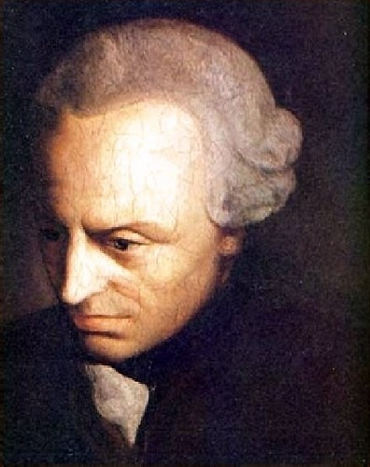
HISTORICAL PROGRESS
What is Enlightenment? (Essay, 1784)
Immanuel Kant, 1724-1804

Slide 16
‘Enlightenment is mankind’s exit from self-incurred immaturity. Immaturity is the inability to make use of one’s own understanding without the guidance of another. Sapere aude! (Dare to know, to use your own understanding!) This is the motto of the enlightenment.’
(From: Immanuel Kant, ‘An Answer to the Question: What is Enlightenment?’ Berlinerische Monatsschrift (1784): 481-494, 481.)

Slide 17
‘It is now asked “whether we live at present in an enlightened age?”, the answer is: “No, but we do live in an age of enlightenment.” As matters stand now, much is still lacking for men to be completely able – or even to be placed in a situation where they would be able – to use their own reason confidently and properly in religious matters without the guidance of another. Yet we have clear indications that the field is now being opened from them to work freely towards this, and the obstacles to general enlightenment or to the exit out of their self-incurred immaturity become even fewer.’
From: Immanuel Kant, ‘An Answer to the Question: What is Enlightenment?’ Berlinerische Monatsschrift (1784): 481-494, 481

Slide 18
Progress
See Condorcet reading:
Of understanding (proof: Enlightenment)
Of humankind (proof: History)

Slide 19
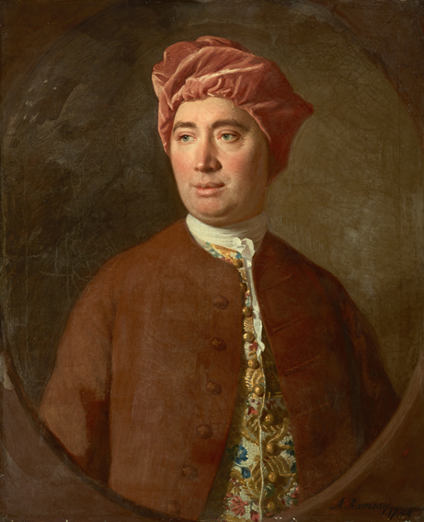
A Treatise of Human Nature: Being
an Attempt to introduce the
experimental Method of Reasoning
into Moral Subjects (1739)
The History of England: from the invasion of Julius Caesar to the Revolution of 1688 (1754–61) , first published in installments.
Not ancient constitution that mattered: History as evolution of political structures. Beyond absolutism, there was the rise of political liberty.
Unintended consequences (Absolutism had provoked Puritanism, which kept the spirit of liberty alive – will triumph in 1688.)
Emphasis on national character.
Progress: David Hume 1711-1767

Slide 20
How can we see history as linear – progress/decline?
Conjectural History – A rational reconstruction or speculation of what must have happened to mankind in the past, even if it can’t be empirically shown

Slide 21
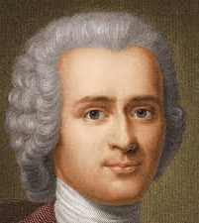
Conjectural History
Rousseau: Humans were born free and moral (or at least morally neutral) but civilisation corrupted them. (Discourse on the Origins of Inequality)
Scottish historians would refute this.

Slide 22
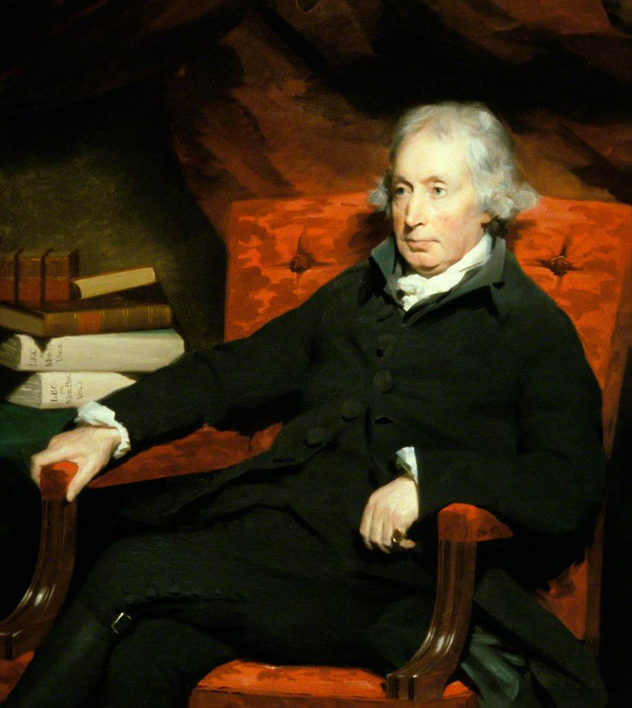
Conjectural History
Adam Ferguson
Stadial History (stages)
1. Hunting – no property, no wealth to accumulate, stage of savagery’
2. Pasturage – less mobile but still nomadic, wealth can be accumulated
3. Agriculture -- even less mobile, farmer live on land in own houses,
more wealth and greater inequality
4. Commerce – property ownership, laws governing property, complex societies

Slide 23
Moral lessons through sympathy
Experience, or the experience of reading about past experiences, makes one ‘feel’ history, empathise with others, absorb moral lessons, and become more virtuous

Slide 24
Hume, sympathy, history
Why study history, according to Hume?
Entertainment, which leads to erudition, accumulation of knowledge, and moral-intellectual improvement.
‘A man acquainted with history may, in some respects, be said to have lived from the beginning of the world, and to have been making continual additions to his stock of knowledge in every century.’ (note: knowledge is accumulative)
3. History has the power to direct readers’ wills and make them become more virtuous; because historians do not possess the vice of self-love or self-interest.

Slide 25
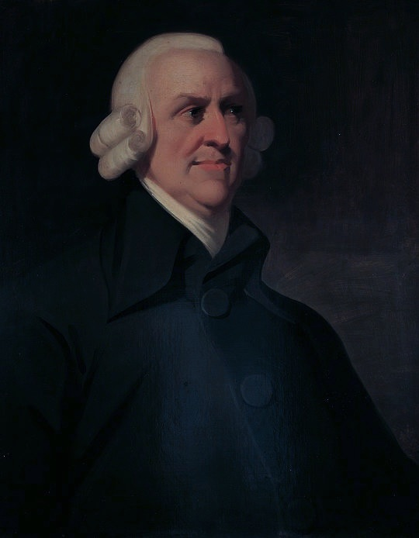
Lectures on Rhetoric and Belles Lettres, 1762
“The accidents…which affect the human
Species interest us greatly by the
sympathetical affections they raise in us.
We enter into their misfortunes, grieve
when they grieve, rejoice when they rejoice,
and in a word feel for them in some respect
as if we ourselves were in the same
condition.”
( p. 90)
‘The facts must be real otherwise they will not
assist us in our future conduct, by pointing
us the means to avoid or produce any event.
Feigned Event and the Causes contrived from
them, as they did not exist, can not inform us
of what happened in former times, nor of
consequences assist us in a plan of future
conduct.’
(p. 91)
Adam Smith, 1723-1790
Sympathy, knowledge, morality

Slide 26
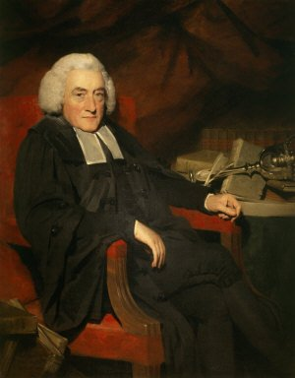
Example of making people feel history:
‘The Queen, worn out with fatigue,
covered with dust, and bedewed with tears,
was exposed as a spectacle to her own
Subjects.’
Moral lessons through empathy with the
the past
(History of Scotland, 1759, vol. 1, p. 367)
William Robertson, 1721-1793

Slide 27
History: the discovery of natural laws
Before Enlightenment: History as art in search of a scientific method
During Enlightenment: History as the science of human morality

Slide 28
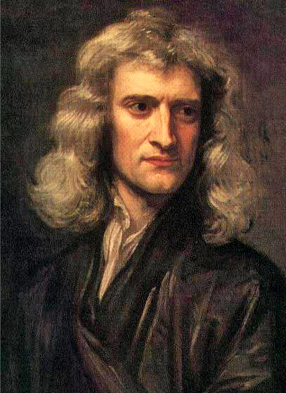
NATURAL LAWS as discoverable (Newton)
Hume and other historians were inspired by Newtonian experimental methods of reasoning:
‘the empirical observation of human
activities in the present and past.’
HUME:
‘Mankind are so much the same, in all times
and places, that history informs us of nothing
new or strange in this particular. Its chief use is
only to discover the constant and universal
principles of human nature, by showing men
in all varieties of circumstances and situations
and furnishing us with materials from which
we may form our observations and become
acquainted with the regular spring of human
action and behaviour…’
(Hume, Enquiry Concerning Human
Understanding, pp. 83-4)
Isaac Newton, 1642-1726

Slide 29
Montesquieu – Spirit of the Laws (1748)
Contemporary of Voltaire
Spirit was put on the Vatican’s Index of banned books
Erudite sociological history: historical examples to discover ‘natural laws’ governing societies.
Forms of government and their guiding principle
Monarchy, republican (aristo and demo), despotism
Climate matters
Checks-and-balances
Implicit message: European exceptionalism
Climate drove Europe from classical world of virtuous republics to commercial monarchies. Implicit rejection of cyclical history. Implied linear progress.

Slide 30
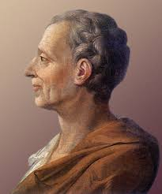
Montesquieu – Spirit of the Laws (1748)
I have first of all considered mankind […] amidst such an infinite diversity of laws and manners, they were not solely guided by the caprice of fancy…

Slide 31
Montesquieu – Spirit of the Laws (1748)
I have laid down the first principles [i.e., hypotheses], and have found that the particular cases follow naturally from them; that the histories of all nations are only consequences of them, and that every particular law is connected with another law… of a more general extent…

Slide 32
Montesquieu – Spirit of the Laws (1748)
Forms of government and their corresponding guiding principles
Monarchy → Honour
Republics (aristocratic and democratic) → Virtue
Despotism → Fear
Ones senses he preferred aristocratic republics and checks-and-balances – not surprising, since he was a magistrate of the French court system
Not based on cycles but on environment, climate
Harsher climate led to the emergence of commercial monarchies…
Implicit message: Within natural laws, European exceptionalism

Slide 33
Focus of History?
Not just kings and queens… or one-off events.
Focus on Society, Civilisation, Nations

Slide 34
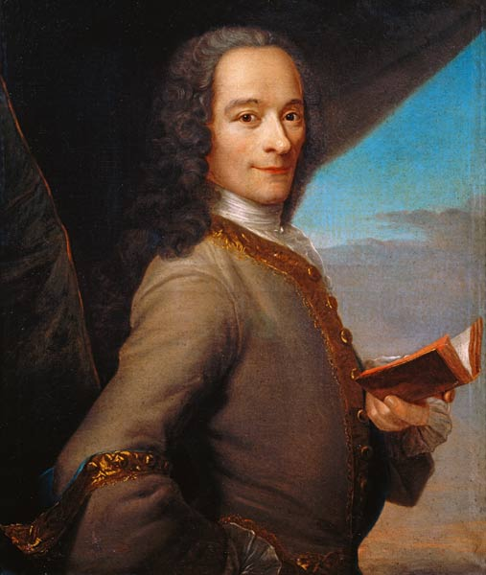
History of Charles XII, King of Sweden
(1731)
Charles XII vain hunt for glory v.
Peter I’s sober resolve to civilise society
History of civilisation is what’s
Important…
The Age of Louis XIV (1751)
Hardly about Louis XIV
Focused more on French civilisation
Essay on the Manners of Nations
(or 'Universal History') (1754)
One of many studies of ‘moeurs’ (morals
and customs) at the time. Again, history
of civilisation and progress.
‘History is the narrative of facts taken
to be true, in contrast to the fable
which is the narrative of facts taken
to be false.’
From: “Histoire”, p. 164
François-Marie Arouet, 1694-1778,
known as Voltaire

Slide 35
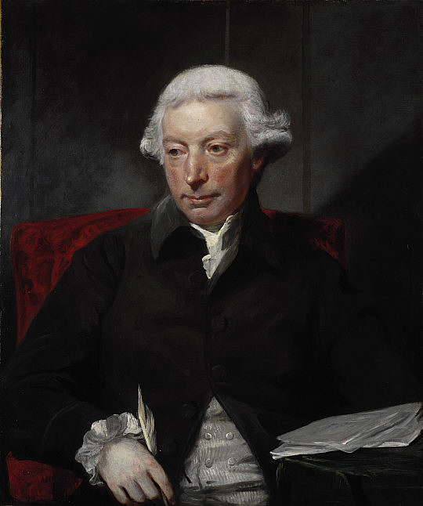
An Essay on the History of Civil Society,1767
‘Mankind are to be taken in groups, as they have always subsisted. The history of the individual is but a detail of the sentiments and thoughts he has entertained in the view of his species: and every experiment relative to this subject should be made with entire societies, not with single men.’
(p.6)
I
‘…if we are asked therefore, Where the state of nature is to be found? we may answer, It is here; and it matters not whether we are understood to speak in the island of Great Britain, at the Cape of Good Hope, or the Straits of Magellan. While this active being is in the train of employing his talents, and of operating on the subjects around him, all situations are equally natural.’
(Ferguson, Essay, pp. 11–12)
Adam Ferguson, 1723-1816

