Slide 1
Wrap up II
Historiography
Dr Claudia stein

Slide 2
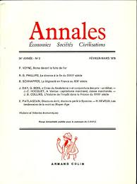
Les Annales, 1929
A reaction to nationalistic Rankean history writing that dominated at the time

Slide 3
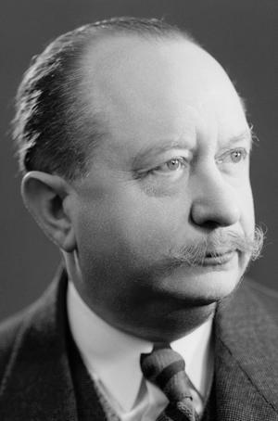
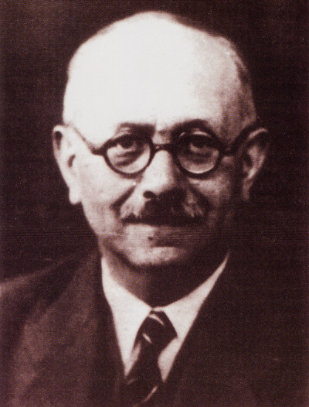
The Annales school
Marc Bloch, 1886-1944
Lucien Fevbre, 1876-1956

Slide 4
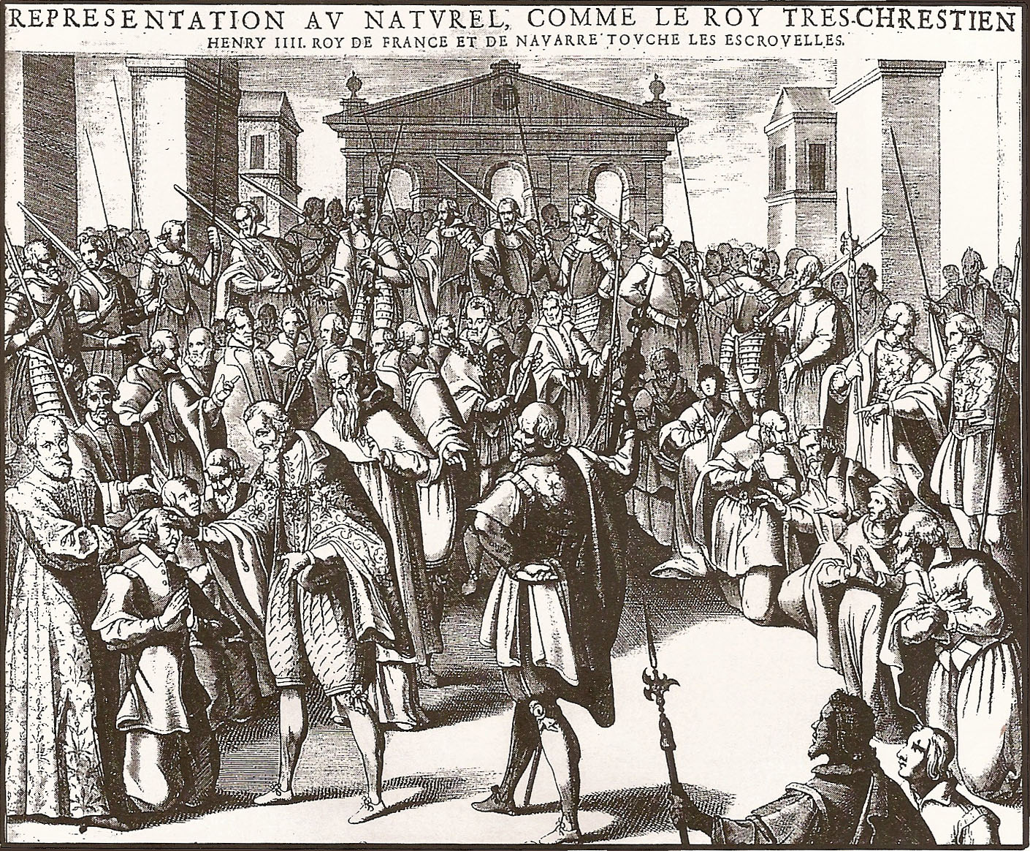
General themes of the Annales
long view; long duree
‘problem’ focused
‘history of mentalities’: study of systems of belief; modes of feelings and thoughts
comparative history
Strong influence of sociology, psychology and natural sciences
Hope of a ‘total history’ through interdisciplinary approach that combine humanities, social sciences and natural sciences
Marc Bloch, The Royal Touch, 1924: early example of a history of mentalities

Slide 5
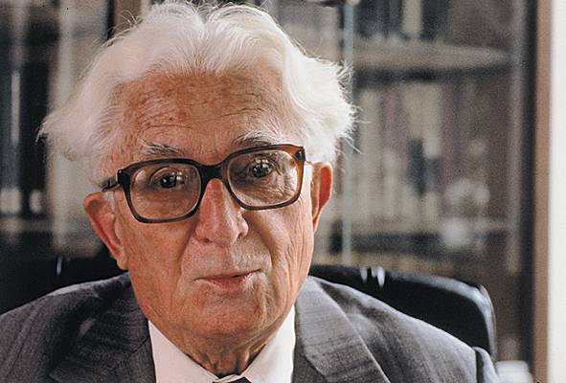
2nd generation of the Annales continues focus on
‘total history’ aim (social sciences and natural science
Methodologies, statistics etc.)
Dominates the entire field for
decades until the 1970/80s
A reminder that success of a historical paradigm
Is not only about great thought but also about
Institutional dominance!
Fernand Braudel, 1902-1985

Slide 6

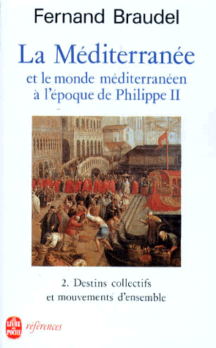
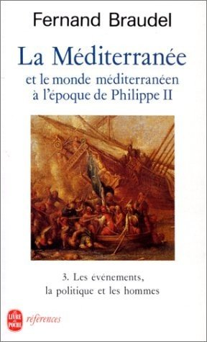
The Mediterranean and the Mediterranean World in the Age
of Philip II (1923-1949)
Time of long duration (l’histoire de la longue durée)
Deep time; thousands of years
Time of conjunctures
shorter movements of economies, social structures, political institutions and civilisations; roughly 200 years
Time of events (l’histoire événementielle)

Slide 7
What is Social History?
Practiced by Annales scholars and left-leaning historians between 1930-1960
objectivist idea of history as a ‘social science
a holistic and totalising approach to history
quantitative methodologies
long-run analysis (long duree) analysis of economic fluctuation trough prizes, interest in trade flows and population, or geographical conditions
a materialist and structural model of causation (e.g. geography in the case of Braudel; forces of productive for Marxists)

Slide 8
A radical break in the way history is thought about and practices after about WWII...
‘…..who fell victim to the fascist and communist belief in inexorable laws of historical destiny.'
(Karl Popper, The Poverty of Historicism, 1957)
Atrocities of the war
Decolonisation
Freedom and civic rights movements of the 1960s
All this leads to a move away from traditional history writing a la Ranke but also ‘social history’ and its reliance on the method of the social sciences and natural sciences; we see a move to ‘culture'

Slide 9
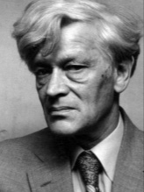
The rise of cultural history
The ‘culture’ begins to replace ‘society’ as a central reference point for historians from the 1960s
The ‘new’ social history as a ‘history from below’
Edward Palmer Thompson (1924-1993)

Slide 10
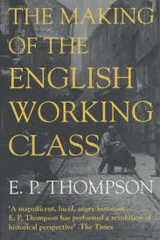
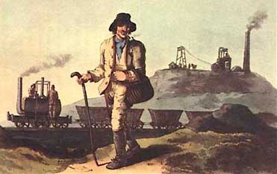
The Making of the English Working Class (1963)
‘The working class did not rise like the sun at an appointed hour. It was present at its own making.’

Slide 11
Claim: class is relational and a result of human experiences (not a mere result of economic structure)
‘Experience’ becomes central in the making of ‘class’
‘I do not see class as a “structure”, nor even as a “category”, but as something which in fact happens (and can be shown to have happened) in human relationships...Like any other relationship, it is a fluency which evades analysis if we attempt to stop it dead at any given moment and anatomize its structure.
The finest-meshed sociological net cannot give us a pure definition of class, any more than it can give us one of deference or of love. The relationship must always be embodied in real people and in a real context. Moreover, we cannot have two distinct classes, each with an independent being, and then bring them into relationship with each other. We cannot have love without lovers, nor deference without squires and labourers. (p.1)

Slide 12

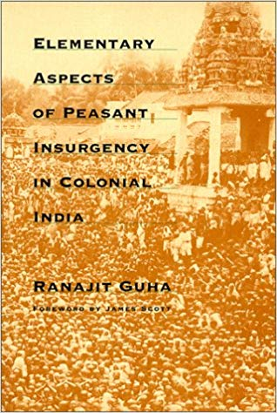
‘THE HISTORY FROM BELOW’ SHAPES OTHER AREAS OF HISTORY WRITING
1960S/70s historian try to recover
the experiences from those forgotten by Rankean history (experience of those who rule and traditional social/Marxist history or in the Annales school (all these favor structure over individual experience, statistics and numbers over human individual life)
SUBALTERN Study Group; Subaltern history; Gramsci’s idea of hegemony; subaltern history is part of the rise of postcolonialism (see lecture on it)
WOMEN’S HISTORY; 2nd wave of feminism

Slide 13
Lecture 9, term I
The Rise of Cultural History II:
History and Anthropology

Slide 14
A bit of the history of anthropology.....
Anthropology: the study of humans and human behaviour and societies since the Enlightenment (Herder is one of the founders!)
Several branches of study:
Social anthropology/cultural anthropology: study the norms and values of societies
Linguistic anthropology: studies how language affects social life
Biological/physical anthropology: studies the biological development of humans
Ethnography: (from Greek ethnos ‘folk, people, nation’ and grapho "I write"):
the accumulatio of necessary data by residence and observation, and the subsequent description of such societies

Slide 15
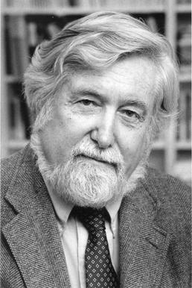
Symbolic Anthropology becomes ‘big’ in the 1970s as a way to deal with colonial entanglement during the 19th century
Interest in language theory
Geertz sought to separate off anthropology from its influences by the social sciences and to define culture as a ‘semiotic concept’ whose analysis is not ‘an experimental science in search of law but an interpretive one in search of meaning.’ (Thick Description, 1973, p. 5).
and
‘.......historically transmitted pattern of meanings embodied in symbols, a system of inherited conceptions expressed in symbolic forms by means of which men communicate, perpetuate, and develop their knowledge about and their attitudes towards life’.
Thick description: a thick description results from a scientific observation of any particular human behaviour that describes not just the behaviour, but its context as well, so that the behaviour can be better understood by an outsider. A thick description typically adds a record of subjective explanations and meanings provided by the people engaged in the behaviours, making the collected data of greater value for studies by other social scientists.
Clifford Geertz, 1926-2006

Slide 16
‘Meaning-making’ becomes big in history writing of the late 1970s and 1980s
Nathalie Zemon Davis on her discovery of symbolic anthropology for her study of early modern French history in the early 1970s:
I could consider the social and cognitive meanings of symbolic and ritual forms of behaviour, which earlier I had accounted for only in terms of groups solidarity…Now I could look at the non-literature with more discernment…and take more serious the techniques and endowments of oral culture, such as proverbs and memory devices. I began to doubt my earlier commitment to a single ‘progressive’ trajectory utowards the future…’
(Davis, 1997, 14).

Slide 17
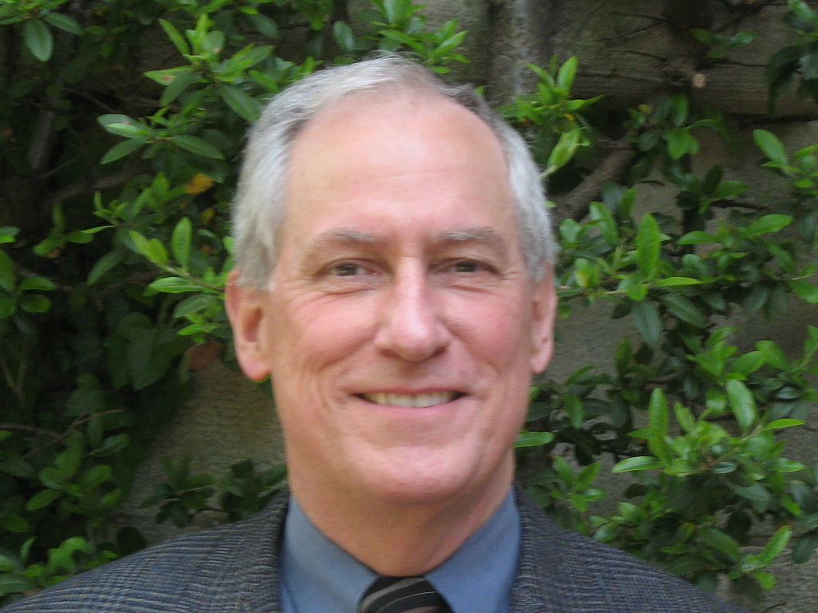
History writing in the ‘ethnographic grain’ in the 1980s Anglo-American history writing
Example:
The Great Cat Massacre and Other Episodes in French Cultural History (1984)
‘When we cannot get a joke, or a ritual, or a poem, we know we are on to something. By picking at the document where it is most opaque, we may be able to unravel an alien system of meaning.”’
The role of ‘difference’ and ‘surprise’ is central; like other cultures in the present, past societies are now understood as a ‘foreign land’ to be discovered by the historian who pretends to be an anthropologists of the past
Robert Choate Darnton (1939-),

Slide 18
What can historians learn from anthropology?
New new awareness of the importance of informal or small-scale interactions
New mechanisms of social interaction and exchange : the role and place of gifts and reciprocity in the social exchange
New insights into gender system: how men’s and women’s different spheres of actions relate to each other
New topics are possible: magic, rituals, cults and witchcraft

Slide 19
So, what is this ‘new’ cultural history (or socio-cultural history) in the 1980s in the US is about?
‘...questions the past by asking how people at the time perceived and interpreted themselves, what material, mental and social motivations respectively influenced their forms of perception and production of sense, and the effects such forms produced.’
(Ute Daniels, Kompendium Kulturgeschichte (Frankfurt, 2001), p. 19)
‘The cultural turn asks not only ‘How it really was?’ but rather “how was it for him, or her or them?’
(Miri Rubin, ‘What is cultural history now’, in D. Cannadine (ed.), What is history now? (Basingstoke, 2002), p. 81

Slide 20
Lecture 10, term 1
The Rise of Cultural History III:
Italian Microhistory

Slide 21
What united the Italian microhistorians?
Disillusion with grand narratives of modernity (progress, economic growth, consumer culture etc.)
dissatisfaction with large scale seriel analysis; Braudelian ‘longue durée’; quantitative analysis and reliance on structural approaches
Bring back the narrative into history writing
Interest in social and cultural anthropology rather than scientistic sociological models
Lesser interest in a general history ‘from below’; they were drawn to idiosyncratic figures and phenomena rather than to ordinary people and consistent patterns (therefore: distance to other histories of everyday life which developed at the time, such as the German Alltagsgeschichte (history of everyday life)
Note: a slightly different agenda than the cultural historians in the US

Slide 22
Overall Aim: to employ the microscale of analysis in order to test the validity of macro-scale explanatory paradigms
  ‘Microhistory as a practice is essentially based on the reduction of the scale of observation, on a microscopic analysis and an intensive study of the documentary material”
  ‘Microscopic observation will reveal factors previously unobserved ... phenomena previously considered to be sufficiently described and understood assume completely new meanings by altering the scale of observation. It is then possible to use these results to draw far wider generalizations ...’
[Giovanni Levi, ‘On Microhistory’, pp. 101-2]
‘It is on this reduced scale, and probably only on this scale, that we can understand, without deterministic reduction, the relationships between systems of beliefs, of values and representations on the one hand, and social affiliations on the other.’ (Roger Chartier, 4th generation of Annales scholars)

Slide 23
New ways to deal with sources:
  Aim: Making clear the process of historical research; avoiding the claim of ‘objectivity’
    Highlighting the gaps of knowledge, they become part of the narrative
    Conversation with reader about gaps, showing possibilities of interpretation by the historian (Davis does this,too, in Return of Martin Guerre)
    Reading against the grain: Use institutional sources to reconstruct the vision and experiences of those who were its subjects (Ginsburg in The Cheese and the Worms)

Slide 24
Lecture 1/Term 2
The Rise of Cultural History IV:
The Power of Language and ‘Practices’ of Everyday Life

Slide 25
In the 1960s, particularly in France, new theories about language were developed which seriously challenge socio-cultural
‘the history below’ and anthropologically inspired histories aiming to get at the ’experience’ of the past
‘Experience’ becomes a problem
What stands at the core of this postmodernist critique?
‘….postmodernism is typically defined by an attitude of scepticism … it questioned Enlightenment morals and beliefs in rationality, objective reality and the existence of absolute truth.’

Slide 26
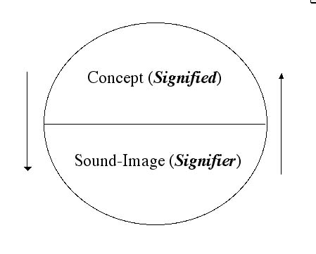
We also call this development.....
Linguistic Turn (def.):
Analytical turn upon (or problematisation of words/language used in a given field of study.
Based on the theories of the Swiss linguist Ferdinand de Saussure who is also
the founder of structuralism

Slide 27
What did postmodernism do to the ’reality’ and ‘truth’ and ‘neutrality’ of the modern historian?
Reality is not representable in any form of human culture (whether written, spoken, visual or dramatic). All ‘reality’ and ‘truth’ is a construction or a represention.
What ‘reality’ is changes from period to period and from culture to culture, and is also dependent on the perspective of the person who constructs ‘reality’ in past and present. What we think ‘reality’ is --- in the past and present – is thus culturally determined and NOT universal or transhistorical. What humans consider as ‘truth’ is also not universal but also culturally determined -- ’truths’ change through time.
Any representation of ‘reality’ therefore can never be complete and no person or technology can replicate the complexity of relations between things or human beings. Therefore there cannot be a universal ‘truth’ about things.
No authoritative account can exists of anything. Nobody can know everything, and there is never one authority on a given subject. No human can ever speak or discover a ‘universal truth’.

Slide 28
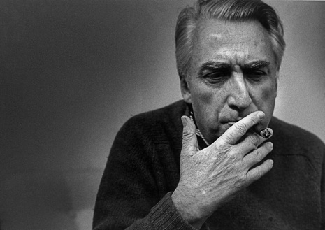
Note: Barthes is first a structuralists (following Saussure) but then turns to post-structuralism
Barthes develop Saussure’s theory further and turns it political.
He moved form a concern with language to the study of structures in culture and everyday life
He politisizes structuralism which was a linguistic endevour at the beginning!
Roland Barthes, 1915-1980
Def. Structuralism

Slide 29
Reasons for Roland Barthes’s enthusiasm for linguistic structuralism
‘The starting point of these reflections was usually a feeling of impatience at the sights of the ‘naturalness’ with which newspaper, art and common sense constantly dress up a reality which, even though it is the one we live in, is undoubtedly determined by history. In short, in the account given of our contemporary circumstances, I resented seeing Nature and History confused at every turn, and I wanted to track down the decorative display of what-goes-without-saying, the ideological abuse which, in my view, is hidden there.
(Barthes, Mythologies, p. 11)
The aim of his structural efforts:
‘The goal of all structuralist activities to reconstruct an ‘object’ in such a way as to make evident the rules of its functioning .’

Slide 30

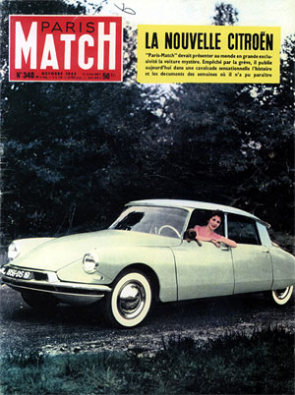
Barthes structural phase....to understand the ideological structure beyond everyday activities such as advertisement
‘The Rhetoric of an Image’

Slide 31
With the ‘Death of the Author’ (1967) Barthes move from ‘structuralism’ to ‘poststructuralism’
Structuralism
knowledge is founded on the "structures" that make experience possible: concepts, and language or signs; an observer can analyse this structure and make it intelligible.
Poststructuralism
Post-structuralist authors all present different critiques of structuralism, but common themes include the rejection of the self-sufficiency of structuralism and an interrogation of the binary oppositions that constitute its structures.
Post structuralists do not reject structure – we need them to communicate and understand the world – but we need to understand that they are human inventions at a particular moment in time (e.g. class)
We need therefore to then we need to de-centre them and problematise them.

Slide 32
Lecture 2, Term II
The Rise of Cultural History V:
Episteme, Discourses, Discipline and Docile Bodies
Dr Claudia Stein

Slide 33
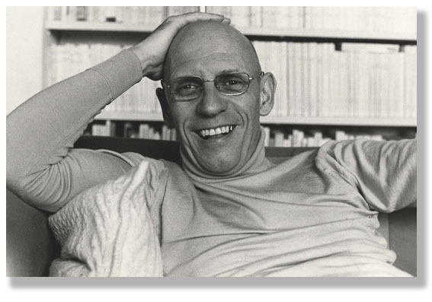
Michel Foucault 1926-1984

Slide 34
Foucault’s life-long interest is the history of the human subject and the self
‘… the interaction between oneself and others and in the technologies of individual domination, the history of how an individual acts upon himself (or herself); I am interested in the technologies of the self and a history of the subject.’

Slide 35
His inspirations:
Linguistic structuralism – we talked about it last week –Saussure
Philosophical thinking of the 19^{th-}century German Friedrich Nietzsche

Slide 36
Working thesis
There is no universal ‘subject’ or ‘self’ (as other philosophers at the time suggested such as Satre) to be ‘discovered’.
We need to study how the self (including our own selves) are historically ‘made’ through specific power relations and techniques

Slide 37
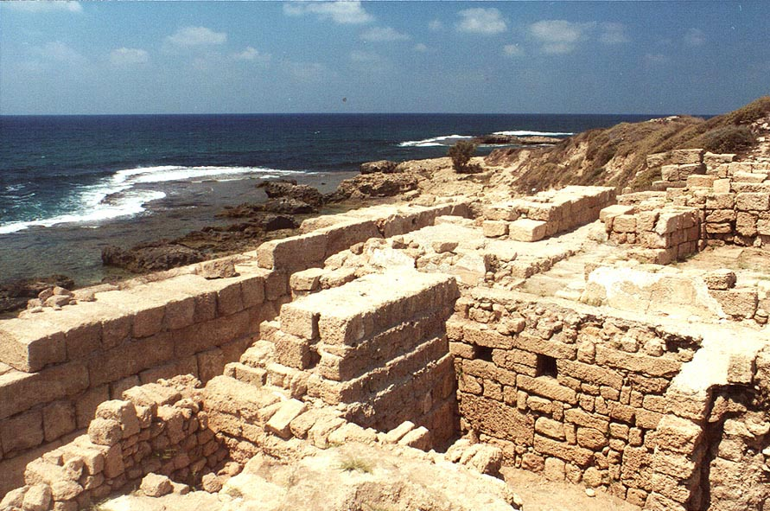
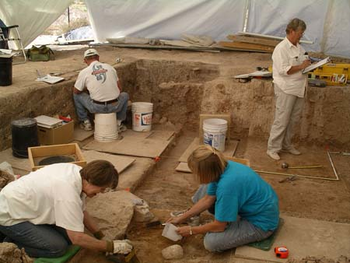
Two methodologies which Foucault develops over time to investigate the question of how the human subject is ‘made’
I. Method of Archaeology
Investigation of the rules of
Language at a given moment
in time

Slide 38
2. Method of Genealogy
A historical causal explanation that is material, multiple, and corporeal (it focusses on the human body).
It is concerned with the analysis of historical ‘emergence’ – not search for ‘origins’
It is conceptualised not as a ‘discovery’, the culmination of events, or as the end of a process of development but rather as a particular momentary manifestation of chances or as a struggle between forces of power.

Slide 39
Geneology is a ‘history of the present’:
The subject matter of this kind of history is the origins of present rules, practices or institutions that claim authority over us. It starts from an investigation of the present.
What claims authority over us now? What makes us think that certain ideas, practices, institutions in the present are ‘normal’)
The aim is not to understand the past for its own sake, but to understand and evaluate the present, particularly with a view to discrediting unjustified claims of authority and power (see slide on Nietzsche)

Slide 40
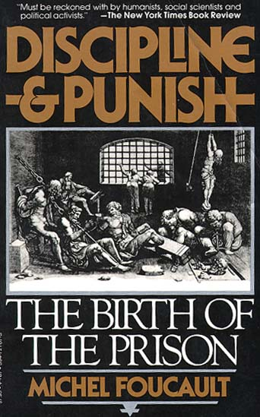
His first ‘history of the present’
Aim of all power struggles is:
The human body
Question:
Why do we think we are more ‘human’ today when it comes to punishment?
Analysis of disciplinary power which emerges since the late 17th century; creates docile bodies

Slide 41
Power according to Foucault...
Power is not a commodity or a possession of an individual, a group or a class, rather it circulates through the social body, and is exercised through a net-like organisation in which all are caught; power is strategic.
Therefore analysis of power begins at the micro-level in order to reveal the particular histories, techniques and tactics of power
Power is always directed at the human body
Power produces knowledge and knowledge always produces power (Power/Knowledge nexus)
power is productive and not repressive. It often produces pleasure. So, we need to start investigation into modern power by choosing something we think is ‘good’, ‘pleasurable’; something that we consider ‘normal’; any investigation has to proceed from there
Power always requires resistance; so to resist power actually supports it.

Slide 42
Recap:
Foucault develops his view of modern power AGAINST prevailing ideas of power at the time, mainly Marxists ideas of power:
1. power as manifestations of a specific mode or configuration of class relations. Power is ‘held’ by the domineering class or individual or in institutions
2. Power is ‘negative’; it supresses, dominates individuals or groups in order
to be kept in the hands of person/group
3. Different views on origin/location of class power and how it is ‘kept’ (e.g. in
forces/social relations of production, in control of the state, or in intellectual
‘hegemony’ over minds (Gramsci)
but common to all of them is.....
4. ....that continuing ‘struggle’ is needed to secure/overturn power

Slide 43
Lecture 3, Term II
The Rise of Cultural History VI:
Biopower and De(constructing) Experience
Dr Claudia Stein

Slide 44
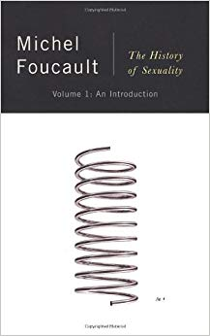
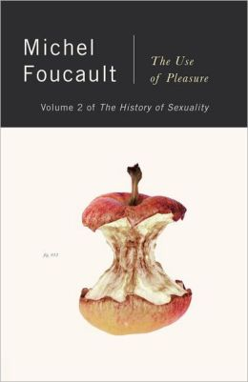
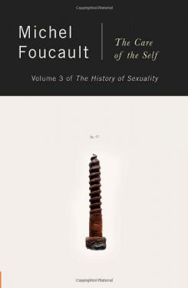
After his book on the prison he starts to think: People are not only part of disciplinary power games which focus on their individual bodies; they are also part of power games as members of a ‘population’
Human sexuality becomes THE central mechanism to exercise power over individual and large population.
sex is individual and is disciplined but also part of state intervention (e.g. sterilization; one-child policies

Slide 45
How does government work? how are people actually governed
‘Biopower’ consists of two components:
Disciplinary control: centres on the body as a machine and its disciplining, the optimization of its capabilities, the extortion of its forces, the parallel increase of usefulness and its docility
Regulatory control: centres on the whole population through technologies such as statistics that traces life/death, disease, productivity, migration etc.
Biopower/biopolitics:
‘I mean a number of phenomena that seem to me to be quite significant, namely, the set of mechanisms through which the basic biological features of the human species became the object of a political strategy, of a general strategy of power, or, in other words, how, starting from the 18th century, modern Western societies took on board the fundamental biological fact that human beings are a species. This is what I have called biopower.’

Slide 46
Why does biopower emerge from the 18th century?
‘without question an indispensable element of the development of free-market liberal capitalism’
‘This biopower… would not have been possible without the controlled insertion of bodies into the machinery of production and the adjustment of the phenomena of population to economic processes.’
(HS, p. 141)
Governmentality: the history of the art of governing people

Slide 47
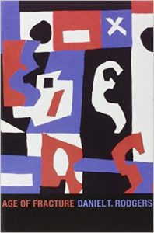
‘French Theory’ travels.....and encounters different intellectual needs
‘French theory’ in the US engages with an entirely different socio-economic and political context
Poststructuralism here helps to rework notions of power and identity in a rapidly globalizing free-market society in which the individual and its self-interest is key
‘Identity’ as a matter of individual choice and performance; a hybrid construct of ‘self-fashioning’; in endless re-construction one the self without a core in order to adapt to new opportunities offered by a globalizing liberal market economy
Robert D. Putman, ‘Bowling Alone: America’s Declining Social Capital’, Journal of Democracy 6 (1995): 65-78.
disappearance of older models/practices of sociability; decline in the use of older notions of power or ‘class’

Slide 48
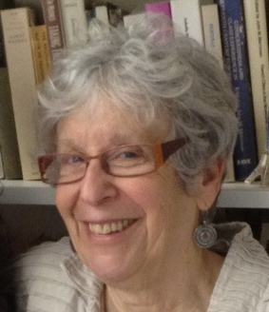
French Theory Travels.....and encounters different intellectual needs...
‘My article (experience) embodied my growing impatience with my fellow social historians who assumed that experience was transparent, that there was a direct relationship between, say, economic circumstances and political action, that there was no need to ask what counted as experience – we could know what that was from a sociological description of the conditions of life of groups and individuals.
The telling point in Toews’ article (articles she was writing against) was the absence of any definition of the term experience – he assumed we all knew what it meant.
My readings of Foucault, Derrida, Freud, Lacan, Irigaray and others had led me to doubt that words like experience were self-evident;
the point was to ask what kind of work they were doing, how they were establishing meaning, how some things and not others came to be included in the term. When ‘experience’ was alluded to by historians what did they mean by the term? What were they including and excluding? How were they measuring the impact of ‘experience’ on the psyches of individuals? How did an appeal to a common experience create a sense of member- ship in a group?
These were the kinds of questions that seemed to me to be left aside when the meaning of experience was taken to be known by historians.’
(Victoria Hesford and Lisa Diedrich, ‘On ‘The evidence of experience’ and its reverberations: An interview with Joan W. Scott’, Feminist Theory 15,2 (2014) 15(2), p. 199)
Joan Scott, 1941-

Slide 49
Theory Applied I:
Women’s History, Poststructuralism and the Questioning of Women’s Experience
Laura Schwartz
Associate Professor of Modern British History

Slide 50
‘gender is a constitutive element of social relations based on perceived differences between the sexes’
Joan Scott

Slide 51
Postcolonial Histories
Professor David Lambert
Historiography (HI323)
10-11am, 19th February 2019

Slide 52
Defining postcolonialism
‘Historiographically, the postcolonial perspective has sought to deconstruct the grand narratives of imperial and national histories deriving often from an Enlightenment vision of a progressive history, in order to reveal or point to suppressed, defeated, or negated histories and stories’
(Duara, 2002, p. 417).

Slide 53
Theory Applied IV:
Global History
Anne Gerritsen

Slide 54

What is global history?
Global history develops from the 1980s; from the US and has strong relations to economic history
History that challenges the dominance of the nation-state narrative;
History that compares or connects different parts of the world;
  How can you know about the uniqueness of anything or anywhere without knowing about other things and places?
History that attempt to understand (aspects of) the ways in which people, ideas and things move;
Histories that seek to explain inequalities between different parts of the world as well as their commensurabilities.

Slide 55
Theory Applied V:
History of Emotion
Joachim Haeberlen

Slide 56
Why a History of Emotions from the 1990?
Dissatisfaction with cultural relativism Hope to move beyond the ‘linguistic turn‘ (everything is a representation, remember)
Hype of emotions in the natural sciences (neurosciences; cogntive psychology etc.)

Slide 57
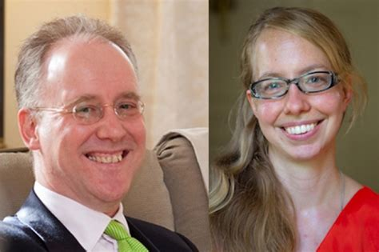
Big Data NOW! Why is it urgent in 2019?
The History Manifesto, 2014
https://www.cambridge.org/core/what-we-publish/open-access/the-history-manifesto
‘A spectre is haunting our time: the spectre of the short term.’
Claim: Short-term history is an expression of a general short-term thinking (critique of today’s short-term economic thinking)
Jo Goldi and David Armitage

Slide 58
The ‘big data’ is now available to do this future orientated history writing:
‘Renewing the connection between past and future, and using the past to think critically about what is to come, are the tools that we need now. Historians are those best able to supply them.’
Buckle anyone?....this is clearly not a new idea that social/natural science methodologies help
To control the future (see lecture on Buckle and positivism)

Slide 59
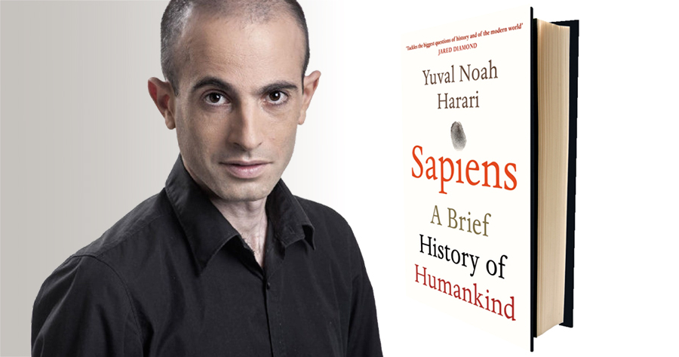
‘Deep History’ combined with ‘Big History’ in Sapiens
What a are the conditions of possibility that makes such history writings so successful today?
Why are we all convinced that human history is driven by evolution?

Slide 60
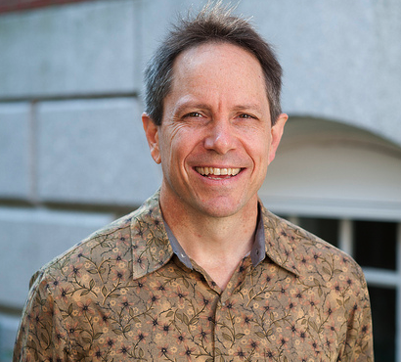
The Grand Narrative of Human Evolution: Deep History
Deep history is a term for the distant past of the human species. As an intellectual discipline, deep history encourages scholars in history, anthropology, archaeology, primatology, genetics, and to work together to write a common narrative about the beginnings of humans, and to redress what they see as an imbalance among historians, who mostly concentrate on more recent periods.
Deep history forms the earlier part of Big History and looks at the portion of deep time when humans existed, going further back than prehistory, mainly based on usually ventures, and using a wider range of approaches.
Daniel Lord Smail,

