Slide 1
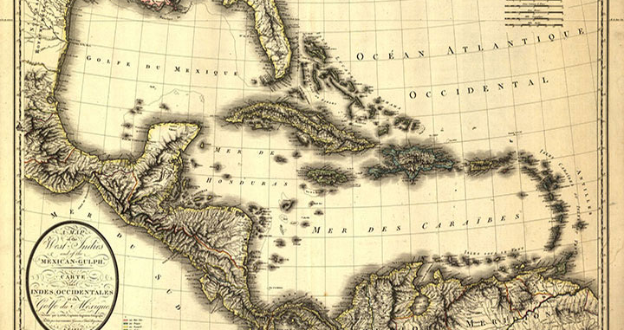
HI341 - Medicine , Empire, and the Body c1750 - 1914
Week 11 – Control of the Caribbean
By Mira and Ramlah

Slide 2
Medicine and Empire by Pratik Chakrabarti, Ch. 3 Medicine and the Colonial Armed Forces
The period between the 17th century and the 19th century was marked by numerous wars over colonial territories between European nations as well as with indigenous peoples which led to economic stress and high number of casualties, with more servicemen dying from disease than battle injuries.
The realization of diseases’ great fatality triggered a shift in European medical practice towards preventative medicine (the focus of the chapter) and tropical medicine. Scurvy used as a case study to depict the adoption of preventative medicine.
By the beginning of the 19th century the navy and military had transformed thanks to implementation of preventative medicine, better humanitarian care, organisation, and discipline.
In the colonies, such medical changes took longer to make an impact, which could be felt only in the second half of the 19th century.
Empires’ successes were strongly aided by these new medical practices, but according to the author a greater factor was the states’ access to labour, resources, and military strategies.
“The benefits of modern medicine and humanitarianism were primarily and predominantly enjoyed by European states, although many of the stimulants of such changes came from colonial experiences.”

Slide 3
Secret Cures of Slaves: People, Plants and Medicine in the Eighteenth-Century World by Londa Schiebinger, Ch.2: Experiments with the Negro Dr's Material Medica
Many new medical cures came from 18th century plantations, typically of unclear and debatable origin. To support her point the author uses the popularisation of bois fer by a slave doctor as a treatment for yaws as a case study.
The African hypothesis - As yaws was an African disease, it is possible for the bois fer to have been previously used as a cure, and the knowledge to have been brought from Africa by the slaves.
The European hypothesis - Bois fer was an established French cure, which the slave doctor learned from previous French masters.
The American hypothesis - It is widely believed by historians that the wood referred to as bois fer by Alexander was Robinia panacoco, which is native to America.
The Greater Atlantic hypothesis - Africans devised the cure using an American plant, bios fer, which was similar to one used in Africa.
“The “Negro Dr” as knowledge broker. A. J. Alexander’s enslaved African seemingly brokered knowledge between the French and British empires.”

Slide 4
*David Geggus, ‘Yellow Fever in the 1790s: the British Army in occupied Saint Domingue,’ Medical History, 23 (1979), 38-58
This reading looks at the pandemic of the Yellow Fever in the 1790’s in Saint Dominique. Wartime expeditions, and the slave trade were seen to be the major cause of the recurring epidemics of the disease.
Characteristics of Yellow Fever – typically affected young men recently arrived from northern climates, it was neither contagious, nor amenable to treatment with cinchona bark, and rarely occurred twice in the same person
There was a high death rate among recently – arrived colonists, whilst local inhabitants have acquired immunity in childhood, or when they had when first arrived in the Caribbean. Wartime was the main tribute to this, because these expeditions resulted in dense concentrations of non-immunes, and coupled with low standards of medical care, nutrition, and the facilitations of excessive drinking as well as poor hygiene, led to huge losses – while Battle casualties were low, the majority died from disease
Climate was also an important factor, which led to the possibility of a dual infection of malaria AND yellow fever - the malaria carrying vectors were impacted by the increased rainfalls of the time, and the water shortages in times of drought caused the yellow fever carrying vector to multiply
Both French and British doctors lacked proper understanding of tropical medicine, and whilst their techniques for treating the disease were very clearly different, they were both ineffective
‘Losses for the military regiments – in comparison to the “Jamaican” regiments, that fared better. By 1796 , 7,530 British troops had died’

Slide 5
Kenneth F. Kiple and Krimhild Conee Ornelas, ‘Race, War and Tropical Medicine in the Eighteenth-Century Caribbean,’ in David Arnold (ed.), Warm Climates and Western Medicine: The Emergence of Tropical Medicine, 1500-1900
This reading looks at the findings from an important group of physicians and their insights of observations regarding differential treatment meted out by these tropical killers to whites and blacks
There was the growing observation being made that these new diseases often ‘struck strangers’ , which include yellow fever and malaria, the British commented on the dramatic resistance that black people seemed to have.
Physicians, when making these observations, questioned whether there was something inherent in the ‘constitution’ of black people, which makes him proof against malaria. (we now know that there was a form of blood resistance that black people had, an anomaly that affords resistance to malaria) but also from acquired resistance that came from having and surviving the disease
Therefore, many slaves, even before reaching the America’s, had hosted the disease in both their, and yellow fever’s homeland, and had acquired a level of immunity. Europeans on the other hand, had no innate protection, and no opportunity for acquiring resistance.
These observations amounted to an adoption of policy to substitute black troops for white troops in the West Indies a policy that put black disease resistance to work for the empire – few whites would likely to opt in for service in the West Indies, so there was use of slaves, to spare the lives of white troops
‘the tropical physicians had saved thousands of white lives by spying the blacks' ability to escape fevers.’

Slide 6
Questions for discussion :
Do you think the transition to preventative and tropical medicine reflects the history of colonialism? If so, how?
In what ways did race shape tropical medicine in The Caribbean?

