Slide 1
The control of the Caribbean
By Abbie and Marcia

Slide 2
Rana A. Hogarth, Medicalising Blackness: Making Racial Difference in the Atlantic World, 1780-1840, pp.48-77
The Americas saw the rise of hybrid medical knowledge. Enslaved Africans would combine African, Amerindian and European healing practices to treat and cure their maladies
Hogarth portrays enslaved Africans as medical innovators, as they experimented with methods that often outperformed European methods. This was especially true of the ‘N*gro Dr’ in Grenada who treated yaws with sweating and plant based medicine. Many enslaved people became intermediaries
Despite this, European physicians who documented and circulated medical knowledge rarely credited enslaved people for their medical advancements. Many enslaved healers would refuse to share their knowledge to resist exploitation
Europeans often misattributed medical knowledge. Cures that originated from indigenous or enslaved people were often either dismissed or absorbed into European medical literature without proper recognition
European plantation owners frequently used enslaved people as test subjects for medical experiments, such as Alexander J. Alexander, who relied on the coerced participation of enslaved patients
“Thereafter, he put the slave in charge of all yaws patients in his plantation hospital, and at the end of the 2 months, all but 10 of the original 32 had been cured” pg.51

Slide 3
Kenneth F, Kiple & Krimchild Conee Ornelas, Race, War and Tropical Medicine in the Eighteenth-Century Caribbean, pp. 65 - 79
Disease, particularly yellow fever, greatly hindered European powers and their ability to maintain control and defend their Caribbean possessions. (Eg. France lost almost their entire Caribbean empire to GB, but were able to get it back bc GB troops suffered from yellow fever)
Diseases often influenced the status quo, as they disproportionately impacted European forces, and altered the cost-effectiveness of military actions; the possibility of disease had to be taken into consideration and European troops would time their projects around times of lowered mosquito population.
The spread of diseases was intensified by the conditions of the Caribbean, such as the tropical climate, increased trade and the movement of people and ships
The Caribbean’s climate and standing water helped to spread diseases, which was facilitated by ships and sailors. Yellowfever transmitted by the Aèdes aegypti mosquito and malaria were major concerns, especially as the lethality of Yellowfever increased between c17 & 18
Colonial medicine as deeply influenced by racial theories; often non-European populations were portrayed as inherently different, as they often had greater immunity to Yellowfever
“In the latter year Thomas Trotter… wrote bleakly that Yellowfever was so bad that any further campaign in the West Indies ‘is now considered as little better than a forlorn hope’” pg. 70

Slide 4
J.R. McNeil, The Ecological Basis of Warfare in the Caribbean, 1700-1804, pp. 26 - 42
Disease played a crucial role in the Caribbean during c18, as it influenced the status quo and impacted things such as the Hiatian Revolution.
The two most significant tropical diseases were yellow fever and malaria. Yellowfever, transmitted by the aèdes aegypti mosquito, had a higher mortality rate for non-immune populations, which increased markedly from the 17th to 18th century
These diseases were especially prevalent in the Caribbean due to things such as the climate and standing water. Tropical diseases were also spread by the mass movement of ships and and sailors as a result of the Trans-Atlantic Slave Trade. Although such mass movement was also prevalent in West Africa, the difference in climate and higher proportion of immune population meant that it was less of a problem
European colonisation efforts were significantly impacted by the presence of disease; locals would utilise the European susceptibility to disease to help them in their revolutions (Haitian Revolution). It also often dictated the outcome of colonial wars, especially disadvantaging the British
The presence of tropical infections significantly altered the effectiveness of military actions.
“So Europeans tried to conduct their attacks in the Caribbean in a five or six month period between December and May, thereby reducing the variety of dangers they faced” pg. 34

Slide 5
Doctors and slaves:
A medical and demographic history of slavery in the British West Indies, 1680-1834 - Richard B. Sheridan
Ch. 1: The Disease Environments and Epidemiology
Immunity to disease based on exchange between environments.
Outside influencers disrupt the balance of ecosystems.
Reports and writings including statistical data were used to interpret the differences between black and white people on their susceptibility of diseases.
  Discourse of the State of Health in the Island of Jamaica (1679), by Thomas Trapham, Jr.
  Observations on the Changes of the Air, and the Concomitant Epidemical Diseases of Barbadoes (1759) by William Hillary.
  A Treatise on the Scurvy (1754) by James Lind.
  An Essay on the More Common West India Diseases; and the Remedies which that Country itself produces: To which are added, Some Hints on the Management, &c, of Negroes. By a Physician in the West Indies (London, 1764) by James Grainger.
“People who inhabit isolated disease environments are highly susceptible to exotic diseases brought in by people from other disease environments. The most significant immunities are acquired, not inherited.” p. 3.
Notes:
The reasons for this relocation and subsequent cause in the transference of disease by migration can be linked to refugees, pilgrims, nomads, migrant labourers, armies, and others.
“Columbian exchange”- discovering America offset the balance of the ecosystem leading to the exchange of both microparasites and macroparasites- firearms and new enforced ideologies but also dangerous diseases.
Disease environment was less hostile to the invading Europeans- far worse for the indigenous people. ”disease shock”
Exchange also with plants and animals as we’ve looked into before-> rapid growth in population
Amerindians died by the millions due to this disease exchange
The West Indies: populations majority black slave labourers- slave plantation system for economic endeavours between islands and the mainland
British West India colonies exports: sugar, rum, molasses. Exceptions Jamaica, Dominica and Grenada- coffee and cotton.
Ratio of 1-13 betw whites and free and slave black people- threat to public order and racial subordination
Ratio sometimes more- th4 military force vital for maintaining order
Malaria and Yellow Fever: shortened lifespans considerably for all
Very good at explaining definitions- easy to read and understand
Malaria- infected mosquito hosts- debate as to where it came from- some say Americas but most see that it was due to the Atlantic slave trade and was transmitted from Africa
Helped depopulate lowland tropical areas that opened up areas for Euro plantations to take over
YF- also mosquito hosts- high mortality and morbidity to nonimmune people- significant in military operations led to change of plans etc
Lots of detain- young 14 and under and women less likely to die- strange, black people less likely to get it than white people
Army Medical Report: “Alexander M. Tulloch, captain, 45th Regiment, and Henry Marshall, deputy inspector general of hospitals, were appointed to search the voluminous historical records accumulated by the Army Medical Board since 1816 and report their findings to the secretary at war.”
Wide range of mortality rates across British Emp
Compares between West Africa white black mortality rates compared to the West Indies: the rates show that white people 1/6th mortality in WA to WI, black people DR= WI 1/3 greater than WA
Malaria = 90% of the deaths from fevers; yellow fever & typhus = other 10 percent.”
Dysentery also a prob- 1in5 fatal
Black troops “better seasoned” to WI climate- disease raking: first lungs, then stomach and bowels, then fevers
Male black troops died more than the slaves- but most likely underreported
“Because of their immunity to malaria and yellow fever, black regiments were recruited and dispatched to parts of the British Empire where European troops had been plagued with tropical diseases.”
Report was released after the emancipation of slaves in the Brit Emp
Epidemiology: “as the study of the distribution and determinants of diseases and injuries in human populations”
“epidemiology draws on demography to supply information on age, sex, race, geographical distribution, and occupation”
History of humoral medical theory- balance between hot and cold, dry and moist humors
causes: god, environment, contagion and difference in resistance
Slave medicine important in economic terms: DR had to be below the rate of BR or else price for slaves would rise with their commodity they were selling
Indig diseases of Africa called for a surge in looking into the local folk medicines
Also a push for better standards of living- diet, housing, sanitation, work load and punishment etc
Thomas Trapham, Jr: dr lived in Jamaica- wrote first eng book on tropical medicine
Racist views throughout- explained the origins were that those infected were inferior races
Sir Hans Sloane: euro dr- went about disease experimenting the theory of humors- hard to support in practice
His medical practice more aimed at white people, but a little attention to black people too
Disliked af folk medicine and indifferent to slave treatment
William Hillary: his book looked at the link betw disease and the weather- linked to the hot moist month being bad in the spread of disease and the dry cold months having very little
Fever classification not looked into as well
Fever books:
James Lind: lemon juice for stopping disease
Unhealthy countries: quick temp changes day to night, fogs and stagnated air, rotting meats and sandy soils
“fevers and fluxes”, tropical countries: wet and dry seasons
Slave medical manuals: importance = treatment>causation
James Grainger: first doctor to write a medical manual for the treatment of slaves in the British West Indies
Slave owner himself- saw that if they worked on Christian values they were better servants and thus treated less severely
Important to season slaves properly
Stressed the importance of better standards of living in general not just better treatment for when they got sick
David Collins- dr owned slaves also agreed that it was the conditions that lead to more deaths, th4 improving management improved their health that then improved their labour efficiency

Slide 6
Secret Cures of Slaves:
People, Plants, and Medicine in the 18th-century Atlantic world - Londa Schiebinger
Ch. 2: Experiments with the Negro Dr's Material Medica
The mixture of enslaved Africans sent to the New World ensured that there was no single “pure” African medical regime. The medicine also mixed with indigenous methods too.
“Africanization” of food systems on Caribbean plantations also brought medicinal plants. There was a “fusion of two tropical farming systems: African and Amerindian.”
All learned from each other, but methods of this exchange were not all willing to share their secrets.
The study of Yaws and how experimentation led to a cure not from a white surgeon but from a black slave.
Notes:
Indigenous methods, despite being called savages were crucial in the learning of cures for diseases such as dysentery.
Woman that didn’t want to share her healing cure to stomach issues. Europeans spied on her and found out how to cure it.
Another example of exchange- observation and experimentation from euros used by Africans- hot springs to cure movement pains
Goes into detail about the Guinea worms and black nurse practices
AJ Alexander’s experiments with his “Negro Dr’s” cure for yaws in 1770s
Experiments designed to enhance the efficiency of his plantation and his enslaved workforce
Yaws: tropical disease sores affecting the skin bones and joints
Originally thought to be a venereal disease (sexually transmitted)- surgeons used a standard mercurial treatment- didn’t work so he took things into his own hands
Got a slave to treat two patients- goes into detail on the treatments- within a fortnight they were cured in comparison to the still suffering surgeons patients
“Negro Materia Medica”
Yaws was associated with slaves and moreover sexually transmitted so if white people got the disease the stigma around it meant that they were banned from elite society until cured and even then social status was ruined- unlikely to marry and potentially even commit suicide
Yaws hut banishment- cared for by an old slave woman
“The whole operation was calculated to transpire “without any expence to the estate.””
Difficulties in understanding where what parts of the process of treatment was from Africa and what wasn’t- ex sweating actually galenic medicine method well-known to Europeans
The use of terms in the process such as bois royale and bois fer refer to the French but Alexander tied them to the black man that used them
Questions: is bois fer African or American? Is the tree indigenous to Af or Am or both? Was it trial and error or a known method from the Amerindians or even the French?
Despite the speculation, it was clear that the process worked and so it spread across the Caribbean adopting differing techniques but ultimately using the same steps such as sweating but also emphasising other factors such as better diets
Still- exploitation of slaves as experimental objects to be studied

Slide 7
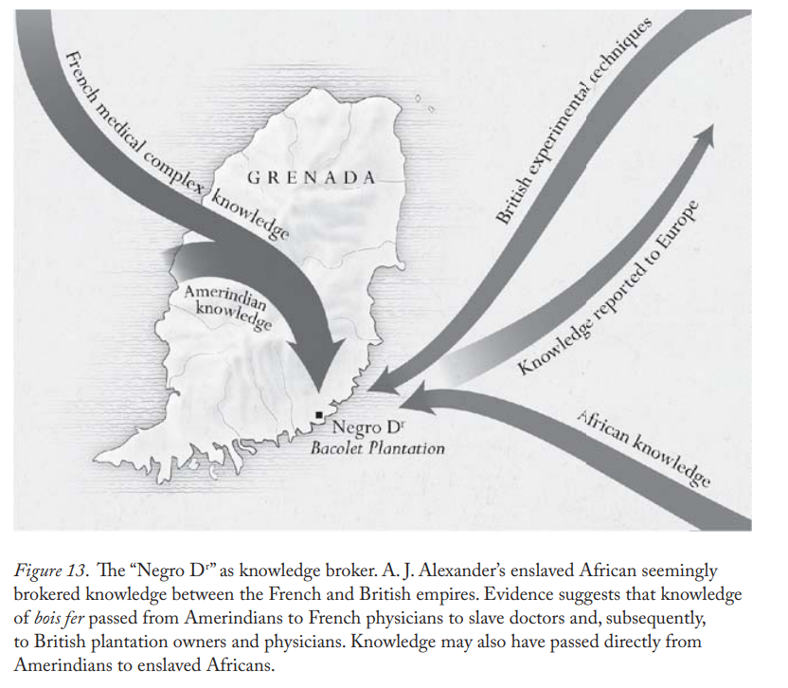

“Slaves either learned its medicinal virtues from Amerindians or experimented
with it on their own. This would be true of any plantation medicine that featured indigenous American plants, such as ipecacuanha, jalap, or cinchona.
Sometimes Africans curated Amerindian cures; sometimes they combined
Amerindian techniques with their own to create something new. At other
times, Africans found indigenous American plants and devised cures necessary for their own survival.”
p. 47.
p. 63.

Slide 8
Questions to Consider:
How does the study of disease and medicine impact slave/owner relations?
In what way does the study and publishing of knowledge surrounding disease and medicine improve its method?
How does objectivity seen in the West Indies process of medicinal treatments link and/or differ to the objectivity seen in Africa?
Thank you for listening ☺

