Slide 1
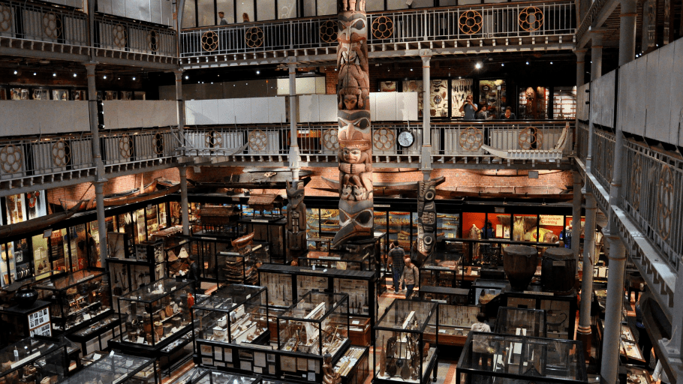
‘Collecting Empire’ – Term 2, Week 8 ‘Medicine, Empire and the Body, c.1750-1914’- Rosa Kazaz

Slide 2
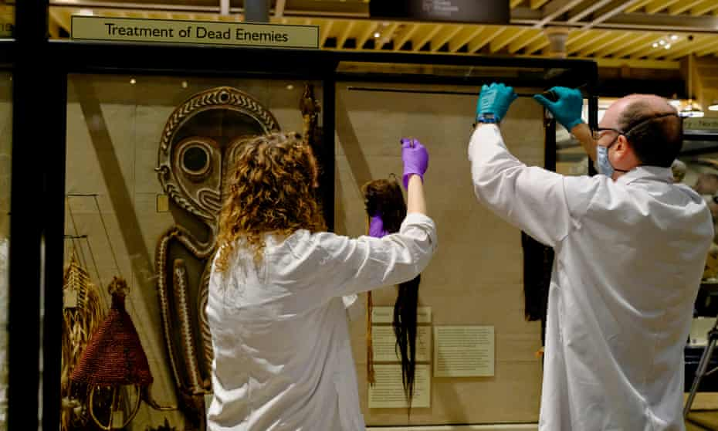
William Ryan Chapman, 'Arranging Ethnology: AHLF Pitt Riers and the Typologial Tradition,' in George W. Stocking Jr (ed.), Objects and Others: Essays on Museums and Material Culture (University of Wisconsin, 1985), pp. 15-48.
Illustrative quote: “In the history of anthropology, the name Pitt Rivers is indissolubly linked to a museum, and to the "evolutionary" principle of its organization-which like the name, was specified in the terms of a bequest (bequest means legacy).”. (p. 449)
Nineteenth century and the interest in displays being organised.
Pitt Rivers collection contrasting with The Christy collection, for example, which was geographically sorted.
The rifles collected by Pitt Rivers displayed to show technological progress and superiority. Interest in skulls and ideas of human development/hierarchy being formed around it. Craniological evidence important for Pitt Rivers.
Emphasis on the exotic rather than the antique.
Chapman discusses history being reconstructed.
Staff removing the shrunken heads, or tsantsas, from Peru and Ecuador, from → the ‘Treatment of Dead Enemies’ cabinet

Slide 3
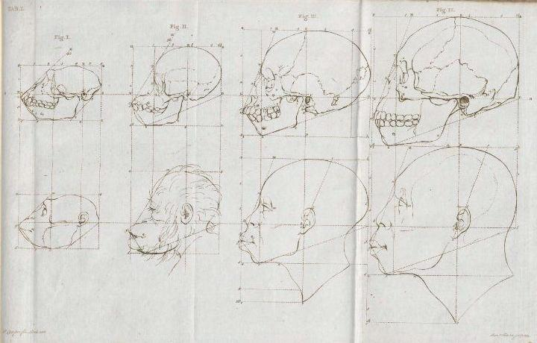
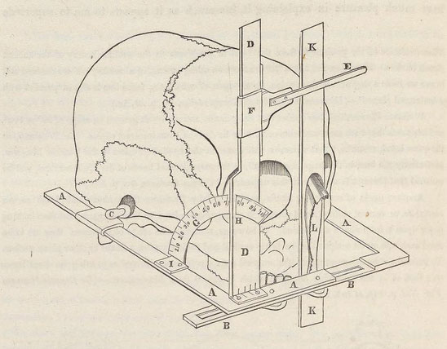
Nelia Dias, 'The visibility of difference: nineteenth-century French anthropological collections’, in MacDonald, Sharon (ed.), The Politics of Display: Museums, Science, Culture (London, 1998)
Illustrative quote: “In their search for differentiating characteristics of the skull and of the face in human groups, anthropological studies focused on the Other—inferior races, women, idiots, criminals. In the process, they confirmed the latter as objects of difference and otherness.”. (p. 33)
Samuel George Morton and craniology.
Issue of objectivity and anthropology being challenged as it entered the public sphere.
The process of cleaning bones/skeletons and making them ‘natural objects’.
Topinard emphasising the visual displays. International exhibition of anthropological sciences in 1878.
Léonce Manouvrier challenging the reality of ‘facts’ shown by anthropologists using instruments and
proposing they are artefacts instead. Mathematics making it seem more objective.

Slide 4
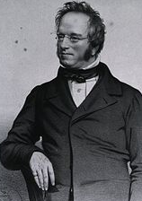
David van Keuren, 'Museums and Ideology: Augustus Pitt-Rivers and Social Change in Later Victorian Britain,' Victorian Studies 28 (1984), pp. 171-189.
Illustrative quote: “Using criteria of comparative relative homogeneity and simplicity to chronologically order similar sets of artifacts, the researcher could establish a sequence of material objects which displayed the progress of culture from the more to less primitive...”. (p. 176)
The Museum Movement.
Idea of private and public.
J. Edward Gray and the two intentions that a museum serves.
Similar point to the Chapman reading about the typology of organisation in Pitt Rivers.
Audience!

Slide 5
Questions
Do you think Edward J. Gray’s idea of education through the museum was genuinely possible when the objects were displayed to show hierarchies?
Considering audiences going to the Pitt Rivers, how accessible do you think the museum was/is?
Pitt Rivers Strategic Plan 2017-2022: https://www.prm.ox.ac.uk/sites/default/files/prm_strategicplan2017-22-foronlineuse-singlepages-ilovepdf-compressed.pdf

