Slide 1
HI34i: Medicine Empire and the Body
Week 12: Collecting Empire
N.B. This presentation contains images of human remains

Slide 2
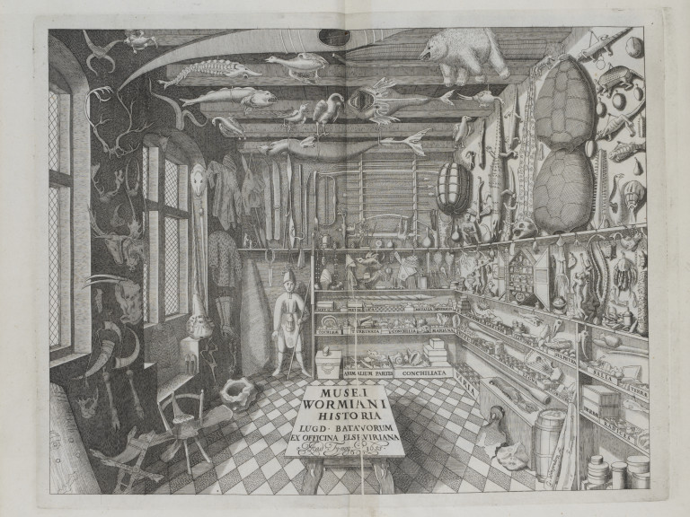
‘Natural History’ and Cabinets of Curiosity
-Collecting the ‘exotic’ (‘unicorn horns’)
-Rare plants and animals from around the world
-Aided by exploration and imperialism
-Interest in diversity and classification
-Keeping examples of extinct species (e.g. Worm’s Great Auk)
‘Museum Wormianum’ of Ole Worm (1588-1654)

Slide 3
Hans Sloane and the
British Museum
-Hans Sloane (1660-1753): Physician, Collector, President of Royal College of Physicians and Royal Academy
-Travels to Jamaica (1687) as personal physician to the Governor. Collects 800 plants and other live specimens… Keeps collecting from contacts on his return to London.
-By the time of his death, he had acquired c.71,000 objects, including coins, books, herbarium, antiquities
-Leaves whole collection to the nation in return for £20,000

Slide 4
Enlightenment Taxonomies and
‘the Order of Things’

Slide 5
Popular Collecting in the Nineteenth Century
How We Went Birds'-Nesting: Field, Wood and Meadow Rambles, by Amanda Bartlett Harris (1880)
Advertisement (Boston, 1887)

Slide 6
Scientific Societies, Collections and Museums
Scarborough Rotunda Museum (from 1829)—Collection of Scarborough Philosophical Society and geologist William Smith

Slide 7
Colonial Scientific Societies and Museums
Tasmanian Museum and Art Gallery—Zoological Gallery

Slide 8
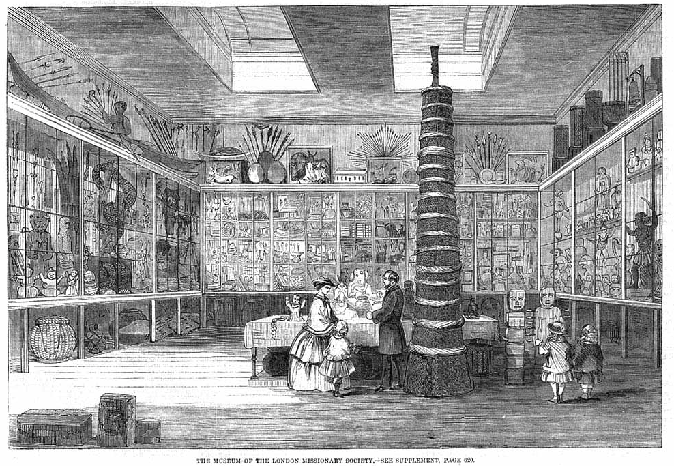
Missionaries and Museums

Slide 9
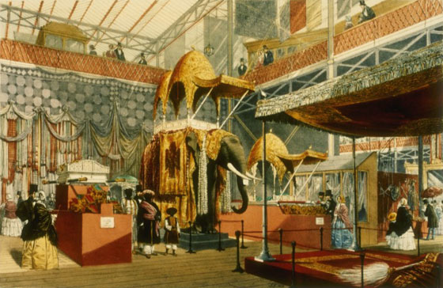
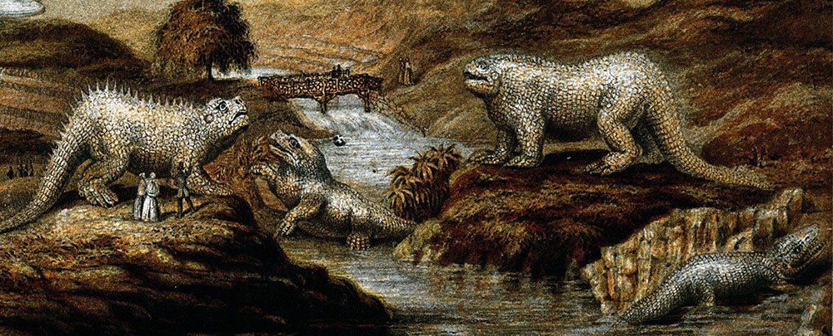
Science, Culture and Imperialism at the Great Exhibition (1851) –
The Victoria and Albert Museum
-An estimated 6 million visitors

Slide 10
Human Remains, Natural History, and Comparative Anatomy: Hunterian Museum
Drawing c.1842
RCS Website, 2018

Slide 11
Museums and Racial Anthropology
Manchester Anatomical Museum, c.1890

Slide 12
1879

Slide 13
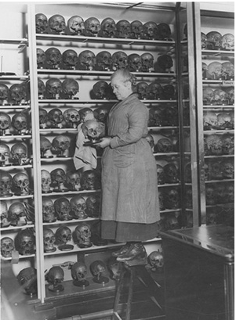
Craniological Collection, Hunterian Museum, RCS

Slide 14
Oxford University Museum, c.1887

Slide 15
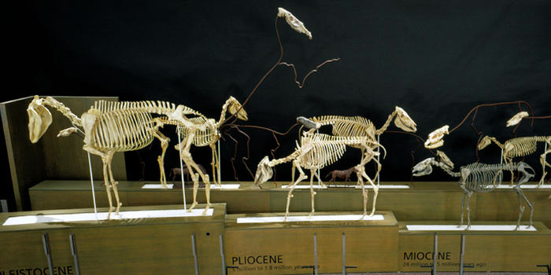
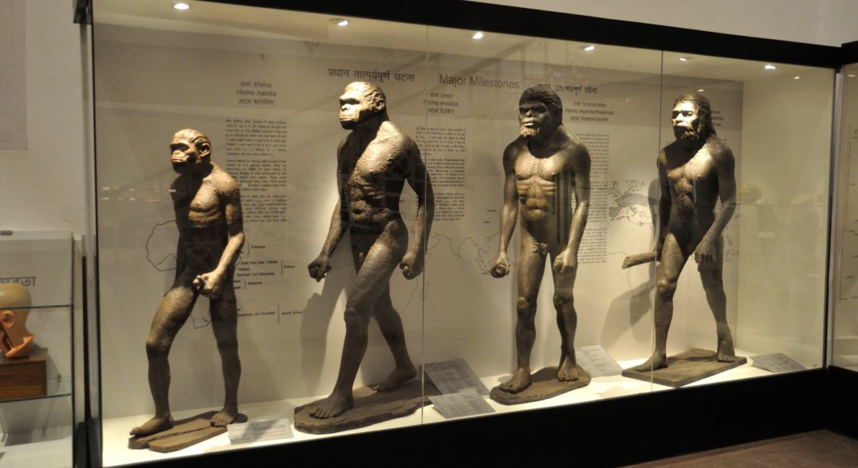
Evolution in the Museum
American Museum of Natural History (New York)
Indian Museum (Kolkata)

Slide 16
Evolution as an organising principle
‘Museums functioned as the most widely accessible public forum to underscore a positivist, progressive and hierarchical view of the world, and they gave that view material form and scientific legitimacy.’
-Steven Coon, Museums and American Intellectual Life, 1876-1926 (Chicago UP, 1996)

Slide 17
Anthropology and Evolution
Spurred by archaeological discoveries revealing remains and tools of early hominids.
Contemporaneous with diffusion of evolutionary theory throughout the natural sciences
Allows anthropologists to see biological processes operating not only at the physical level, but at the societal one. Both physical and socio-cultural anthropologists leverage this idea to promote the scientific status of their approach.
Inspires Pitt-Rivers’ ‘typological’ approach, which explicitly sought to demonstrate evolution of technology.

Slide 18
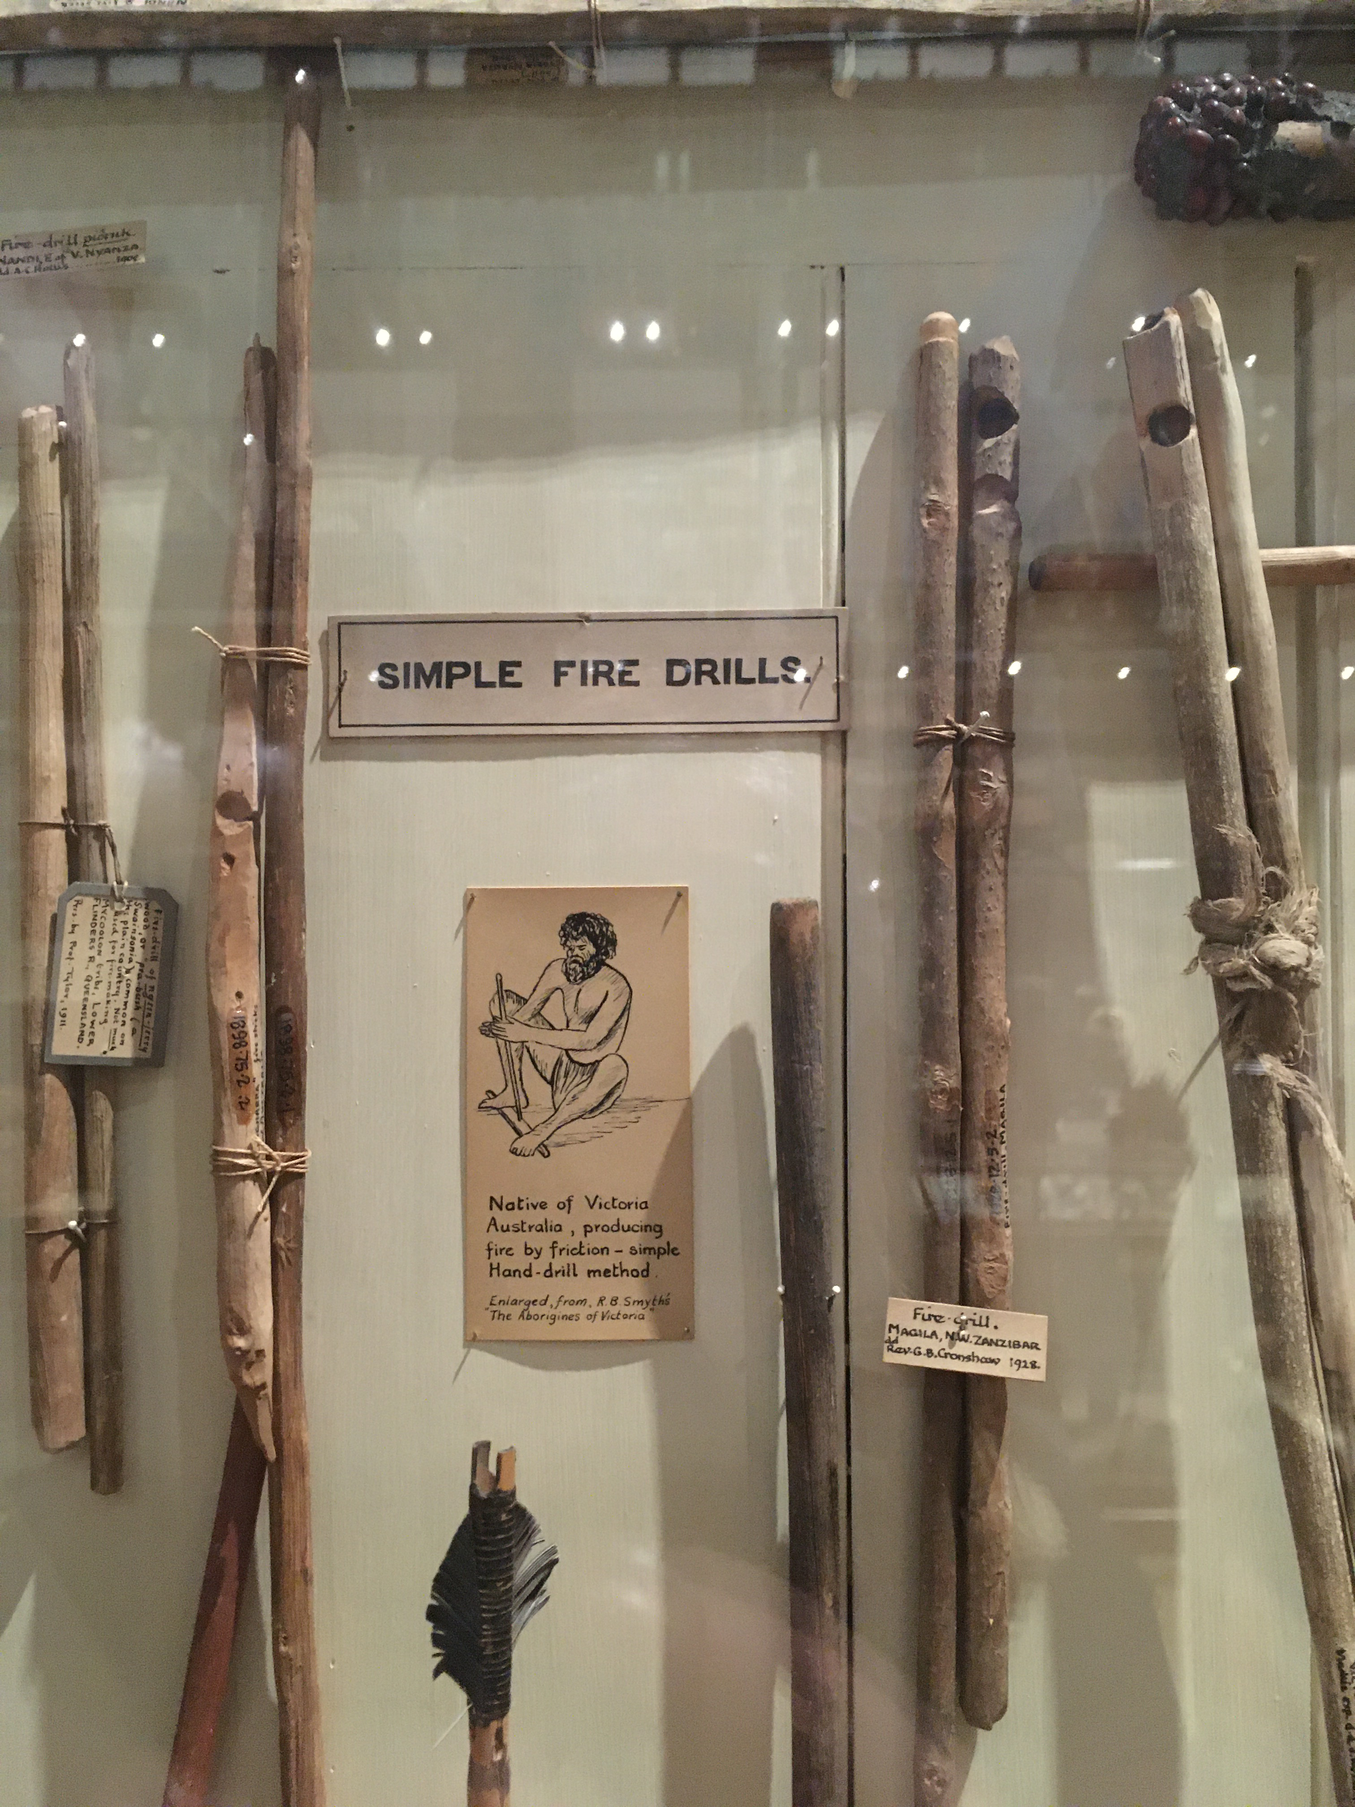

Slide 19
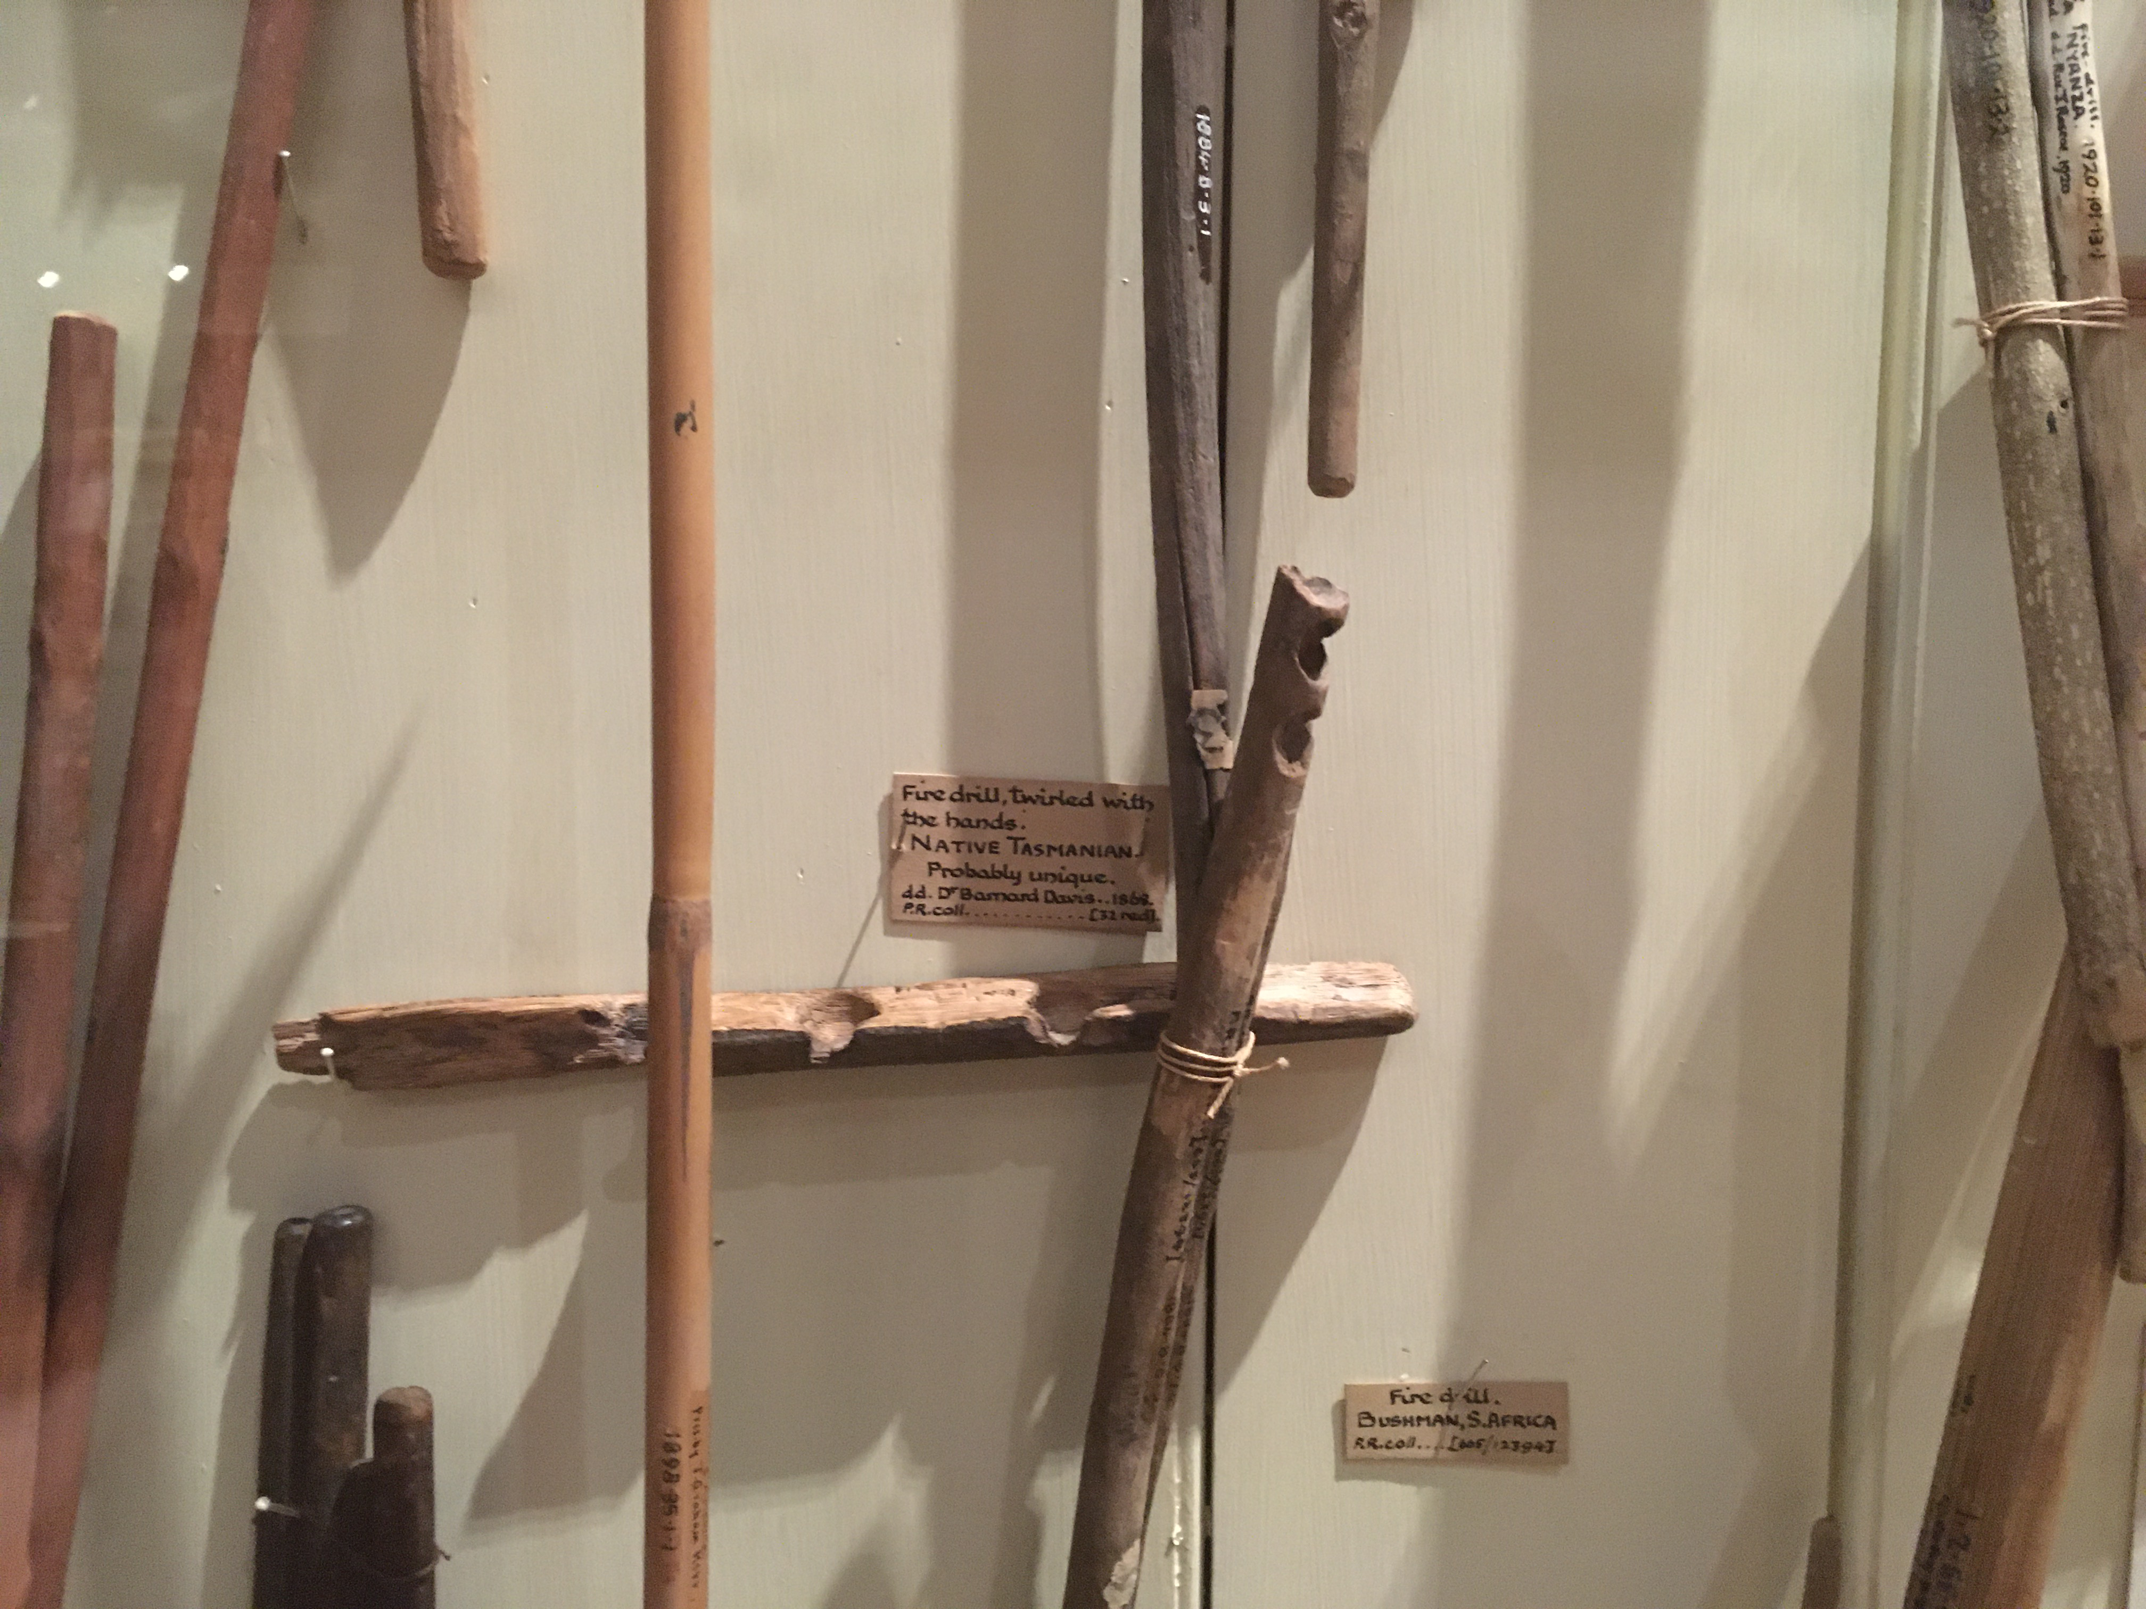

Slide 20
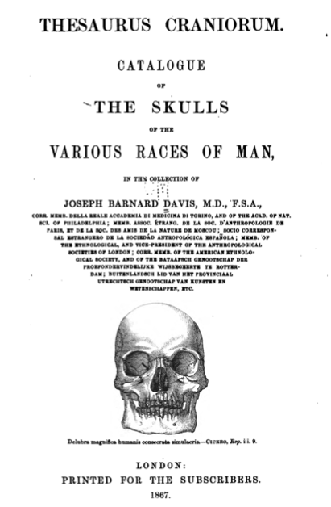
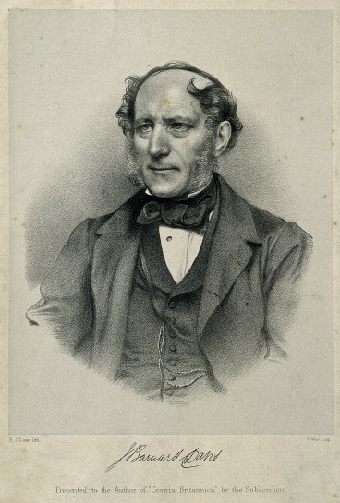
Joseph Barnard Davis (1801-1881)

Slide 21
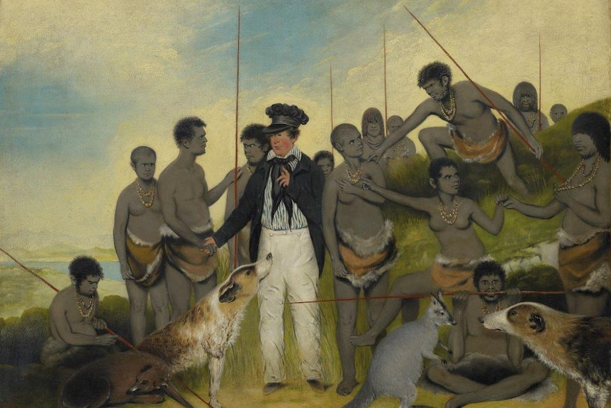
‘The Conciliation’ by Benjamin Duterrau (1840)

Slide 22
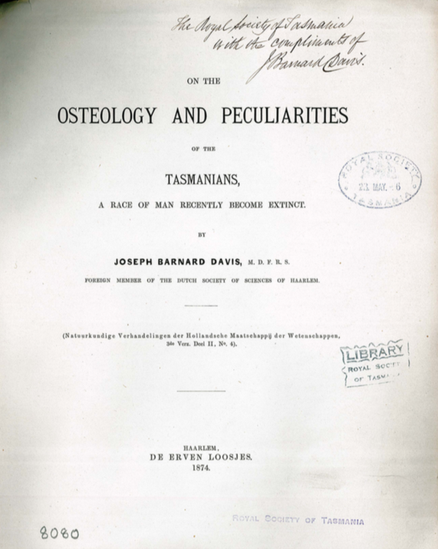

Slide 23
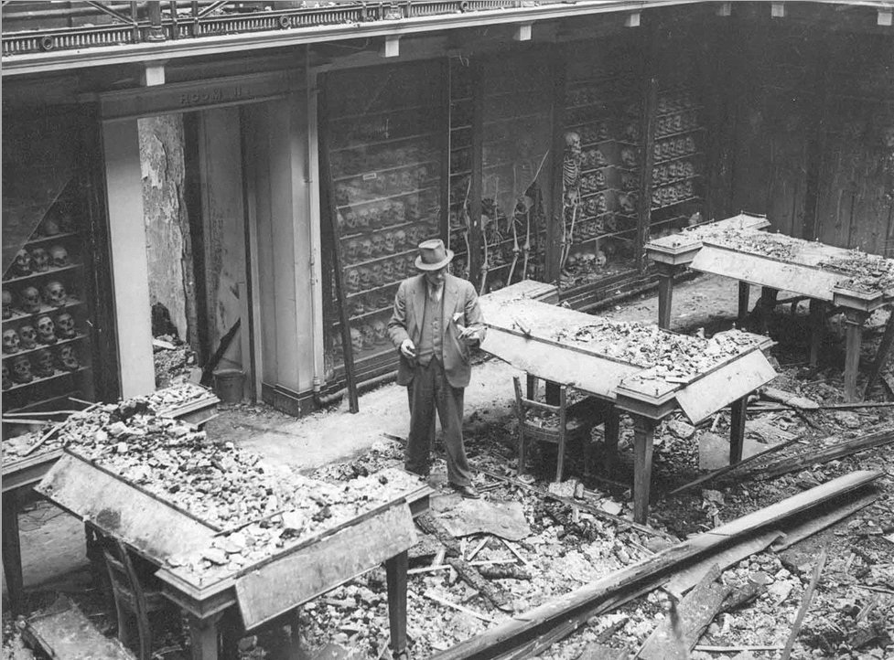
Royal College of Surgeons,
1941

