Slide 1

Evolution, Anthropology, and Racial Science
Week 9:
By Mackenzie and Emily

Slide 2



Michael Banton, Racial Theories (Cambridge: Cambridge University Press, 1998), Ch. 4, ‘Race as Subspecies’, pp. 81-116
‘With the recognition that plant and animal populations were distinguished by the gene frequencies they had acquired in the course of evolution… a new foundation was laid for biological science’ (p. 116).
Charles Darwin’s theory of evolution subsumed the two main views of human diversity, prevalent in the 1850s, within a new synthesis which explained both change and continuity.
Darwin was led to his infamous theory of evolution through English economist, cleric and scholar Thomas Robert Malthus in his theory of overpopulation and human competition.
Darwin also worked with a new conception of genealogy and theories of genealogical inheritance that challenged other concepts of the time.
His theories were not, however, accepted without resistance and they caused much contention within the field. As Banton puts it, ‘the change-over to a Darwinian mode of explanation was neither simple nor straightforward’ (pp. 88-89).
By the time Darwin came to write The Descent of Man, he was following other anthropologists in applying his theories of natural selection in terms of eugenics.

Slide 3
Stephen J. Gould, The Mismeasure of Man (New York: Norton,1996), Ch. 3 ‘Measuring Heads’, pp. 105-141
‘Evolutionary theory swept away the creationist rug that had supported the intense debate between monogenists and polygen­ists, but it satisfied both sides by presenting an even better rationale for their shared racism’ (p. 105).
Charles Darwin’s evolutionary theory provided an anthropological concept that unified polygenists and monogenists alike through providing a theory of racial difference that satisfied both groups.
In the nineteenth century there was a new authority that was assigned to statistics and numbers. Academics sought to support their claims of race and racial distinction with numerical data, as if it made them factual.
These empirical, data driven “scientific” studies were entirely based upon prior racial prejudice. Before undertaking these anthropological studies there was already a pre-determined outcome in the mind of the those carrying it out; they were already looking for the conclusions which they drew.
The groups which craniological and anthropological studies such as these determined to be inferior were interchangeable.
Anthropology, and more specifically craniometry, became a public and press sensation in this period.

Slide 4
Discussion Questions:
To what extent was racial science a dominant field within both the academic community and wider public sphere?
How did Darwin’s theory of evolution challenge and unify current anthropological understandings?

Slide 5
Suman Seth Constitutional selection: Darwin race and medicine

Slide 6
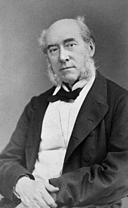

William Fergusson
Darwin read the works of Fergusson who spoke of the “negros” being immune to the endemic.
Fergusson wrote about how Europeans with thick skin and dark hair could withstand marsh poison better.
He then investigated the Austrian aborigine declining and said it was down to 3 things
1)introduction of spirits
2)loss of wildlife
3)European disease

Slide 7
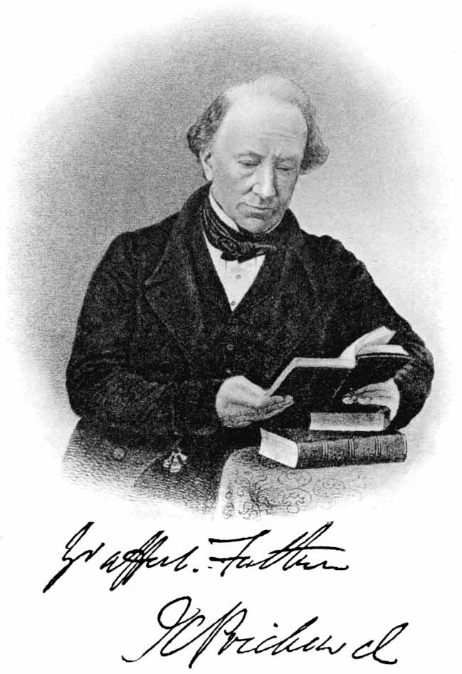
James Prichard
Wrote about the history of man and prichardian paradigm.
Which was the idea that different anatomical structures might support the idea that all humans are a different race.
He also spoke about immunity and suggested it can be inherited.
Therefore, race must have existed since the world began.

Slide 8
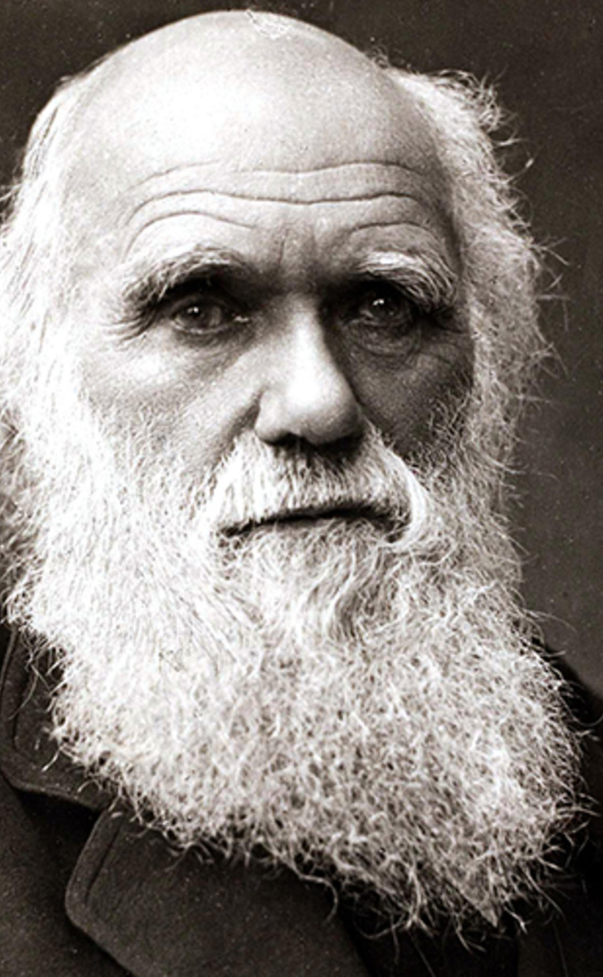
Back to Darwin
From reading these he was left with 2 ideas.
1) immunity is related to complexion
2) racial immunity is from origin
He uses sexual selection as explanation, this stated that those who have the preferred feature (white) would get more mates and thus pass the gene on more.
People want aesthetic partners and so race is sexual and not natural.
Darwin used an example of black pigs to explain this:
Black pigs in Virginia who are exposed to to a certain nut develop red bones, but white pigs lose their hooves and perish.
This was backed up by Olge who said animals' sense of smell is related to the pigmentation near the nose and therefore differs.
Colour has an impact .

Slide 9

Further developments.
This was then elaborated by Nott and Glidden who spoke about ugliness of the “negro”
Knox also speaks about ugliness of race and concludes that race could be habitual. However, this is then developed by looking at language and how it differs from continent to continent and so we must be different species.
Nothing much came of this idea it was was just brushed over.

Slide 10
Darwin's conclusion
1) Different immunities were markers of race not species
2) immunity is innate
3) immunity doesn’t explain race

Slide 11
Thomas F Glick Anthropology of race across Darwinian revolution

Slide 12
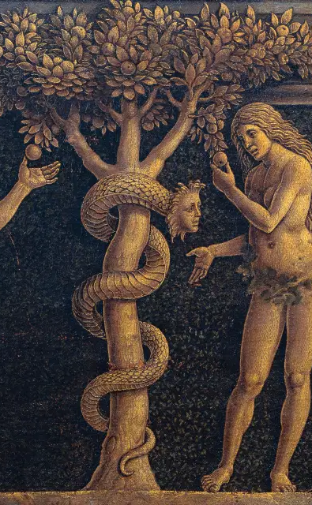
Before Darwin
America thinkers Morton and Glidden produced the idea of polygenesis which stated that race is from different sites and so we adapt to the environment.
All humans are descents from Adam and Eve, and so race is a slow adaptation to the environment.

Slide 13
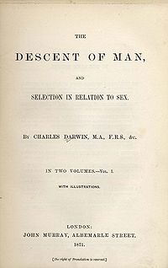
Darwin's anthropology
Hobbs and Smith spoke about sympathy being a natural impulse in humans.
It's developed through natural selection as one of the most important elements of social instinct.
Darwin wrote about this Decent. Naming the idea “reversive effect evolution” whereby he means that these instincts are developed by struggle.
Saying that its crucial to note that society does things to harm the best of society… we sent the best men to war! As a result, society degenerates rather than progresses.
Therefore natural selection acts tentatively.
There was also the idea that primitive people are much more child like than Europeans.

Slide 14
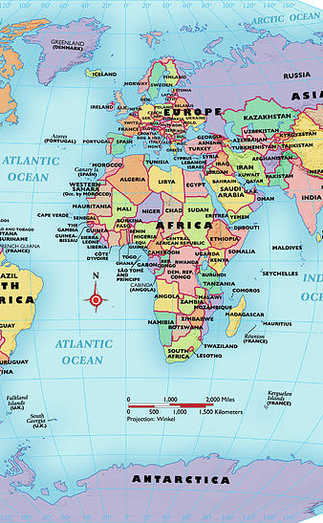
Medical ideas abroad
America- The accept the racist ideas very well arguing primitive people are fixed at a lower stage of evolution and so are prone to extinction.
France – Société d’anthropalgic de Paris founded in 1859 took this view. Broca was the main thinker and said that polygenes is caused by hybrids and then these people are infertile.
Germany- was liberal with ideas and influenced by Virchow. He investigated Jews and called them the national race. 1890 they adopted Darwin's idea of race and perused it.

Slide 15
The origin of human races and the antiquity of man deduced from the theory of natural selection (primary)
Alfred Russell Wallace

Slide 16
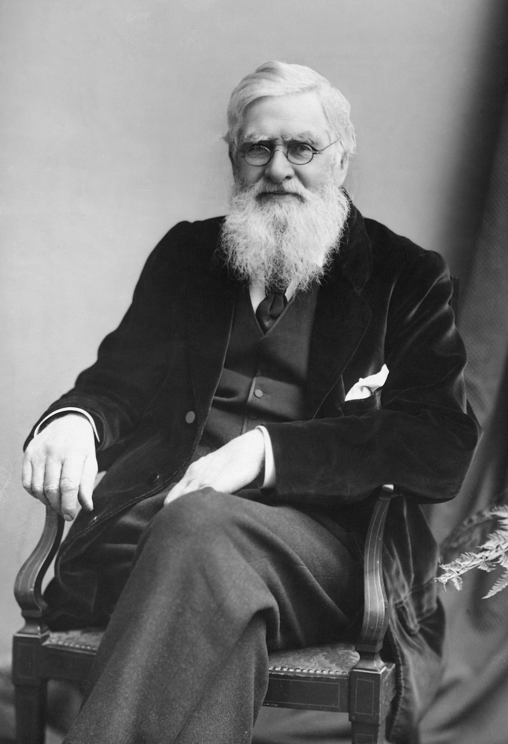
An overview of Wallace…
In June 1858 he got a conclusion to the natural selection idea.
He argued that humans are different to animals because they are in a world where selection is based of mental and moral conditions.
“the higher must displace the lower and more degraded… this process occurs until a homogenous race exists.
He spoke about how we can all agree on antiquity and that we have been on earth since thousands of decades ago. He also noted that we have changed and adapted to the environment.

Slide 17
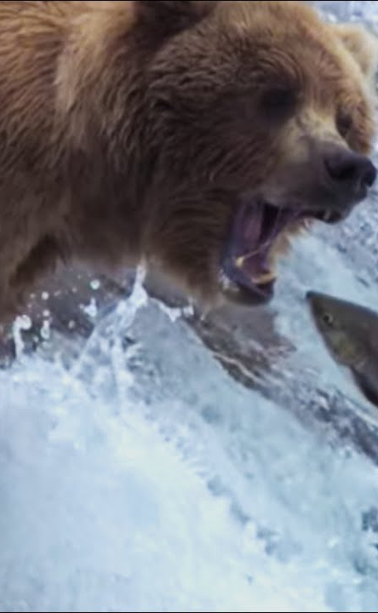
Applying Darwin's natural selection
He tried to see if Darwin's theory of natural selection was true. To do this he looked at situations and how animals would act and then how humans would act.
He found that if an animal was hurt the rest of the pack would just continue and leave the animal to die. Whereas if this was in a human tribe the other members of the tribe would look after them. Showing that in animals’ the idea of survival of the fittest works.
He also looked at the environment. By looking at how an animal or human would act if there was a lack of food. If a fish-eating animal couldn’t get fish, he would hunt other animals, and adapt to what was required of them but to do this only those with stronger teeth and claws would survive, and then those who can adapt to the new food. In humans we would just make new weapons and not change ourselves to be able to hunt differently. Therefore, once again natural selection applies to animals more.
It became very apparent form this that natural selection inevitable occurs within animals but not humans because we can adapt and have sympathy to one another, so we don’t leave people to die.
THEREFORE, PHYSICAL FEATURES ARN’T THAT IMPORTANT

