Slide 1



First Encounters and the Origins of Anthropology
Week 3
MEDICINE, EMPIRE & THE BODY

Slide 2
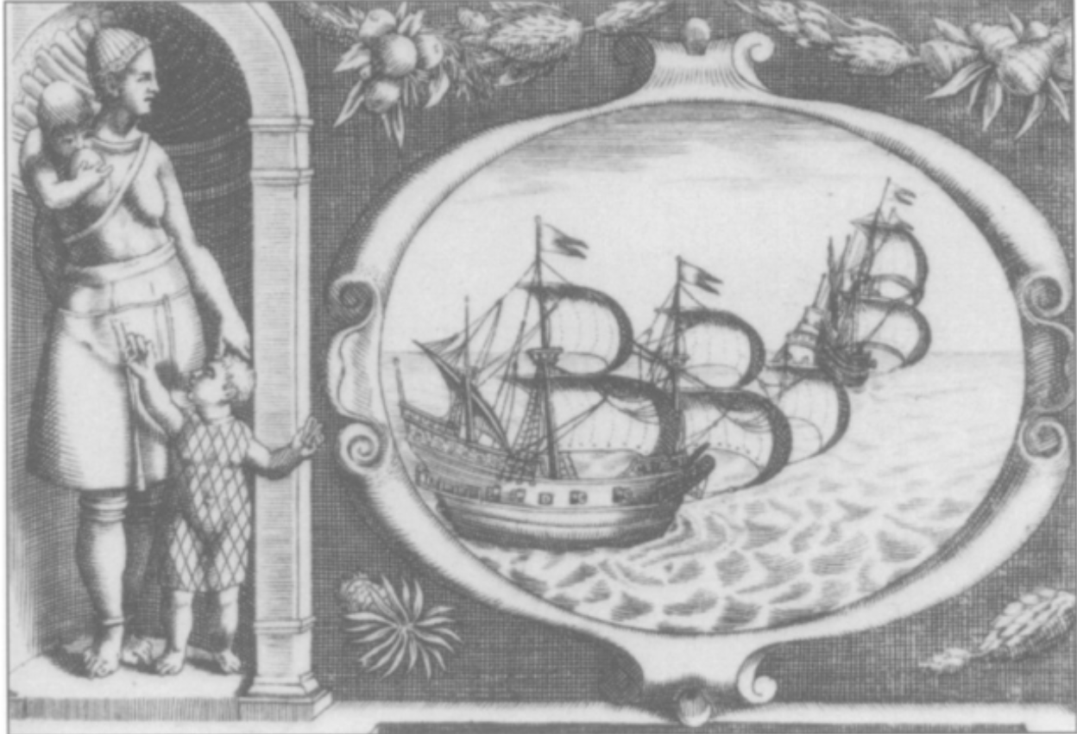
Overview
First encounters between Europeans and Indigenous Americans shaped attitudes towards gender and ‘race’.
The inhabitants of different geographic areas began to be stereotyped—both appearances and behaviours were generalised.
The hardening of ‘race’ as a biological concept and emergence of racial hierarchies emerged in the context of slavery and imperial expansion.

Slide 3
Jennifer L. Morgan, ‘“Some Could Suckle over Their Shoulder”: Male Travelers, Female Bodies, and the Gendering of Racial Ideology, 1500-1770’
Quote: 'If African women gave birth without pain, they somehow sidestepped God's curse upon Eve. If they were not her descendants, they were not related to Europeans and could therefore be forced to labour on England's overseas plantations with impunity.' - p. 189.
This article draws out the link between how Europeans (mainly men) used women of colour to distinguish 'otherness' and establish lines between the groups.
In literature that was somewhat complementary to women of colour, it was always implied that this was in contrast to their culture's civility.
Women were often used to invoke images of both the familiar and unfamiliar - 'her nakedness and monstrous adornments' vs. 'in her role as a mother, she evoked the familiar.'
Observations about African women's reproductive habits were used to justify their exploitation and place further divisions between the people of England and Africa.
By the end of the 18th century, literature presented African women as total savages who could only be contained by enslavement - development in narrative.

Slide 4
Nicholas Hudson, ‘From “Nation” to “Race”: The Origin of Racial Classification in Eighteenth-Century Thought’, Eighteenth-Century Studies, 29 (1996)
Quote: 'Well before the emergence of the formal doctrine of 'race', Africans were losing their national identities to the brutal and mechanistic process of the slave trade … the process of shipping and marketing slaves literally stripped the signs of national difference from the bodies of Africans.' - p. 251.
Early descriptions of 'race' were confined to describe family lines or breeds of animals - the first modernly recognisable description of race in a dictionary first appears in 1835, but was used in science prior to this inclusion.
'Race' became the major term of ethnographic scholarship, 'nation' was used to describe the political and social division of Europe, and 'tribe' was used to replace 'nation' in descriptions of 'savage' peoples outside of Europe.
The Enlightenment separated the terms 'race' and 'nation' as each term developed throughout the period - 'race' was only rejoined with 'nation' after it had been established as a term for biological subdivision.
Religious aspect - the Old Testament indicated that Africans were the common descendants of Ham (disfavoured son of Noah). Europeans saw this as an explanation for their superiority, seeing themselves as more civilised than other nations.
The broad definition of race brought into consciousness by Buffon in the late 18th century grouped people living in huge regions or continents, with considerable national variation between members of the same race - mid 19th century pseudoscientific studies of 'race' focused on differences between increasingly smaller groups.

Slide 5
I.C. Campbell, ‘Savages Noble and Ignoble: the Preconceptions of Early European Voyages in Polynesia’
Quote: 'the belief in the actual or possible existence of people living virtuously, happily and simply is one of the great continuities of European history.' - p. 45.
The Noble Savage was a romantic European ideal that portrayed non-European peoples as living in a state of natural virtue, free from the corruption of civilization. This idea, often attributed to Rousseau, shaped European expectations of Polynesian peoples, which is the geographic area Campbell focuses on.
Literature from Bougainville, Banks, and the Forsters observed both the positive and negative aspects of Polynesian society, they were not swayed by the ideal of the Noble Savage. They documented both the virtues and the vices of these societies.
Campbell argues that European actions in the Pacific cannot be solely attributed to the Noble Savage myth. These explorers often had more complex motives and perceptions.
While some explorers used romanticized imagery in their descriptions, it was more a narrative device than evidence of a deep belief in savagery as ideal. Explorers often adapted descriptions to the realities they encountered.
Europeans exhibited an ambivalent attitude towards Polynesians, alternating between admiration for their perceived virtues and fear of their 'savage' qualities, particularly around practices like cannibalism.

Slide 6
Joyce E. Chaplin, ‘Natural Philosophy and an Early Racial Idiom in North America: Comparing English and Indian Bodies’ (1997)
Quote: ‘By applying the language of natural philosophy to Native American attrition and English vigour, the colonists defined a new idiom: that the significant human variation in North America was not due to external environment but instead lay within the bodies of its European and Indian peoples.’ (p.231)
‘Natural philosophy’ provided an explanatory model for physical differences prior to the development of biological racism, and linked propensity to disease to constitution and climate.
In early colonial America, English settlers understood their dominance of the territory in corporeal terms: they seemed to be physically well adapted to the environment.
Meanwhile, they observed the Indigenous population suffering terribly from diseases, which they initially believed to be local in origin (rather than imported).
Increasingly, the English became increasingly convinced of Native American bodily inferiority; they were worse at surviving in their own climate than English settlers, who were thriving by comparison.
The English ultimately dispossessed Indigenous Americans of their own land; suggesting they were poorly adapted migrants from abroad while the English were physically foreordained to inhabit the territory.

Slide 7
Henry Louis Gates, Jr. and Andrew S. Curran, ‘Introduction: The 1741 Contest on the Degeneration of Black Skin and Hair,’ (2022), pp. 3-44
Quote: ‘As naturalists and savants freed themselves from the imperatives of Scripture, they increasingly attributed the origins of human phenotypes to purely material or physical causes.’ (p. 7)
In 1741, the Royal Academy of Sciences of Bordeaux ran an essay prize competition on the question ‘what is the physical cause of the Negro’s colour, the quality of their hair, and the degeneration of both?’ 16 essays were received, although no prize was awarded.
Bordeaux had significant financial investments in the slave colony of St Domingue (especially sugar), explaining why such a topic constituted ‘useful’ knowledge for the city’s elites.
The competition entries reflected both religious and ‘scientific’ approaches to the study of human difference, demonstrating that the mid-C18 was a period of transition from divine to secular explanations for natural phenomena.
Responses alluded to theoretical beliefs (particularly in monogenism and racial degeneration) as well as empirical evidence (direct observation, and in some cases, autopsies).
A further competition in 1772 on how best to preserve the health of Africans during their ‘crossing to the New World’ equally explored the nature of racial difference, but the link to slavery was now far more explicit and reflected the development of ‘racial taxonomies’ in the late C18.

Slide 8
Seminar Questions
How were indigenous people represented in European first-hand accounts?
How did explanations of human difference change across the eighteenth century—and why?

