Slide 1
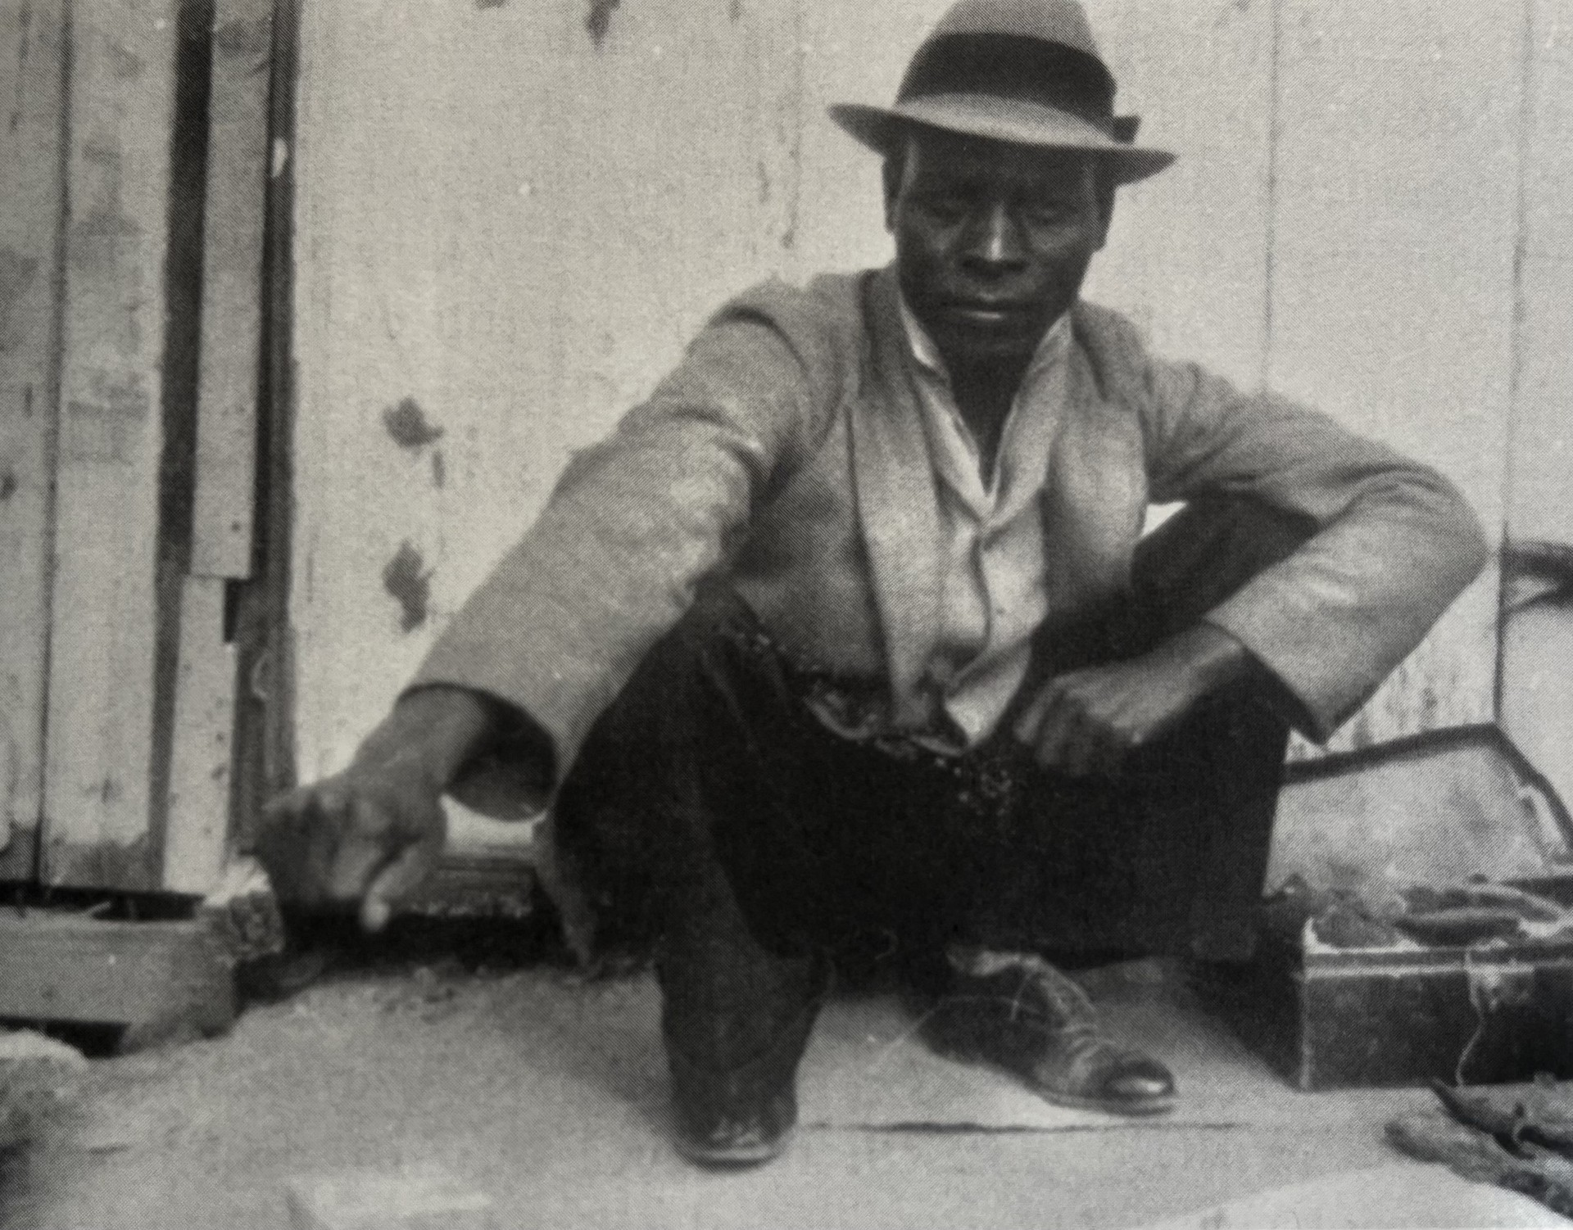
Black Hamlet: The Introductions
Saul Dubow and Jacqueline Rose

Slide 2
Introduction: Part One- Saul Dubow
1930s significance
2025 significance
Fallibility of the narrator W J Sachs
Growth of W Sachs
Broader narrative
‘The tension lies at the heart of our interpretive difficulties… whose story is this, who is transformed and by who?’

Slide 3
Introduction: Part Two- Jacquline Rose
The Colonial dynamic
Lying and truth in psychoanalysis
The paradox of projection
The significance of Sachs’ positionality
Feminism’s parallel with Black Hamlet
‘Black Hamlet makes it clear that the analyst who does all this, who most fervently wishes for the patient’s emancipation, locks the patient into the imaginary world of his own demands.’

Slide 4
Three Questions:
In what ways does Sachs’ fallibility paradoxically make the source valuable to contemporary historians?
To what extent does Sach’s psychoanalysis perpetuate colonial racial hierarchies? Or does it do anything to topple them?
What are the differences and similarities between the dynamic of Sachs and Chavafambira, and that of scientists such as Paul Broca and his research subjects?

