Slide 1
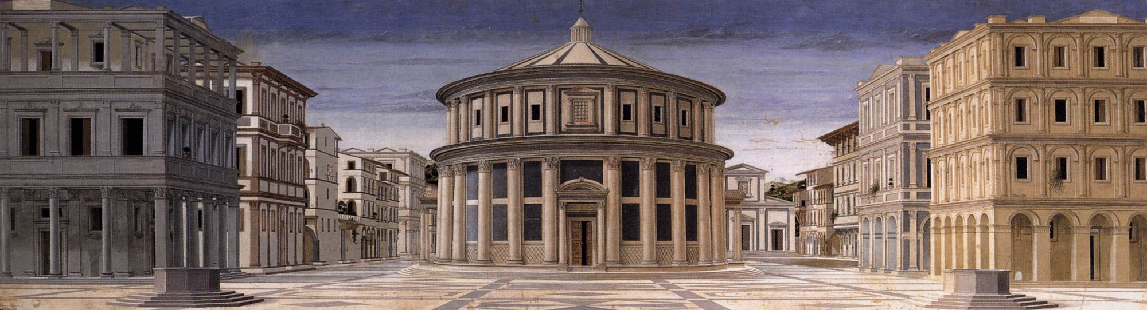
The Italian Renaissance Jonathan Davies (Powerpoint and handout are on the module website)

Slide 2
Once they have seen how art... had fallen into complete ruin from such a noble height ... they will now be able to recognise more easily the progress of art’s rebirth (rinascita) and the state of perfection to which it has again ascended in our own times...
Giorgio Vasari, Preface, The Lives of the Most Excellent Painters, Sculptors and Architects (1550)

Slide 3
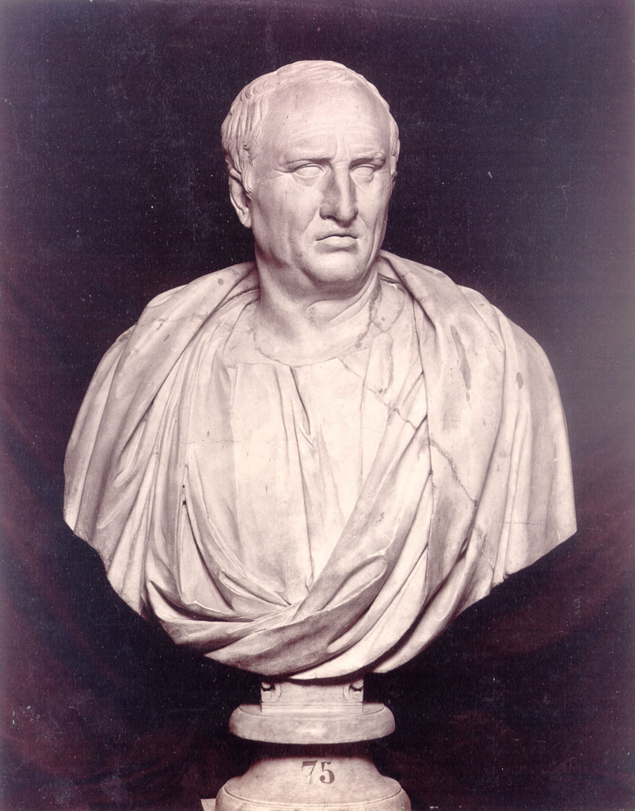
Cicero

Slide 4
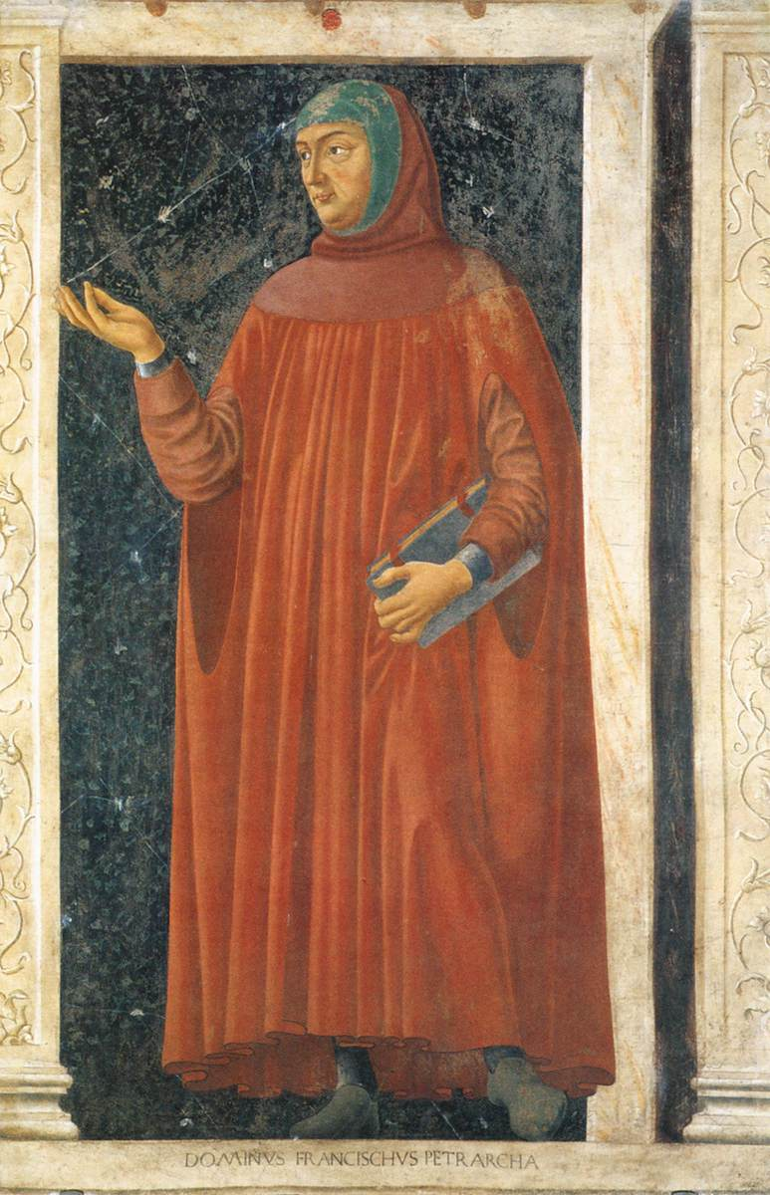
Petrarch

Slide 5
Questions
What was humanism?
What was the rebirth of letters?
What was the rebirth of the visual arts?
Why was there a rebirth of antiquity?
What is meant by Italy in the Age of the Renaissance?

Slide 6
The studia humanitatis
Grammar
Rhetoric
Poetry
History
Moral philosophy

Slide 7
The seven liberal arts
Grammar
Rhetoric
Logic
Arithmetic
Geometry
Astronomy
Music

Slide 8
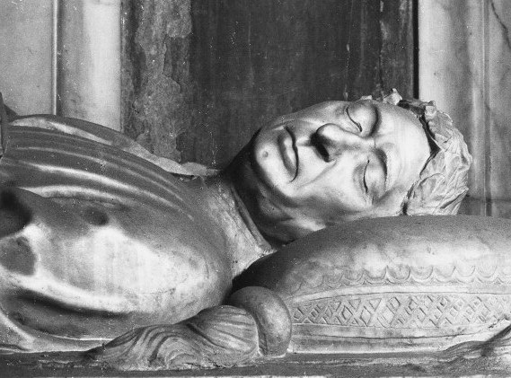
Leonardo Bruni

Slide 9
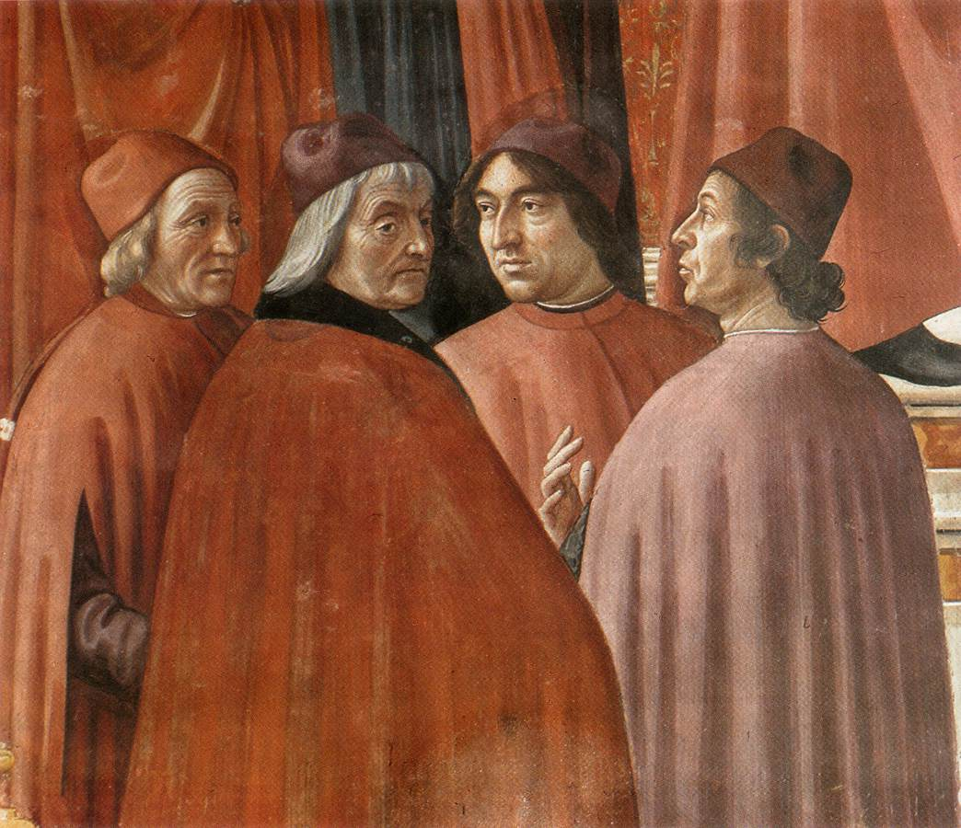
Angelo Poliziano and Marsilio Ficino

Slide 10
‘At a young age, [his father] sent him, according to the custom of the city, to learn to read and write. When, in a brief time, the boy had mastered the learning necessary to become a merchant, his father took him away from elementary school and sent him to arithmetic [abacus] school, where in a few months he similarly learned enough to work as a merchant. At the age of ten he went to work in a bank.’ [Vespasiano da Bisticci, ‘Life of Giannozzo Manetti’ quoted in Robert Black, ‘Florence’ in Roy Porter and Mikulas Teich (eds.), The Renaissance in National Context (Cambridge, 1992), p. 32]

Slide 11
‘Being the son of Messer Andrea and a young man of handsome appearance, devoted to the delights and pleasures of the world, Piero gave little thought to the study of [Latin] letters: indeed, his father was a merchant and like those who have little education themselves, he had scant regard for learning nor did he think that his son would show much inclination in that direction... One day Messer Piero de’ Pazzi, who had never spoken to Niccolò, was walking past the palace of the podestà. Seeing that he was a young man of handsome appearance, Niccolò called to him. Since Niccolò was someone of the highest reputation, Piero immediately went over to him.

Slide 12
When Niccolò had had a look at him, he asked whose son he was. He replied that his father was Messer Andrea de’ Pazzi. He asked him what his occupation was. He replied, as do the young: ‘Having a good time.’ Niccolò said to him: ‘Considering whose son you are, considering the good family you come from and your good looks, it is disgraceful that you do not devote yourself to Latin letters, which would give you great distinction. If you do not study the classics, you will be considered a nothing; when you have passed the prime of your youth, you will find yourself without any merit and you will enjoy no one’s esteem. [Vespasiano ad Bisticci, ‘Life of Piero de’ Pazzi’, quoted in Black, ‘Florence’, p. 33]

Slide 13
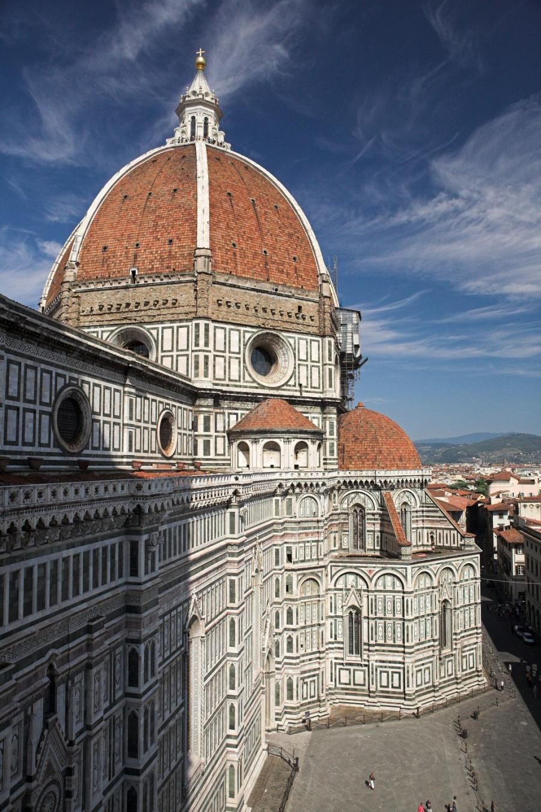
Filippo Brunelleschi, The Dome of Florence Cathedral

Slide 14
Luciano Laurana The Ideal City

Slide 15
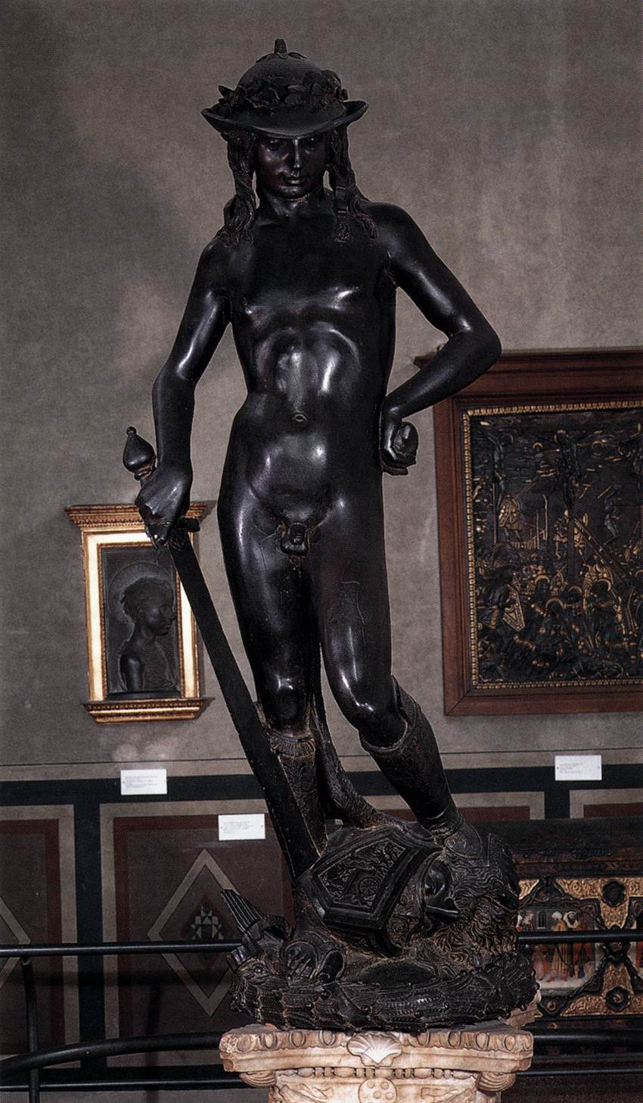
Donatello David

Slide 16
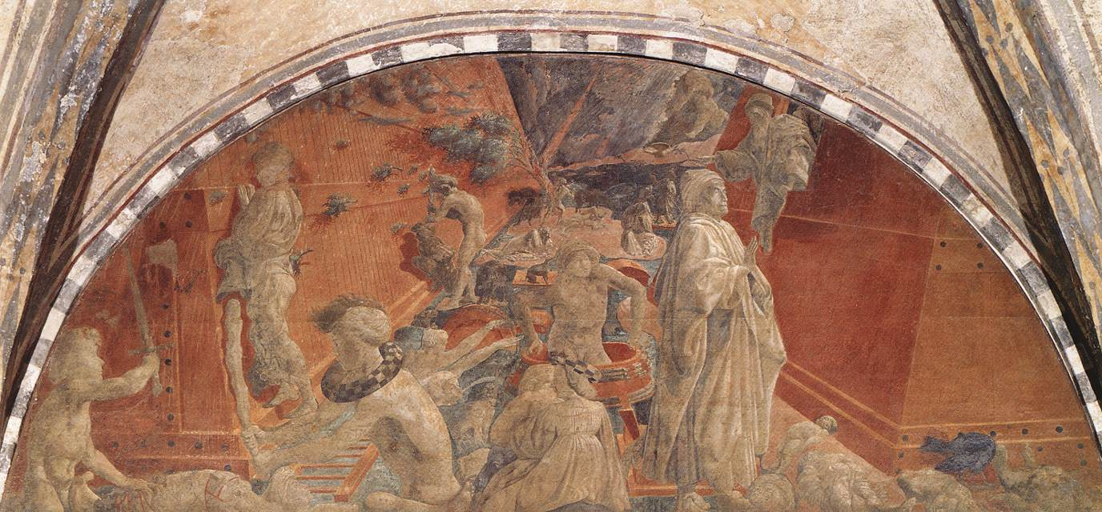
Paolo Uccello The Flood and Waters Subsiding

Slide 17
If Italy’s princes needed to celebrate their lineage and special prowess, civic governments and the Papacy needed to elevate institutions as well as individuals. Thus while the signori [lords] searched for their models in the stories and images of Roman emperors and military heroes, communal governments, such as Siena, Florence, and Venice, found their heritage in the Roman republic. [Evelyn Welch, Art and Society in Italy 1350-1500 (Oxford, 1997), p. 241]

Slide 18
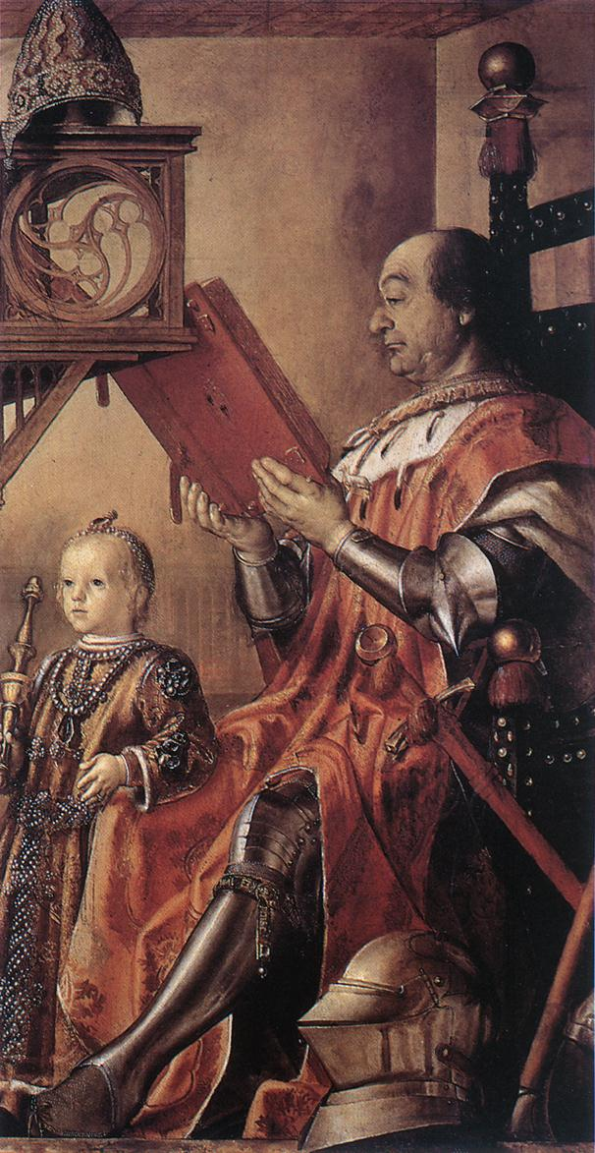
Pedro Berruquete, Federico and Montefeltro, duke of Urbino, and his son Guidobaldo

Slide 19
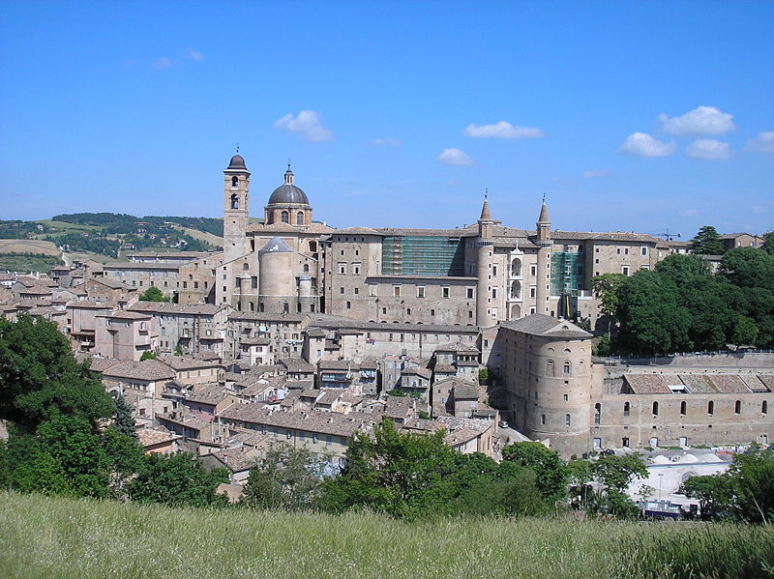
Luciano Laurana, Palazzo Ducale, Urbino

Slide 20
the magnificent man is made great through great expenditure. Thus the works of the magnificent man consist in illustrious palaces, in churches of excellent manufacture, in theatres, in porticoes, in streets, in sea-ports ... But since magnificence consists in great expense, it is necessary that the size of the object itself is sumptuous and imposing, otherwise it will not justifiably excite either admiration or praise.

Slide 21
And impressiveness, in turn, is obtained through ornamentation, the extent and the excellence of the material and the capacity of the work to last for a long time. Without art, in truth, nothing whether large or small, will merit true praise. Thus if something is tawdry and lacking in ornament, or made in a low-cost material which will not guarantee longevity, it truly cannot be great, nor should it be held to be so. [Giovanni Pontano, I trattati delle virtu’ sociali, quoted in Welch, Art and Society, pp. 221, 223]

Slide 22
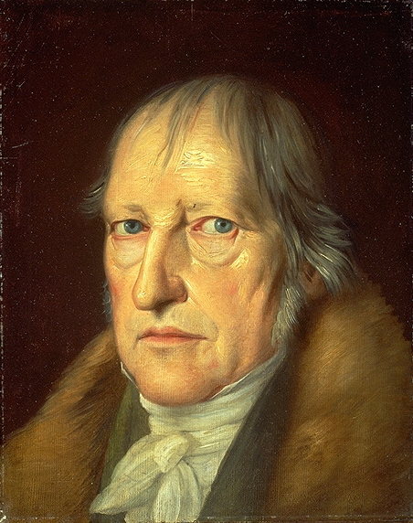
Georg Hegel 1770-1831

Slide 23
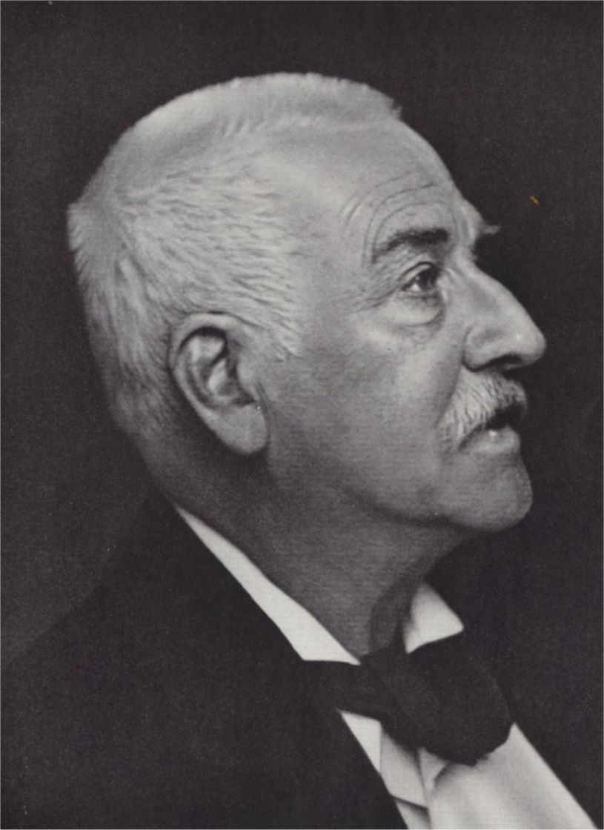
Jacob Burckhardt 1818-1897

Slide 24
In the character of these States, whether republics or despotisms, lies, not the only, but the chief reason for the early development of the Italian. To this it is due that he was the firstborn among the sons of modern Europe… In the Middle Ages both sides of human consciousness--that which was turned within as that which was turned without-- lay dreaming or half-awake beneath a common veil.

Slide 25
The veil was woven of faith, illusion, and childish prepossession, through which the world and history were seen clad in strange hues. Man was conscious of himself only as a member of a race, people, party, family, or corporation--only through some general category. In Italy this veil first melted into air; an objective treatment and consideration of the State and of all the things of this world became possible.

Slide 26
The subjective side at the same time asserted itself with corresponding emphasis; man became a spiritual individual, recognized himself as such. In the same way the Greek had once distinguished himself from the barbarian, and the Arab had felt himself an individual at a time when other Asiatics knew themselves only as members of a race. It will not be difficult to show that this result was due above all to the political circumstances of Italy. Jacob Burckhardt, The Civilization of the Renaissance in Italy: An Essay (1860), Preface to Part II.

Slide 27
We must insist upon it, as one of the chief propositions of this book, that it was not the revival of antiquity alone, but its union with the genius of the Italian people, which achieved the conquest of the western world. Jacob Burckhardt, The Civilization of the Renaissance in Italy: An Essay (1860), Introduction to Part III.

