Slide 1
The politics of hunger
FOOD AND FEEDING IN OCCUPIED GERMANY AND JAPAN

Slide 2
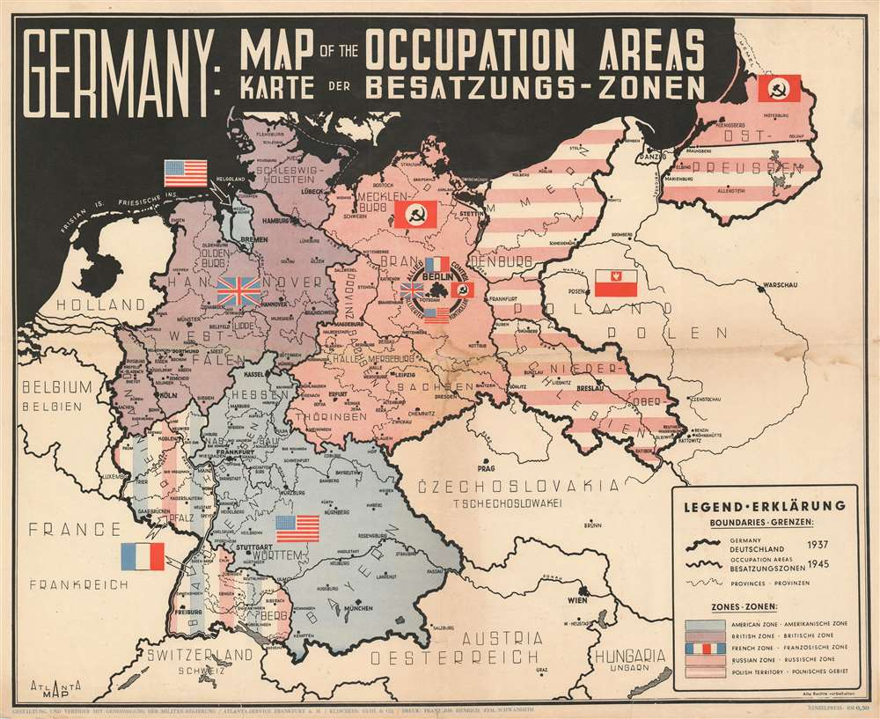
The Occupation and Division of Postwar Germany
From 1 January 1947 the US and British zones merged to become the Bizone (or “Bizonia”), joined by the French occupation zone on 1 August 1948.
This area became the Federal Republic of Germany ("West Germany") on 23 May 1949 with the passage of the Basic Law.

Slide 3
Training for occupation
Officer trainees study
a map of Japan
at the School of
Military Government,
University of Virginia,
Charlottesville, VA
OWI
Library of Congress

Slide 4
“Expert knowledge”
Propaganda and psychological warfare: Ministry of Information (UK);
Office of War Information; SHAEF/PWD (Psychological Warfare Division)
“Knowing the enemy”– the better to manipulate psychological weaknesses
and encourage defeatism
Understanding allies and enemy-occupied territories
Knowledge as key to control

Slide 5
FOOD
In what different ways does food matter to humans?
Why is food such an important topic to historians of the war and postwar years?

Slide 6
Why did food loom so large in wartime planning for postwar?
Why was food such a vital political question after WWII?
How else– besides as a political issue– did occupiers and occupied conceptualize food?

Slide 7
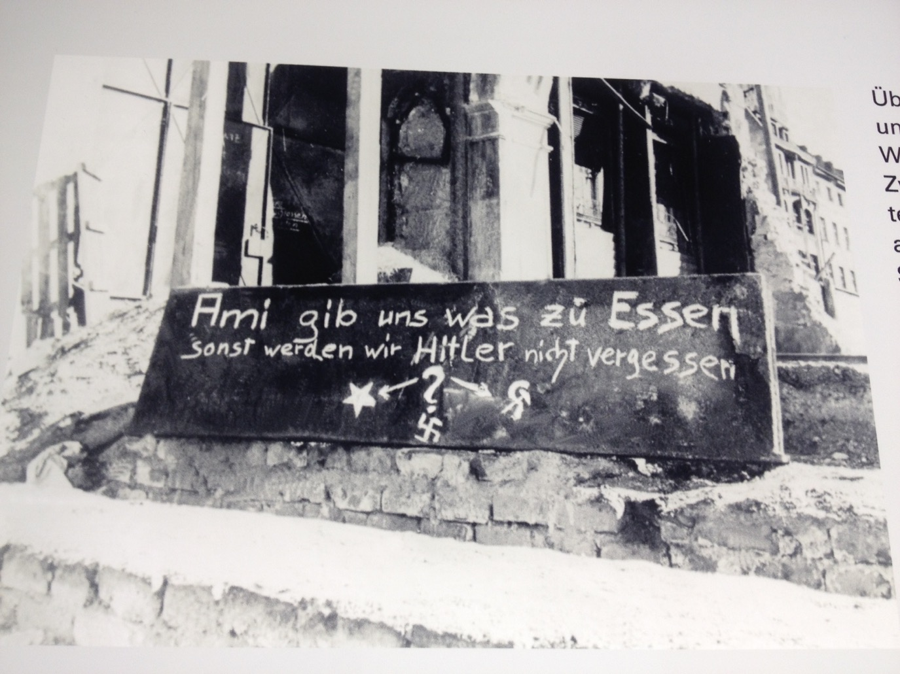
Graffiti in Munich,
Winter 1945-46
On display at the
National Socialism
Documentation Centre,
Munich

Slide 8
Margaret Mead
born Dec. 16, 1901, Philadelphia, U.S.—died Nov. 15, 1978, New York
a student of Franz Boas and Ruth Benedict
author of 23 books, several earlier volumes based on field work/observation undertaken in the South Pacific
Coming of Age in Samoa (1928)
“The most famous anthropologist who ever lived,” Peter Mandler, Return from the Natives: How Margaret Mead Won the Second World War and Lost the Cold War (Yale University Press, 2013)

Slide 9
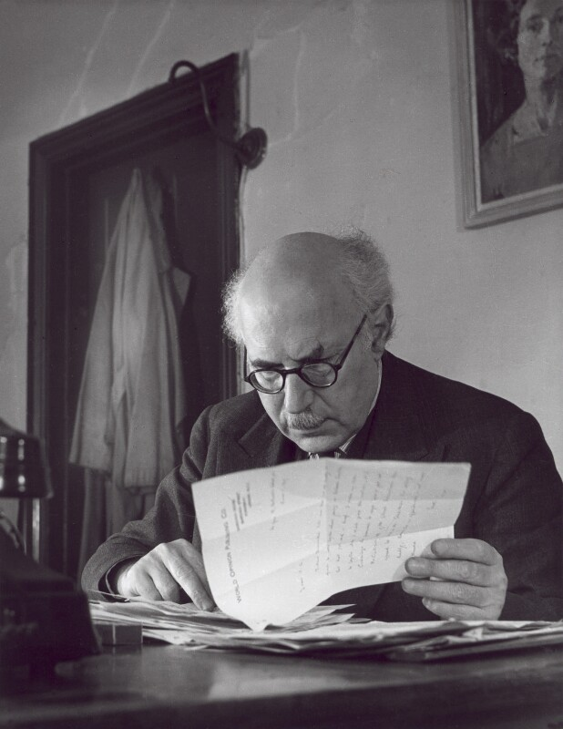

Victor Gollancz
(1893-1967)
Sir Victor Gollancz
by John Gay
bromide fibre print, 1947
National Portrait Gallery

Slide 10
Save Europe Now
A fierce opponent of “Vansittartism”
September 1945: starts “Save Europe Now”
Later campaigns against poverty
War on Want
And against capital punishment
A plea against Germans’ “collective guilt”

Slide 11
1st edition,
Jan. 1947

Slide 12
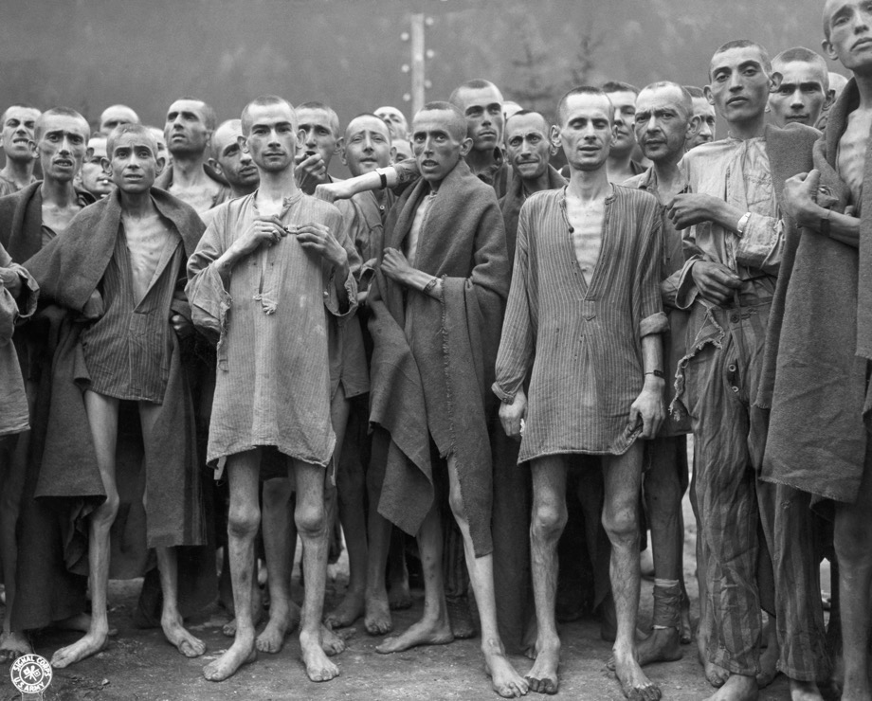
Photography as advocacy—the accusatory starved body
Survivors of Ebensee concentration camp

Slide 13
“Children chosen for a ‘recovery home’ at
an elementary school in Hamburg.”
”The same.”

Slide 15
Abundance amid scarcity
Gollancz’s menus
St. Germain Soup
__
Braised Beef
Cauliflower au Gratin
Fondant Potatoes
__
Apple Tart
Cream
__
Welsh Rarebit
__
Coffee
Schloss Friedrichshof-Kronberg: US officers’ mess

Slide 16
What do you imagine motivated Gollancz’s intervention on behalf of
hungry Germans?
How effective a piece of advocacy do you consider In Darkest Germany?
Why do you think German hunger seemingly become a much more
dominant postwar preoccupation—at least in North America and
Western Europe– than Japanese hunger?
Drawing on all the readings, how much agency do you think
“ordinary” Germans and Japanese enjoyed in securing
access to sources of nutrition in the immediate postwar years?
In what ways was gender implicated in the politics of food?

Slide 17
Illicit economies
What is a black market and how does it work?
Why were black markets so pervasive in both Germany and Japan
after the war?
How are postwar black markets best understood? Immorality vs ingenuity?
Why did the occupation authorities in Germany and Japan struggle to
eradicate illicit buying and selling?

Slide 18
Tokyo Times, Nov. 7, 2002
Tokyo’s Ueno district may well be home to some of the city’s most important museums, but it’s also where many of the poorest call home too. The area’s park in particular shelters an increasingly obvious number of the capital’s growing homeless population, creating an odd environment where day-trippers and the destitute show utter indifference to one another.
Thrown into this unusual mix is also Ameyoko; a decidedly working class shopping district that in post-war Japan was a well-known black market — elements of which are really not hard to imagine even today.
http://wordpress.tokyotimes.org/shadowy-ueno/

Slide 19
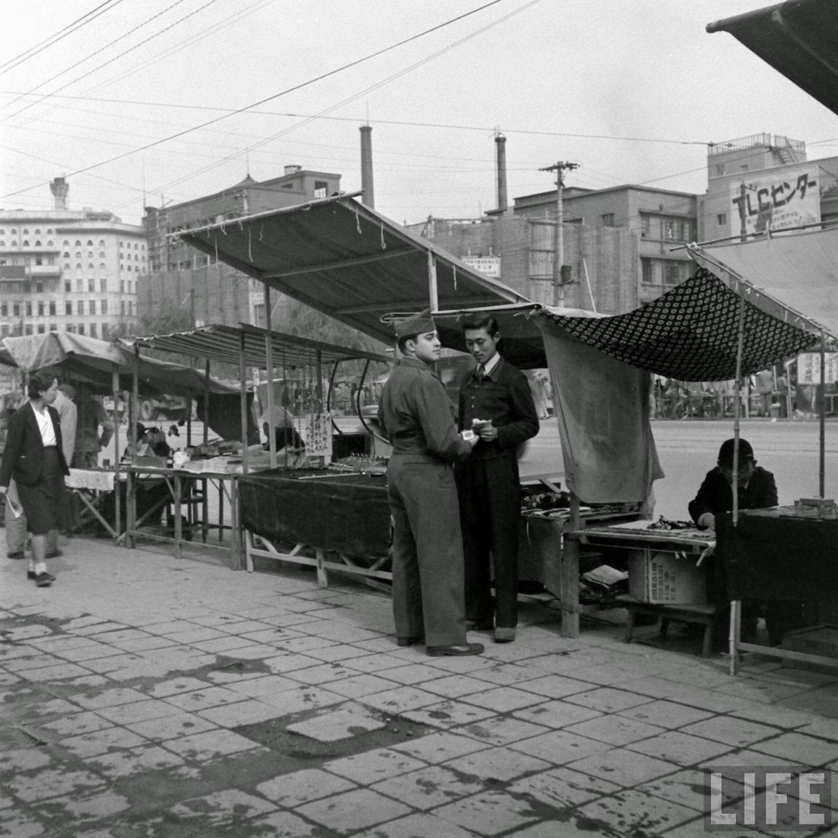
John Florea for
Life, 1946

Slide 20
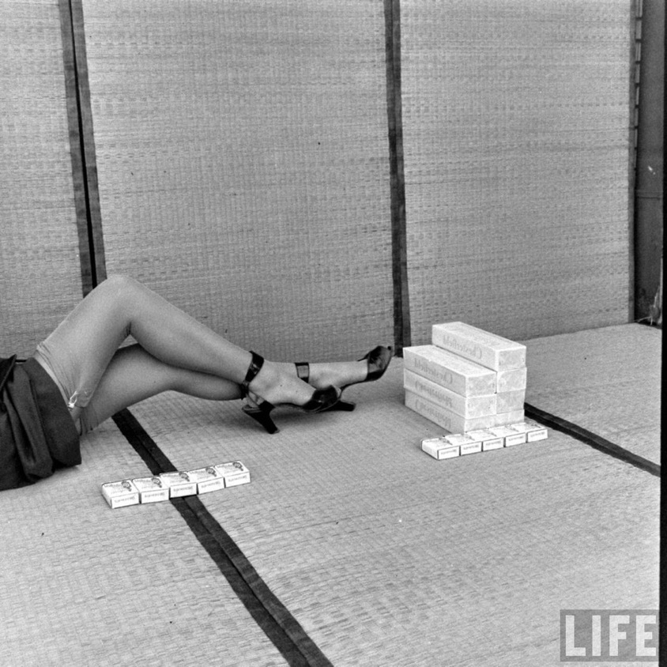
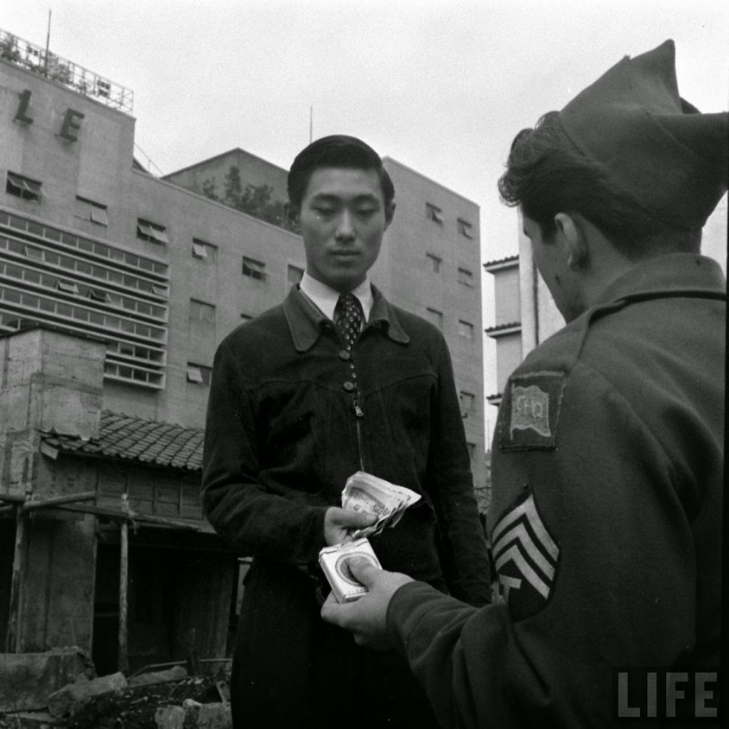

Slide 21
Tokyo, Photograph by Jesse W. Scott, “Junction Ginza and 2nd avenue. The PX has been moved to a large building. It gets shot over and over a ‘landmark’ for Ginza prowlers”
https://munzerfamilyarchives.wordpress.com/2015/01/27/tokyo-buildings-streets-and-bridges-1946-1949/

Slide 22
More primary sources:
NB: Google has digitized Life magazine, which ran
many illustrated photo-stories about the postwar occupations:
https://books.google.co.uk/books/about/LIFE.html?id=N0EEAAAAMBAJ
Pathe newsreel:
“Germany’s Food: The Truth” (1946):
https://www.britishpathe.com/video/germanys-food-the-truth

