Slide 1
Sex under occupation

Slide 2


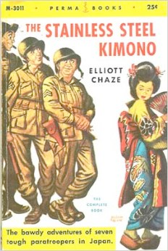
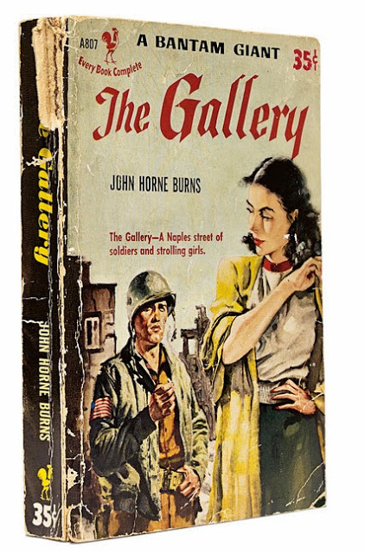

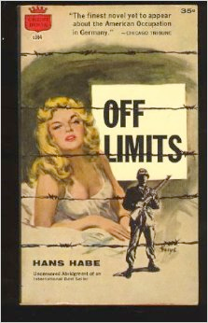

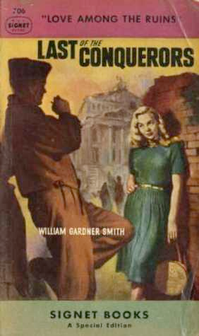

Slide 3
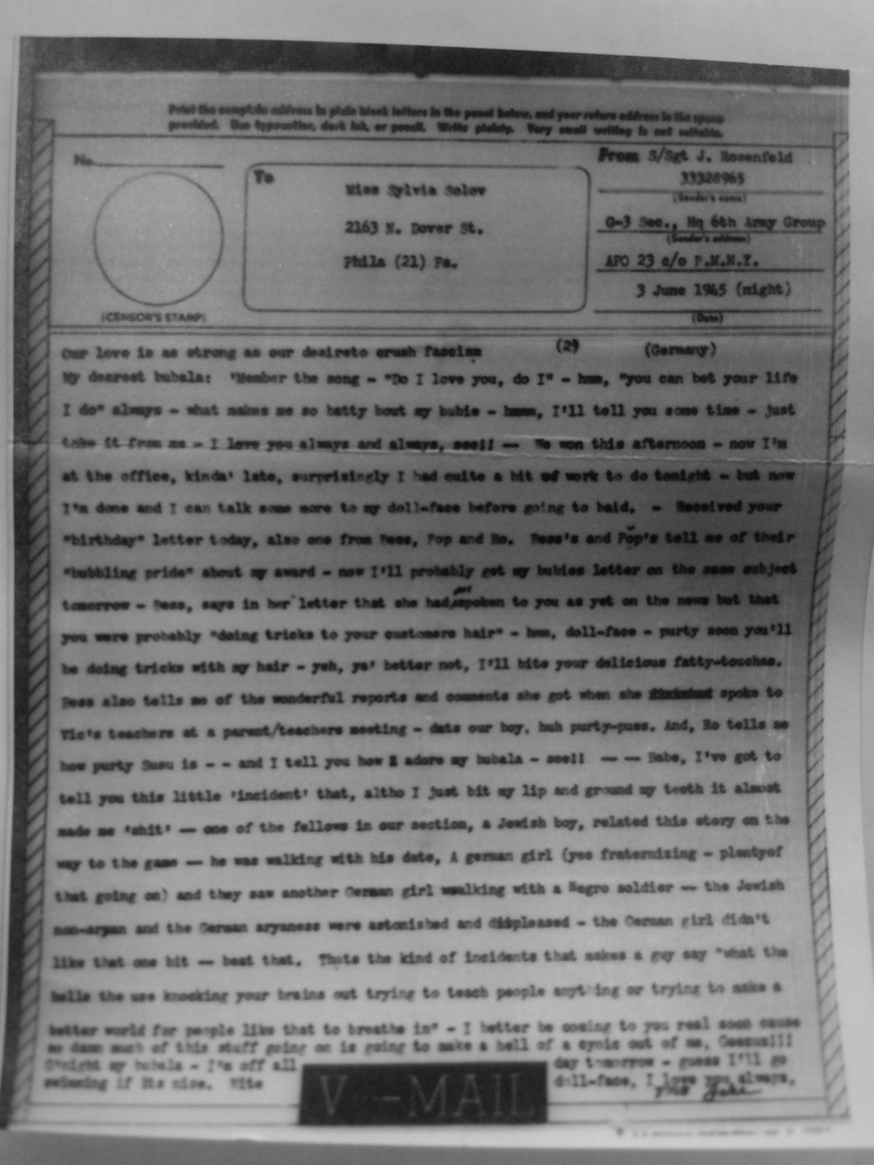
S/Sgt Jack Rosenfeld
V-mail to Sylvia Solov
June 3, 1945
Rare book and manuscript collection,
Van Pelt Library,
University of Pennsylvania

Slide 4
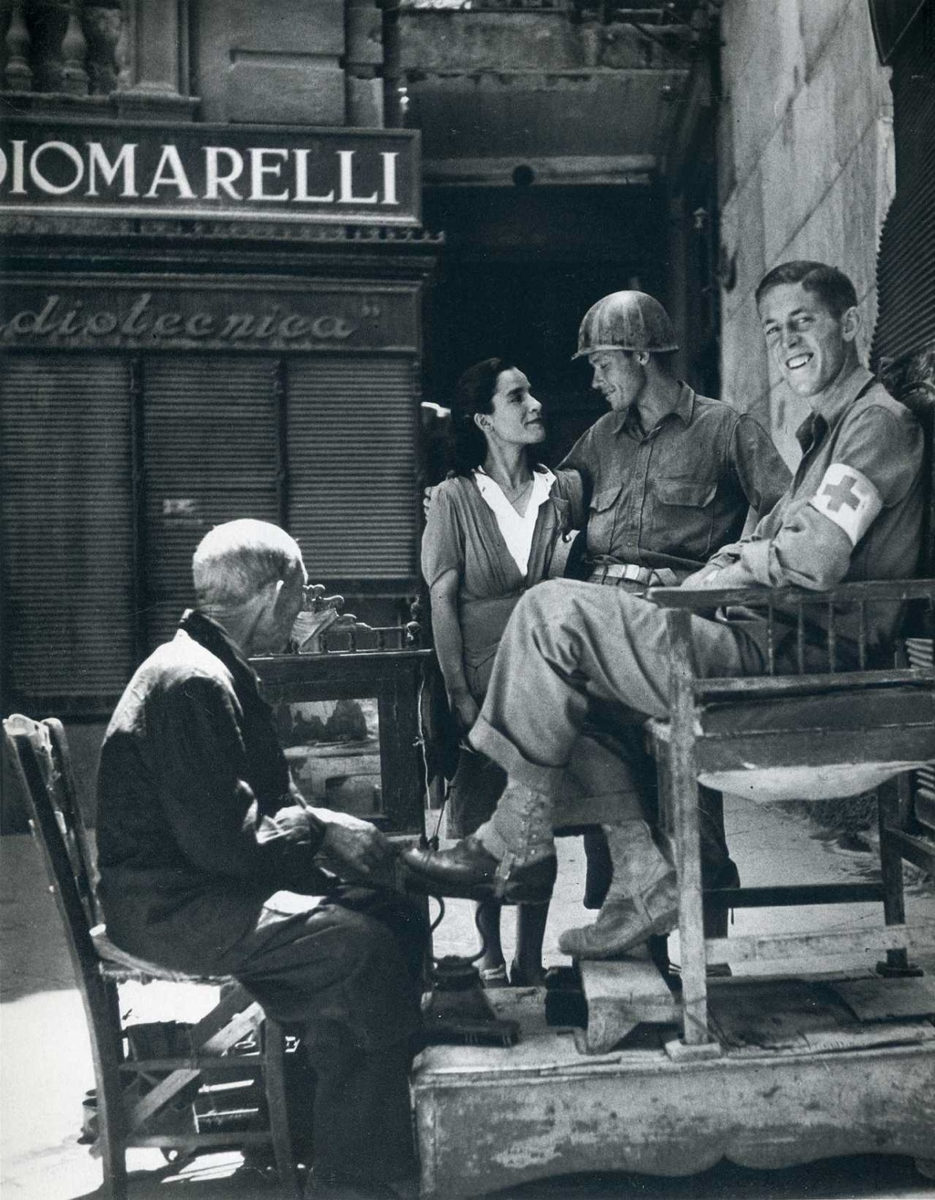
“AMGOT
at work”
Robert Capa
Palermo, Sicily
Life
August 23, 1943

Slide 5
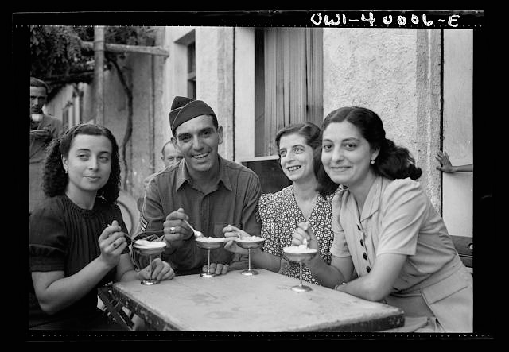
“Palermo, Sicily. One American soldier who found his relatives in Sicily was Vincent J. Orivello
of Milwaukee, Wisconsin, eating ice-cream at a sidewalk cafe in Palermo with three of his cousins.”
Nick Parrino for the Office of War Information, Sept. 1943
Digital ID: (digital file from original neg.) fsa 8d34225 http://hdl.loc.gov/loc.pnp/fsa.8d34225
Reproduction Number: LC-DIG-fsa-8d34225 (digital file from original neg.) LC-USW3-040006-E (b&w film nitrate neg.)
Repository: Library of Congress Prints and Photographs Division Washington, D.C. 20540 http://hdl.loc.gov/loc.pnp/pp.print

Slide 6
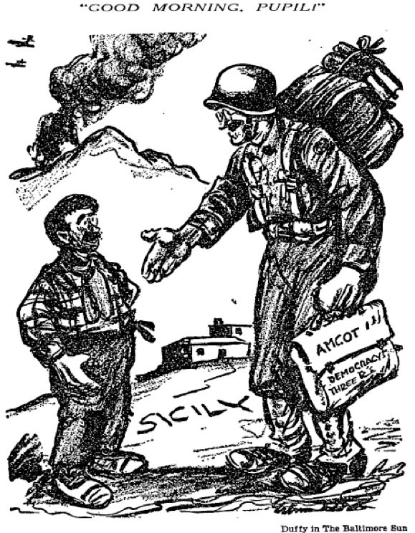
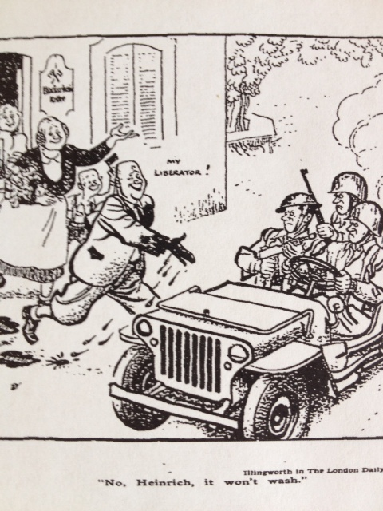
Occupations pedagogical and punitive
Duffy, Baltimore Sun, July 19, 1943
Illingworth, New York Times, Oct. 8, 1944

Slide 7
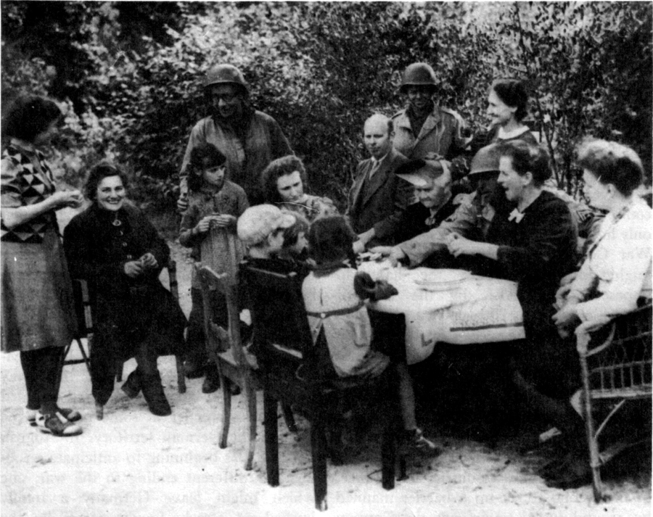
“US TROOPS AND GERMAN CIVILIANS (September 1944).
This and a few other pictures like it provoked the President's order against fraternization.”
Earl Ziemke, http://www.history.army.mil/books/wwii/occ-gy/ch08.htm

Slide 8
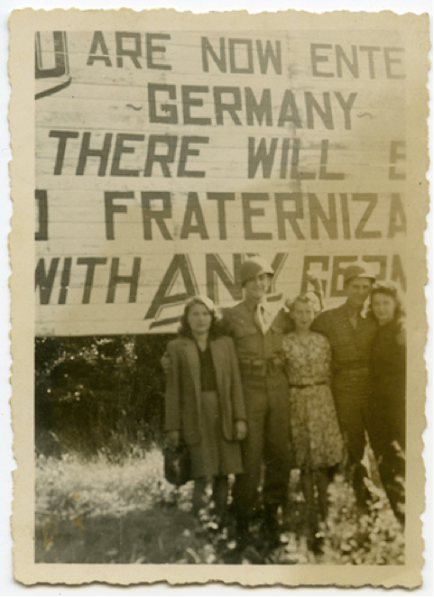
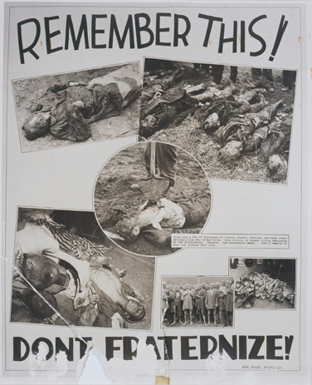
“Two buddies, three girls. Not bad”
Arnold Samuelson, USHMM, Photograph #62779

Slide 9


http://www.gutenberg-e.org/pfau/detail/112-P-48NACP.html
U.S. Government Printing Office -
Library of Congress. Prints and Photographs division cph.3g04256.

Slide 10
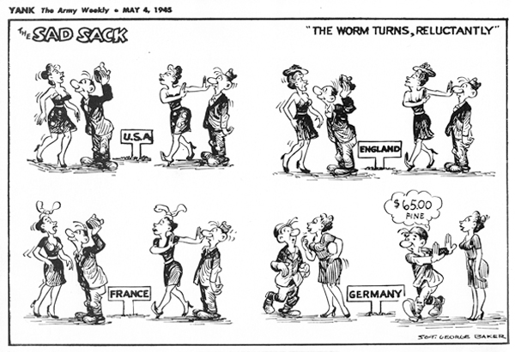
“The $65 question”
Source: Stars and Stripes. © 1945, 2007 Stars and Stripes.
http://www.gutenberg-e.org/pfau/detail/WormTurn050445.html

Slide 11
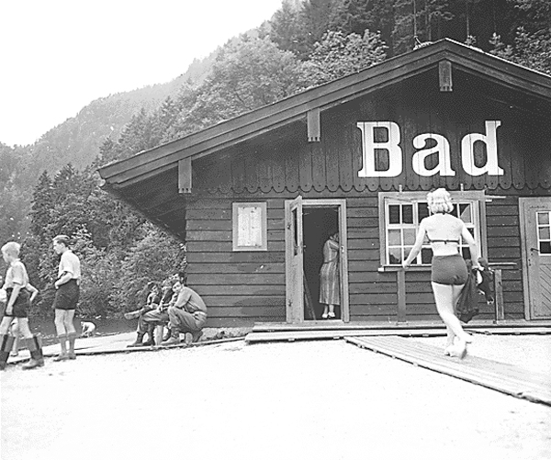
"Verboten—
but not too bad
from this angle."
Stars and Stripes
Source: NACP.
http://www.gutenberg-e.org/pfau/detail/Bad531301.html

Slide 12
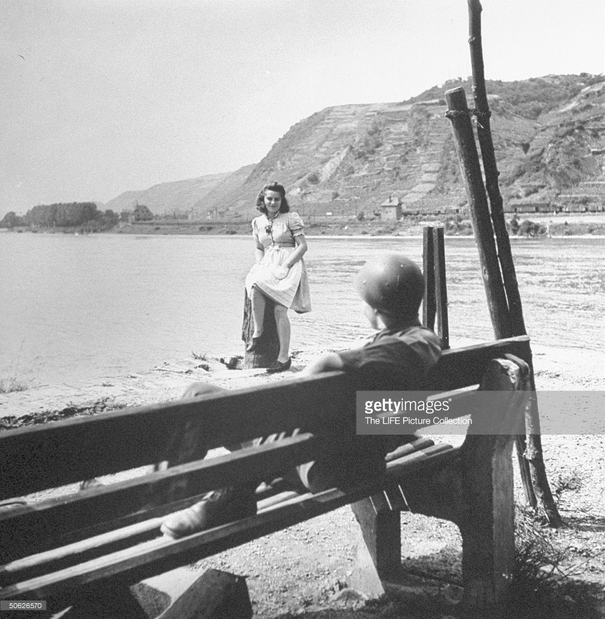
(Photo by Ralph Morse/The LIFE Picture Collection/Getty Images

Slide 13
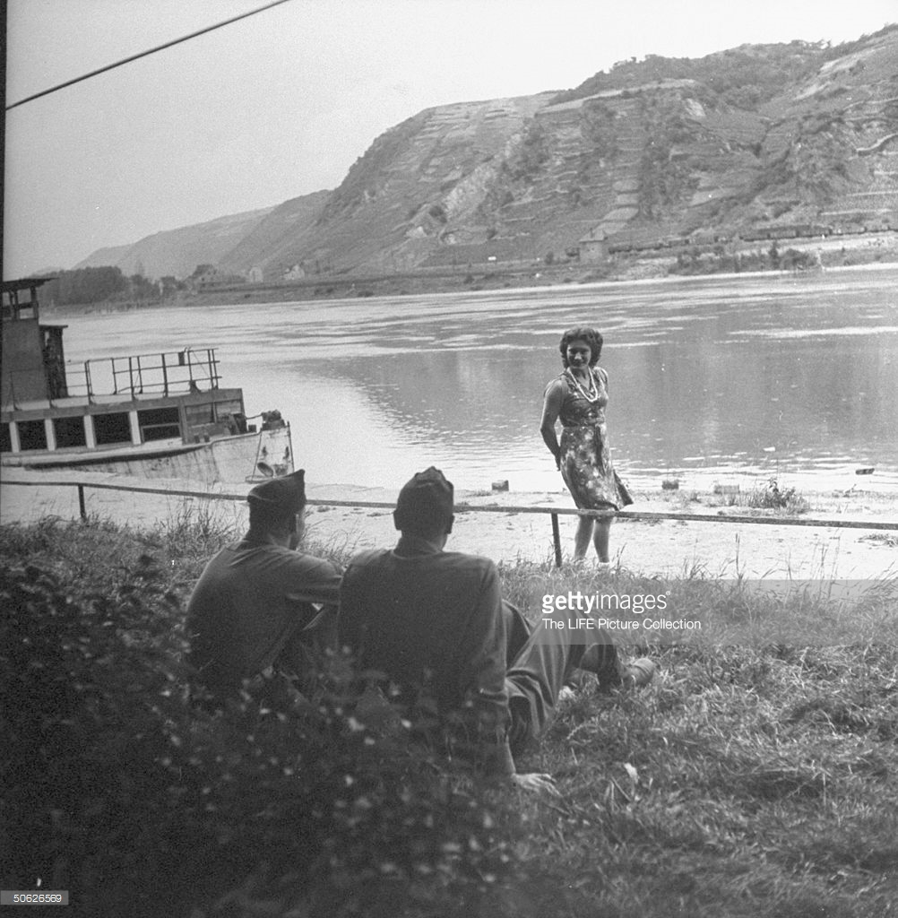
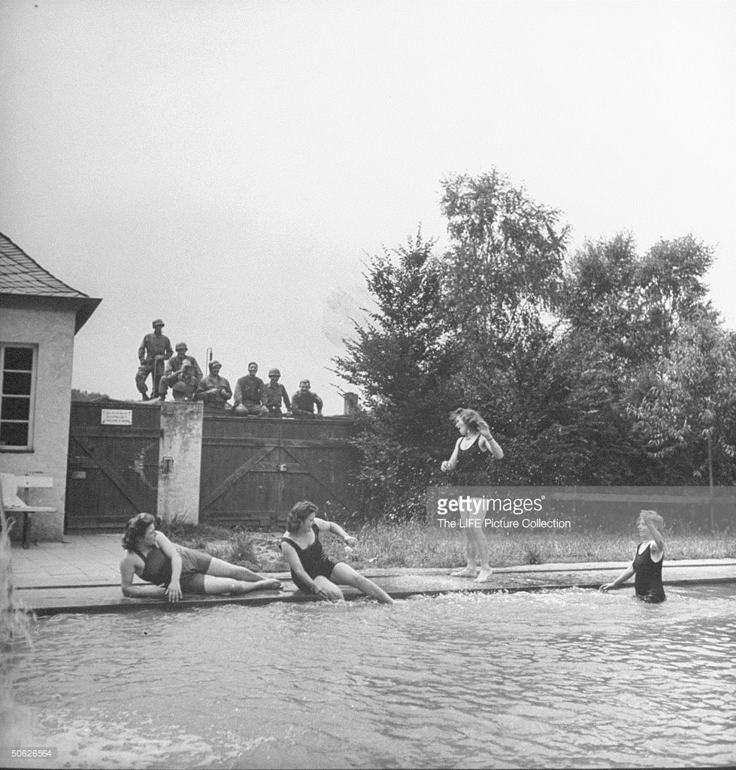
“a new form of German sabotage...
wearing fewer and fewer clothes...”
Field Marshal Bernard Montgomery
Ralph Morse/The LIFE Picture Collection/Getty Images

Slide 14
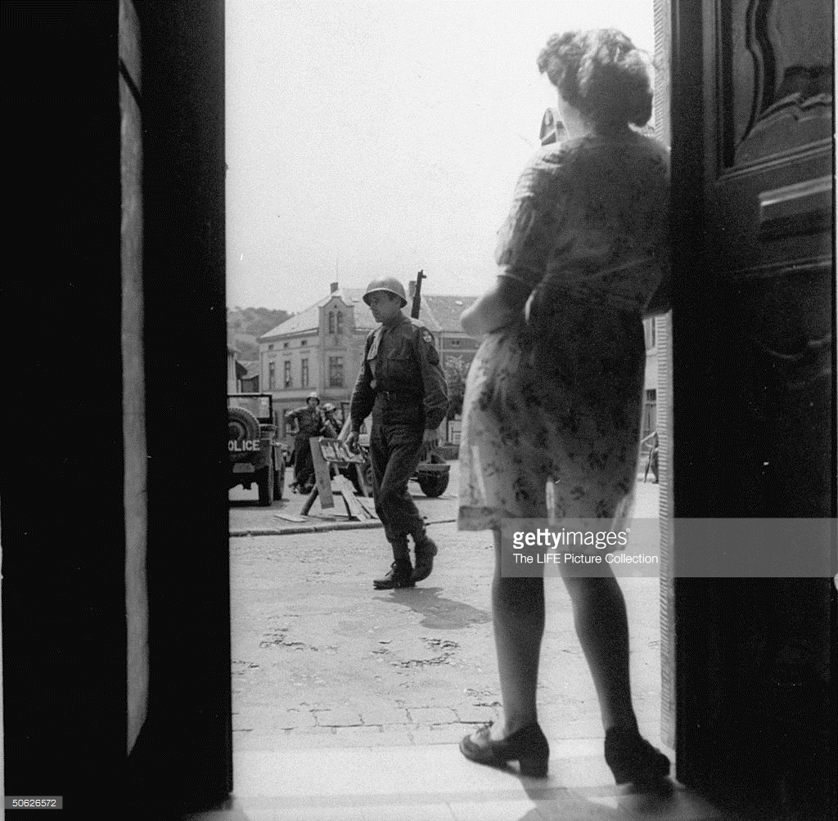
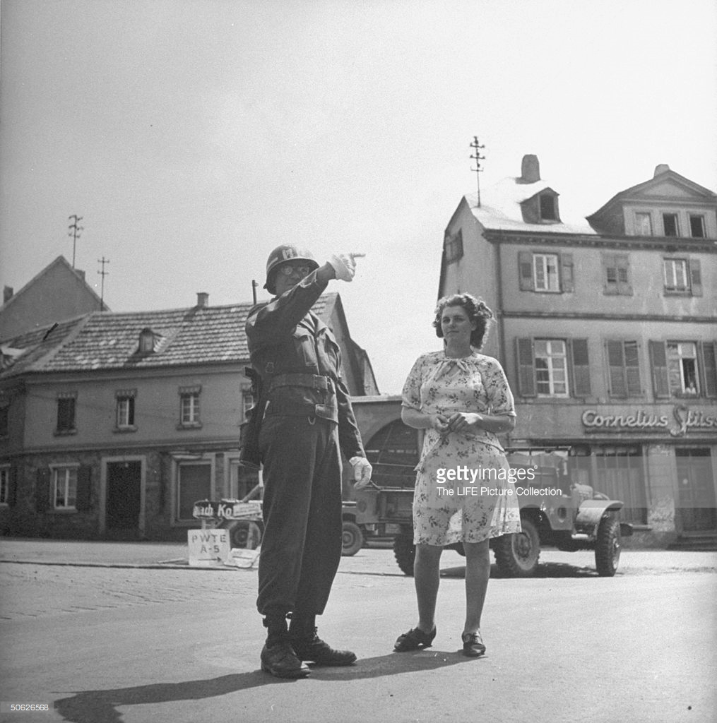
Ralph Morse/The LIFE Picture Collection/Getty Images

Slide 15
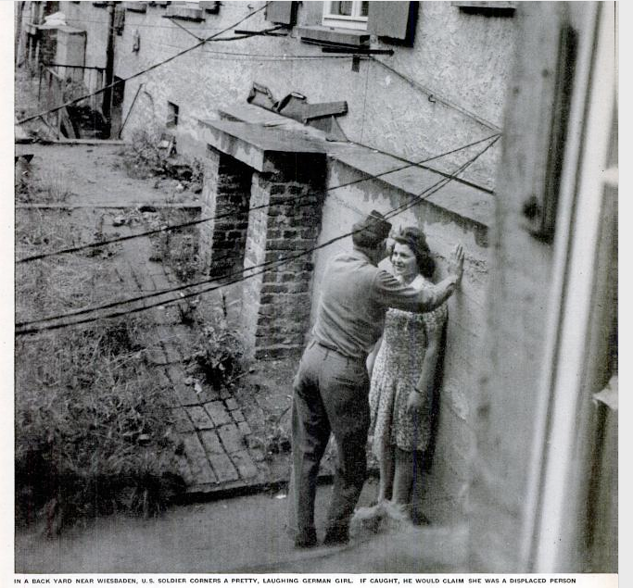
“GERMAN
GIRLS
US Army boycott
fails to stop
GIs fraternizing
with them”
Life
July 23, 1945

Slide 16
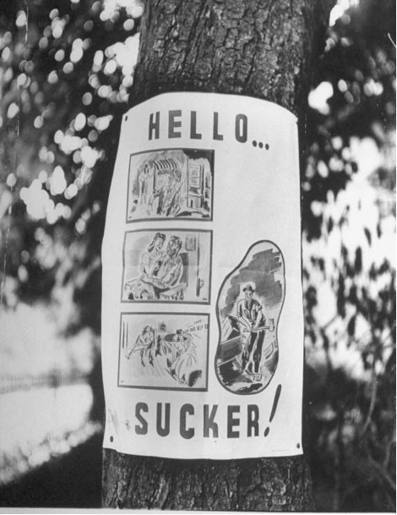
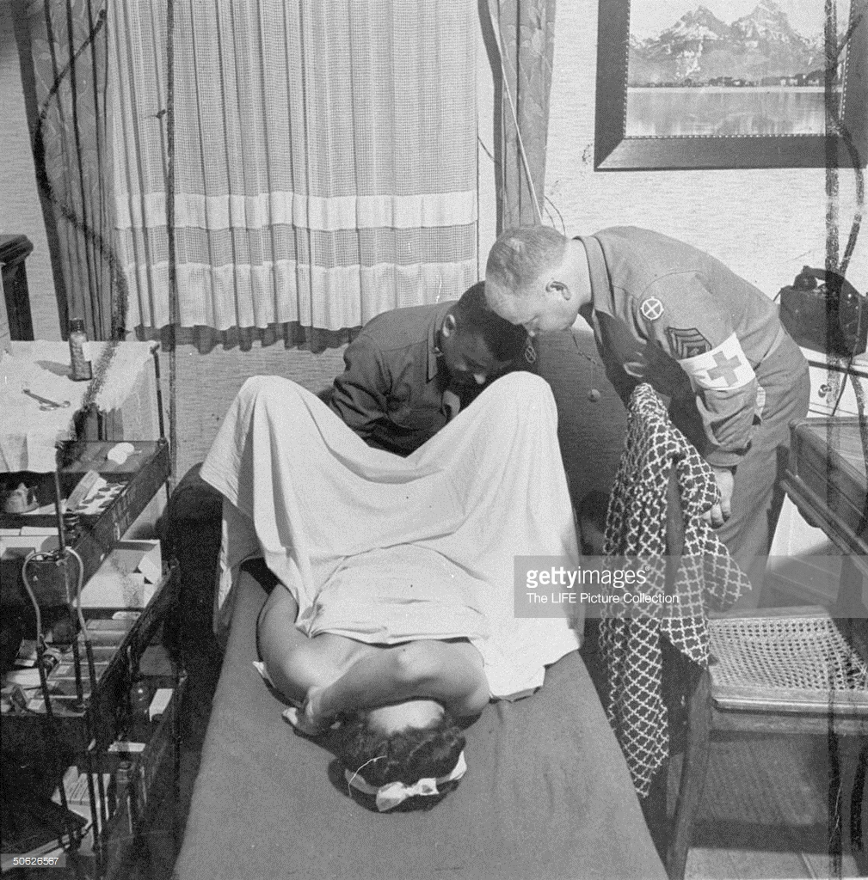
The image below, found captioned on the Getty images site, belongs to the same collection of Ralph Morse photographs that Life used in its July 23, 1945 issue. This one was not published. The poster (right) was.
Caption:
“Army poster shows not uncommon sequence of willing girl,
love-making, yells of ‘Rape,’ six months’ hard labor.
‘Rape’ has become a word in German vocabulary.”
“Fraternization of American troops with German civilians.
The most punishable kind of fraternization case is a rape case. Shot showing German
girl being examined by Army doctor and assistant for signs of VD, etc.”
Photo by Ralph Morse/The LIFE Picture Collection/Getty Images)

Slide 17
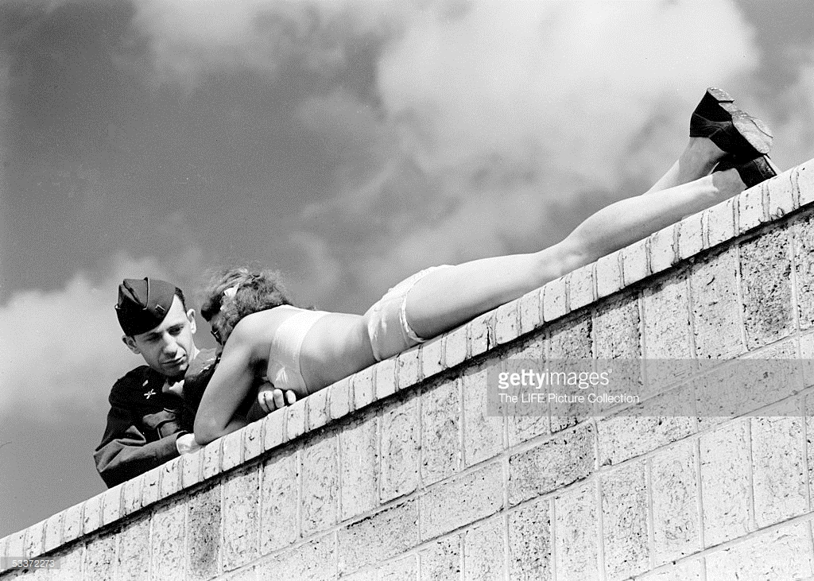
Bourke-White’s Berlin wall
GERMANY - AUGUST 1945: American soldier chatting with a sunbathing German girl in postwar Berlin.
(Photo by Margaret Bourke-White/The LIFE Picture Collection/Getty Images)

Slide 18
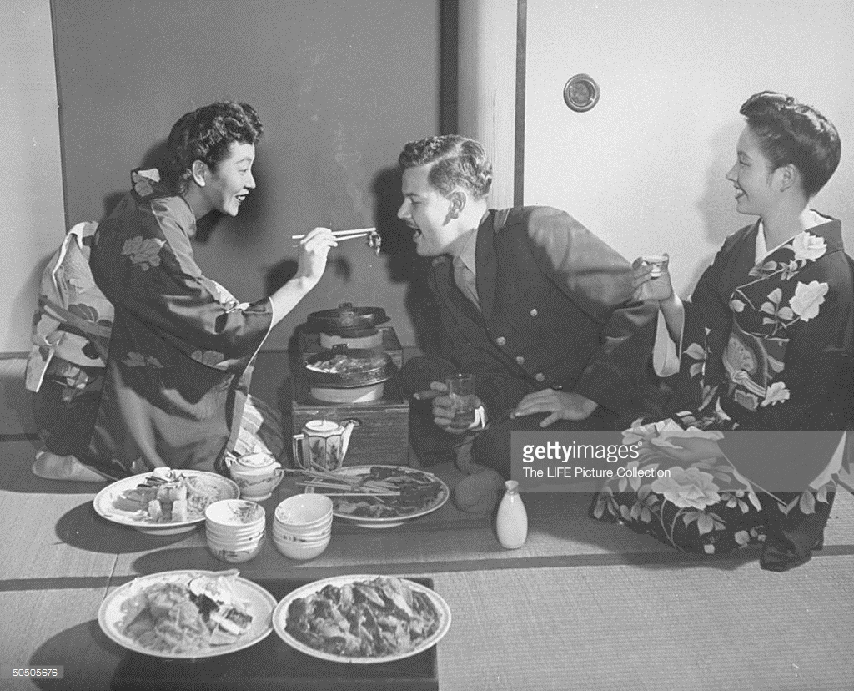
“Geisha Yae Murata (L), known as Miss Peach Blossom, feeding a customer.” (Photo by John Florea/The LIFE Picture Collection/Getty Images)
Credit: John Florea / contributor

Slide 19
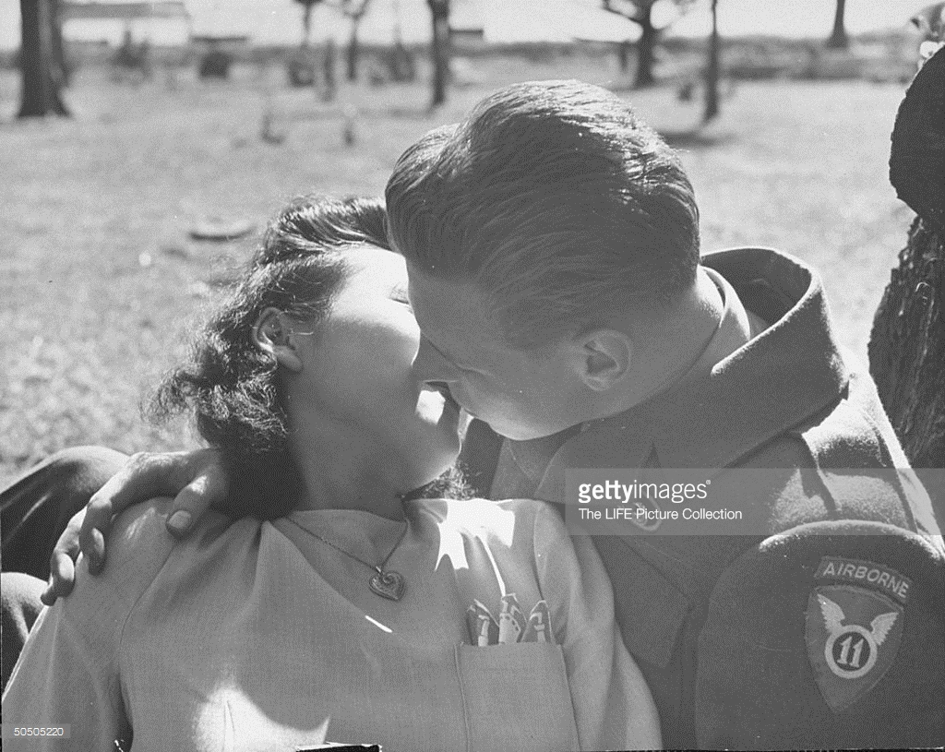
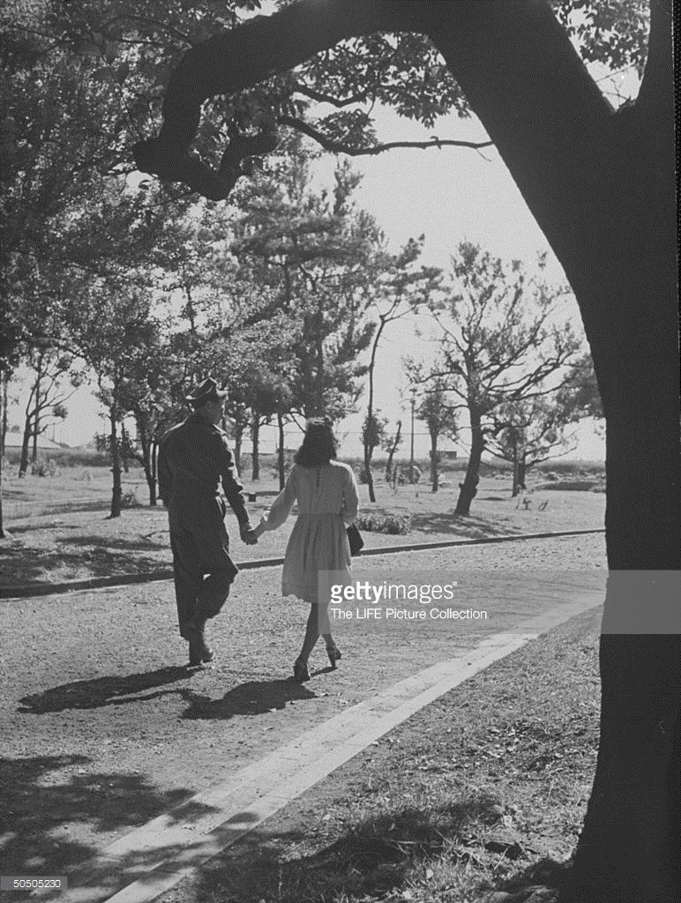
Boundary maintenance
“US soldier and a Japanese girl can hold hands in public.”
(Photo by John Florea/The LIFE Picture Collection/Getty Images)
Credit: John Florea / contributor
“US soldier and local girl sharing a kiss, which is not allowed.”
(Photo by John Florea/The LIFE Picture Collection/Getty Images)
Credit: John Florea / contributor

Slide 20
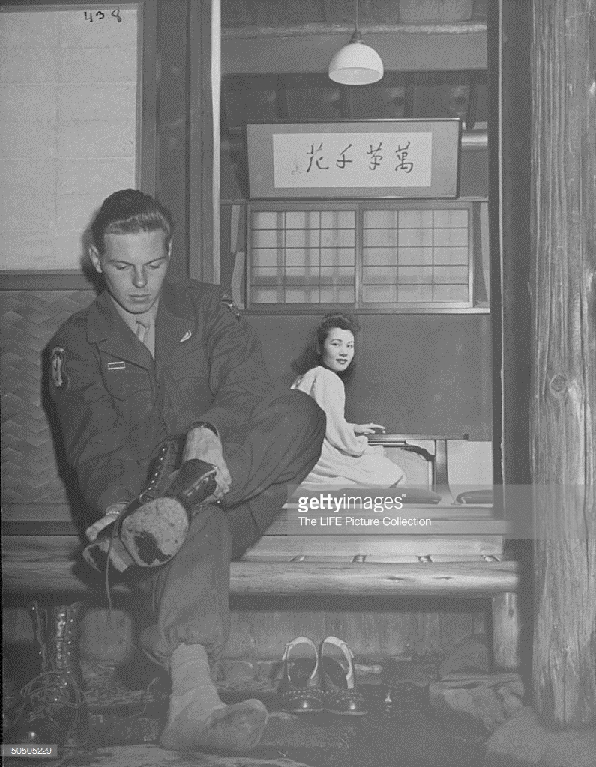
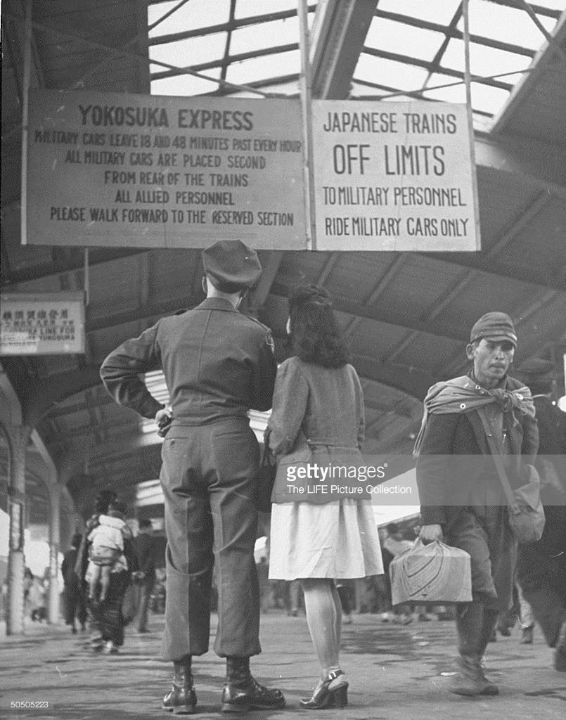
Degrees of separation
US soldier joining a Japanese girl in off-limits dinner, taking off his shoes.
(Photo by John Florea/The LIFE Picture Collection/Getty Images)

Slide 21
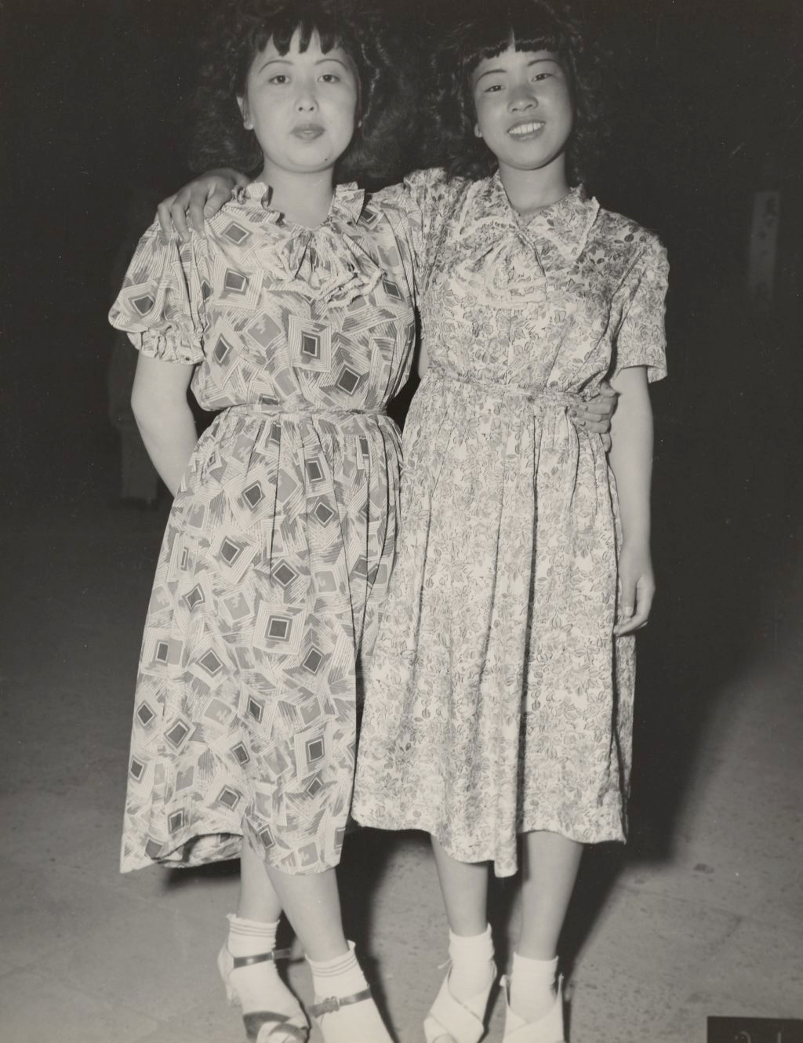
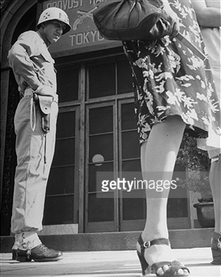
John Florea for Life,
Japan 1946
http://library.osu.edu/projects/bennett-in-japan/images/full/04/8.jpg
“Their legs and figures did not fit readily into our type clothing... Why they tried to imitate American girls is more than I have ever been able to understand...”
General Robert Eichelberger

Slide 22
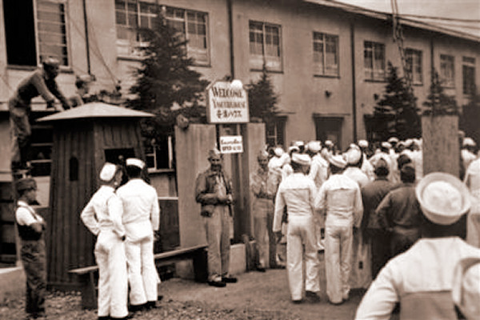
“Comfort stations” for the conquerors
“In this undated image released by the Yokosuka City Council in Japan, U.S. sailors gather
in front of a Yasu-ura House"comfort station" in Yokosuka, south of Tokyo.”
(AP Photo/Yokosuka City Council, HO)
http://navy.memorieshop.com/World-Ports/Japan/Comfort-Women.html

Slide 23
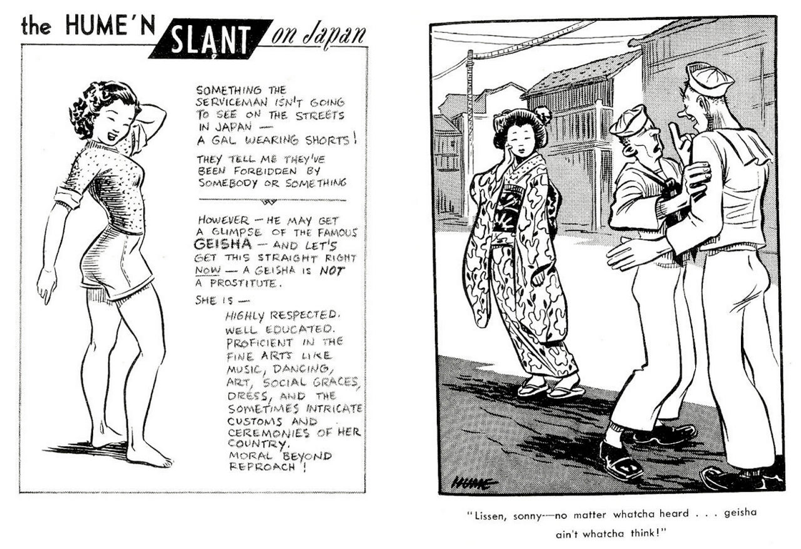
Bill Hume’s Baby-San explains the “Geisha girl”

Slide 24
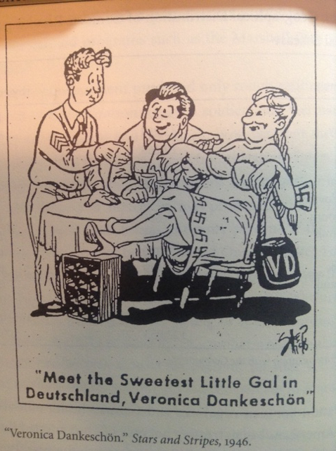

Slide 25
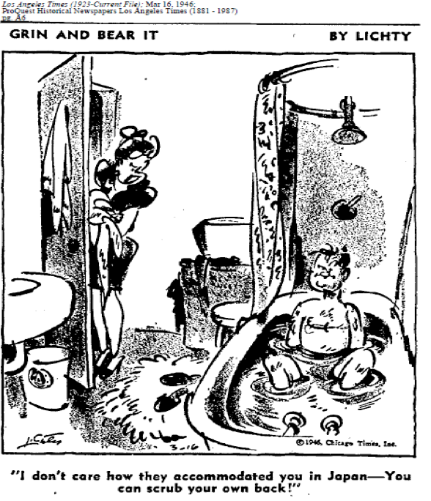
Reconversion
blues

Slide 26
A Foreign Affair (dir. Billy Wilder,1948)
https://www.youtube.com/watch?v=02U-iFF9Lug
Marlene Dietrich sings “Black Market”

Slide 27
Teahouse of the August Moon (dir. Daniel Mann, 1956
Theatrical trailer
https://www.youtube.com/watch?v=XU42uHtmw7o

Slide 28
A U.S. Marine Corps Stinson OY-1 Sentinel observation plane flies low over Naha, capital of Okinawa, ca. May 1945. ARC Identifier: 532379; NARA file no. 127-GR-106-121116; U.S. www.defenseimagery.mil photo no. HD-SN-99-02994.

