Slide 1
Sex under occupation
Postwar: aftermaths of World War II
Term 2, week 3

Slide 2


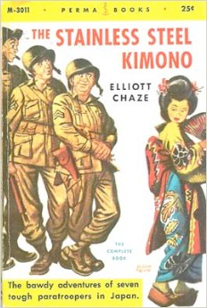


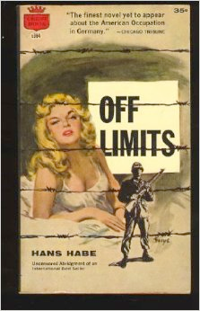
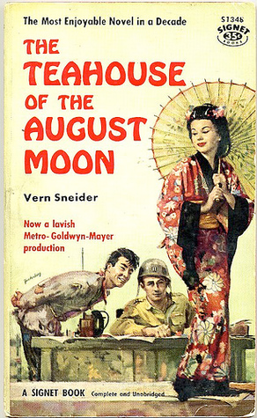
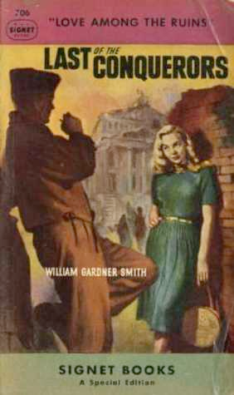

Slide 3
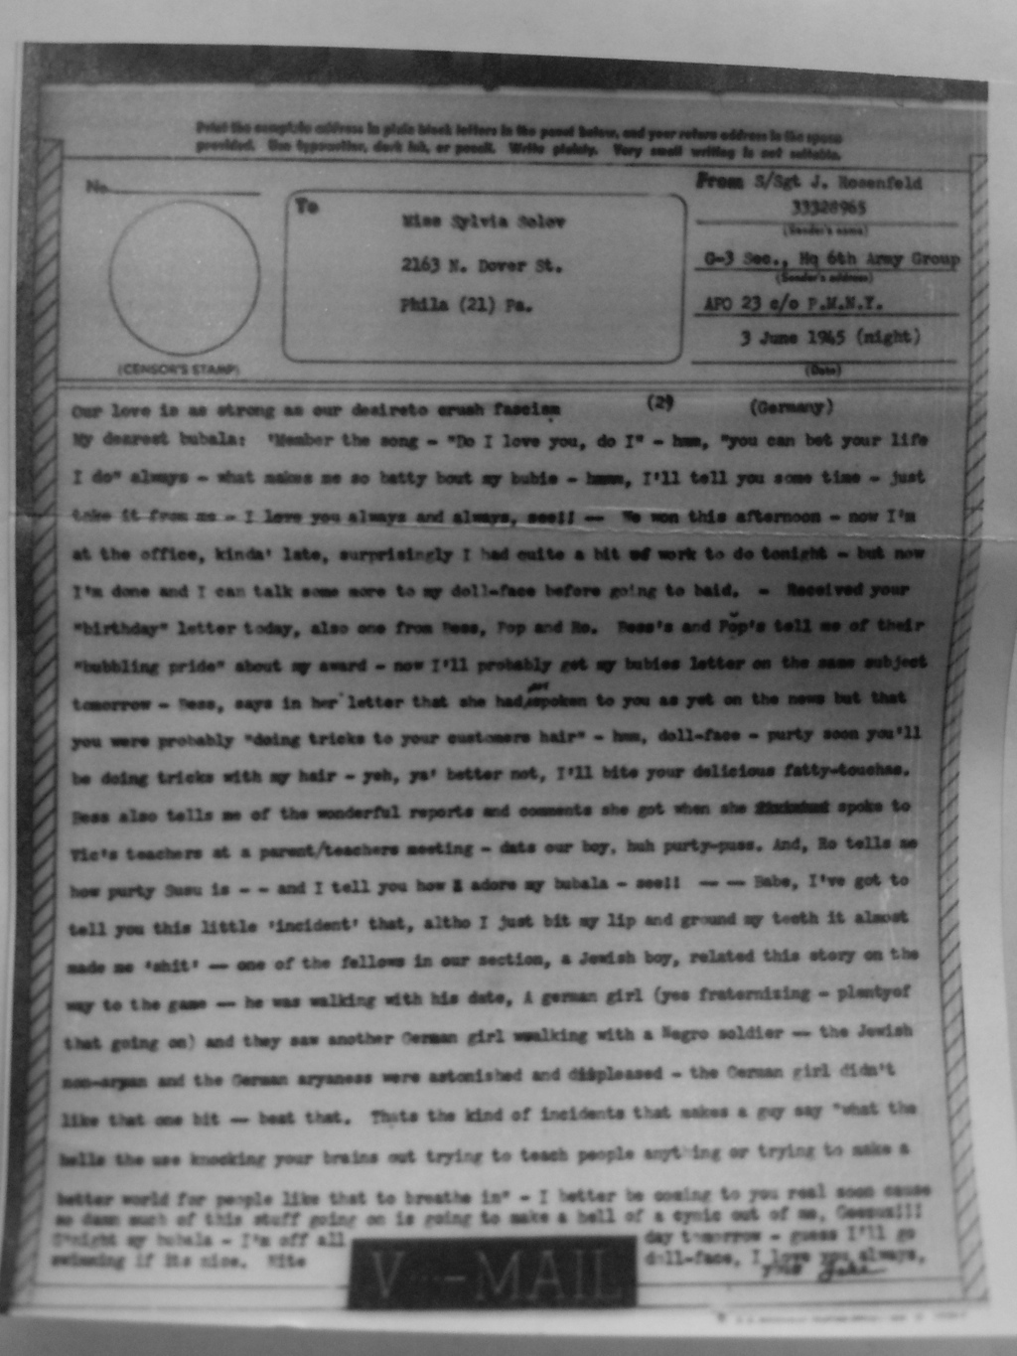
The private
circulation of
knowledge
of forbidden
‘fraternization’
S/Sgt Jack Rosenfeld
V-mail to Sylvia Solov
June 3, 1945
Rare book and manuscript collection,
Van Pelt Library,
University of Pennsylvania

Slide 4
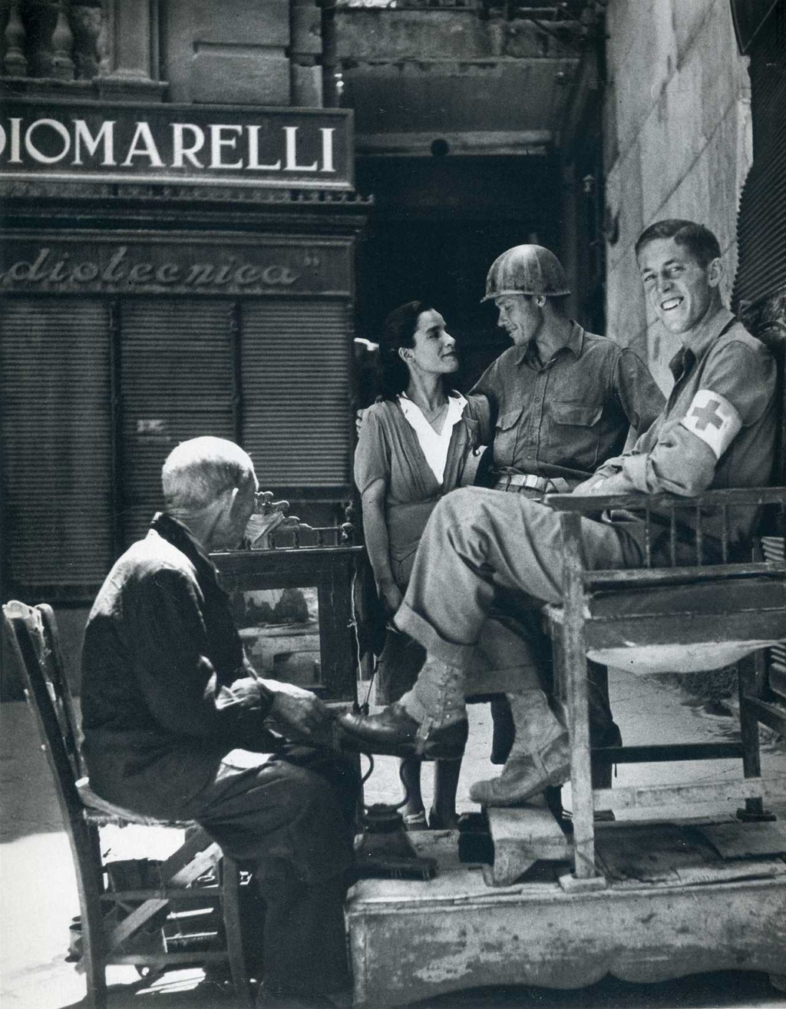
‘AMGOT
At Work’
John Hersey
ata
Allied Military Government
Of Occupied Territory
Robert Capa
Palermo, Sicily
Life
August 23, 1943

Slide 5
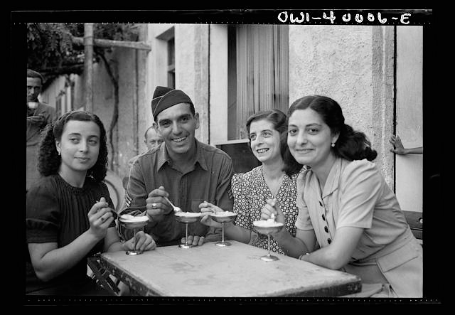
“Palermo, Sicily. One American soldier who found his relatives in Sicily was Vincent J. Orivello
of Milwaukee, Wisconsin, eating ice-cream at a sidewalk cafe in Palermo with three of his cousins.”
Nick Parrino for the Office of War Information, Sept. 1943
Digital ID: (digital file from original neg.) fsa 8d34225 http://hdl.loc.gov/loc.pnp/fsa.8d34225
Reproduction Number: LC-DIG-fsa-8d34225 (digital file from original neg.) LC-USW3-040006-E (b&w film nitrate neg.)
Repository: Library of Congress Prints and Photographs Division Washington, D.C.

Slide 6
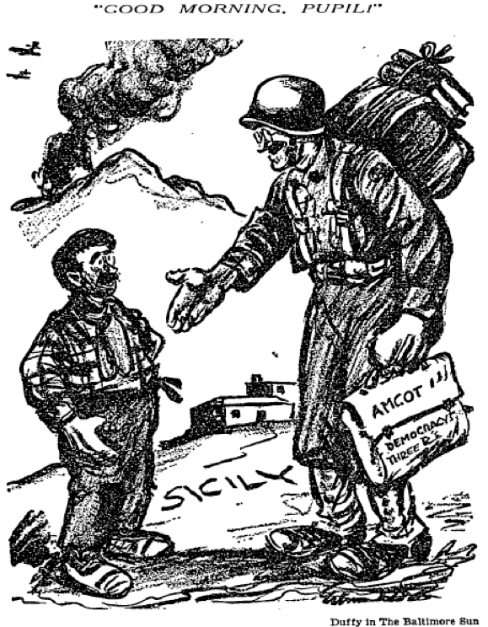
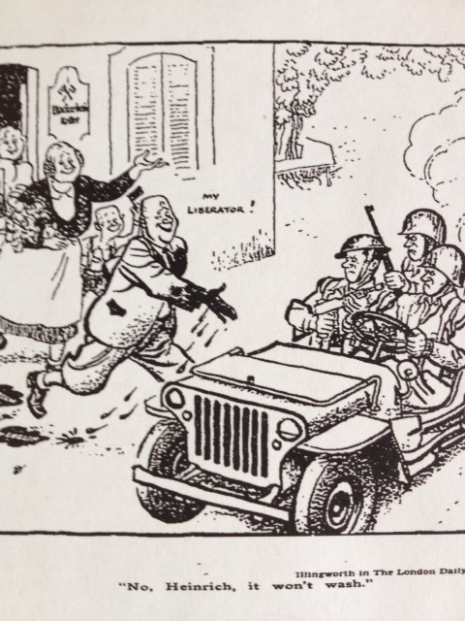
Occupations pedagogical and punitive
Differentiating ‘liberated’ territories from Axis states
Duffy, Baltimore Sun, 19 July 943
Illingworth, New York Times, 8 Oct.1944

Slide 7
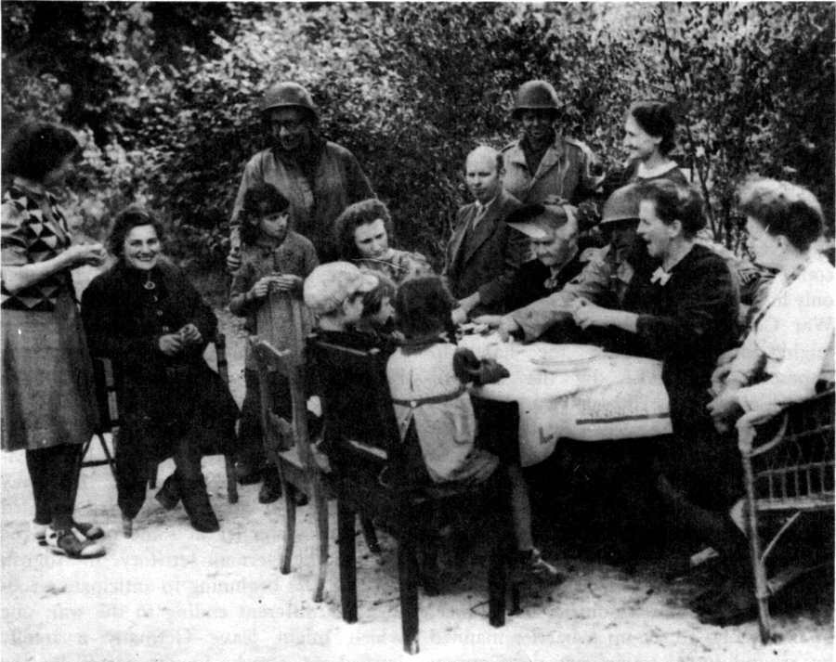
In June 1945, the prohibition against speaking with German children was eased.
In July, it was permitted to speak to German adults in certain circumstances.
In September, the policy was abandoned in US zones of Austria and Germany.
Montgomery lifted the ‘fraternization ban ‘ in the British zone in July 1945.
US TROOPS AND GERMAN CIVILIANS (September 1944).
This and pictures like it provoked the President's order against fraternization.
Earl Ziemke, http://www.history.army.mil/books/wwii/occ-gy/ch08.htm

Slide 8
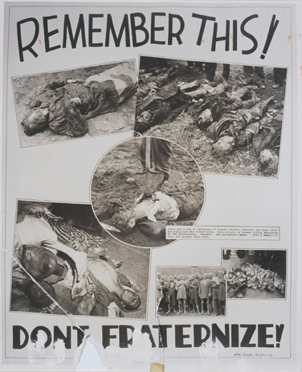
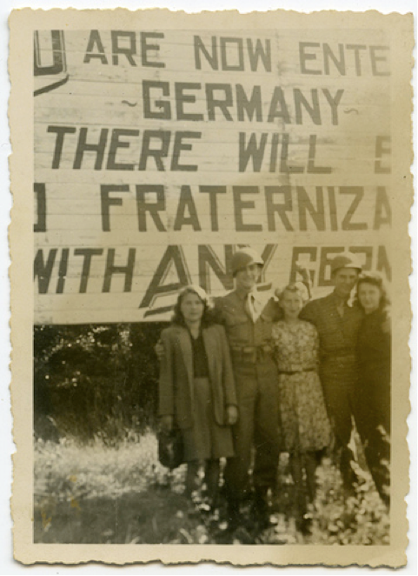
Deterrence and its failure: the ‘frat ban’
Arnold Samuelson, USHMM,
Photograph #62779
“Two buddies, three girls. Not bad”

Slide 9
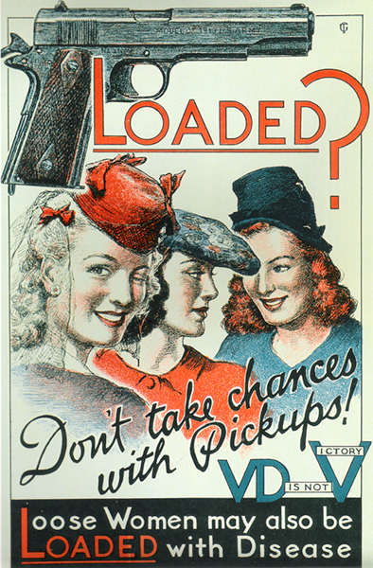

http://www.gutenberg-e.org/pfau/detail/112-P-48NACP.html
U.S. Government Printing Office -
Library of Congress. Prints and Photographs division cph.3g04256.

Slide 10
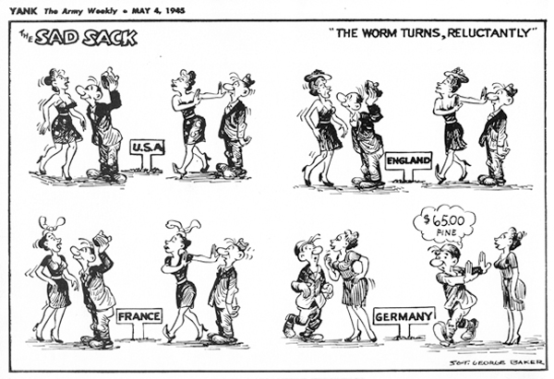
Source: Stars and Stripes. © 1945, 2007 Stars and Stripes.
http://www.gutenberg-e.org/pfau/detail/WormTurn050445.html
“The $65 question”

Slide 11
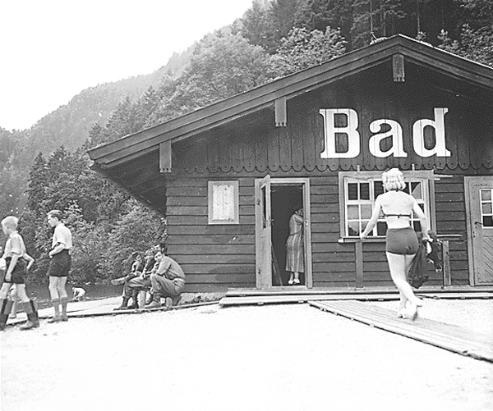
"Verboten—
but not too bad
from this angle."
Stars and Stripes
Source: NACP.
http://www.gutenberg-e.org/pfau/detail/Bad531301.html

Slide 12
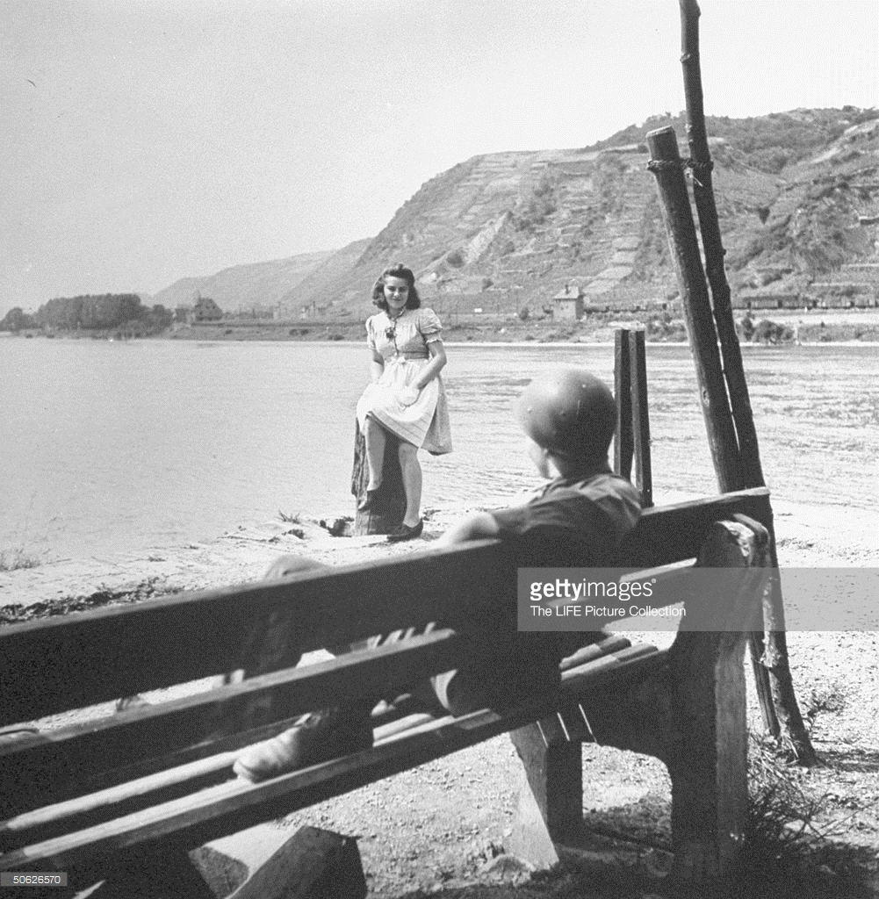
Photo by Ralph Morse/The LIFE Picture Collection/Getty Images

Slide 13
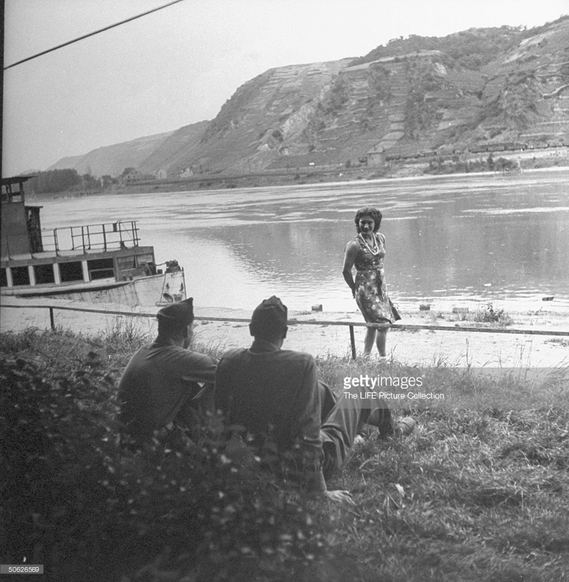
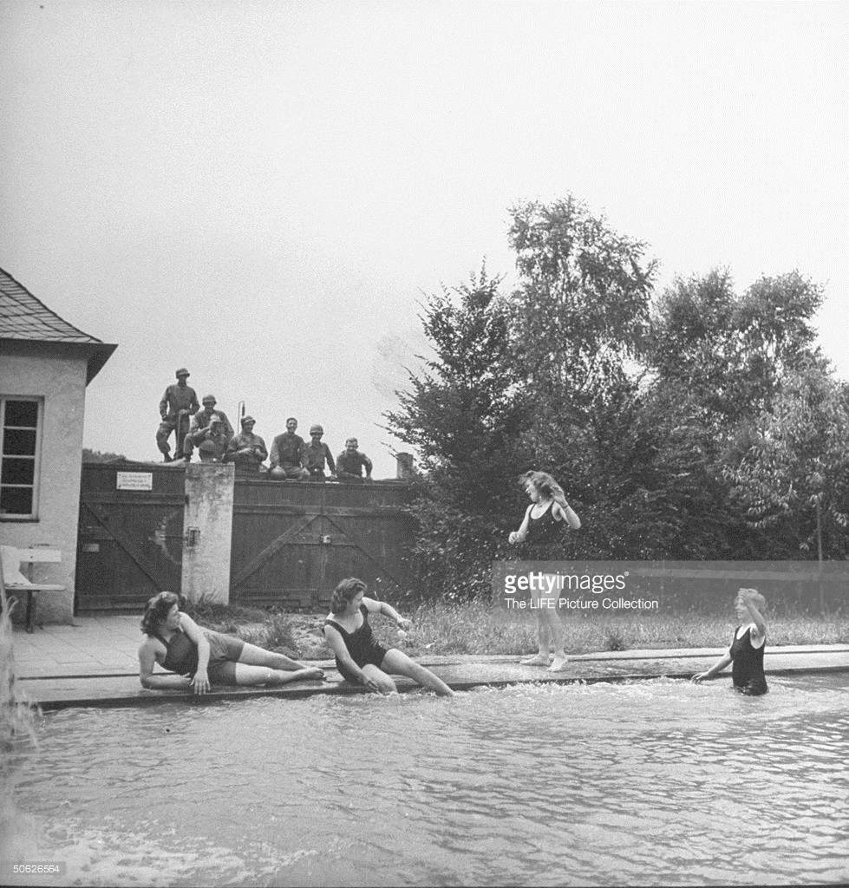
“a new form of German sabotage...
wearing fewer and fewer clothes...”
Field Marshal Bernard Montgomery
Ralph Morse/
The LIFE Picture Collection/Getty Images

Slide 14
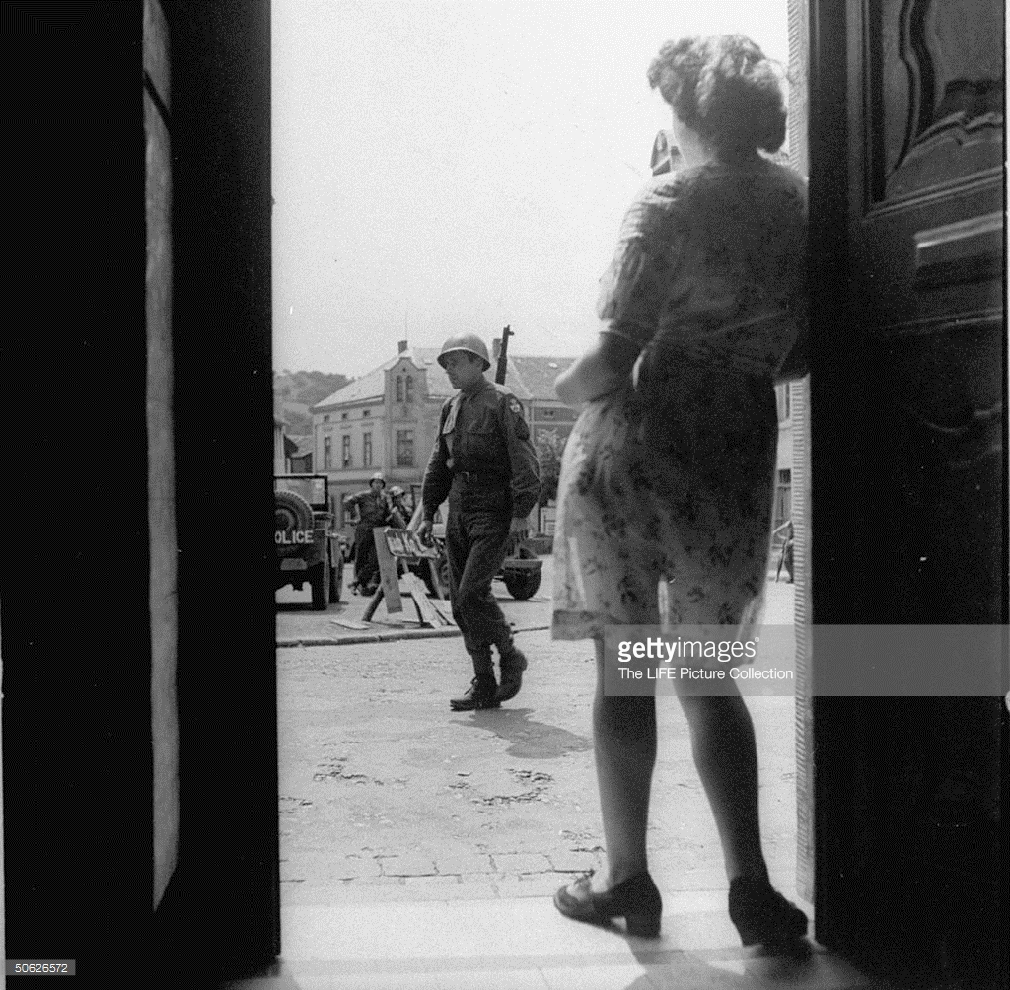
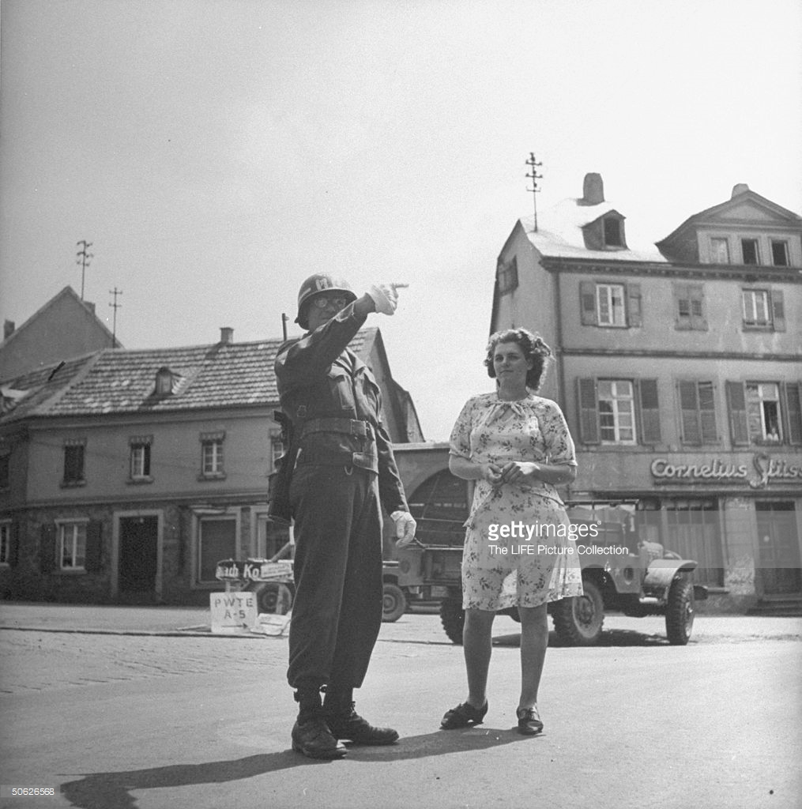
Ralph Morse/
The LIFE Picture Collection/Getty Images

Slide 15
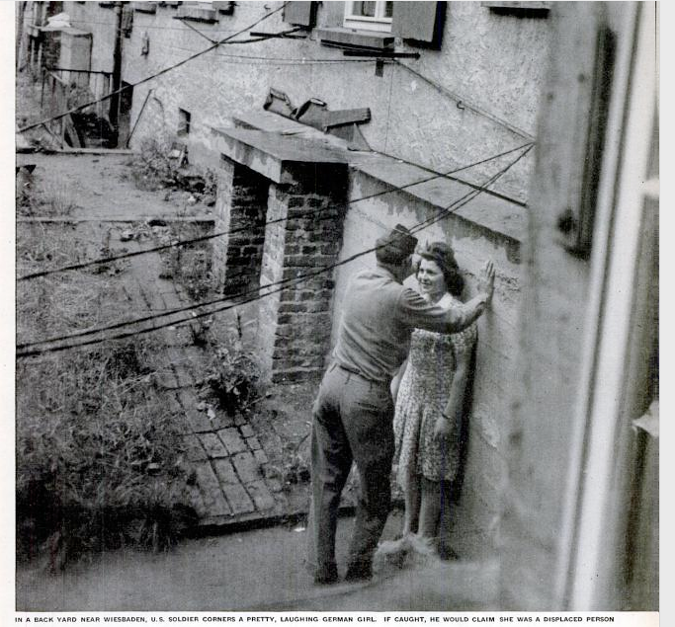
“GERMAN
GIRLS
US Army boycott
fails to stop
GIs fraternizing
with them”
Life
July 23, 1945

Slide 16
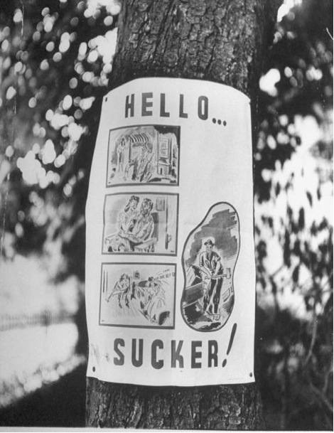
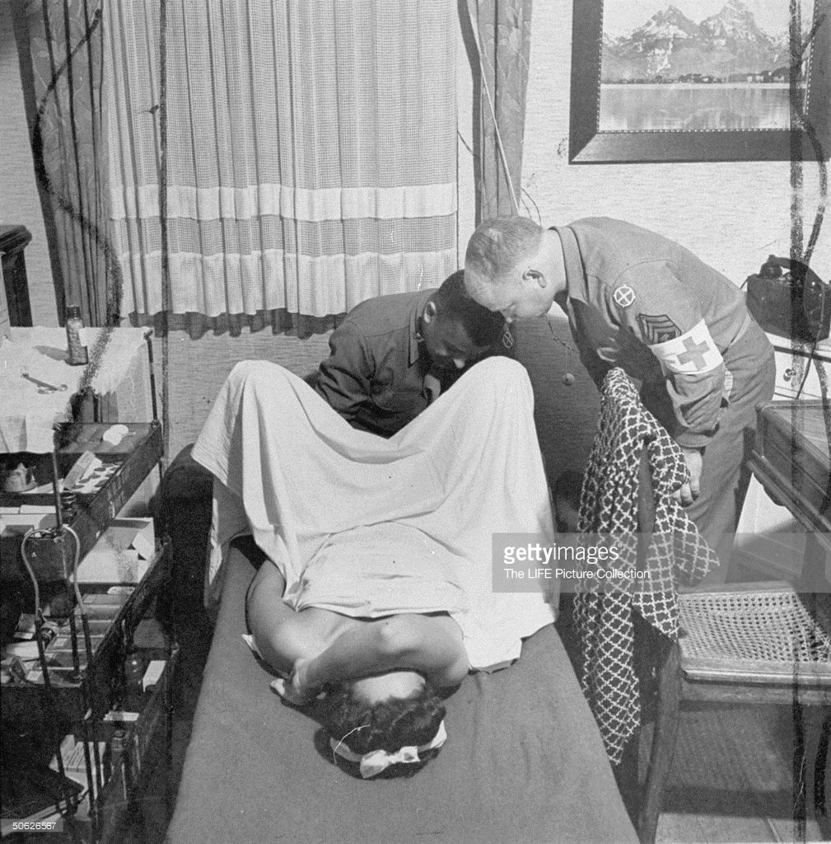
The image below, found captioned on the Getty images site, belongs to the same collection of Ralph Morse photographs that Life used in its July 23, 1945 issue. This one was not published. The poster (right) was.
Caption:
“Army poster shows not uncommon sequence of willing girl,
love-making, yells of ‘Rape,’ six months’ hard labor.
‘Rape’ has become a word in German vocabulary.”
“Fraternization of American troops with German civilians.
The most punishable kind of fraternization case is a rape case. Shot showing German girl being examined by Army doctor and assistant for signs of VD, etc.” Photo by Ralph Morse/The LIFE Picture Collection/Getty Images)

Slide 17
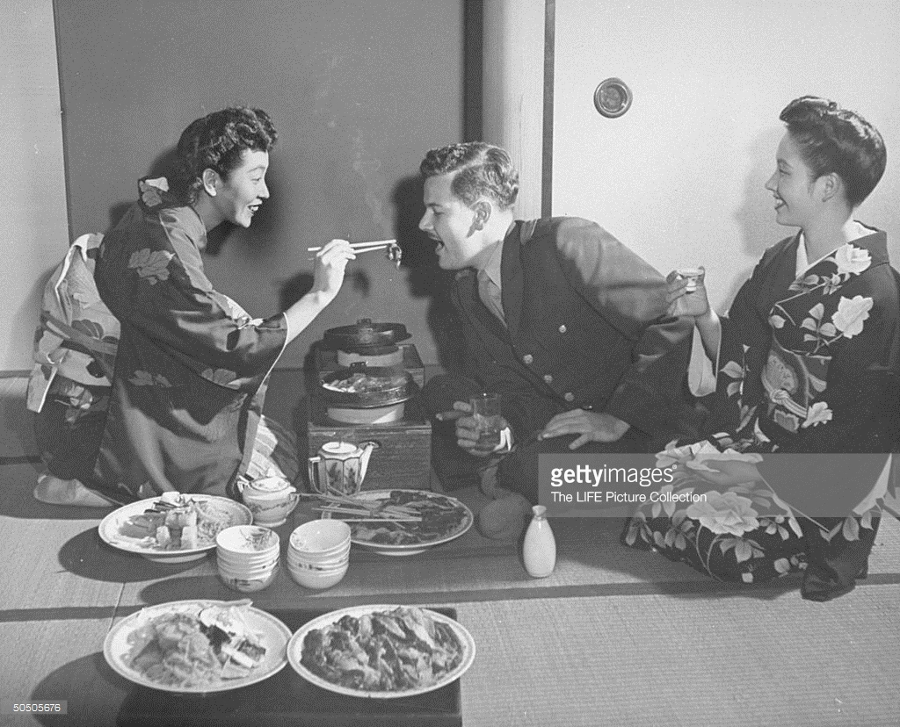
The American “Geisha Girl” fixation
“Geisha Yae Murata (L), known as Miss Peach Blossom, feeding a customer.”
(Photo by John Florea/The LIFE Picture Collection/Getty Images)

Slide 18
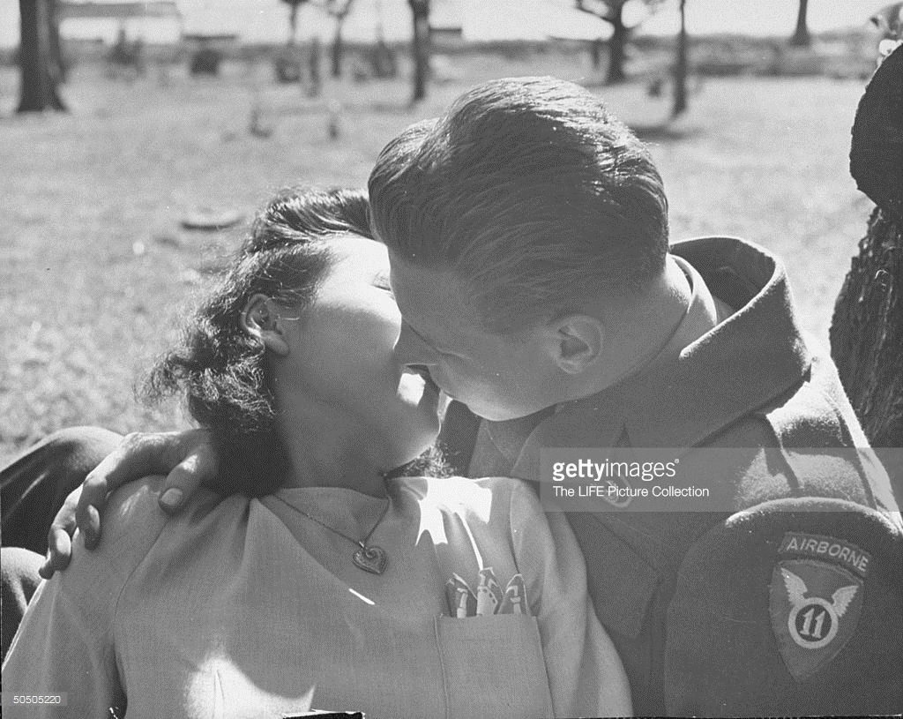
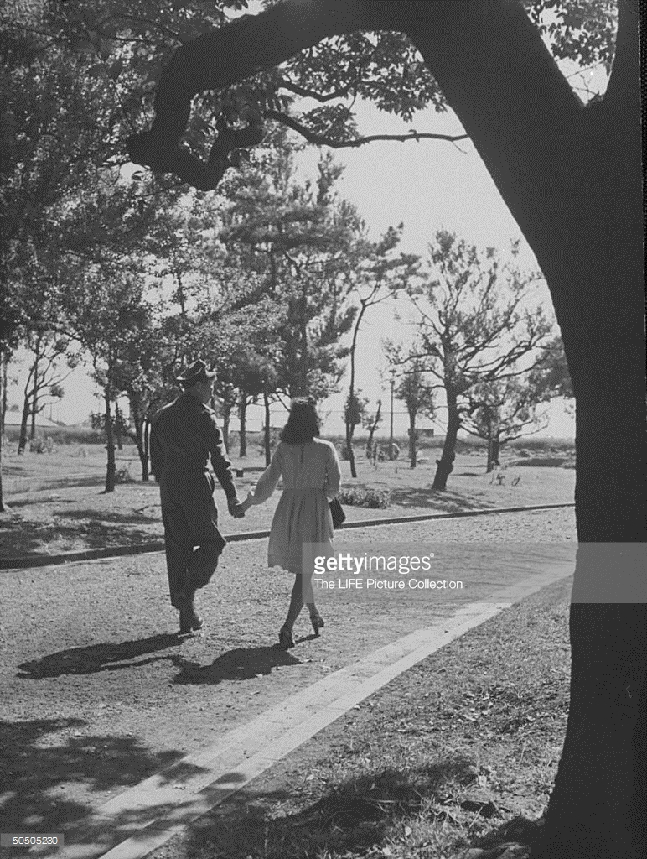
Rules of engagement
“US soldier and a Japanese girl can hold hands in public.”
(Photo by John Florea/The LIFE Picture Collection/Getty Images) Credit: John Florea / contributor
“US soldier and local girl sharing a kiss, which is not allowed.”
(Photo by John Florea/The LIFE Picture Collection/Getty Images)

Slide 19
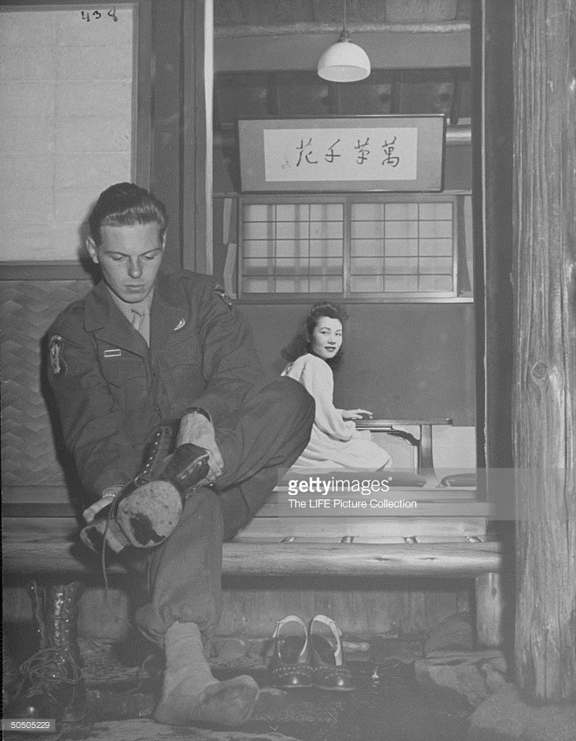
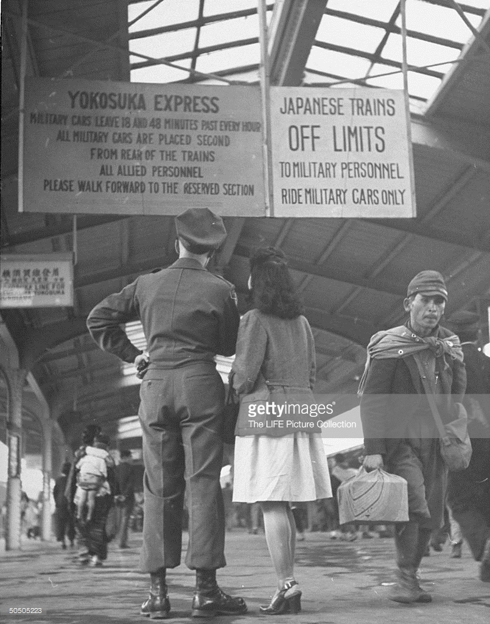
Degrees of separation
US soldier joining a Japanese girl in off-limits dinner, taking off his shoes.
(Photo by John Florea/The LIFE Picture Collection/Getty Images)

Slide 20
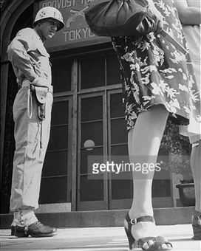
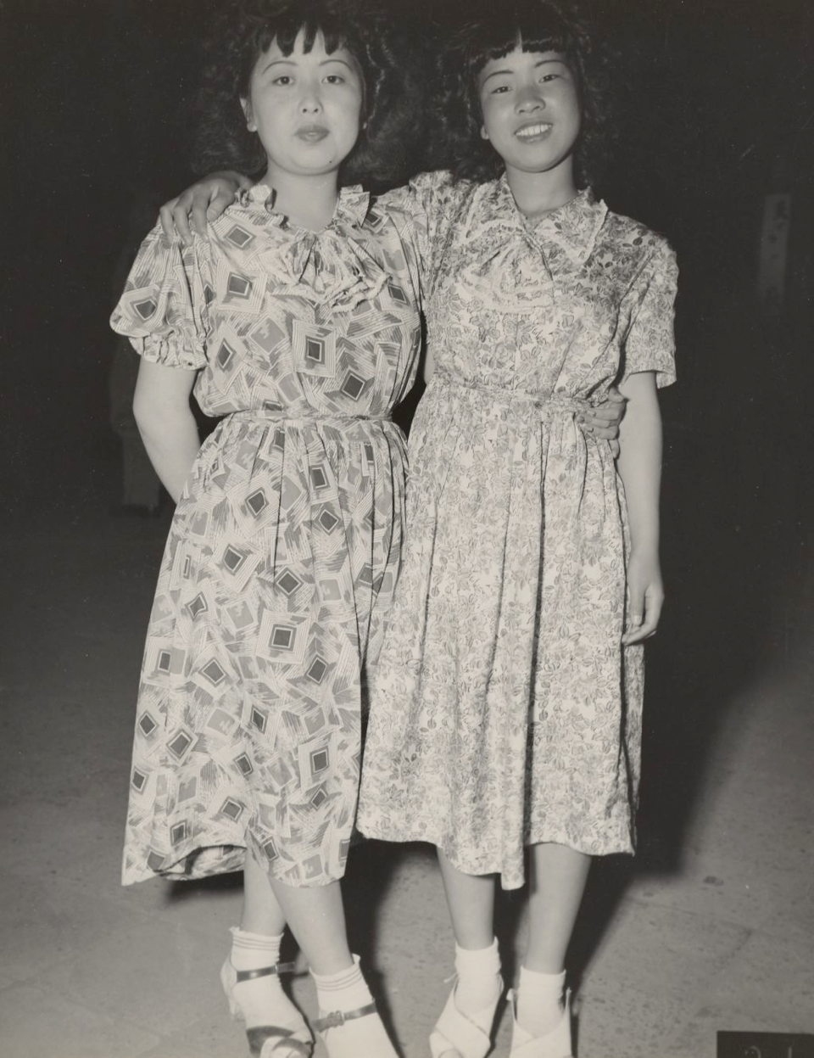
“Americanization”
“Their legs and figures did not fit readily into our type clothing... Why they tried to imitate American girls is more than I have ever been able to understand...”
General Robert Eichelberger
http://library.osu.edu/projects/bennett-in-japan/images/full/04/8.jpg
John Florea for Life,
Japan 1946

Slide 21
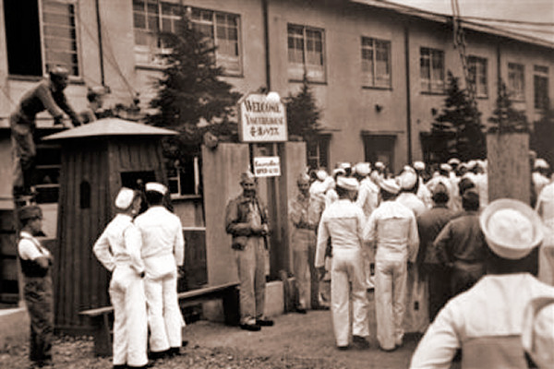
“Comfort stations” for the conquerors
“In this undated image released by the Yokosuka City Council in Japan, U.S. sailors gather in front of a Yasu-ura House"comfort station" in Yokosuka, south of Tokyo.”
(AP Photo/Yokosuka City Council, HO)
http://navy.memorieshop.com/World-Ports/Japan/Comfort-Women.html

Slide 22
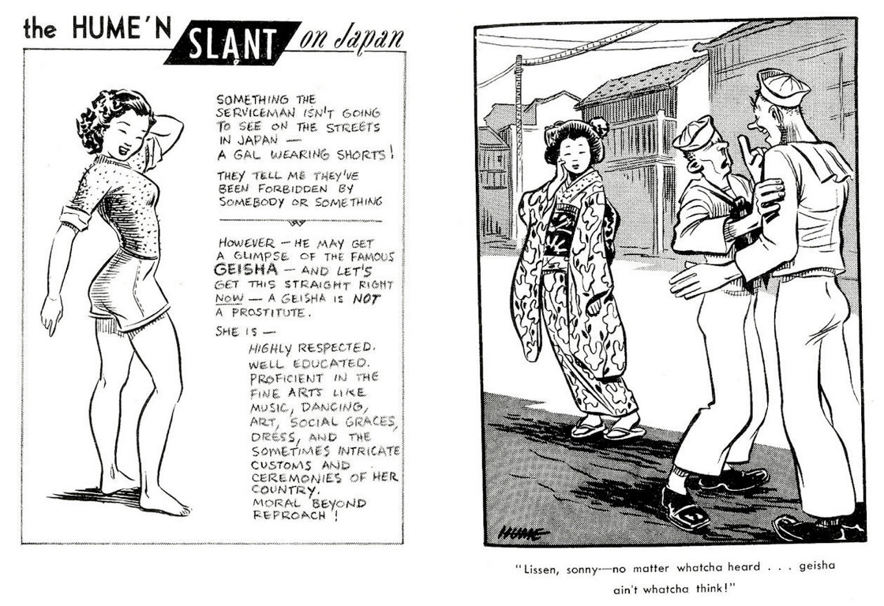
Bill Hume’s Baby-San explains the “Geisha girl”

Slide 23
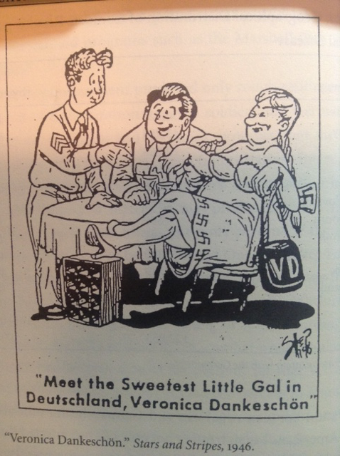
“Cute” Japanese
vs “sluttish”
Germans

Slide 24
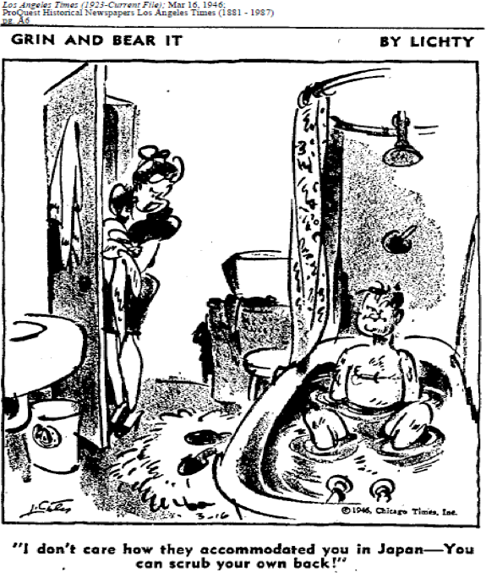
16 Mar

Slide 25
A Foreign Affair (dir. Billy Wilder,1948)
https://www.youtube.com/watch?v=02U-iFF9Lug
Marlene Dietrich sings “Black Market”

Slide 26
Teahouse of the August Moon (dir. Daniel Mann, 1956)
Theatrical trailer
https://www.youtube.com/watch?v=XU42uHtmw7o

Slide 27
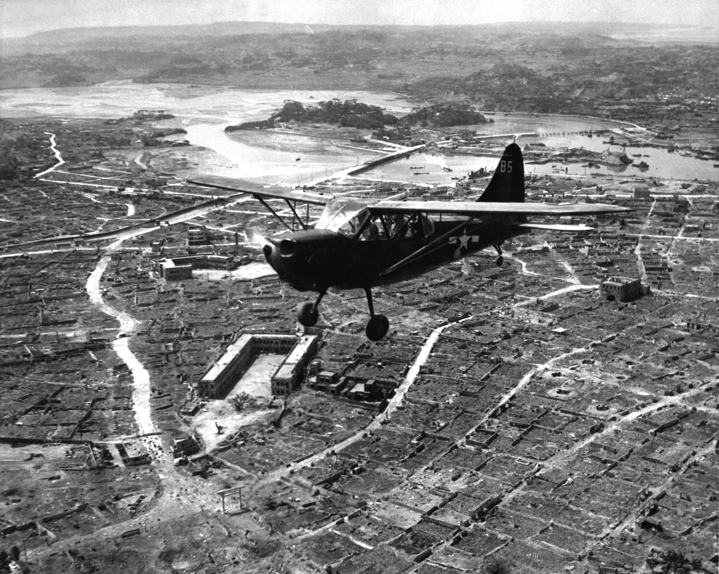
A U.S. Marine Corps Stinson OY-1 Sentinel observation plane flies low over Naha, capital of Okinawa, ca. May 1945. ARC Identifier: 532379; NARA file no. 127-GR-106-121116; U.S. www.defenseimagery.mil photo no. HD-SN-99-02994.

