Slide 1
Victors’ justice?
The International Military Tribunal at Nuremberg
Postwar: Term 2, week 5

Slide 2
Opening questions
What is a trial?
What is a “show trial”?
Why stage war crimes trials at all? Alternatives??

Slide 3
Why nuremberg?
https://www.ushmm.org/wlc/en/article.php?ModuleId=10007089
The Palace of Justice in Nuremberg, where the International Military Tribunal trial of war criminals was held. The flags of the four prosecuting countries (French, American, British, and Soviet) hang above the entrance.
— National Archives and Records Administration, College Park, Md.
Exterior view of the Castle of the Duke of Faber-Castell– home to the press corps.
— US Holocaust Memorial Museum, courtesy of Robert Kempner
Nuremberg in ruins: https://www.britishpathe.com/asset/71104/

Slide 4
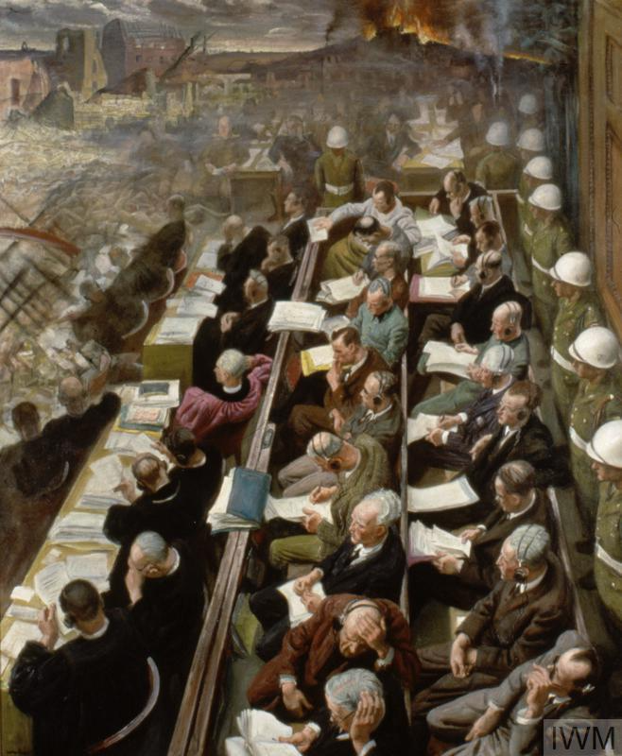
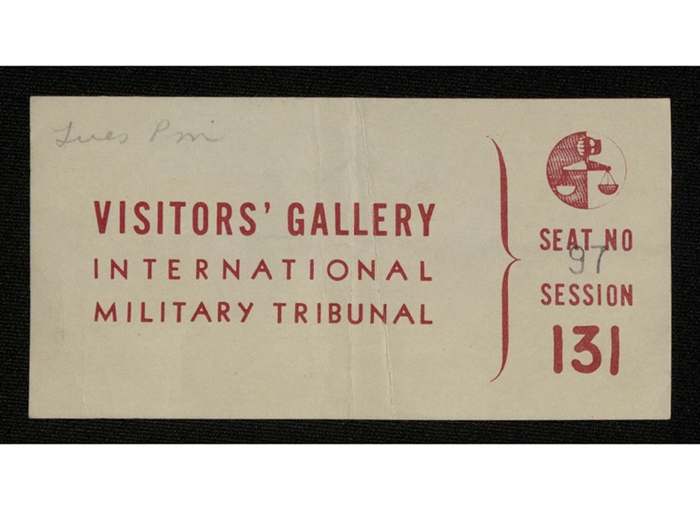
British official war artist Laura Knight’s
Depiction of Nuremberg, 1946
Imperial War Museum
https://www.iwm.org.uk/collections/item/object/15506

Slide 5
The accused and their defense attorneys at the International Military Tribunal courtroom.
— National Archives and Records Administration, College Park, Md.
The Palace of Justice in Nuremberg being remodeled in preparation for the International Military Tribunal trial.
— Harry S. Truman Library

Slide 6
Birds-eye view of the fenced-in cell block where defendants in the IMT were imprisoned.
— US Holocaust Memorial Museum, courtesy of Robert Kempner

Slide 7
What was the IMT intended to do?
Can we talk of a single set of Allied intentions? Arguably, the four powers (US, UK, France and USSR) who
convened the IMT had distinct—sometimes divergent—aspirations, beholden to national power-political agendas
Establish that the war itself resulted from a criminal conspiracy on the part of several Nazi organizations
Establish indisputably that these organizations perpetrated crimes, amassing textual documentation, witness testimony
and visual evidence (film and photography)– a bequest to the future/guarantee against later denial
Signal to the entire German population the utter illegitimacy of the Nazi regime, furthering the broader agenda
of de-nazification and Germans’ democratic re-education
Underscore the victors’ own moral credentials for the benefit of domestic audiences as well as international observers
Establish a clear moral narrative (good vs evil) for WWII along stark binary lines
Inaugurate a new era of international legal cooperation
Inscribe precepts such as “crimes against humanity” in the canon of international law

Slide 8
Framing the charges
AUGUST 8, 1945
CHARTER OF THE INTERNATIONAL MILITARY TRIBUNAL (IMT) ANNOUNCED AT LONDON CONFERENCE
The International Military Tribunal (IMT) is composed of judges from the United States, Great Britain, France and the Soviet Union. Leading Nazi officials will be indicted and placed on trial in Nuremberg, Germany, under Article 6 of the IMT's Charter for the following crimes:
Conspiracy to commit charges 2, 3, and 4, which are listed here;
crimes against peace—defined as participation in the planning and waging of a war of aggression in violation of numerous international treaties;
war crimes—defined as violations of the internationally agreed upon rules for waging war;
crimes against humanity—"namely, murder, extermination, enslavement, deportation, and other inhumane acts committed against any civilian population, before or during the war; or persecution on political, racial, or religious grounds in execution of or in connection with any crime within the jurisdiction of the Tribunal, whether or not in violation of domestic law of the country where perpetrated."
For the Charter of the IMT, follow this link: http://avalon.law.yale.edu/imt/imtconst.asp

Slide 9
The defendants
WHO WAS TRIED AT NUREMBERG?
Hitler, Goebbels and Himmler committed suicide before V-E Day, May 8, 1945. But the Allies indicted 24 other Nazi leaders, of whom 23 were arrested and brought to trial at Nuremberg. Martin Bormann was thought to be still at large when the proceedings began, and was tried in absentia.
Before the trial began, it was decided that the industrialist Gustav Krupp von Bohlen und Halbach was too weak to stand trial. Shortly before the trial, Dr. Robert Ley managed to hang himself in his Nuremberg cell. That left 21defendants in the dock at Nuremberg.
The Verdict
After 216 court sessions, on October 1, 1946, the verdict was rendered. Three of the defendants were acquitted: Hjalmar Schacht, Franz von Papen, and Hans Fritzsche. Four were sentenced to terms of imprisonment ranging from 10 to 20 years: Karl Dönitz, Baldur von Schirach, Albert Speer, and Konstantin von Neurath. Three were sentenced to life imprisonment: Rudolf Hess, Walther Funk, and Erich Raeder. Twelve of the defendants were sentenced to death by hanging. Ten of them—Hans Frank, Wilhelm Frick, Julius Streicher, Alfred Rosenberg, Ernst Kaltenbrunner, Joachim von Ribbentrop, Fritz Sauckel, Alfred Jodl, Wilhelm Keitel, and Arthur Seyss-Inquart—were hanged on October 16, 1946. Hermann Goering managed to take a cyanide capsule hours before the execution.
Martin Bormann was condemned to death and sentenced to hang in absentia. In 1972, remains thought to be Bormann’s were found by construction workers in Berlin. In 1998 DNA testing substantiated it was Bormann, and that the mode of death had been cyanide poisoning.
http://www.nurembergfilm.org/trial_defendants_verdicts.shtml

Slide 10
Defendant Hermann Göring in the prisoners' dock at the International Military Tribunal trial of war criminals at Nuremberg, 20 November 1945-1 October, 1946: photographer unknown (Harry S. Truman Library)
https://www.trumanlibrary.gov/photograph-records/72-911
German Reichsmarschall, Commander of the Luftwaffe Hermann Göring (1893-1946) during cross examination at his trial for war crimes in Room 600 at the Palace of Justice during the International Military Tribunal (IMT), Nuremberg, Germany, March 1946: photo by Raymond D'Addario, 3264th Signal Photo Service Company, US Army (National Archives, courtesy of USHMM Photo Archives)

Slide 11
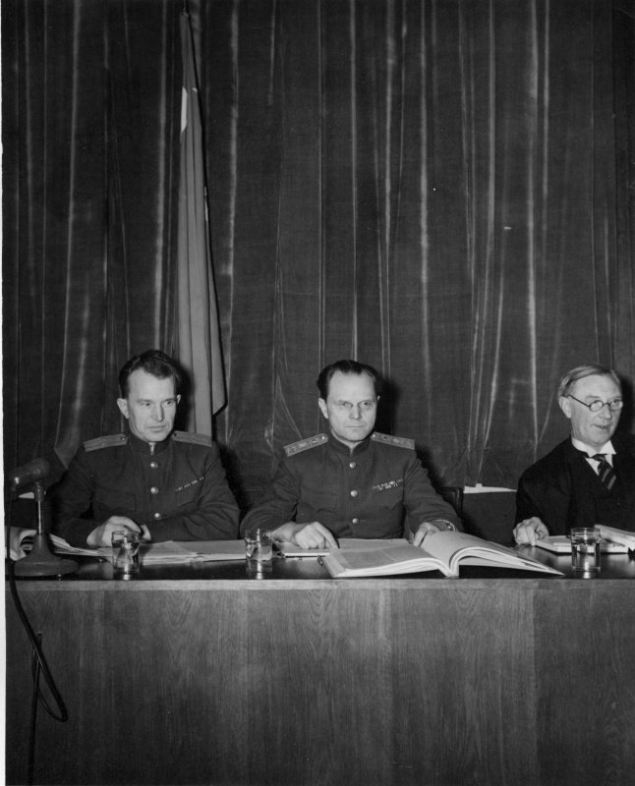
Mixed verdicts
Nuremberg as a triumph for postwar human rights/international humanitarian law in some scholars’ eyes… BUT…
The Soviet role/presence as a prosecuting power– fuels perceptions in some quarters of Nuremberg as a “show trial”
The Katyn massacre of Polish officers, soldiers and civilians– conducted by the Soviet NKVD in Sept. 1939 but charged to the Nazis by Soviet prosecutors
Yet, as Hirsch argues, Soviet legal theorists were also instrumental in formulating “crimes against peace” as the legal scaffolding for Nuremberg
The Russian judges at the Nuremberg War Crimes Trials.
From left to right: A. F. Volchkov and General Ion Nikitchenko. On far right is British judge Norman Birkett.
Donor: Robert Jackson. Date(s)
ca. October 1945
Truman Presidential Library

Slide 12
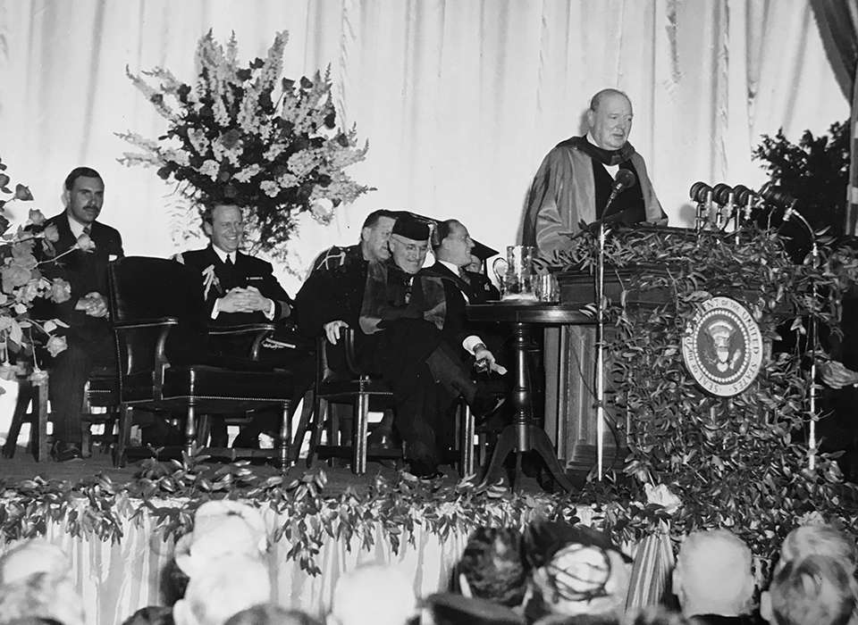
The cold war and the court
A day later, the Nuremberg trials moved into their defense stage. The very existence of a defense upset the Soviets, a fact that defense attorneys as a wedge to drive Russia and the United States even further apart. Western judges were afraid of a “victor’s justice” and wanted to preserve the integrity of the trials, which made them even more forgiving toward the defense than the prosecution expected. This turn of events disappointed the Soviets, who “never expected their own actions to be subject to scrutiny.” The result was a heightening of tensions that helped usher in the Cold War.
So argues Francine Hirsch in Soviet Judgment At Nuremberg (Oxford University Press, 2020)
https://jordanrussiacenter.org/blog/event-recap-soviet-judgment-at-nuremberg-a-new-history-of-the-international-military-tribunal-after-world-war-ii-with-francine-hirsch
Churchill delivering his “Iron Curtain” speech, Fulton, MO, 5 March 1946

Slide 13
The absent presence of the holocaust at nuremberg
The gap between retrospective popular conceptions of what Nuremberg represented– a trial of Nazi leaders who perpetrated genocide– vs the framing of the charges in 1945
A confusion of the Eichmann trial held in Israel in 1961 with Nuremberg
the “tyranny of a construct” (Bloxham) subordinates the mass murder of Jews and other groups targeted by the Third Reich under the rubric of aggressive war– making genocide epiphenomenal to the “conspiracy to wage war”
the Holocaust becomes subsumed within the larger “crime against peace”
Lack of attention to survivors’ testimony– including by Rebecca West

Slide 14
What nuremberg did not do
“[T]he allies decided in Nuremberg a case against a past Hitler, but refused to envisage future Hitlers, or like situations … In brief, the Germans were punished only for crimes committed during or in connection with the war of aggression. Crimes against humanity were not an independent category of crimes in themselves. They were only considered crimes when their connection with other crimes could be established.”
Unpublished memoir of Raphael Lemkin
The IMT did NOT establish genocide as a crime punishable under international law— although this is precisely what “Nuremberg” has come to symbolize.
In 1944, a Polish Jewish lawyer named Raphael Lemkin (1900-1959) sought to describe Nazi policies of systematic murder, including the destruction of European Jewry. He formed the word genocide by combining geno-, from the Greek word for race or tribe, with -cide, from the Latin word for killing. In proposing this new term, Lemkin had in mind “a coordinated plan of different actions aiming at the destruction of essential foundations of the life of national groups, with the aim of annihilating the groups themselves.” The next year, the IMT at Nuremberg charged top Nazis with “crimes against humanity.” The word genocide was included in the indictment, but was used as a descriptive, not legal, term.
https://www.ushmm.org/wlc/en/article.php?ModuleId=10007153
Raphael Lemkin (right) with Ambassador Amado of Brazil (left) before a plenary session of the General Assembly at which the Convention on the Prevention and Punishment of Genocide was approved. Palais de Chaillot, Paris, December 11, 1948.
— United Nations Archives and Records Management Section

Slide 15
US Refusal to ratify the genocide convention (Until 1988)
Why didn’t the US Government ratify the Genocide Convention until the Reagan era?
https://www.cfr.org/blog/international-treaties-united-states-refuses-play-ball

Slide 16
“we charge genocide”
On December 17, 1951, Paul Robeson and William Patterson submitted a petition from the Civil Rights Congress (CRC) to the United Nations. Titled, “We Charge Genocide: The Crime of Government Against the Negro People,” the petition was signed by almost 100 U.S. intellectuals and activists. The book-length petition documented hundreds of lynching cases and other forms of brutality and discrimination, evincing a clear pattern of government inaction and complicity.
It charged that in the 85 years since the end of slavery more than 10,000 African Americans were known to have been lynched (an average of more than 100 per year)…
The petition cited the UN’s definition of genocide: “Any intent to destroy, in whole or in part, a national, racial, or religious group is genocide.”
The petition concluded therefore, that “. . .the oppressed Negro citizens of the United States, segregated, discriminated against, and long the target of violence, suffer from genocide as the result of the consistent, conscious, unified policies of every branch of government.”
https://www.zinnedproject.org/news/tdih/we_charge_genocide_petition

Slide 17
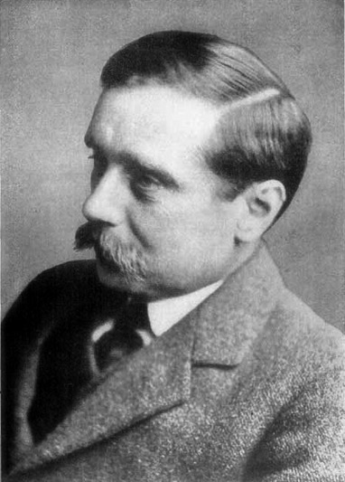
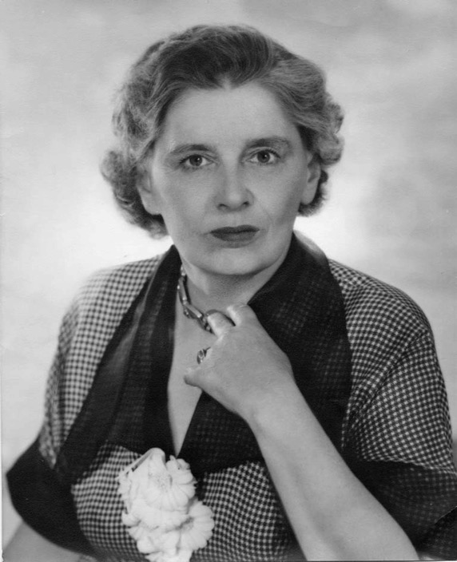
rebecca west
“indisputably the world’s number one woman writer”
Time (1947)
From 1911, West became involved in journalism, contributing frequently to the left-wing press and making a name for herself as a fighter for woman suffrage. In 1916 she published a critical biography of Henry James, and then embarked on a career as a novelist with The Return of the Soldier (1918). Her other novels include The Judge (1922), Harriet Hume (1929), The Thinking Reed (1936), The Fountain Overflows (1957), and The Birds Fall Down (1966). In 1937 West visited Yugoslavia and later wrote Black Lamb and Grey Falcon, 2 vol. (1942), an examination of Balkan politics, culture, and history. In 1946 she reported on the trial for treason of William Joyce (“Lord Haw-Haw”) for The New Yorker magazine. But she’s perhaps best known for her reports on the Nürnberg trials of war criminals (1945–46). https://www.britannica.com/biography/Rebecca-West
HG Wells
Cicely Fairfield (1892-1983)
Francis Biddle

Slide 18
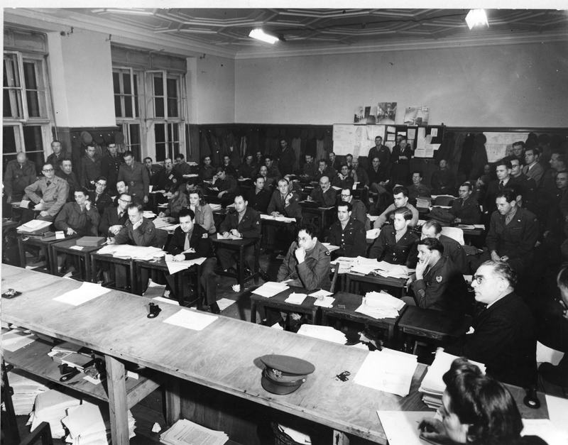
The Press Room at the Nuremberg War Crimes Trials.
Among the journalists pictured is M.J. Nurenberger (seated front row, left center, in dark coat), correspondent for the Jewish Morning Journal. Donor: Robert Jackson.
Date(s) ca.1946
https://www.trumanlibrary.gov/photograph-records/72-862

Slide 19
A Reporter at Large
September 7, 1946 Issue
Extraordinary Exile
By Rebecca West
“Greenhouse with Cyclamens, Part I”
was adapted from West’s essay
“Extraordinary Exile” in The New Yorker
West also reported on the IMT for
The Daily Telegraph.
But it is clear from the text of the
“Cyclamen” essays (if not from the dates
assigned to them in A Train of Powder)
that West returned and reworked
earlier material on Nuremberg
before publication in that
volume in 1955.
https://www.newyorker.com/magazine/1946/09/07/extraordinary-exile

Slide 20
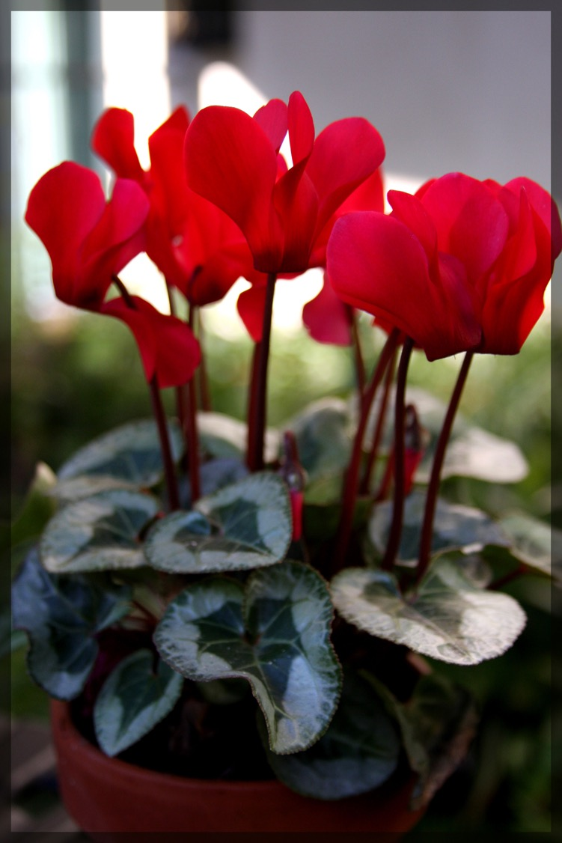
For the non-horticulturalists,
in case you were
wondering….
British Gaumont newsreel
footage of the final day of the IMT:
https://www.britishpathe.com/asset/171978/

Slide 21
Further questions
What does the expression “victors’ justice” connote?
Do you consider this a fair characterization of the IMT?
On what grounds are the proceedings open to critical scrutiny?

