Slide 1
The end of the Palestine Mandate

Slide 2
World War II and empire
In what ways was World War II entangled with imperialism?

Slide 3
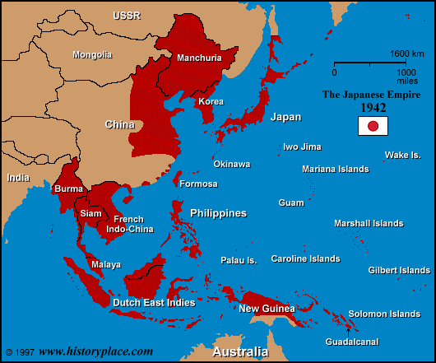

Slide 4
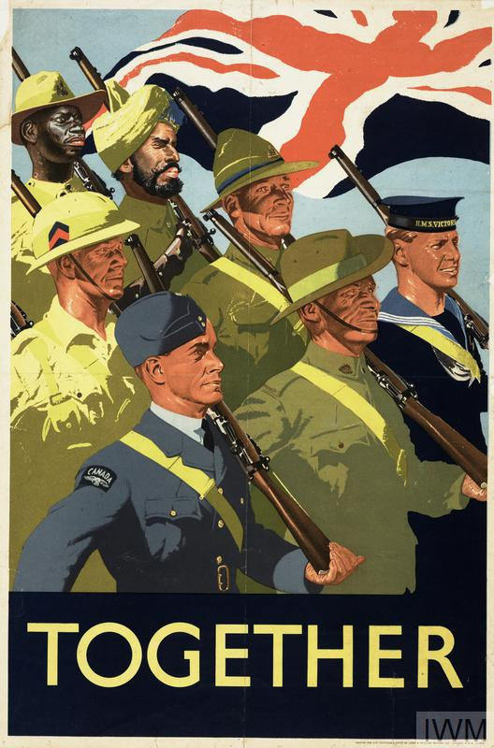
MOI,
Jan. 1939
https://www.theguardian.com/world/2019/feb/13/african-british-army-paid-less-than-white-soldiers

Slide 5
The Atlantic Charter, August 14, 1941
First, their countries seek no aggrandizement, territorial or other;
Second, they desire to see no territorial changes that do not accord with the freely expressed wishes of the peoples concerned;
Third, they respect the right of all peoples to choose the form of government under which they will live; and they wish to see sovereign rights and self government restored to those who have been forcibly deprived of them;
Fourth, they will endeavor, with due respect for their existing obligations, to further the enjoyment by all States, great or small, victor or vanquished, of access, on equal terms, to the trade and to the raw materials of the world which are needed for their economic prosperity;
Fifth, they desire to bring about the fullest collaboration between all nations in the economic field with the object of securing, for all, improved labor standards, economic advancement and social security;
Sixth, after the final destruction of the Nazi tyranny, they hope to see established a peace which will afford to all nations the means of dwelling in safety within their own boundaries, and which will afford assurance that all the men in all lands may live out their lives in freedom from fear and want;
Seventh, such a peace should enable all men to traverse the high seas and oceans without hindrance;
Eighth, they believe that all of the nations of the world, for realistic as well as spiritual reasons must come to the abandonment of the use of force. Since no future peace can be maintained if land, sea or air armaments continue to be employed by nations which threaten, or may threaten, aggression outside of their frontiers, they believe, pending the establishment of a wider and permanent system of general security, that the disarmament of such nations is essential. They will likewise aid and encourage all other practicable measure which will lighten for peace-loving peoples the crushing burden of armaments. http://avalon.law.yale.edu/wwii/atlantic.asp

Slide 6
Britain’s postwar imperial problems
India (Independent, 1947; partitioned between India and Pakistan with 14 million displaced and massive loss of life)
South East Asia (Malaya; Singapore; Burma)
Middle East (Egypt; Palestine)
Sub-Saharan Africa
Fear of Soviet influence everywhere, esp. Middle East

Slide 7
The “Palestine Problem”
A brief timeline

Slide 8
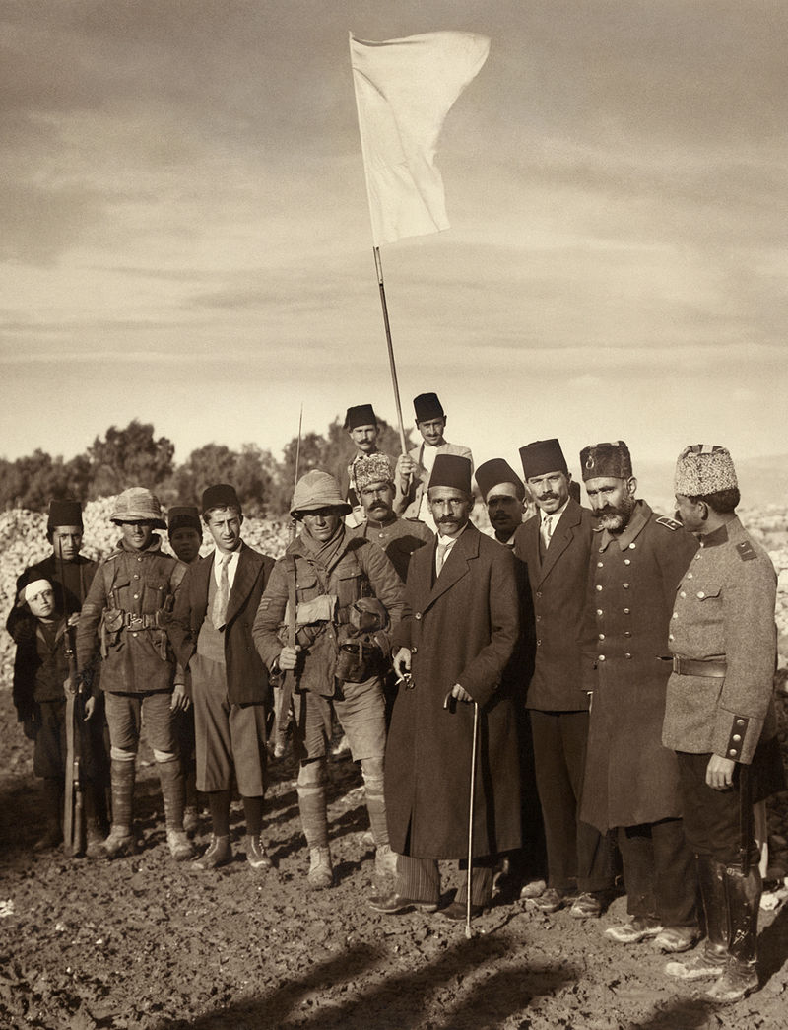
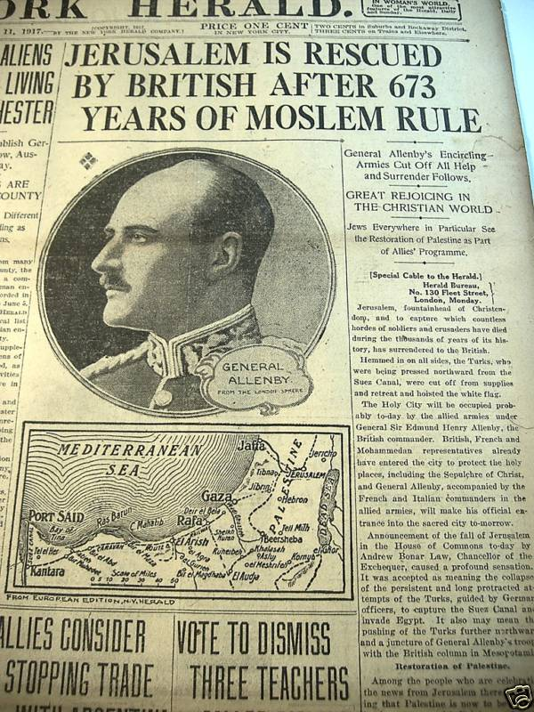
World War I
New York Herald
front page
December 11, 1917
Ottoman surrender of Jerusalem,
Dec. 9, 1917
Library of Congress

Slide 9
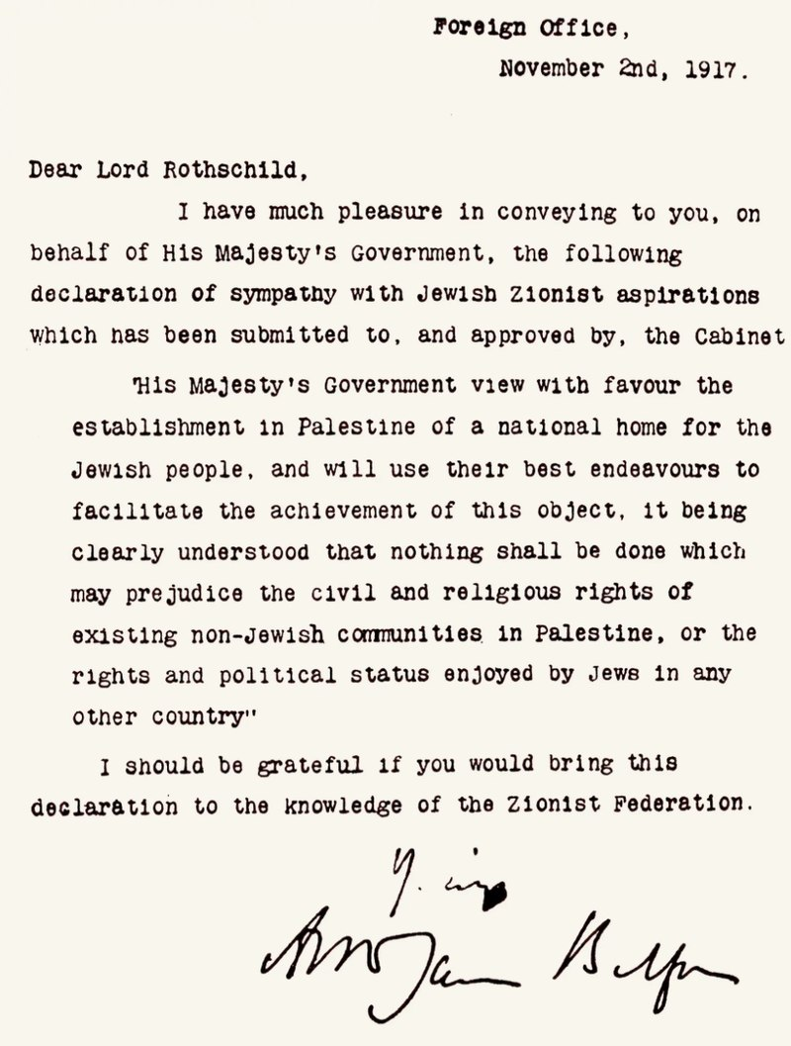
The Balfour Declaration
United Kingdom Government signed by Arthur Balfour, British Library. Originally published 9 November 1917

Slide 10
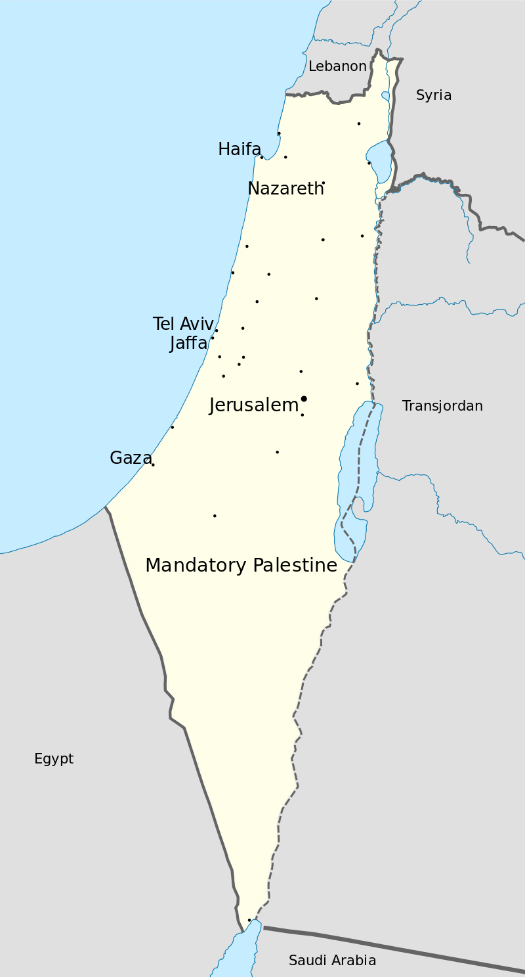
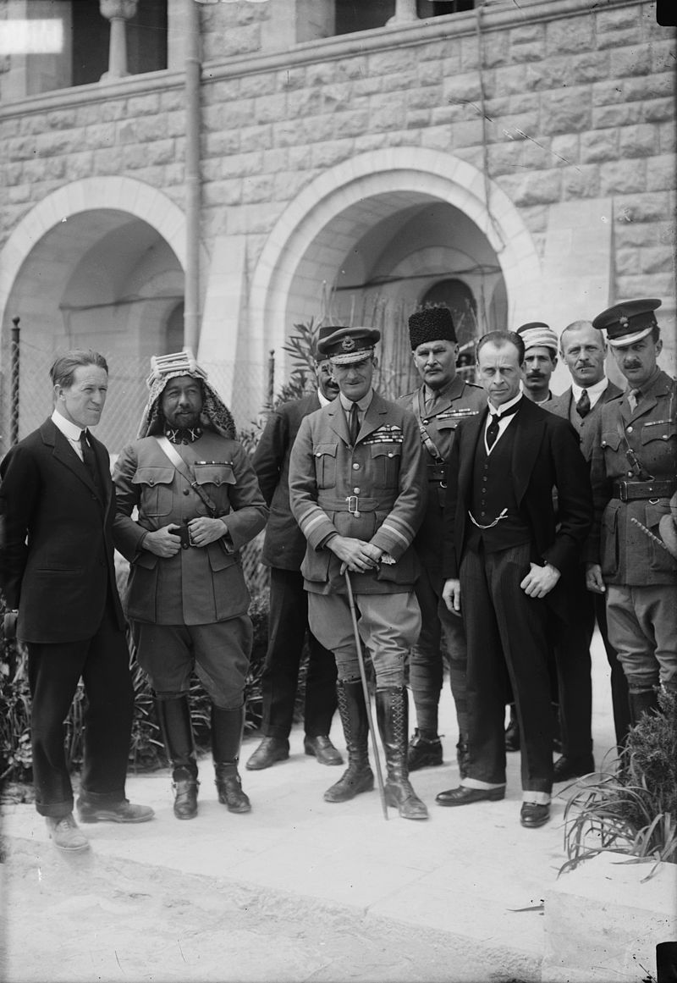
The Mandate
The new era in Palestine. The arrival at the 1920 Cairo Conference of Sir Herbert Samuel, H.B.M. high commissioner, etc. Col. Lawrence, Emir Abdullah, Air Marshal Sir Geoffrey Salmond and Sir Wyndham Deedes. Library of Congress.
1920 – May 1948

Slide 11
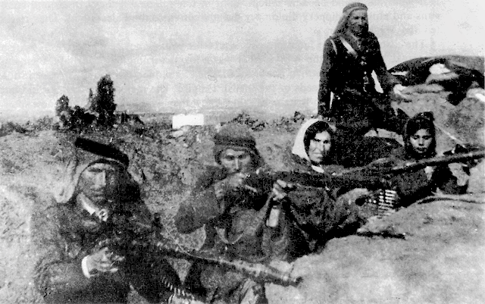
The Arab Revolt (1936-39)

Slide 12
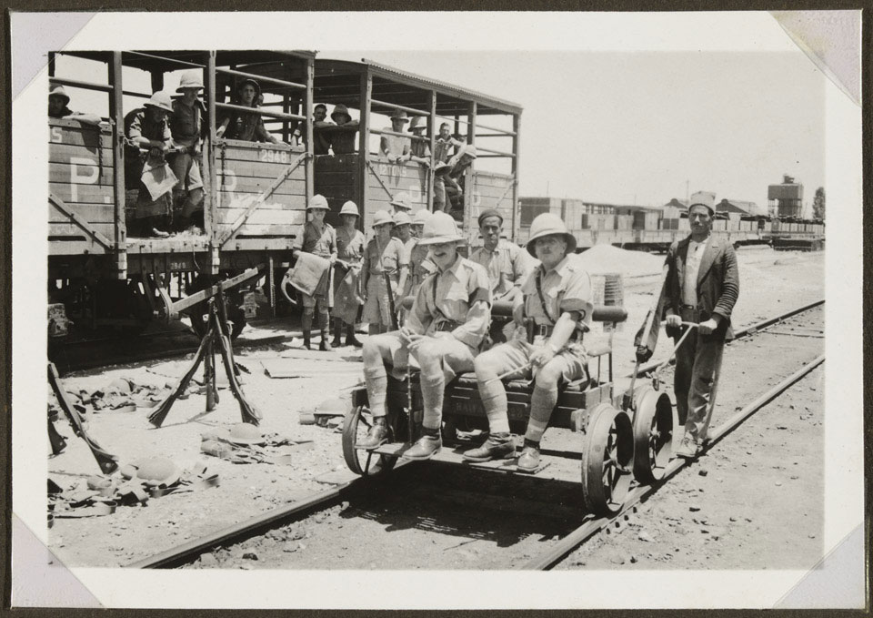
Officers of 1st Battalion The Loyal Regiment (North Lancashire) on a pump trolley pass a railway wagon full of men from 'B' Company. The Loyals were then engaged in rail protection duties against militant Arab groups opposed to the British Mandate and growing Jewish immigration.
From album of 178 photographs, with captions, compiled by Lt Col J M G Halsted, 1936-1937.
https://collection.nam.ac.uk/detail.php?acc=1987-04-11-89

Slide 13
The Peel Commission (1936-37)
The causes of the Arab rebellion that broke out in the previous year were judged to be
“[F]irst, the desire of the Arabs for national independence; secondly, their antagonism to the establishment of the Jewish National Home in Palestine, quickened by their fear of Jewish domination. Among contributory causes were the effect on Arab opinion of the attainment of national independence by ‘Iraq, Trans-Jordan, Egypt, Syria and the Lebanon; the rush of Jewish immigrants escaping from Central and Eastern Europe; the inequality of opportunity enjoyed by Arabs and Jews respectively in placing their case before Your Majesty’s Government and the public; the growth of Arab mistrust; Arab alarm at the continued purchase of Arab land by the intensive character and the "modernism" of Jewish nationalism; and lastly the general uncertainty, accentuated by the ambiguity of certain phrases in the Mandate, as to the ultimate intentions of the Mandatory Power.”
Partition Plan, 1937

Slide 14
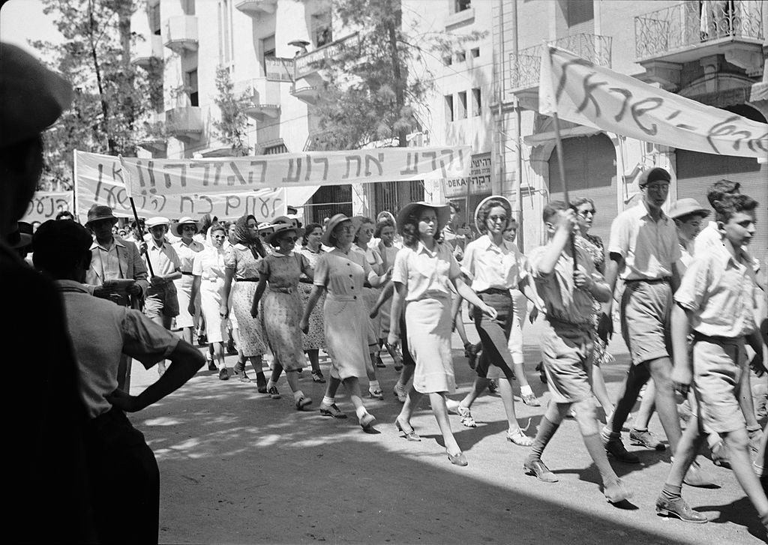
The 1939 White Paper
Jewish protest demonstrations against Palestine White Paper, May 18, 1939. King George Ave, Jerusalem.
Library of Congress

Slide 15
Jewish immigration during the next five years will be at a rate which, if economic absorptive capacity permits, will bring the Jewish population up to approximately one third of the total population of the country. Taking into account the expected natural increase of the Arab and Jewish populations, and the number of illegal Jewish immigrants now in the country, this would allow of the admission, as from the beginning of April this year, of some 75,000 immigrants over the next five years…
For each of the next five years a quota of 10,000 Jewish immigrants will be allowed on the understanding that a shortage one year may be added to the quotas for subsequent years, within the five year period, if economic absorptive capacity permits.
In addition, as a contribution towards the solution of the Jewish refugee problem, 25,000 refugees will be admitted as soon as the High Commissioner is satisfied that adequate provision for their maintenance is ensured, special consideration being given to refugee children and dependents…
After the period of five years, no further Jewish immigration will be permitted unless the Arabs of Palestine are prepared to acquiesce in it.
His Majesty's Government are determined to check illegal immigration, and further preventive measures are being adopted. The numbers of any Jewish illegal immigrants who, despite these measures, may succeed in coming into the country and cannot be deported will be deducted from the yearly quotas.
His Majesty's Government are satisfied that, when the immigration over five years which is now contemplated has taken place, they will not be justified in facilitating, nor will they be under any obligation to facilitate, the further development of the Jewish National Home…
…transfers of land must be restricted if Arab cultivators are to maintain their existing standard of life and a considerable landless Arab population is not soon to be created… [T]he High Commissioner will be given general powers to prohibit and regulate transfers of land.
http://avalon.law.yale.edu/20th_century/brwh1939.asp

Slide 16
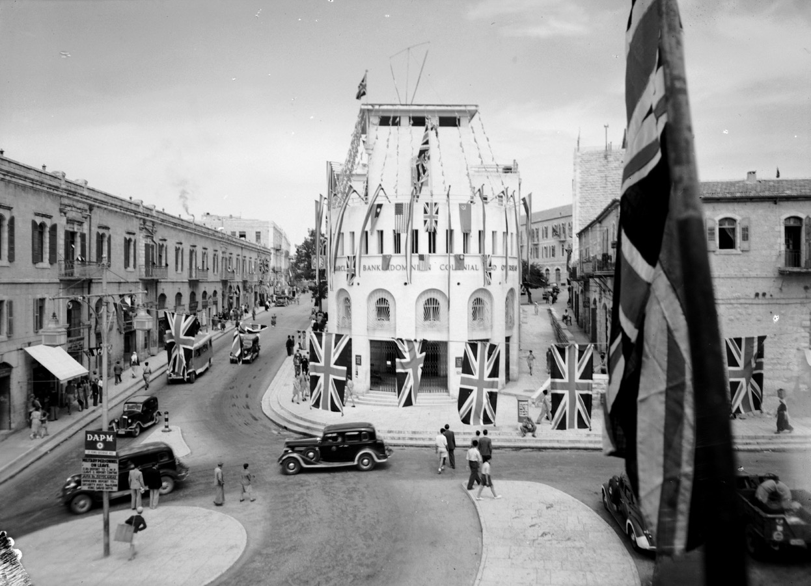
In what ways did World War II alter the situation in Palestine?
Barclay's Bank, on VE Day, in Jerusalem, Palestine. Slightly cropped from original at the Library of Congress.

Slide 17
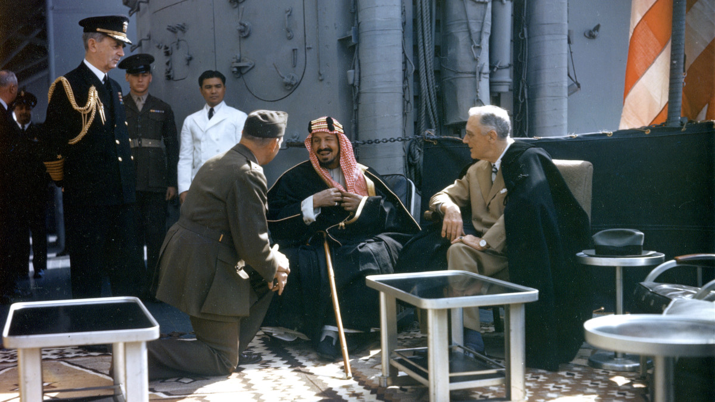
The US role and interests in the Middle East
King Abdul Aziz Ibn Saud meets with FDR, Egypt, Feb. 14, 1945
Getty Images

Slide 18


The Holy Land in the western Christian imaginary
(George A. Tirrell, 1862)
Syrian Protestant College (1866-1920)

Slide 19
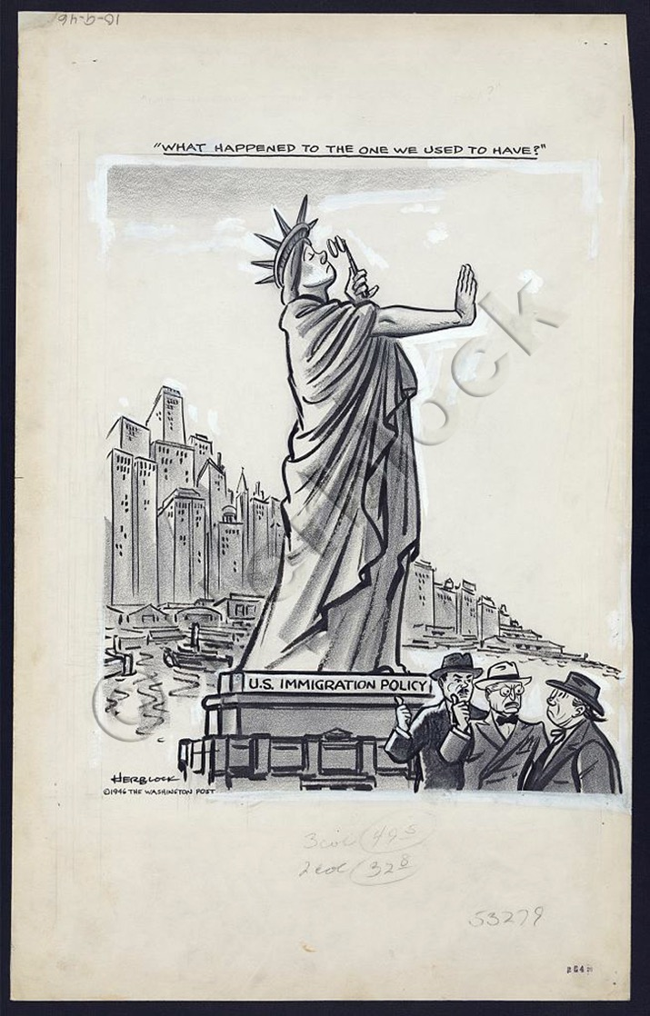
Truman intervenes
Aug. 31, 1945
Truman urges
UK to admit
100,000 Jewish DPs
into Palestine.
What motivates
this intervention?
“Herblock,”
Library of Congress

Slide 20
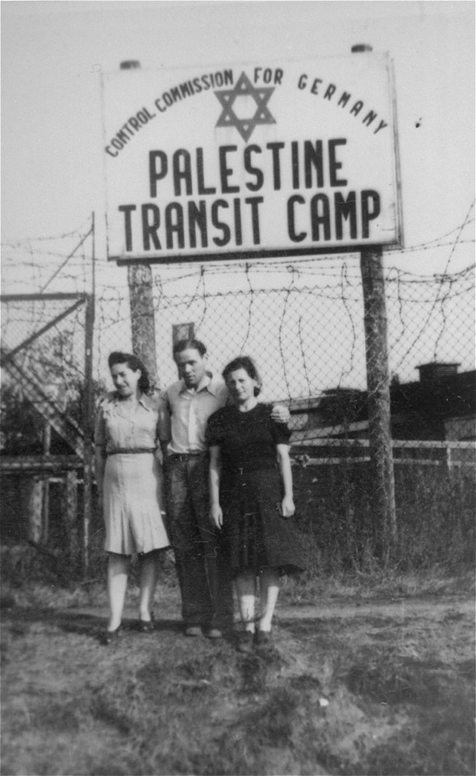
The DP “problem”
Three Jewish DPs pose in front of the entrance to the Palestine Transit Camp in Bremen, where they await transport to Palestine. (1947)
https://collections.ushmm.org/search/catalog/pa1059736
Prolonged encampment; legal and illegal immigration to Palestine; anti-Semitism in Europe

Slide 21
The Anglo-American Committee of Enquiry (1946)
Why did the Attlee government seek to involve
the US in Palestine policy after the war?
Composition of the committee:
US: Judge Joseph Hutcheson (chair);
Frank Aydelotte (academic; former president Swarthmore)
Frank Buxton (editor, Boston Herald)
Bartley Crum (lawyer)
James McDonald (career diplomat)
William Phillips (career diplomat)
UK: John Singleton (chair; former Conservative MP; judge)
W.F. Crick (economic adviser to Midland Bank)
R.H.S. Crossman (Labour MP; journalist)
Sir Frederick Leggett (Ministry of Labour conciliator)
R.E. Manningham-Buller (lawyer, Conservative MP for Daventry)
Lord Morrison (Scottish former Labour MP for Tottenham)
What does Palestine Mission suggest about the presuppositions
an “uninformed” Briton brought to bear on this question?
Where do Crossman’s sympathies appear to lie?

Slide 22
The Report
What picture of Palestine emerges from the report?
Does the Enquiry appear a partisan venture (ie weighted more
towards one community in Palestine than the other?)
Are there any striking omissions from the report?
What were the key recommendations?
How workable do the recommendations seem?

Slide 23
“I am struck by the superficiality and intellectual dishonesty of this Report… the Committee demands the admission within less than a year of 100,000 immigrants (i.e. a larger number than have ever been brought in within such a short period at any time in the past) without making any mention of the question of Palestine’s economic capacity to absorb them. It must have been perfectly obvious to the members of the Committee, as it is to all of us, that their proposals must result in acute political and military conflict between the Arabs and the Jews in Palestine and the Arab countries round it.”
Sir Walter Smart, Oriental Secretary, British Embassy, Cairo, May 2, 1946

Slide 24
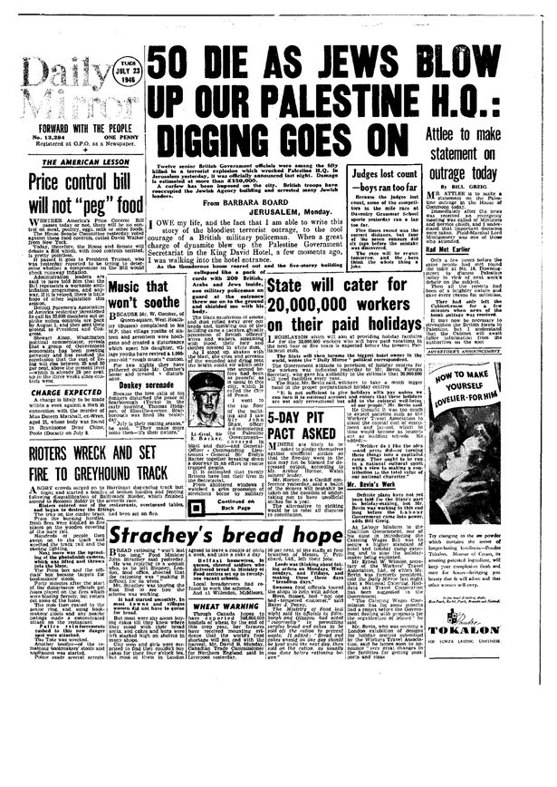
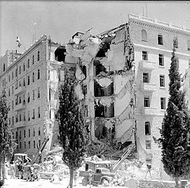
What next?
The Committee’s
recommendations were
rejected.
Violent attacks on the
Mandatory govt. in Palestine
intensified, with the blowing
up of the King David Hotel
by Irgun, July 22, 1946.

Slide 25
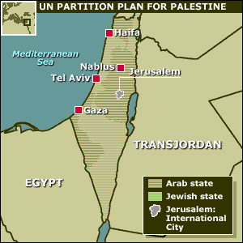
The UN Partition Plan (1947)
Feb. 1947
Britain referred
Palestine to the UN
Aug. 31, 1947
USCOP called for
Partition
Sept. 26, 1947
Britain announced
intention to withdraw
Nov. 1947
UNGA discussed the
USCOP plan.
Rejected by Arab
states
http://news.bbc.co.uk/hi/english/static/in_depth/world/2001/israel_and_palestinians/key_maps/6.stm

Slide 26
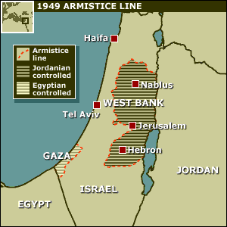
The birth of Israel and war (1948)
The West Bank and the Gaza Strip became distinct geographical units as a result of the 1949 armistice that divided the new Jewish state of Israel from other parts of Mandate Palestine.
From 1948 to 1967, the West Bank, including East Jerusalem, was ruled by Jordan. During this period, the Gaza Strip was under Egyptian military administration.
In the 1948 Arab-Israeli War, Israel took control of the western part of Jerusalem, while Jordan took the eastern part, including the old walled city containing important Jewish, Muslim and Christian religious sites.
The British Mandate ended on May 14, 1948. Israel proclaimed
Independence, immediately recognized by the US. Armies of 5
Arab states cross into Palestine at midnight. War begins.
http://news.bbc.co.uk/hi/english/static/in_depth/world/2001/israel_and_palestinians/key_maps/5.stm

