Slide 1
Postwar Asia & the partition of korea
Postwar: Term 2, week 8

Slide 2
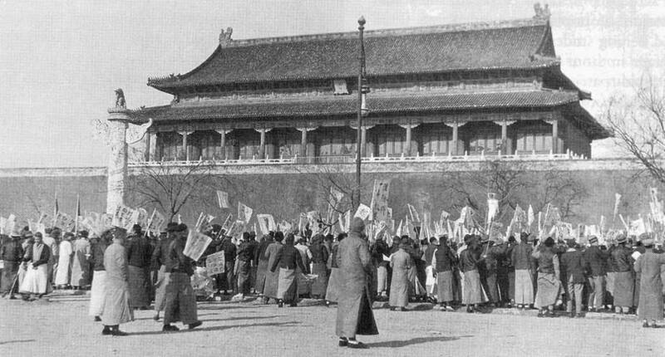
Nationalist struggles
Decolonization as a fitful, non-linear process; not reducible a neatly compartmentalized “age of decolonization”
Struggles for self-determination in Asia date back decades– punctuated by two world wars and continuing in their aftermath, challenging eurocentric ideas of WWII as a discrete, stand-alone chapter in twentienth-century history
peace-making at Versailles after WWI saw leaders of Asian independence movements attempt to press their case– in the face of western hostility/indifference
Beijing students protest the Treaty of Versailles during the May Fourth Movement of 1919
https://apjjf.org/2021/21/baik
Ho Chi Minh, seen here in 1945, went to Versailles at the end of World War I and tried to petition the U.S. delegation to push for greater rights for the residents of Indochina.
President Woodrow Wilson and the US delegates refused to meet him.
Agence France-Presse/Getty Images
http://online.wsj.com/ww1/ho-chi-minh

Slide 3
Japanese
empire-building
in East Asia
Korea (1910)
Manchuria (Manchukuo)
1931
China (1937)
https://worldview.stratfor.com/article/japans-territorial-expansion-1931-1942

Slide 4
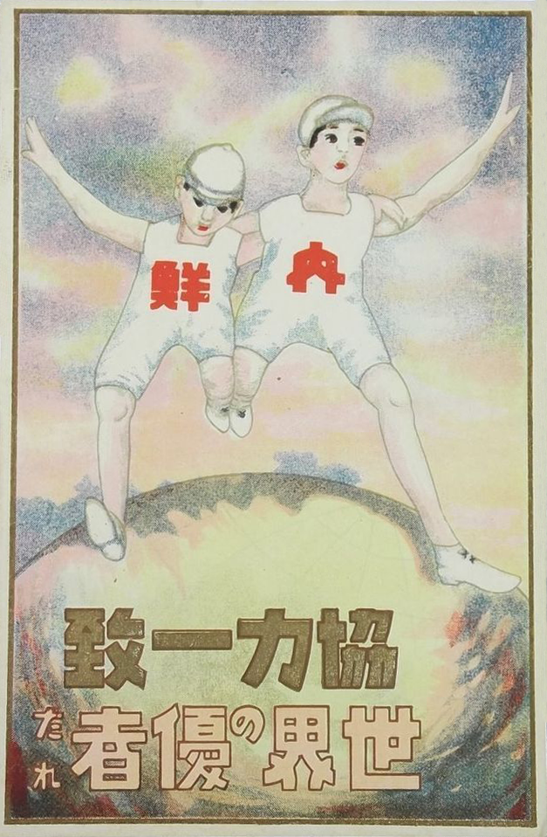
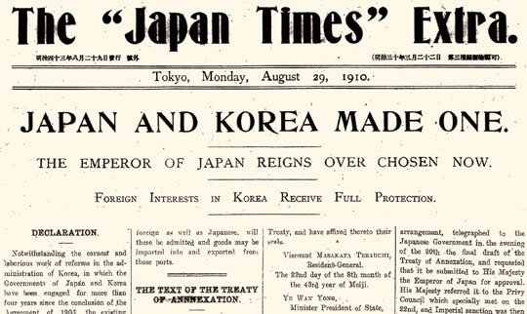
Japan-Korea Cooperative Unity, World Leader.
Japanese propaganda postcard, 1920s

Slide 5
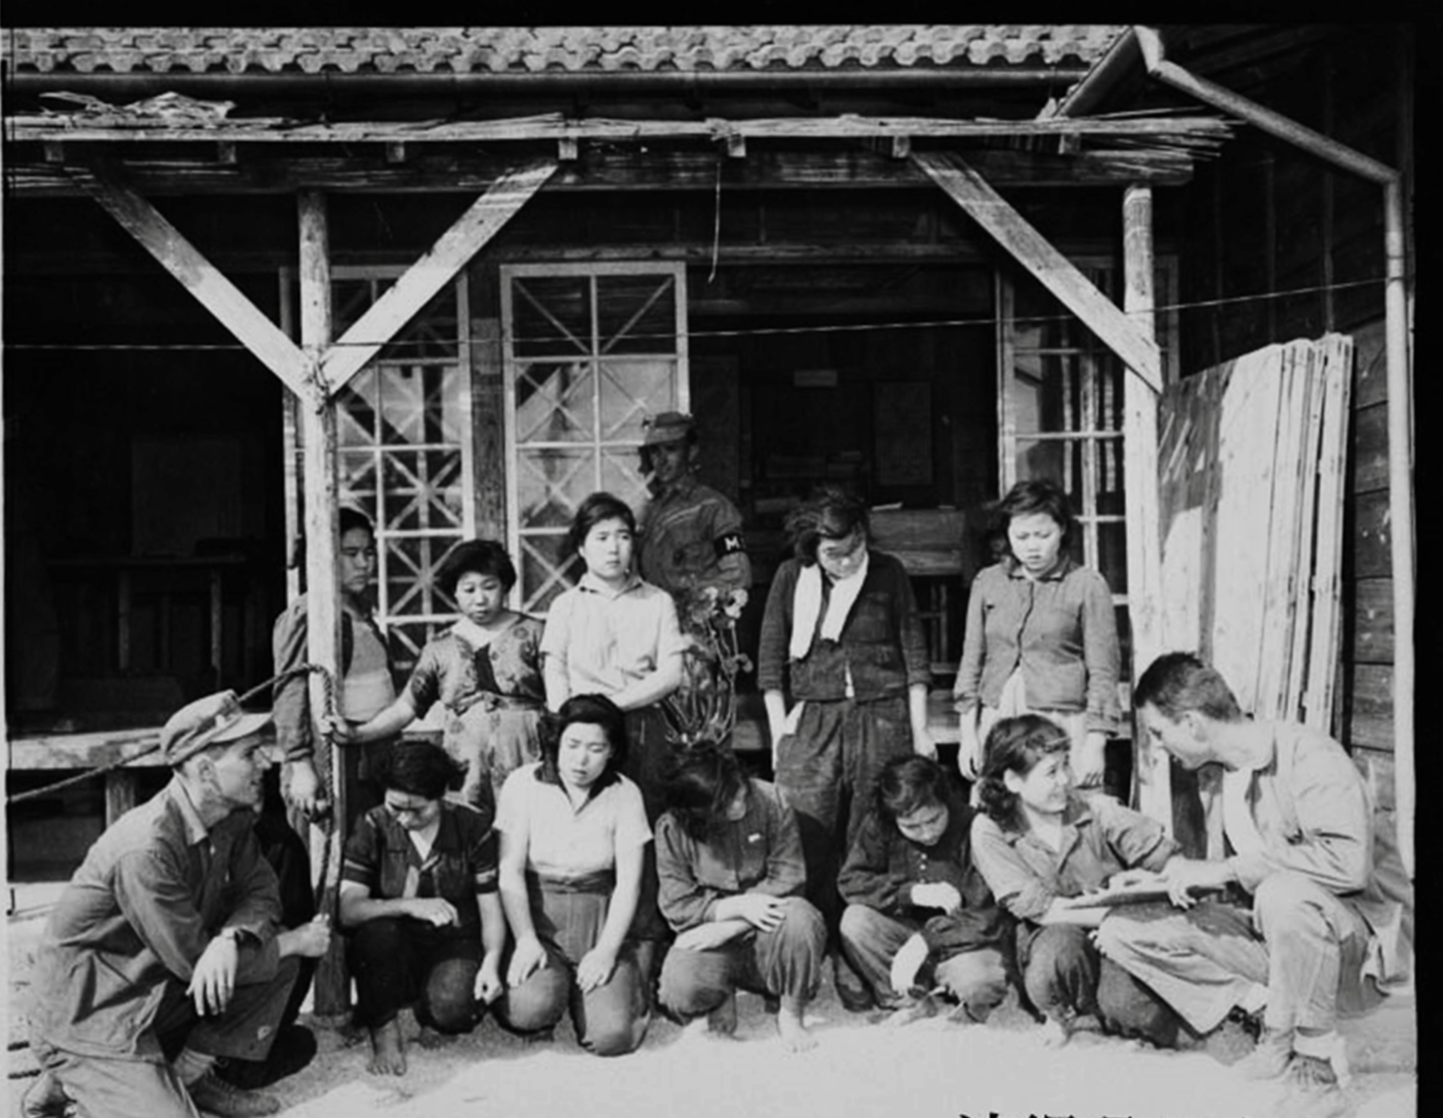
Korean ‘comfort women’
Original caption:
‘These ten Korean girls, sold into prostitution by their destitute families, were found by a Marine patrol near an enemy quartermaster after a skirmish with Japanese soldiers, on Okinawa.’
US Marine Corps
December 1945

Slide 6
The postwar fate of Korea
What makes Korea a particularly
significant case study in postwar Asian history?
Surrender of Japanese Forces in southern Korea, September 1945. Lowering the Japanese flag, during surrender ceremonies at Keijo (now Seoul), Chosen (now Korea), 9 September 1945.
US National Archives
The Cairo Declaration (Nov. 1943)
“in due course, Korea shall
become independent.”

Slide 7
https://blueprintforhistory.files.wordpress.com/2013/05/decolonization-in-asia.gif

Slide 8
Korea: August 1945
“The August 15, 1945 announcement by the Japanese Emperor declaring Japan’s intention to accept the Allied forces’ terms of unconditional surrender sent Koreans throughout the empire into the streets in celebration. For the first time in decades they could freely associate with their fellow countrymen, communicate in their native language, and wave their national flag (taegeukgi) as Koreans without fear of punishment.”
https://apjjf.org/-Mark-Caprio/3221/article.html

Slide 9
Korean
expectations of
liberation
“The first day a flier from some Korean organization was passed out to all of us asking us to kill and behead the Japs. The Koreans really hated them.”
From a US infantry veteran’s website
http://www.kilroywashere.org/003Pages/Benedetto/Benedetto.html

Slide 10
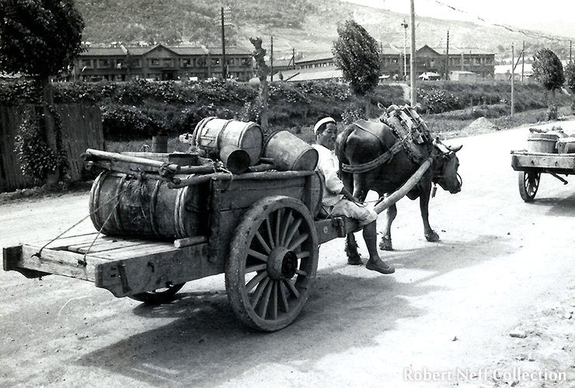
American ‘Orientalism’: the politics of disgust
Many American
soldiers, serving
during the
cccupation (and later
During the Korean War)
passed disgusted comment on the ‘honey-wagons’ that collected human ‘night-soil’ for use as fertilizer
https://www.koreatimes.co.kr/www/opinion/2025/02/715_246799.html

Slide 11
Korea: Sept. 1945
US troops arrive in Korea in Sept. 1945 and
begin disarming Japanese soldiers prior to their
repatriation to Japan

Slide 12
“At the end of the war over six million Japanese were scattered throughout the islands in the Western Pacific and on the Asiatic mainland. Their repatriation became one of the major problems confronting General MacArthur. Their early return to Japan was desirable for purely humanitarian reasons as well as for the purpose of easing the economic burden of the liberated countries. (Plate No. 48) .
In addition, there were approximately 1,170,000 aliens in Japan, many of whom had been forcibly removed from their homelands. Early in September 1945 a large number of these displaced persons flocked to ports in southern Honshu and Kyushu, hoping thereby to obtain preferential treatment for their repatriation. This influx resulted in congestion and created health and sanitation problems which threatened public welfare in Japan.”
https://history.army.mil/books/wwii/MacArthur%20Reports/MacArthur%20V1%20Sup/ch6.htm
Japanese to be Repatriated: August 1945

Slide 13
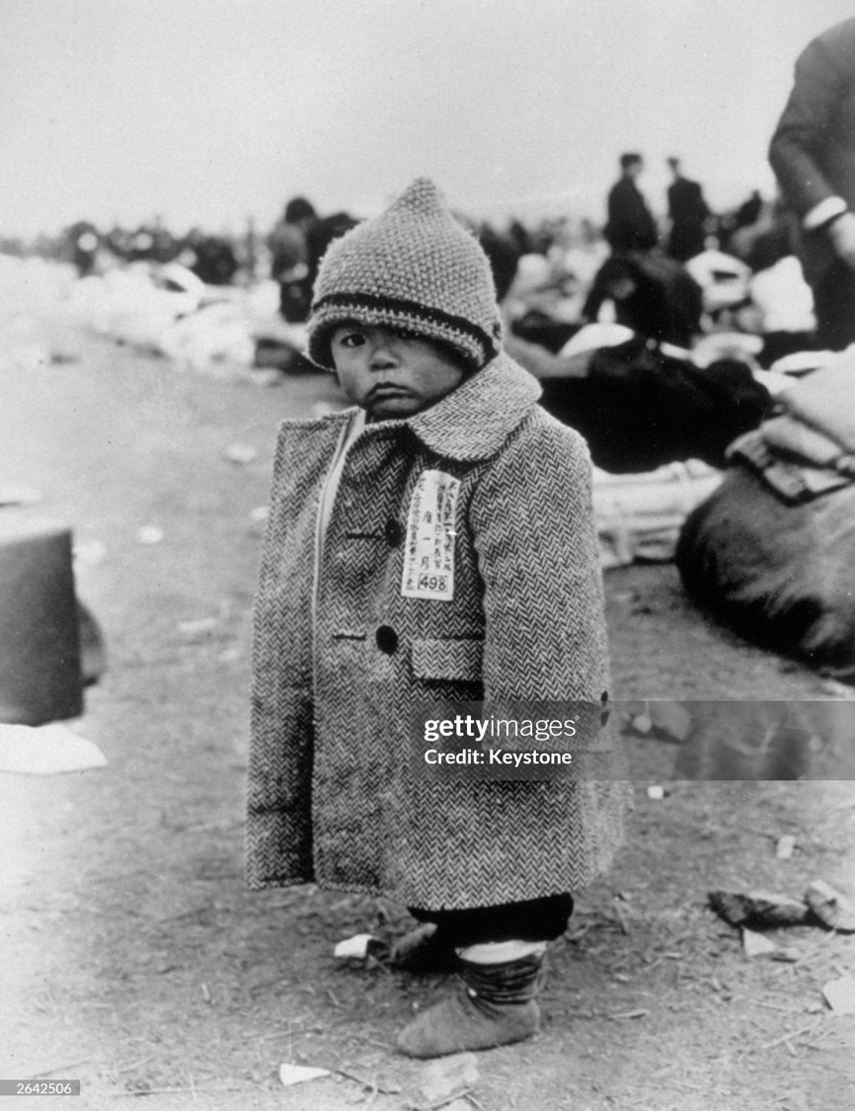
Repatriation:
This Japanese baby is one of over 4 million Japanese repatriated from far eastern ports by the Americans.’
1 August 1946
(Photo by Keystone/Getty Images)
Watch an American serviceman’s footage of Japanese repatriation from Korea, 1946:
https://av.lib.umd.edu/media_objects/r207tq18s

Slide 14
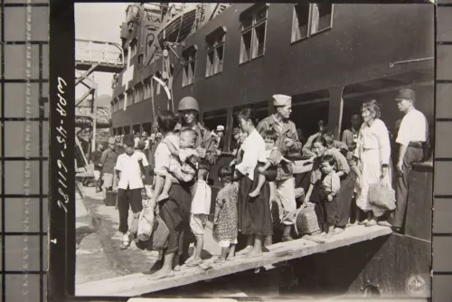
Koreans displaced during World War II return to Busan, Korea, from Japan, October 12, 1945.
Record Group 111, National Archives and Records Administration, via The Archives of Korean History #IM000011279, http://archive.history.go.kr/id/AUS005_06_03V0000_736

Slide 15
In search of a pliable client: General Douglas MacArthur greets Syngman Rhee
“Prior to his return to Korea in 1945—courtesy of a War Department transport plane—Rhee spent nearly forty years in the United States. He earned degrees from Harvard and Princeton, spoke English fluently, and was a dedicated Christian to boot. He seemed tailor-made for the task of “righting” a newly liberated Korea that was lurching to the left.”
David Fields
https://www.wilsoncenter.org/blog-post/left-right-and-rhee

Slide 16
South Korean citizens protest
Allied trusteeship in December 1945
https://en.wikipedia.org/wiki/Division_of_Korea#/media/File:Anti-Trusteeship_Campaign.jpg

Slide 17
The Soviets in northern Korea
Locals of liberated villages welcome Soviet soldiers during the Manchurian Strategic Offensive Operation in the 1945 Soviet-Japanese War.
TASS (Photo by TASS via Getty Images)

Slide 18
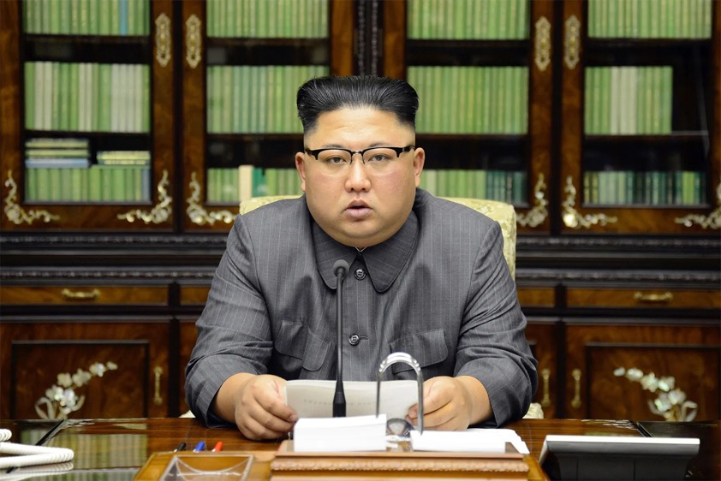
The man and the myth:
creating the legend of
Kim Il Sung
Above: Kim Jong Un, the third and present supreme leader of North Korea: grandson of Kim Il Sung (left),
who was succeeded by his son,
Kim Jong Il (1997-2011)

Slide 19
Team-work exercise
Group A (Soviet memo, Jan. 1946)
What is this document? Can you find any information online about its author or other Red Army personnel mentioned in it?
What does the memo reveal about (a) the character of Soviet occupation of North Korea and (b) how the Red Army functioned?
Identify 3-4 especially revealing passages in the text for close critical scrutiny
Comparisons with other sources?
What do the two documents together reveal about US & Soviet attitudes towards Koreans?
Group B (Anna Louise Strong)
Who was Anna Louise Strong? What light does her biography shed on postwar American politics?
What was Soviet Russia Today, and who do you imagine read this pamphlet?
What hints does this pamphlet convey about the character of Japanese colonial rule over Korea?
What vision of North Korea does Strong convey, and how credible do you find it?
What are the most revealing passages in this source?
What do the two documents together reveal about US & Soviet attitudes towards Koreans?

Slide 20
Anna Louise Strong
born November 24, 1885, Friend, Nebraska, U.S.—died March 29, 1970, Beijing, China
American journalist and author who published numerous articles and books about developments in the nascent Soviet Union and then in communist China, based on her extensive travel in and firsthand knowledge of those countries.
https://www.britannica.com/biography/Anna-Louise-Strong
Soviet Russia Today was a monthly magazine published from 1932 to 1951 by the Friends of the Soviet Union.
New York World-Telegram and the Sun staff photographer - Library of Congress Prints and Photographs Division. New York World-Telegram and the Sun Newspaper Photograph Collection. http://hdl.loc.gov/loc.pnp/cph.3c19377
Strong in Moscow, 1937

Slide 21
From a CIA report, ‘The Situation in Korea’, 3 January 1947
‘Unity and independence are the dominant aspirations of the Korean people, while partition and joint occupation by the US and USSR are the governing factors in the political and economic life of the peninsula. The promises of independence made at Cairo, and confirmed at Yalta, have not been fulfilled. The division of Korea at the 38th parallel has become an almost impenetrable barrier between the US and Soviet Zones. The Moscow Decision, which provides for the unification and eventual independence of Korea, has not been implemented, largely because of disagreement between the US and USSR over the interpretation of the document and the meaning of democracy. All efforts to reconvene the Joint Commission since its adjournment last May have failed.’
https://digitalarchive.wilsoncenter.org/document/104024/download

Slide 22
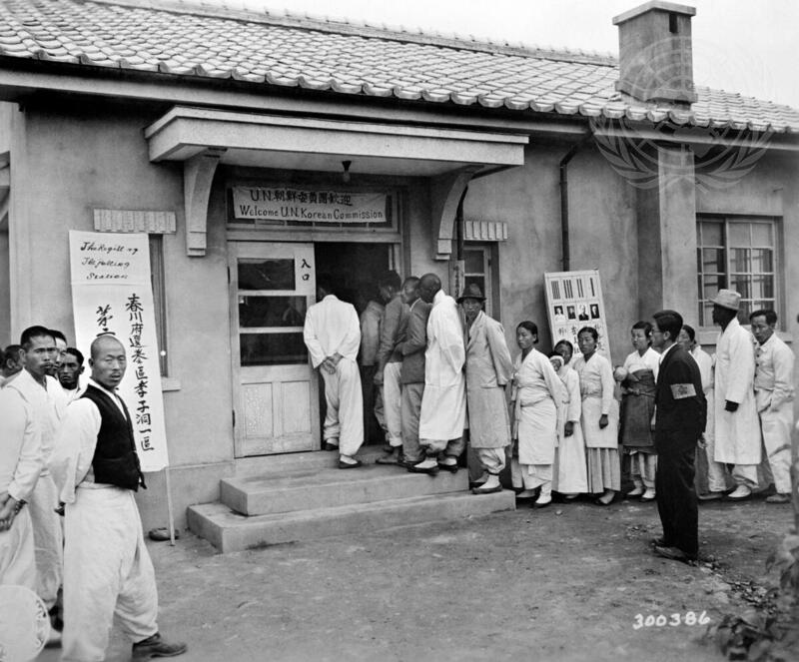
May 1948
Caption from UN website:
‘Koreans waiting to cast their votes in the first free election in the history of Korea. The United Nations Commission on Korea (UNCOK) supervised the election.’
https://media.un.org/photo/en/asset/oun7/oun7667695
But because elections were held in the South alone, they had the effect of hardening Korea’s division into two separate states.

Slide 23
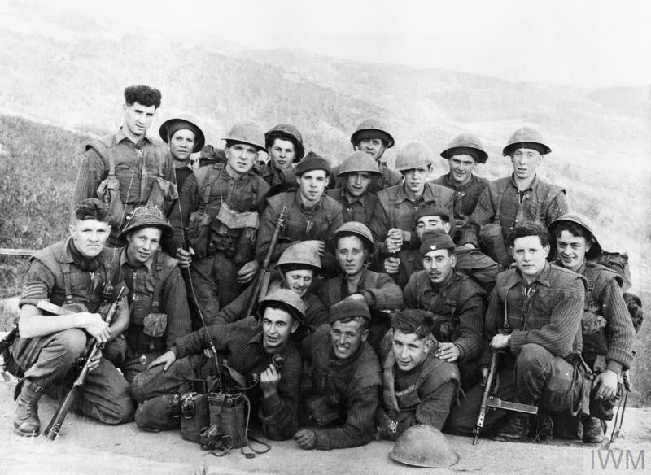
From division to war (1950-53)
Korean war casualties
Approximately 3 million people died during the Korean War, including around 1000 British service personnel.
https://cdn.britannica.com/99/72799-050-C69F5F60/Table-battle-casualties-Korean-War-Death-toll.jpg
https://www.iwm.org.uk/history/25-photographs-of-the-korean-war

