Slide 1
Postwar re-ordering: The birth of the UN
A “strange triumph” for Human Rights?

Slide 2
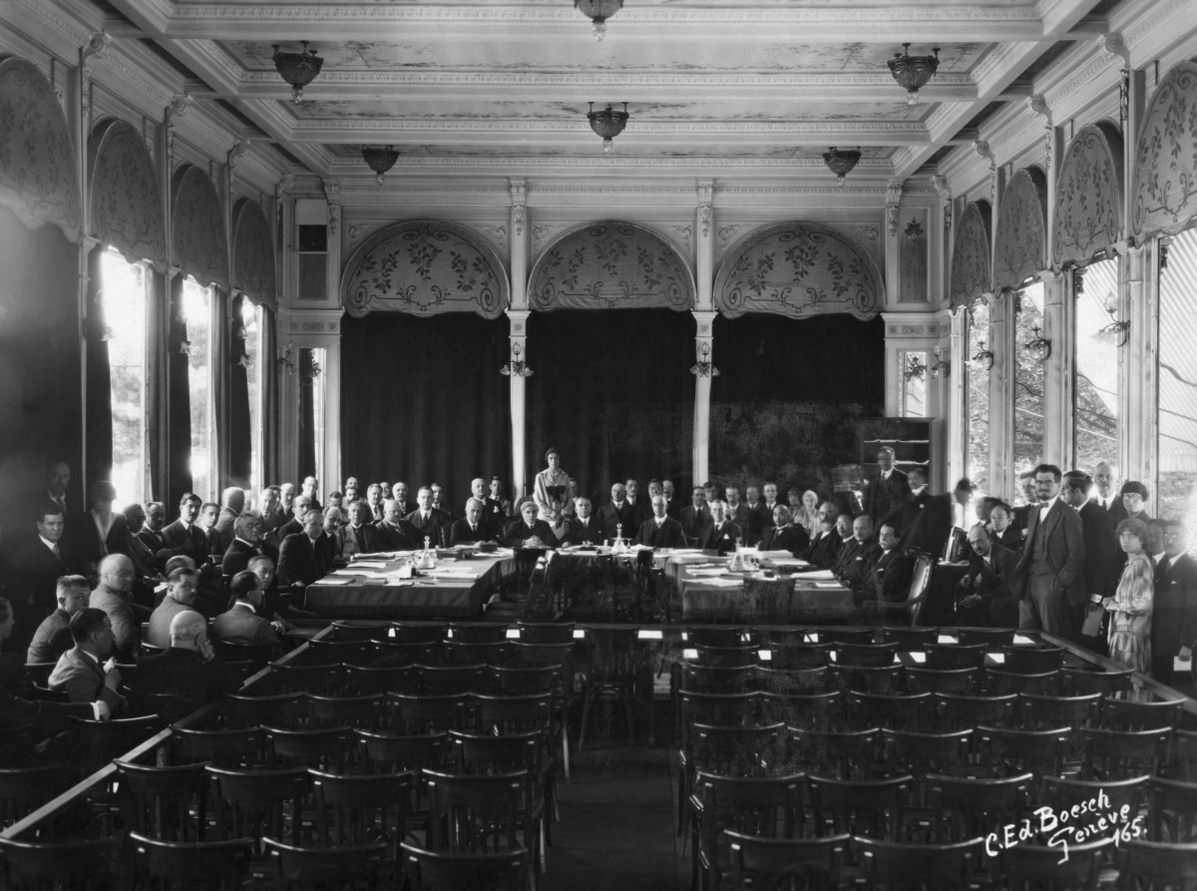
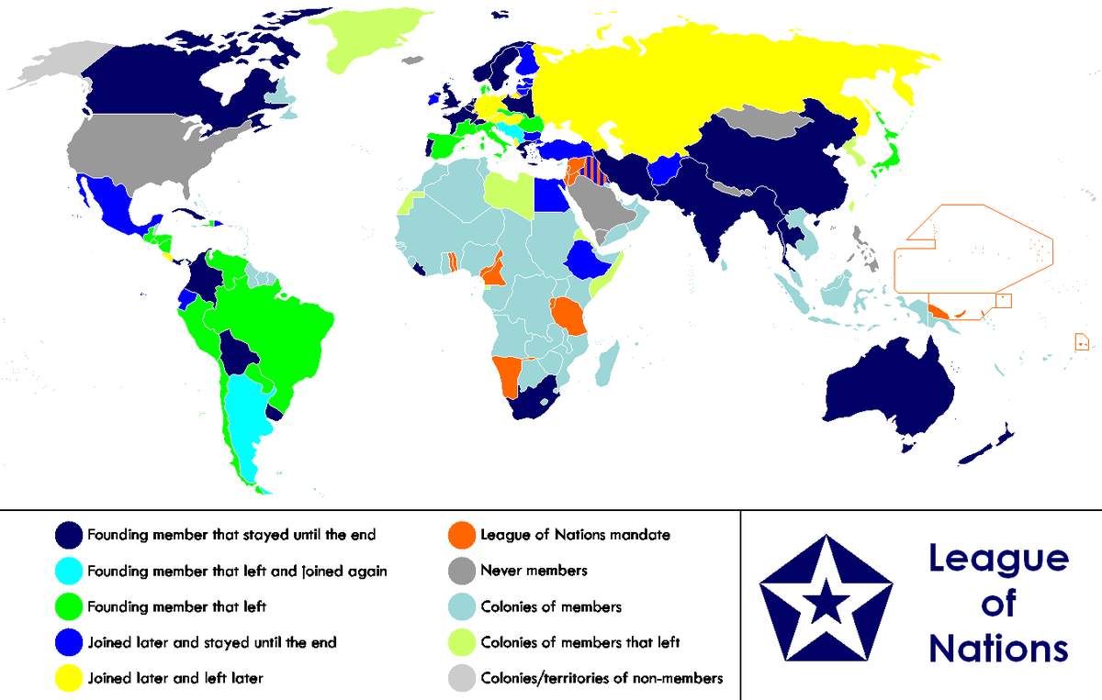
Why did the Allies seek to create a permanent postwar institution?

Slide 3
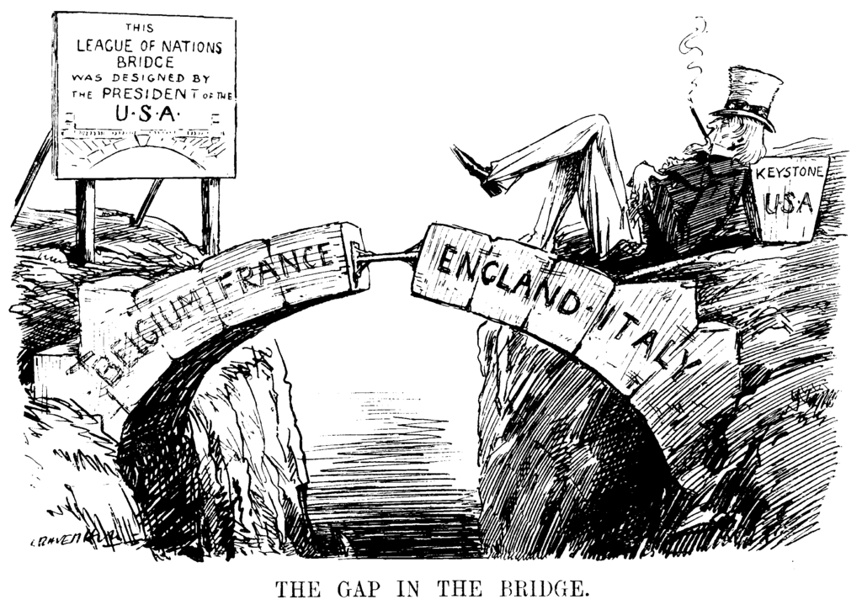
Leonard Raven-Hill
Punch Magazine
December 10, 1919

Slide 4
Wartime ideas about postwar order
Moscow Declaration
The Declaration pledged further joint action in dealing with the enemies’ surrender and, in clause 4, proclaimed:
“That they [the Foreign Ministers] recognize the necessity of establishing at the earliest practicable date a general international organization, based on the principle of the sovereign equality of all peace-loving states, and open to membership by all such states, large and small, for the maintenance of international peace and security.”
30 October 1943 || Moscow
The United States Secretary of State, Cordell Hull, made the first flight of his life to journey to Moscow for the conference. On October 30, the Moscow Declaration was signed by Vyaches Molotov, Anthony Eden, Cordell Hull and Foo Ping Shen, the Chinese Ambassador to the Soviet Union.
http://www.un.org/en/sections/history-united-nations-charter/1943-moscow-and-teheran-conferences/index.html

Slide 5
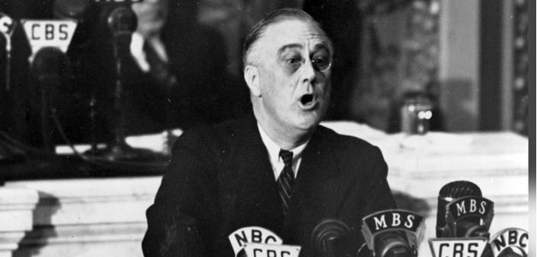
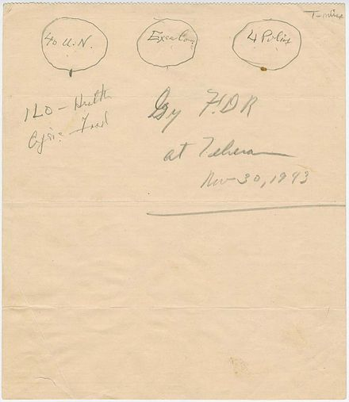
FDR and the “Four Policemen” idea
The UN envisioned by Roosevelt consisted of three branches: an executive branch comprising the Big Four, an enforcement branch composed of the same four powers acting as the Four Policemen, and an international assembly representing the UN member nations.
The Four Policemen would be responsible for keeping order within their spheres of influence: Britain in its empire and in Western Europe; the Soviet Union in Eastern Europe and central Eurasia; China in East Asia and the Western Pacific; and the United States in the Western hemisphere. Only these four powers would be armed.
FDR maps out ideas at Teheran,
Nov. 1943

Slide 6
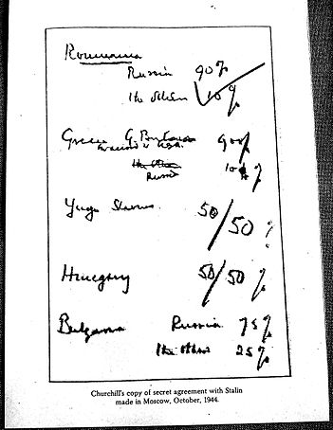
Churchill, Stalin and the percentages deal
a secret informal agreement between Churchill and Stalin during the Fourth Moscow Conference in Oct. 1944
it gave the percentage division of control over Eastern European countries, dividing them into spheres of influence
the content of the agreement was first made public by Churchill in 1953 in the final volume of his memoirs

Slide 7
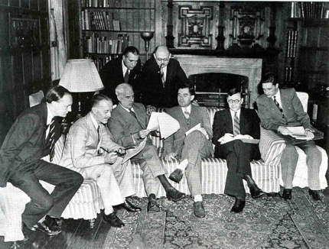
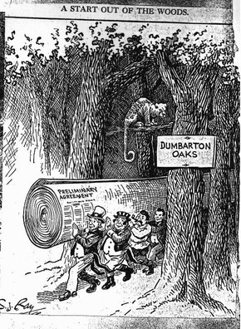
Dumbarton Oaks: late summer/early fall 1944
Informal meeting in the Study at Dumbarton Oaks. Seated (left to right): Peter Loxley, Sir Alexander Cadogan, Edward R. Stettinius Jr., Andrei A. Gromyko, Arkadii A. Sobolev, Valentin M. Berezhkov. Standing (left to right): James Clement Dunn and Leo Pasvolsky. Photo: National Archives, Washington, D.C., 1944
https://www.doaks.org/research/library-archives/dumbarton-oaks-archives/historical-records/75th-anniversary/blog/the-dumbarton-oaks-conversations-1944
S. J. Ray, Kansas City Star, August 1, 1944.

Slide 8
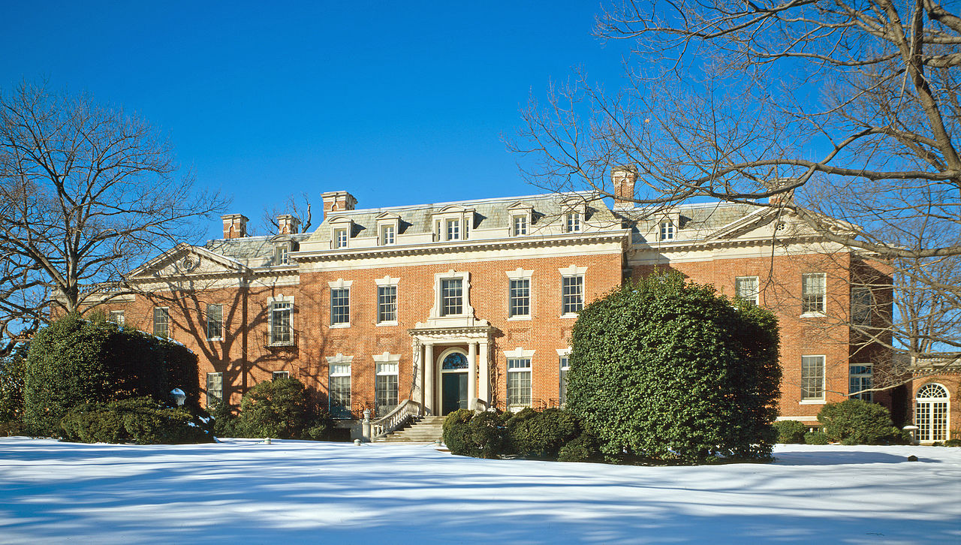

Slide 9
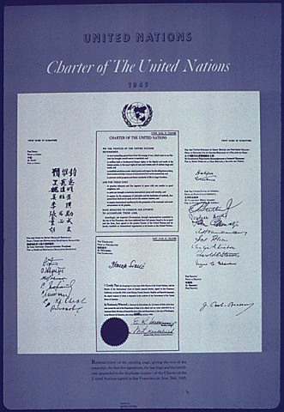
The San Francisco Conference
“The next day [June 26, 1945], in the auditorium of the Veterans' Memorial Hall, the delegates filed up one by one to a huge round table on which lay the two historic volumes, the Charter and the Statute of the International Court of Justice. Behind each delegate stood the other members of the delegation against a colorful semi-circle of the flags of fifty nations. In the dazzling brilliance of powerful spotlights, each delegate affixed his signature. To China, first victim of aggression by an Axis power, fell the honour of signing first.”
http://www.un.org/en/sections/history-united-nations-charter/1945-san-francisco-conference/index.html

Slide 10
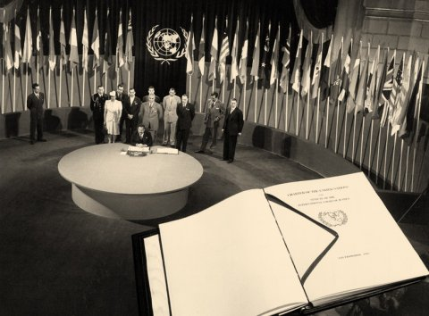
UN Photo/Historical Photo
The San Francisco Conference: Egypt signs the UN Charter. A facsimile copy of the Charter is superimposed on the photo.
http://webtv.un.org/watch/san-francisco-1945/4018283569001

Slide 11
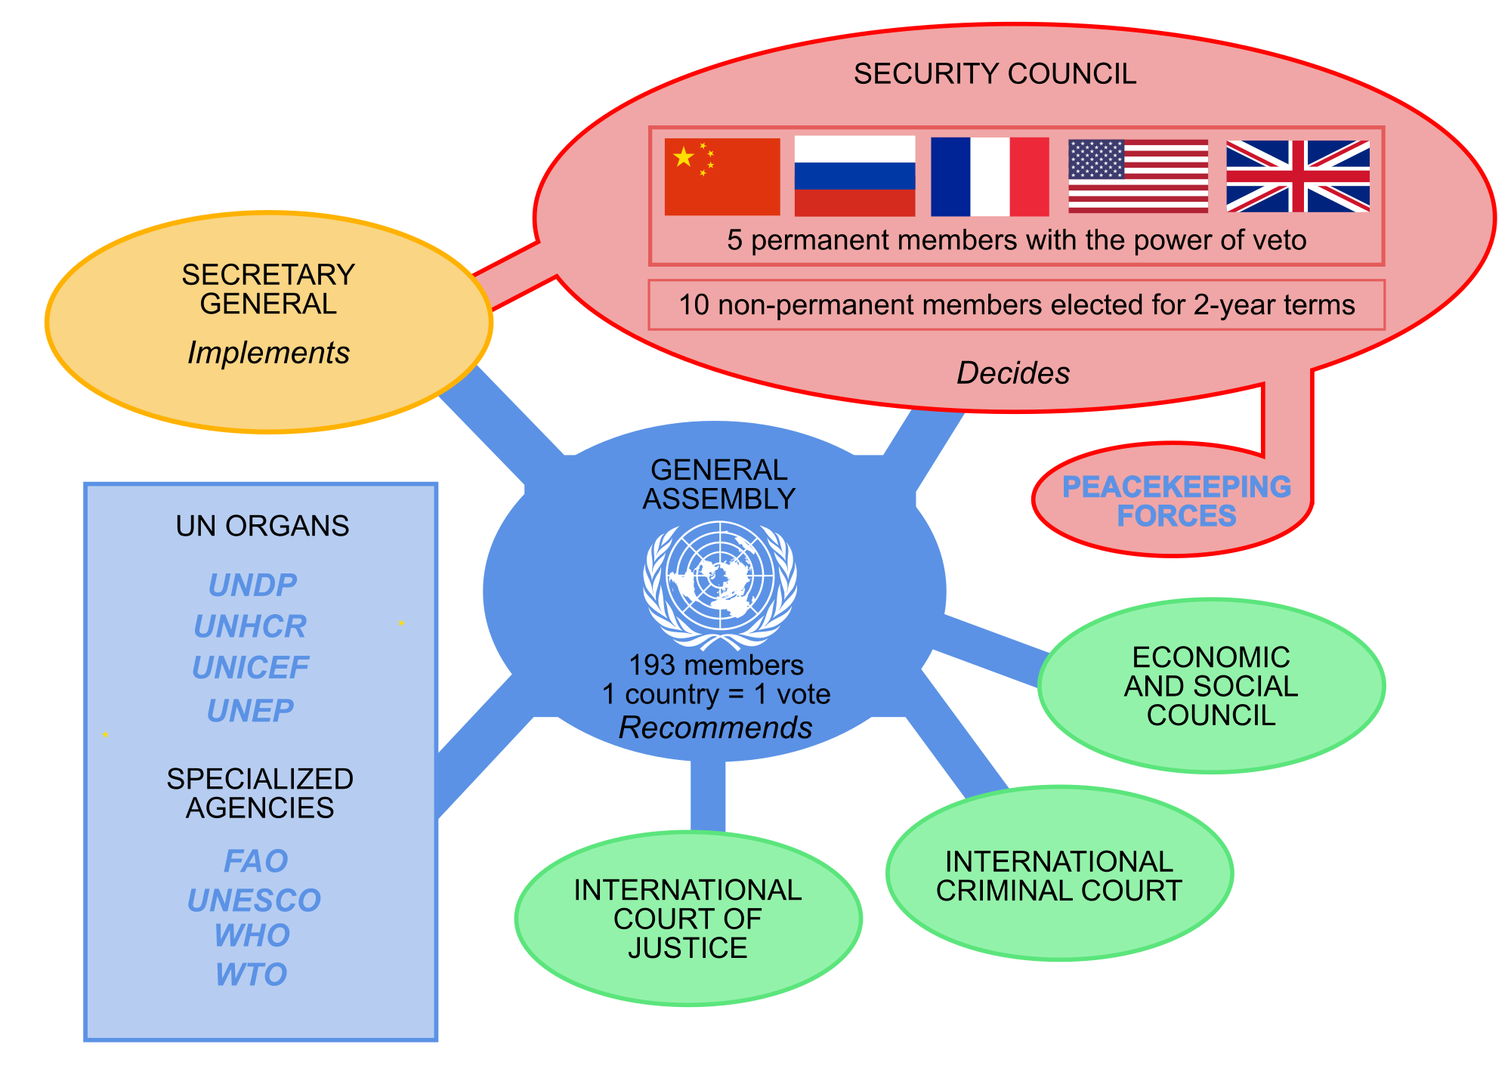
The structure of the UN
as it currently stands

Slide 12
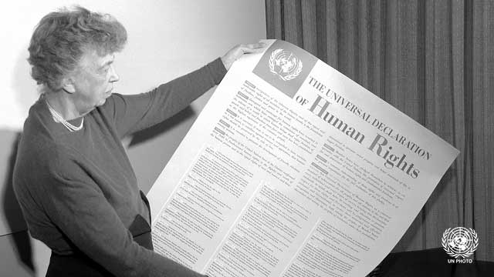
The Universal Declaration of Human Rights
The world of 1948
What’s altered since 1945?
Which article(s) are most
surprising/striking?
What kinds of rights
does the UDHR enshrine?
What kinds of rights are
signally lacking here?
Eleanor Roosevelt and the UDHR

Slide 13
Voting in the plenary session on adoption of the UDHR: Green countries voted in favour;
Orange countries abstained; Black countries failed to abstain or vote; Grey countries were not then part of the UN. Rodentologist - Own work, CC BY-SA 4.0, https://commons.wikimedia.org/w/index.php?curid=49435530

Slide 14
Historians, the UN and Human Rights
Realists vs. idealists
Optimists vs. pessimists
Leftists vs. liberals
Q: How and why do Mazower and Bradley
diverge in their interpretations of the postwar
“human rights moment”?
Q: How do we weigh up the balance of human
rights and wrongs in the postwar world?

