Slide 1
Hiroshima
A war ends and an ‘age’ begins

Slide 2
Photograph: Asahi Shimbun via Getty Images

Slide 3
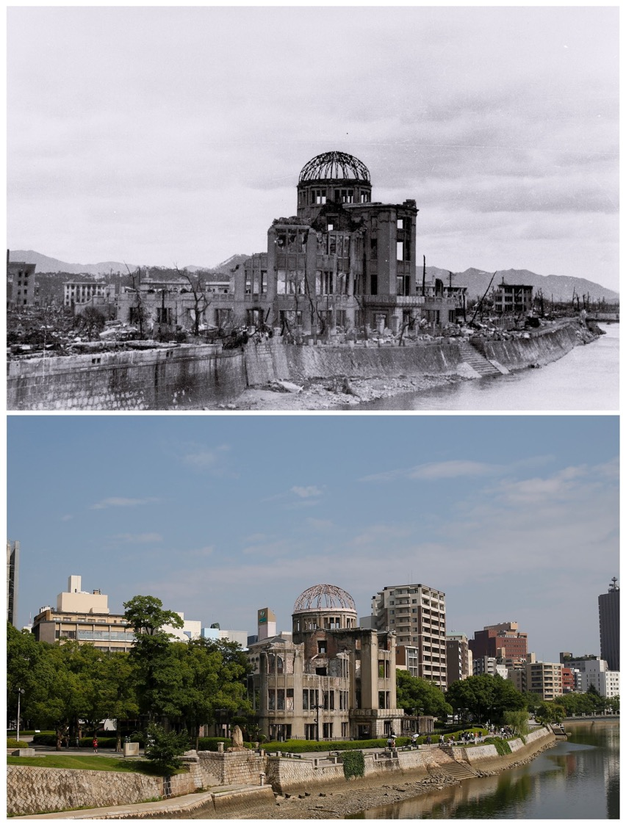
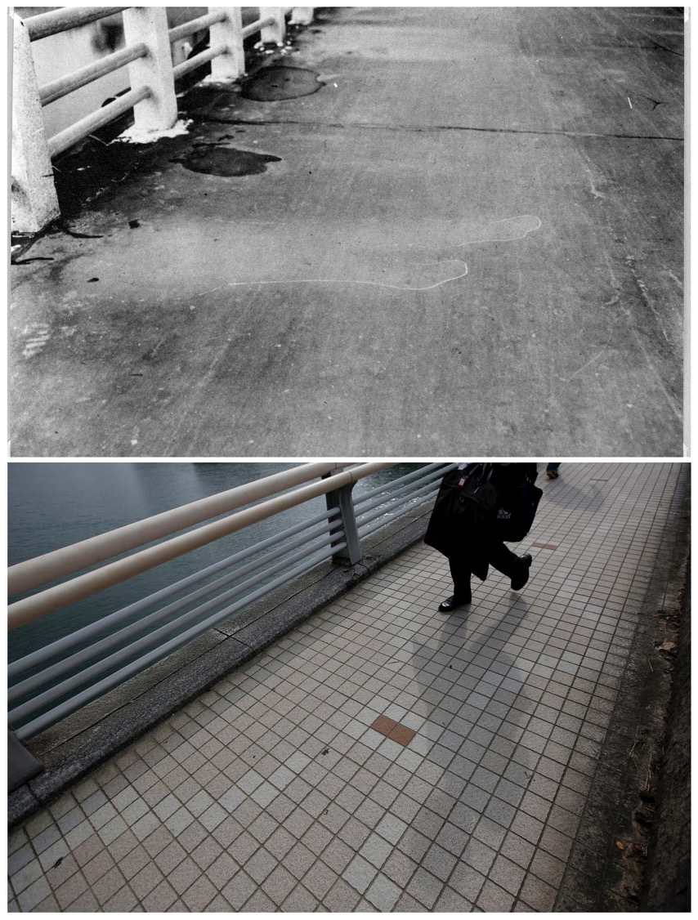
https://www.theguardian.com/artanddesign/gallery/2015/aug/06/after-the-atomic-bomb-hiroshima-and-nagasaki-then-and-now-in-pictures
The etched outline of a passerby that was imprinted on the Yorozuyo Bridge after the heat of the bomb. This was 860 metres from the centre of the blast; the asphalt was scorched everywhere except the light area, which was shielded by their body. Today, the bridge has been tiled over.
Photograph: Hiroshima Peace Memorial Museum/Reuters/
Issei Kato

Slide 4
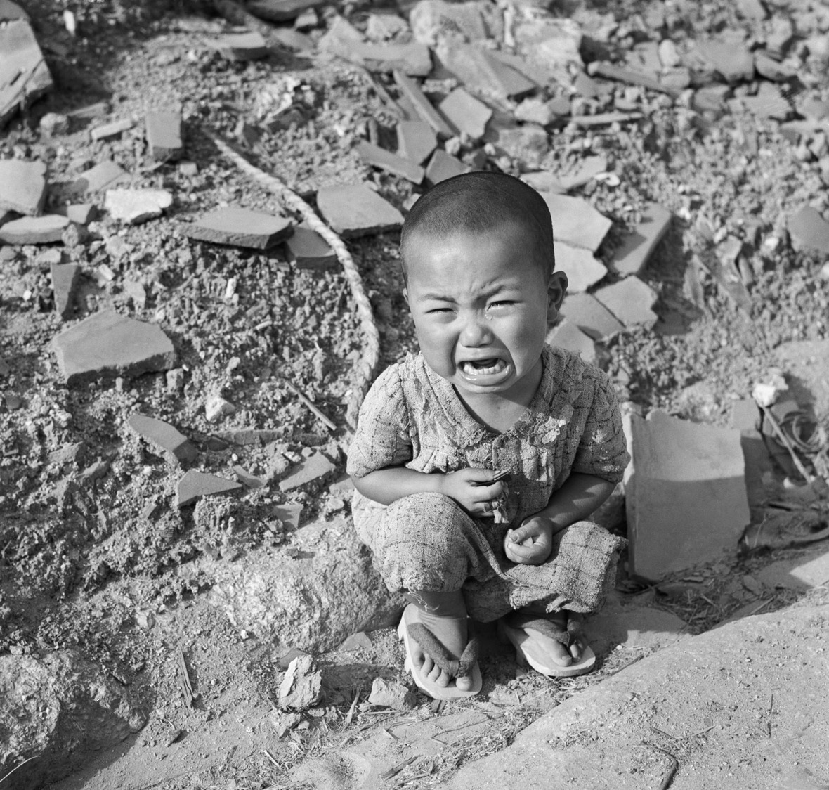
Photograph:
Bettmann/Corbis

Slide 5
Woman with Burns Through Kimono, 1945,
Kimura Gon'ichi, Peace Memorial Museum

Slide 6
Ishiuchi Miyako, chromogenic print of an A-bombed dress from Hiroshima: Strings of Time, 2008
Hiroshima: A Visual Record
Elin o’Hara Slavic
Asia Pacific Journal
Vol. 30-3-09, July 27, 2009
http://apjjf.org/-elin-o'Hara-slavick/3196/article.html

Slide 7
Visual resources on Hiroshima:
https://www.britishpathe.com/asset/254030
British Pathe Newsreel footage
Hiroshima and the nuclear age – a visual guide
On 6 August 1945, the US attacked the Japanese city of Hiroshima with an atomic bomb in a bid to end the second world war. Seventy years after the devastating power of nuclear weapons was first demonstrated, nine states retain them in their arsenals
Wednesday 5 August 2015 20.30 BST
https://www.theguardian.com/world/ng-interactive/2015/aug/05/hiroshima-nuclear-guide-anniversary-atomic-bomb

Slide 8
A Tale of Two Cities
The United States War Department produced a film in 1946 about the atomic bomb and its impact on Hiroshima and Nagasaki. (12:02)
https://www.youtube.com/watch?v=nvCvm8Q80ls
But for many years, US audiences had only limited access to newsreel footage
and photographic images taken at Hiroshima and Nagasaki.
Read more:
https://www.huffingtonpost.com/greg-mitchell/for-64th-anniversary-the_b_252752.html

Slide 9
The
racialization
of the United
States’
Japanese
nemesis.
For more on
the Pacific theatre
as a race war,
see John Dower,
War Without Mercy
(New York:
Pantheon Books,
1986)

Slide 12
The liberal New York newspaper
PM offers a sardonic editorial
response to the dropping
of the atomic bomb
on Hiroshima. August 7, 1945

Slide 13
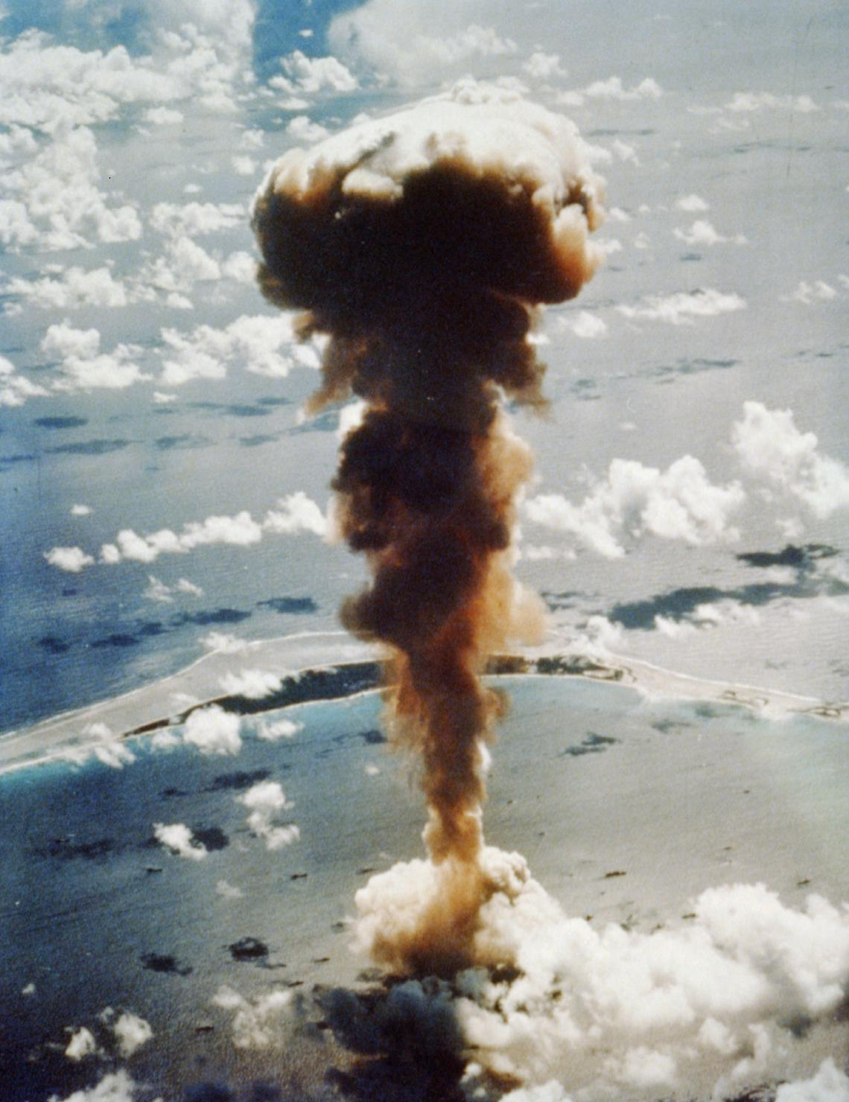
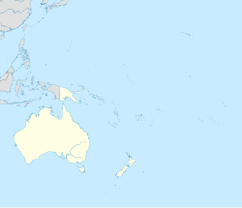
One year on….
US nuclear bomb tests on Bikini Atoll in the Marshall Islands
Aerial view of the Able test, a 23 kt (96 TJ) device detonated on July 1, 1946 at an altitude of 520 ft (160 m)
USAAF - This image is available from the United States Library of Congress's Prints and Photographs division under the digital ID cph.3b48627.

Slide 14
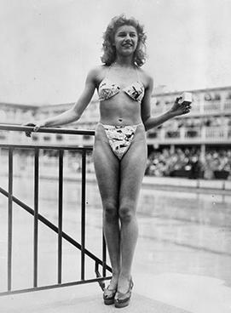
Bikini…. Sounds familiar??
Micheline Bernardini wearing the first bikini, 21 June, 1946.
Caption: The new 'Bikini' swimming costume (in a newsprint-patterned fabric), which caused a sensation at a beauty contest at the Molitor swimming pool in Paris. Designer Louis Réard was unable to find a 'respectable' model for his costume and the job of displaying it went to 19-year-old Micheline Bernardini, a nude dancer from the Casino de Paris. She is holding a small box into which the entire costume can be packed. Celebrated as the first bikini, Luard's design came a few months after a similar two-piece design was produced by French designer Jacques Heim.

Slide 15
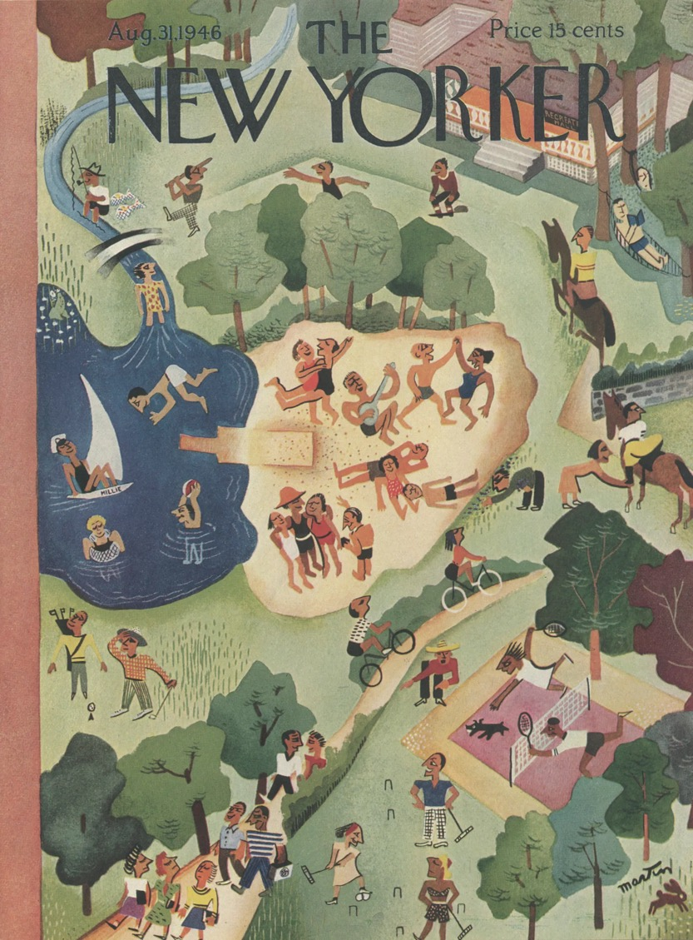
The New Yorker editors on their decision to devote the entire 31 August 1946 issue to John Hersey’s ‘Hiroshima’ feature:
Because of a ‘conviction that few of us have yet comprehended the all but incredible destructive power of this weapon, and that everyone might well take time to consider the terrible implications of its use’.

Slide 16
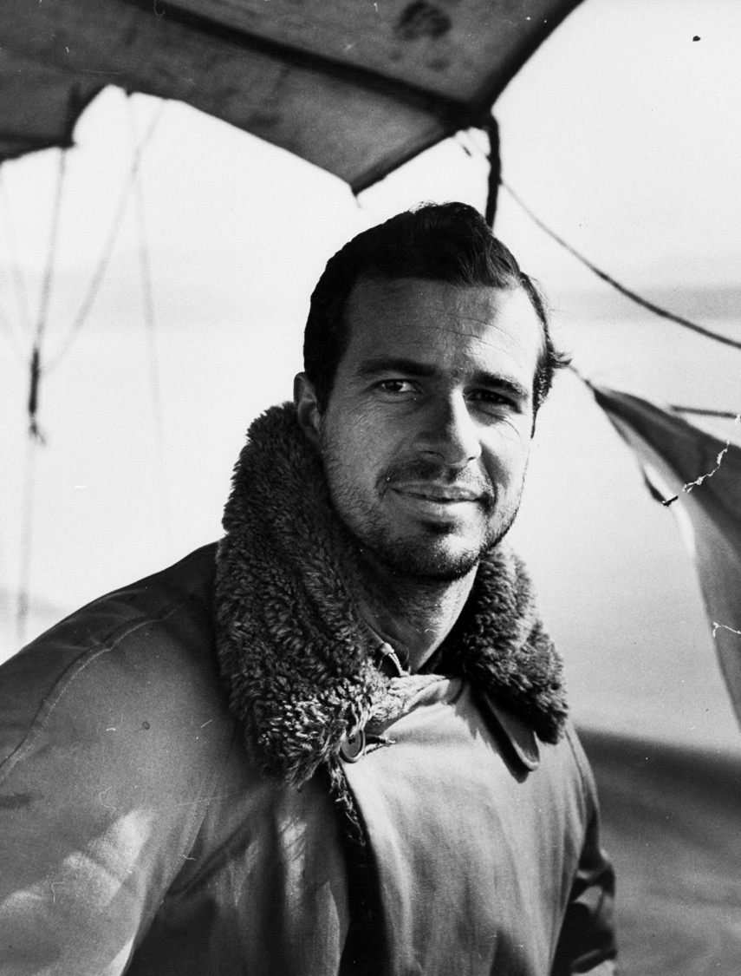
John Hersey was thirty-two when The New Yorker published his massively influential article on the atomic bombing.
PHOTOGRAPH BY DMITRI KESSEL / THE LIFE PICTURE COLLECTION / GETTY
https://www.newyorker.com/culture/culture-desk/john-hersey-the-writer-who-let-hiroshima-speak-for-itself

Slide 17
Hersey’s previous works,
published in 1942, 1943 and 1944

Slide 18
A precursor to the ‘New Journalism’
With journalism, Hersey once said, the reader is always conscious of ‘the person who’s writing it and explaining to you what’s taken place’. He said he wanted to have ‘the reader directly confronted by the characters’, so he tried to write the piece in such a way that, as he put it, ‘my mediation would, ideally, disappear’.
As a result, the author of the biggest publishing sensation of its time was a virtual stranger to the world of publicity. He never went on tour. He never wanted to ‘flog his wares,’ as he said. He didn’t go on TV or radio, didn’t give lectures. He only did two interviews in his life.
https://www.newyorker.com/culture/culture-desk/john-hersey-the-writer-who-let-hiroshima-speak-for-itself

Slide 19
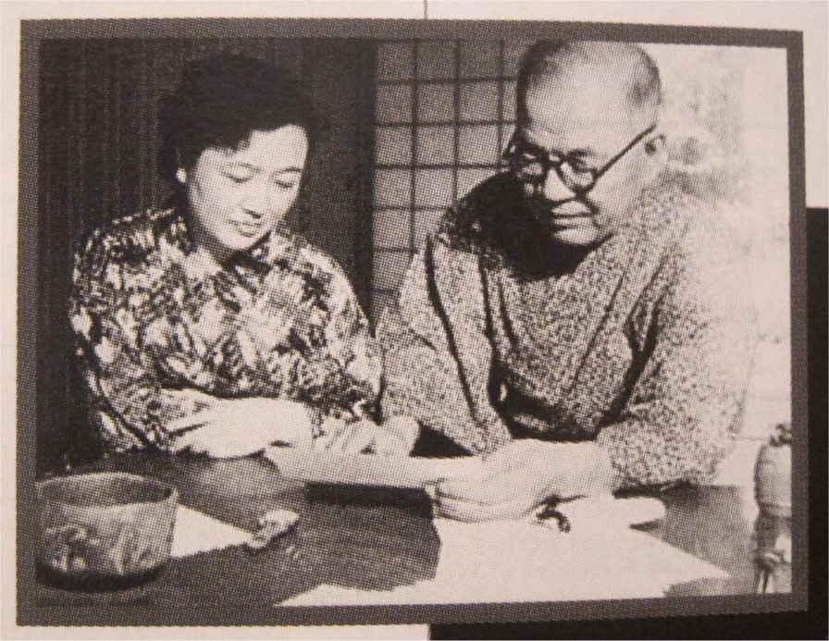
Michihiko Hachiya (蜂谷道彦 Hachiya Michihiko, 1903 in Okayama Prefecture - 1980)
http://voiceseducation.org/content/hibakusha-dr-michihiko-hachiya

Slide 20
http://www.rerf.or.jp/general/qa_e/qa12.html

