Slide 1
Cold war origins
The disintegration of the wartime alliance

Slide 2
The Big Three
at Yalta,
February 1945
Taken by the UK
War Office
Official photographer
IWM, TR2828.jpg

Slide 3
Army Signal Corps Collection in the U.S. National Archives. - http://www.history.navy.mil/photos/events/wwii-dpl/hd-state/potsdam.htm

Slide 4
Truman meets
Stalin at
Potsdam,
July 1945
From left to right, first row: Premier Joseph Stalin; President Harry S. Truman, Soviet Ambassador to the United States Andrei Gromyko, Secretary of State James F. Byrnes, and Soviet Foreign Minister Vyacheslav Molotov. Second row: Brigadier General Harry H. Vaughan, Truman's confidant and military aide; Russian interpreter Charles Bohlen, Truman naval aide James K. Vardaman, Jr., and (partially obscured) Charles Griffith Ross. https://www.trumanlibrary.org/photographs/view.php?id=392

Slide 5
  Discussion questions
  What were the key preoccupations of US, Soviet and British leaders assembled at Yalta and Potsdam?
  Where did prisoners and other ‘mobile’ people fit in the matrix of concerns on the agenda at Yalta and Potsdam?
  Which issues mattered most to Washington and Moscow respectively?
  Where does ‘emotionalism’ find reflection in these documents?
  How did the postwar world that evolved after 1945 differ from the blueprints established at Yalta & Potsdam?

Slide 7
Occupation zone borders in Germany, 1947. The territories east of the Oder-Neisse line, under Polish and Soviet administration/annexationare shown as cream as is the likewise detached Saar protectorate. Berlin is the multinational area within the Soviet zone

Slide 8
“At the conclusion of the First World War it was borders
that were invented and adjusted, while people were on
the whole left in place. After 1945 what happened was
rather the opposite: with one major exception boundaries
stayed broadly intact and people were moved instead.”
Tony Judt, Postwar: A History of Europe since 1945
(NY: Penguin Books, 2005), p. 27

Slide 9
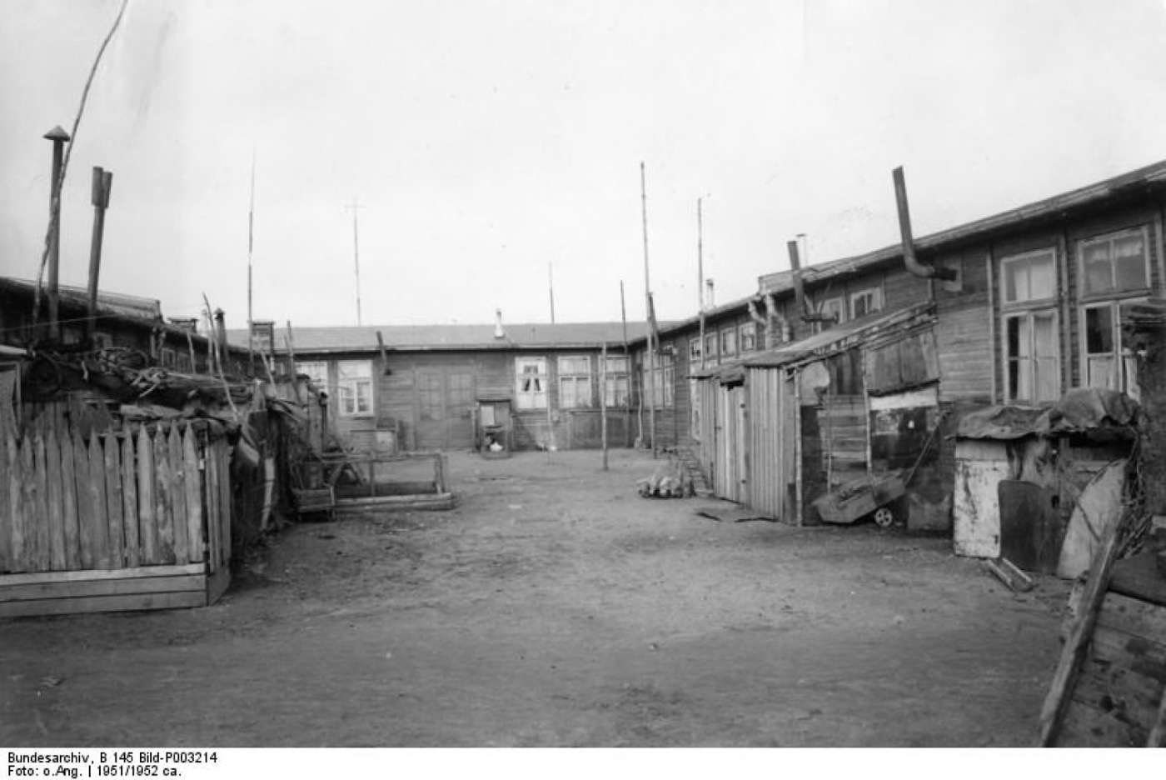
Camp for expellees in Eckernförde, Germany, in 1951. (Bundesarchiv
“Orderly and humane”?
R.M. Douglas:
"not merely the largest forced migration but probably the largest single movement of population in human history," with between 12 and 14 million civilians to move in just a few years… accomplished "largely by state-sponsored violence and terror"
https://www.washingtonpost.com/news/worldviews/wp/2015/09/03/the-forgotten-story-of-when-the-germans-were-the-refugees/?noredirect=on&utm_term=.2a9bbbcfb728

Slide 10
PowS and the politics of emotion

Slide 11
Of 96 million men mobilized for WWII, about one third–
35 million individuals– experienced captivity as POWs

Slide 12
“The brutal treatment of Soviet POWs by the Germans violated every standard of warfare. Existing sources suggest that some 5.7 million Soviet army personnel fell into German hands during World War II. As of January 1945, the German army reported that only about 930,000 Soviet POWs remained in German custody. The German army released about one million Soviet POWs as auxiliaries of the German army and the SS. About half a million Soviet POWs had escaped German custody or had been liberated by the Soviet army as it advanced westward through eastern Europe into Germany. The remaining 3.3 million, or about 57 percent of those taken prisoner, were dead by the end of the war. Second only to the Jews, Soviet prisoners of war were the largest group of victims of Nazi racial policy.”
https://www.ushmm.org/wlc/en/article.php?ModuleId=10007178

Slide 13
By contrast, only about 1% of 16 million US military
personnel endured captivity during WWII.
General Jonathan Wainwright (standing, left) with General Douglas MacArthur at Japan's surrender, USS Missouri, September 2, 1945
General Jonathan Mayhew Wainwright
(1883-1953), ca. 1946

Slide 14
Captivity and US identity
Frontispiece, The Captivity and Sufferings of Mrs. Mary Velnet. Boston, 1828.
Courtesy of the American Antiquarian Society.

Slide 15
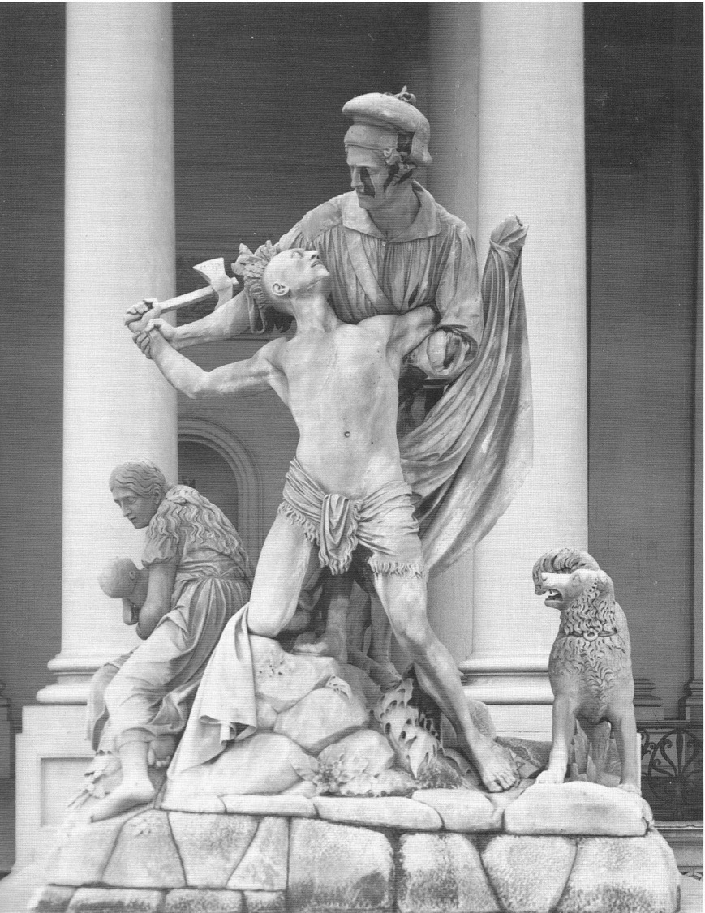
Horatio Greenough,
“The Rescue”
(1853)

Slide 16
Korean War POWs and the “brainwashing scare”
The Manchurian Candidate (1962)

Slide 17
Vietnam: the “betrayed” POW/MIA

Slide 18
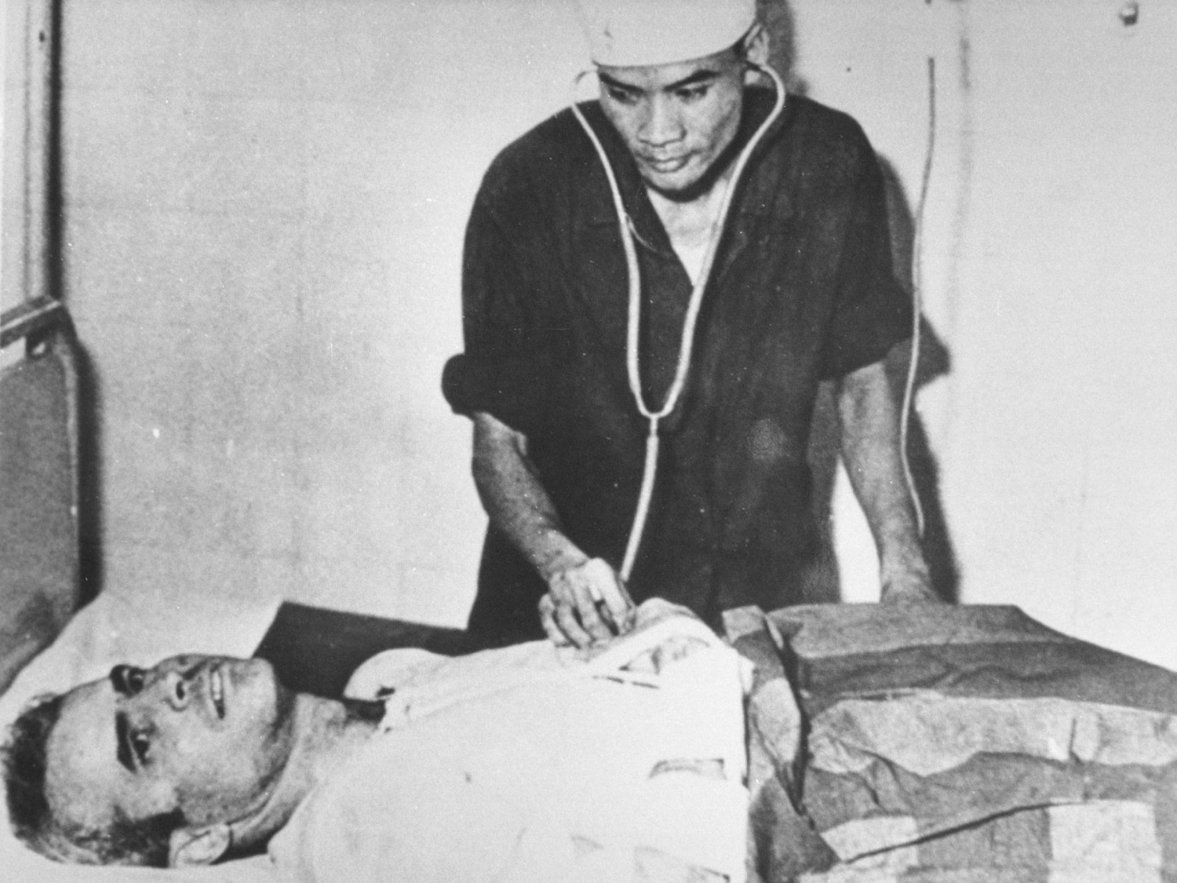
McCain/Trump
“I prefer the
ones that
didn’t get
caught”.
Donald Trump
Handout/
Getty Images

Slide 19
Kennan and the long telegram

Slide 20
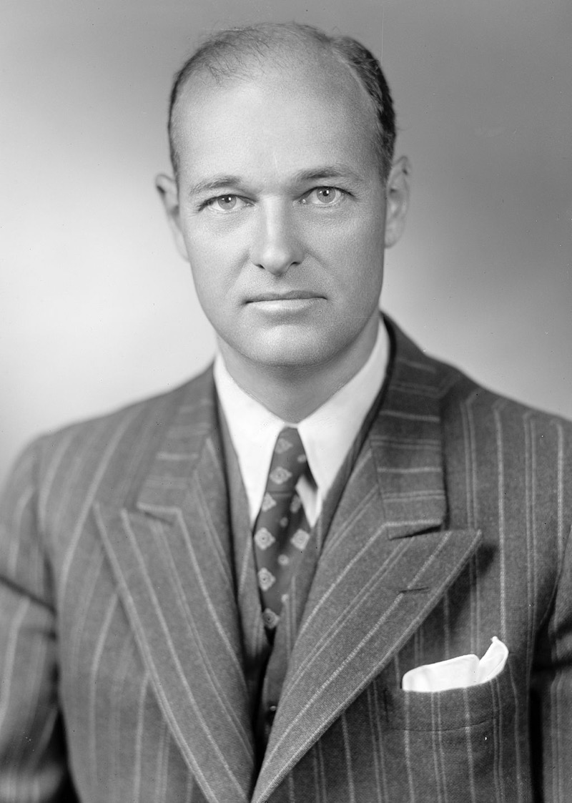
George Kennan (1904-2005)
Pictured in 1947
Library of Congress

Slide 21
Spaso House,
Residence of
the US
Ambassador
to the USSR
from 1933

Slide 22

Getting Real
George F. Kennan’s Cold War.
Louis Menand
‘The country he felt closest to… was Russia. Russia was “in my blood,” he says in the “Memoirs.” “There was some mysterious affinity which I could not explain even to myself.” He wondered whether he had lived in St. Petersburg in a previous life. The Russia he loved, or fantasized about, was, of course, a pre-Bolshevik and pre-industrial Russia—the Russia of Tolstoy, whose estate, Yasnaya Polyana, he visited in 1952, feeling, he said later, “close to a world to which, I always thought, I could really have belonged,” and of Chekhov, whose biography he several times contemplated writing.’
https://www.newyorker.com/magazine/2011/11/14/getting-real

Slide 23
Kennan’s ‘Long Telegram’:
What are the most salient points of Kennan’s analysis of the Soviets’ worldview
and the Kremlin’s behaviour in the postwar world?
Where do we discern ‘emotionalism’ in the Long Telegram?
What’s strikingly absent from Kennan’s dissection of the Kremlin?
What might a more sympathetic appraisal of the Soviet viewpoint have looked like?
How do we explain the traction Kennan’s critique gained in the US?
Does this document shift our sense of US foreign policy ‘realism’?

