Slide 1
Welcome back!
Thanks for all the extremely positive feedback on term 1.

Slide 2
Thinking ahead…
Time to start considering ideas for the long essay due in week 10!
The essay should relate to one week’s topic-- though it could cut thematically across more than one week
It MUST combine some original primary source analysis (including sources beyond those assigned as core reading) with appropriate secondary literature
You can, if you wish, use this opportunity to extend the geographic focus of the module’s weekly topics
Please email me to share ideas as soon as you’re ready– but no later than Monday of week 7
I am also very happy to arrange individual appointments to discuss essay topics/questions.

Slide 3
Where we’re heading…
Postwar occupation in Germany and Japan
Refugees
The politics of food and hunger (week 2)
Sex (week 3)
Re-education
Postwar Justice/Nuremberg (week 5)
FOCUS ON SOURCE ANALYSIS:
In weeks 2, 3 or 5 we’ll discuss ‘gobbets’ from the primary sources that members of the seminar will select in advance (if you didn’t already do so in term 1).
Please identify– and email to me in advance– a passage approximately 10-12 lines, or a paragraph in length that you think is particularly expressive of key themes.

Slide 4
Some Key concepts
Humanitarianism
Human rights
Power relations and asymmetries– occupiers and occupied; victors and vanquished; ‘rescuers’ and refugees; perpetrators and victims
Sovereignty/authority
Territoriality/borders/spaces
Empire and decolonization

Slide 5
Constructing and controlling refugees
The origins of a new universal humanitarianism?

Slide 6

What IS humanitarianism?
And did 1945 mark ‘year zero’ in its emergence and/or universalization?

Slide 7
‘Refugee’: The origins of a term
Etymologically, the English term refugee is the Anglicized derivation of the French term refugie.
The first known use of this term in print dates to1573, used in reference to persons fleeing religious persecution from the Low Countries
The French term derives from the Latin word refugere, meaning to flee (fugere) back (re).

Slide 8
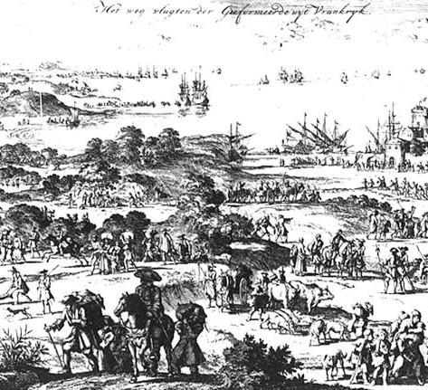
The term refugee entered popular parlance with reference specifically to the flight of the Huguenots from France in 1685.

Slide 9
Over the next two hundred years, various terms--
including suppliant, exile, asylee, emigre, fugitive,
and banished-- were used to name ‘displaced’ people.
Only in the twentieth century, in the wake of two catastrophic world wars, did the phenomenon of mass displacement register as a ‘problem’ requiring state and inter-state action to manage.
But what kind of ‘problem’-- for whom and why?
Who exactly qualified as a ‘refugee’, and what did that classification mean in terms of policy?
How to solve the problem of mobile people’s placelessness?

Slide 10
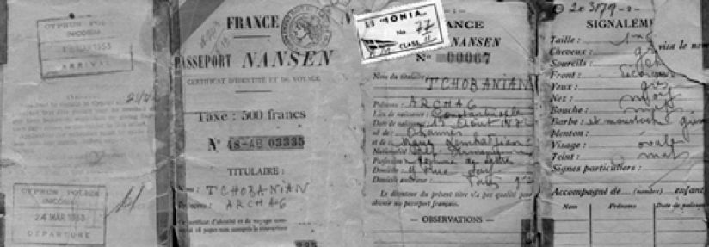
In 1921, the League of Nations High Commissioner
for Refugees came into existence, the first commissioner being Norwegian humanist Fridtjof Nansen
Nansen passport given to Armenian refugees

Slide 11
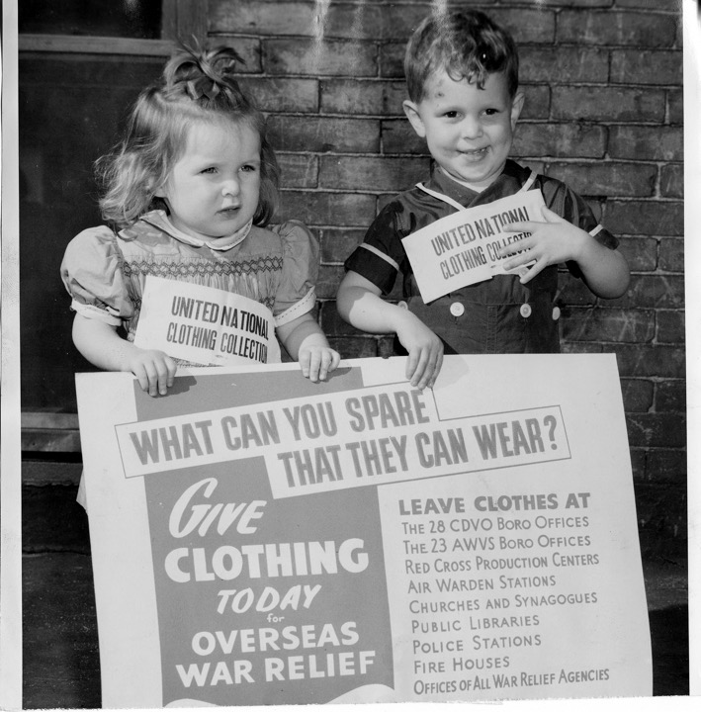
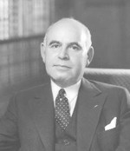
UNRRA: The United Nations Relief and Rehabilitation Administration
Founded 1943
Headed by American politician (D-NY)
Herbert Lehman
By 1947, UNRRA
operated 762 camps
in Europe– but its
operations terminated
that year, folded into
those of the
International Refugee
Organization (IRO)
‘Victory Clothing Drive’ (April 1945)
New York State Archives. New York State War Council. Photographs of War Council agency activities, ca. 1942-1945. Series A4299-78, Box 4, Folder 1.
Read more about Lehman’s
political career:
https://library.columbia.edu/libraries/rbml/units/lehman/biography.html

Slide 12
Female survivors of the Nazi camp at Bergen-Belsen remove louse-ridden
clothing from corpses (15 April 1945)
Credit: Galerie Bilderwelt / Contributor Hulton Archive/Getty Images
https://www.iwm.org.uk/collections/item/object/10406

Slide 13
'Harrods’– the clothing store at Belsen
Credit: Sgt. Hewitt, IWM
https://collections.ushmm.org/search/catalog/irn1001293

Slide 14
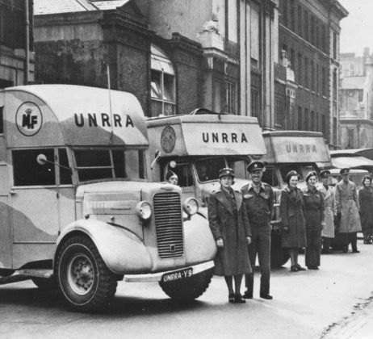
Some UNRRA records have been digitized and made publicly accessible online via the UN Archives:
https://archives.un.org/content/united-nations-archives-21st-century

Slide 15
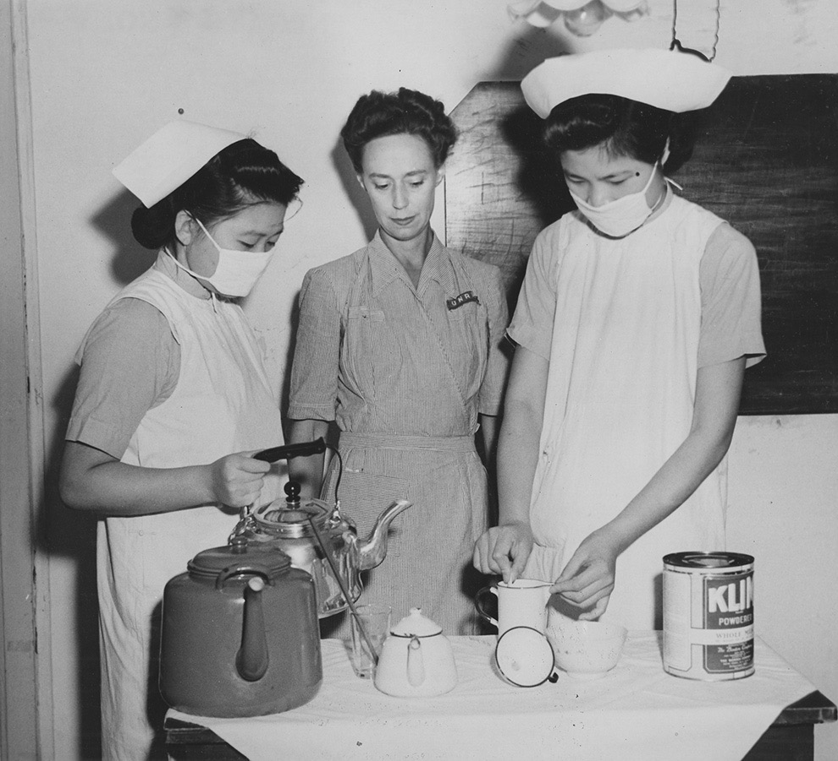
Unrra beyond europe
UNRRA’s China office opened in 1944
Photo from the UN Archives shows an UNRRA worker presiding over the preparation of powered baby milk formula at a Chinese orphanage
For more on UNRRA in China:
https://zeitgeschichte-online.de/themen/uncovering-international-aid-china-unrra-1943-1947
Follow this link to an excellent online
mapping project detailing the global reach of
UNRRA’s operations
https://uploads.knightlab.com/storymapjs/645f850c9fc05474dccb4878f9a1a154/unrra/index.html

Slide 16
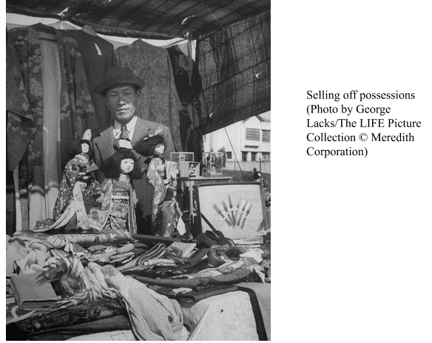
‘Repatriation’ in Asia
From 1945 to 1954, some 6,240,000 Japanese people, accounting for 10% of the entire Japanese population, relocated to Japan, while foreigners living in Japan at that time were deported.
‘Repatriates’ included surrendered Japanese military personnel but also ‘extruded’ Japanese settlers from Japan’s former colonies in China and elsewhere.
Read more on the ‘repatriation’ of Japanese
from postwar Shanghai:
https://apjjf.org/2020/23/Sheng.html

Slide 17
A proliferation of labels and statuses
Refugee
Displaced Person
Expellee
‘Infiltree’
Extruded populations
Repatriates

Slide 18

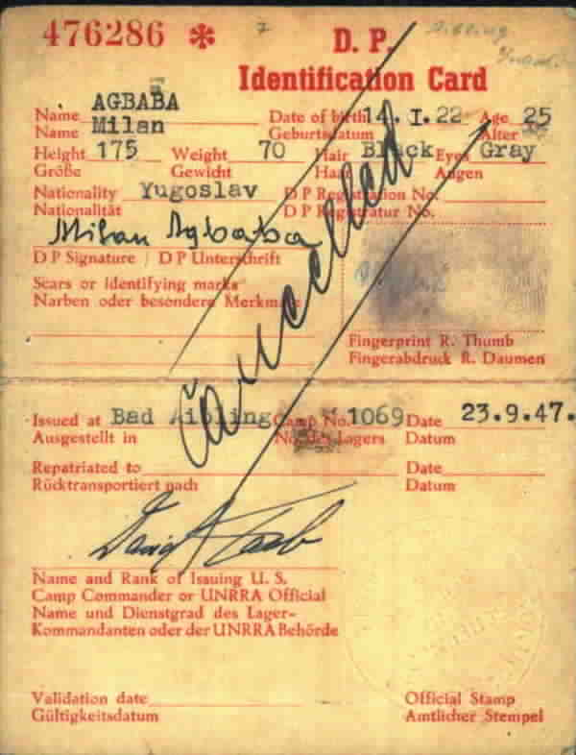
1944 special passport issued to an UNRRA official
The postwar validation of personhood
DP Identity card

Slide 19
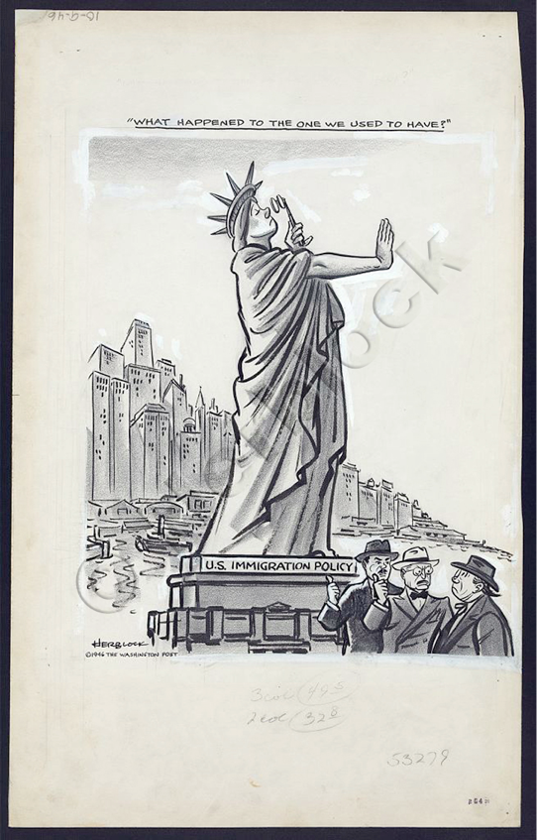
Transience vs permanence: A ‘final solution’ for the ‘hard core’
European Volunteer Workers (EVWs) in the UK
Emigration to the ‘white Dominions’– Australia, Canada, NZ
Jewish DPs’ emigration to Palestine (week 7)
Emigration to the US
“What Happened to the One We Used to Have?”
Washington Post, October 9, 1946
Herblock collection (Library of Congress)

Slide 20
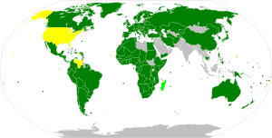
According to Article 1A(2) of the 1951 Refugee Convention, the term ‘refugee’ shall apply to any person who:
‘As a result of events occurring before 1 January 1951 and owing to well founded fear of being persecuted for reasons of race, religion, nationality, membership of a particular social group or political opinion, is outside the country of his nationality and is unable or, owing to such fear, is unwilling to avail himself of the protection of that country; or who, not having a nationality and being outside the country of his former habitual residence as a result of such events, is unable or, owing to such fear, is unwilling
to return to it.’
https://www.unhcr.org/uk/1951-refugee-convention.html
Light green = Parties to only the 1951 Convention
Yellow = Parties to only the 1967 Protocol
Dark green = parties to both
Grey = Non-members

Slide 21
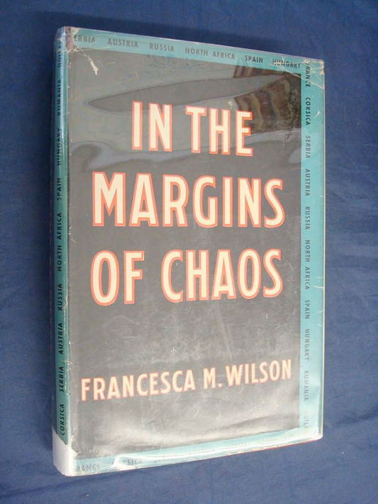

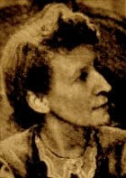
Francesca M. Wilson
(1888-1981), Birmingham-born Quaker, graduate of Newnham College, Cambridge and relief worker
Read more about Wilson’s life:
https://jvc.oup.com/2014/06/02/thinking-about-francesca-wilson-and-the-victorian-imaginery-that-surronded-her/

Slide 22
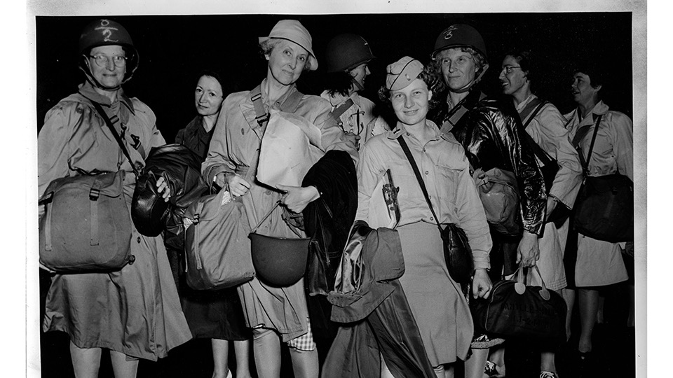
‘Relief and Rehabilitation’– but what did those aspirations entail? Who and what was to be ‘rehabilitated’ how?
‘Helping the people to help themselves’:
The self-understandings of relief workers:
Altruistic humanitarians-- or egotistical adventurers?
What were the ‘right’ motivations’ for relief work?
What kind of training &/or prior experience did
relief workers require?
What ethical complexities are at stake in ‘helping others’?
US relief workers (sporting UNRRA uniforms) embarking for Europe from Newport News, Va, 1944 (US National Archives) https://www.nationalww2museum.org/war/articles/united-nations-relief-and-rehabilitation

Slide 23
SHAEF Administrative Memorandum Number 39 (rev. 16 April 1945)
Displaced Persons and Refugees in Germany
What were Allied high commanders’ key objectives in managing mobility in Germany?
What made controlling ‘out-of-place’ people so challenging?
How did SHAEF define various categories of mobile people? And what’s striking about these definitions?
Was it ‘better’ (i.e. likely to lead to more material provisions and greater security) to be defined as a Displaced Person than a refugee in Germany in April 1945?
In what ways, and how far, does this document exhibit a different understanding of the ‘problem’ of human displacement than Wilson’s Advice pamphlet?
What connections might we draw between this document and other sources we’ve already encountered?

