Slide 1
postwar
Aftermaths of World War II
Professor Susan Carruthers

Slide 2
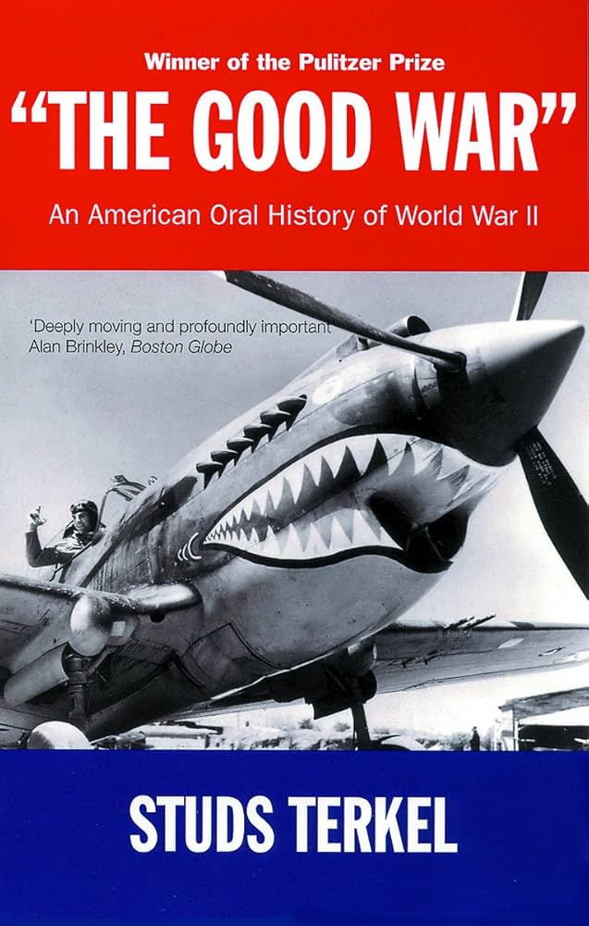
Research-led teaching
(1984)
Harvard University Press, 2016

Slide 3
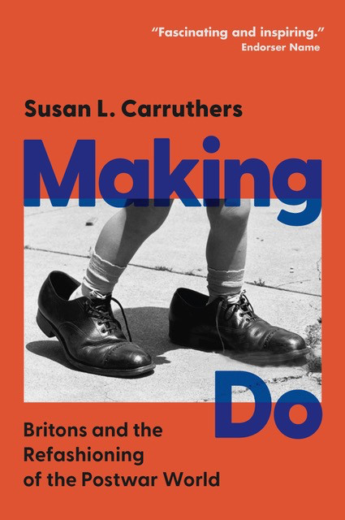
Teaching-led research
Forthcoming Cambridge University Press, April 2025

Slide 4
A truly world war
Or a cluster of intersecting civil and inter-state conflicts

Slide 5
A world war
Dark Green: Allies before the Japanese attack on Pearl Harbor, including colonies and occupied countries.
Light Green: Allied countries that entered the war after the attack on Pearl Harbor.
Blue: Axis Powers and their occupied territories.
Grey: Neutral countries during WWII
https://commons.wikimedia.org/wiki/Atlas_of_World_War_II#/media/File:Map_of_participants_in_World_War_II.png

Slide 6
A war between empires
Indian infantrymen
of the 7th Rajput
Regiment about to
go on patrol on the Arakan front,
Burma, 1944.
Imperial War Museum

Slide 7
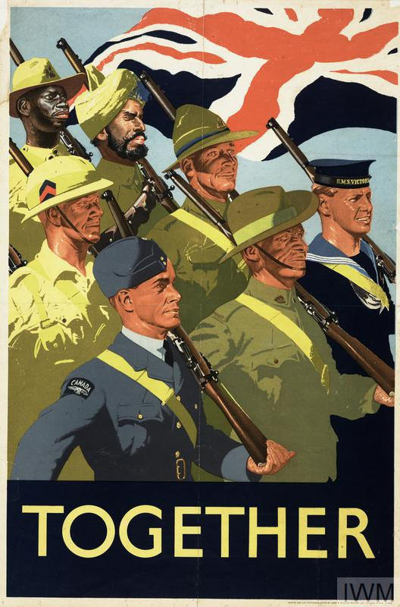
https://www.theguardian.com/world/2019/feb/13/african-british-army-paid-less-than-white-soldiers

Slide 8
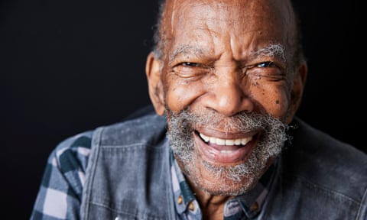
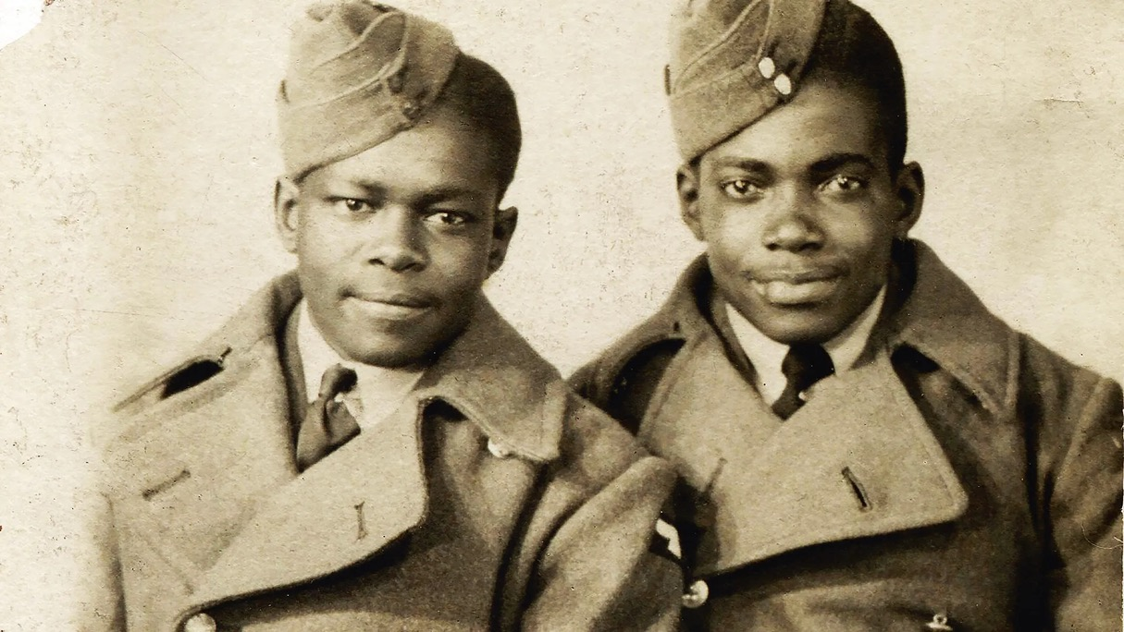
Alford (right) with friend and fellow soldier Dennis Wilberforce Reed in their RAF uniforms, c. 1944.
‘Alford Gardner, one of the last remaining Windrush passengers, who has died at the age of 98.’
Photograph: Christopher Thomond/The Guardian
(2 October 2024)

Slide 9
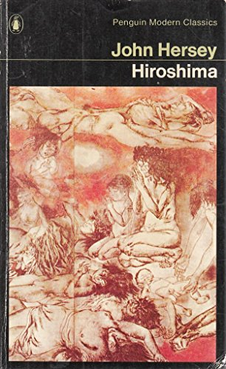
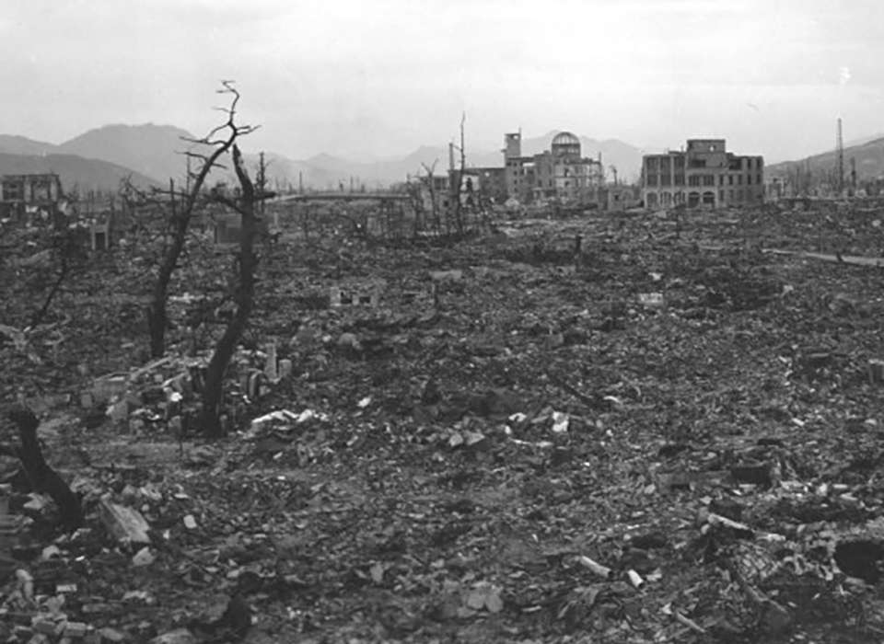
A War of Unprecedented Lethality
Hiroshima, August 6, 1945
New Yorker, August 23, 1946

Slide 10
More than
60 million
people lost
their lives
during WWII:
around 3% of the global
population.
By Jroehl - Own work, CC BY-SA 4.0, https://commons.wikimedia.org/w/index.php?curid=41644418

Slide 11
When did world war II end?
Locating the ‘post’ in postwar

Slide 12
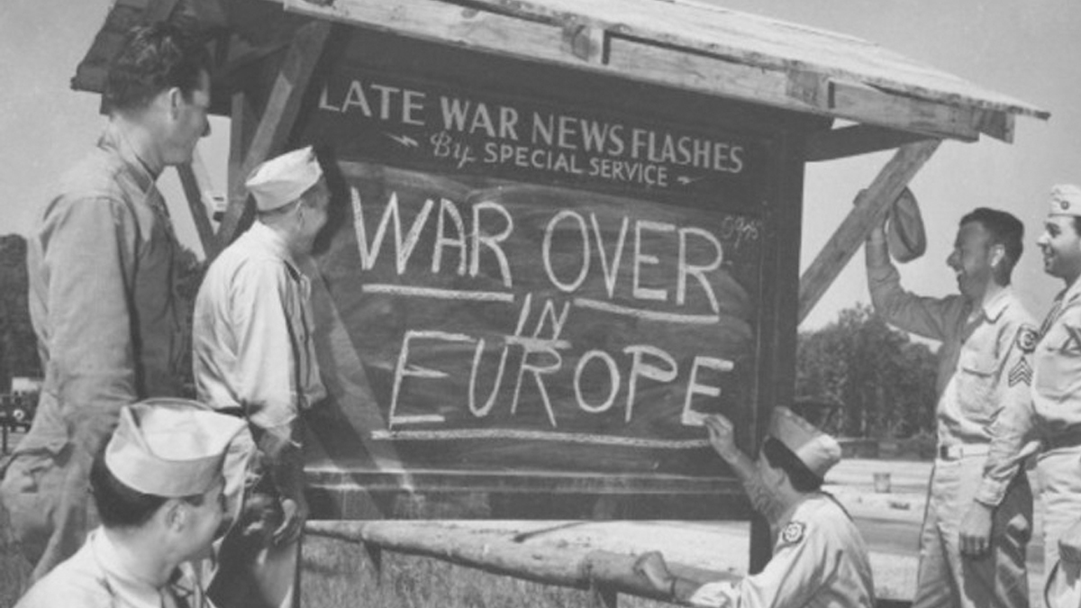

Slide 13
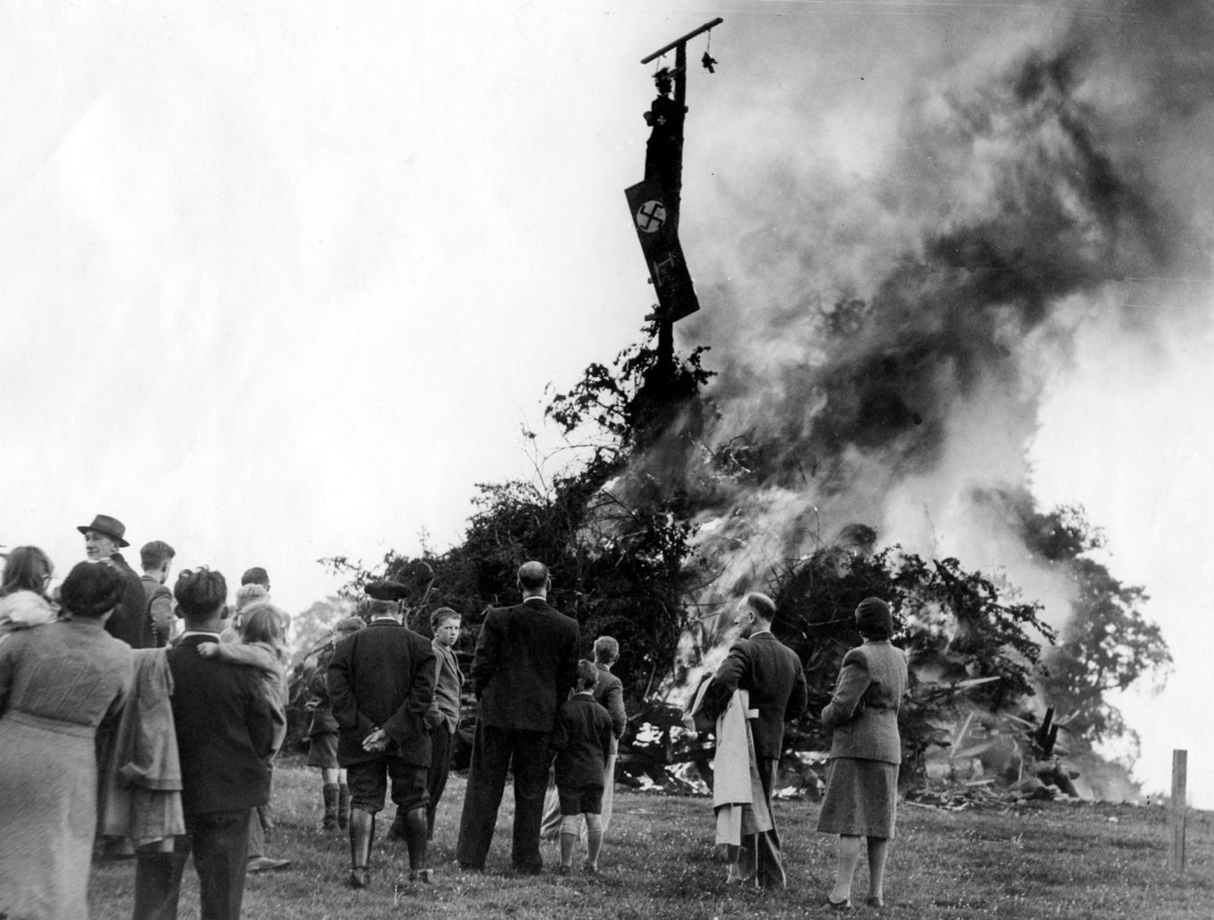
A 40’ bonfire, complete with an effigy of Hitler, was lit in the village of Ashow, Warwickshire to celebrate VE Day
8 May 1945

Slide 14
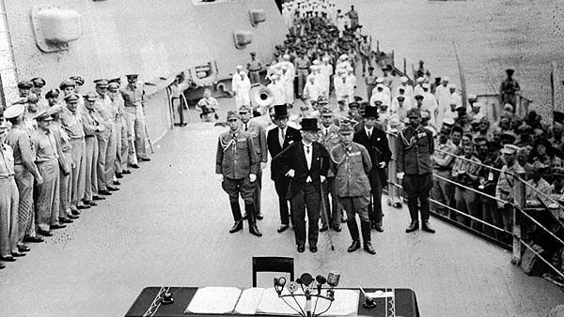
Japanese delegates sign the instrument of surrender September 2, 1945

Slide 15
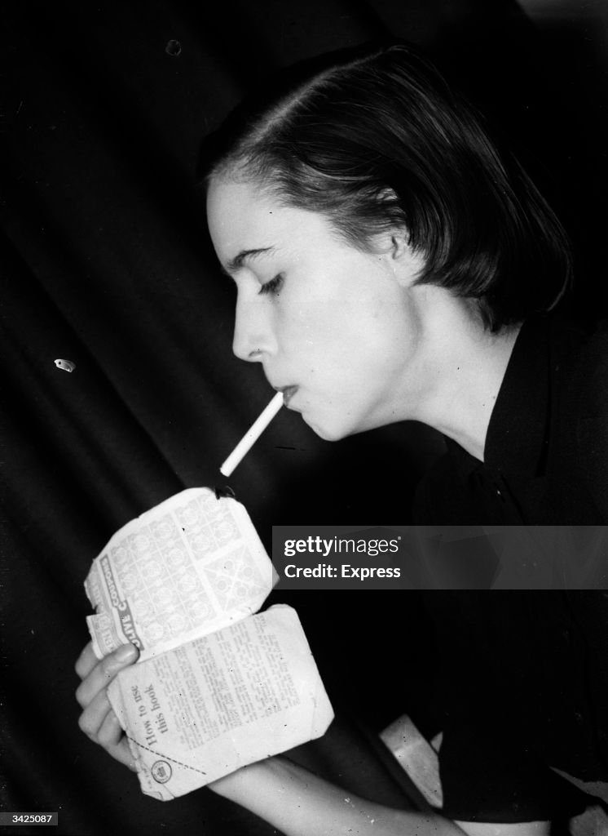
The “bonfire of controls”?
Daily Express columnist Drusilla Beyfus sets light to a clothing ration book.
15 March 1949
(Photo by Express/Express/Getty Images)

Slide 16
Protracted
austerity
The end of
food rationing
in Britain
“Freedom at Last!”
http://manchesterhistorian.com/wp-content/uploads/2014/02/A-Year-in-Photos2.jpg?w=410

Slide 17
Displaced and ‘displeased’ people
The politics of going home’

Slide 18
Martial militancy: GIs demand early demobilization
American soldiers who took part in the GI demonstrations shouting 'We want to go home!' January, 1946.
Bettmann Archive/Getty Images

Slide 19
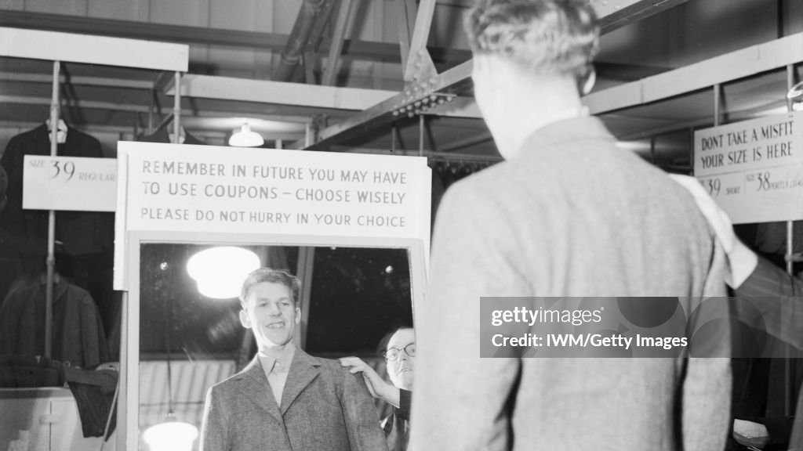
The Full Monty

Slide 20
The impossibility
of return
Pathe newsreel of the
liberation of Belsen,
April 15, 1945
‘Starving prisoner at Belsen
delouses clothes’
Imperial War Museum, BU 3766

Slide 21
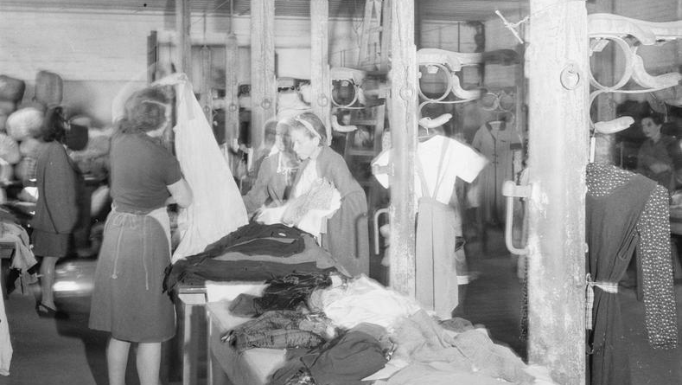
Imperial War Museum

Slide 22
Landsberg Displaced Persons camps
(Above) the refectory at Landsberg DP
Camp in Bavaria, 1945.
(Left) Major Irving Heymont greets
David Ben Gurion.

Slide 23
Occupation and reconstruction

Slide 24
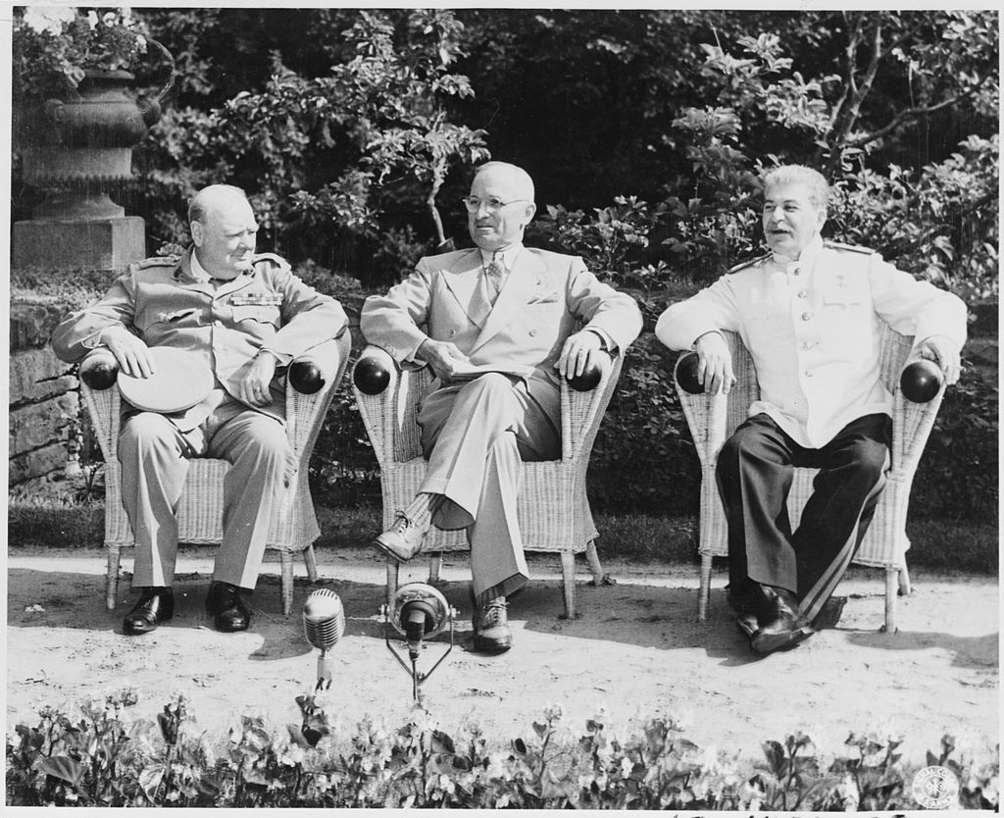
The “Big 3” and the “4 Ds”
The Potsdam Conference, July-Aug. 1945

Slide 25
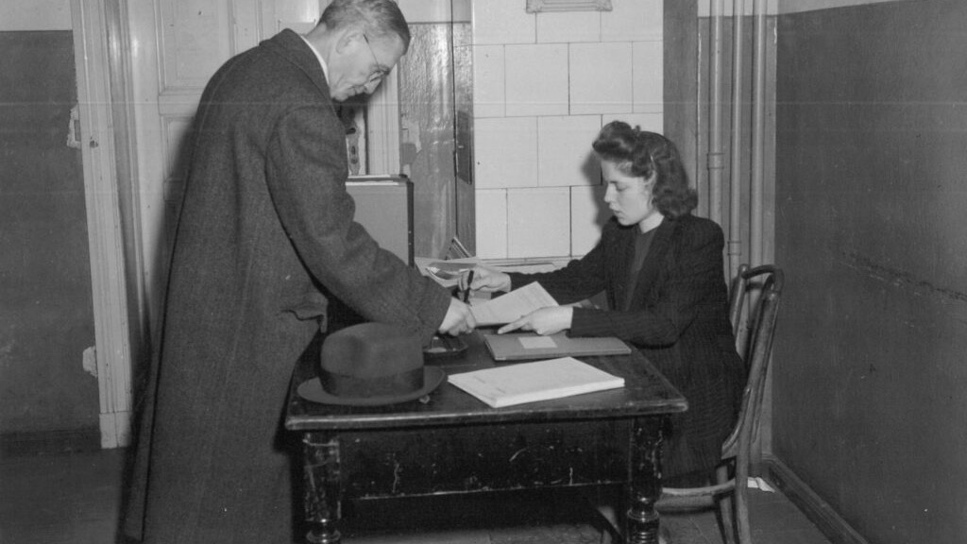
Denazification

Slide 26
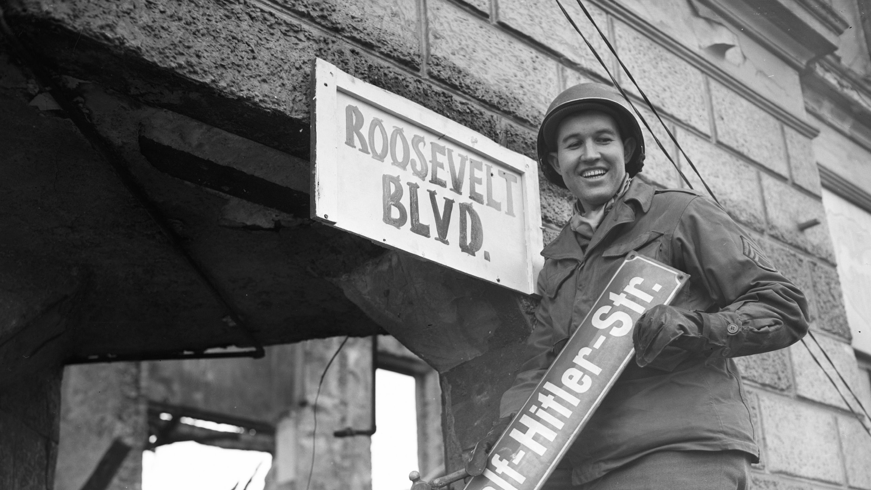

Slide 27

Die Todesmühlen
US Army Signal Corps, 1945
Germany, 1945. Caption reads: “German prisoners of war held in an American camp watch a film about German concentration camps.”
United States Holocaust Memorial Museum, courtesy of Joseph Eaton.
https://rarehistoricalphotos.com/german-soldiers-forced-watch-footage-concentration-camps-1945/

Slide 28
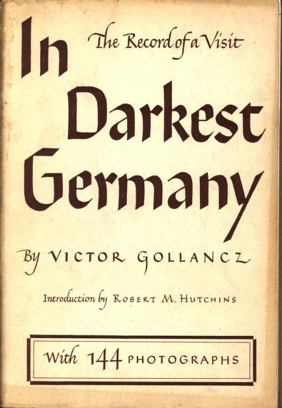
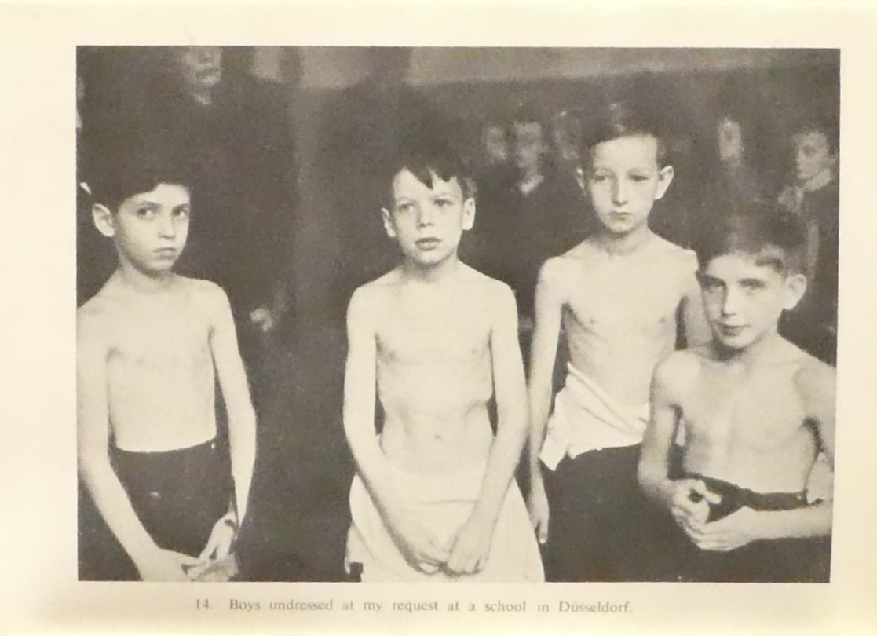
“Save Europe Now”
Modern Records Centre, University of Warwick

Slide 29
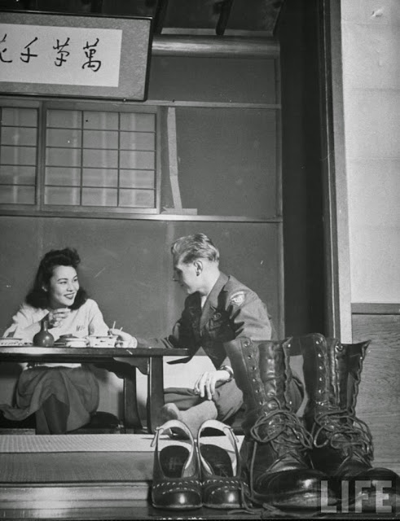
From punitive occupation to the
‘romance of reconciliation’
General Douglas MacArthurtowers over Emperor Hirohito

Slide 30
From world war to cold war

Slide 31
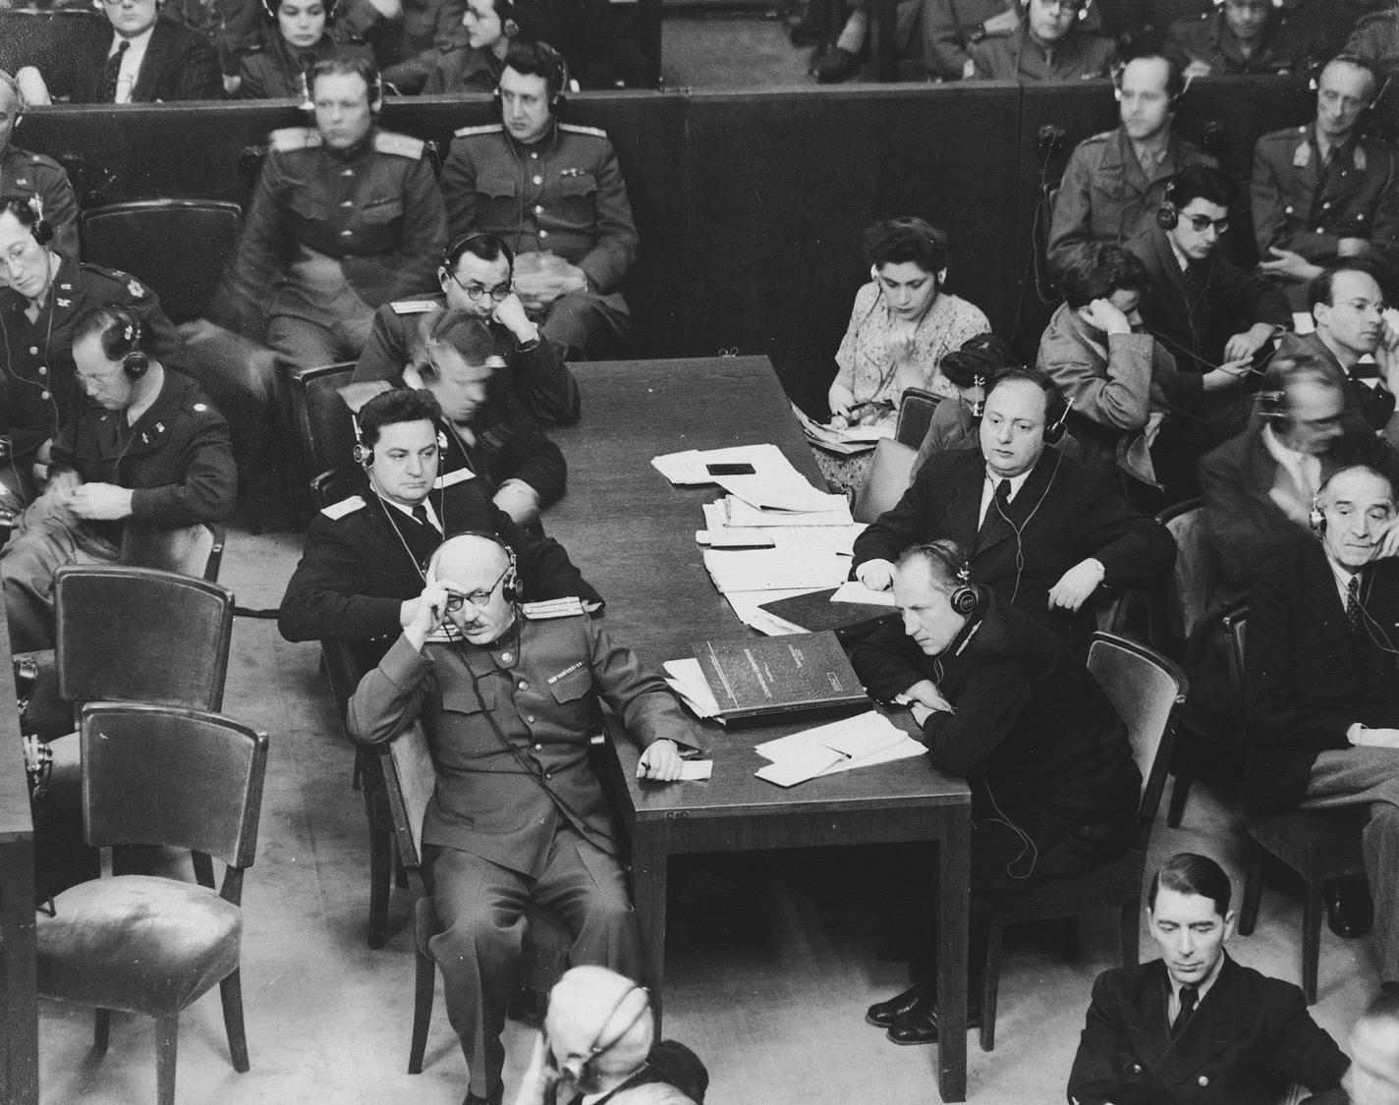
The Soviet prosecution team at the International Military Tribunal trial of war criminals at Nuremberg.
Photographer
Charles Alexander
20 Nov. 1945- 1 Oct.1946
United States Holocaust
Memorial Museum

Slide 32
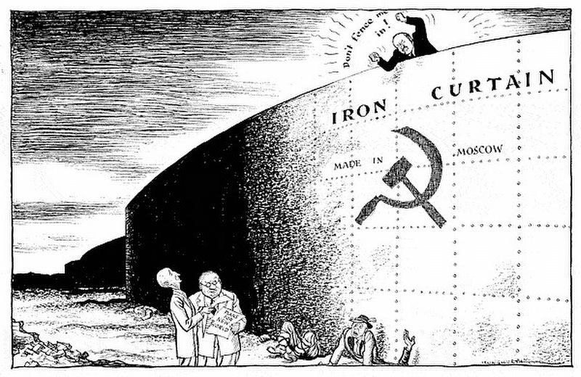
Churchill delivered his ‘Iron Curtain’ speech on 5 March 1946

Slide 33
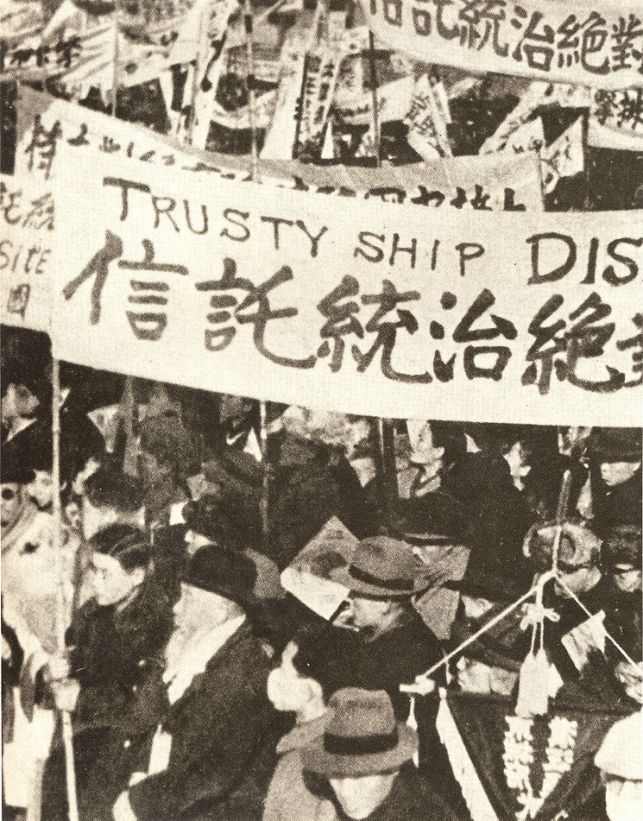
The partition of Korea
South Korean citizens protest
Allied trusteeship in December 1945

Slide 34
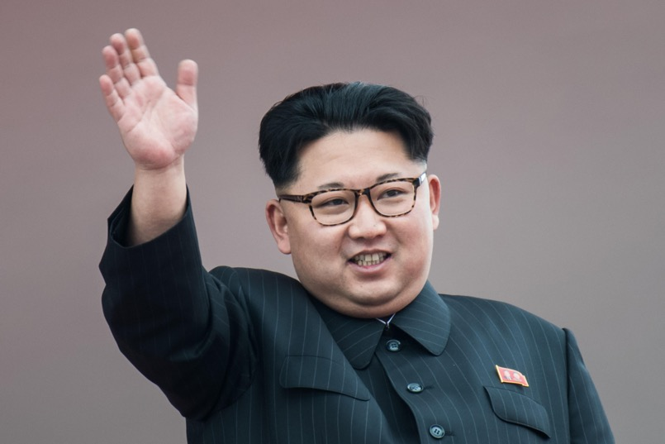
From war to cold war to hot war

Slide 35

Questions?

