Slide 1




THE ELLIS ISLAND BODY
ABOUT
START

Slide 2
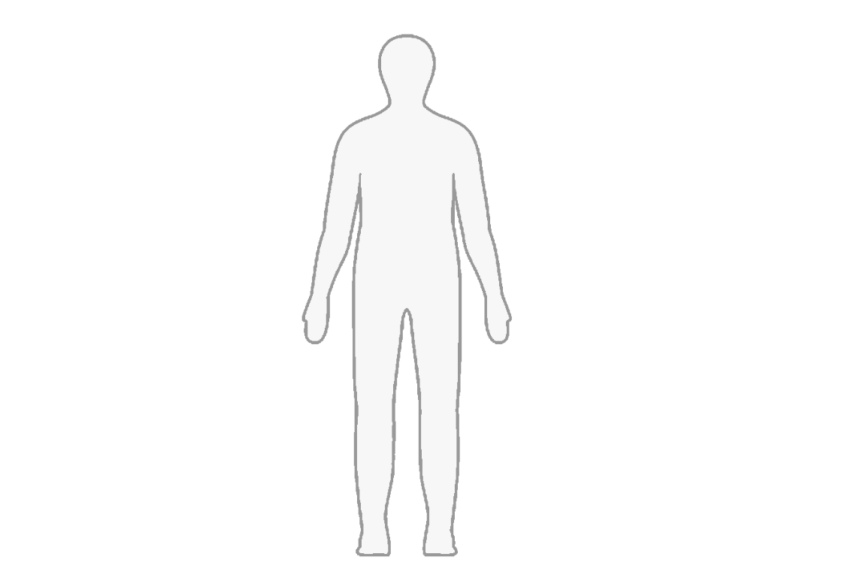

Back
To what extent did medicine and biology determine the third-class immigrant’s bodily experience of Ellis Island?
Click on the icons to find out.
KEY
Legislative Background
Start with me!
Immigrant Bodily Experiences
Warning: This project employs offensive language to reflect its historic use

Slide 3
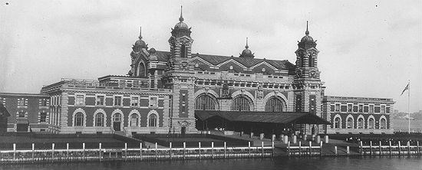
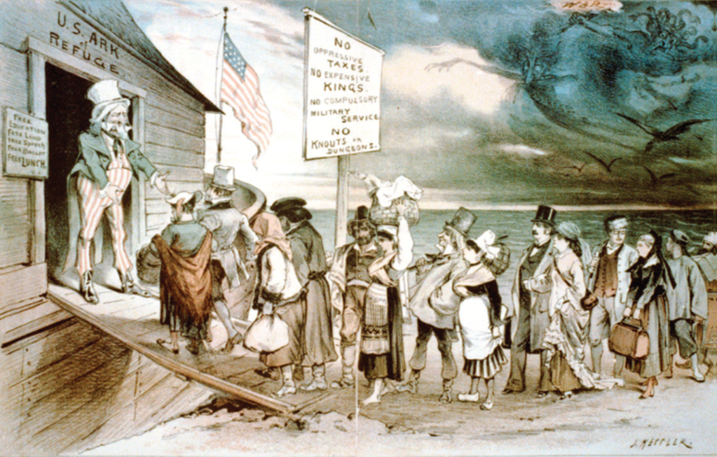
ABOUT
Home
The Ellis Island Body is an interactive project allowing you to investigate the experience of third-class immigrants who entered the US from the late 19th-early 20th centuries via Ellis Island.
1.
Ellis Island was a federally-controlled immigrant processing station that operated from 1897-1954 to help regulate increased immigration to the US. From 1890-1924 approximately 15 million immigrants passed through Ellis Island.
2.
Are all immigrants welcomed?

Slide 4
KEY LEGISLATION
Back
Increased immigration to the US was accompanied by the increased variety and number of medical diseases and conditions identified in the immigrant body. This led to federal legislation which sought to regulate the movement of immigrant bodies understood as threatening:
1882: First act bringing immigration under federal control using the new United States Public Health Service (PHS). Meanwhile, informal eugenic nativist theory located danger in “defective” immigrants.
Eugenics: Structured reproduction within a human population to increase certain “desirable” inheritable characteristics.
1891: New categories used in immigrant inspection to formally exclude anyone deemed ‘”suffering from a loathsome or dangerous contagious disease”, grouped as category A, including leprosy and “mental defectives”.
1903: New class B category for medical conditions that made an immigrant “likely to become a public charge”. Both categories A and B expanded to include new diseases over time, including chronic alcoholism (1917) and all heart diseases (1919).
1924: Act restricting immigration of different ethnic groups in proportion to their pre-existing US community. No more than 2% of each “race” could immigrate.
This shows that categories impacting the immigrant were not just objectively scientific, but socialised and racialised constructions.

Slide 5
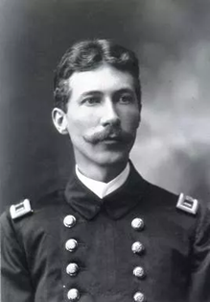
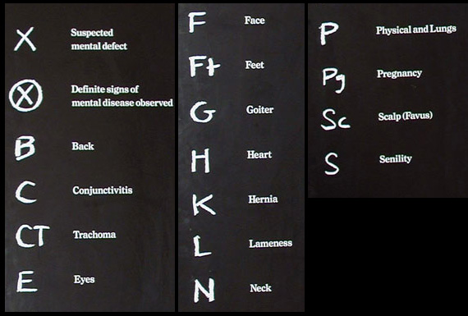


INFORMING EXCLUSION
Back
Medical categories were fluid and externally influenced by socio-cultural, racial and economic prejudices. This made seemingly objective scientific categories laden with subjective public anxiety about immigrant “disease”, “contagion”, and “germs”.
Medical categories gave the reassuring impression of protection of the American public’s biological and moral health. In reality, they sought to imitate a certain immigrant type- the white, northern European original settler population.
In other words, they pursued “Anglo-conformity”, using medicine to categorise immigrants based on how close they conformed to this original immigrant identity. This meant “old” northern-European immigrants like those from Ireland or Germany were more valued than “new” immigrants who arrived from southern and eastern European countries including Poland and Italy from 1880-1924.
Physicians (also called surgeons) working on Ellis island were important UPS agents who utilised these medical categories and more implicit racialised immigrant preference to inspect immigrant bodies.
All third-class immigrants had to be processed by Ellis Island physicians in a 6-second “snapshot diagnosis”, using an amalgamation of medical and socio-cultural preconceptions to judge immigrant bodies already understood as natural harbingers of disease.
If an immigrant presented fault using medical categories, they were marked with chalk for further inspection using various signs, including:
3.

Slide 6
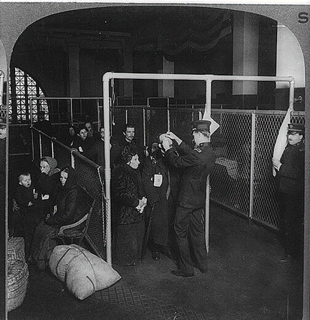
TRACHOMA
Back
Trachoma was the poster boy of immigrant disease. Caused by the Chlamydia trachomatis bacteria, it was easily transmitted in the confined and unhygienic steamship steerages third-class immigrants travelled in. Symptoms included inflamed weeping eyes and pustules on the inner eyelid which caused blindness if left untreated.
Trachoma was evidently perceived as a threat. It was the first disease classified under Category A and the most common medical reason for immigrant rejection, as 80% of all category A rejections from 1897-1902.
It also informed immigrant inspections. Physicians used button-hooks to flip immigrant eyelids and check for inflammation. Ironically, failure to disinfect between inspections only encouraged trachoma’s spread.
Trachoma was notorious amongst immigrants as a cause of moral and physical pain. The stigma attached to being marked with a “T” for trachoma, risked rejection, but also painful treatments like having your inner eyelids rubbed with a steel toothbrush dipped in corrosive chemicals.
Importantly, it was understood to be naturally prevalent in less socially-favourable “new” immigrant groups like East-European Jews and Greeks. This emphasises that trachoma was not a purely biological disease but one also informed by social prejudices.
Supervising Surgeon General of the US Marine Hospital:
4.
Ellis Island Commissioner William Williams, April 29th 1910:

Slide 7
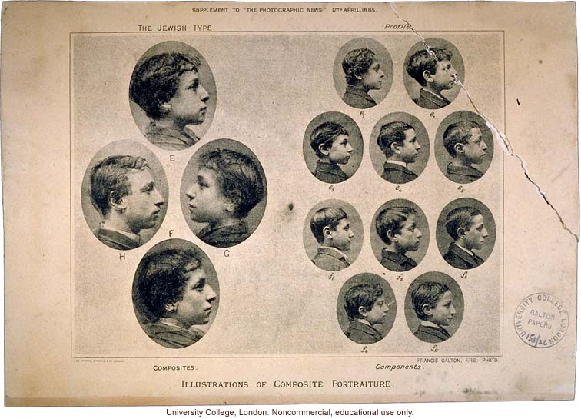
FACIAL CHARACTERISTICS
Back
The face provided key biological signs that embodied socio-cultural prejudices held by physicians and the American public, used to confirm “otherness”, including:
The “Jewish Nose”: a large, protruding, or sloped nose seemingly distinct to Jews (especially from east Europe). A racialised facial symbol that continues to have potent anti-Semitic meaning.
The “Oriental Eye”: a narrow, slanted-eye identified with Asian ethnicities. Whilst perhaps less prevalent on Ellis Island, it continues to permeate 21st-century culture and racism.
Both examples indicate the biological manifestation of an otherwise socio-cultural belief of immigrant difference. Cosmetic surgeries like rhinoplasty or oriental eye “revision” could later be used to change facial signs and “become” more American. However, these were often beyond the financial means of third-class immigrants, and failed to be of assistance for the immediate inspections they faced.
12.
The Jewish Facial “Type”

Slide 8
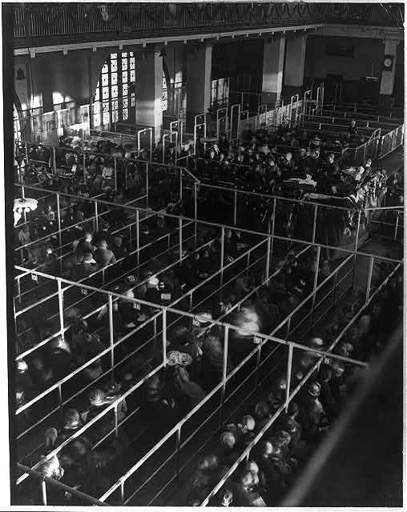
PHYSICALITY
Back
The inspection’s attention to the immigrant’s physicality ensured medical categories extended socio-cultural meaning to account for economic imperatives. During the period of Ellis Island’s operation, the US underwent significant industrialisation and urbanisation amidst 13 minor and 6 major economic downturns from 1870-1921. This created large demands for cheap, menial and short-term industrial hand labour. “New” immigrants were ideal candidates precisely because they were racially devalued, deemed more complaint and less willing to challenge low pay and working conditions.
The search for more manual labourers meant immigrant’s posture and physicality underwent close inspection. The immigrant body had to be physiologically valuable enough to permit entry.
Simultaneously, Category B sought to prevent further economic detriment to the US by rejecting immigrants deemed likely to become “public charges”, understood to only hinder national development. This economically-sourced attention on posture also suggests an ageist immigration inspection that favoured fully mobile working-age immigrants because of their industrial value, to the detriment of mature immigrants past working age.
The fact that less than 3% of immigrants were actually rejected for entry under Category A, indicates that short-term economic imperatives were prioritised over long-term concerns about the medical and moral inferiority of immigrants.
The Ellis Island inspection process arguably reflected systems of industrial organisation: a well-oiled mechanical mechanism processing thousands of future industrial parts.
5.

Slide 9
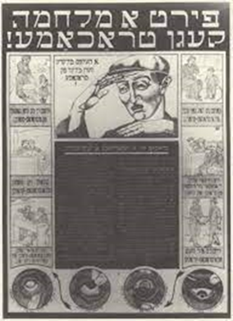
IMMIGRANT HANDS
Back
Immigrant hands stood for extensive socio-cultural anxieties and debates. The US public was occupied by fears of “germs” and hygiene closely associated with immigrants, deemed natural harbingers of disease. The medical categories used at Ellis Island helped perpetuate the assumption that immigrants were contagious and unhygienic.
These beliefs were racialised and most applicable to “new” immigrants, allowing “objective” medicine to justify subjective prejudice. This belief was only furthered by the fact that third-class immigrants admitted into the US often settled in lower-income urban neighbourhoods with conditions that epitomised contagion including cramped dwellings and poor air quality. This meant racialised exclusion also acted out class-based prejudices that disadvantaged the urban poor.
Dr Manly H Simons, Medical Director of US Navy, 1908:
Established immigrant communities as well as American philanthropists sought to counter these perceptions by educating immigrants to practice better hygiene. For example, in 1911, John Foster Carr created pamphlets aimed at the immigrant, advocating:
6.
Yiddish Hygiene Pamphlet

Slide 10
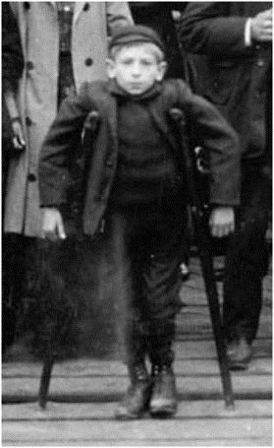
PHYSIOLOGICAL IMPERFECTION
Back
Medical categories determined immigrant value on grounds of physical disabilities like blindness, epilepsy or limb-loss.
The inspection was used to locate these conditions, which were deemed harmful to the national economy and society; they could create public charges whilst also risking the purity and health of the future US population.
The observation of physical imperfection lacking a clear disability category could be expressed by focusing on the immigrant’s posture. The unstable and fluid category of “poor physique” was used to categorise immigrants deemed physiologically different and not economically valuable enough for labour under one undefined umbrella term. The deployment of this category was racialised to certain immigrant groups including East European Jews understood to have naturally poor posture and rounded shoulders. As sociologist E. A. Ross attested in 1914, it stood for their wider inferiority:
This meant that immigrants with physical disabilities occupied a particularly low-status that intersected with prejudices of race, class and gender. Physicians’ use of medical categories placed greater value in physically-abled immigrant bodies and thus served to curate an American population united in its ablebodiedness.
Inspection signs denoting physiological imperfection:
7.

Slide 11
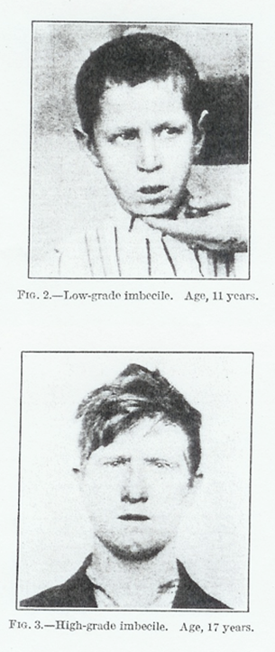
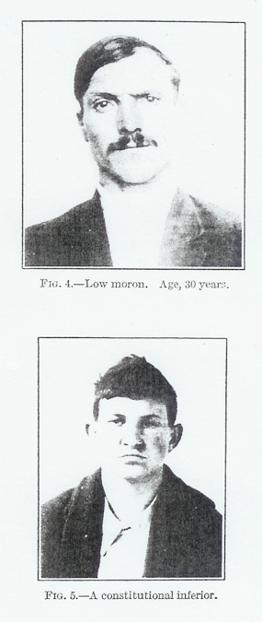

MENTAL DISEASE AND DIFFERENCE
Back
Mental disease and difference furthered disability-based exclusion. Eugenic anxiety about American “national stock” sought pervasive exclusion of immigrants understood to characterise the vague medical category “feeblemindedness”. This included the subcategories “imbeciles” from 1907 and “constitutional psychopathic inferiority” from 1917.
However, unlike physical disability, inspection had to detect conditions that arose from the hidden brain. Although physical external signs were not guaranteed, mental disease was nevertheless rooted in external physiology that allowed detection, including pre-conceptualised “feeble-minded” facial expressions.
Unsurprisingly, mental disability was racialised to emphasise certain immigrant ethnicities’ mental inferiority, including East-European Jewry:
and
Slavic immigrants, including Polish, Czech, and Russian:
Signs used by physicians to show the detection of mental difference:
8.

Slide 12
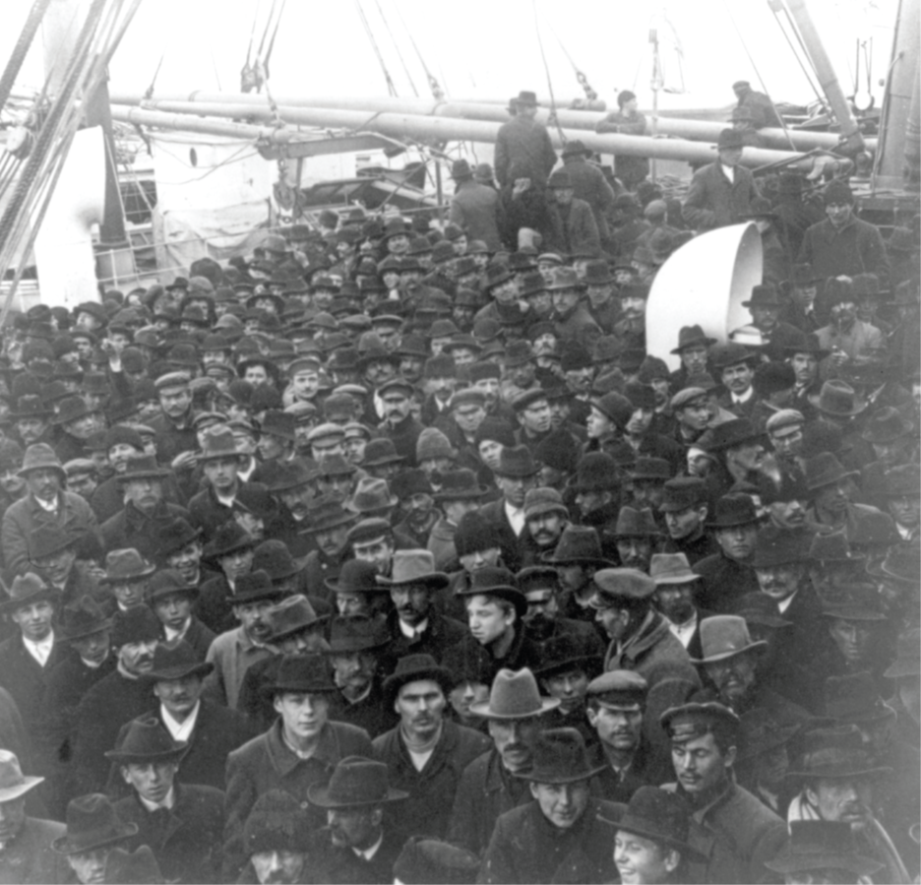
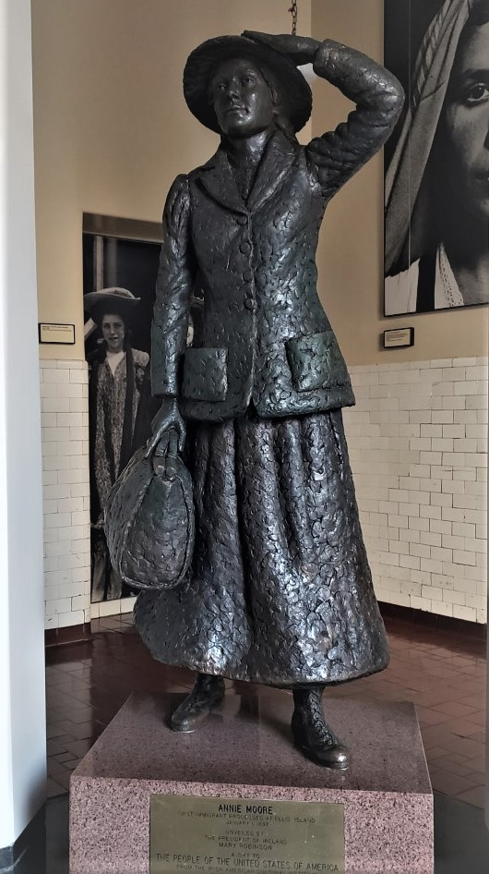
GENDER
Back
The process of inspection was gendered. Aside from the fact that biological sex informed contagions like syphilis (Class A), as well as public constructions of the “sexually loose” and morally threatening immigrant, cultural constructions of gender meant certain immigrants were preferred over others.
Omnipotent economic imperatives for labour skewed value towards male bodies deemed more physiologically powerful and useful. Therefore, despite concerns of sexual morality, single working-aged men could often enter the US provided they were able-bodied.
In contrast, the female body was less physiologically valued, allowing moral anxieties to outweigh economic considerations in the construction of female bodies and efforts to regulate them. Single women were perceived to be the most socially and economically threatening. Understood as less likely to work and earn wages, they could become dependent on the state whilst simultaneously threatening native sexual morality. Even within a heterosexual family unit, pregnant women were less valuable, marked out by the Class C category of non-long-term dependency that emphasised their gendered reliance on others.
Male immigrant bodies
10.
Despite the gendered preference for male immigrants, the first immigrant through Ellis Island was a young single woman. 17 year-old Irish immigrant Annie Moore was processed on January 2nd 1892 after travelling with her two younger brothers. Her arrival is embedded in popular memory, but would she have been celebrated if she had arrived pregnant and alone? What if she was non-European?
Annie Moore
9.

Slide 13
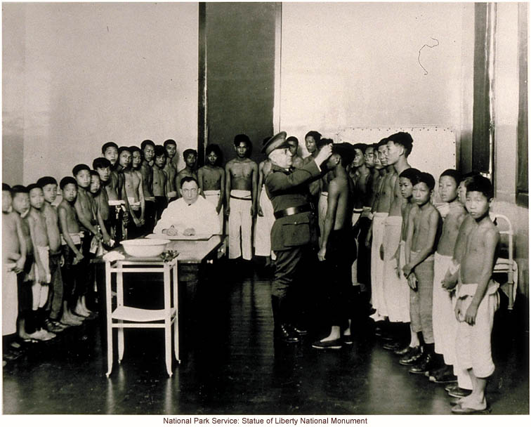
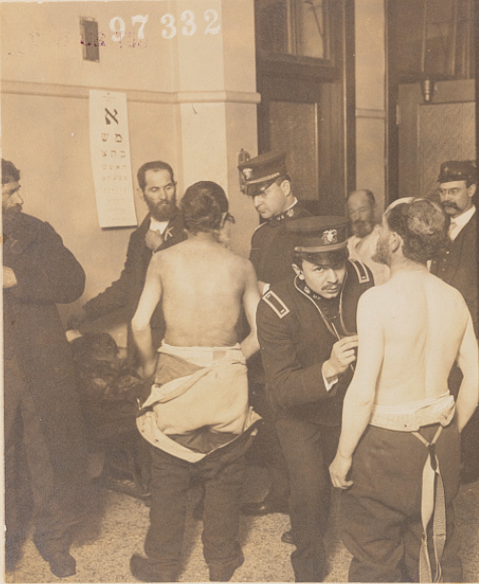
IMMIGRANT SKIN
Back
Immigrant skin was highly evocative, displaying signs of dirt and disease which physicians used to fuel stereotypes of unhygienic tendencies. It also presented visible evidence of otherwise invisible racialised ethnic difference.
The “old” north-European immigrants constructed as most suited and valuable in the US were predominantly pale-skinned, making this skin tone the norm. Any immigrant deviating from this was immediately inferior and assumed to have a higher disposition to all exclusive medical categories.
Combined with the 1924 immigration act, immigrant inspections were highly racialised. The intensity of scrutiny placed on immigrant bodies hinged on how similar or different they appeared to the physician. Pale-skinned immigrants without signs of contagion or disability would quickly pass the 6-second snapshot diagnosis. In contrast, darker-skinned immigrants received more focused physician observations and could also be subjected to more extensive and intrusive inspections from the onset.
East-European Jewish immigrants could be required to undress (left). Meanwhile, whilst fewer Asian immigrants were processed at Ellis Island than the west-coast Angel Island processing centre, Asian immigrants in both locations were made to have strip-searches and disinfection procedures that extended beyond the standard inspection (right).
11.
13.

