Slide 1
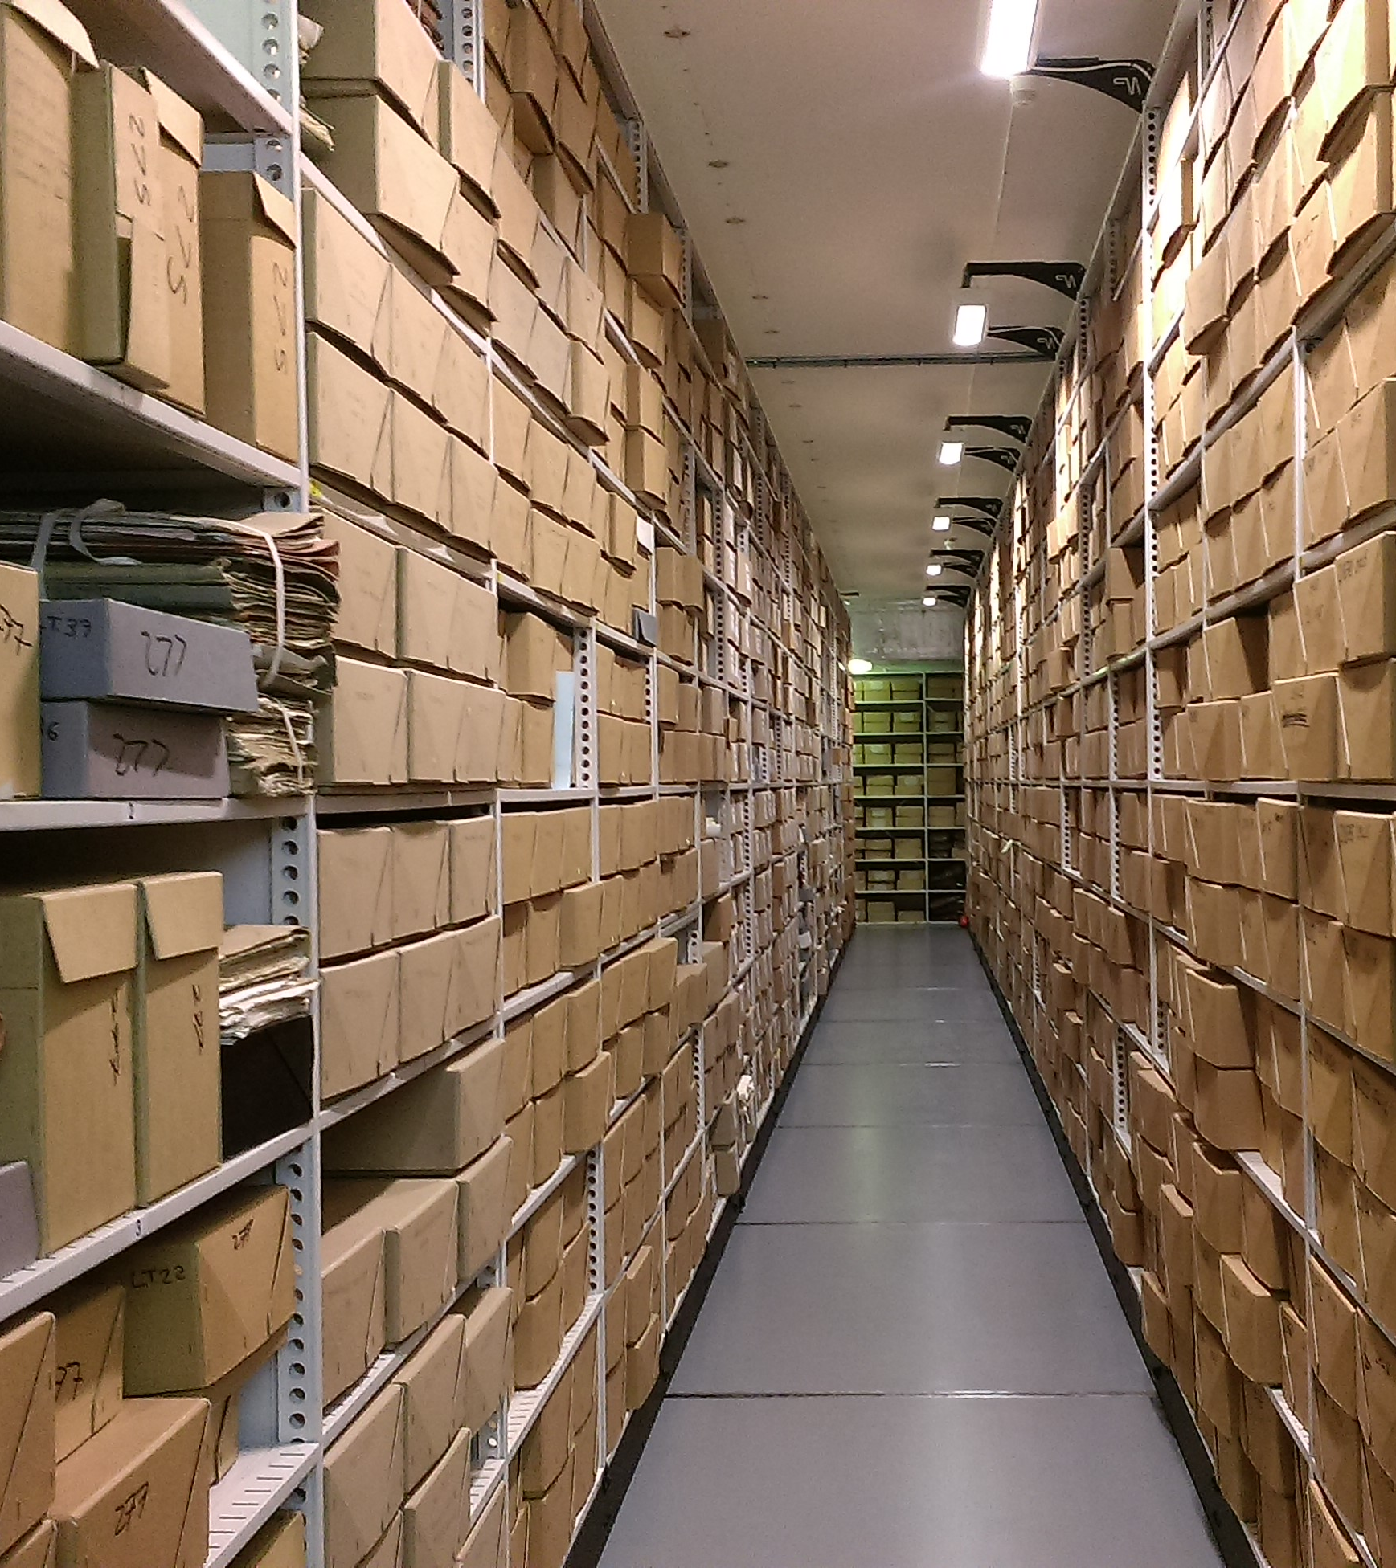
Archive research & the Modern Records Centre
Pierre Botcherby Outreach & Widening Participation Officer, Modern Records Centre

Slide 2
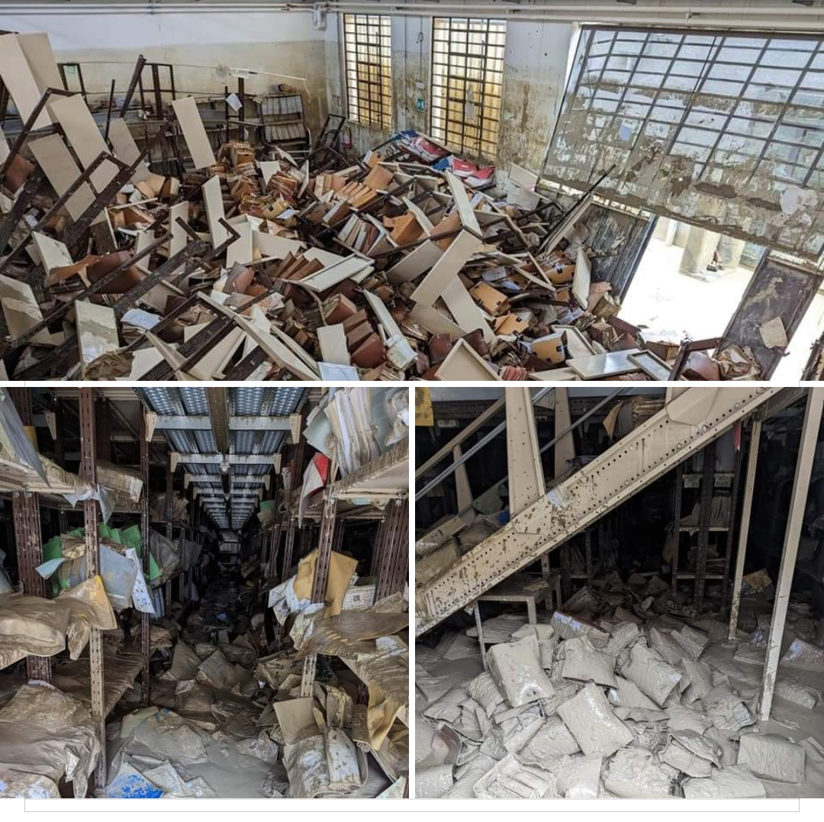
What are archives?
Records created in the course of normal activity
Fragments of the past
Perceived historical, cultural, political, personal, evidentiary value
E. H. Carr, What is History (1961)
Michael Foucault, The Archaeology of Knowledge (1969); The Order of Things (1966)
Jacques Derrida, Archive Fever (1995)
Michelle Caswell, ‘“The Archive” is not an archives: acknowledging the intellectual contributions of archival studies’, Reconstruction, 16:1.

Slide 3
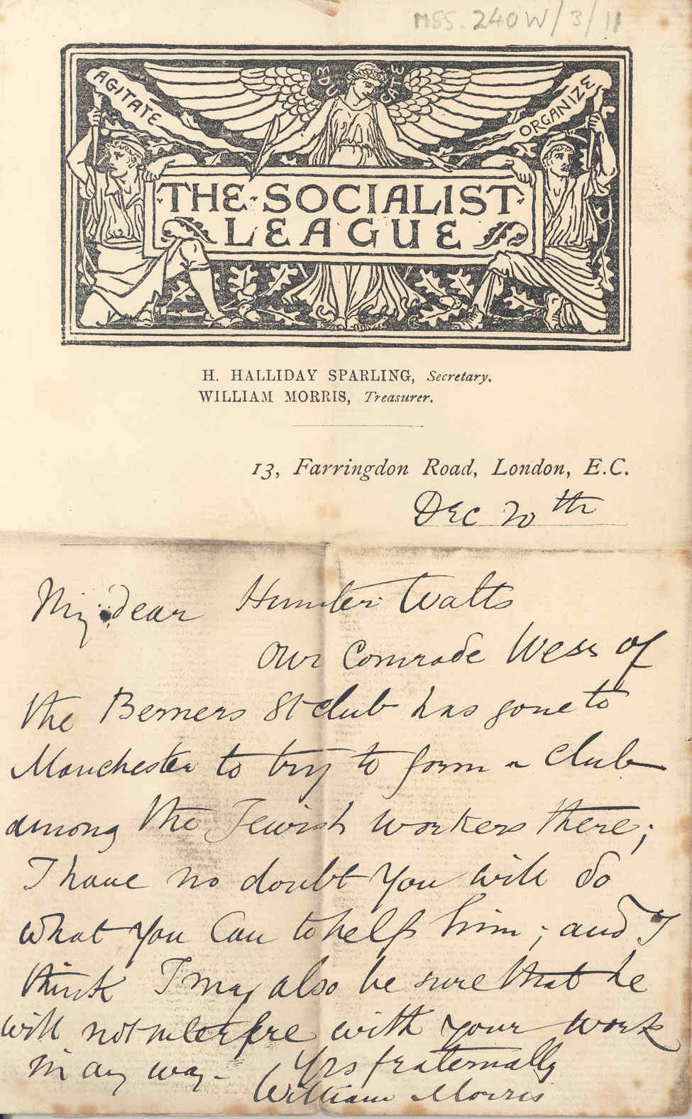
Context
The basics:
Who wrote it?
When and why was it written?
Who was the intended audience?
Context within the archive collection (linked with provenance)
Broader societal context

Slide 4
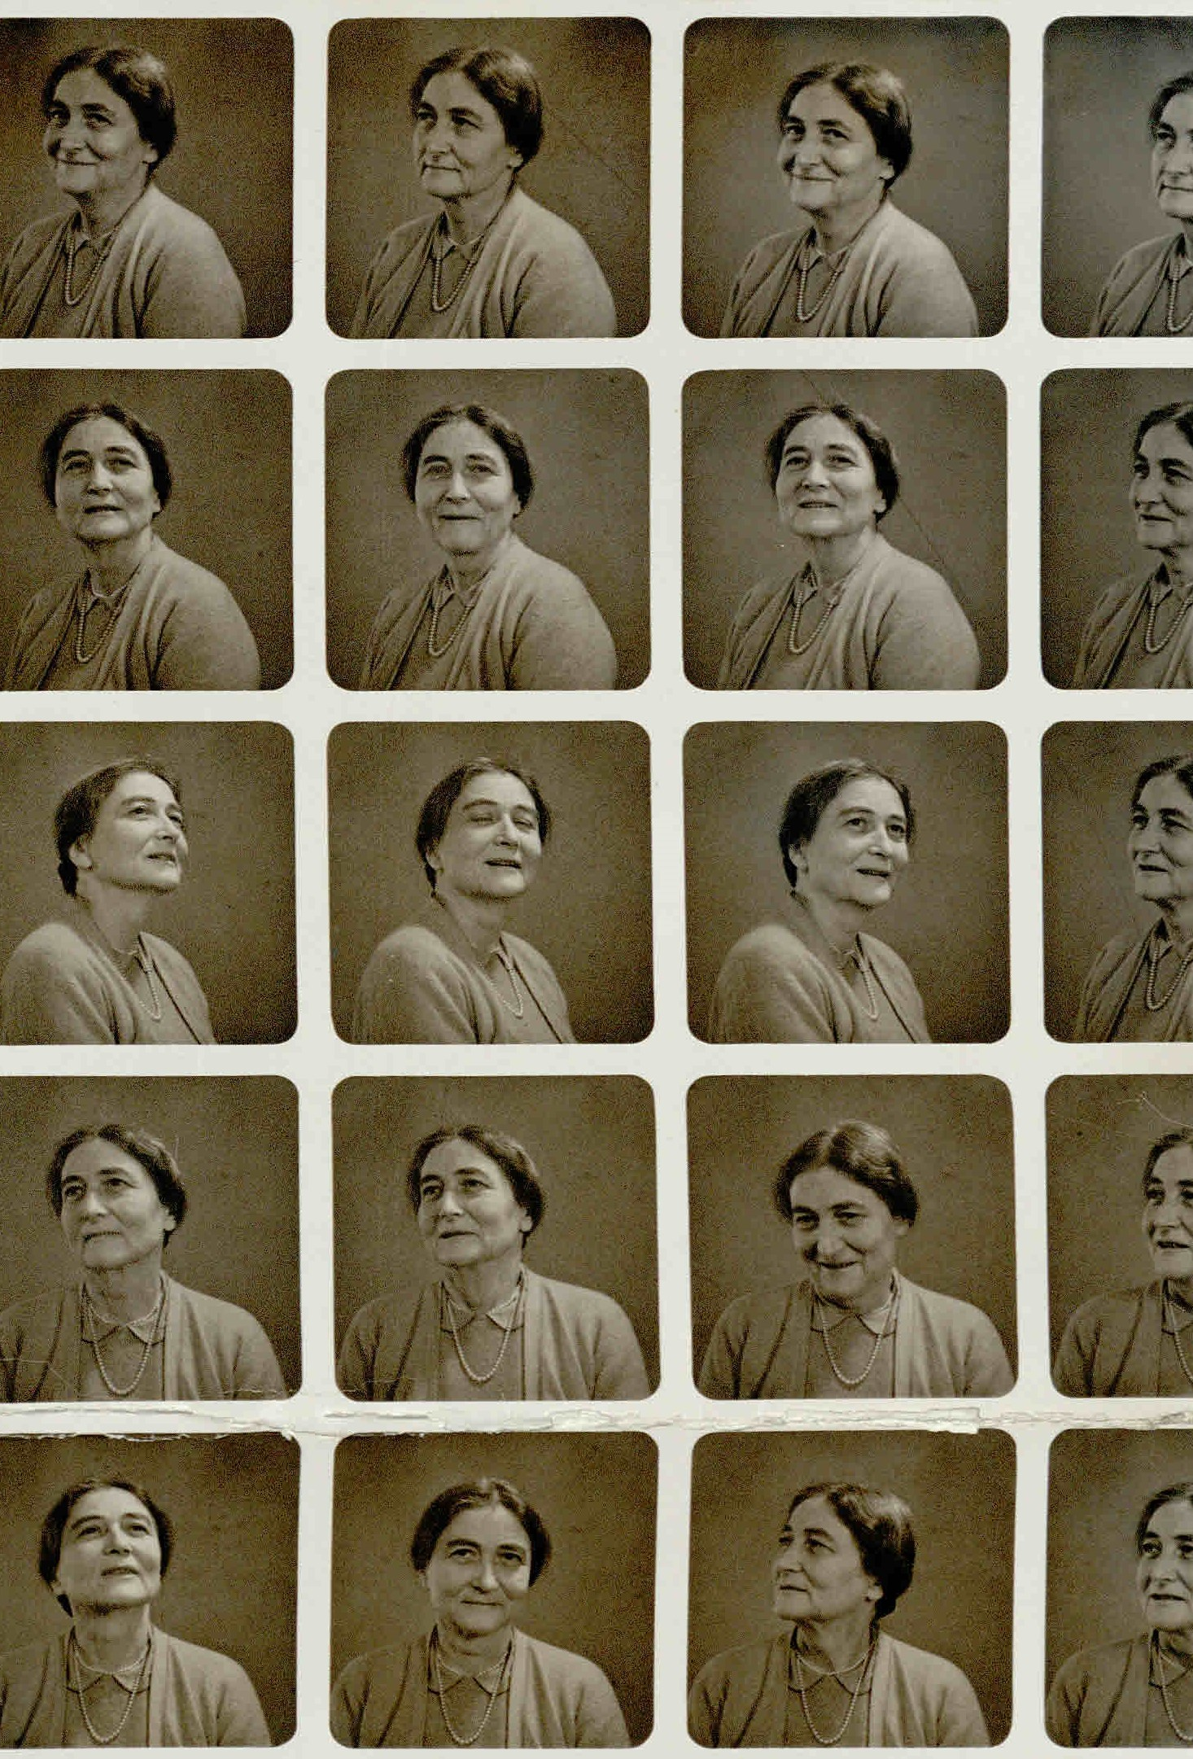
Provenance
Where does the document come from?
Who owned it?
How did the archive repository acquire it?

Slide 5
Collection
National Union of Teachers
MSS.639
Series
Communications and Publicity
MSS.639/11
SubSeries
Gender equality and women teachers
MSS.639/11/21
Item
'Men Teachers for Boys', by W G Cove MP, 1934
MSS.639/11/21/5
Archival arrangement

Slide 6
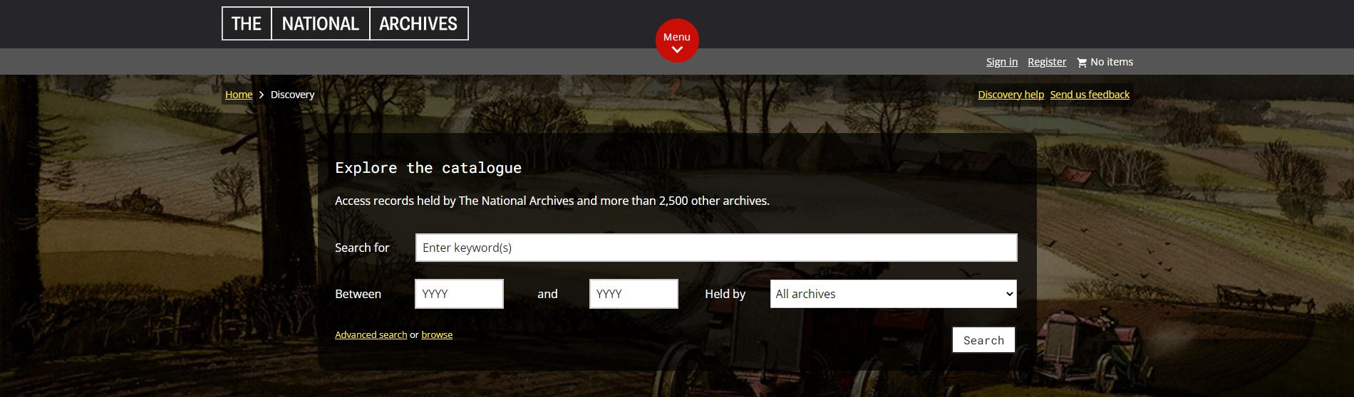
Searching archive catalogues
Every item won't be individually listed…
Terminology & language changes over time…
Think laterally… … and if all else fails, ask an archivist!
Search tips:
Trade Union: 40,000+ results “Trade Union”: 23,000 results
Trade OR Union: 143,000 results Trade AND Union: 40,000 results Trade NOT Union: 14,000 results
Trade Un*: 49,000 results (trade union, trade unions, trade unionist, trade unionists, etc.)

Slide 7
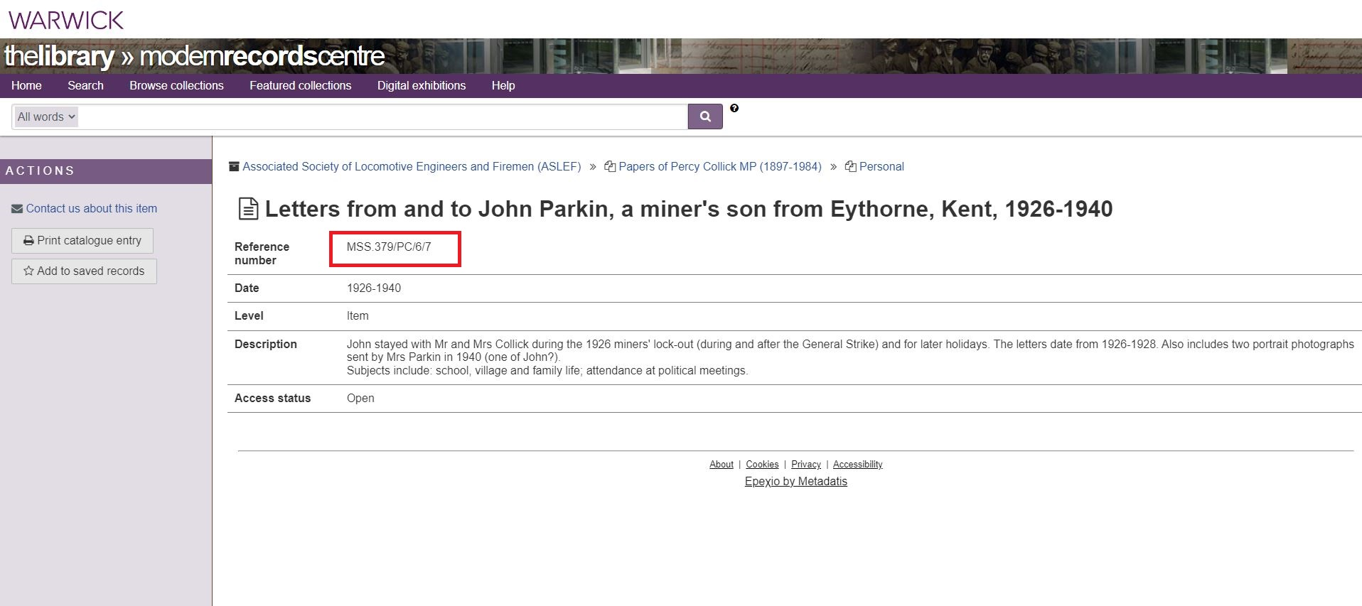

Slide 8
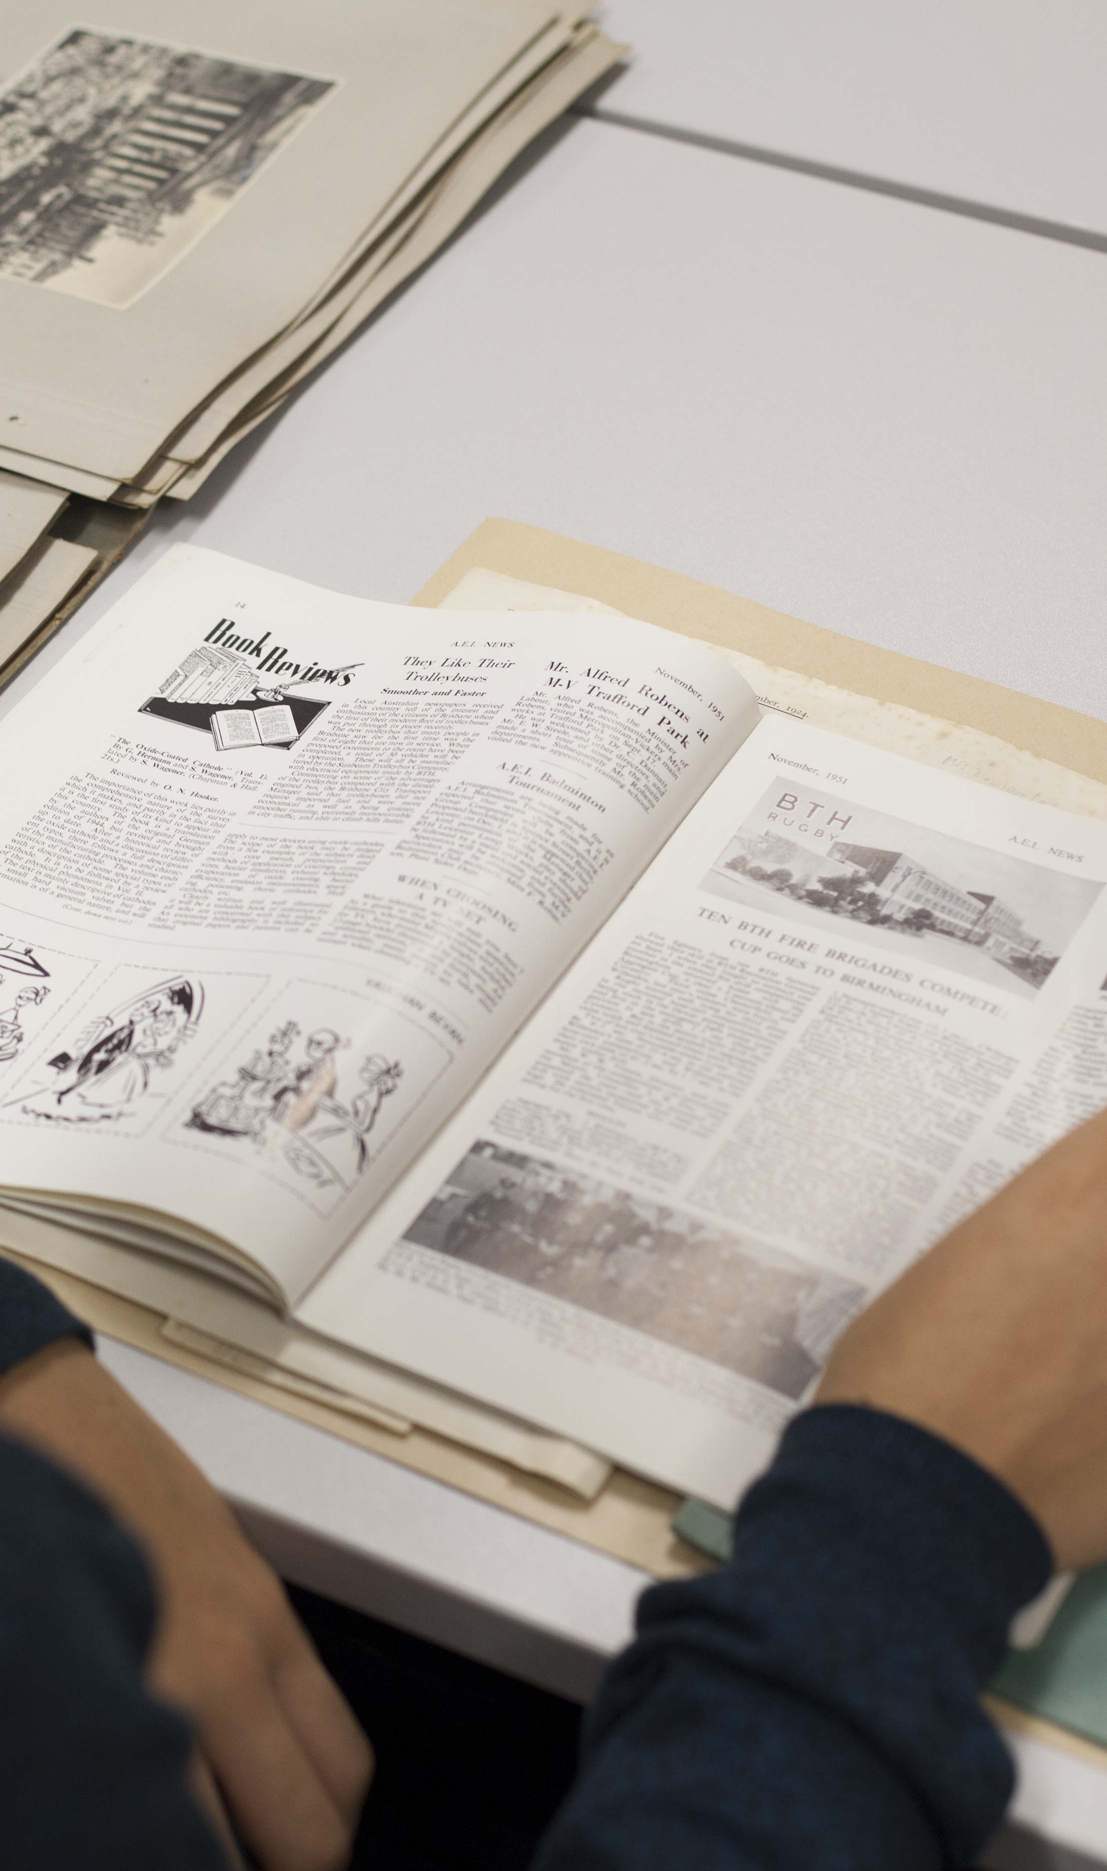
Planning your research trip
The basics: opening hours, location, reading room rules, whether an appointment is required
Use online catalogues to identify and preorder material
How to record the information: handwritten notes, photos, etc.
Learn how to use any equipment you need, e.g. cameras
Organise information as you go, e.g. noting document references systematically

Slide 9






Make sure that you record the basics accurately:
From the name of the repository …
… to the document reference

Slide 10
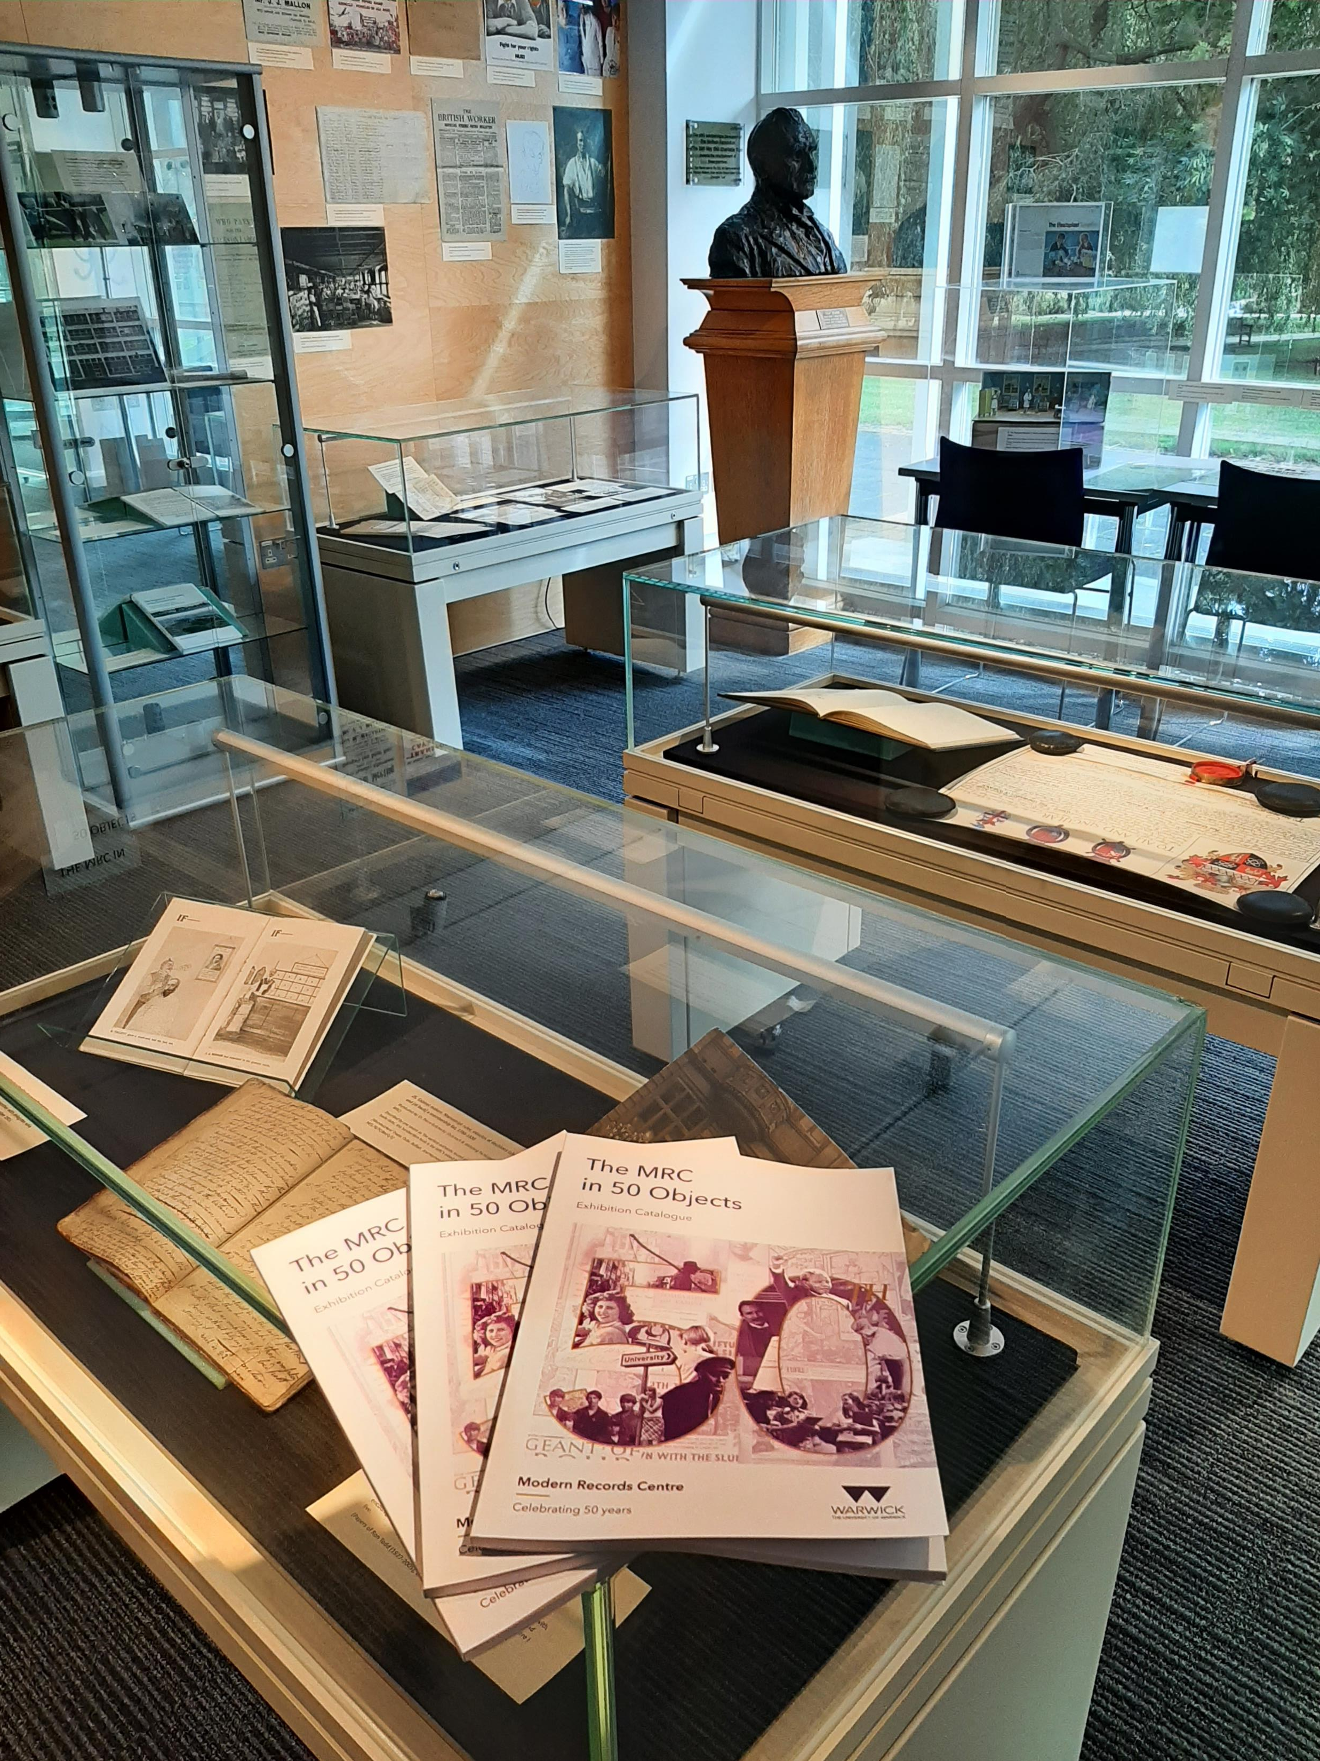
The MRC
Established 1973
Trade Unions
Trade Associations
Higher/Further education (University of Warwick archive)
Grassroots campaign/pressure groups
Far-left (and some far-right) politics
National Cycle Archive
Theatre & Arts collections (Minority Arts, Marandet, Hall)
Library Special Collections
Physical and digital resources
Exhibition space and seminar room

Slide 11
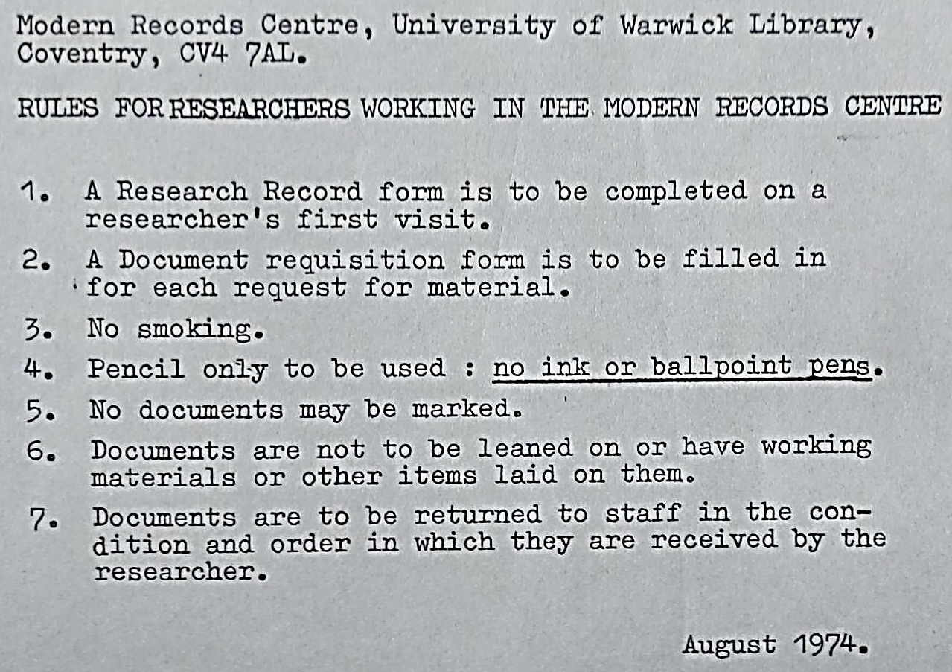
Using our resources
Visit us in person, Monday-Friday
Browse our archive catalogue
Our digitised collections
Archives digitised for UG/PGT modules:
Archive Vault
Guide to sources for History students ; Sociology students ; PAIS students ; by research area
Archives digitized for University of Warwick modules

Slide 12
