Slide 1
Migration, multiculturalism, and medicalization
Primary Source Analysis

Slide 2
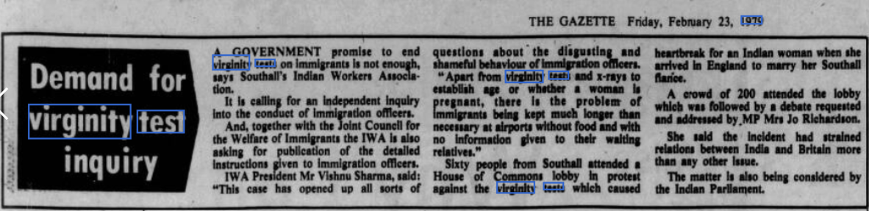

Slide 3
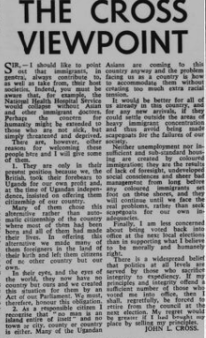
Newspaper Article 1972 – Eastbourne Herlad- The Cross Review – Ugandan Asian displacement
Shows the positive impact immigrants have on Britain – sustaining the NHS
Call for British humanity
Places blame for situation on British – made Ugandan Asians 'foreigners in the land of their birth'
Notes how racial tension is a potential problem
Notes how immigrants have been made scapegoats for socioeconomic problems
Talks about sense of britain upholding it's international reputation

Slide 4
