Slide 1
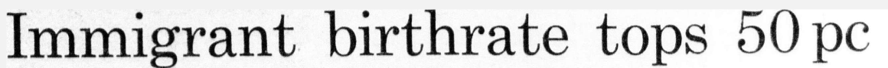
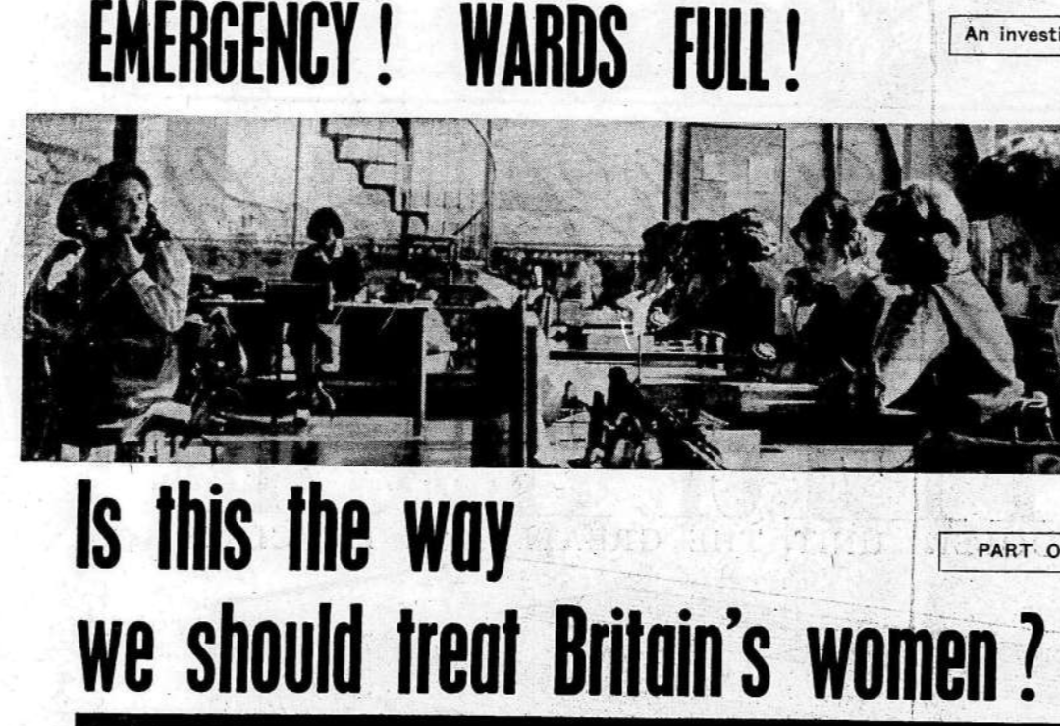

Fecund, stubborn and deceitful: situating migrant women in postwar, “tolerant” Britain

Slide 2
What is the topic of your dissertation?
Migrant (black and asian) women in Britain in the post war period → interested in how they are treated by the state and the ways that these women are constructed and viewed
National myths and framings of Britain in the postwar period

Slide 3
Historiographical significance of the dissertation
Focus on constructions of motherhood - neglected in literature
Centers women - shift from the masculinist view that often dominates migration histories
Focus on Britain - shift from US domination in the literature

Slide 4
Findings and argument
Thesis: examining the (mis)treatment and construction of black and Asian migrant women challenges British claims to tolerance
3 strands to support my argument:
Virginity testing
Pregnancy / Fertility
Migrant women as ‘mothering dangerously’

