Slide 1
Dissertation Presentation:
South Asian Visibility in The Midlands From the 1960’s
Gitanj Kaur Kambo

Slide 2
What We will Cover:
Dissertation Background And Topic
Historiographical Significance of research
Preliminary Findings and Research
South Asian Visibility in The Midlands From 1960

Slide 3
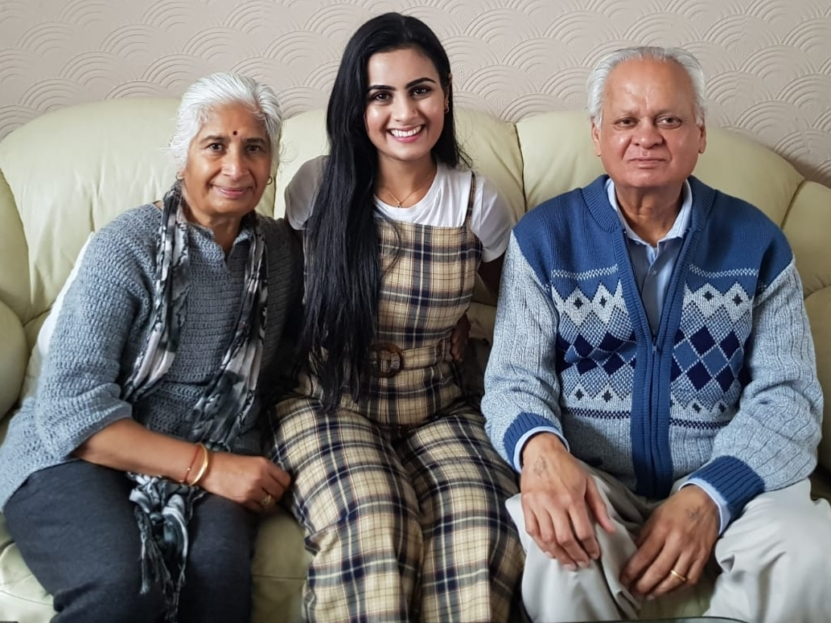
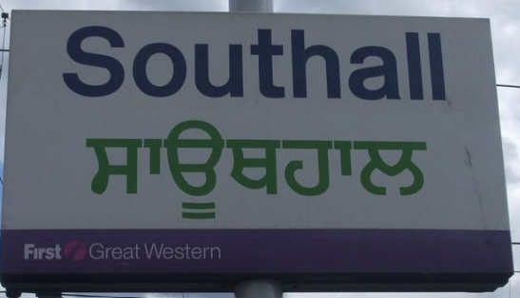
Dissertation Background
My motivation: my Grandparents
Wanting to see from the shift in visibility from an academic perspective
Visibility: Clothing, Food, Places of Worship
1967 1965
South Asain Visibility in The Midlands From 1960
Notes:
Grandparents inspired my research
Grew up in the Midlands surrounded by South Asian identity tropes
Define Visibility
Explain why Midlands: ethnic density

Slide 4
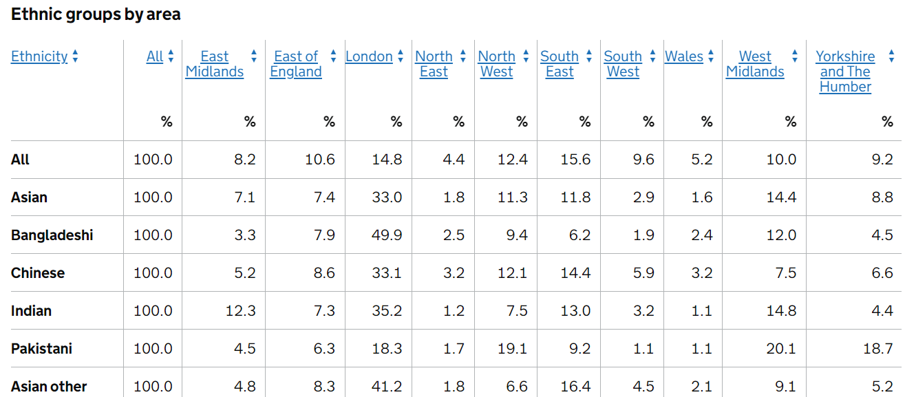

Dissertation Topic
The 2011 Census showed that almost half (46%, 3.4 million) of the foreign-born population identified with a White ethnic group, a third identified as Asian/Asian British (33%, 2.4 million) and 13% (992,000) identified with Black/African/Caribbean/Black British.
Difference in Asian / South Asian
What is visibility
Why Midlands
South Asian Visibility in The Midlands From 1960
Notes:
Define Visibility
Explain why Midlands: ethnic density

Slide 5
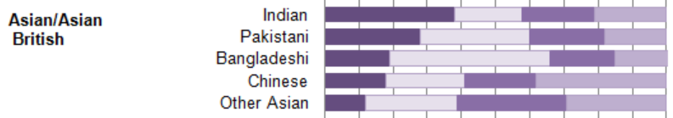

Historiographical Significance of research
Where does the piece sit within wider scholarship and conversations on this topic?
- within a growing diversification of literature by South Asian voices and 2nd/3rd generations
- I add a specific focus on physical and visible identities within the community.
What scholarship does it speak to, add to or challenge?
- speaking to ideas of identification, assimulation and Intergration
- Adding to multiculturalism in UK debate
Ethnicity of the non-UK born population by period of arrival, England and Wales, 2011
Notes:
Where does the piece sit within wider scholarship and conversations on this topic?
- It adds to a growing diversification of literature on the settlement and experience of South Asian Migrants in the UK by South Asian voices and 2nd/3rd generations
- I add to the conversation by acknowledging the advancements made by South Asian communities since the Commonwealth Mass Migration with a specific focus on physical and visible identities within the community.

Slide 6
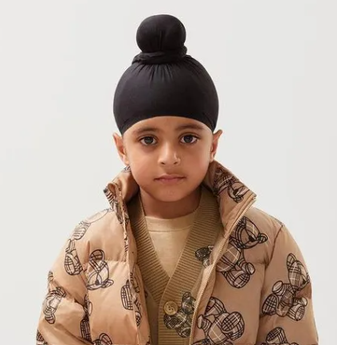
Preliminary Findings and research
 | THEN (PRE 2000’s) | NOW (POST 2000)
CLOTHING | Smethwick Bus Strikes 1967 Soho Road, cultural hub | Vouge, Nike, Burberry Parliamentary racist remarks
FOOD | White flight from homes Indian Takeaways as a home comfort for new migrants | South Asian fusion food restaurants Food streotypes, ‘Chicken Tikka a National Dish’
PLACES OF WORSHIP | People’s homes / old factories Freedom of religion | Bespoke built places of worship Islamiphobia and targeting Mosques
South Asian groups have created a visible hub and a home for themselves in the UK.
Sahib Singh, Burberry Model

Slide 7
Citations
Regional ethnic diversity
https://www.ethnicity-facts-figures.service.gov.uk/uk-population-by-ethnicity/national-and-regional-populations/regional-ethnic-diversity/latest
Ethnicity of the non-UK born population by period of arrival, England and Wales, 2011
https://www.ons.gov.uk/peoplepopulationandcommunity/culturalidentity/ethnicity/articles/2011censusanalysisethnicityandreligionofthenonukbornpopulationinenglandandwales/2015-06-18
Sahib Singh, Sikh Model
https://www.vogue.in/fashion/content/sahib-singh-becomes-burberry-childrens-first-sikh-model

