Slide 1
The Diasporic Self-Fashioned Identity of Hashomer Hatzair, 1927-1939

Slide 2
“The way the Aliyah is organised is inextricably linked with the way of life to which the immigrants aspire”
“אופן ארגון העליה קשור קשר בלתי נתק עם צורת החיים אשר אליו שואפים העולים”
Hashomer Hatzair, September 5th 1927, p. 2.

Slide 3
THE PERIODICALS
Hashomer Hatzair: from July 20th 1927- May 1st 1939.
135 issues and 2,363 vs my selective 23.
-July 20th, 1927
-September 5th, 1927
-December 1st, 1927
-August 1st, 1928
-December 15th, 1928
-January 1st, 1929
-September 30th, 1929
-January 15th, 1930
-December 15th, 1930
-January 1st, 1931
-December 1st, 1931
-January 15th, 1932
-May 1st, 1932
-June 1st 1933
-December 25th, 1933
-February 15th, 1934
-June 15th, 1934
-March 15th, 1935
-November 15th, 1936
-May 2nd, 1936
-December 31st, 1937
-December 1st, 1938
-May 1st (May-June issue), 1939

Slide 4
KEY CONCERNS
Socio-cultural self-fashioning (and not just politics)
Transnational balances: Aliyah, the Land of Israel (Yishuv), and the Diaspora.
Presence of key historiographical themes: pioneer identity r.e. land, the New Jew, ableism/immigrant selectivism?

Slide 5


SELF FASHIONED IDENTITY
The PUSH of Conflict and Division
The PULL of Cultural Unity

Slide 6
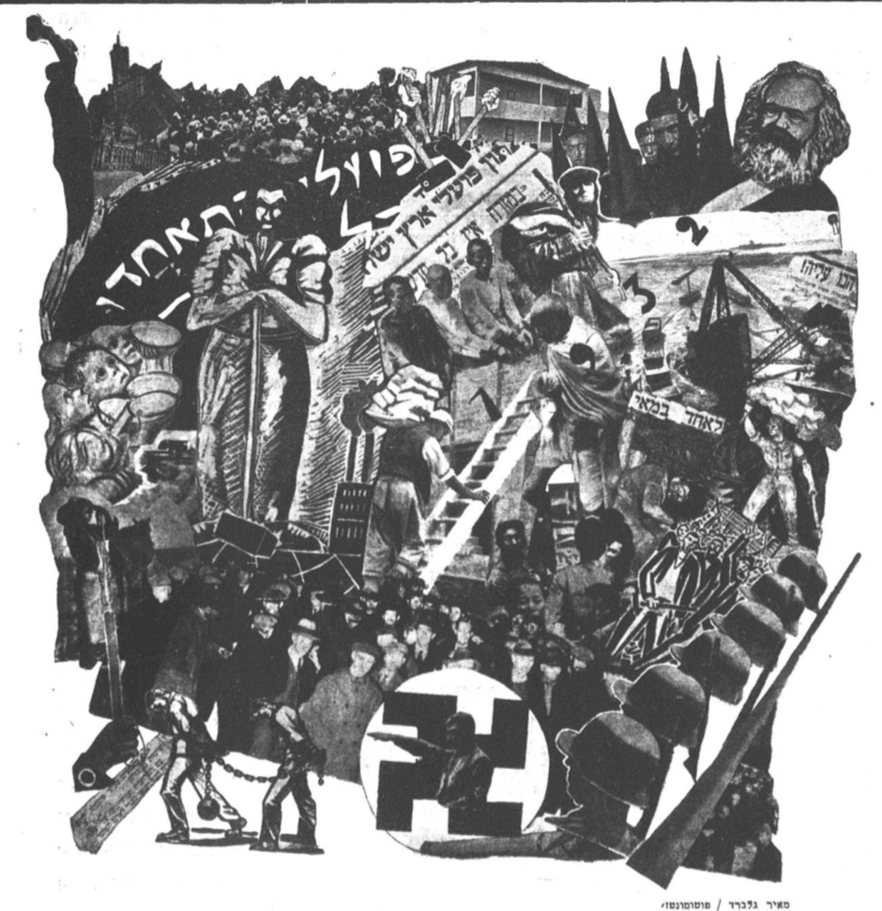
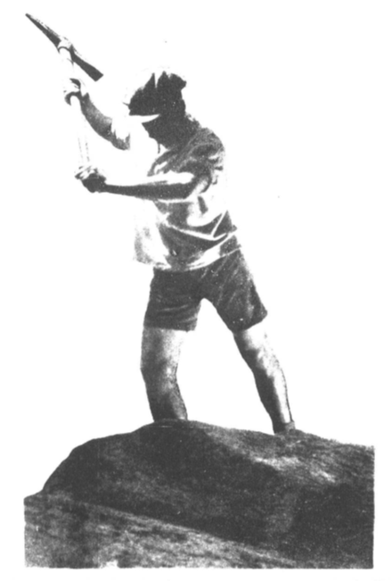
The PULL Of Unity
Hashomer Hatzair, Photomontage, May 1st 1932.
Hashomer Hatzair, December 25th 1933

Slide 7
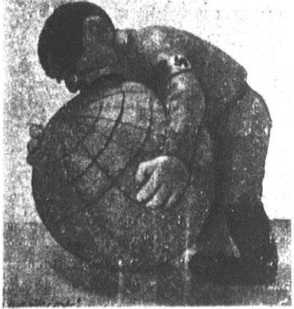
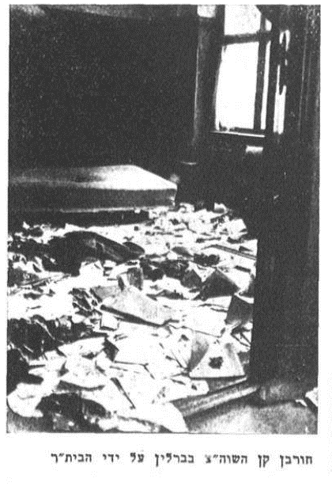
The PUSH OF Conflict
Hashomer Hatzair, May 1st 1939.
Hashomer Hatzair, June 1st 1933.

