Slide 1
Foreign Bodies: Migration, multiculturalism, and medicalization
Professor Roberta Bivins
Centre for the History of Medicine
University of Warwick
peopleshistorynhs.org

Slide 2
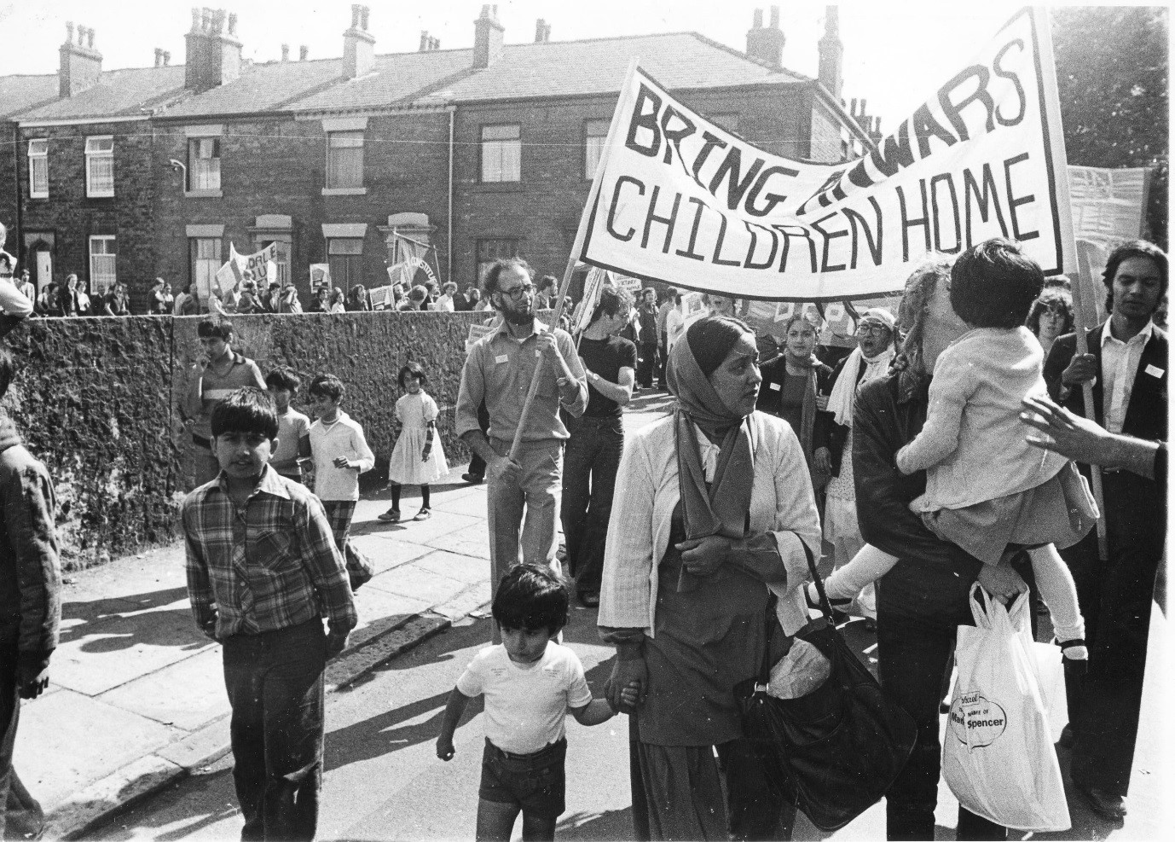
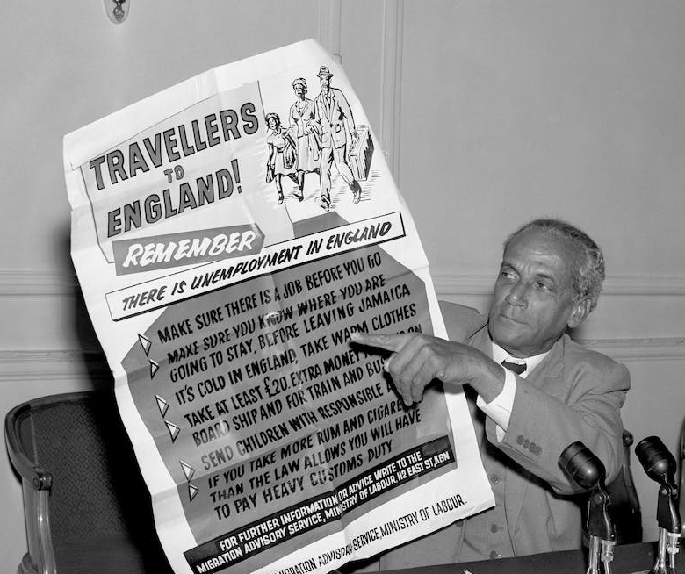
Control and Contestation
What is the relationship between migration ‘control’ and medicalization?
Families Divided

Slide 3
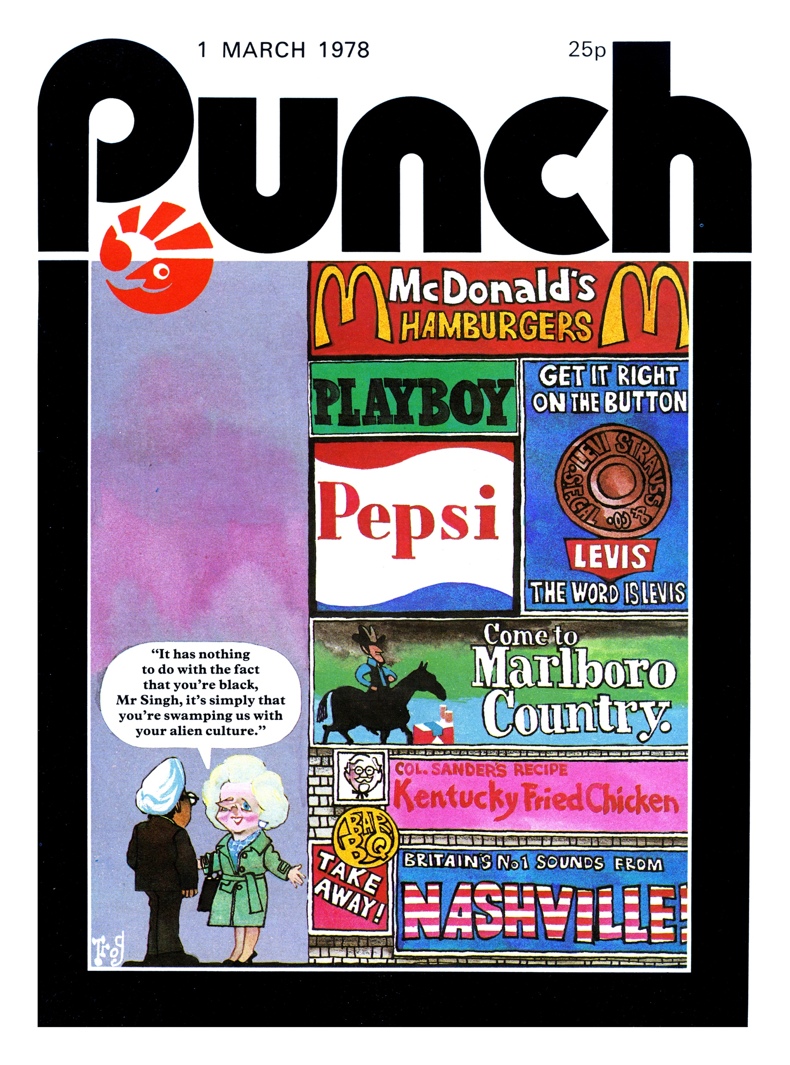
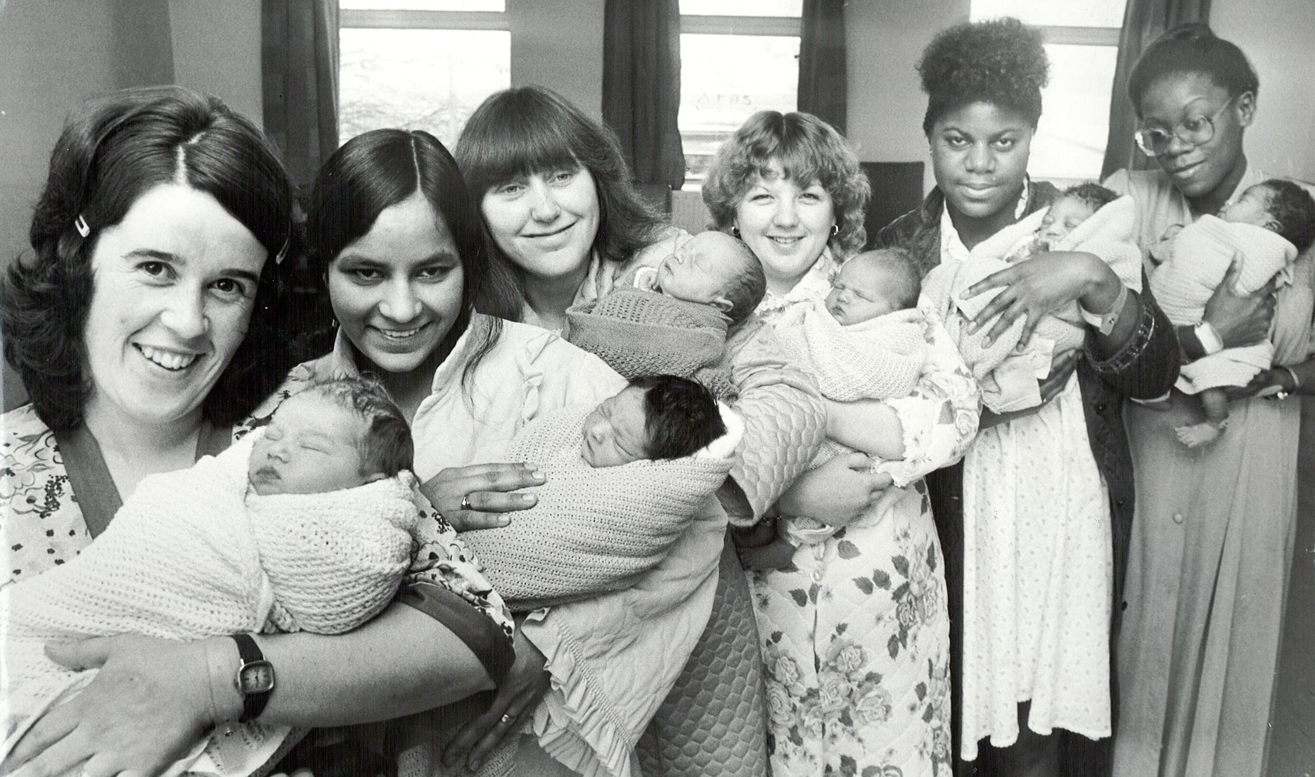
What did ‘multicultural Britain’ look like (and to whom)?

Slide 4
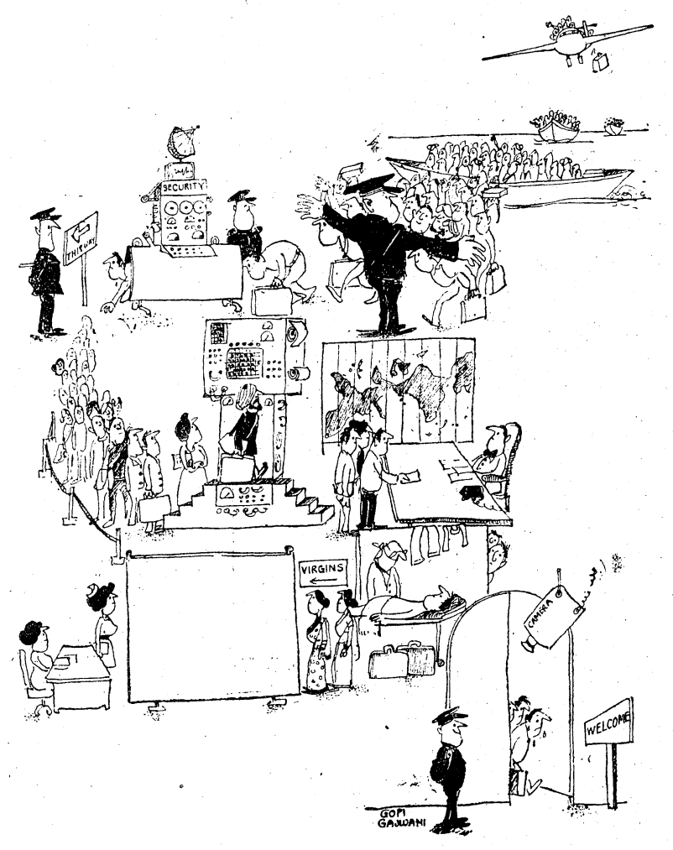
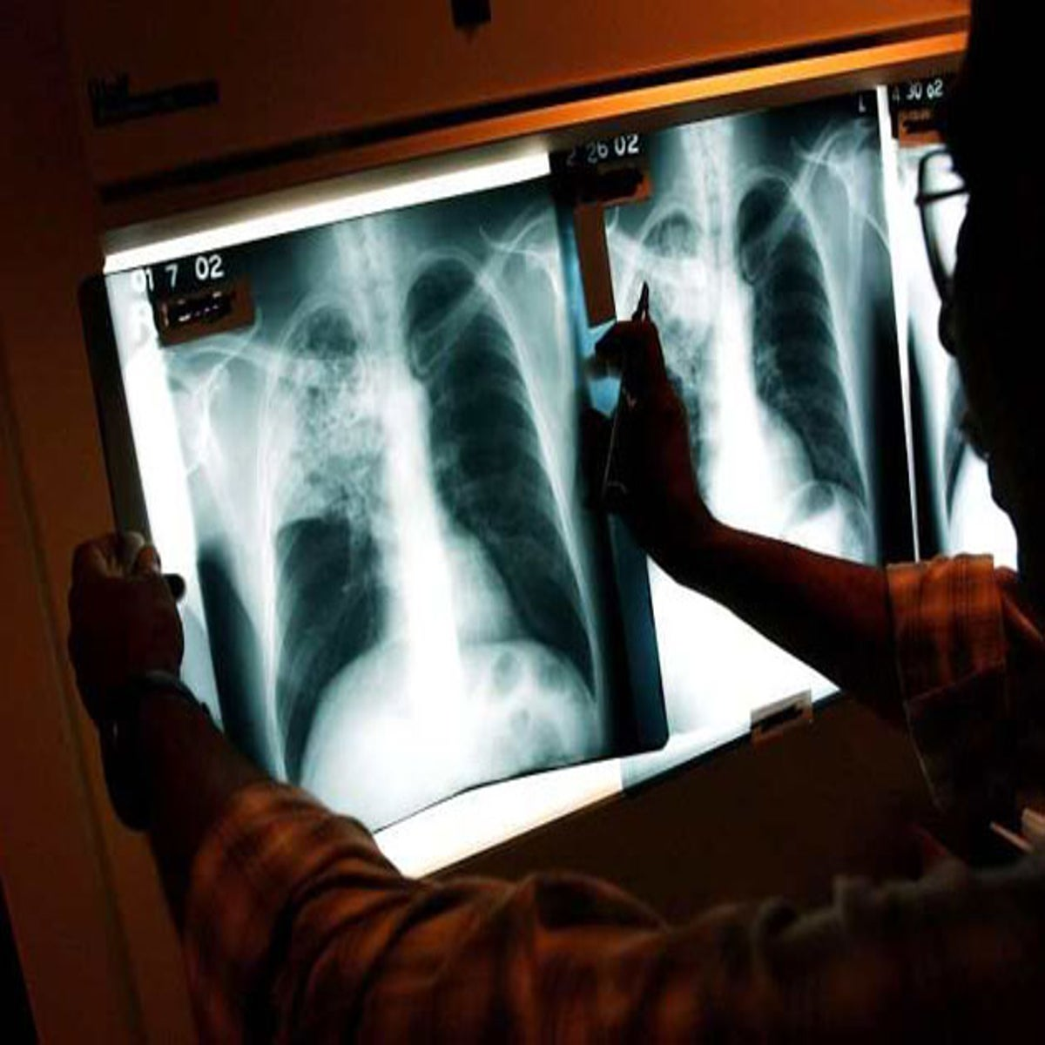
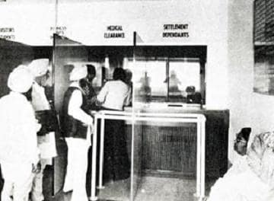
Medicalising ‘Control’
Abha Thapalyal, ‘Entry Laws – British Style’, Times of India, 29 April 1979.
‘Under the immigration Rules, officials are entitled to carry out medical examinations, the purpose of which is to control infectious disease… Immigration officials … have extended the use of medical examinations into a field for which it had not been intended. … “It is against English Criminal law that anyone should be forced to give evidence against herself through a medical examination to show that she is lying”.’
Alex Lyon, ex-Minister of State, Home Office, 1979
‘Falsification and fraud are so widespread that it must be assumed in every case, until the contrary is proved.’
Anthony Kershaw, Junior Minister, Foreign Office 1970-73.

Slide 5
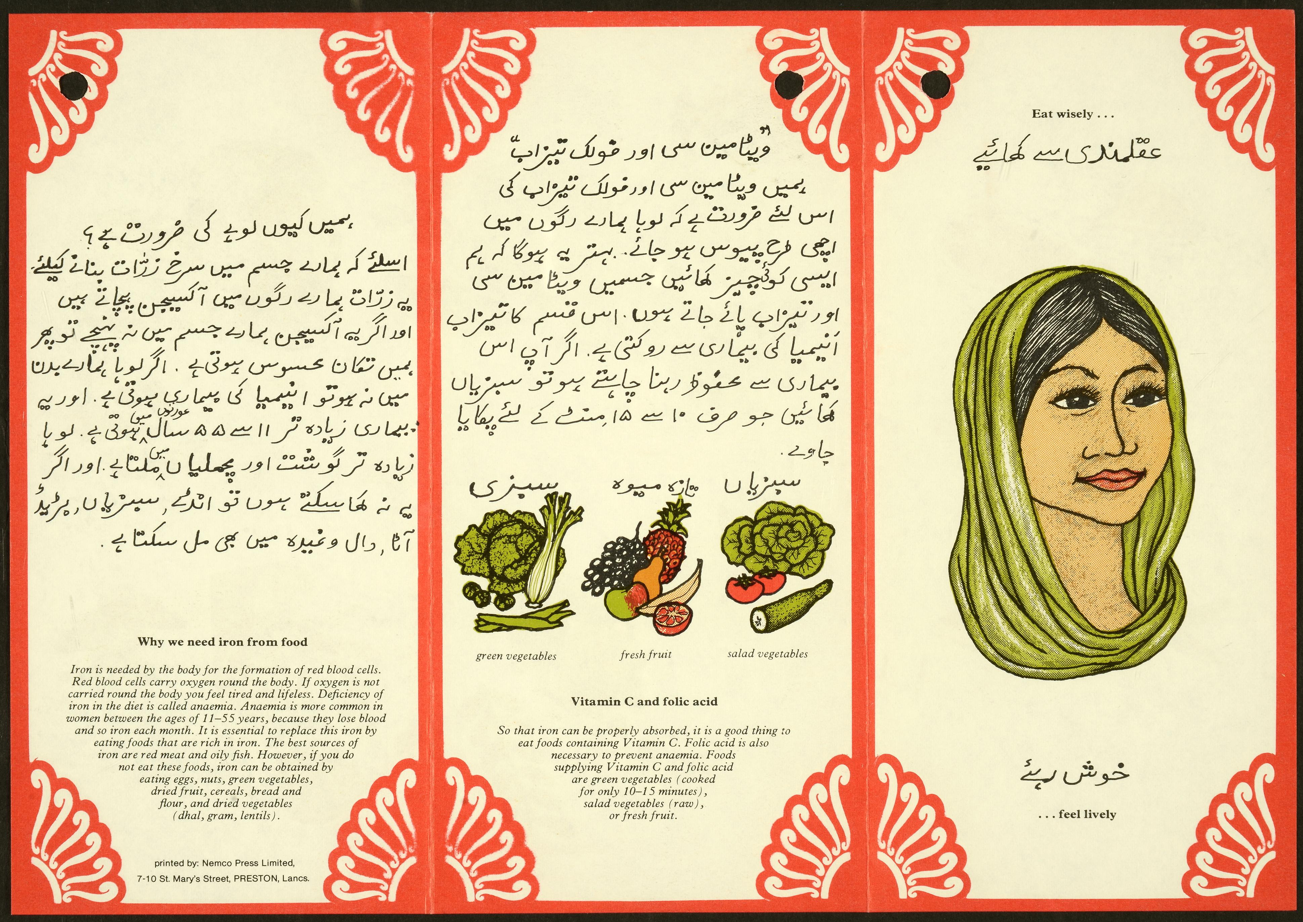
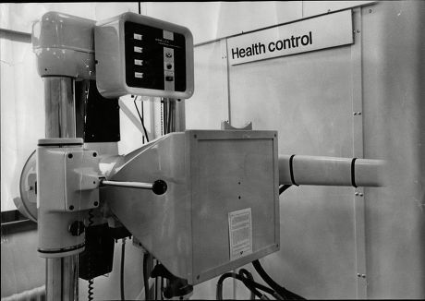
Why medicalisation, post 1973? Health control or population control?
The New X-ray Unit Which Has Been Installed At Heathrow Airport
Creator: Anthony Wallace/ANL/Shutterstock | Credit: Anthony Wallace/ANL/Shutterstock
Copyright: Copyright (c) 1965 Shutterstock.

Slide 6
'Sovereignty’ and the Supra-National State
From Empire to EEC
What can the state control in a globalised world?
Does this represent change of continuity for the UK?
From Integration to Multiculturalism
What are the advantage (to the state) of ‘multiculturalism’?
What are the risks?
Q.: Is ‘control’ a goal, or a rhetorical strategy for the British state?

Slide 7
Thinking with primary sources
In May 1966, then Home Secretary Roy Jenkins famously addressed the National Committee for Commonwealth Immigrants: in this, ‘the liberal hour’, he defined a new policy for addressing migration and diversity in Britain, combining immigration limitation with migrant ‘integration’:
“Integration is perhaps rather a loose word. I do not regard it as meaning the loss, by immigrants, of their own national characteristics and culture. I do not think that we need in this country a ‘melting-pot’, which would turn everybody out in a common mould, as one of a series of carbon copies of someone’s misplaced vision of the stereotyped Englishman. It would be bad enough if that were to occur to the relatively few in this country who happen to have pure Anglo-Saxon blood in their veins. If it were to happen to the rest of us, to the Welsh (like myself) , to the Scots, to the Irish, to the Jews, to the mid-European, and to still more recent arrivals, it would be little short of a national disaster. It would deprive us of most of the positive advantages of immigration, which … I believe to be very great indeed…
I define integration, therefore, not as a flattening process of assimilation but as equal opportunity, accompanied by cultural diversity, in an atmosphere of mutual tolerance. That is the goal. We may fall a little short of its full attainment, as have other communities both in the past and in the present. But if we are to maintain any sort of world reputation for civilized living and social cohesion, we must get far nearer to its achievement than is the case today.”
To achieve this, he paired it with immigration restriction.
Today, you are going to debate whether ‘integration’ or immigration restriction is the best response to anti-immigration and nationalist sentiments. Use your readings and the primary sources on our module page to help you.

