Slide 1
Foreign Bodies: Migration, multiculturalism, and medicalization
Professor Roberta Bivins
Centre for the History of Medicine
University of Warwick
peopleshistorynhs.org

Slide 2
'Sovereignty’ and the Supra-National State
From Empire to EEC
What can the state control in a globalised world?
Does this represent change of continuity for the UK?
From Integration to Multiculturalism
What are the advantage (to the state) of ‘multiculturalism’?
What are the risks?
Q.: Is ‘control’ a goal, or a rhetorical strategy for the British state?

Slide 3
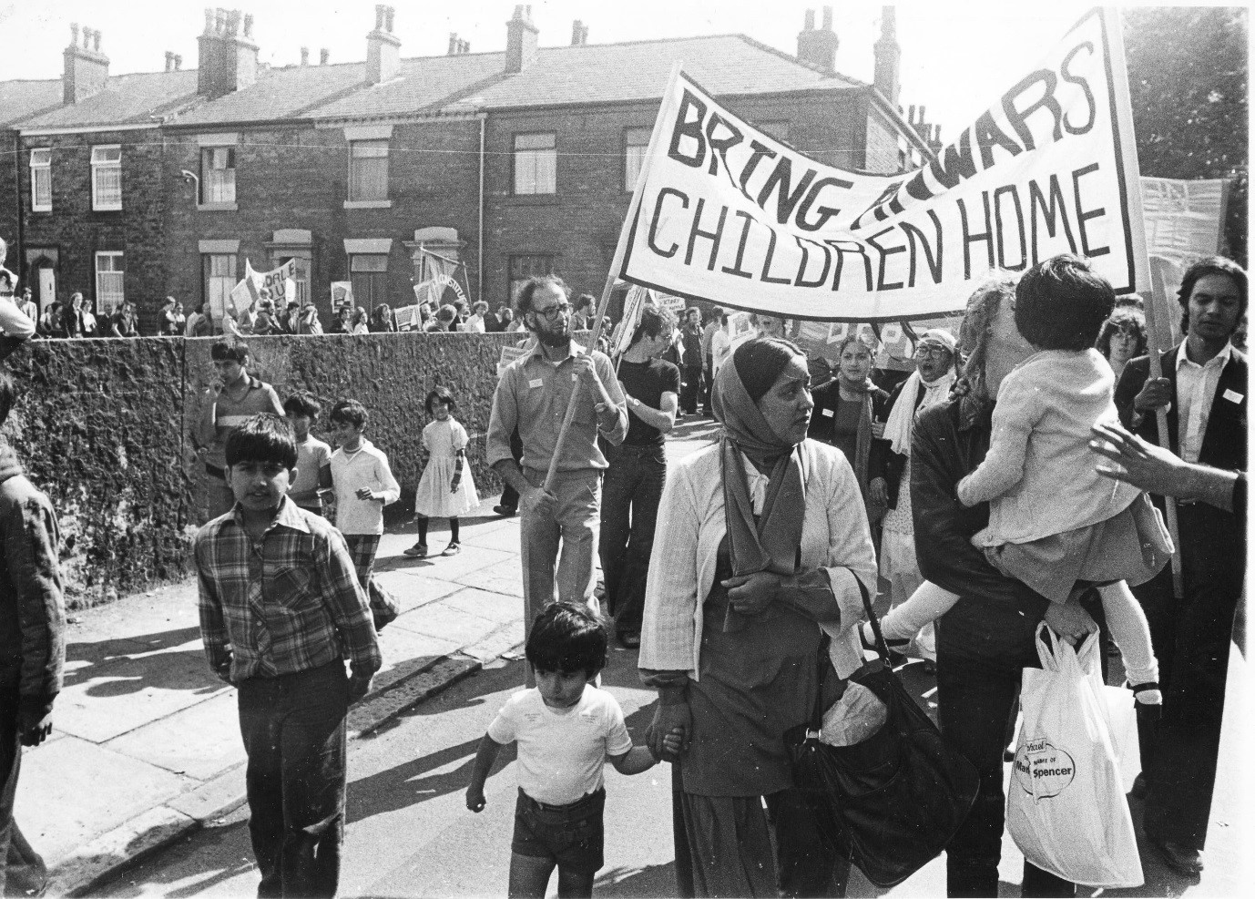
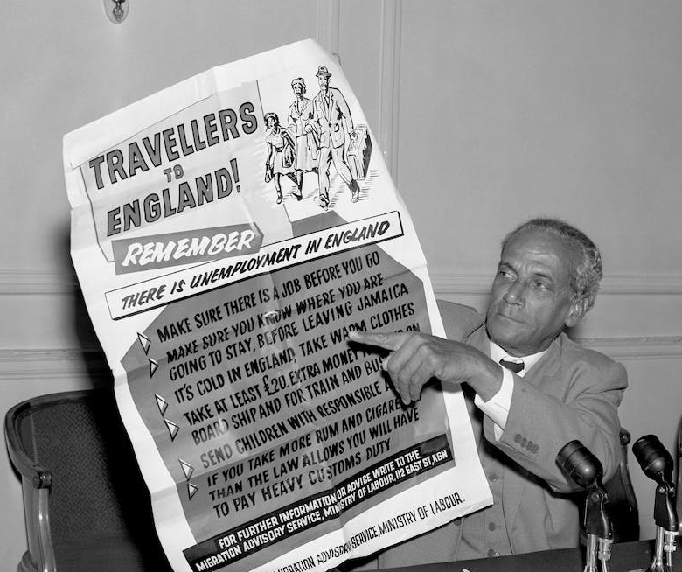
Control and Contestation
What is the relationship between migration ‘control’ and medicalization?
Families Divided

Slide 4
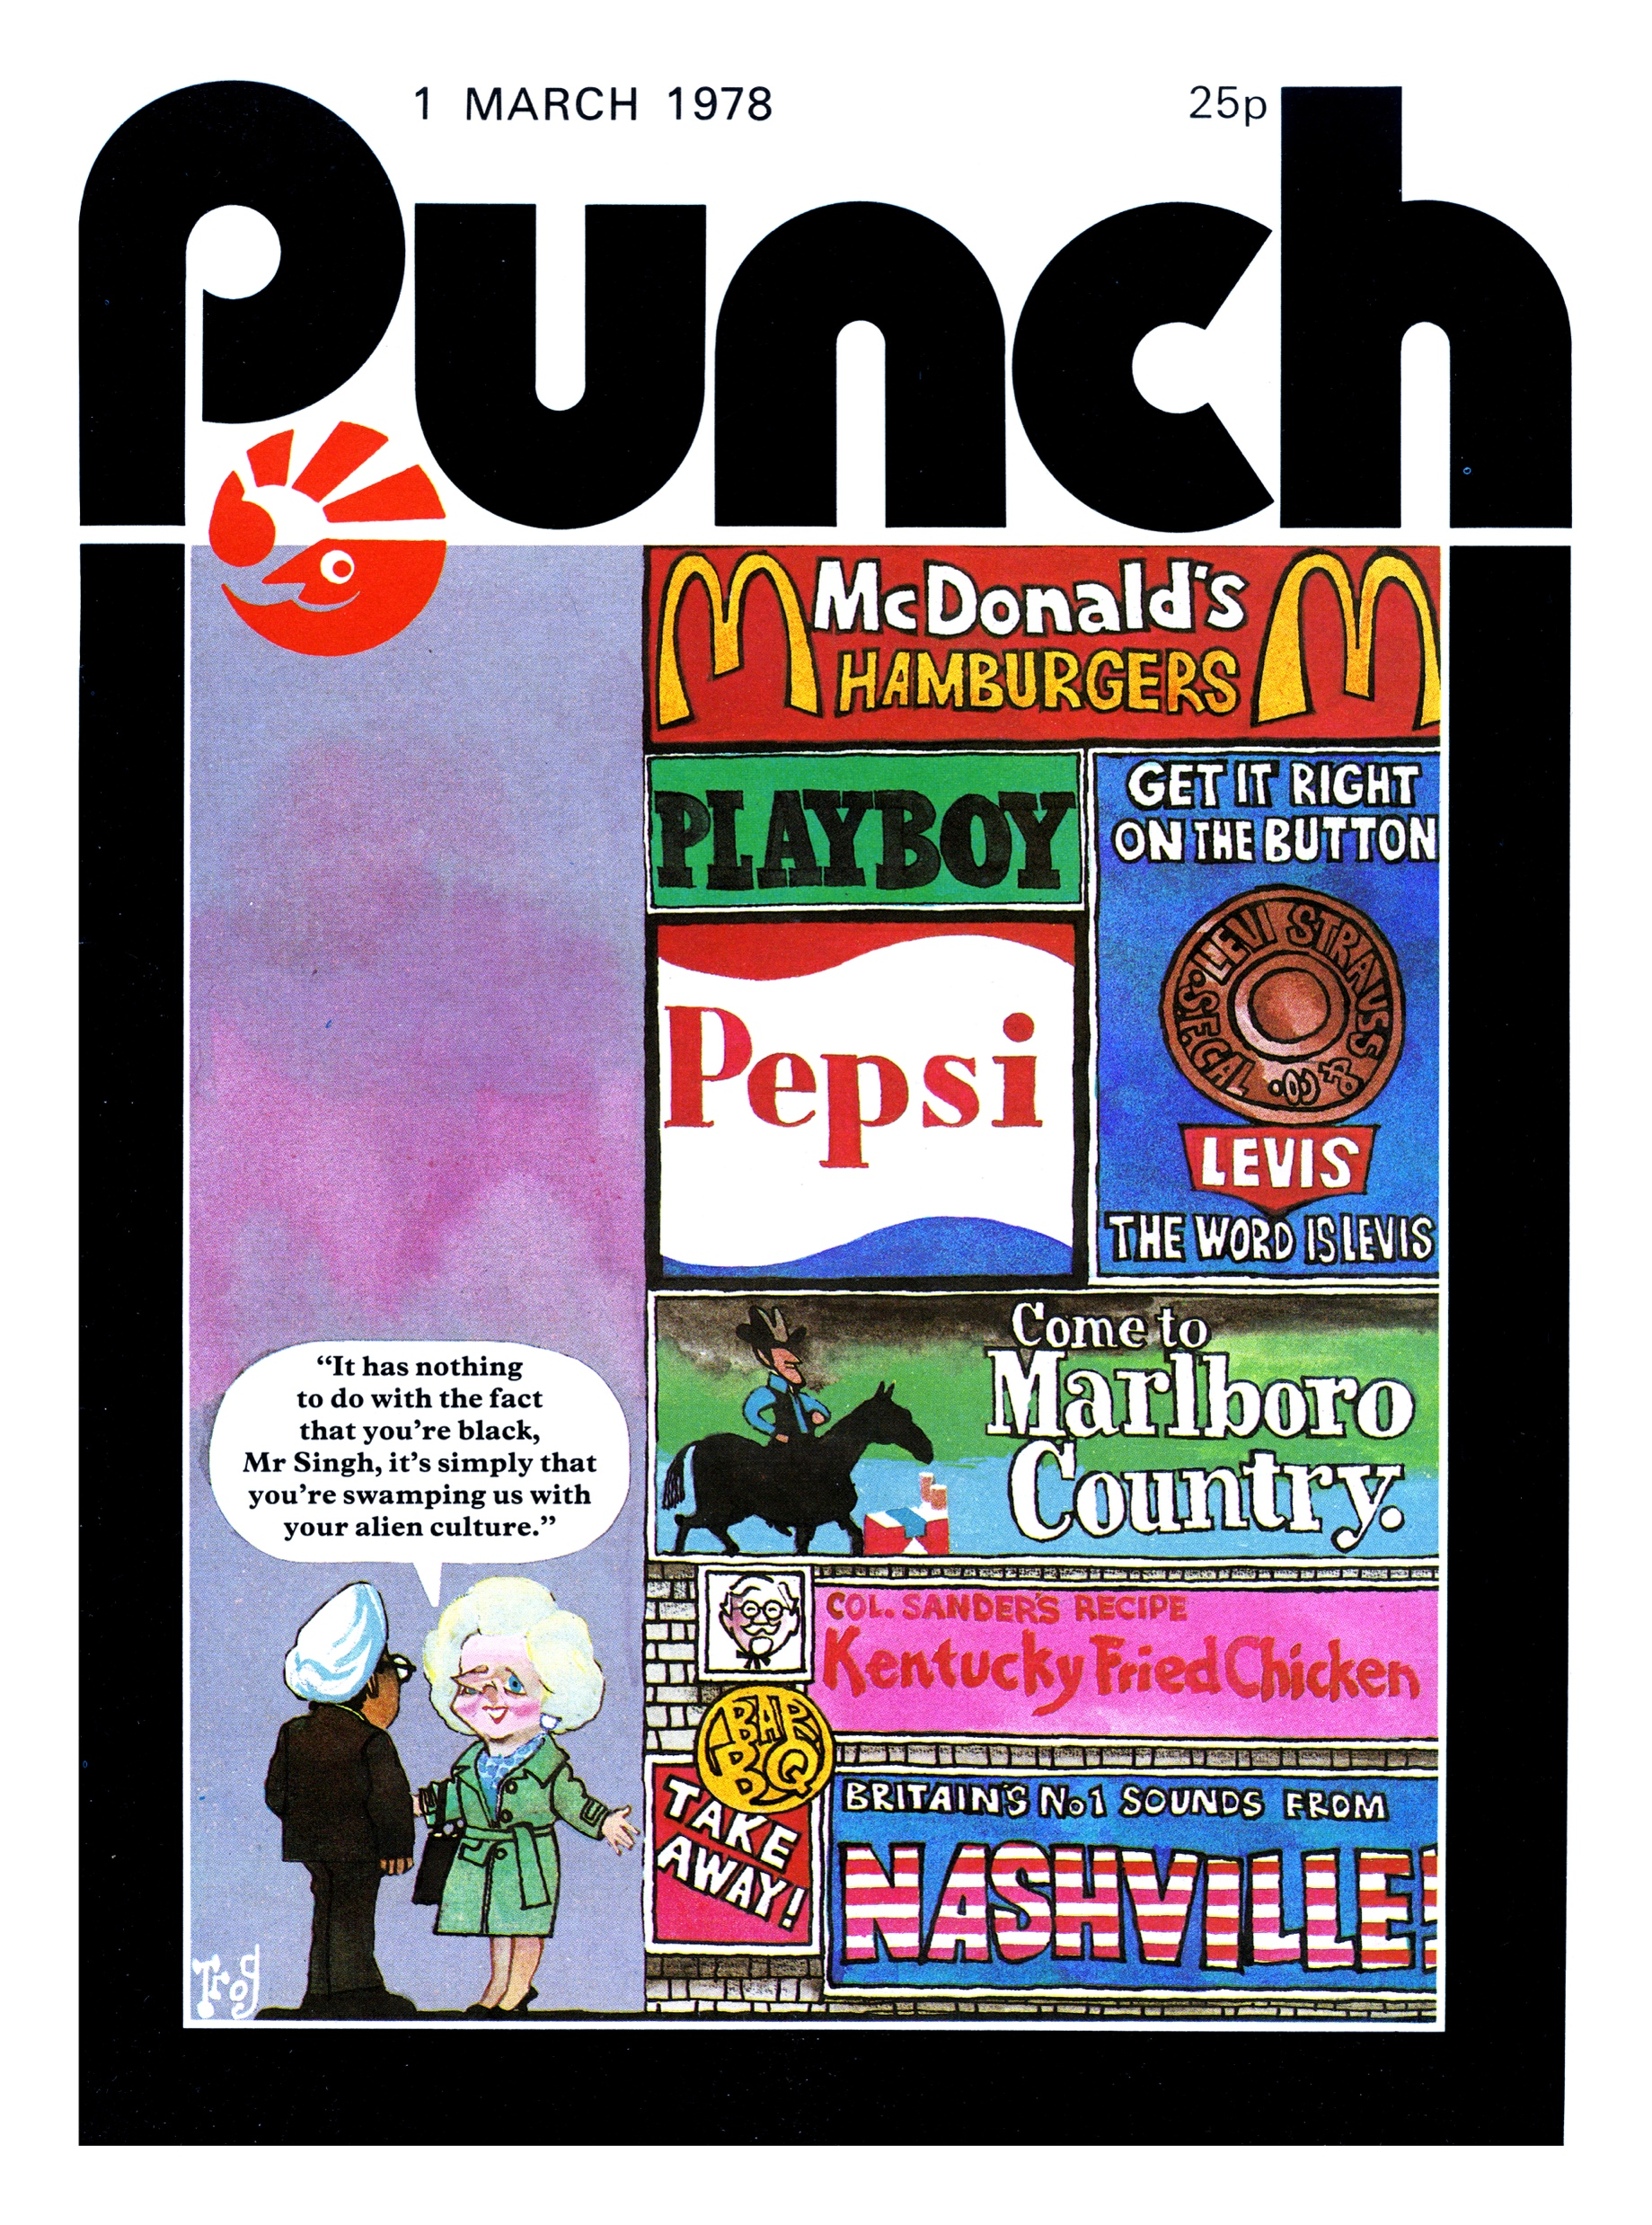
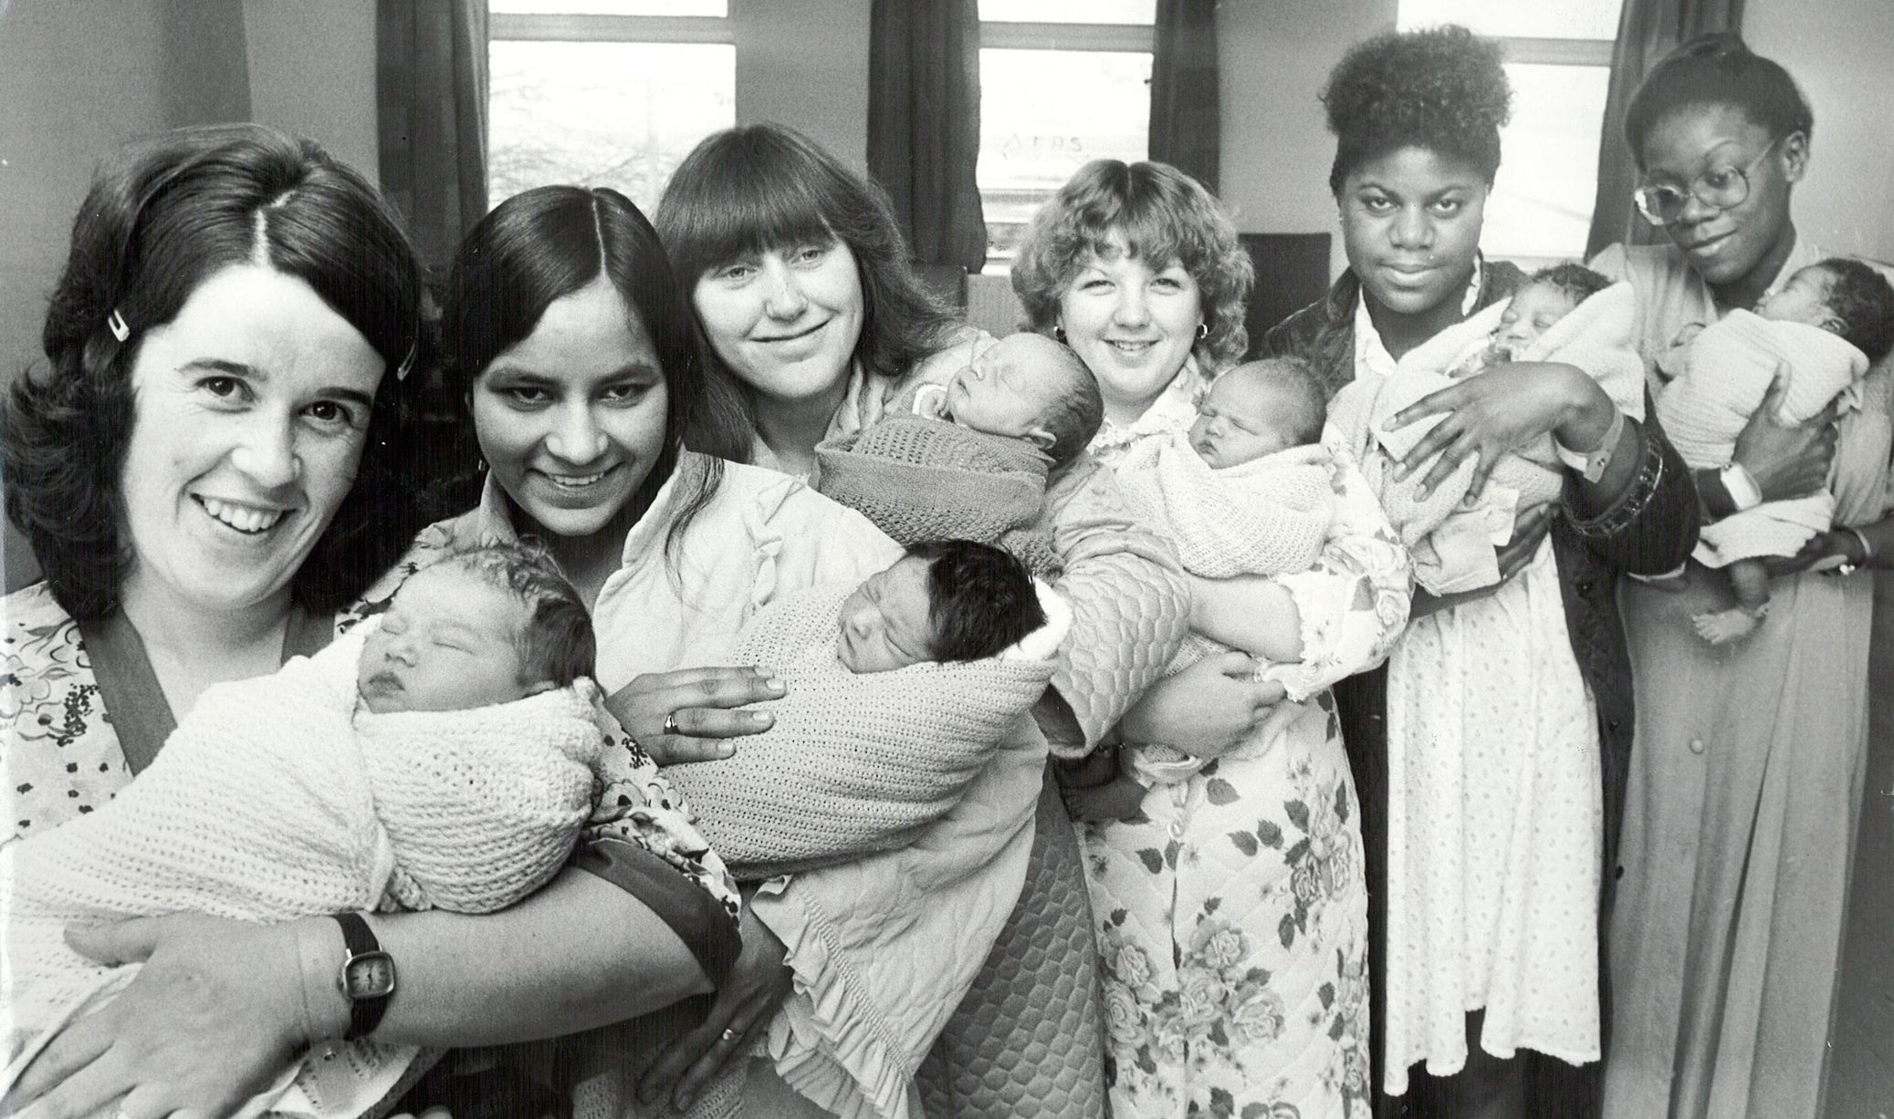
What did ‘multicultural Britain’ look like (and to whom)?

Slide 5
Working with primary sources
Assess the materials on our seminar page in relation to Kostakopoulou’s discussion of ‘multiculturalism’ and ‘probationary citizenship’.
What examples (if any) can you think of to support or contest the existence of ‘probationary citizenship’? Of ‘isolationism’?
Comparing these materials with our module archive, assess how British approaches to migrant and ethnic communities compare to those of other migrant receiving nations in the twentieth and early twenty-first centuries… Is ‘social cohesion’ the new assimilation?

Slide 6
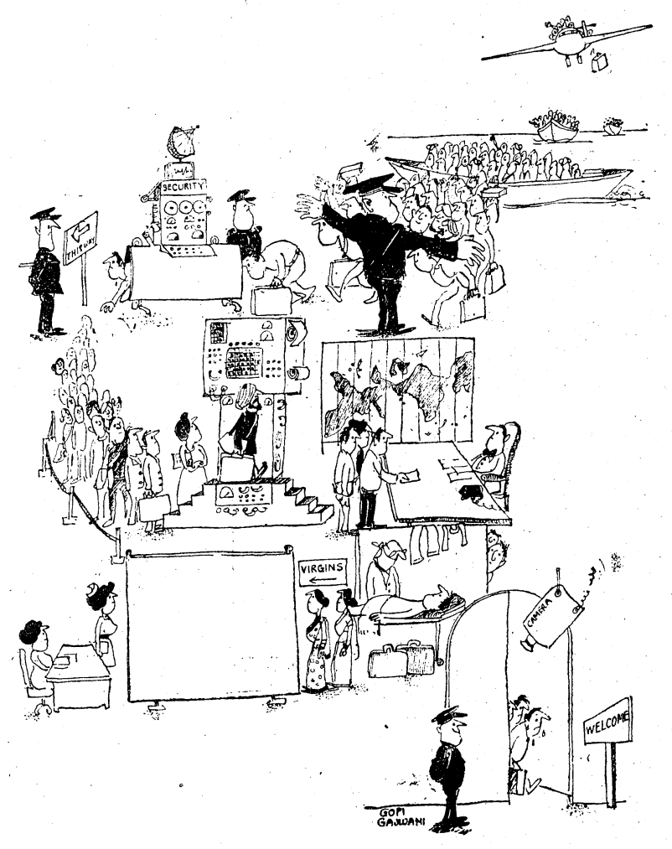
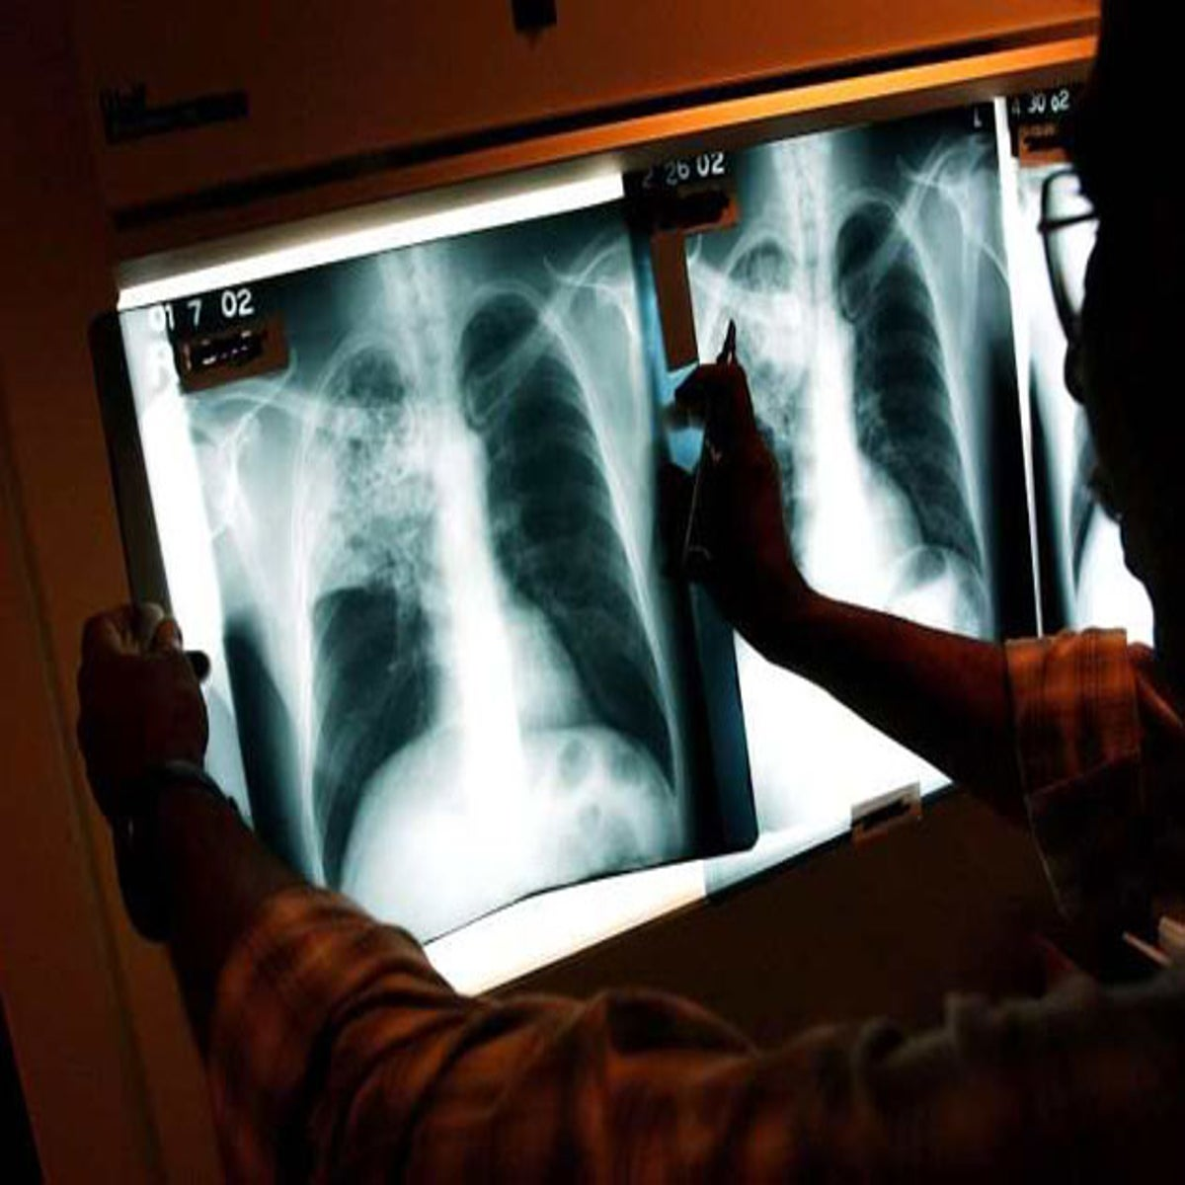
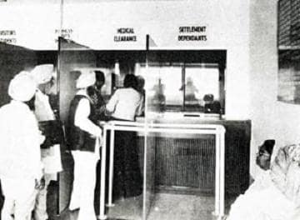
Medicalising ‘Control’
Abha Thapalyal, ‘Entry Laws – British Style’, Times of India, 29 April 1979.
‘Under the immigration Rules, officials are entitled to carry out medical examinations, the purpose of which is to control infectious disease… Immigration officials … have extended the use of medical examinations into a field for which it had not been intended. … “It is against English Criminal law that anyone should be forced to give evidence against herself through a medical examination to show that she is lying”.’
Alex Lyon, ex-Minister of State, Home Office, 1979
‘Falsification and fraud are so widespread that it must be assumed in every case, until the contrary is proved.’
Anthony Kershaw, Junior Minister, Foreign Office 1970-73.

Slide 7

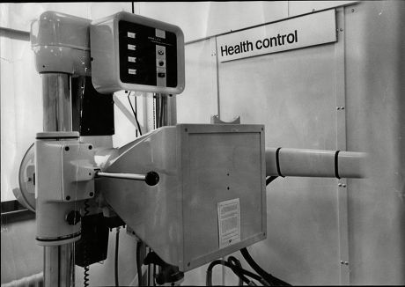
Why medicalisation, post 1973? Health control or population control?
The New X-ray Unit Which Has Been Installed At Heathrow Airport
Creator: Anthony Wallace/ANL/Shutterstock | Credit: Anthony Wallace/ANL/Shutterstock
Copyright: Copyright (c) 1965 Shutterstock.

